Slide 1
The power of one

Slide 2
Warm up

Slide 3
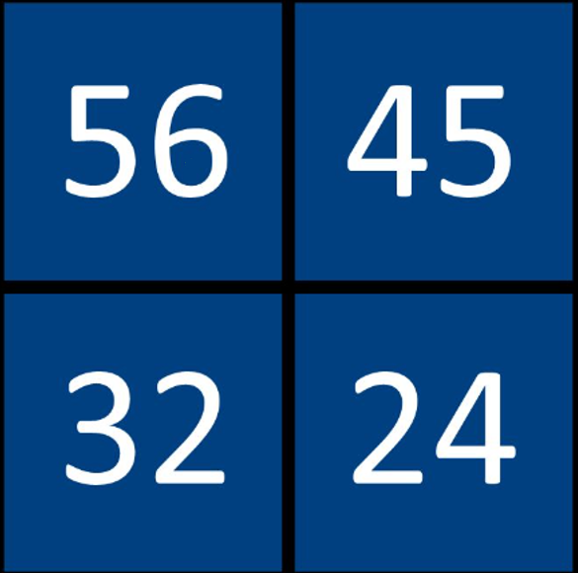
The power of one (1)
Which one doesn’t belong
Number 37 by Beth Benjamine

Slide 4
Launch

Slide 5
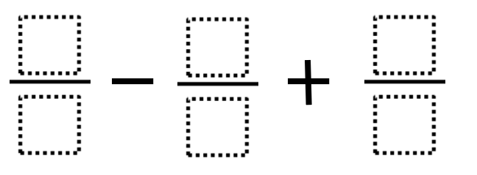
The power of one (2)
Launch
Using the digits 0–9, at most one time each, place a digit in each box to create an expression that equals 1.

Slide 6
Explore

Slide 7
Appendix A (1)
Modified questions
Question 1 | Question 2 | Question 3
$$\frac{3x}{4}+\frac{4x}{5}$$ | $$\frac{2x}{5}+\frac{2x}{3}$$ | $$\frac{x}{8}+\frac{3x}{5}$$
Question 4 | Question 5 | Question 6
$$\frac{2w}{7}+\frac{2w}{3}$$ | $$\frac{3y}{4}+\frac{5y}{6}$$ | $$\frac{2xy}{3}+\frac{5xy}{12}$$

Slide 8
Appendix A (2)
Modified questions with solutions
Question 1 | Question 2 | Question 3
$$\frac{3x}{4}+\frac{4x}{5}=\frac{31x}{20}$$ | $$\frac{2x}{5}+\frac{2x}{3}=\frac{16x}{15}$$ | $$\frac{x}{8}+\frac{3x}{5}=\frac{29x}{40}$$
Question 4 | Question 5 | Question 6
$$\frac{2w}{7}+\frac{2w}{3}=\frac{20w}{21}$$ | $$\frac{3y}{4}+\frac{5y}{6}=\frac{19y}{12}$$ | $$\frac{2xy}{3}+\frac{5xy}{12}=\frac{13xy}{12}$$

Slide 9
Adding fractions
Unknown denominator
$$\frac{3}{x}+\frac{4}{5}$$

Slide 10
Summarise

Slide 11
The power of one (3)
Worked example 1
$$\frac{4x}{5}−\frac{x}{3}$$
$$=\frac{3}{3}×\frac{4x}{5}−\frac{x}{3}×\frac{5}{5}$$
$$=\frac{12x}{15}−\frac{5x}{15}$$
$$=\frac{7x}{15}$$
Simplify $\frac{4x}{5}−\frac{x}{3}$

Slide 12
The power of one (4)
Worked example 1
$$\frac{4x}{5}−\frac{x}{3}$$
$$=\frac{3}{3}×\frac{4x}{5}−\frac{x}{3}×\frac{5}{5}$$
$$=\frac{12x}{15}−\frac{5x}{15}$$
$$=\frac{7x}{15}$$
Simplify $\frac{4x}{5}−\frac{x}{3}$
Why doesn’t multiplying by $\frac{3}{3}$ or $\frac{5}{5}$ affect the question?
Can you explain why this step is important?
Why is $4x−x$ not just $4$?

Slide 13
The power of one (5)
Your turn – question 1
Simplify $\frac{3x}{4}+\frac{x}{7}$

Slide 14
The power of one (6)
Your turn – solution 1
Simplify $\frac{3x}{4}+\frac{x}{7}$
$$\frac{3x}{4}+\frac{x}{7}$$
$$=\frac{7}{7}×\frac{3x}{4}+\frac{x}{7}×\frac{4}{4}$$
$$=\frac{21x}{28}+\frac{4x}{28}$$
$$=\frac{25x}{28}$$

Slide 15
The power of one (7)
Worked example 2
Simplify $\frac{4}{5x}−\frac{1}{15}$
$$\frac{4}{5x}−\frac{1}{15}$$
$$=\frac{3}{3}×\frac{4}{5x}−\frac{1}{15}×\frac{x}{x}$$
$$=\frac{12}{15x}−\frac{x}{15x}$$
$$=\frac{12−x}{15x}$$

Slide 16
The power of one (8)
Worked example 2
Simplify $\frac{4}{5x}−\frac{1}{15}$
$$\frac{4}{5x}−\frac{1}{15}$$
$$=\frac{3}{3}×\frac{4}{5x}−\frac{1}{15}×\frac{x}{x}$$
$$=\frac{12}{15x}−\frac{x}{15x}$$
$$=\frac{12−x}{15x}$$
Why multiply by $\frac{x}{x}$?
What would happen if $\frac{4}{5x}$ was multiplied by $\frac{x}{x}$?
Why can this not be simplified?

Slide 17
The power of one (9)
Your turn – question 2
Simplify $\frac{1}{4x}+\frac{3}{8}$

Slide 18
The power of one (10)
Worked example 2
Simplify $\frac{1}{4x}+\frac{3}{8}$
$$\frac{1}{4x}+\frac{3}{8}$$
$=\frac{2}{2}×\frac{1}{4x}+\frac{3}{8}$ $×\frac{x}{x}$
$$=\frac{2}{8x}+\frac{3x}{8x}$$
$$=\frac{2+3x}{8x}$$

Slide 19
Copyright
© State of New South Wales (Department of Education), 2024
The copyright material published in this resource is subject to the Copyright Act 1968 (Cth) and is owned by the NSW Department of Education or, where indicated, by a party other than the NSW Department of Education (third-party material).
Copyright material available in this resource and owned by the NSW Department of Education is licensed under a Creative Commons Attribution 4.0 International (CC BY 4.0) license.
This license allows you to share and adapt the material for any purpose, even commercially.
Attribution should be given to © State of New South Wales (Department of Education), 2024.
Material in this resource not available under a Creative Commons license:
the NSW Department of Education logo, other logos and trademark-protected material
Material owned by a third-party that has been reproduced with permission. You will need to obtain permission from the third-party to reuse its material.
Links to third-party material and websites
Please note that the provided (reading/viewing material/list/links/texts) are a suggestion only and implies no endorsement, by the New South Wales Department of Education, of any author, publisher, or book title. School principals and teachers are best placed to assess the suitability of resources that would complement the curriculum and reflect the needs and interests of their students.
If you use the links provided in this document to access a third-party’s website, you acknowledge that the terms of use, including licence terms set out on the third-party’s website apply to the use which may be made of the materials on that third-party website or where permitted by the Copyright Act 1968 (Cth). The department accepts no responsibility for content on third-party websites.

