Slide 1
Multiplying multiple ways

Slide 2
Launch

Slide 3
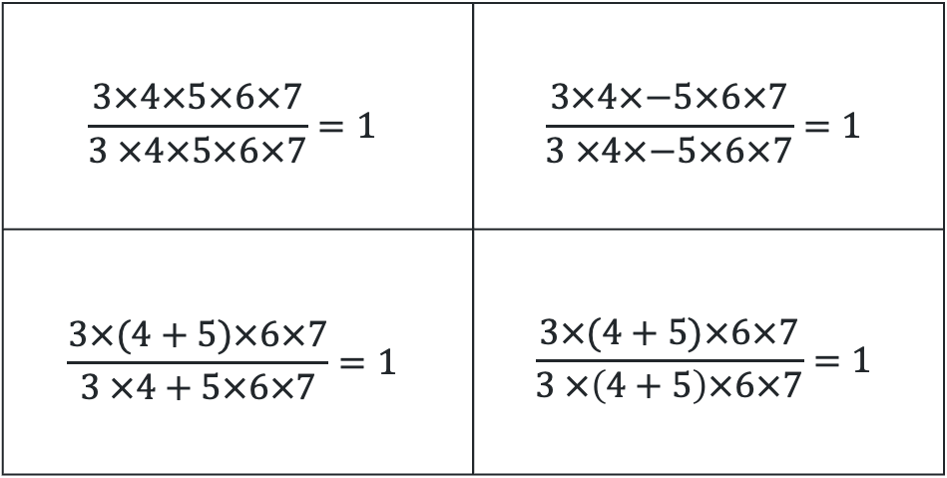
Multiplying multiple ways (1)
Three truths, one lie
$$\frac{3×4×5×6×7}{3 ×4×5×6×7}=1$$ | $$\frac{3×4×−5×6×7}{3 ×4×−5×6×7}=1$$
$$\frac{3×(4+5)×6×7}{3 ×4+5×6×7}=1$$ | $$\frac{3×(4+5)×6×7}{3 ×\left(4+5\right)×6×7}=1$$

Slide 4
Explore

Slide 5

Multiplying multiple ways (2)
Core – worked example
Simplify $\frac{3x}{10}×\frac{5y}{6}$
$$\frac{3x}{10}×\frac{5y}{6}$$
$$=\frac{3×x×5×y}{5×2×3×2} \\ =\frac{3×5×x×y}{3×5×2×2} \\ =\frac{xy}{4}$$

Slide 6

Multiplying multiple ways (3)
Core – worked example self-explanation prompts
Simplify $\frac{3x}{10}×\frac{5y}{6}$
$$\frac{3x}{10}×\frac{5y}{6}$$
$$=\frac{3×x×5×y}{5×2×3×2} \\ =\frac{3×5×x×y}{3×5×2×2} \\ =\frac{xy}{4}$$
Why is there one fraction now?
Why can we remove the 3 but not the 2?
How do we know we can stop here?

Slide 7

Multiplying multiple ways (4)
Core – Your turn – question
Simplify $\frac{3x}{8}×\frac{4y}{9}$

Slide 8

Multiplying multiple ways (5)
Core – Your turn – solution
Simplify $\frac{3x}{8}×\frac{4y}{9}$
$$\frac{3x}{8}×\frac{4y}{9} \\ =\frac{3×x×2×2×y}{2×2×2×3×3} \\ =\frac{3×2×2×x×y}{3×2×2×3×2} \\ =\frac{xy}{6}$$

Slide 9

Multiplying multiple ways (6)
Path – worked example
Simplify $\frac{3}{5xy}×\frac{2y}{6}$
$$\frac{3}{5xy}×\frac{2y}{6}$$
$$=\frac{3×2×y}{5×x×y×3×2} \\ =\frac{3×2×y}{3×2×y×5×x} \\ =\frac{1}{5x}$$

Slide 10

Multiplying multiple ways (7)
Path – worked example self-explanation prompts
Simplify $\frac{3}{5x}×\frac{2y}{6}$
$$\frac{3}{5x}×\frac{2y}{6}$$
$$=\frac{3×2×y}{5×x×y×3×2} \\ =\frac{3×2×y}{3×2×y×5×x} \\ =\frac{1}{5x}$$
Why is there one fraction now?
Why can we remove the 3 but not the 5?
Why is there a 1 in the numerator?

Slide 11

Multiplying multiple ways (8)
Path – Your turn – question
Simplify $\frac{3x}{8}×\frac{4y}{9x}$

Slide 12

Multiplying multiple ways (9)
Path – Your turn – solution
Simplify $\frac{3x}{8}×\frac{6y}{9x}$
$$\frac{3x}{8}×\frac{6y}{9x} \\ =\frac{3×x×2×3×y}{2×2×2×3×3×x} \\ =\frac{3×2×x×3×y}{3×2×x×3 ×2×2} \\ =\frac{y}{4}$$

Slide 13

Multiplying multiple ways (10)
Core – any which way
$$\frac{3ab}{8}×\frac{4a}{9}$$

Slide 14

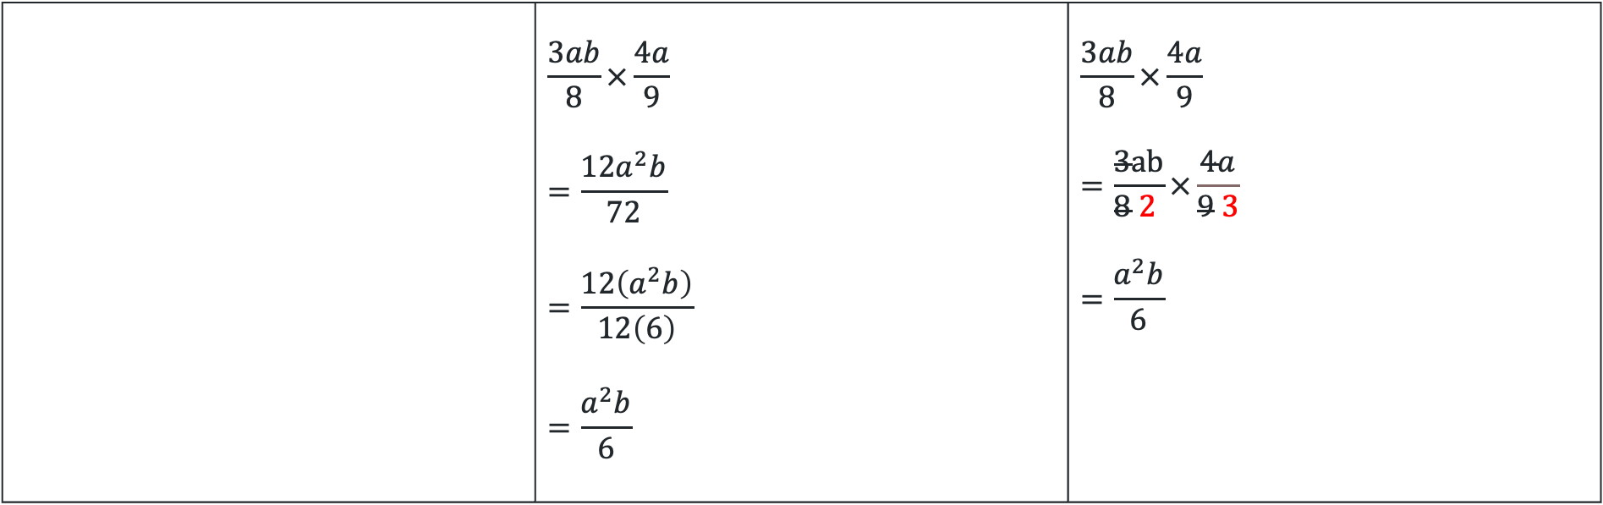
Multiplying multiple ways (11)
Core – 3 different methods
$$\frac{3ab}{8}×\frac{4a}{9} \\ =\frac{3×a×b×2×2×a}{2×2×2×3×3} \\ =\frac{3×2×2×a×a×b}{3×2×2×2×3}$$
$$=\frac{a^{2}b}{6}$$
 | $$\frac{3ab}{8}×\frac{4a}{9} \\ =\frac{12a^{2}b}{72} \\ =\frac{12\left(a^{2}b\right)}{12\left(6\right)} \\ =\frac{a^{2}b}{6}$$ | $$\frac{3ab}{8}×\frac{4a}{9}$$ $$=\frac{3ab}{8 2 }×\frac{4a}{9 3} \\ =\frac{a^{2}b}{6}$$

Slide 15

Multiplying multiple ways (12)
Path – any which way
$$\frac{2a^{3}b}{3}×\frac{6}{ab^{2}}$$

Slide 16

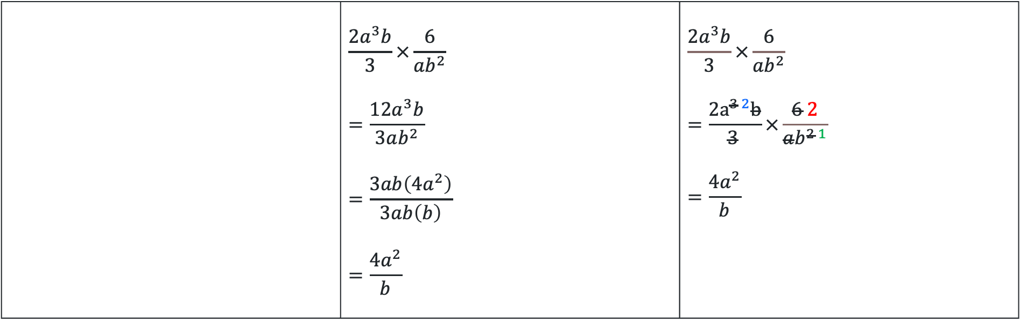
Multiplying multiple ways (13)
Path – 3 different methods
$$\frac{2a^{3}b}{3}×\frac{6}{ab^{2}} \\ =\frac{2×a×a×a×b×2×3}{3×a×b×b} \\ =\frac{3×a×b×2×2×a×a}{3×a×b×b}$$
$$=\frac{{4a}^{2}}{b}$$
 | $$\frac{2a^{3}b}{3}×\frac{6}{ab^{2}} \\ =\frac{12a^{3}b}{3ab^{2}} \\ =\frac{3ab\left(4a^{2}\right)}{3ab\left(b\right)} \\ =\frac{4a^{2}}{b}$$ | $$\frac{2a^{3}b}{3}×\frac{6}{ab^{2}}$$ $$=\frac{2a^{3 2}b}{3 }×\frac{6 2}{ab^{2 1}} \\ =\frac{4a^{2}}{b}$$

Slide 17
Copyright
© State of New South Wales (Department of Education), 2024
The copyright material published in this resource is subject to the Copyright Act 1968 (Cth) and is owned by the NSW Department of Education or, where indicated, by a party other than the NSW Department of Education (third-party material).
Copyright material available in this resource and owned by the NSW Department of Education is licensed under a Creative Commons Attribution 4.0 International (CC BY 4.0) license.
This license allows you to share and adapt the material for any purpose, even commercially.
Attribution should be given to © State of New South Wales (Department of Education), 2024.
Material in this resource not available under a Creative Commons license:
the NSW Department of Education logo, other logos and trademark-protected material
Material owned by a third-party that has been reproduced with permission. You will need to obtain permission from the third-party to reuse its material.
Links to third-party material and websites
Please note that the provided (reading/viewing material/list/links/texts) are a suggestion only and implies no endorsement, by the New South Wales Department of Education, of any author, publisher, or book title. School principals and teachers are best placed to assess the suitability of resources that would complement the curriculum and reflect the needs and interests of their students.
If you use the links provided in this document to access a third-party’s website, you acknowledge that the terms of use, including licence terms set out on the third-party’s website apply to the use which may be made of the materials on that third-party website or where permitted by the Copyright Act 1968 (Cth). The department accepts no responsibility for content on third-party websites.

