Slide 1
Divide and conquer

Slide 2
Launch

Slide 3
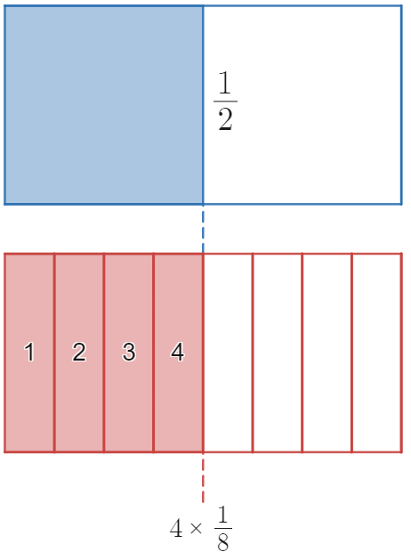
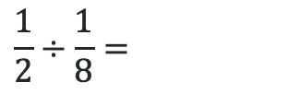
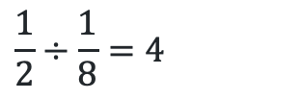
Dividing fractions reminder (1)
Dividing fractions
$$\frac{1}{2}÷\frac{1}{8}=$$
$$\frac{1}{2}÷\frac{1}{8}=4$$

Slide 4
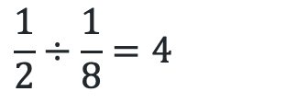
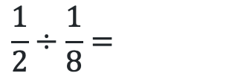
Dividing fractions reminder (2)
Dividing fractions
$$\frac{1}{2}÷\frac{1}{8}=$$
Why don’t we divide one half into 8 pieces?
How do we know to count 4 of the ‘eighths’?
What will it mean when the two fractions can’t be lined up?
$$\frac{1}{2}÷\frac{1}{8}=4$$

Slide 5
Explore

Slide 6
Dividing by 1
Visual representation
How many times does 1 go into ½ ?
How many times does 1 go into 5?

Slide 7

Finding 1 (1)
How many can you find?
$$\frac{\frac{2}{5}×\frac{3}{4}}{\frac{4}{3}×\frac{3}{4}}$$

Slide 8


Finding 1 (2)
How many can you find?
$$\frac{\frac{2}{5}×\frac{3}{4}}{\frac{4}{3}×\frac{3}{4}}$$
What happens to the denominator in this question?
Why is this equal to 1?
Why is this equal to 1?
$$\frac{4}{3}×\frac{3}{4}$$

Slide 9

Dividing all algebraic fractions (1)
Question
$$\frac{a}{b}÷\frac{x}{y}$$

Slide 10


Dividing all algebraic fractions (2)
$$=\frac{\frac{a}{b}}{\frac{x}{y}} \\ =\frac{\frac{a}{b}×\frac{y}{x}}{\frac{x}{y}×\frac{y}{x}} \\ =\frac{a}{b}×\frac{y}{x} \\ =\frac{ay}{bx}$$
Solution
$$\frac{a}{b}÷\frac{x}{y}$$

Slide 11
Summarise

Slide 12

Dividing fractions (1)
Example 1
$$\frac{3x}{4}÷\frac{2x}{5}=\frac{3x}{4}×\frac{5}{2x} \\ =\frac{15x}{8x} \\ =\frac{15}{8}$$

Slide 13

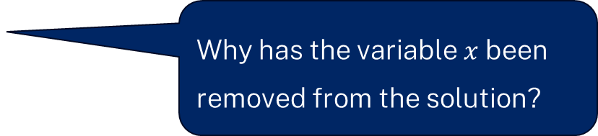
Dividing fractions (2)
Example 1: self-explanation prompts
$$\frac{3x}{4}÷\frac{2x}{5}=\frac{3x}{4}×\frac{5}{2x} \\ =\frac{15x}{8x} \\ =\frac{15}{8}$$
Why do we multiply by the reciprocal?
Why has the variable $x$ been removed from the solution?

Slide 14

Dividing fractions (3)
Your turn – question 1
$$\frac{5x}{4}÷\frac{2x}{7}=$$

Slide 15
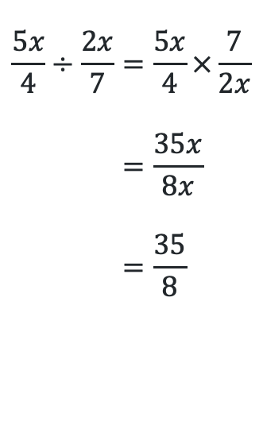
Dividing fractions (4)
Your turn – solutions 1
$$\frac{5x}{4}÷\frac{2x}{7}=\frac{5x}{4}×\frac{7}{2x} \\ =\frac{35x}{8x} \\ =\frac{35}{8}$$

Slide 16

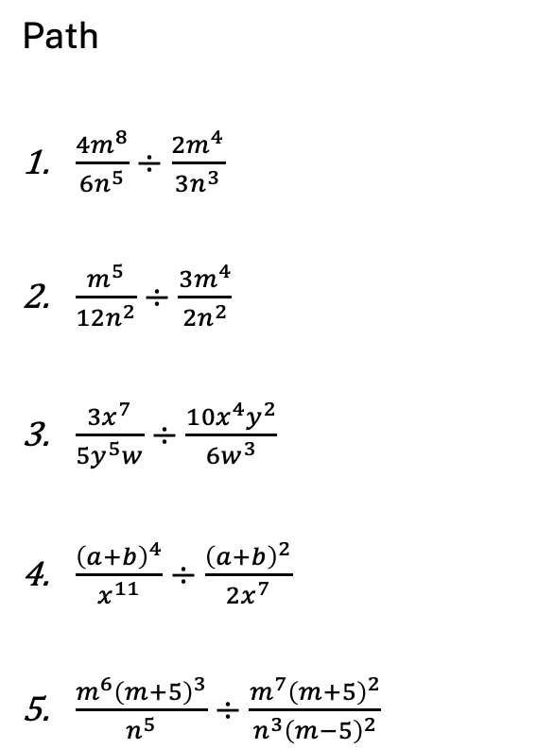
Dividing fractions (5)
Practice questions
Core
$\frac{3m}{5}÷\frac{m}{4}$
$\frac{3m}{5}÷\frac{5m}{4}$
$\frac{6m}{5}÷\frac{4m}{15}$
$\frac{6m^{2}}{5}÷\frac{4m}{15}$
$\frac{6m^{2}}{5}÷\frac{4}{15m}$
Path
$\frac{4m^{8}}{6n^{5}}÷\frac{2m^{4}}{3n^{3}}$
$\frac{m^{5}}{12n^{2}}÷\frac{3m^{4}}{2n^{2}}$
$\frac{3x^{7}}{5y^{5}w}÷\frac{10x^{4}y^{2}}{6w^{3}}$
$\frac{{\left(a+b\right)}^{4}}{x^{11}}÷\frac{{\left(a+b\right)}^{2}}{2x^{7}}$
$\frac{m^{6}{\left(m+5\right)}^{3}}{n^{5}}÷\frac{m^{7}{\left(m+5\right)}^{2}}{n^{3}{\left(m−5\right)}^{2}}$

Slide 17
Apply

Slide 18
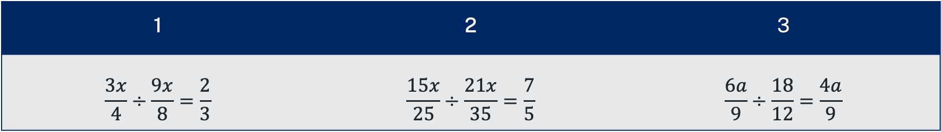
Divide and conquer(1)
Core – Two truths and one lie
1 | 2 | 3
$$\frac{3x}{4}÷\frac{9x}{8}=\frac{2}{3}$$ | $$\frac{15x}{25}÷\frac{21x}{35}=\frac{7}{5}$$ | $$\frac{6a}{9}÷\frac{18}{12}=\frac{4a}{9}$$

Slide 19
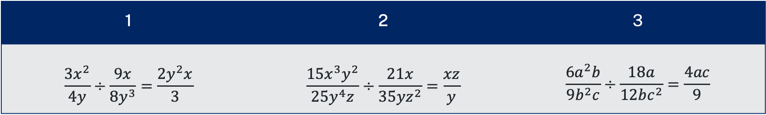
Divide and conquer (2)
Path – Two truths and one lie
1 | 2 | 3
$$\frac{3x^{2}}{4y}÷\frac{9x}{8y^{3}}=\frac{2y^{2}x}{3}$$ | $$\frac{15x^{3}y^{2}}{25y^{4}z}÷\frac{21x}{35yz^{2}}=\frac{xz}{y}$$ | $$\frac{6a^{2}b}{9b^{2}c}÷\frac{18a}{12bc^{2}}=\frac{4ac}{9}$$

Slide 20
Copyright
© State of New South Wales (Department of Education), 2024
The copyright material published in this resource is subject to the Copyright Act 1968 (Cth) and is owned by the NSW Department of Education or, where indicated, by a party other than the NSW Department of Education (third-party material).
Copyright material available in this resource and owned by the NSW Department of Education is licensed under a Creative Commons Attribution 4.0 International (CC BY 4.0) license.
This license allows you to share and adapt the material for any purpose, even commercially.
Attribution should be given to © State of New South Wales (Department of Education), 2024.
Material in this resource not available under a Creative Commons license:
the NSW Department of Education logo, other logos and trademark-protected material
Material owned by a third-party that has been reproduced with permission. You will need to obtain permission from the third-party to reuse its material.
Links to third-party material and websites
Please note that the provided (reading/viewing material/list/links/texts) are a suggestion only and implies no endorsement, by the New South Wales Department of Education, of any author, publisher, or book title. School principals and teachers are best placed to assess the suitability of resources that would complement the curriculum and reflect the needs and interests of their students.
If you use the links provided in this document to access a third-party’s website, you acknowledge that the terms of use, including licence terms set out on the third-party’s website apply to the use which may be made of the materials on that third-party website or where permitted by the Copyright Act 1968 (Cth). The department accepts no responsibility for content on third-party websites.

