Slide 1
Expand your mind

Slide 2
Launch

Slide 3
Expand your mind (1)
Launch
How many different ways can we work out the answer to:
23 x 7=161
 | 10 | 10 | 3
7 | 70 | 70 | 21

Slide 4
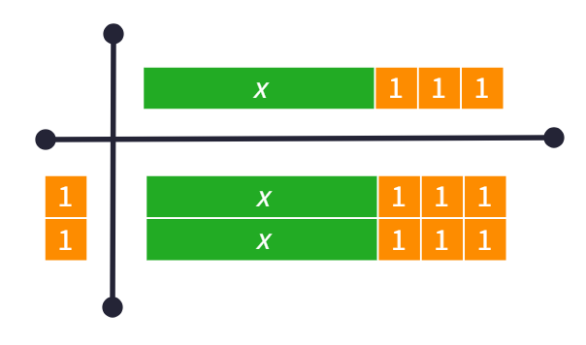
Expand your mind (2)
Launch
$$2\left(x+3\right)=2x+6$$
 | $$x$$ | 3
2 | $$2x$$ | 6

Slide 5
Explore

Slide 6
Expand your mind (3)
Is there an easy way to simplify the expression?
Is there an easy way to simplify the expression?
$$3(4x+2y+5)$$

Slide 7
Expand your mind (4)
Area model 1
$$3\left(4x+2y+5\right)=12x+6y+15$$

Slide 8
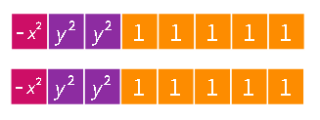
Expand your mind (5)
Can we write this a different way?
Can we write this a different way?
$$2(−x^{2}+2y^{2}+5)$$

Slide 9
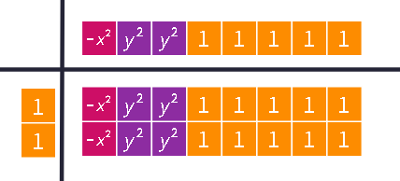
Expand your mind (6)
Area model 2
$$2\left(−x^{2}+2y^{2}+5\right) \\ =−2x^{2}+4y^{2}+10$$

Slide 10
Expand your mind (7)
How does the negative affect our model?
Can we write this a different way?
$$−2(x+3)$$

Slide 11
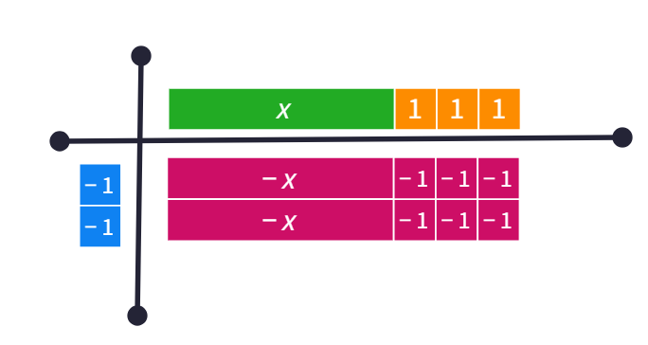
Expand your mind (8)
Area model 3
$$−2\left(x+3\right)=−2x−6$$

Slide 12
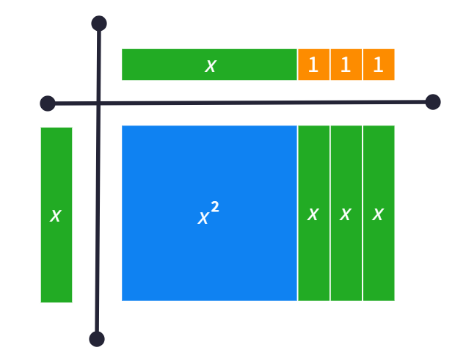
Expand your mind (9)
Area model 4
$x\left(x+3\right)=x^{2}$+3x
 | $$x$$ | 3
$$x$$ | $$x^{2}$$ | $$3x$$

Slide 13
Summarise

Slide 14
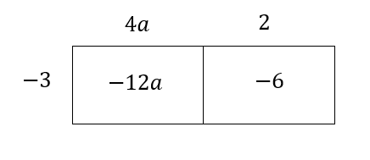
Expand your mind (10)
Worked example 1
Expand and simplify
$$−3\left(4a+2\right) \\ −3×4a+−3×2 \\ −12a−6$$

Slide 15
Expand your mind (11)
Self-explanation prompts
Expand and simplify
$$−3\left(4a+2\right) \\ −3×4a−3×2 \\ −12a−6$$
Why is the constant now negative?
What is the connection between the diagram and the solution?

Slide 16
Expand your mind (12)
Your turn – question 1
Expand and simplify
$$−4\left(5b+2\right)$$

Slide 17
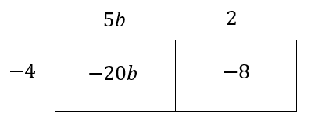
Expand your mind (13)
Your turn – solution 1
Expand and simplify
$$−4\left(5b+2\right) \\ −4×5b−4×2 \\ −20b−8$$

Slide 18
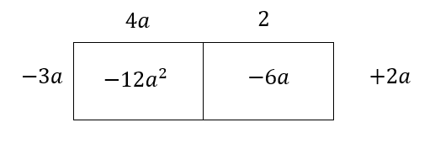
Expand your mind (14)
Worked example 2
Expand and simplify
$$−3a\left(4a+2\right)+2a \\ −3×4×a×a−3a×2+2a \\ −12a^{2}−6a+2a \\ −12a^{2}−4a$$

Slide 19
Expand your mind (15)
Self-explanation prompts
Expand and simplify
$$−3a\left(4a+2\right)+2a \\ −3×4×a×a−3a×2+2a \\ −12a^{2}−6a+2a \\ −12a^{2}−4a$$
Why is this negative?
How does this match the area model?

Slide 20
Expand your mind (16)
Your turn – question 2
Expand and simplify
$$a^{2}\left(a−6\right)+5a^{2}$$

Slide 21
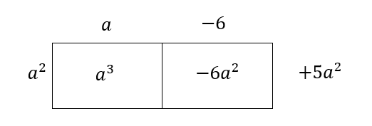
Expand your mind (17)
Your turn – solution 2
Expand and simplify
$$a^{2}\left(a−6\right)+5a^{2} \\ a^{2}×a−a^{2}×6+5a^{2} \\ a^{3}−6a^{2}+5a^{2} \\ a^{3}−a^{2}$$

Slide 22
Copyright
© State of New South Wales (Department of Education), 2024
The copyright material published in this resource is subject to the Copyright Act 1968 (Cth) and is owned by the NSW Department of Education or, where indicated, by a party other than the NSW Department of Education (third-party material).
Copyright material available in this resource and owned by the NSW Department of Education is licensed under a Creative Commons Attribution 4.0 International (CC BY 4.0) license.
This license allows you to share and adapt the material for any purpose, even commercially.
Attribution should be given to © State of New South Wales (Department of Education), 2024.
Material in this resource not available under a Creative Commons license:
the NSW Department of Education logo, other logos and trademark-protected material
Material owned by a third-party that has been reproduced with permission. You will need to obtain permission from the third-party to reuse its material.
Links to third-party material and websites
Please note that the provided (reading/viewing material/list/links/texts) are a suggestion only and implies no endorsement, by the New South Wales Department of Education, of any author, publisher, or book title. School principals and teachers are best placed to assess the suitability of resources that would complement the curriculum and reflect the needs and interests of their students.
If you use the links provided in this document to access a third-party’s website, you acknowledge that the terms of use, including licence terms set out on the third-party’s website apply to the use which may be made of the materials on that third-party website or where permitted by the Copyright Act 1968 (Cth). The department accepts no responsibility for content on third-party websites.

