Slide 1
Factor it in

Slide 2
Warm up

Slide 3

Factor it in (1)
Warm up – always true, sometimes true or never true
$${\left(4x\right)}^{2}=4x^{2}$$

Slide 4
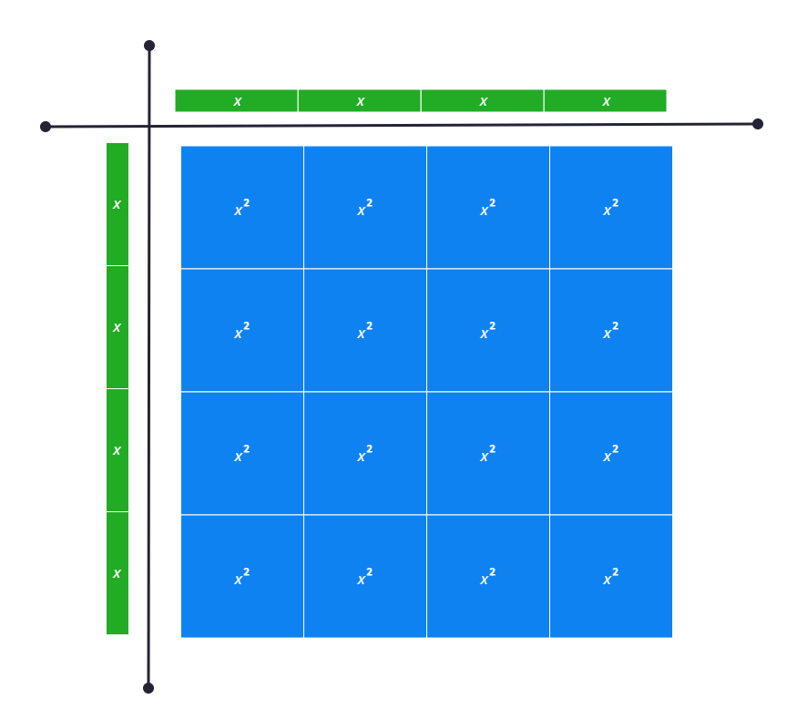
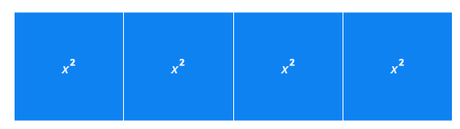


Factor it in (2)
Warm up – always true, sometimes true or never true
$${\left(4x\right)}^{2}$$
$${4x}^{2}$$

Slide 5
Launch

Slide 6
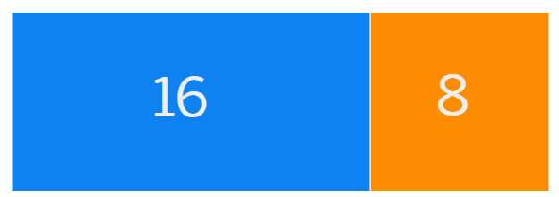
Factor it in (3)
Backwards
What could the dimensions of the rectangle be?

Slide 7
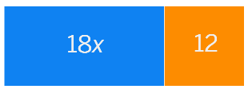
Factor it in (4)
Backwards
What could the dimensions of the rectangle be?

Slide 8
Explore

Slide 9



Factor it in (5)
Backwards
What could the dimensions of the rectangle be?
$$2(9x+6)$$
$$6(3x+2)$$
$$18x+12$$
Expanded form
Factorised

Slide 10
Summarise

Slide 11
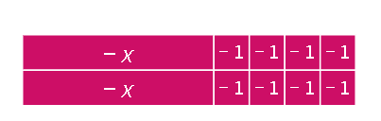
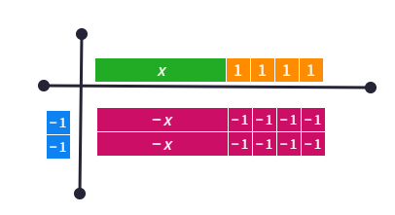
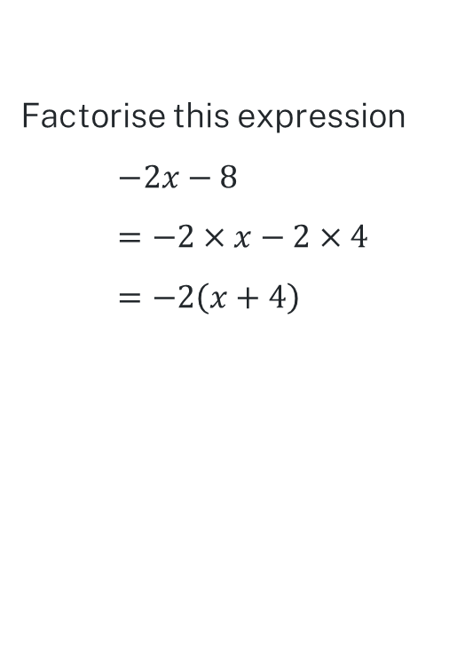
Factor it in (6)
Worked example 1
Factorise this expression
$$−2x−8 \\ =−2×x−2×4 \\ =−2\left(x+4\right)$$

Slide 12

Factor it in (7)
Self-explanation prompts
$$\text{Factorise} \text{this} \text{expression} \\ −2x−8 \\ =−2×x−2×4 \\ =−2\left(x+4\right)$$
What is the HCF of -2x and -8?
Where does the +4 come from here?

Slide 13

Factor it in (8)
Your turn – question 1
Factorise this expression
$$−3x+15$$

Slide 14

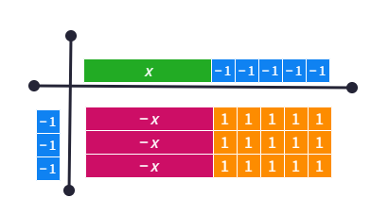
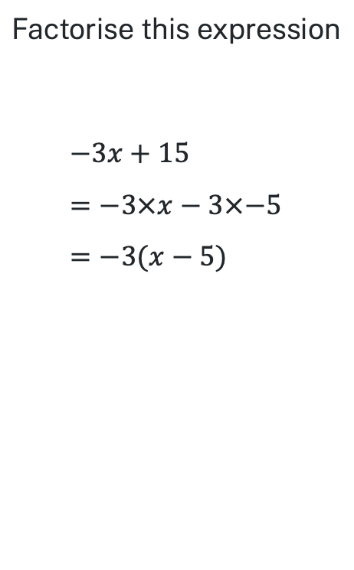
Factor it in (9)
Your turn – solution 1
$$\text{Factorise} \text{this} \text{expression}$$
$$−3x+15 \\ =−3×x−3×−5 \\ =−3(x−5)$$

Slide 15
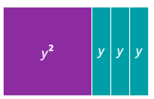
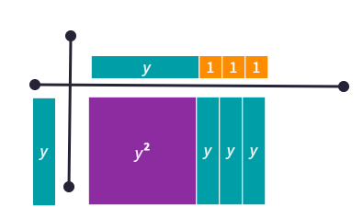
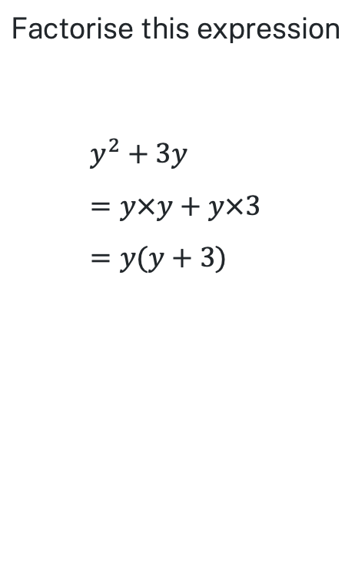
Factor it in (10)
Worked example 2
$$\text{Factorise} \text{this} \text{expression}$$
$$y^{2}+3y \\ =y×y+y×3 \\ =y(y+3)$$

Slide 16


Factor it in (11)
Self-explanation prompts
$$\text{Factorise} \text{this} \text{expression}$$
$$y^{2}+3y \\ =y×y+y×3 \\ =y(y+3)$$
How does this connect with the index laws?
What is the highest common factor?

Slide 17

Factor it in (12)
Your turn – question 2
$$\text{Factorise} \text{this} \text{expression}$$
$$2g^{3}−g^{8}$$

Slide 18

Factor it in (13)
Your turn – solution 2
$$\text{Factorise} \text{this} \text{expression}$$
$$2g^{3}−g^{8} \\ =g^{3}×2−g^{3}×g^{5} \\ =g^{3}\left(2−g^{5}\right)$$

Slide 19
Copyright
© State of New South Wales (Department of Education), 2024
The copyright material published in this resource is subject to the Copyright Act 1968 (Cth) and is owned by the NSW Department of Education or, where indicated, by a party other than the NSW Department of Education (third-party material).
Copyright material available in this resource and owned by the NSW Department of Education is licensed under a Creative Commons Attribution 4.0 International (CC BY 4.0) license.
This license allows you to share and adapt the material for any purpose, even commercially.
Attribution should be given to © State of New South Wales (Department of Education), 2024.
Material in this resource not available under a Creative Commons license:
the NSW Department of Education logo, other logos and trademark-protected material
Material owned by a third-party that has been reproduced with permission. You will need to obtain permission from the third-party to reuse its material.
Links to third-party material and websites
Please note that the provided (reading/viewing material/list/links/texts) are a suggestion only and implies no endorsement, by the New South Wales Department of Education, of any author, publisher, or book title. School principals and teachers are best placed to assess the suitability of resources that would complement the curriculum and reflect the needs and interests of their students.
If you use the links provided in this document to access a third-party’s website, you acknowledge that the terms of use, including license terms set out on the third-party’s website apply to the use which may be made of the materials on that third-party website or where permitted by the Copyright Act 1968 (Cth). The department accepts no responsibility for content on third-party websites.

