Slide 1
Age old question

Slide 2
Explore

Slide 3
Age old question (1)
Explore

Slide 4
Summarise

Slide 5
Age old question (2)
Worked example 1
$$\frac{2x−3}{7}=5 \\ ×7=×7 \\ 2x−3=35 \\ +3=+3 \\ 2x=38 \\ ÷2=÷2 \\ x=19$$
Solve for $x$.

Slide 6
Age old question (3)
Self-explanation prompts 1
$$\frac{2x−3}{7}=5 \\ ×7=×7 \\ 2x−3=35 \\ +3=+3 \\ 2x=38 \\ ÷2=÷2 \\ x=19$$
Solve for $x$.
Why do we multiply both sides by 7 here?
Why do we multiply by 7 before adding the 3?
What would a backtracking diagram look like for this question?

Slide 7
Age old question (4)
Your turn – question 1
$$2=\frac{3x−2}{4}$$
Solve for $x$.

Slide 8
Age old question (5)
Your turn – solution 1
$$2=\frac{3x−2}{4} \\ ×4=×4 \\ 8=3x−2 \\ +2=+2 \\ 10=3x \\ ÷3=÷3 \\ x=\frac{10}{3} \\ x=3\frac{1}{3}$$
Solve for $x$.

Slide 9
Age old question (6)
Worked example 2
$$\frac{3}{2x}+1=7 \\ −1=−1 \\ \frac{3}{2x}=6 \\ ×2x=×2x \\ 3=12x \\ ÷12=÷12 \\ x=\frac{3}{12} \\ x=\frac{1}{4}$$
Solve for $x$.

Slide 10
Age old question (7)
Self-explanation prompts 2
$$\frac{3}{2x}+1=7 \\ −1=−1 \\ \frac{3}{2x}=6 \\ ×2x=×2x \\ 3=12x \\ ÷12=÷12 \\ x=\frac{3}{12} \\ x=\frac{1}{4}$$
Solve for $x$.
Why do we minus 1 here first?
Would we get the same answer here if we multiplied by 2x first instead of subtracting 1?
What would a backtracking diagram look like for this question?

Slide 11
Age old question (8)
Your turn – question 2
$$\frac{2}{3x}+3=5$$
Solve for $x$.

Slide 12
Age old question (9)
Your turn – solution 2
$$\frac{2}{3x}+3=5 \\ −3=−3 \\ \frac{2}{3x}=2 \\ ×3x=×3x \\ 2=6x \\ ÷6=÷6 \\ x=\frac{2}{6} \\ x=\frac{1}{3}$$
Solve for $x$.

Slide 13
Apply

Slide 14
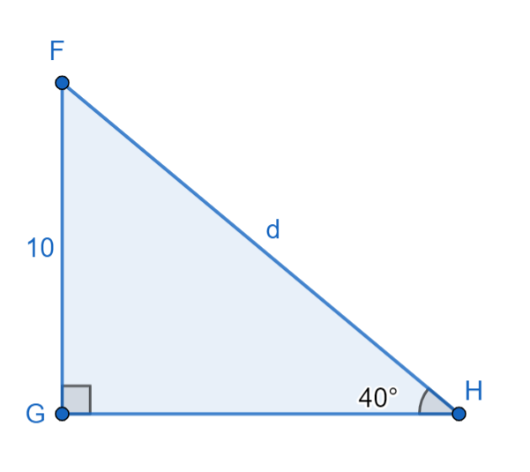
Age old question (10)
Application 1
Calculate the length of the distance, d.

Slide 15
Age old question (11)
Application 1 solution
Calculate the length of the distance, d.
$$\sin{40=\frac{10}{d}} \\ ×d=×d \\ d×\sin{40=}10 \\ ÷\sin{40=÷\sin{40}} \\ d=\frac{10}{sin40} \\ =15.557 \\ ≈16$$

Slide 16
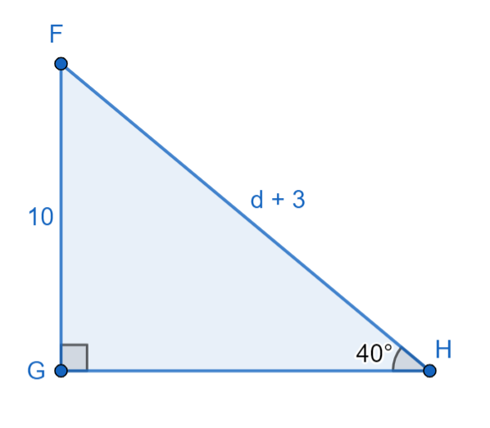
Age old question (12)
Application 2
Find the value of d.

Slide 17
Age old question (13)
Application 2 solution
$$\sin{40=\frac{10}{d+3}} \\ ×(d+3)=×(d+3) \\ (d+3)×\sin{40=}10 \\ ÷\sin{40=÷\sin{40}} \\ d+3=\frac{10}{sin40} \\ −3=−3 \\ d=\frac{10}{\sin{40}}−3 \\ =12.557 \\ ≈13$$
Find the value of d.

Slide 18
Copyright
© State of New South Wales (Department of Education), 2024
The copyright material published in this resource is subject to the Copyright Act 1968 (Cth) and is owned by the NSW Department of Education or, where indicated, by a party other than the NSW Department of Education (third-party material).
Copyright material available in this resource and owned by the NSW Department of Education is licensed under a Creative Commons Attribution 4.0 International (CC BY 4.0) license.
This license allows you to share and adapt the material for any purpose, even commercially.
Attribution should be given to © State of New South Wales (Department of Education), 2024.
Material in this resource not available under a Creative Commons license:
the NSW Department of Education logo, other logos and trademark-protected material
Material owned by a third-party that has been reproduced with permission. You will need to obtain permission from the third-party to reuse its material.
Links to third-party material and websites
Please note that the provided (reading/viewing material/list/links/texts) are a suggestion only and implies no endorsement, by the New South Wales Department of Education, of any author, publisher, or book title. School principals and teachers are best placed to assess the suitability of resources that would complement the curriculum and reflect the needs and interests of their students.
If you use the links provided in this document to access a third-party’s website, you acknowledge that the terms of use, including license terms set out on the third-party’s website apply to the use which may be made of the materials on that third-party website or where permitted by the Copyright Act 1968 (Cth). The department accepts no responsibility for content on third-party websites.

