Slide 1
Packing then unpacking

Slide 2
Launch

Slide 3
Which one does not belong?
Provide reasoning for your choice.
$$4x+4=24$$ | $$4x−3=17$$
$$4x+8=20$$ | $$\frac{4x+1}{3}=7$$

Slide 4
Explore

Slide 5
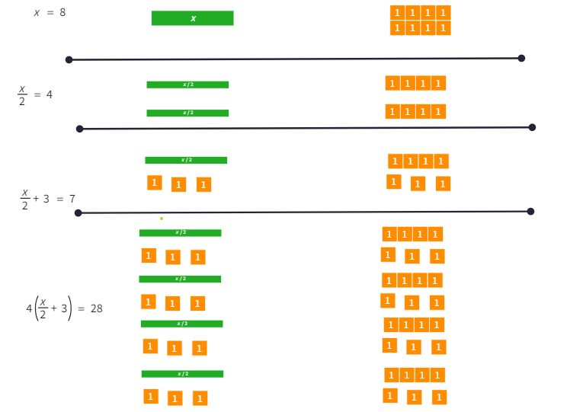
Equations visually (1)
Example
Why have I separated the x and the 8 into two groups?
Justify why the two sides are balanced throughout.
Describe the changes that would occur if there was an additional step to subtract 5.

Slide 6
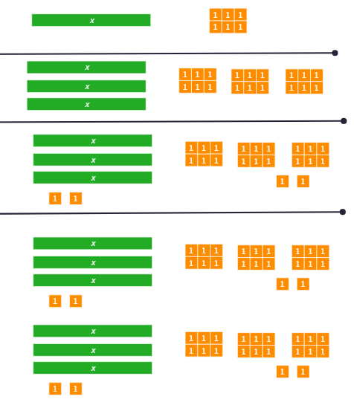
Equations visually (2)
Equation 1

Slide 7
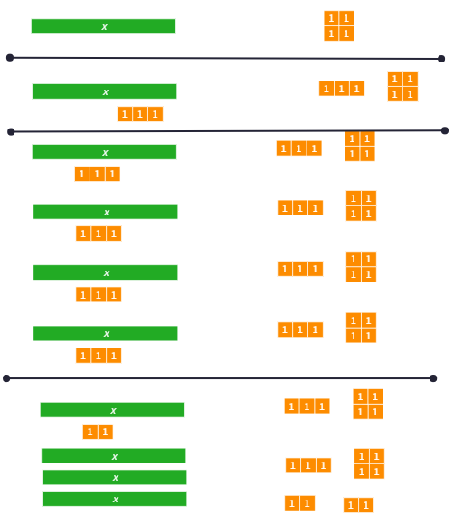
Equations visually (3)
Equation 2

Slide 8
Summarise

Slide 9
Solving equations (1)
Worked example 1
Solve for $x$.
$$3\left(4x−5\right)=21 \\ ÷3=÷3 \\ 4x−5=7 \\ +5=+5 \\ 4x=12 \\ ÷4=÷4 \\ x=3$$

Slide 10
Solving equations (2)
Self-explanation prompts
Solve for $x$.
$$3\left(4x−5\right)=21 \\ ÷3=÷3 \\ 4x−5=7 \\ +5=+5 \\ 4x=12 \\ ÷4=÷4 \\ x=3$$
Would you get the same answer if you were to expand the brackets first? Why?
Why did we not +5 in the first step?
How do we check the answer is correct?

Slide 11
Solving equations (3)
Your turn – question 1
Solve for $x$.
$$5(\frac{x}{3}+4)=30$$

Slide 12
Solving equations (4)
Your turn – solution 1
Solve for $x$.
$$5\left(\frac{x}{3}+4\right)=30 \\ ÷5=÷5 \\ \frac{x}{3}+4=6 \\ −4=−4 \\ \frac{x}{3}=2 \\ ×3=×3 \\ x=6$$

Slide 13
Copyright
© State of New South Wales (Department of Education), 2024
The copyright material published in this resource is subject to the Copyright Act 1968 (Cth) and is owned by the NSW Department of Education or, where indicated, by a party other than the NSW Department of Education (third-party material).
Copyright material available in this resource and owned by the NSW Department of Education is licensed under a Creative Commons Attribution 4.0 International (CC BY 4.0) license.
This license allows you to share and adapt the material for any purpose, even commercially.
Attribution should be given to © State of New South Wales (Department of Education), 2024.
Material in this resource not available under a Creative Commons license:
the NSW Department of Education logo, other logos and trademark-protected material
Material owned by a third-party that has been reproduced with permission. You will need to obtain permission from the third-party to reuse its material.
Links to third-party material and websites
Please note that the provided (reading/viewing material/list/links/texts) are a suggestion only and implies no endorsement, by the New South Wales Department of Education, of any author, publisher, or book title. School principals and teachers are best placed to assess the suitability of resources that would complement the curriculum and reflect the needs and interests of their students.
If you use the links provided in this document to access a third-party’s website, you acknowledge that the terms of use, including licence terms set out on the third-party’s website apply to the use which may be made of the materials on that third-party website or where permitted by the Copyright Act 1968 (Cth). The department accepts no responsibility for content on third-party websites.

