Slide 1
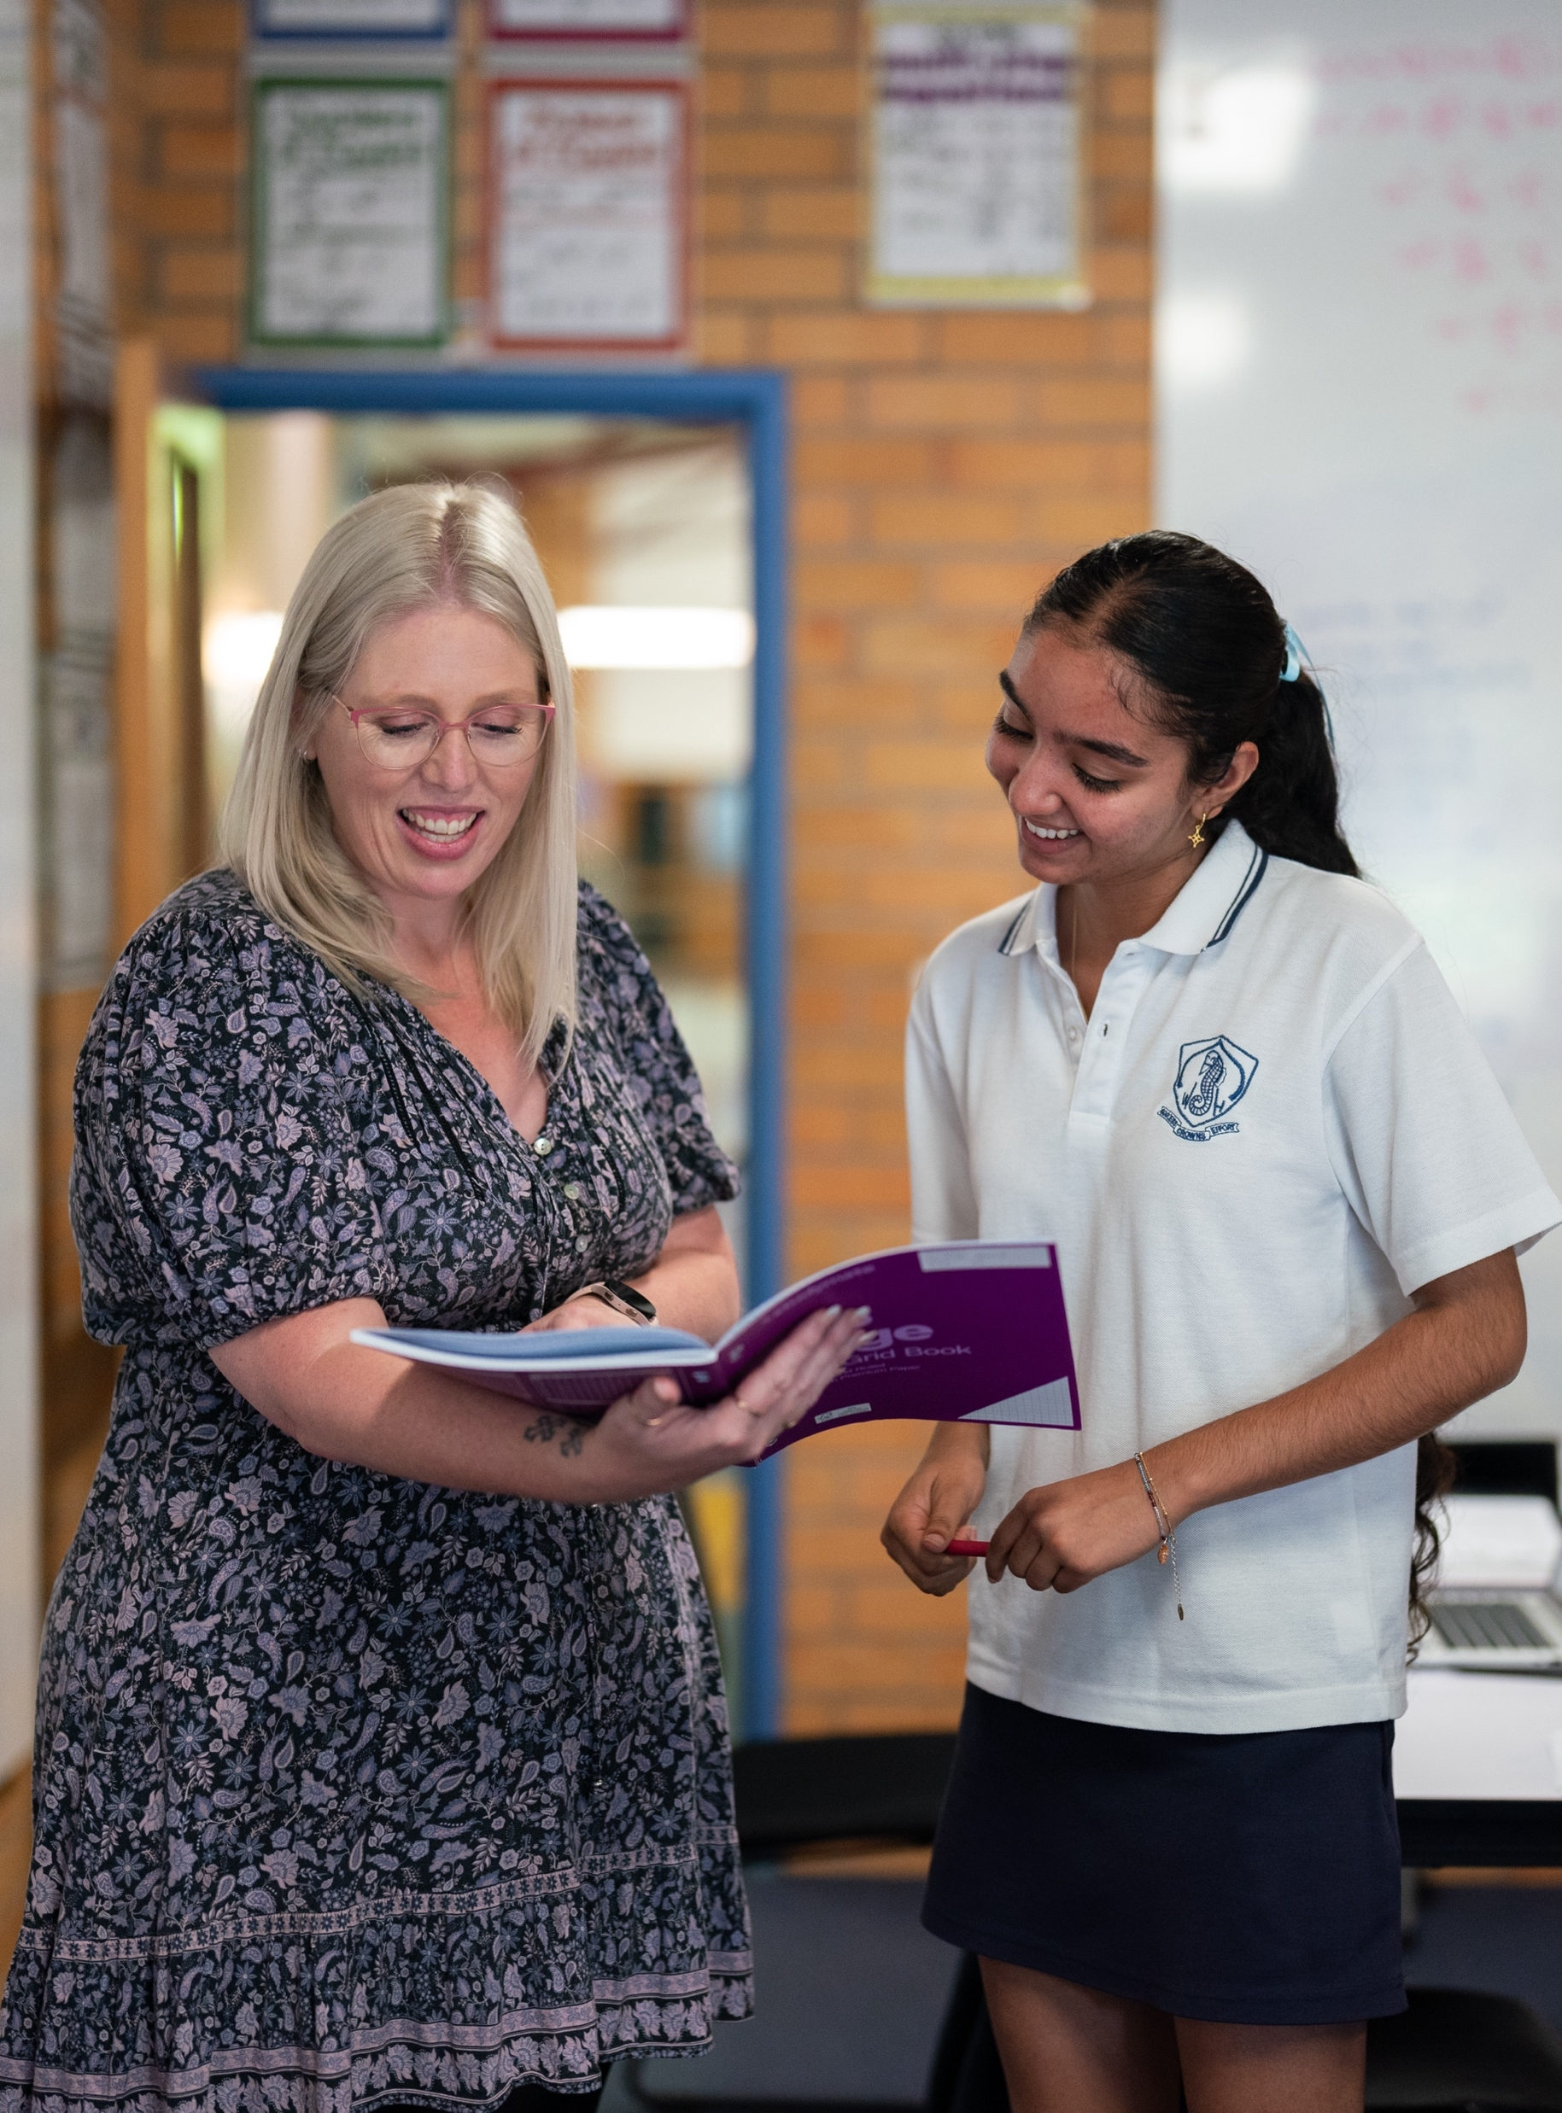
Simple and compound interest
NSW Department of Education
Stage 5

Slide 2
Launch
NSW Department of Education

Slide 3
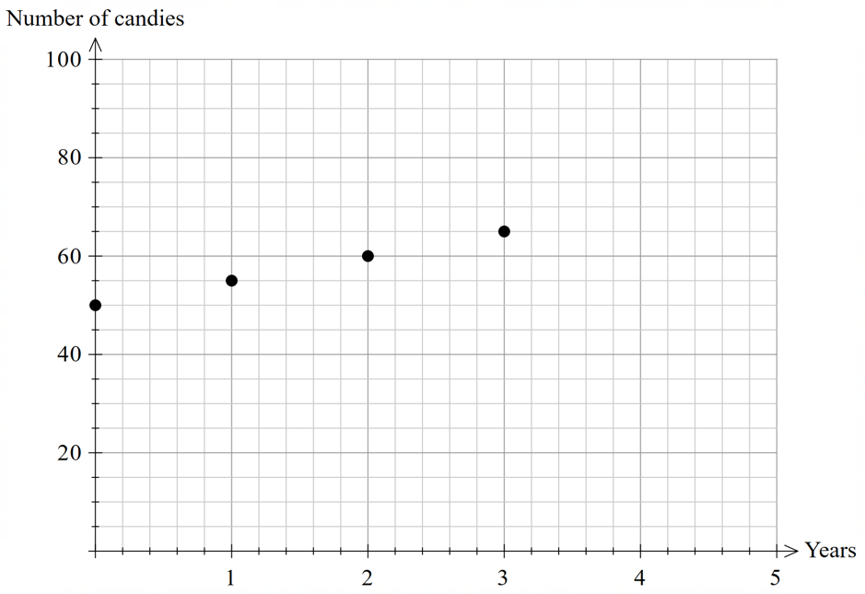
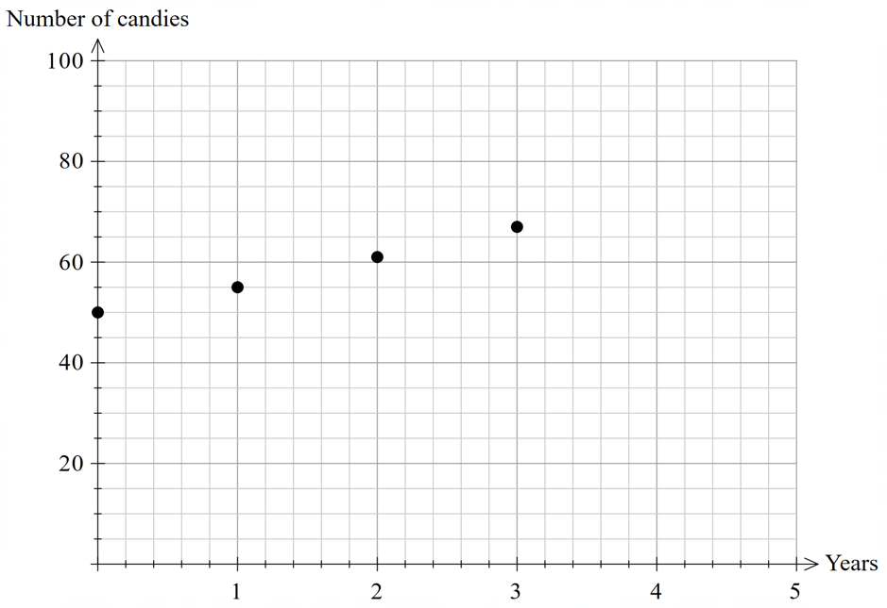
Simple and compound interest (1)
Simple and compound candy
Simple interest
Compound interest

Slide 4
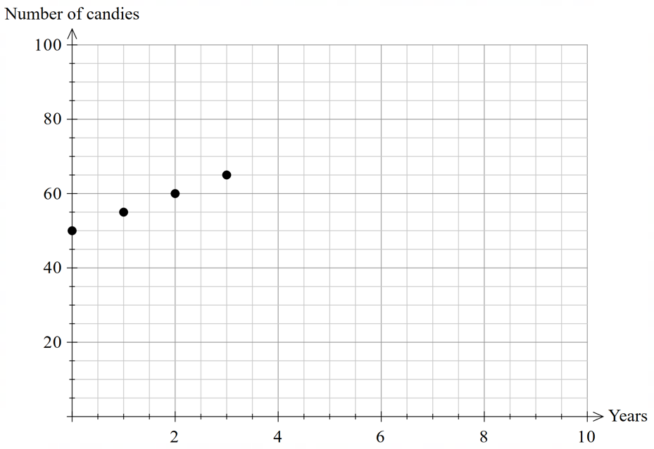
Simple and compound interest (2)
Simple and compound candy – 10 years
Simple interest
Compound interest

Slide 5
Explore
NSW Department of Education

Slide 6
Simple and compound interest (3)
Spot the difference
Simple interest
Compound interest
Year 1
$$=50+50×0.10×1 \\ =55$$
Year 1
$$=50+50×0.10×1 \\ =55$$
Year 2
$$=55+50×0.10×1 \\ =60$$
Year 2
$$=55+55×0.10×1 \\ =61$$
Year 3
$$=60+50×0.10×1 \\ =65$$
Year 3
$$=61+61×0.10×1 \\ =67$$

Slide 7
Simple and compound interest (4)
Compound interest first 5 years
Compound interest
Year 1
$$=50+50×0.10×1 \\ =55$$
Year 4
Year 2
$$=55+55×0.10×1 \\ =61$$
Year 5
Year 3
$$=61+61×0.10×1 \\ =67$$

Slide 8
Simple and compound interest (5)
Compound interest first 5 years - solutions
Compound interest
Year 1
$$=50+50×0.10×1 \\ =55$$
Year 4
$$=67+67×0.10×1 \\ =74$$
Year 2
$$=55+55×0.10×1 \\ =61$$
Year 5
$$=74+74×0.10×1 \\ =81$$
Year 3
$$=61+61×0.10×1 \\ =67$$

Slide 9
Simple and compound interest (6)
Worked example 1
Compound interest
Year 1
$$=50+50×0.10×1 \\ =50\left(1+0.10\right) \\ =50\left(1.10\right) \\ =55$$
Year 3
$$=61+61×0.10×1 \\ =61\left(1+0.10\right) \\ =61\left(1.10\right) \\ =67$$
Year 2
$$=55+55×0.10×1 \\ =55\left(1+0.10\right) \\ =55\left(1.10\right) \\ =61$$

Slide 10
Simple and compound interest (7)
Worked example 1
Compound interest
Year 1
$$=50+50×0.10×1 \\ =50\left(1+0.10\right) \\ =50\left(1.10\right) \\ =55$$
Year 3
$$=61+61×0.10×1 \\ =61\left(1+0.10\right) \\ =61\left(1.10\right) \\ =67$$
50 is the common factor in this expression, what does this mean?
Year 2
$$=55+55×0.10×1 \\ =55\left(1+0.10\right) \\ =55\left(1.10\right) \\ =61$$
We know Year 1 can be expressed as $50\left(1.10\right)$ so, we could express Year 2 as $50\left(1.10\right)\left(1.10\right)$ How could you express Year 3 in terms of Year 1?
What is the same each year?

Slide 11
Simple and compound interest (8)
Your turn - problem 1
Compound interest
Year 1
$$=50+50×0.10×1 \\ =50\left(1+0.10\right) \\ =50\left(1.10\right) \\ =55$$
Year 4
Year 2
$$=55+55×0.10×1 \\ =55\left(1+0.10\right) \\ =55\left(1.10\right) \\ =61$$
Year 5
Year 3
$$=61+61×0.10×1 \\ =61\left(1+0.10\right) \\ =61\left(1.10\right) \\ =67$$

Slide 12
Simple and compound interest (9)
Your turn - solution 1
Compound interest
Year 1
$$=50+50×0.10×1 \\ =50\left(1+0.10\right) \\ =50\left(1.10\right) \\ =55$$
Year 4
$$=67+67×0.10×1 \\ =67\left(1+0.10\right) \\ =67\left(1.10\right) \\ =74$$
Year 2
$$=55+55×0.10×1 \\ =55\left(1+0.10\right) \\ =55\left(1.10\right) \\ =61$$
Year 5
$$=74+74×0.10×1 \\ =74\left(1+0.10\right) \\ =74\left(1.10\right) \\ =81$$
Year 3
$$=61+61×0.10×1 \\ =61\left(1+0.10\right) \\ =61\left(1.10\right) \\ =67$$

Slide 13
Summarise
NSW Department of Education

Slide 14
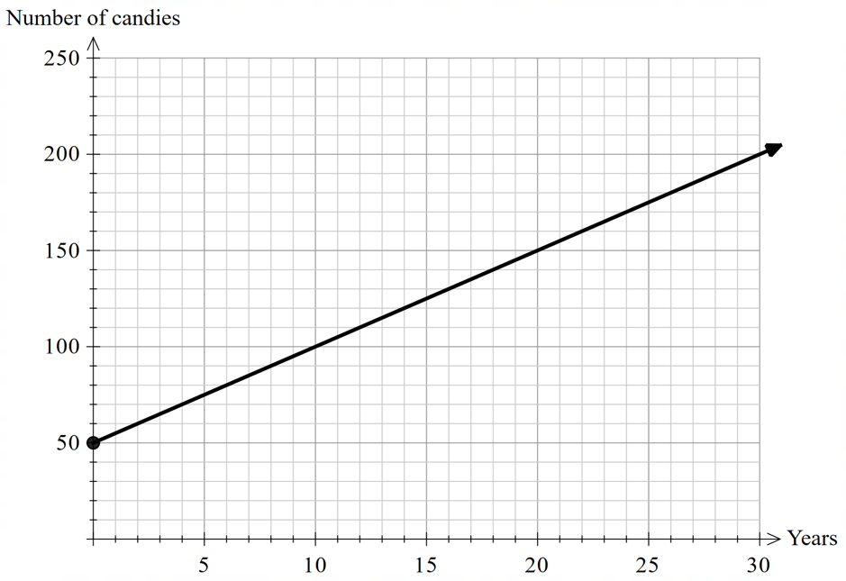
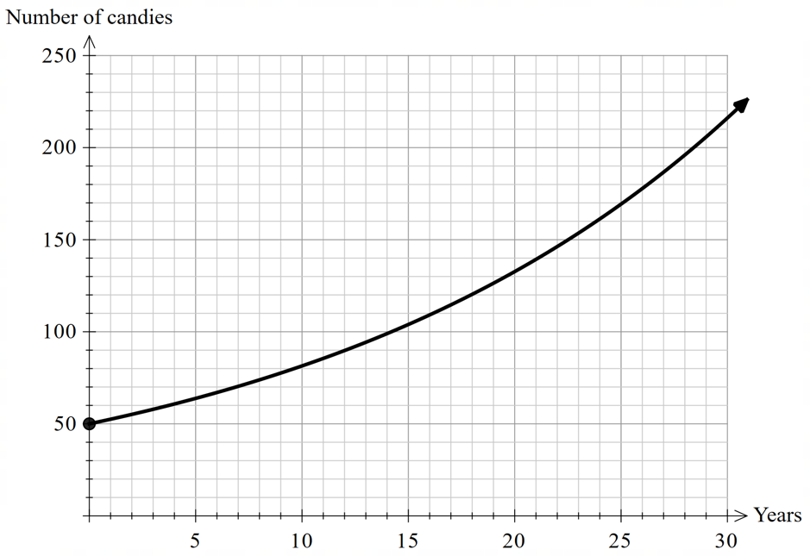
Simple and compound interest (10)
Simple and compound interest graphs
Simple interest
Compound interest

Slide 15
Simple and compound interest (11)
Linear and exponential graphs
Linear
Exponential

Slide 16
Simple and compound interest (12)
Compound interest formula
r represents the interest rate, per annum.
n represents the number of years.
$$FV=PV{\left(1+r\right)}^{n}$$
FV represents future value. What does future value represent in the candy problem?
PV represents present value. What does present value represent in the candy problem?

Slide 17
Simple and compound interest (13)
Worked example 2
Find the future value of 50 candies invested at $10\%$per annum, compounded annually, after 100 years.
$$FV=PV{\left(1+r\right)}^{n} \\ FV=50{\left(1+0.10\right)}^{100} \\ =50{\left(1.10\right)}^{100} \\ =689030.62 \\ =689030 \text{candies}$$

Slide 18
Simple and compound interest (14)
Worked example 2 – self explanation prompts
Find the future value of 50 candies invested at $10\%$per annum, compounded annually, after 100 years.
Compounded means how frequently interest is calculated. What might change if the interest was compounded monthly?
$$FV=PV{\left(1+r\right)}^{n} \\ FV=50{\left(1+0.10\right)}^{100} \\ =50{\left(1.10\right)}^{100} \\ =689030.62 \\ =689030 \text{candies}$$
How does a percentage increase of 110% relate to repeated applications of simple interest?
The simple interest formula calculates the interest earned, does the compound interest formula do the same?
Why didn’t we round up to 689031 candies?

Slide 19
Simple and compound interest (15)
Your turn – problem 2
Find the future value of 10 candies invested at $7\%$per annum, compounded annually, after 20 years.

Slide 20
Simple and compound interest (16)
Your turn – solution 2
Find the future value of 10 candies invested at $7\%$per annum, compounded annually, after 20 years.
$$FV=PV{\left(1+r\right)}^{n} \\ FV=10{\left(1+0.07\right)}^{20} \\ =10{\left(1.07\right)}^{20} \\ =228.98 \\ =228 \text{candies}$$

Slide 21
Copyright
© State of New South Wales (Department of Education), 2024
The copyright material published in this resource is subject to the Copyright Act 1968 (Cth) and is owned by the NSW Department of Education or, where indicated, by a party other than the NSW Department of Education (third-party material).
Copyright material available in this resource and owned by the NSW Department of Education is licensed under a Creative Commons Attribution 4.0 International (CC BY 4.0) license.
This license allows you to share and adapt the material for any purpose, even commercially.
Attribution should be given to © State of New South Wales (Department of Education), 2024.
Material in this resource not available under a Creative Commons license:
the NSW Department of Education logo, other logos and trademark-protected material
Material owned by a third party that has been reproduced with permission. You will need to obtain permission from the third party to reuse its material.
Links to third-party material and websites
Please note that the provided (reading/viewing material/list/links/texts) are a suggestion only and implies no endorsement, by the New South Wales Department of Education, of any author, publisher, or book title. School principals and teachers are best placed to assess the suitability of resources that would complement the curriculum and reflect the needs and interests of their students.
If you use the links provided in this document to access a third-party’s website, you acknowledge that the terms of use, including licence terms set out on the third-party’s website apply to the use which may be made of the materials on that third-party website or where permitted by the Copyright Act 1968 (Cth). The department accepts no responsibility for content on third-party websites.

