Slide 1
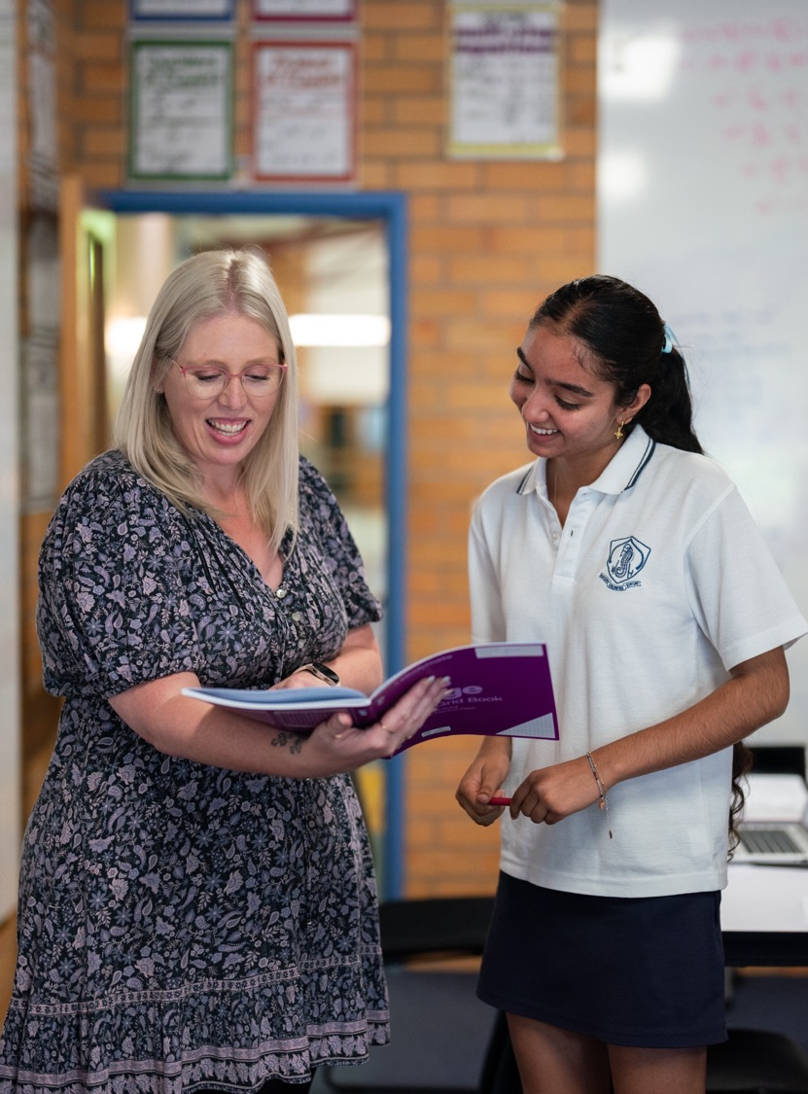
Bad investments
NSW Department of Education
Stage 5

Slide 2
Explore
NSW Department of Education

Slide 3
Ford Everest
Depreciated value and graph
Adapted from Australian Tax Office.

Slide 4
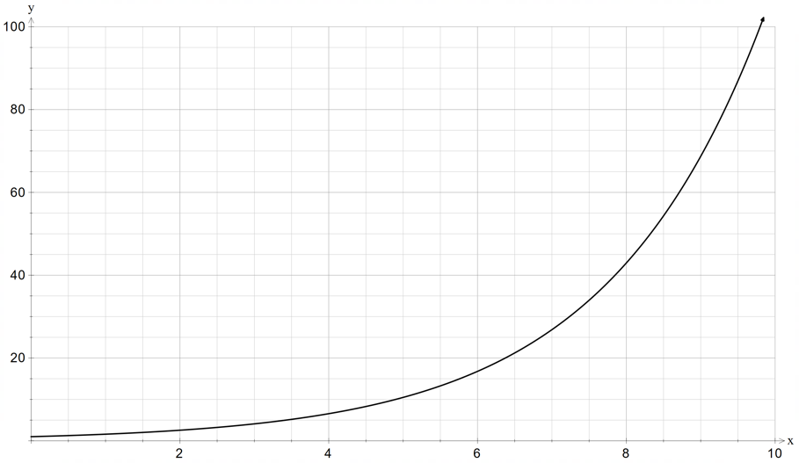
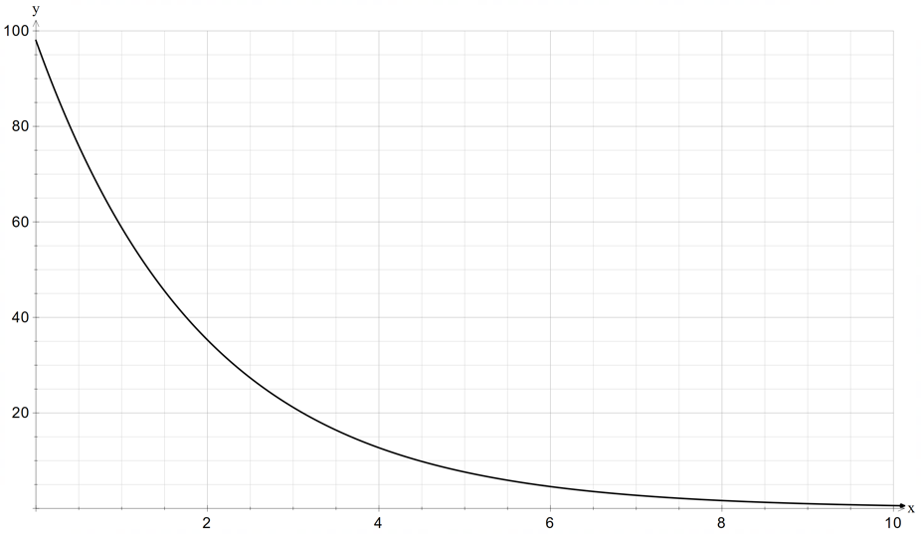
Compare the pair
What do you notice and wonder
Compound interest
Depreciation

Slide 5
Summarise
NSW Department of Education

Slide 6
Depreciation formula (1)
Declining balance
Which formula is like this? How does it differ?
$$S=V_{o}{\left(1−r\right)}^{n}$$
Describe the effect of the negative sign?
S = salvage value
$V_{0}$=initial value of the asset
$r$ = depreciation rate per time period
$n$ = number of periods
What does the term salvage mean? Why is it used in this context?

Slide 7
Depreciation formula (2)
Worked example 1
A car initially valued at $45 000 depreciated at a rate of 6% p.a. What is the car’s salvage value after 4 years?
$$S=V_{o}{\left(1−r\right)}^{n} \\ =45000{\left(1−0.06\right)}^{4} \\ =\$35133.70$$

Slide 8
Depreciation formula (3)
Self-explanation prompts
A car initially valued at $45 000 depreciated at a rate of 6% p.a. What is the car’s salvage value after 4 years?
$$S=V_{o}{\left(1−r\right)}^{n} \\ =45000{\left(1−0.06\right)}^{4} \\ =\$35133.70$$
Why substitute 0.06 not 6?
How can you use the salvage value to calculate how much the car has depreciated?

Slide 9
Depreciation formula (4)
Your turn – question 1
Tang’s new car cost $56 000. What is the value of the car after 5 years if it declines at a rate 7% p.a.?

Slide 10
Depreciation formula (5)
Your turn – solution 1
Tang’s new car cost $56 000. What is the value of the car after 5 years if it declines at a rate 7% p.a.?
$$S=V_{o}{\left(1−r\right)}^{n} \\ =56000{(1−0.07)}^{5} \\ =\$38958.55$$

Slide 11
Apply
NSW Department of Education

Slide 12
Are cars a bad investment?
Justify your answer
Other investments | 2022 | 2024
iPhone 13 | $1087 | $879
Google Pixel 7 Pro | $1299 | $599
Median house price Cessnock | $532 475 | $590 000
Median house price Orange | $713 500 | $831 769
Toyota Land Cruiser (VX model) | $119 000 | $122 000

Slide 13
Copyright
© State of New South Wales (Department of Education), 2024
The copyright material published in this resource is subject to the Copyright Act 1968 (Cth) and is owned by the NSW Department of Education or, where indicated, by a party other than the NSW Department of Education (third-party material).
Copyright material available in this resource and owned by the NSW Department of Education is licensed under a Creative Commons Attribution 4.0 International (CC BY 4.0) license.
This license allows you to share and adapt the material for any purpose, even commercially.
Attribution should be given to © State of New South Wales (Department of Education), 2024.
Material in this resource not available under a Creative Commons license:
the NSW Department of Education logo, other logos and trademark-protected material
Material owned by a third party that has been reproduced with permission. You will need to obtain permission from the third party to reuse its material.
Links to third-party material and websites
Please note that the provided (reading/viewing material/list/links/texts) are a suggestion only and implies no endorsement, by the New South Wales Department of Education, of any author, publisher, or book title. School principals and teachers are best placed to assess the suitability of resources that would complement the curriculum and reflect the needs and interests of their students.
If you use the links provided in this document to access a third-party’s website, you acknowledge that the terms of use, including licence terms set out on the third-party’s website apply to the use which may be made of the materials on that third-party website or where permitted by the Copyright Act 1968 (Cth). The department accepts no responsibility for content on third-party websites.

