Slide 1
Euler’s number
NSW Department of Education
Stage 5

Slide 2
Launch

Slide 3
Euler’s number (1)
Compounded annually
Sam invested $20 000 in a savings account for 5 years, which pays interest at 6% per annum, compounded annually.

Slide 4
Euler’s number (2)
Compounded daily
Sam invested $20 000 in a savings account for 5 years, which pays interest at 6% per annum, compounded daily.

Slide 5
Explore
NSW Department of Education

Slide 6
Euler’s number (3)
Compounded annually or daily
Compounded annually
Compounded daily
$$FV=20 000{\left(1+\frac{0.06}{365}\right)}^{5×365}=\$26 996.51$$
$$FV=20 000{\left(1+0.06\right)}^{5}=\$26 764.51$$

Slide 7
Euler’s number (4)
Would you rather
Would you rather invest at:
an interest rate of 100% per annum compounded annually
an interest rate of 90% per annum compounded bi-annually
an interest rate of 80% per annum compounded quarterly
an interest rate of 70% per annum compounded daily?

Slide 8
Summarise
NSW Department of Education

Slide 9
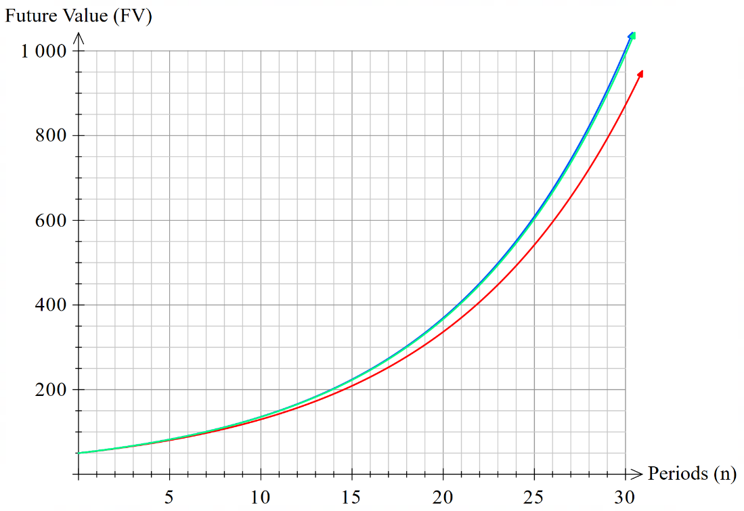
Euler’s number (5)
Compounded annually, monthly, daily
$$y=50{\left(1+\frac{0.10}{365}\right)}^{n×365}$$
$$y=50{\left(1+0.10\right)}^{n}$$
$$y=50{\left(1+\frac{0.10}{12}\right)}^{n×12}$$

Slide 10
Apply
NSW Department of Education

Slide 11
Euler’s number (6)
Increasing compounding
$1 invested at 100% per annum, for one year, compounded …

Slide 12
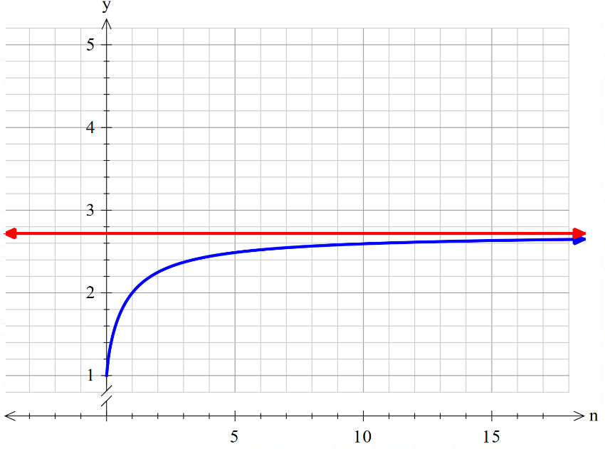
Euler’s number (7)
Graphing $e$ and ${\left(1+\frac{1}{n}\right)}^{n}$
$$n$$ | $$y$$
$$1$$ | $$2.0$$
$$2$$ | $$2.25$$
$$4$$ | $$2.44140625$$
$$12$$ | $$2.61303529022$$
$$52$$ | $$2.69259695444$$
$$365$$ | $$2.71456748202$$
$$8760$$ | $$2.71812669162$$
$$525 600$$ | $$2.71827924258$$
$$y=e$$
$$y={\left(1+\frac{1}{n}\right)}^{n}$$

Slide 13
Copyright
© State of New South Wales (Department of Education), 2024
The copyright material published in this resource is subject to the Copyright Act 1968 (Cth) and is owned by the NSW Department of Education or, where indicated, by a party other than the NSW Department of Education (third-party material).
Copyright material available in this resource and owned by the NSW Department of Education is licensed under a Creative Commons Attribution 4.0 International (CC BY 4.0) license.
This license allows you to share and adapt the material for any purpose, even commercially.
Attribution should be given to © State of New South Wales (Department of Education), 2024.
Material in this resource not available under a Creative Commons license:
the NSW Department of Education logo, other logos and trademark-protected material
Material owned by a third party that has been reproduced with permission. You will need to obtain permission from the third party to reuse its material.
Links to third-party material and websites
Please note that the provided (reading/viewing material/list/links/texts) are a suggestion only and implies no endorsement, by the New South Wales Department of Education, of any author, publisher, or book title. School principals and teachers are best placed to assess the suitability of resources that would complement the curriculum and reflect the needs and interests of their students.
If you use the links provided in this document to access a third-party’s website, you acknowledge that the terms of use, including licence terms set out on the third-party’s website apply to the use which may be made of the materials on that third-party website or where permitted by the Copyright Act 1968 (Cth). The department accepts no responsibility for content on third-party websites.

