Slide 1
Invasive species
NSW Department of Education
Stage 5

Slide 2
Launch

Slide 3
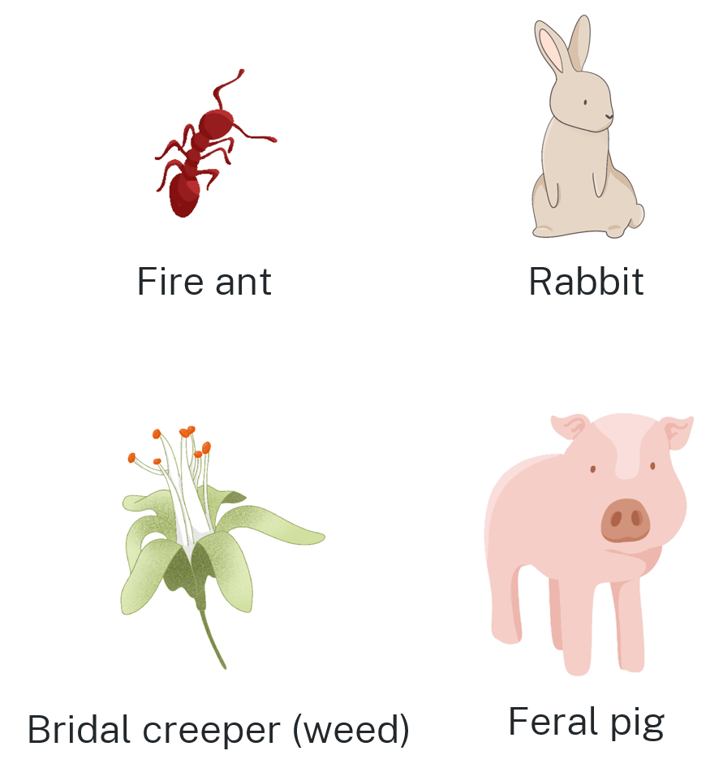
Which one doesn’t belong?
Justify your thinking

Slide 4
Explore
NSW Department of Education

Slide 5
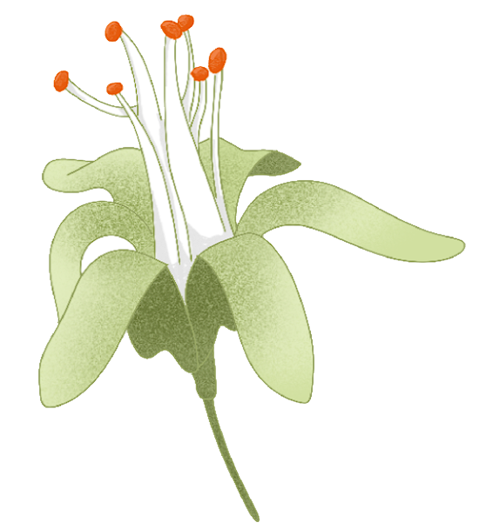
Invasive species (1)
Bridal creeper (Asparagus asparagoides)
Bridal creeper is a smothering vine that:
outcompetes native plants
reduces food and habitat for native animals
forms thick root mats that can stop other plants and seedlings growing
reduces fruit production in citrus and avocado orchards
increases the chance of disease in orchards by reducing airflow around trees.
NSW Weedwise (bit.ly/bridalcreeper)

Slide 6
Invasive species (2)
Bridal creeper (Asparagus asparagoides)​
A sample from a small area is taken each week.
Week 0
1 plant

Slide 7
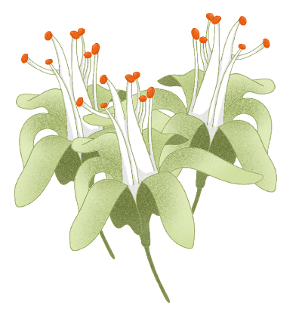
Invasive species (3)
Bridal creeper (Asparagus asparagoides)​
A sample from a small area is taken each week.
Week 0
Week 1
1 plant
3 plants

Slide 8
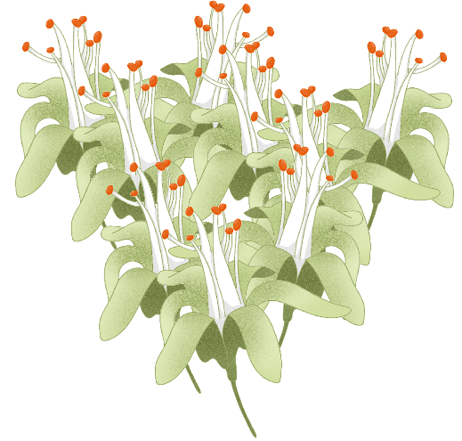
Invasive species (4)
Bridal creeper (Asparagus asparagoides)​
A sample from a small area is taken each week.
Week 0
Week 1
Week 2
1 plant
3 plants
9 plants

Slide 9
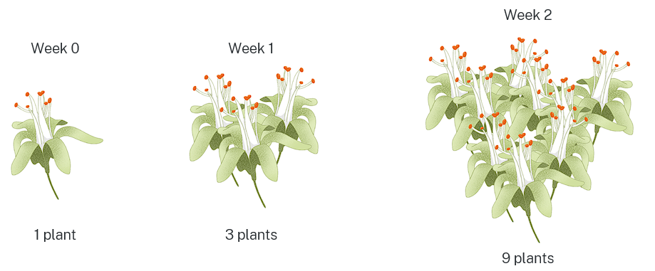
Invasive species (5)
$$Weeks (x)$$ | $$Plants (y)$$
$$0$$ | $$1$$
$$1$$ | $$3$$
$$2$$ | $$9$$
Bridal creeper (Asparagus asparagoides)

Slide 10
Invasive species (6)
$$Weeks (x)$$ | $$Plants (y)$$
$$0$$ | $$1$$
$$1$$ | $$3$$
$$2$$ | $$9$$
Bridal creeper (Asparagus asparagoides)
$$y=3^{x}$$
How does the $3^{x}$ relate to the pattern shown?
How could you verify that the equation is correct?

Slide 11
Invasive species (7)
Exponential equation
$$y=a^{x}$$
$x$ is the exponent.
$y$ is the output.
$a$ is the base.

Slide 12
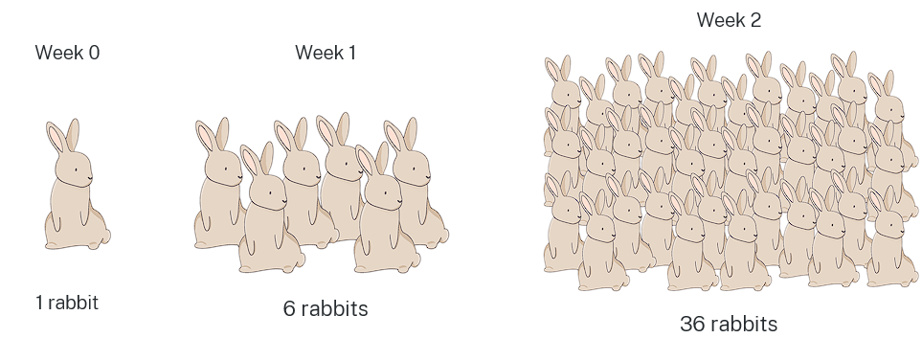
Invasive species (8)
$$Weeks (x)$$ | $$Rabbits (y)$$
$$0$$ | $$1$$
$$1$$ | $$6$$
$$2$$ | $$36$$
Rabbits
A sample from a small area is taken each week
$$y={\left(\right)}^{x}$$

Slide 13
Invasive species (9)
$$Weeks (x)$$ | $$Rabbits (y)$$
$$0$$ | $$1$$
$$1$$ | $$6$$
$$2$$ | $$36$$
Rabbits
$$y={\left(\right)}^{x}$$
Why is zero weeks always 1?
How many rabbits will there be in week 3?
How many rabbits will there be in 1 year?

Slide 14
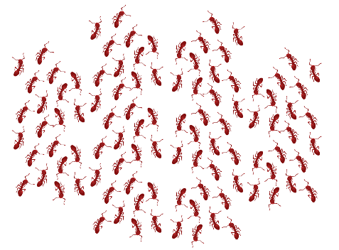
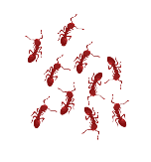
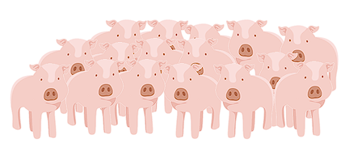
Invasive species (10)
Fire ants and feral pigs
Week 2
Week 0
Week 1
1 fire ant
10 fire ants
100 fire ants
Week 0
Week 1
Week 2
1 feral pig
4 feral pigs
16 feral pigs

Slide 15
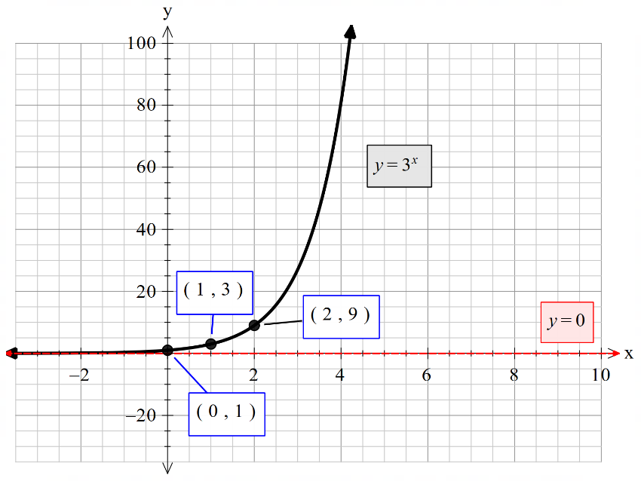
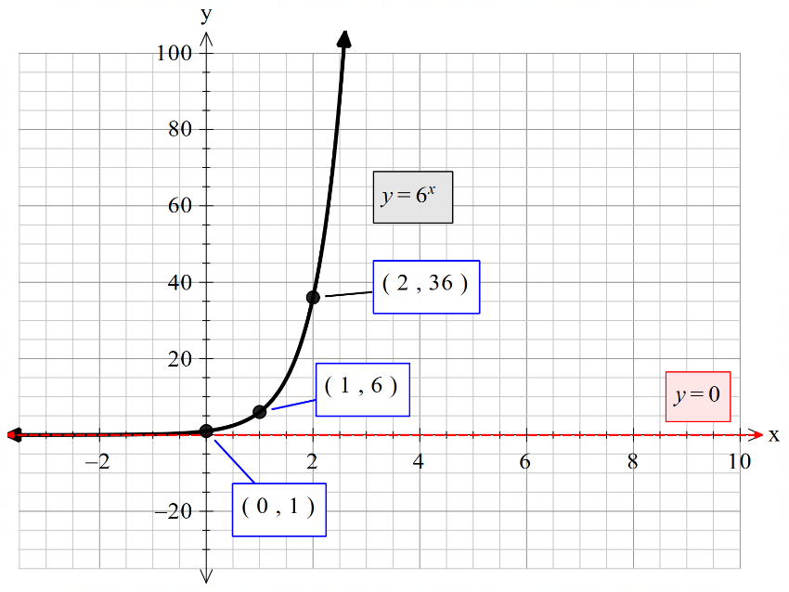
Invasive species (11)
Bridal creeper and rabbits
Bridal creeper
Rabbits

Slide 16
Copyright
© State of New South Wales (Department of Education), 2024
The copyright material published in this resource is subject to the Copyright Act 1968 (Cth) and is owned by the NSW Department of Education or, where indicated, by a party other than the NSW Department of Education (third-party material).
Copyright material available in this resource and owned by the NSW Department of Education is licensed under a Creative Commons Attribution 4.0 International (CC BY 4.0) license.
This license allows you to share and adapt the material for any purpose, even commercially.
Attribution should be given to © State of New South Wales (Department of Education), 2024.
Material in this resource not available under a Creative Commons license:
the NSW Department of Education logo, other logos and trademark-protected material
Material owned by a third party that has been reproduced with permission. You will need to obtain permission from the third party to reuse its material.
Links to third-party material and websites
Please note that the provided (reading/viewing material/list/links/texts) are a suggestion only and implies no endorsement, by the New South Wales Department of Education, of any author, publisher, or book title. School principals and teachers are best placed to assess the suitability of resources that would complement the curriculum and reflect the needs and interests of their students.
If you use the links provided in this document to access a third-party’s website, you acknowledge that the terms of use, including licence terms set out on the third-party’s website apply to the use which may be made of the materials on that third-party website or where permitted by the Copyright Act 1968 (Cth). The department accepts no responsibility for content on third-party websites.

