Slide 1
Instructions for use
This resource is not a teaching and learning program. It should be used in conjunction with 11HMS-FA2 – biomechanics learning program from the Planning, programming and assessing PDHPE 11–12 webpage.
Classroom teachers are encouraged to add and adapt slides as required to meet the needs of their students.
Save a copy of the file to make changes to the slide deck. Go to File > Download a Copy (this downloads a copy to your computer to edit in the PowerPoint app).
To convert the PowerPoint to Google Slides:
  Upload the file into Google Drive and open it.
  Go to File > Save as Google Slides.
  (Note – conversion may cause formatting changes in the slides.)
Notes:
Access the Year 11 Focus area 2 – biomechanics on the Planning, programming and assessing PDHPE 11–12 curriculum webpages.

Slide 2
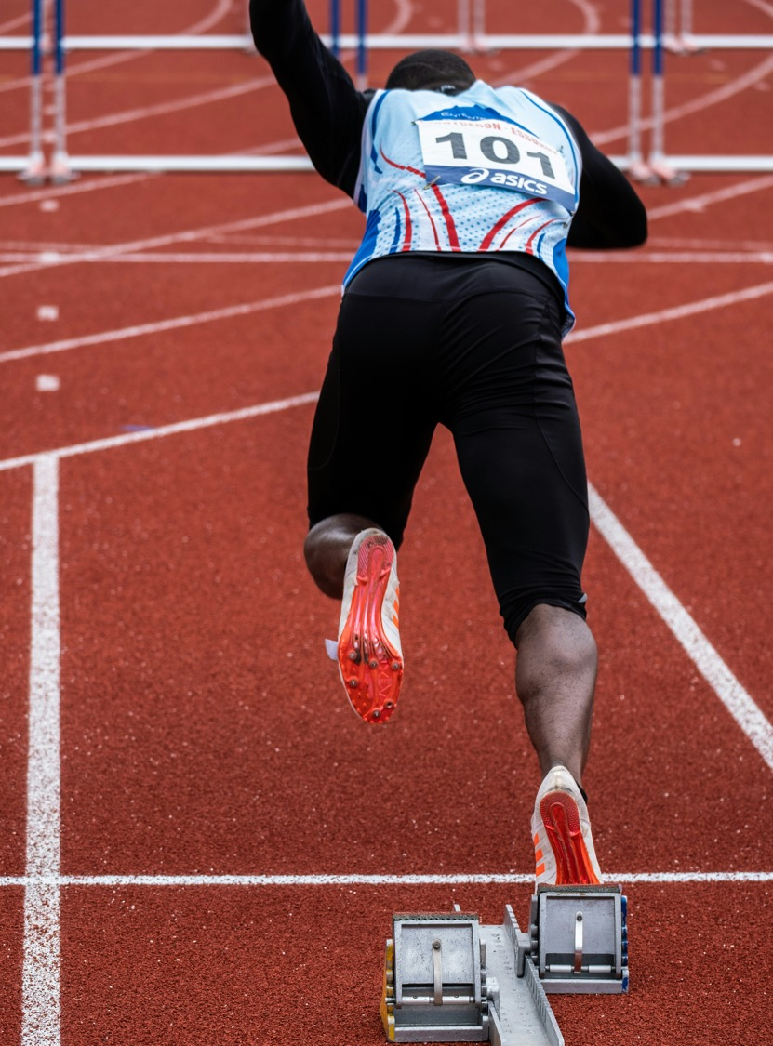
Biomechanics
Year 11 – Focus area 2
The body and mind in motion
Notes:
Image licensed under Pixabay Content License.

Slide 3
Topics
1
5
Biomechanical principles
Activity 4 – base of support
2
6
Activity 5 – centre of gravity and base of support
Activity 1 – summation of force
3
7
Activity 2 – absorbing force
Activity 6 – fluid mechanics
4
8
Activity 3 – applying force
Activity 7 – linear motion
Notes:
Teacher notes:
Click topic numbers to go to specific topics
Interactive features can be viewed in slide show

Slide 4
Learning intentions and success criteria (1)
We are learning to:
develop an understanding of the biomechanical principles of motion, balance and stability, fluid mechanics and force and how they affect movement through analysing a range of sporting examples
define and understand the terms ‘safe movement’ and ‘movement efficiency’
make predictions about the impact of a biomechanical principle on the outcome of a practical application
justify their observations through applying their understanding of biomechanical principles
work collaboratively with peers.
Notes:
Notes for teachers:
Learning intentions and success criteria are best co-constructed with students. Adapt the learning intentions as required and add matching success criteria.
For more information see ⁠AITSL or the NSW Department of Education explicit teaching strategies, ⁠Sharing learning intentions and ⁠Sharing success criteria.
LISC is not necessarily presented at the beginning of the lesson. Teacher needs to consider most effectual time to introduce.
LISC should be revisited during the lesson to support students' evaluation of their learning.

Slide 5
Learning intentions and success criteria (2)
We can:
[classroom teacher to insert co-constructed success criteria]
[classroom teacher to insert co-constructed success criteria]
[classroom teacher to insert co-constructed success criteria].
Notes:
Notes for teachers:
Learning intentions and success criteria are best co-constructed with students. Adapt the learning intentions as required and add matching success criteria.
For more information see ⁠AITSL or the NSW Department of Education explicit teaching strategies, ⁠Sharing learning intentions and ⁠Sharing success criteria.
LISC is not necessarily presented at the beginning of the lesson. Teacher needs to consider most effectual time to introduce.
LISC should be revisited during the lesson to support students' evaluation of their learning.

Slide 6
Understanding terminology and biomechanical principles
What is biomechanics?
Biomechanics is the science of how and why the human body moves the way it does. This includes how muscles, bones and joints work together to produce movement. When used in sport, it can help to minimise the potential risk of injury and allow an athlete to pursue their potential, be more efficient and hence improve sport performance.

Slide 7
Biomechanical principles
Definitions
Motion – is the movement of the body or an object through space. Speed, acceleration and momentum are important parts of motion.
Balance and stability – are the alignment of the body’s centre of gravity over the base of support. This includes centre of gravity, line of gravity and base of support.
Fluid mechanics – is the study of forces and flows through fluid. This includes flotation, centre of buoyancy and fluid resistance.
Force – is a push or pull that causes a person or object to speed up, slow down, stop or change direction. The body applies force, the body absorbs force, the body can apply force to an object.

Slide 8
Activity 1 – standing long jump
Summation of force

Slide 9
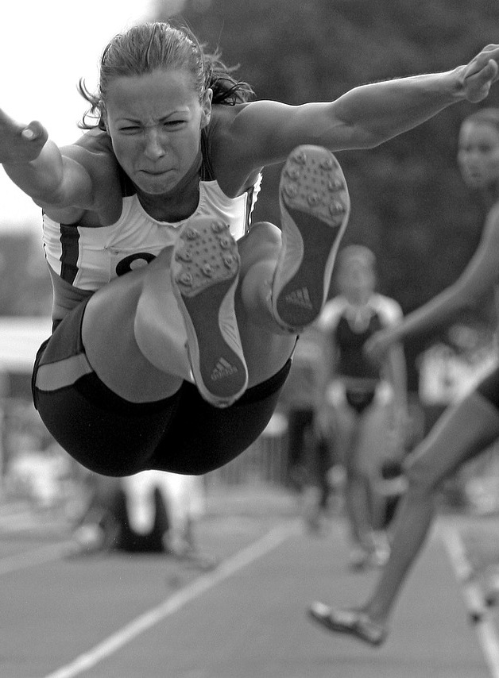
Summation of force activities
Group activities
Undertake the following practical experiences:
Hop off one leg without using your arms.
Jump off 2 legs without using your arms.
Jump off 2 legs while using both arms.
Run up, jump off 2 legs and use both arms.
Notes:
Image licensed under Pixabay Content License.

Slide 10
Summation of force questions
Questions to check understanding
Based on the practical experience:
What allowed you to jump forward regardless of the technique or posture used?
What do you notice about the distance that you were able to travel in each jump?
Why do you think that is?
What were the differences between the jumps? Explain using your understanding of the principles of force.
How effective would a high jumper or basketball player be if suspended in mid-air with nothing to push against? Explain your answer.

Slide 11
Activity 2 – catching eggs and cricket balls
Absorbing force

Slide 12

Absorbing force activities
Group activities
Undertake the following practical experiences using an underarm throw:
catch an egg with a partner
gradually increase the distance between throws by stepping back after each catch
repeat the same process with a cricket ball.
Notes:
Image licensed under Unsplash License.

Slide 13
Absorbing force questions
Questions to check understanding
Based on the practical experience:
How did you avoid breaking the egg? Describe the techniques you used.
How did your techniques change when the distance was increased? What was the successful outcome and why?
Why do you think the techniques of catching an egg might be applied to catching a hard object, such as a cricket ball?
Using your knowledge of absorbing force, account for the different techniques used to catch both objects.
How do you think this can be applied to something like rugby league? Why is technique important to allow a smaller opponent to tackle a larger person? How do they absorb shock or force?

Slide 14
Activity 3 – basketball and tennis ball activity
Applying force

Slide 15
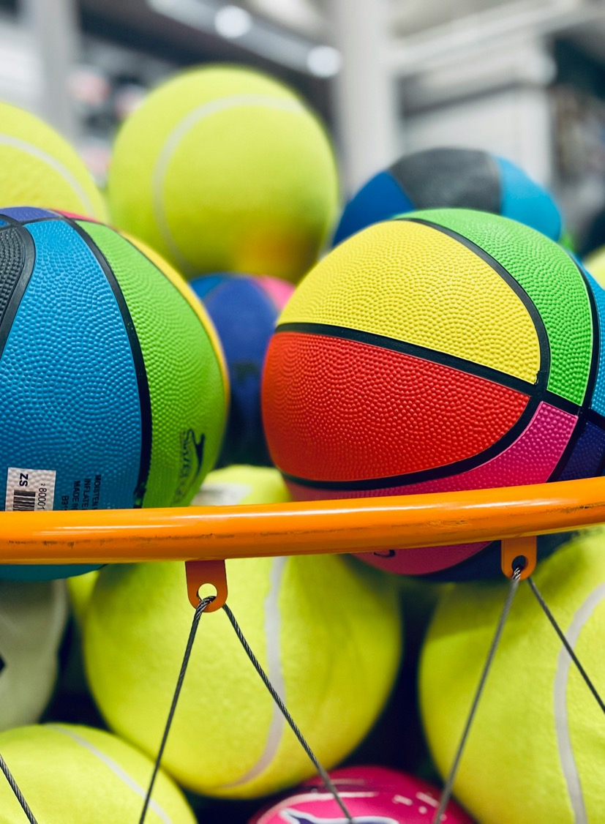
Applying force activities
Group activities
Undertake the following practical experiences.
Place a basketball and a tennis ball on a line.
Push both balls at the same time using the same force.
Notes:
Image licensed under Unsplash License.

Slide 16
Applying force questions
Questions to check understanding
Based on the practical experience answer the following questions:
Although the same amount of force was used, did one ball move further than the other? Propose why this occurred.
Explain the difference in distances travelled in terms of application of force to the masses of each ball.
Explain what you would expect to happen in the following situations and how each situation impacts the amount of force applied to the ball:
        it was raining and the ball became wet
        the basketball was only half inflated.
Notes:
Teacher note:
An alternate activity to explore this principle could be to use simple throwing techniques, such as throwing:
without stepping forward
with stepping forward
with body rotation.
Questions should focus on why more force is generated with a stepping motion or rotation of the body.

Slide 17
Activity 4 – partner activity
Base of support

Slide 18
Base of support activities
Group activities
Undertake the following practical experiences:
Stand with feet together. Partner uses chalk to draw around their feet or base of support.
While still standing, partner pushes them lightly.
Repeat steps 1 and 2 with your partner using the same amount of force, but change the positioning of the feet to change the base of support such as:
        standing on one leg
        widening the stance on both feet
        kneeling on hands and knees.
Introduce line of gravity by using a wide base of support with a sideways lean or movement towards the force before it makes contact.

Slide 19
Base of support questions
Questions to check understanding
What did you notice as the base of support becomes bigger?
How does a person’s base of support affect their stability?
Account for reasons why an improved or greater base of support improves stability in relation to centre of gravity and line of gravity.
Identify 2 examples of when a wide base of support is needed in a sporting situation and explain why.
What did you notice when you had a wide base of support and moved towards the force before contact? Why do you think this is the case?
Describe how athletes who perform skills with a narrow base of support control their upper body movement to assist in maintaining balance.
Notes:
Sample answer to question 5:
In this position someone is more stable and able to withstand the force because they are moving their line of gravity towards the direction of the force. This allows more movement to occur after the force before their line of gravity is being pushed outside the base of support.

Slide 20
Activity 5 – sprint position stability
Centre of gravity and base of support

Slide 21
Centre of gravity and base of support activities
Group activities
Undertake the following practical experiences.
With a partner, complete a 10-metre sprint from the following positions:
  standing straight with arms by their side
  feet apart with a slight forward lean and arms in the ready positions (standing start)
  crouch start with hands on the floor and using blocks if possible.
Partners record each sprint time in the table.
Starting position | Time
A
B
C

Slide 22
Centre of gravity and base of support questions
Questions to check understanding
Based on the practical experience:
Describe the effect of the height of the centre of gravity on balance and stability.
Explain the impact of the area of base of support on balance and stability.
Which starting position was the fastest and why?
Are there other biomechanical principles, such as force, that play a part in influencing the times? What is happening and why?

Slide 23
Activity 6 – swimming
Fluid mechanics

Slide 24
Fluid mechanics activities
Group activities
Float positions:
floating on back
floating on back with head held out of water
prone float (floating face down) with arms by side and legs together
prone float with arms and legs spread
prone float while breathing out
deep inhalation and then prone float, holding breath
back sculling
floating while holding knees to chest.
Undertake the following practical experiences with a partner:
One person in the water performing a variety of float positions for 10 to 15 seconds each.
The other person is outside of the pool recording what they observe, including what happens to their partner’s arms, legs, trunk and hips.

Slide 25
Fluid mechanics questions
Questions to check understanding
What did you observe with the different floats performed by your partner? How did shifting different body parts (together, tucked, spread, out of water) impact the float?
Which body position resulted in the most effective float position for the time? Explain why.
If you were to turn an empty bucket upside down and push down on it, would it float? Why or why not?
Where is the centre of buoyancy located in the body? What is the similarity between the bucket of air and the centre of buoyancy?
Why would holding your breath support floating?
Why does the centre of buoyancy keep changing with the different floats?
Notes:
Question 3 sample answer: for example, there is air trapped in the bucket and air is lighter than water.
Question 4 sample answer: for example, usually in the middle of the lung area.

Slide 26
Activity 7 – swimming
Linear motion

Slide 27
Linear motion activities
Group activities
Swim and stroke techniques:
dog paddle
freestyle with head out of water while swimming
freestyle, lifting head up out of water to breathe
freestyle with no leg kick
freestyle with breath taken by rolling whole body onto side
freestyle with hand slapping the water on entry
identify any other technique faults that would affect linear motion and make movements less smooth.
Undertake the following practical experiences with a partner:
One person in the water performing a variety of swim and stroke techniques for 10 to 15 seconds each.
The other person is outside of the pool recording what they observe, including the effect that the variations in swimming techniques have on linear motion and smooth, efficient motion through the water.

Slide 28
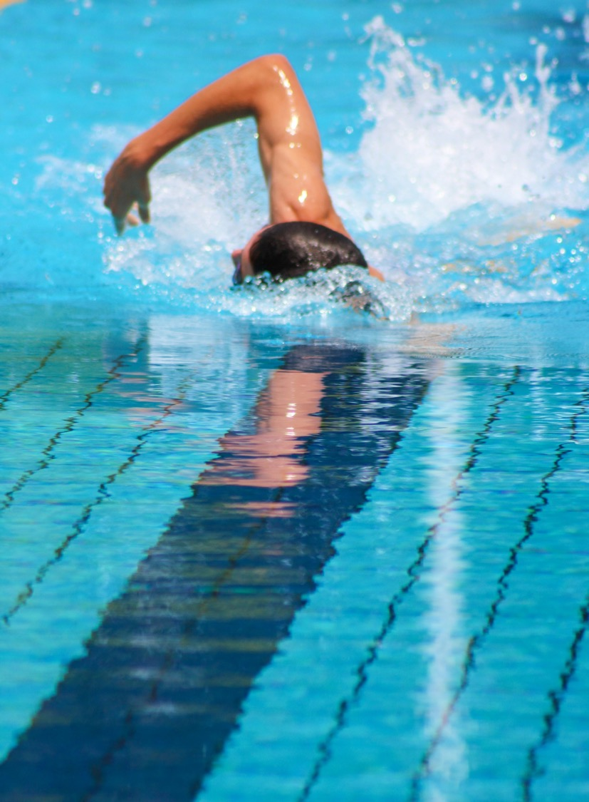
Linear motion questions
Questions to check understanding
Based on the practical experience:
What did you notice about the variations in swim and stroke techniques? Account for why this occurs.
Why does being streamlined create a smooth efficient motion through the water?
How can we create less drag?
Outside of swim or stroke techniques, what other options are available to reduce drag and increase efficiency in the water?
Notes:
Image licensed under Unsplash License.
Teacher note: for question 4, students should consider the impact of technology such as racing swimsuits, designs to boats or kayaks in their answer.

Slide 29
References
This presentation contains NSW Curriculum and syllabus content. The NSW Curriculum is developed by the NSW Education Standards Authority. This content is prepared by NESA for and on behalf of the Crown in the right of the State of New South Wales. The material is protected by Crown copyright.
Please refer to the NESA Copyright Disclaimer for more information https://educationstandards.nsw.edu.au/wps/portal/nesa/mini-footer/copyright.
NESA holds the only official and up-to-date versions of the NSW Curriculum and syllabus documents. Please visit the NSW Education Standards Authority (NESA) website https://educationstandards.nsw.edu.au/ and the NSW Curriculum website https://curriculum.nsw.edu.au.
Heath and Movement Science 11–12 Syllabus © NSW Education Standards Authority (NESA) for and on behalf of the Crown in right of the State of New South Wales, 2023.

Slide 30
Copyright
© State of New South Wales (Department of Education), 2024
The copyright material published in this resource is subject to the Copyright Act 1968 (Cth) and is owned by the NSW Department of Education or, where indicated, by a party other than the NSW Department of Education (third-party material).
Copyright material available in this resource and owned by the NSW Department of Education is licensed under a Creative Commons Attribution 4.0 International (CC BY 4.0) license.
This license allows you to share and adapt the material for any purpose, even commercially.
Attribution should be given to © State of New South Wales (Department of Education), 2024.
Material in this resource not available under a Creative Commons license:
the NSW Department of Education logo, other logos and trademark-protected material
Material owned by a third party that has been reproduced with permission. You will need to obtain permission from the third party to reuse its material.
Links to third-party material and websites
Please note that the provided (reading/viewing material/list/links/texts) are a suggestion only and implies no endorsement, by the New South Wales Department of Education, of any author, publisher, or book title. School principals and teachers are best placed to assess the suitability of resources that would complement the curriculum and reflect the needs and interests of their students.
If you use the links provided in this document to access a third-party’s website, you acknowledge that the terms of use, including licence terms set out on the third-party’s website apply to the use which may be made of the materials on that third-party website or where permitted by the Copyright Act 1968 (Cth). The department accepts no responsibility for content on third-party websites.

