Slide 1
Instructions for use
This resource is not a teaching and learning program. It should be used in conjunction with 11HMS-FA2-DS-energy systems on Planning, programming and assessing PDHPE 11–12 webpage.
Classroom teachers are encouraged to add and adapt slides as required to meet the needs of their students.
Save a copy of the file to make changes to the slide deck. Go to File > Download a Copy (this downloads a copy to the computer to edit in the PowerPoint app).
To convert the PowerPoint to Google Slides:
Upload the file into Google Drive and open it.
Go to File > Save as Google Slides.
(Note – conversion may cause formatting changes in the slides.)

Slide 2
Depth study – energy systems
Year 11 – Focus area 2
The body and mind in motion
Notes:
Image © 2024 iStockphoto LP.

Slide 3
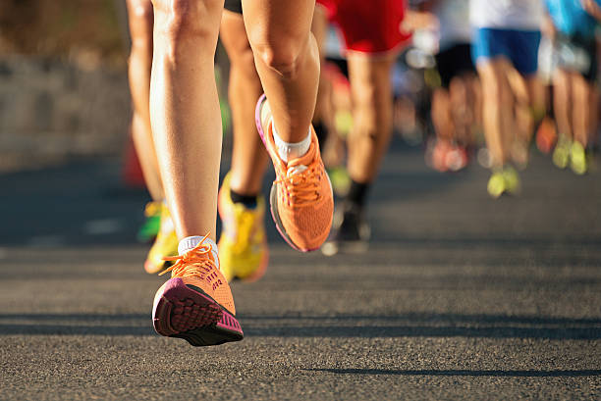
Lessons
1
Phosphate recovery test (ATP-PCr)
2
400-metre sprint (glycolytic or lactic acid system)
3
1.6-kilometre run or walk (aerobic system)
4
Touch football or netball (interplay of energy systems)
5
Interplay of energy systems – Biathlon
Notes:
Teacher notes:
Click lesson numbers to go to specific lessons
Interactive features can be viewed in slide show
Image © 2024 iStockphoto LP.

Slide 4
Learning intentions and success criteria
We are learning to:
record, graph and interpret heart rate and ventilation rate data to understand the body’s immediate physiological responses during several practical activities
identify and explain the predominant energy system (glycolytic/lactic acid) used throughout the activity including the onset of muscle fatigue and the role of different energy systems in high-intensity exercise
evaluate factors influencing performance, including physical and psychological aspects, and compare personal data with that of a trained athlete to identify similarities, differences and possible reasons.
We can:
[classroom teacher to insert co-constructed success criteria]
[classroom teacher to insert co-constructed success criteria]
[classroom teacher to insert co-constructed success criteria].
Notes:
Notes for teachers:
Learning intentions and success criteria are best co-constructed with students. Adapt the learning intentions as required and add matching success criteria.
For more information see ⁠AITSL or the NSW Department of Education explicit teaching strategies, ⁠Sharing learning intentions and ⁠Sharing success criteria.
LISC is not necessarily presented at the beginning of the lesson. Teacher needs to consider most effectual time to introduce.
LISC should be revisited during the lesson to support students' evaluation of their learning.

Slide 5
Practical experience 1 – phosphate recovery test (ATP-PCr)

Slide 6
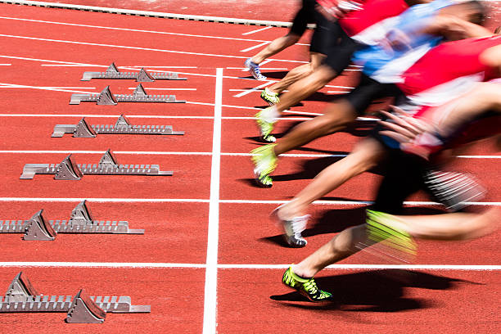
Phosphate recovery test
ATP-PCr
The phosphate recovery test is an anaerobic capacity fitness test, designed to assess the ability of an individual to recover between sprints and produce the same level of power repeatedly.
The test involves 6 maximal sprints over 35 metres with 30 seconds recovery time between each sprint.
Notes:
Image © 2024 iStockphoto LP.

Slide 7
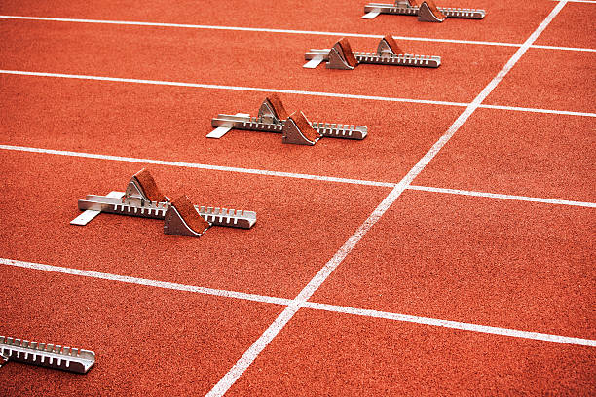
Equipment and set-up (1)
Equipment and set-up for the practical
Measured distance of 35 metres – tape measure, markers
Whistle, recording sheets/devices, stopwatches,
heart rate monitors
Students working in pairs – runner and recorder
Notes:
Explain the importance of each piece of equipment and the roles of students during the practical session.
Highlight the significance of accurate measurements for heart rate and sprint time.
Image © 2024 iStockphoto LP.

Slide 8
Procedure overview (1)
Step-by-step procedure
Record resting heart rate and breathing rate
Predictions about physical and emotional responses
6 x 35-metre sprint execution and observation with 30 seconds rest between sprints
Post-sprint heart rate and breathing rate recordings
Notes:
Walk students through the procedure, ensuring they understand each step, especially the importance of recording their observations and data.
Note: students should complete a thorough warm up before undertaking any of the practical experiences in each lesson. On conclusion of the practical, students should participate in a cool down to restore their body to pre-exercise state.
Students work in pairs. One student adopts the role of runner and the other adopts the role of timekeeper and recorder.
Record resting heart rate (RHR) and breathing rate (rate and depth) prior to any physical activity taking place including warm up.
Record thoughts, emotions and physical feelings about completing this activity such as motivation levels, feelings in legs and overall body.
Make predictions about how your body may feel at the end of the 6 sprints and record.
Timekeepers and recorders stand at the 35-metre line.
Runners begin at the zero metre or start line and prepare to run towards the 35-metre line.
On the whistle, they sprint towards and across the 35-metre line, then do a slow jog or walk to the zero metre or start line.
The sprint is then repeated until 6 sprints have been completed.
Six sprints are performed in total with 30 seconds between each sprint.
A 5 second warning is given before each sprint.
Each sprint is timed to the nearest 0.01 seconds and recorded.
On a false start, the sprint continues but the timing doesn’t. The false starter completes an extra sprint at the end.
At the end of each sprint heart rate is recorded.
Measure and record heart rate each minute thereafter, to establish the time it takes to return to RHR.
Runners describe their physical response after each sprint to be recorded, such as breathing rate and depth, feelings in legs and overall body response.
Runners and recorders then reverse roles.
Image © 2024 iStockphoto LP.

Slide 9
Results and data collection (1)
Results and data collection
Record resting heart rate and breathing rate
Record heart rate at the end of each sprint, and for 7 minutes on the minute after the sixth and final sprint
Graphing heart rate and breathing rate responses
Notes:
Use a whole class debrief or check-in after each practical experience to discuss results, answer the related questions and consolidate the content and its application.
Guide students on how to properly record their results and the importance of consistency in data collection.
Explain how to graph their results and what trends to look for.
Formative assessment opportunity:
Gather evidence of learning from the questions at the completion of each practical experience.
What was the predominant energy system being used for this activity? Give reasons for your answer.
What happened to your times from sprint one to sprint 6?
Describe how your body responded from sprint one to sprint 6. What do you notice? Compare that with others in the class.
Explain what the body’s response tells you about the energy system being used.
Outline any factors that may have impacted positively on your performance, such as motivation levels, previous training, rest.
Outline any factors that may have impacted negatively on your performance such as motivation levels, illness or injury.
For those that may have false started, what impact did this have? For those that didn’t false start, predict what ways this could make a difference to performance.
If you trained for this test, what would you expect your percentage score to do and why?
An average score for an elite athlete is less than 10%. What does your score indicate?
Suggest ways you could train to improve your performance for this test.
Image © 2024 iStockphoto LP.

Slide 10
Practical experience 2 – 400-metre sprint (glycolytic or lactic acid system)
Notes:
The 400-metre sprint is a long sprint test, and a test of anaerobic capacity which is an important fitness attribute for performing short intense bursts of effort.

Slide 11
Introduction to 400-metre sprint and glycolytic energy system
400-metre sprint – exploring the glycolytic (Lactic Acid) energy system
Understanding anaerobic capacity.
Overview of the glycolytic energy system.
Key focus – physiological responses during a 400-metre sprint.
Notes:
Introduce the 400-metre sprint as a test of anaerobic capacity, which relies heavily on the glycolytic energy system.
Emphasise the importance of understanding the physiological responses during this intense physical activity through practical participation.
Image © 2024 iStockphoto LP.

Slide 12
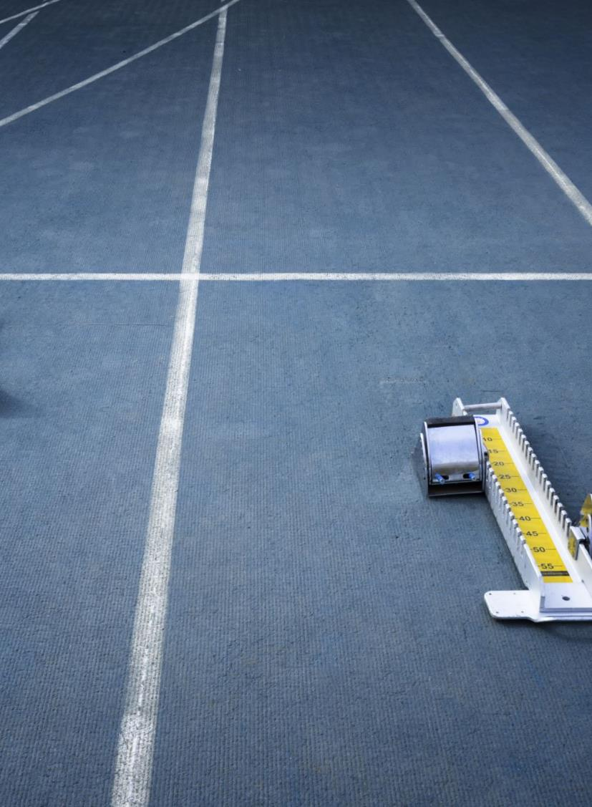
Equipment and set-up (2)
Equipment and set-up for the practical
Measured 400-metre track
Whistle, recording sheets/devices, stopwatches,
heart rate monitors
Students working in pairs – runner and recorder
Notes:
Explain the importance of each piece of equipment and the roles of students during the practical session.
Highlight the significance of accurate measurements for heart rate and sprint time.
Image © 2024 iStockphoto LP.

Slide 13
Procedure overview (2)
Step-by-step procedure
Record resting heart rate and breathing rate
Predictions about physical and emotional responses
400-metre sprint execution and observation
Post-sprint heart rate and breathing rate recordings
Notes:
Walk students through the procedure, ensuring they understand each step, especially the importance of recording their observations and data.
Note: students should complete a thorough warm up before undertaking any of the practical experiences in each lesson. On conclusion of the practical, students should participate in a cool down to restore their body to pre-exercise state.
Students work in pairs. One student adopts the role of runner and the other adopts the role of timekeeper and recorder.
Record resting heart rate (RHR) and breathing rate (rate and depth) prior to any physical activity taking place.
Record heart rate every minute for 5 minutes prior to sprinting.
Record thoughts, emotions and physical feelings about completing this activity such as motivation levels, feelings in legs and overall body.
Make predictions about how your body may feel at the end of the 400-metre sprint and record.
Timekeepers and recorders stand at the 400 metre or finish line but must be able to observe their partner at all times.
Runners begin at the zero metre or start line.
Runners sprint or run at maximal effort for 400 metres. Encourage participants to complete the 400 metres even if they have to jog or walk. The recorded time is necessary data for the task.
Recorders should record their observations as their partner runs. For example, do they stop, where do they speed up, where do they slow down, what is their body language or posture?
At the immediate end of the 400-metre sprint, record heart rate (HR). Then continue to record HR every minute after completing the sprint for a total of 7 minutes.
Record personal observations about breathing rate and depth, feelings in legs and overall body after completing the run.
Runners and recorders then reverse roles.
Image © 2024 iStockphoto LP.

Slide 14
Recording and observing
Recording and observing during the sprint
Record heart rate the minute before the sprint and each minute for 7 minutes after
Observations during the sprint – speed, body language, posture
Post-sprint observations – breathing, muscle fatigue, physical feelings
Notes:
Discuss what students should be observing during the sprint, such as changes in speed, body posture and signs of fatigue.
Encourage students to be detailed in their observations.
Recorded time at the conclusion of the sprint.
Recorded HR at the immediate end of the 400-metre sprint.
Recorded HR for each minute after the sprint up to 7 minutes.
Graph the heart rate response for pre, during and post 400-metre sprint.
Image © 2024 iStockphoto LP.

Slide 15
Results and data collection (2)
Results and data collection
Review sprint time, heart rate immediately after, and for 7 minutes post-sprint
Graph heart rate and breathing rate responses
Notes:
Use a whole class debrief or check-in after each practical experience to discuss results, answer the related questions and consolidate the content and its application.
Guide students on how to properly record their results and the importance of consistency in data collection.
Explain how to graph their results and what trends to look for.
Formative assessment opportunity:
Gather evidence of learning from the questions at the completion of each practical experience.
What was the predominant energy system being used for this activity? Give reasons for your answer.
What other energy system(s) contributed to this activity? Provide a brief explanation of their role in the 400-metre sprint.
Describe how your body responded from the start line to the finish line during the 400-metre sprint. What did your partner notice about your sprint and body response? Compare that with others in the class.
When performing the 400-metre sprint, did you experience muscle fatigue? How do you know this?
Explain what the body’s response tells you about the energy system(s) being used.
Outline any factors that may have positively impacted on your performance such as motivation levels, previous training, rest.
Outline any factors that may have had a negative impact on your performance such as fatigue, dehydration, training the previous day, illness, injury, lack of motivation.
Image © 2024 iStockphoto LP.

Slide 16
Target heart rate
Calculate your upper and lower target heart rate (THR) zones
Maximum heart rate (MHR) can be calculated by using the following formula: MHR = 220 − age.
Target heart rate (THR) zone can be calculated by 0.60 × MHR equals the lower end of the target heart rate zone.
The upper end of the target heart rate zone is equal to 0.80 × MHR.
In general, the higher your heart rate during physical activity, the higher the exercise intensity.
Monitoring heart rate provides an objective measure of exercise intensity.
Example – Sam is 18 years old.
His MHR is 202 bpm.
His THR zone is between 121–161 bpm.
Notes:
Image © 2024 iStockphoto LP.

Slide 17
Results and data collection (3)
Analysis of heart rate response to pre, during and post 400-metre sprint (Fig 1)
Notes:
Using your knowledge of maximum heart rate, calculate your upper and lower target heart rate (THR) zones and mark this on Figure 1.
For this activity, we are assuming all participants are the same age and therefore have the same maximum and target heart rate zones.
Students will need to have graphed their own heart rate responses for the 400-metre sprint to complete the following task.
Figure 1 represents the heart rate of a 17-year-old trained female athlete. This data was collected from a recent 400-metre sprint she completed mid-way through her normal 2-hour training session. Her resting heart rate is 60 beats per minute.
Using the results on the graph and your own results that you have added, answer the following questions.
Look at the graph. What are 3 things you notice?
At the start of the 400-metre sprint, why are your results similar to that of the trained athlete?
What similarities and differences do you see between the 2 sets of data?
Identify possible reasons for the similarities and differences paying attention to pre, during and post 400-metre sprint.
Imagine that at the 375-metre mark of the 400-metre sprint, you and the other runner represented in Figure 1 are tied. You both give a maximal effort to win the race. Predict which participant would win the race and why?

Slide 18
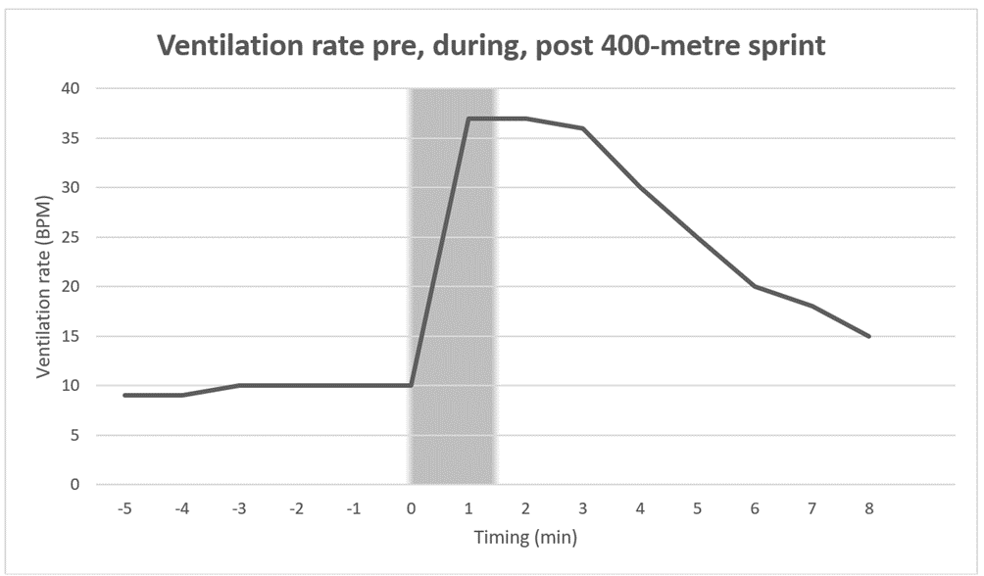
Results and data collection (4)
Analysis of ventilation rate pre, during and post 400-metre sprint (Fig 2)
Notes:
Students will need to have graphed their own ventilation or breathing rate responses for the 400-metre sprint on Figure 2 to complete the following task.
Figure 2 represents the ventilation rate of a 17-year-old trained female athlete. This data was collected from a recent 400-metre sprint she completed mid-way through her normal 2-hour training session. Using the results on the graph and your own results that you have added, answer the following questions.
Look at the graph. What are 3 things you notice?
Compare your own results to the runner. Describe the difference between ventilation rates.
What assumptions can be made about the fitness level of the runner that was initially on the graph based on ventilation rates?

Slide 19
Energy systems involved
Energy system involved in the 400-metre sprint
Predominant energy system – Glycolytic/Lactic Acid system
Contribution of other energy systems – ATP-PC and aerobic system
Impact of energy system on muscle fatigue and performance
Notes:
Discuss the glycolytic energy system in detail, explaining how it provides energy during the 400-metre sprint.
Mention the role of the ATP-PC system at the start and the aerobic system in recovery.
Using the results on Fig 1 and your own results that you have added, answer the following questions.
Consider the energy system used for this activity. How do you know this?
How long would each participant need to wait before they could replicate the activity to the same intensity?
If you were asked to complete another 400-metre sprint within 5 minutes of completing the first, how might your body and mind be feeling?
How would you know you could replicate this? Give examples.
Would you expect your time to be quicker or slower? Give reasons for your answer.
Explain at what point during the 400-metre sprint you would anticipate each participant to start to experience muscle fatigue?
During the 400-metre sprint did you exhaust any of your energy systems? How do you know this? What did you experience? How did this impact your performance in the 400-metre sprint?
Examine both the heart rate and ventilation graphs provided in Figures 1 and 2.
What correlations can be seen between heart rate and ventilation rate for each participant? What are the possible reasons for this?
Account for these correlations in regard to the energy system used, including fuel source, intensity of exercise, duration of exercise, by products, causes of fatigue.
If you trained for this test, what would you expect your time to do and why?
Suggest ways you could train to improve your performance for this test.
Image © 2024 iStockphoto LP.

Slide 20
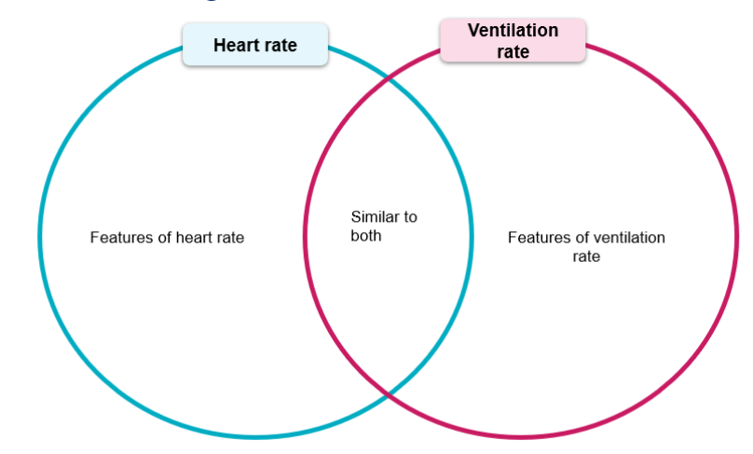
Analysis and discussion
Analysis and discussion
Comparing heart rate and ventilation rates
Impact of physiological responses on sprint performance
Factors affecting performance – motivation, fatigue, training
Notes:
Facilitate a discussion comparing the heart rate and ventilation rate responses between students and the trained athlete.
Explore how these physiological responses relate to performance and fatigue.

Slide 21
Key questions for reflection
Reflection and analysis questions
How did your body respond from start to finish?
What was your experience of muscle fatigue?
How do energy systems explain your body’s response?
What factors influenced your performance positively or negatively?
Notes:
Pose reflection questions to the class and encourage them to think critically about their experiences during the sprint.
Connect their experiences with the theoretical knowledge of energy systems from the syllabus content.
Image © 2024 iStockphoto LP.

Slide 22
Final thoughts and next steps
Final thoughts and next steps
Review of key concepts – glycolytic energy system, heart rate, muscle fatigue
Application to future physical activities
Preparing for the next practical session
Notes:
Summarise the key learning points from the session.
Encourage students to think about how they can apply this knowledge in future physical activities and sports.
Image © 2024 iStockphoto LP.

Slide 23
Practical experience 3 – 1.6 kilometre run or walk (aerobic system)
Notes:
This is a test of aerobic fitness, an important component of endurance-based and team sports.

Slide 24
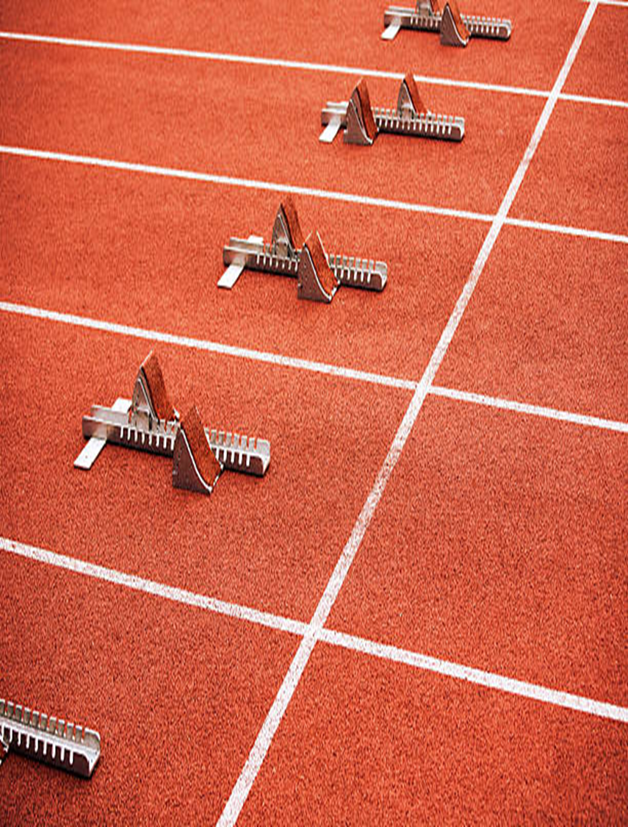
Equipment and set-up (3)
Equipment and set-up for the practical
Measured distance of 1.6 kilometres – trundle wheel, markers
Whistle, recording sheets/devices, stopwatches,
heart rate monitors
Students working in pairs – runner and recorder
Notes:
Explain the importance of each piece of equipment and the roles of students during the practical session.
Image © 2024 iStockphoto LP.

Slide 25
Procedure overview (3)
Step-by-step procedure
Record resting heart rate and breathing rate
Predictions about physical and emotional responses
Run or walk briskly, continuously for 1.6 kilometres
Post run or walk to take heart rate and breathing rate recordings
Notes:
Walk students through the procedure, ensuring they understand each step, especially the importance of recording their observations and data.
Note: students should complete a thorough warm up before undertaking any of the practical experiences in each lesson. On conclusion of the practical, students should participate in a cool down to restore their body to pre-exercise state.
Students work in pairs. One student adopts the role of runner and the other adopts the role of timekeeper and recorder.
Record resting heart rate (RHR) and breathing rate (rate and depth) prior to any physical activity taking place including warm up.
Record thoughts, emotions and physical feelings about completing this activity such as motivation levels, feelings in legs and overall body.
Make predictions about how your body may feel at the end of the 1.6-kilometre run and record.
Timekeepers and recorders stand in a position to observe their partner at all times.
Runners begin at the zero metre or start line.
Runners run or walk continuously for 1.6 kilometres. Encourage participants to complete the 1.6 kilometres even if they must jog or walk. The recorded time is necessary data for the task.
Recorders should record their observations as their partner runs. For example, do they stop, where do they speed up, where do they slow down, what is their body language or posture?
Record HR at the 800-metre mark of the run or jog if possible.
At the immediate end of the 1.6-kilometre run, record heart rate (HR).
Take heart rate each minute to record the time it takes to return to RHR.
Record personal observations about breathing rate and depth, feelings in legs and overall body after completing the run.
Runners and recorders then reverse roles.
Image © 2024 iStockphoto LP.

Slide 26
Results and data collection (5)
Results and data collection
Record resting heart rate and breathing rate
Record heart rate at the 800-metre mark, at the end of the 1.6 kilometres and again every minute for 7 minutes
Graphing heart rate and breathing rate responses
Notes:
Use a whole class debrief or check-in after each practical experience to discuss results, answer the related questions and consolidate the content and its application.
Guide students on how to properly record their results and the importance of consistency in data collection.
Explain how to graph their results and what trends to look for.
Formative assessment opportunity:
Gather evidence of learning from the questions at the completion of each practical experience.
What was the predominant energy system being used for this activity? Give reasons for your answer.
What other energy system(s) contributed to this activity? Provide a brief explanation of their role in the 1.6-kilometre run. Include at what time of the run the energy system contributed and the evidence of this occurring.
Describe how your body responded from the start line to the finish line during the 1.6-kilometre run. What did your partner notice about your run and body response? Compare that with others in the class.
Explain what the body’s response tells you about the energy system(s) being used.
Did you reach a steady state at any time during this activity? How did you recognise this?
Outline any factors that may have positively impacted your performance such as motivation levels, previous training, rest.
Outline any factors that may have had a negative impact on your performance such as fatigue, dehydration, training the previous day, illness, injury, lack of motivation.
If you were asked to complete another 1.6-kilometre run within 5 minutes of completing the first, how might your mind and body feel? Would you expect your time to be quicker or slower? Give reasons for your answer.
How long do you think you would need to physically recover before running 1.6 kilometres again to get a similar time to what you just recorded? Give reasons for your answer.
If you trained for this test, what would you expect your time to do and why?
Suggest ways you could train to improve your performance for this test.
If you had to sprint the final 100 metres of the run how would your body have responded? Give reasons for your answer that include references to energy systems.
Image licensed under Pixabay Content License.
https://media.istockphoto.com/id/1446902902/photo/writing-on-the-safety-checklist-in-audit.jpg?s=612x612&w=0&k=20&c=uItL12lUeB41brSWkKc5Pv-lUzWdCKDPwpyW4fQF6IM=

Slide 27
Practical experience 4 – touch football or netball (interplay of energy systems)
Notes:
To gain an understanding of how energy systems interact and impact performance during participation in a team sport.

Slide 28
Equipment and set-up (4)
Equipment and set-up for the practical
Space and equipment for chosen sport
Heart rate monitors
Students working in pairs – participant and recorder
Notes:
Explain the importance of each piece of equipment and the roles of students during the practical session.
Highlight the significance of accurate measurements for heart rate and sprint time.
Image © 2024 iStockphoto LP.

Slide 29
Procedure overview (4)
Step-by-step procedure
Record resting heart rate and breathing rate
Predictions about physical and emotional responses
Record heart rate and breathing rate at regular intervals throughout the game
Post game heart rate and breathing rate recordings
Notes:
Walk students through the procedure, ensuring they understand each step, especially the importance of recording their observations and data.
Note: students should complete a thorough warm up before undertaking any of the practical experiences in each lesson. On conclusion of the practical, students should participate in a cool down to restore their body to pre-exercise state.
Students work in pairs. One student adopts the role of player or participant and the other adopts the role of recorder.
Record resting heart rate (RHR) and breathing rate (rate and depth) before any physical activity takes place including warm up.
Record thoughts, emotions and physical feelings about completing this activity such as motivation levels, feelings in legs and overall body.
Make predictions about how your body may feel at the end of the game and record.
As a playing group, choose regular intervals throughout the game to record HR and breathing rate and depth. Record the physical response, including feeling in legs and overall body, if possible.
At the conclusion of the game, record HR and breathing rate and depth. Record the physical response, including feeling in legs and overall body.
Take heart rate each minute to record the time it takes to return to RHR.
Player or participant and recorder then reverse roles.
Image © 2024 iStockphoto LP.

Slide 30
Results and data collection (6)
Results and data collection
Record resting heart rate and breathing rate
Record heart rate and breathing rate at regular intervals throughout the game
Graphing heart rate and breathing rate responses
Notes:
Use a whole class debrief or check-in after each practical experience to discuss results, answer the related questions and consolidate the content and its application.
Guide students on how to properly record their results and the importance of consistency in data collection.
Explain how to graph their results and what trends to look for.
Formative assessment opportunity:
Gather evidence of learning from the questions at the completion of each practical experience.
What is the predominant energy system being used for this activity? Give reasons for your answer.
In what parts of the game did you use your ATP-PCr energy system? How did you know you were using that energy system? How did your body respond or feel when doing this?
In what parts of the game did you use your Glycolytic or Lactic Acid energy system? How did you know you were using that energy system? How did your body respond or feel when doing this?
In what parts of the game did you use your Aerobic energy system? How did you know you were using that energy system? How did your body respond or feel when doing this?
Would you expect your use of energy systems to differ if you were playing a different position? Give reasons for your answer and support with specific examples.
Suggest ways a player in this sport could train to maximise their ability to move between energy systems. Apply the FITT principle to this training.
Image © 2024 iStockphoto LP.

Slide 31
Practical application of interplay of energy systems – Biathlon

Slide 32
Biathlon (1)
What is it?
Watch the video Biathlon in Beijing 2022: How it works (3:23).
Focus particular attention to the structure of the 10-kilometre sprint biathlon (0:59–3:23).
Notes:
The biathlon combines cross country skiing with target shooting. The sprint biathlon for men is a 10-kilometre time trial event. At 2 designated points in the race, athletes fire 5 rounds at a target from their rifle. The first set of shots must be done lying down and occur at the 3.3-kilometre race mark. The second set of shots occur at the 6.7-kilometre mark from a standing position. For every target an athlete misses, a 150-metre penalty lap is added and must be completed at the end of the race before crossing the finish line. The sprint event normally takes 23 minutes for elite athletes to complete.
The cross-country skiing is a demanding endurance element of biathlon that involves continuous changes in speed, external power and energy system contributions while skiing across varying terrain. Added to the high aerobic metabolic power required to excel in cross-country (XC) skiing, sufficient anaerobic power and well-developed efficiency with associated technical and tactical skills are of high importance.
Image © 2024 iStockphoto LP.

Slide 33
Biathlon (2)
Group task
In small groups:
discuss how the sport of biathlon and the 10-kilometre sprint event uses all 3 energy systems
identify the specific movements that occur when using each energy system
record these in the table below
share with the class.
Specific movements for each system | ATP-PCr | Glycolytic (Lactic Acid) | Aerobic
Specific movements | Laying down to shoot Standing up from the laying down position | Penalty lap | 10 km skiing

Slide 34
Interplay of energy systems
What energy systems are used at different times in the event?
Identify when and where in the event each energy system is used. Why was this energy system used at this moment and was it the best energy system to be used to enhance performance? Explain your answer.
What implications would variations in terrain have on the intensity of the performance?
Predict how performance may be impacted if an athlete missed 3 targets and had to complete 3 penalty laps immediately before they sprinted to the finish line.
During the shooting phases, what happens to the athlete’s heart and ventilation rates?
Notes:
In small groups, discuss the interplay of energy systems. Use the questions on screen as a guide for the discussion and share as a class.

Slide 35
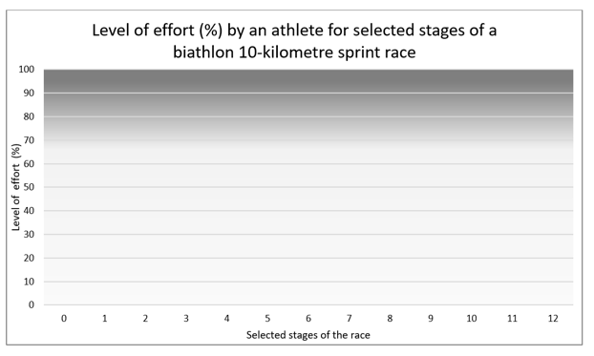
Race stages
Plot the race stages on the graph (Fig 3)
Notes:
Work in small groups to complete the following activity:
Based on your knowledge of energy systems, use the table to draw a hypothetical line graph for the 10-kilometre sprint biathlon by plotting the following race stages.
The x axis of Figure 3 represents the following 12 stages.
Race stages
A standing still race start.
The athlete sprints the first 100 metres to get the best start possible.
The first kilometre of the race is a gradual uphill climb, and the athlete has a strong head wind to ski into.
From the 2-kilometre to 2.5-kilometre mark the terrain creates a very steep incline.
There is a gradual downhill run from the 2.5-kilometre mark to the 3-kilometre mark as the athlete heads towards the rifle range.
At the 3.3-kilometre mark, the athlete must lie down to shoot 5 rounds at a target that is 45 millimetres in diameter. They miss one target and will incur a penalty lap.
The course is flat for the next kilometre and the athlete knows they must take this opportunity to improve their time, as they have a penalty lap to complete.
At the 6.7-kilometre mark, the athlete remains standing to shoot 5 rounds at a target that is 115 mm in diameter. They are successful in completing all shots.
The athlete falls over at the 7.5-kilometre mark. They are slow to their feet and have sustained a minor injury that slows them down for the next 500 metres.
The athlete needs to increase their speed to make up for lost time from their fall and recovery.
Complete penalty lap of 150 metres because a shot was missed at 3.3 kilometres.
Sprint to the finish line.
On the Y axis, identify where the energy systems change from one to another.
As a class, discuss the interplay of energy systems in this event.

Slide 36
References
This presentation contains NSW Curriculum and syllabus content. The NSW Curriculum is developed by the NSW Education Standards Authority. This content is prepared by NESA for and on behalf of the Crown in the right of the State of New South Wales. The material is protected by Crown copyright.
Please refer to the NESA Copyright Disclaimer for more information https://educationstandards.nsw.edu.au/wps/portal/nesa/mini-footer/copyright.
NESA holds the only official and up-to-date versions of the NSW Curriculum and syllabus documents. Please visit the NSW Education Standards Authority (NESA) website https://educationstandards.nsw.edu.au/ and the NSW Curriculum website https://curriculum.nsw.edu.au.
Heath and Movement Science 11–12 Syllabus © NSW Education Standards Authority (NESA) for and on behalf of the Crown in right of the State of New South Wales, 2023.

Slide 37
Copyright
© State of New South Wales (Department of Education), 2024
The copyright material published in this resource is subject to the Copyright Act 1968 (Cth) and is owned by the NSW Department of Education or, where indicated, by a party other than the NSW Department of Education (third-party material).
Copyright material available in this resource and owned by the NSW Department of Education is licensed under a Creative Commons Attribution 4.0 International (CC BY 4.0) license.
This license allows you to share and adapt the material for any purpose, even commercially.
Attribution should be given to © State of New South Wales (Department of Education), 2024.
Material in this resource not available under a Creative Commons license:
the NSW Department of Education logo, other logos and trademark-protected material
Material owned by a third party that has been reproduced with permission. You will need to obtain permission from the third party to reuse its material.
Links to third-party material and websites
Please note that the provided (reading/viewing material/list/links/texts) are a suggestion only and implies no endorsement, by the New South Wales Department of Education, of any author, publisher, or book title. School principals and teachers are best placed to assess the suitability of resources that would complement the curriculum and reflect the needs and interests of their students.
If you use the links provided in this document to access a third-party’s website, you acknowledge that the terms of use, including licence terms set out on the third-party’s website apply to the use which may be made of the materials on that third-party website or where permitted by the Copyright Act 1968 (Cth). The department accepts no responsibility for content on third-party websites.

