Slide 1
Biomechanics for sustained movement and performance – learning sequence support
Health and Movement Science 11–12 Syllabus
Focus area 2 – Training for improved performance

Slide 2
Learning intentions and success criteria
Through these activities, students will:
understand the basic biomechanical principles involved in an effective spiking action in volleyball
recognise key factors contributing to sustained and efficient spiking.

Slide 3
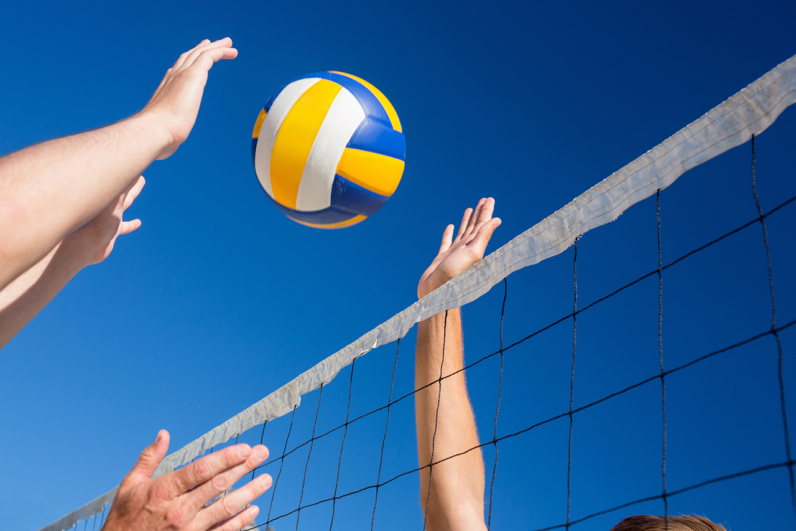
Biomechanics of a volleyball spike
HLPE3531: Biomechanics Of The Volleyball Spike (3:18)
This video breaks down the execution of a spike into phases and considers the biomechanical principles of each phase.
Answer the following questions related to the video to build understanding for further application.
Notes:
Students view HLPE3531: Biomechanics of a volleyball spike (3:18).
This video breaks down the execution of a spike into phases and considers the biomechanical principles of each phase.
Students answer the following questions related to the video to build understanding for further application.

Slide 4
Phase 1 – the approach
How does Newton’s third law of motion help the athlete start running towards the ball?
How does the athlete use the momentum gained from running to jump effectively?
Notes:
Phase 1 – the approach (0:14–0:46)
The athlete will begin running towards the ball serving 2 biomechanical purposes that reflect Newton’s third law. Firstly, the force applied from the legs and feet into the ground will be reciprocated providing a propulsive force that accelerates the body’s mass forward. This propulsive force and acceleration forward will allow the athlete to gain velocity and momentum. The athlete then takes a leaping step. All momentum gained can then be translated as kinetic energy (energy of motion) into the jump phase.
How does Newton’s third law of motion help the athlete start running towards the ball?
Sample answer: Newton’s third law of motion states that for every action, there is an equal and opposite reaction. When the athlete pushes down and back against the ground with their legs and feet, the ground pushes back with an equal force in the opposite direction. This reaction force from the ground moves the athlete forward, helping them to start running and overcome their initial state of rest or inertia.
How does the athlete use the momentum gained from running to jump effectively?
Sample answer: as the athlete runs, the propulsive force from their legs and the reaction from the ground increases their forward velocity and momentum. When the athlete takes a leaping step, all the momentum they have built up from running is converted into kinetic energy, the energy of motion. This helps the athlete to jump higher and further. This use of momentum allows the athlete to perform a powerful and effective jump for spiking a volleyball.

Slide 5
Phase 2 – the jump
How does lowering the centre of mass help an athlete jump higher?
Notes:
Phase 2 – the jump (0:47–1:03)
The athlete now lowers their centre of mass and applies the resultant kinetic energy from the previous phase into the ground as the propulsive force necessary to accelerate that mass upward. This is crucial in maximising the vertical velocity of the jump and thus the jump height.
How does lowering the centre of mass help an athlete jump higher?
Sample answer: lowering the centre of mass helps an athlete jump higher by allowing them to generate more force against the ground. When the athlete bends their knees and lowers their body, they store potential energy in their muscles. As they quickly straighten their legs and push off the ground, this stored energy is converted into kinetic energy, which propels them upward. This increased force and energy transfer maximises the vertical velocity of the jump, making the athlete jump higher.

Slide 6
Phase 3 – the arm swing
What is ipsilateral rotation, and how does it help in the wind-up action of the hitting arm?
How does the movement of the arms and spine during the wind-up action help in generating power for a hit? The athlete is right-handed.
Notes:
Phase 3 – the arm swing (1:04–1:36)
The wind-up action of the hitting arm begins alongside a twisting action of the torso. This is known as the ipsilateral rotation of the body over an axis. Notice the arms rotating conversely with the left arm of the athlete following a high to low motion while the right arm follows a low to high motion with the spine rotating laterally to open the angle of the body. This clearly demonstrates ipsilateral rotation. The resulting position of the body sets up optimal position for angular momentum and velocity that can be generated from the kinetic chain to follow in the next phase.
What is ipsilateral rotation, and how does it help in the wind-up action of the hitting arm?
Sample answer: ipsilateral rotation is when one side of the body moves in the same direction, such as when your torso twists to the same side as the arm you are using to hit. This helps in the wind-up action of the hitting arm by allowing the body to build up energy. When your torso twists and your arms move in opposite directions (one arm goes up while the other goes down), it creates a strong position to generate a lot of speed and power for the hit.
Note: a similar action is seen in overarm bowling action in cricket and a tennis serve.
How does the movement of the arms and spine during the wind-up action help in generating power for a hit? The athlete is right-handed.
Sample answer: during the wind-up action, the left arm moves from high to low while the right arm moves from low to high, and the spine rotates to the side. This coordinated movement helps to open up the body, creating a larger angle and a stronger position. This setup allows the body to use the kinetic chain, where energy is transferred from the legs through the torso and finally to the arms. This process helps generate a lot of angular momentum and velocity, making the hit more powerful.

Slide 7
Phase 4 – hitting the ball
Why is it important to extend your arms at the elbow when taking a shot?
Notes:
Phase 4 – hitting the ball (1:37–2:10)
Through a sequential chain of movements, maximal force can be generated and transferred onto the ball for an effective shot. Firstly, ipsilateral rotation continues opening the angle of which the arms rotate through at the shoulder generating angular velocity and momentum from which the arms extend at the elbow as rotation continues until the hand contacts the ball. The resultant momentum and energy from this kinetic chain is translated onto the ball as a propulsive force downward.
Why is it important to extend your arms at the elbow when taking a shot?
Sample answer: extending your arms at the elbow when taking a shot is important because it helps increase the speed and force of your shot. As you rotate your body and your arms move faster, extending your elbows lets your hands reach their highest speed just before hitting the ball. This way, all the speed and power you’ve built up through your body and arm movements get transferred to the ball, making the shot more powerful and effective. This is known as summation of forces.

Slide 8
Phase 5 – the wrist snap
How does hitting a ball above its centre and making it spin create topspin, and why does the ball move downward faster because of the Magnus effect?
Notes:
Phase 5 – the wrist snap (2:11–2:44)
By flexing the hand at the wrist and hitting the ball above its centre of mass the directional force applied from the athlete should generate topspin off the ball. The Magnus effect comes into play as a crucial principle that forces the ball in a downward direction. With a clockwise rotation of the ball, the air on the top of the ball slows down while the air at the bottom of the ball speeds up. This results in an air pressure gradient where energy moves from high to low pressure generating force from the top of the ball downward. The ball will now move faster towards the ground.
How does hitting a ball above its centre and making it spin create topspin, and why does the ball move downward faster because of the Magnus effect?
Sample answer: when you hit the ball above its centre and flex your wrist, you make the ball spin forward, creating topspin. This means the top of the ball moves forward while the bottom moves backward.
Because of the Magnus effect, the air around the spinning ball behaves differently. The air on top of the ball slows down, while the air at the bottom speeds up. This difference in airspeed creates lower pressure on the top and higher pressure on the bottom of the ball. The ball is then pushed downwards faster due to this pressure difference, making it move towards the ground more quickly.

Slide 9
Phase 6 – the spike follow-through
Why is it important for the body to continue moving smoothly after hitting the volleyball?
Notes:
Phase 6 – the spike follow-through (2:55–3:38)
Continuing the range of motion created from the kinetic chain in the hitting phase serves 2 purposes, firstly the momentum through the ball maintains direction for an accurate flight path and secondly ensures that the limbs involved have a clear path of motion where they can come to rest and not stop suddenly, thereby safely dissipating all leftover kinetic energy that would otherwise place unwanted strain on the joints.
Why is it important for the body to continue moving smoothly after hitting the volleyball?
Sample answer: it is important for the body to keep moving smoothly after hitting a ball for 2 main reasons. Firstly, for accuracy. When you swing and hit the ball, continuing the motion helps guide the ball in the right direction. If you stop suddenly, it can mess up where the ball goes. Secondly, for safety. Letting your body follow through with the motion helps spread out and safely release the leftover energy from the hit. This prevents sudden stops that can strain or injure your joints, like your elbows or shoulders.

Slide 10
Matching spiking action to biomechanical principles
Add the terms to the table:
Absorption of force
Newton’s Third Law of Motion
Motion: momentum and speed
Magnus effect: application of force/fluid mechanics
Linear motion
Propulsive force, summation of force
Balance and stability
Force
Newton’s Second Law of Motion
Phase | Biomechanical principle
The approach
Jump
Arm swing
Hitting the ball
Wrist snap
Follow-through landing
Notes:
Table 1

Slide 11
References
This presentation contains NSW Curriculum and syllabus content. The NSW Curriculum is developed by the NSW Education Standards Authority. This content is prepared by NESA for and on behalf of the Crown in the right of the State of New South Wales. The material is protected by Crown copyright.
Please refer to the NESA Copyright Disclaimer for more information https://educationstandards.nsw.edu.au/wps/portal/nesa/mini-footer/copyright.
NESA holds the only official and up-to-date versions of the NSW Curriculum and syllabus documents. Please visit the NSW Education Standards Authority (NESA) websitehttps://educationstandards.nsw.edu.au/ and the NSW Curriculum website https://curriculum.nsw.edu.au.
Health and Movement Science 11–12 Syllabus © NSW Education Standards Authority (NESA) for and on behalf of the Crown in right of the State of New South Wales, 2023.

Slide 12
Copyright
© State of New South Wales (Department of Education), 2024
The copyright material published in this resource is subject to the Copyright Act 1968 (Cth) and is owned by the NSW Department of Education or, where indicated, by a party other than the NSW Department of Education (third-party material).
Copyright material available in this resource and owned by the NSW Department of Education is licensed under a Creative Commons Attribution 4.0 International (CC BY 4.0) license.
This license allows you to share and adapt the material for any purpose, even commercially.
Attribution should be given to © State of New South Wales (Department of Education), 2024.
Material in this resource not available under a Creative Commons license:
the NSW Department of Education logo, other logos and trademark-protected material
Material owned by a third party that has been reproduced with permission. You will need to obtain permission from the third party to reuse its material.
Links to third-party material and websites
Please note that the provided (reading/viewing material/list/links/texts) are a suggestion only and implies no endorsement, by the New South Wales Department of Education, of any author, publisher, or book title. School principals and teachers are best placed to assess the suitability of resources that would complement the curriculum and reflect the needs and interests of their students.
If you use the links provided in this document to access a third party’s website, you acknowledge that the terms of use, including licence terms set out on the third-party’s website apply to the use which may be made of the materials on that third-party website or where permitted by the Copyright Act 1968 (Cth). The department accepts no responsibility for content on third-party websites.

