Slide 1
Instructions for use
This resource is not a teaching and learning program. It should be used in conjunction with 12HMS-FA2 – sleep, nutrition and supplements learning program.
Classroom teachers are encouraged to add and adapt slides as required to meet the needs of their students.
Save a copy of the file to make changes to the slide deck. Go to File > Download a Copy (this downloads a copy to the computer to edit in the PowerPoint app).
To convert the PowerPoint to Google Slides:
Upload the file into Google Drive and open it.
Go to File > Save as Google Slides.
(Note – conversion may cause formatting changes in the slides.)

Slide 2
The impact of sleep, nutrition and supplementation on performance
Focus area 2
Training for improved performance

Slide 3
Lessons
1
Sports nutrition
2
Fuelling performance
3
Fuelling performance in Rugby 7’s
4
Sleep and performance
5
Improving athletic performance with nutrition, sleep and hydration
Notes:
Teacher notes:
Click lesson numbers to go to specific lessons
Interactive features can be viewed in slide show

Slide 4
Learning intentions and success criteria
We are learning to:
analyse the nutritional requirements of athletes from different sports
draw connections to the nutritional requirements for the energy systems covered in Year 11
develop an understanding of the interconnected nature of sleep, nutrition and hydration
apply knowledge of sleep, nutrition and hydration to different sports and age groups.
We can:
[classroom teacher to insert co-constructed success criteria]
[classroom teacher to insert co-constructed success criteria]
[classroom teacher to insert co-constructed success criteria].
Notes:
Notes for teachers:
Learning intentions and success criteria are best co-constructed with students. Adapt the learning intentions as required and add matching success criteria.
For more information see ⁠AITSL or the NSW Department of Education explicit teaching strategies, ⁠Sharing learning intentions and ⁠Sharing success criteria.
LISC is not necessarily presented at the beginning of the lesson. Teacher needs to consider most effectual time to introduce.
LISC should be revisited during the lesson to support students' evaluation of their learning.

Slide 5
Sports nutrition

Slide 6
Case study – Theodore
Theodore is a 20-year-old man who walks 30 minutes a day to and from the bus stop. He goes to the gym 3 times a week to a strength and conditioning class, eats a nutritious, well-balanced diet and drinks 2 litres of water per day. He gets on average 7 hours of sleep per night and considers himself in good health.
Class discussion: if Theodore were to become an athlete, what changes to his nutrition, sleep and hydration would need to occur and why?
Notes:
Image licensed under Pixabay Content License.

Slide 7
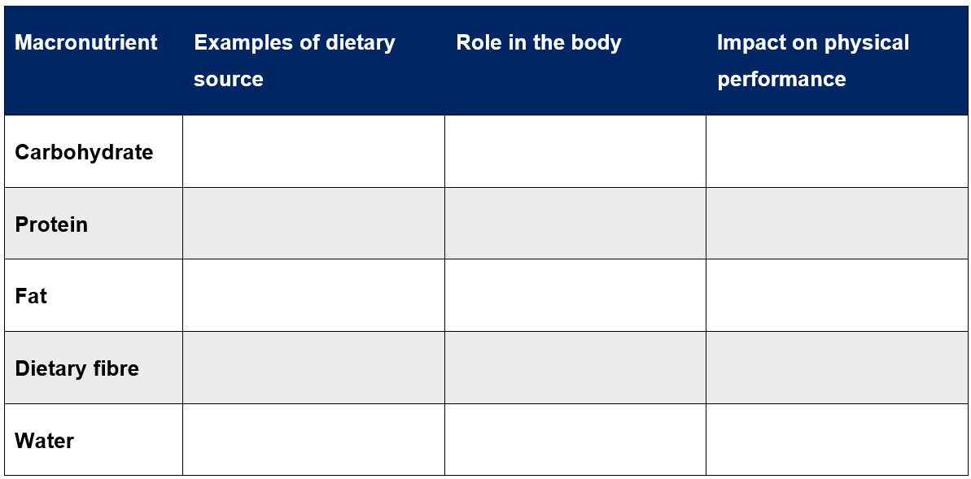
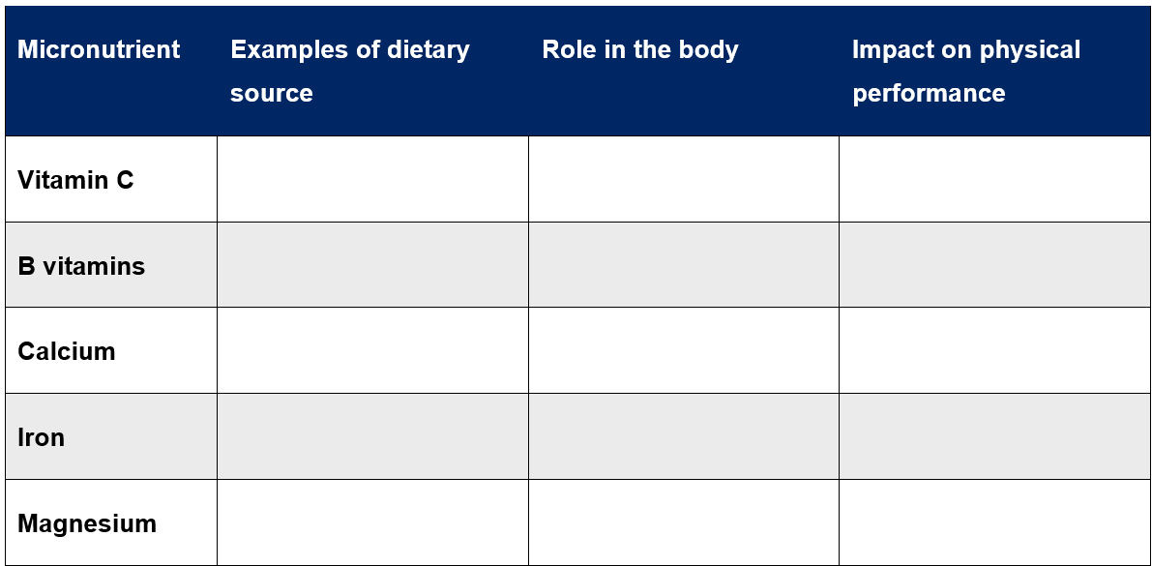
Nutrients
Supporting the body to function
To fuel the body, we need nutrients.
Macronutrients are those required in large amounts. For example, carbohydrates, protein, fat, dietary fibre and water.
Micronutrients are required in small amounts, for example, vitamins and minerals.
Group work: research the dietary sources role in the body, and impact on physical performance of different macronutrients and micronutrients and complete the tables.

Slide 8
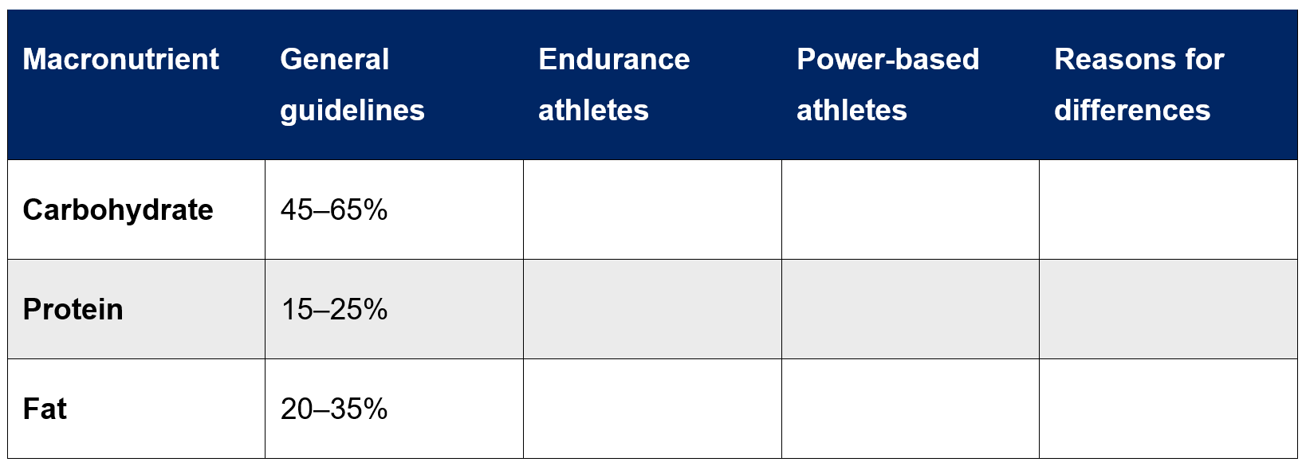
Macronutrients
Fuelling the body for performance
The Australian Dietary Guidelines states that the recommended relative macronutrient distribution for Australians is:
45 to 65% from carbohydrate
15 to 25% from protein
20 to 35% of total energy intake from fat.
Group work: research the macronutrient guidelines for endurance athletes and power-based athletes and record your findings in the table.

Slide 9
Hydration
Why do we need water?
Water is another important macronutrient with adequate hydration critical for performance. Fluid balance helps with:
temperature regulation via sweating
maintaining a healthy blood volume, assisting blood circulation
avoiding symptoms of dehydration including increased rate of perceived exertion, impaired skill execution and impacted decision making which can lead to injury
avoiding over-hydration which dilutes levels of sodium in the bloodstream leading to fluid imbalances in the body’s cells. Symptoms include headaches and disorientation but can also lead to death in severe cases.

Slide 10
‘Weight, Urine, Thirst’ model
Hydration
Visit the Sports Dietitians Australia webpage, Why is hydration important? The effect of dehydration on performance
Individual activity:
outline the ‘Weight, Urine, Thirst’ (WUT) model for monitoring an athlete’s hydration
outline the method to determine how much fluid is needed post-exercise to fully rehydrate.
Notes:
Image licensed under Pixabay Content License.

Slide 11
An AFL case study
Hydration
Individual activity:
How much fluid did Alex lose during the game?
How much fluid should Alex consume to ensure he is fully rehydrated within 60 minutes of completing the game?
In pairs:
Design a checklist that could be used by coaching staff on Alex’s team to monitor the hydration of athletes and prevent dehydration during training and games.
Alex is an AFL player who has just finished playing a pre-season trial match. He weighed himself prior to the game at 95 kg, post-game he weighed in at 93.3 kg.

Slide 12
Fuelling performance

Slide 13
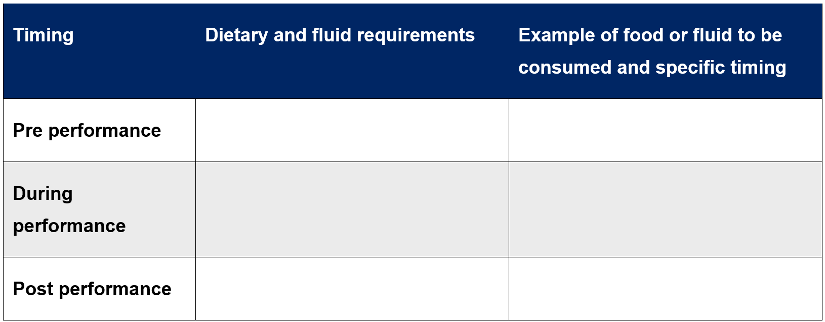
Performance nutrition
Fuelling performance: what to eat and when
Visit the Sports Dietitians Australia webpage, Food for your sport and choose 2 sports with different energy requirements (one endurance sport and one power-based sport) from the website to research.
Individual activity: complete the table for 2 different sports outlining the dietary and fluid requirements, timings and examples of foods pre-, during- and post-performance.

Slide 14
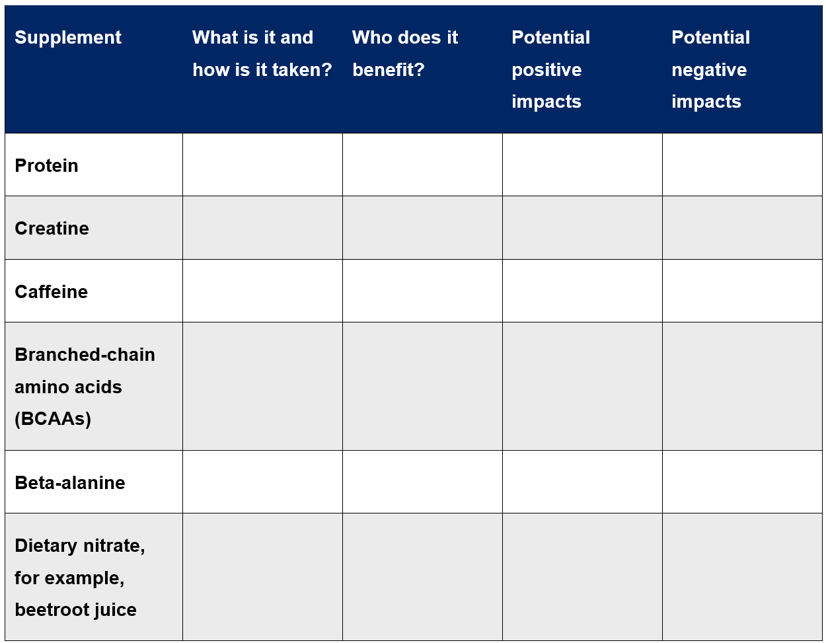
Supplementation
Who benefits from supplementation?
Access the 2 following websites:
Sports Dietitians Australia – Supplements
Australian Institute of Sport – Supplements
Group activity: complete the table to investigate and analyse common supplements used by athletes to improve performance.

Slide 15
Fuelling performance in Rugby 7’s

Slide 16
Nutrition for a rugby 7’s tournament (1)
A case study
You have been appointed as the sports nutritionist for the Australian Men’s Rugby 7’s team. The sport is an abbreviated form of rugby played with 7 per side on a full-sized rugby field. Each game consists of 2 x 7-minute halves of high intensity and significant physical contact.
The upcoming tournament, the Sydney 7’s, consists of 6 games played at the following times:
Friday – 5:30 pm, 8:56 pm
Saturday – 1:20 pm, Quarter final 5:35 pm
Sunday – Semi-final 1:40 pm, Final 3:28 pm
Temperatures are expected to be on average 33 degrees Celsius with high humidity. You have also been informed that 2 athletes are vegetarian.

Slide 17
Nutrition for a rugby 7’s tournament (2)
A case study
Individually, propose and justify a nutrition plan, including hydration, for the upcoming Sydney 7’s tournament including vegetarian meal options.
In pairs, discuss and compare plans.
Class discussion:
What were the main similarities between plans?
What were the key differences between plans?

Slide 18
Nutrition for a Rugby 7’s tournament (3)
A case study
Due to your extremely well-thought-out nutrition plan, and the success of the Australian Men’s 7’s team, Rugby Australia have asked you to modify your nutrition plan for the upcoming Global Youth 7’s tournament for the U18 girls’ and boys’ teams. There will be a very similar schedule for this competition.
Read the Sports Dietitians Australia factsheet Nutrition for the adolescent athlete.
With your partner, write a response to the following question:
Propose and justify the adjustments that you would make to the nutrition plan to cater for adolescent athletes.

Slide 19
Sleep and performance

Slide 20
The benefits of sleep
Individual activity:
Brainstorm the benefits of sleep.
Using coloured highlighters or pens, colour code whether the benefit aligns to one or more of the following applications for athletes:
reducing fatigue
positively influencing movement
preventing injury.
Notes:
Image licensed under Pixabay Content License.

Slide 21
Research task
Sleep and performance
Place information under the following headings:
sleep guidelines
impact on fatigue
impact on performance
impact on injury
additional impacts
barriers to getting adequate sleep for athletes
strategies to improve duration and quality of sleep for athletes.
Group activity: allocate the provided readings about sleep and athletic performance.
Individually collate findings and present to your group.
Notes:
Links to resources are available in Appendix 1, found on slide 30.

Slide 22
The importance of sleep
Discussion
Class discussion:
What are the most significant impacts of sleep on fatigue, performance and injury for athletes?
Group discussion:
To what extent does adequate sleep reduce psychological and physiological fatigue, positively influence movement and help to prevent injury?
Notes:
Image licensed under Pixabay Content License.

Slide 23
Barriers and technologies to support better sleep
Class discussion:
What are the barriers that athletes experience in relation to getting adequate sleep?
What strategies and technologies can be used to support athletes to achieve the required amount of sleep and overcome these barriers?
Notes:
Image licensed under Pixabay Content License.

Slide 24
eNews article on sleep
Individual activity: write an article to be featured in the NSW Institute of Sport e-Newsletter and published on their website, that is targeted to elite athletes and addresses the following:
sleep guidelines
performance benefits of sleep for athletes
how to plan for adequate sleep and monitor the duration and quality of sleep
propose strategies and routines to support adequate duration and quality of sleep.

Slide 25
Improving athletic performance with nutrition, sleep and hydration

Slide 26
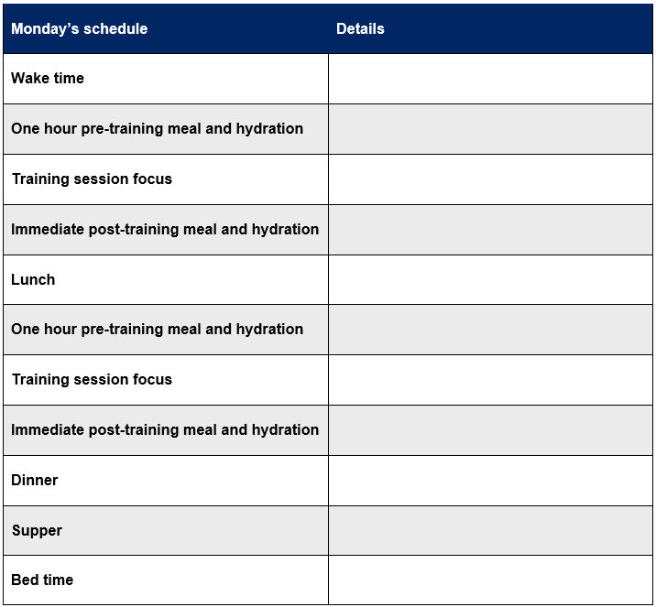
Improving athletic performance with nutrition, sleep and hydration (1)
Individually:
Create a profile for an elite athlete from a sport of your choice, including their age, sex, sport and position (if relevant).
Design a week-long schedule for the athlete to follow during a training week that reflects appropriate nutrition, hydration, sleep and supplementation.

Slide 27
Improving athletic performance with nutrition, sleep and hydration (2)
In pairs:
Swap your schedule with a partner and engage in a discussion by asking probing questions about the program and providing feedback. Some discussion prompts might include questions relating to:
food and supplement choices
the timing of food consumption
the timing of training activities in the schedule
the routines that are evident such as pre-sleep routines.

Slide 28
Improving athletic performance with nutrition, sleep and hydration (3)
Individually:
Write a justification of the week-long schedule that you have developed with reference to:
the guidelines that have been reflected
reasoning for specific routines (for example, post-training fuelling timing, pre-sleep routines).
Notes:
Image licensed under Pixabay Content License.

Slide 29
Improving athletic performance with nutrition, sleep and hydration (4)
Class discussion:
How can the schedules that you have developed be monitored by the athlete and coaching staff?
Why is it important to monitor whether the schedule is being followed?
Notes:
Some potential points for discussion may include:
monitoring may occur formally or informally
objective monitoring of nutrition and sleep could occur with phone apps
journals may be used by the players to monitor any aspects of the schedule they have not met; however, this could be subjective
questionnaires could be provided to players each day or week about how they are feeling to determine how effective the schedule is
coaching staff could conduct player observations to monitor players’ energy levels
monitoring is important to support the best possible performance by the player and for injury reduction
if a schedule is not working for an athlete, it may need to be adjusted to continue to support their health, wellbeing and performance.

Slide 30
Appendix 1 – sleep articles
Australian Institute of Sport – Sleep (PDF 219 KB)
Gatorade Sports Science Institute – Sleep and athletes
Nike: Health & Wellness – Why Is Sleep So Important for Athletic Recovery? Experts Explain
Sleep Foundation – Sleep, Athletic Performance, and Recovery
Sports Osteopaths Australia – The Connection Between Lack of Sleep and Injuries
The Sports Institute – Impacts of Sleep on Athletic Performance.

Slide 31
References
This presentation contains NSW Curriculum and syllabus content. The NSW Curriculum is developed by the NSW Education Standards Authority. This content is prepared by NESA for and on behalf of the Crown in the right of the State of New South Wales. The material is protected by Crown copyright.
Please refer to the NESA Copyright Disclaimer for more information https://educationstandards.nsw.edu.au/wps/portal/nesa/mini-footer/copyright.
NESA holds the only official and up-to-date versions of the NSW Curriculum and syllabus documents. Please visit the NSW Education Standards Authority (NESA) website https://educationstandards.nsw.edu.au and the NSW Curriculum website https://curriculum.nsw.edu.au.
Health and Movement Science 11–12 Syllabus © NSW Education Standards Authority (NESA) for and on behalf of the Crown in right of the State of New South Wales, 2023.
Slides 6, 10, 20, 22, 23, 28, 29 – Images licensed under Pixabay Content License.

Slide 32
Copyright
© State of New South Wales (Department of Education), 2024
The copyright material published in this resource is subject to the Copyright Act 1968 (Cth) and is owned by the NSW Department of Education or, where indicated, by a party other than the NSW Department of Education (third-party material).
Copyright material available in this resource and owned by the NSW Department of Education is licensed under a Creative Commons Attribution 4.0 International (CC BY 4.0) license.
This license allows you to share and adapt the material for any purpose, even commercially.
Attribution should be given to © State of New South Wales (Department of Education), 2024.
Material in this resource not available under a Creative Commons license:
the NSW Department of Education logo, other logos and trademark-protected material
Material owned by a third party that has been reproduced with permission. You will need to obtain permission from the third party to reuse its material.
Links to third-party material and websites
Please note that the provided (reading/viewing material/list/links/texts) are a suggestion only and implies no endorsement, by the New South Wales Department of Education, of any author, publisher, or book title. School principals and teachers are best placed to assess the suitability of resources that would complement the curriculum and reflect the needs and interests of their students.
If you use the links provided in this document to access a third-party’s website, you acknowledge that the terms of use, including licence terms set out on the third-party’s website apply to the use which may be made of the materials on that third-party website or where permitted by the Copyright Act 1968 (Cth). The department accepts no responsibility for content on third-party websites.

