Slide 1
PDHPE K–6 Syllabus (2024)
Familiarisation resource

Slide 2
Acknowledgement of Country
We recognise the Ongoing Custodians of the lands and waterways where we work and live. We pay respect to Elders past and present as ongoing teachers of knowledge, songlines and stories. We strive to ensure every Aboriginal and Torres Strait Islander learner in NSW achieves their potential through education.
‘Kariong – Our meeting place’ created by Stella Haynes from Cammeray Public School on Eora Country as part of the 2022 Calendar for cultural diversity.

Slide 3
Content
Item | Timing
Key inclusions | 5 minutes
Reflection and discussion | 25 minutes
Where to next? | 4 minutes
Contact details | 1 minute

Slide 4
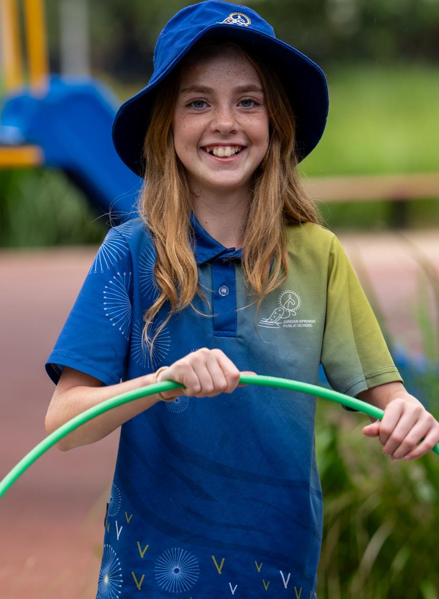
Key inclusions

Slide 5
Key inclusions (1)
A summary of what's new
an equal emphasis on the teaching of physical education (PE) and personal development and health (PDH)
explicit teaching of fundamental movement skills, with complementary content to support students with a physical disability, focusing on ability
explicit teaching of respectful relationships and age-appropriate consent from Early Stage 1
knowledge and skills to build students’ capacity to be safe in offline and online environments
explicit content addressing road, water, fire, sun and local environment safety
content addressing learning in nature and the outdoors, and the benefits to health and wellbeing
Notes:
A summary of key inclusions in the PDHPE K-6 syllabus (2024) as discussed in the familiarisation video.

Slide 6
Key inclusions (2)
A summary of what's new
the development of self-management and interpersonal skills, enabling students to build connections and manage respectful relationships
the use of subject-specific vocabulary to express and communicate students’ understanding of health, safety and wellbeing through Creating Written texts (CWT):
Early Stage 1 and Stage 1 – using PDHPE-specific vocabulary and language to communicate
Stage 2 – embedded within PDHPE content
Stage 3 – a focus area, content group and an assessable PDHPE outcome.
Notes:
A summary of key inclusions (slide 2) in the PDHPE K-6 syllabus (2024) as discussed in the familiarisation video.

Slide 7
Key inclusions (3)
A summary of what's new
content in the Identity, health and wellbeing focus area from Stage 1 onwards includes how saving, goal setting and financial decision-making can influence wellbeing
developing media literacy, including the impact of health and wellbeing messaging in the media
removing duplication of dance content, now represented in the Creative Arts K–6 Syllabus.
Notes:
A summary of key inclusions (slide 3) in the PDHPE K-6 syllabus (2024) as discussed in the familiarisation video.

Slide 8
Reflection and discussion

Slide 9
Reflection (1)
Instructions for reflection activity
There are 4 discussion questions on the following slide.
Participants will require access to the PDHPE K–6 syllabus (2024).
Schools are encouraged to use these in a way that best suits their context. For example, participants may engage with questions as:
individuals,
grade or stage teams, or
a whole staff group.
Participants are encouraged to share their learning to promote further discussion and reflection.
Notes:
Reflect on your learning and engage with the syllabus by discussing one or more of the questions individually or in a group.

Slide 10
Reflection (2)
Discussion questions
Explain how the fundamental movement skills content increases in complexity throughout the stages.
Which content could support the teaching of mandatory child protection and consent education?
How does the syllabus utilise Creating Written Texts to support student learning in PDHPE?
How does the syllabus support students to develop skills to behave safely and respectfully in online and offline environments?
Notes:
Reflect on your learning and engage with the syllabus by discussing one or more of the questions individually or in a group.

Slide 11
Where to next?

Slide 12
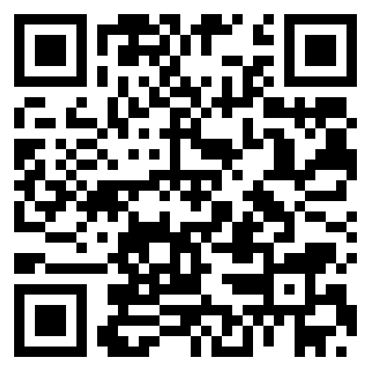
Where to next? (1)
Further information and support
Familiarisation
Engage with the PDHPE K–6 syllabus (2024) to explore content, teaching advice and examples.
Scan the QR code to join the Primary Curriculum Statewide Staffroom PDHPE Channel to ask questions, receive advice and updates on the release of resources.
More information
Read PDHPE K–6 Syllabus (2024) – information for school leaders.
Visit the Curriculum K–12 and PDHPE K–12 websites.
Notes:
So where to next?
Teachers should engage with the PDHPE K-6 syllabus to familiarise with content, teaching advice and examples.

Slide 13
Where to next? (2)
Further information and support
Support
The PDHPE curriculum team is further supporting implementation of the PDHPE K–6 syllabus (2024) by providing a range of resources, including:
microlearning modules
sample scope and sequences
sample units of work
student facing PowerPoint slides.
The release of these resources will be communicated through Staff Noticeboard, the Primary Curriculum Statewide Staffroom and available on the PDHPE Curriculum web page.
Notes:
So where to next?
Teachers should engage with the PDHPE to familiarise with content, teaching advice and examples.

Slide 14
Contact the PDHPE K–6 advisors
For further information and advice, contact pdhpek6@det.nsw.edu.au

Slide 15
References
This presentation contains NSW Curriculum and syllabus content. The NSW Curriculum is developed by the NSW Education Standards Authority. This content is prepared by NESA for and on behalf of the Crown in the right of the State of New South Wales. The material is protected by Crown copyright.
Please refer to the NESA Copyright Disclaimer for more information https://educationstandards.nsw.edu.au/wps/portal/nesa/mini-footer/copyright.
NESA holds the only official and up-to-date versions of the NSW Curriculum and syllabus documents. Please visit the NSW Education Standards Authority (NESA) website https://educationstandards.nsw.edu.au/wps/portal/nesa/home and the NSW Curriculum website https://curriculum.nsw.edu.au.
Personal Development, Health and Physical Education K–6 © Syllabus NSW Education Standards Authority (NESA) for and on behalf of the Crown in right of the State of New South Wales, (2024).

Slide 16
Copyright
© State of New South Wales (Department of Education), 2024
The copyright material published in this resource is subject to the Copyright Act 1968 (Cth) and is owned by the NSW Department of Education or, where indicated, by a party other than the NSW Department of Education (third-party material).
Copyright material available in this resource and owned by the NSW Department of Education is licensed under a Creative Commons Attribution 4.0 International (CC BY 4.0) license.
This license allows you to share and adapt the material for any purpose, even commercially.
Attribution should be given to © State of New South Wales (Department of Education), 2024.
Material in this resource not available under a Creative Commons license:
the NSW Department of Education logo, other logos and trademark-protected material
Material owned by a third party that has been reproduced with permission. You will need to obtain permission from the third party to reuse its material.
Links to third-party material and websites
Please note that the provided (reading/viewing material/list/links/texts) are a suggestion only and implies no endorsement, by the New South Wales Department of Education, of any author, publisher, or book title. School principals and teachers are best placed to assess the suitability of resources that would complement the curriculum and reflect the needs and interests of their students.
If you use the links provided in this document to access a third-party’s website, you acknowledge that the terms of use, including licence terms set out on the third-party’s website apply to the use which may be made of the materials on that third-party website or where permitted by the Copyright Act 1968 (Cth). The department accepts no responsibility for content on third-party websites.

