Slide 1
Instructions for use
This resource is not a teaching and learning program. It should be used in conjunction with (Insert unit name and link).
Classroom teachers are encouraged to add and adapt slides as required to meet the needs of their students.
Save a copy of the file to make changes to the slide deck. Go to File > Download a Copy (this downloads a copy to the computer to edit in the PowerPoint app).
To convert the PowerPoint to Google Slides:
  Upload the file into Google Drive and open it.
  Go to File > Save as Google Slides.
  (Note – conversion may cause formatting changes in the slides.)

Slide 2

Disease
Science – Stage 5/Year 9
Supporting PowerPoint

Slide 3
Contents (1)
TRB 1
1.1
TRB 2
2.1
What do you know?
Causes of infectious disease
1.2
2.2
Maintaining a balance
Disease transmission
1.3
2.3
Preventing entry of and responding to pathogens
Response to stimuli
1.4
2.4
Feedback mechanisms
Endemics, Epidemics and pandemics
1.5
2.5
Coordinating the response to stimuli
Using vaccines to prevent disease
1.6
2.6
Comparing the endocrine and nervous systems
Reducing the incidence and spread of infectious diseases
Notes:
Teacher notes:
Click lesson numbers to go to specific lessons
Interactive features can be viewed in slide show

Slide 4
Contents (2)
TRB 2
2.7
TRB 3
3.1
Aboriginal and Torres Strait Islander Peoples’ use of plants
What is a non-infectious disease?
3.2
2.8
Non-infectious diseases in Australia
Assessment Task
3.3
Reducing incidence of non-infectious disease
3.4
Australia’s medical technology
3.5
Assessing student understanding of disease
Notes:
Teacher notes:
Click lesson numbers to go to specific lessons
Interactive features can be viewed in slide show

Slide 5
1. How and why does the body respond to a changing environment?
Notes:
Content in this section aligns with essential question 1 in the program of learning and Teacher Resource Book 1 (TRB1).

Slide 6
1.1 What do you know?
Learning intentions and success criteria
We are: | I can:
revising Stage 4 content from the focus areas Cells and classification, and Living systems. | identify bacteria and fungi as living things. identify organs and their functions. outline the function of a range of specialised cells. describe the role of specialised cells in multicellular organisms. explain how organ systems work together to carry out their functions.
Notes:
Display this slide at the beginning of the learning sequence. Revisit the slide where appropriate during lesson activities and encourage students to reflect on their progress.

Slide 7
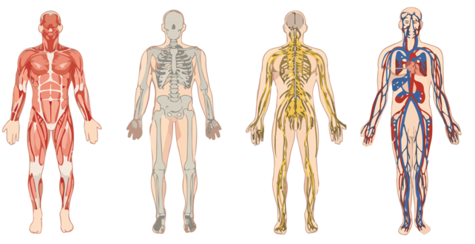
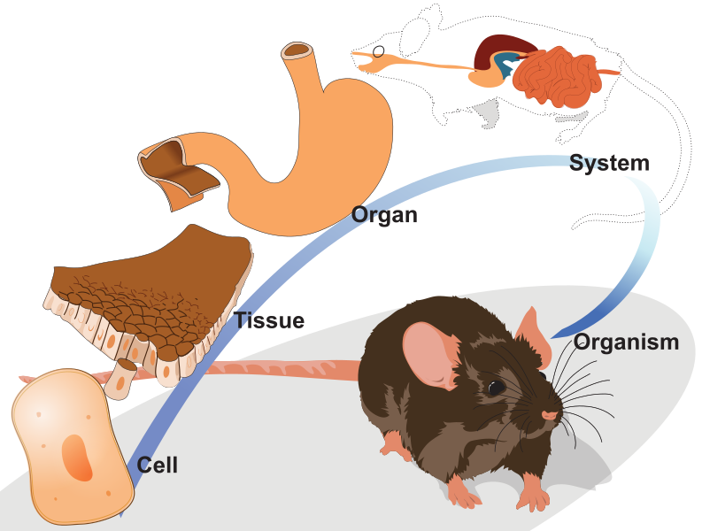
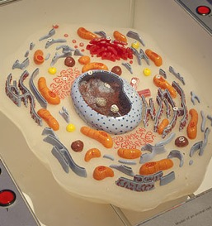
1.1 What do you know about living things and disease?
Revising Stage 4 learning
Human body systems by Loneshieling on Wikimedia commons licensed under CC BY 4.0
Organisation of life by Ladyofhats on Wikimedia commons licensed under CC0 1.0
Model of an animal cell by Naturalis Biodiversity Centre on Wikimedia commons licensed under CC BY 4.0
Notes:
These images can be used to prompt students’ recollection of Stage 4 content relevant to the Disease focus area. Use the images to prompt students to recall in the ‘Write the room’ activity outlined in TRB 1. The information below can be used to revise concepts with students.
Organisation of life in multicellular organisms
In Stage 4, Cells and Classification and Living Systems, students learnt about cells, systems and organisms, including the hierarchy for the organisation of life. This level of organisation reflects the level of complexity and specialisation needed for multicellular organisms. This organisation of the organism as tissues, organs, and systems allows different cells and structures to work together, each contributing to the organism's survival.
The image on the slide shows the organisation of life, starting from the smallest level of cells and progressing to tissues, organs, systems, and finally, the organism.
Cell:
The smallest functional unit of life.
The image shows a single cell specialised to perform a particular function. For example, muscle cells, nerve cells or red blood cells.
Tissue:
Groups of specialised cells work together to perform a specific function.
The image shows a tissue layer (e.g., epithelial tissue) where similar cells are organised to work collectively.
Organ:
Tissues come together to form organs.
The stomach is shown as an example of an organ, composed of different tissues that work together to perform digestion.
System:
Many organs work together to form systems that carry out broader functions in the body.
The digestive system is illustrated, which includes the stomach and other organs that process food.
Organism:
The final level of organisation is where systems combine to form a fully functional living organism.
The image represents a mouse, which is an organism that relies on cells, tissues, organs, and systems to survive.
This organisation shows the interdependence of each level, where cells build tissues, tissues form organs, organs make up systems, and systems collectively maintain the life of the organism.
Model of an animal cell
A model is a mathematical, conceptual or physical representation that describes, simplifies, clarifies or explains the structure, workings or relationships within an object, system or idea. Models can provide a means of testing and predicting behaviour within limited conditions. Models may be physical or exist in digital form (NESA 2023).
Students would have constructed models in Stage 4 in multiple focus areas and in Data Science 1. They may understand what a model is, the purpose of models and the limitations of models.
Human body systems
In Stage 4 Science, the focus area is Living Systems. Students learnt about the interrelationship between cells, tissues, and organs and how the body systems work together to allow the efficient functioning of an organism. They learnt the major organs of and the role of body systems (some of this content has progressed from Stage 3 Science and Technology K–6)
Digestive system: Processes foods and absorbs nutrients, minerals, vitamins, and water.
Circulatory system: Transports oxygen, nutrients, and other substances to the cells and transports wastes, carbon dioxide, and other substances away from the cells; it can also help stabilise body temperature.
Respiratory system: Delivers air to sites where gas exchange can occur.
Excretory system: Removes excess water, salts, and waste products from the blood and body.
Students were required to link this understanding of the structure of the organ systems and the specialised cells within the systems to the function of the organ system.
The idea that a disorder or disease affects the components of a body system, or the removal of any component in the body system, impacts the overall functioning of the system and the organism as a whole was introduced to students in Stage 4.

Slide 8
1.2 Maintaining a balance
Learning intentions and success criteria
We are learning: | I can:
about the importance of maintaining stable internal conditions in the human body to function optimally. | define homeostasis. identify that the body keeps factors such as temperature within a certain range. outline how the human body responds to changes in external temperatures to maintain a constant body temperature.
to understand how scientific models can represent and explain concepts. | explain how a model demonstrates the concept of homeostasis. identify the limitations of a model.
Notes:
Display this slide at the beginning of the learning sequence. Revisit the slide where appropriate during lesson activities and encourage students to reflect on their progress.

Slide 9

1.2 Defining homeostasis
Homeostasis: the ability of an organism to maintain stable internal conditions despite external changes.
‘homeo’ is a Greek word which means ‘similar to’ or ‘like’.
‘stasis’ is a Greek word which means ‘standing still’ or ‘steady’.
Notes:
Use this slide to define homeostasis for students and explore the etymology.

Slide 10
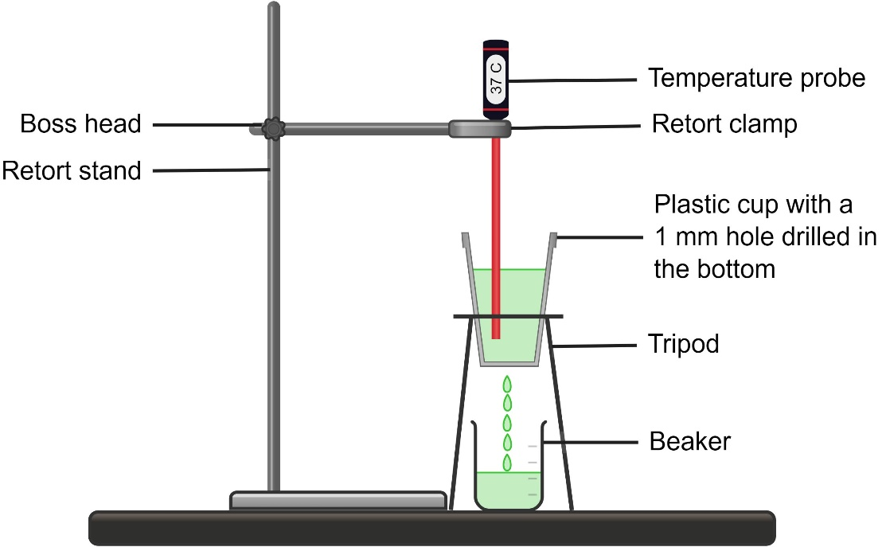
1.2 Modelling homeostasis
Authors own image created in Chemix.org
Notes:
Students are provided with this image in the student resource section of 1.2 Modelling homeostasis. Tell students they must draw in the lines shown on the slide. Instruct students to label it or label it as a class.
This slide has been animated with the answers to discuss with the class.

Slide 11
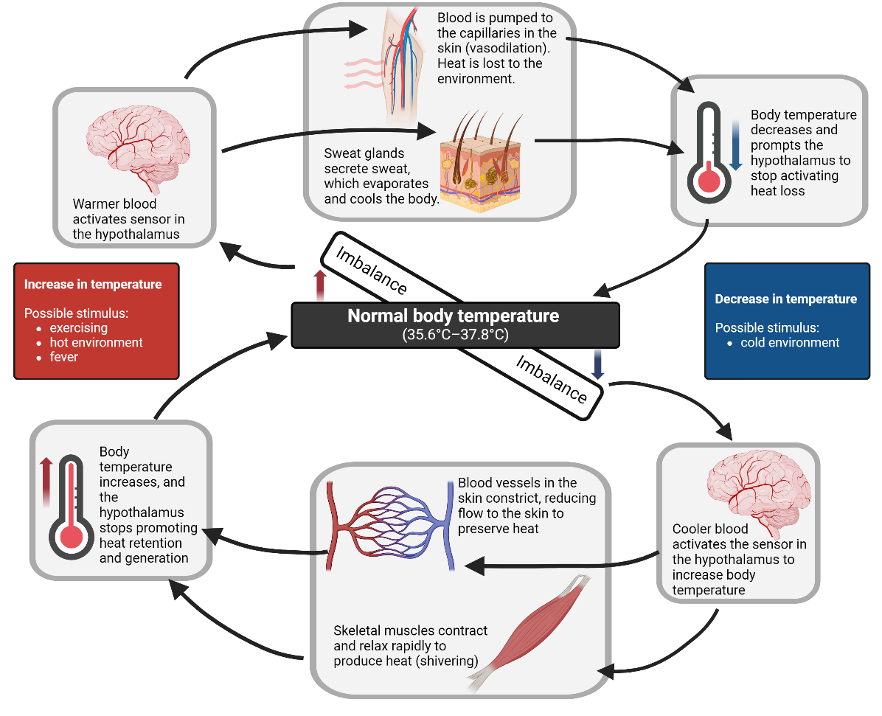
1.2 Thermoregulation in humans
This work has been generated using BioRender.com. Any copyright subsisting in this work is owned by © State of New South Wales (Department of Education) 2024.
Notes:
After students complete the practical component of the ‘Modelling homeostasis’ activity, they have 6 discussion questions to complete. Before students complete questions 5 and 6, ask them what other things in the human body are controlled by the body to stay within a certain range. Show the students this slide and explain how the body temperature is kept in balance through a range of actions triggered by the nervous and endocrine systems.
Notes to support explanation of thermoregulation
Our bodies work hard to keep a stable internal temperature around 36.5°C to 37.8°C, essential for our cells and organs to function properly. This process is called thermoregulation. When our body temperature goes out of this range, sensors in our body trigger actions to restore balance.
If our body temperature increases– for example, from exercise, a hot environment, or fever – it triggers the hypothalamus (the brain’s thermostat). This is shown on the left side of the diagram.
The hypothalamus senses the warmer blood and activates processes to cool the body down.
It signals blood vessels near the skin to widen or vasodilate (open up), which allows more blood flow to the skin where heat can escape to the environment.
It also activates sweat glands to release sweat. As sweat evaporates from the skin, it cools the body.
Once the body cools down, the hypothalamus stops promoting these cooling processes.
If our body temperature decreases as shown– such as in a cold environment – the body works to warm itself up. This is shown on the right side of the diagram.
The hypothalamus detects cooler blood and triggers heat-generating actions.
Blood vessels near the skin constrict (narrow) to reduce blood flow to the surface, which helps retain heat within the body.
It also causes muscles to contract quickly, which we feel as shivering. This muscle activity produces heat and helps raise body temperature.
Once body temperature returns to normal, the hypothalamus stops promoting these warming actions.

Slide 12
1.2 Hinge question – exit ticket
What happens to your body’s internal temperature if you are exposed to a cold environment for an extended period?
Your body’s internal temperature drops rapidly to match the outside temperature.
Your body maintains a stable internal temperature by shivering and constricting blood vessels near the skin.
Your body’s internal temperature increases to compensate for the cold environment.
Your body stops regulating temperature.
Notes:
This can be displayed on the board for students to answer using mini whiteboards or by raising their hands for the option they select.
However, this exit ticket would be best set up digitally to analyse student responses quickly. The form could also be set up to give the students instant feedback.
The response to the question is B. Further explanations of students' understanding and misconceptions based on their responses to the hinge question are below and in TRB 1.
The explanation for each of the responses is below.
A: Students who select this option may think that the body cannot regulate its temperature effectively and will simply conform to the external environment. This indicates a lack of understanding of the body’s mechanisms for maintaining homeostasis, such as thermoregulation through physiological responses.
B: This is the correct answer.
C: Students who select this option might believe the body will respond to the cold by increasing the internal temperature. This shows a misunderstanding of homeostasis, as the body’s response to cold typically involves conserving heat (through vasoconstriction, hairs standing on their end to trap a layer of air around the skin) rather than generating excess heat. Shivering is a response to increased body temperature, but it will not cause the body to rise higher than it should.
D: Students who select this option may not have understood that the body actively regulates temperature in response to environmental changes.

Slide 13
1.3 Response to stimuli
Learning intentions and success criteria
We are learning: | I can:
to describe human responses to stimuli | define stimulus. describe how humans respond to given stimuli.
to assess the reliability and validity of practical data. | define reliability and validity for primary data. outline criteria that make a practical investigation reliable and valid. assess the reliability and validity of practical investigations.
to use various methods like tables and graphs to organise and visualise data. | identify the quality criteria for a table and column graph construct a suitable table and graph for the investigation
Notes:
Display this slide at the beginning of the learning sequence. Revisit the slide where appropriate during lesson activities and encourage students to reflect on their progress.

Slide 14
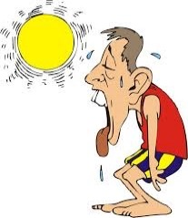

1.3 Response to stimuli think-pair-share
Scenario 1
Scenario 2
What is each person doing?
Why is this happening?
Person sweating by Sushil Rapatwar on Medium, licensed under CC BY-NC-ND 4.0
Person shivering by oksmith on Open Clipart, licensed under CC0 1.0
Notes:
Using the images on the slide to ascertain students’ understanding of how the body responds to stimuli.
Define stimuli as a detectable change in the internal or external environment. Ask students to identify the stimuli in each scenario (Scenario 1 – high temperature and Scenario 2 – low temperature).
Give students time to think independently about the questions on the slide. Then, instruct students to pair up and discuss their ideas with their classmates. Then, facilitate class discussion so students can share their combined knowledge with the class.
Students should be able to identify the following:
in scenario 1, the person is sweating in response to the high temperature
in scenario 2, the person is shivering in response to the low temperature.
Students may also recognise that the people depicted in the images have selected clothing suitable for the temperature they are experiencing. If so, explain that this is a behavioural response to the stimuli rather than a physiological response (internal body function).
Students may or may not be able to respond to the ‘Why is this happening?’ question. Students may already know that sweating helps to cool the body as it removes heat from the skin when it evaporates. They may also know that shivering helps to warm the body up. If not, then describe these stimulus responses to the students.

Slide 15
1.3 Example 1: Is it reliable? Is it valid?
Aim: To determine the impact of the amount of salt on the time it takes water to boil.
Table 1: The impact of the amount of salt on the time it takes water to boil.
Amount of salt (g) | Time for water to boil (s)
 | Trial 1 | Trial 2 | Trial 3 | Trial 4 | Trial 5 | Mean
0 | 62.03 | 62.05 | 62.04 | 62.05 | 62.04 | 62.04
5 | 61.23 | 61.24 | 61.23 | 61.23 | 61.24 | 61.23
10 | 60.01 | 60.00 | 60.03 | 60.03 | 60.00 | 60.01
15 | 58.97 | 58.95 | 58.96 | 58.97 | 58.97 | 58.96
Measurement tools:
Electronic scale
Stopwatch
50mL measuring cylinder
Controlled variables:
50mL of water to dissolve salt
Distilled water
100mL beaker for solution
Use of blue flame to heat
When the solution is deemed to be ‘boiled’
Adding and stirring saltwater solution prior to heating
Notes:
Tell students that the experiment’s procedure has not been provided. However, they must look at this to determine if the experiment is valid. Assume that the procedures used in the examples were appropriate to the given aim.
Reliability: The experiment appears reliable, as the trial data for each salt concentration is highly consistent across trials (please note that this refers to internal reliability/precision). The time to boil for 0 g of salt is extremely similar across all trials (62.03 to 62.05 seconds). For 5 g, the time across trials is consistent (61.23 to 61.24 seconds). For 10 g, the variation is minimal (60.00 to 60.03 seconds). For 15 g, the range is also very tight (58.95 to 58.97 seconds).
Validity: The experiment is valid, as the selection of variables and the control of variables appropriately address the aim of the investigation. The independent variable (amount of salt) directly relates to the aim of determining its effect on the time it takes for water to boil. The dependent variable (time to boil) is appropriate for this aim, reflecting the boiling point change due to the salt concentration.
The experiment controls several important variables, such as:
Volume of water (50 mL): Ensuring the same amount of water is used in each trial.
Type of water (distilled): Using distilled water prevents any impurities from affecting the boiling point.
Beaker size (100 mL): Ensures the container doesn’t impact boiling time.
Flame type (blue flame): Ensures consistent heating conditions.
Procedure for adding salt: Ensures uniformity in the preparation of the salt solution.
Defining the boiling point consistently: Ensures the boiling time is measured consistently for each trial.
The measurements are relevant, and appropriate procedures ensure that the observed differences in boiling time are likely due to the amount of salt and not any other variables.
The tools used (electronic scale, stopwatch, and measuring cylinder) are appropriate for accurately measuring the amount of salt, the time to boil, and the volume of water, ensuring accuracy in each step. The procedures (stirring, controlling flame, dissolving salt prior to heating) are also relevant and correct.

Slide 16
1.3 Example 2: Is it reliable? Is it valid?
Aim: To determine how different temperatures affect the time it takes ice to melt.
Table 1: How different temperatures affect the time it takes ice to melt.
Temperature (°C) | Amount of ice melted (g)
 | Trial 1 | Trial 2 | Trial 3 | Trial 4 | Trial 5 | Mean
15 | 1 | 1 | 1 | 1 | 1 | 1
30 | 10 | 10 | 10 | 10 | 10 | 10
45 | 17 | 17 | 17 | 17 | 17 | 17
60 | 20 | 20 | 20 | 20 | 20 | 20
Measurement tools:
Electronic scale
Temperature probe
Stopwatch
Controlled variables:
Amount of ice to start with (20g)
Time left to melt (2 minutes)
Notes:
Facilitate discussion with the class to determine if the following example is valid and reliable. You may ask the questions below to support students in making their judgement and providing reasons to support their judgement:
What is the independent and dependent variable?
Is the selection of variables relevant to the aim?
Have the correct tools or procedures been used in the experiment so that the measurements are relevant to the aim?
Have appropriate variables been controlled?
Is the trial data similar or the same?

Slide 17
1.3 Example 3: Is it reliable? Is it valid?
Measurement tools:
Measuring cylinder
30cm ruler
Controlled variables:
Type of plant (bean plant)
Amount of water given and the interval between watering
The amount and intensity of exposure to light
Keep temperature of environment plant grows in constant
Consistent size and shape of pot
Nutrient content of soil (except pH)
Depth the seed is planted
Plants at same stage of development when starting experiment
Time left to grow – 4 weeks
Aim: To determine how soil pH affects the amount a plant grows in height.
Table 1: How soil pH affects the amount a plant grows in height.
Soil pH | Plant height (cm)
 | Trial 1 | Trial 2 | Trial 3 | Trial 4 | Trial 5 | Mean
3 | 1.5 | 1.9 | 3.2 | 0.8 | 5.1
5 | 7.2 | 10.5 | 12.3 | 8.9 | 7.6
7 | 6.5 | 4.5 | 5.9 | 4.7 | 5.9
9 | 3.2 | 2.1 | 3.3 | 1.1 | 4.3
Notes:
Facilitate discussion with the class to determine if the following example is valid and reliable. You may ask the questions below to support students in making their judgement and providing reasons to support their judgement:
What is the independent and dependent variable?
Is the selection of variables relevant to the aim?
Have the correct tools or procedures been used in the experiment so that the measurements are relevant to the aim?
Have appropriate variables been controlled?
Is the trial data similar or the same?

Slide 18
1.3 Annotated example of a table
Table is numbered for easy reference.
It is positioned above the table.
A descriptive title.
The table is enclosed and has ruled sides.
A column spanner to group the trials. It contains the heading and units where applicable for the dependent variable.
Table 1: The impact of independent variable on dependent variable.
Independent variable (units) | Dependent variable (units)
 | Trial 1 | Trial 2 | Trial 3 | Trial 4 | Trial 5 | Mean
Column heading for independent variable including units where required
The first column usually contains the treatment groups and control group (where applicable) for the independent variable.
Only the data is recorded in the cells. Units should only be written in column headings.
Notes:
This slide shows an annotated example of a table; however, no specific independent and dependent variable was selected. You can use this slide to recall the components of a quality table in science.
The slide is animated to unpack one element at a time.
The next slide will unpack a quality table using the testable question in TRB 1: ‘How does the amount of salt impact the boiling point of water?’. Depending on the capability of your class, you may use both this slide and the next slide or only the next slide.

Slide 19
1.3 Annotated example of a table with sample data
Table is numbered for easy reference.
It is positioned above the table.
A descriptive title.
The table is enclosed and has ruled sides.
A column spanner to group the trials. It contains the heading and units where applicable for the dependent variable.
Table 1: The impact of salt on boiling point of water.
Amount of salt (g) | Boiling point (°C)
 | Trial 1 | Trial 2 | Trial 3 | Trial 4 | Trial 5 | Mean
0 | 100 | 100 | 100 | 100 | 100 | 100
5 | 102 | 102 | 102 | 102 | 102 | 102
10 | 105 | 105 | 105 | 105 | 105 | 105
15 | 107 | 107 | 107 | 107 | 107 | 107
Column heading for independent variable including units where required
The first column usually contains the treatment groups and control group (where applicable) for the independent variable.
Only the data is recorded in the cells. Units should only be written in column headings.
19
Notes:
Depending on the capability of your class, you may use both this slide and the previous slide or only this slide to recall what a quality table looks like in science.
This table deconstructs a quality table using the testable question from TRB 1, ‘How does the amount of salt impact the boiling point of water?’.
The slide is animated to unpack one component of the table at a time.

Slide 20
1.3 Quality criteria – Table
Enclosed table with ruled sides
Drawn with a ruler and pencil (when hand drawn)
Contains a numbered title (for example, Table 1: …) that reflects the contents of the table
Title is written above the table
Independent variable positioned on the left-hand side of the table
Dependent variable positioned at the top of the table
Appropriate headings, including units (when applicable) for both independent and dependent variable
Allows for the collection of multiple data sets (at least five) and an average
Notes:
These are the quality criteria for constructing a table, which can either be projected on the board for students to see or printed out.
This slide will be used in conjunction with the next slide to provide peer feedback on the quality of the student table.

Slide 21
1.3 Guided feedback chat (1)
Task: Assessing table quality
Name:
Feedback given by:
Student 1
I would like feedback that I receive to be focused on…
The quality of the table I constructed for the practical activity ‘Investigating the heart response to a stimulus’.
The quality criteria for a table.
Student 2
My feedback to Student 1 is…
Student 1
After receiving this feedback, my next steps are…
Notes:
The student seeking feedback completes steps 1 and 3.
The student providing feedback completes step 2. This should be based on the quality criteria: table slide. Students should only comment on those elements of the table.
In Step 3, the student who received feedback looks at the feedback and improves their table.

Slide 22
1.3 Table scaffold 1
Word bank: Exercise type Trial 1 heart rate (bpm) Average Trial 5 Resting Trial 2 Running Trial 3 Walking Jogging Trial 4
Table 1: The impact of exercise type on heart rate (bpm)
Notes:
This is 1 of 2 levels of scaffolding for tables. This is the least scaffolded table. If students in your class require a scaffold, use the most appropriate scaffold that supports student learning. Students who have grasped the concept of constructing tables correctly do not need this scaffold.

Slide 23
1.3 Table scaffold 2
Word bank: Exercise type heart rate (bpm)
Table 1: The impact of exercise type on heart rate (bpm)
 | Trial 1 | Trial 2 | Trial 3 | Trial 4 | Trial 5 | Average
Notes:
This is 1 of 2 levels of scaffolding for tables. If students in your class require a scaffold, use the most appropriate scaffold that supports student learning. Students who have grasped the concept of constructing tables correctly do not need this scaffold.
This scaffold allows the student to identify where the independent and dependent variables should be placed in the table.

Slide 24
1.3 Table for investigation (annotated)
Table is numbered for easy reference.
It is positioned above the table.
A descriptive title.
The table is enclosed and has ruled sides.
A column spanner to group the trials. It contains the heading and units where applicable for the dependent variable.
Table 1: The impact of exercise type on heart rate (bpm)
Exercise type | Heart rate (bpm)
 | Trial 1 | Trial 2 | Trial 3 | Trial 4 | Trial 5 | Average
Resting
Walking
Jogging
Running
Column heading for independent variable including units where required
The first column usually contains the treatment groups and control group (where applicable) for the independent variable.
Only the data is recorded in the cells. Units should only be written in column headings.
Notes:
This is a sample of what the table should look like for the investigation. You may use this slide to consolidate further student understanding of the required components of a quality table.
This slide is animated to allow the teacher to unpack each component.

Slide 25
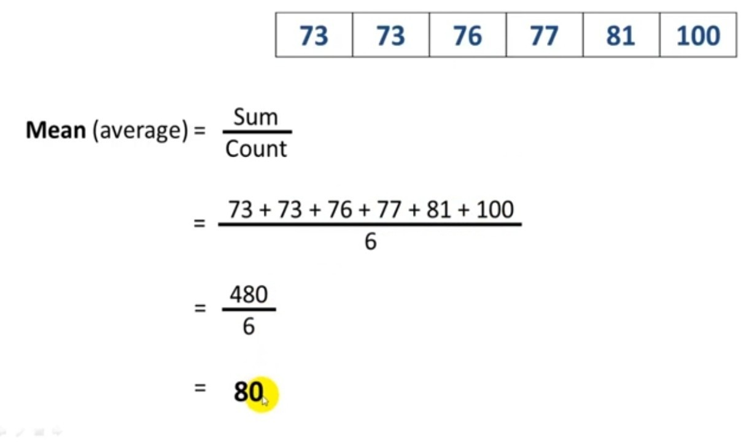
1.3 Calculating the mean
Trial 1
Trial 2
Trial 3
Trial 4
Trial 5
Trial 6
The number here is 6 because there are 6 trials or data points in the given data set. This number will change depending on the amount of data points.
How to calculate a mean by Pulasena on Wikimedia Commons, licensed under CC BY 4.0
Notes:
This is an optional slide. If your students can recall how to calculate the mean, then this slide is not necessary.
Support students to calculate the mean heart rate for each exercise intensity.

Slide 26
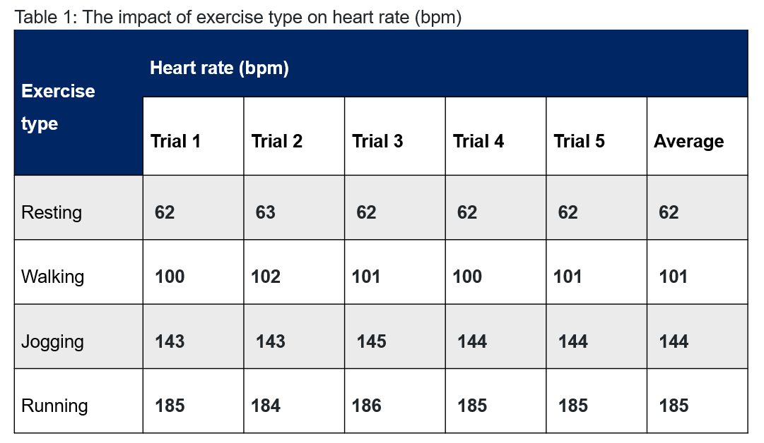
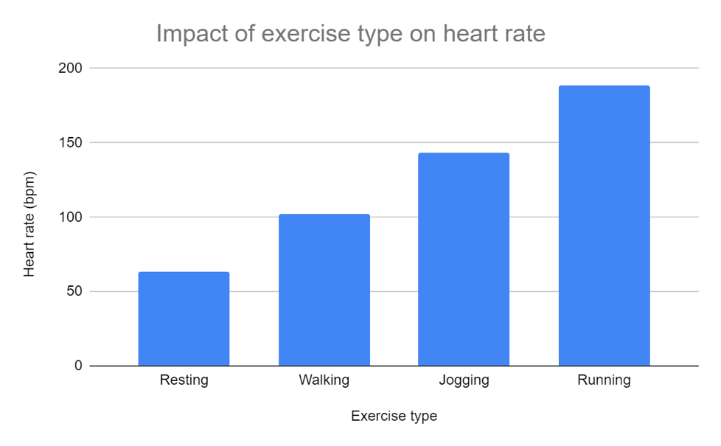
1.3 From table to graph
Title
Source: Student experiment
Images created by author.
Notes:
This slide shows how components of a table translate into a graph.
The slide is animated so the teacher can discuss where the table component goes in the graph.
For example, the green box highlights the independent variable, including the control and treatment groups. In the table, it is on the left-hand side. However, the independent variable is written on the x-axis/horizontal axis in the graph, labelled with an appropriate heading and units where applicable.

Slide 27

1.3 Graph scaffold 1
title
dependent variable (unit)
independent variable (unit)
Notes:
This is graph scaffold 1 of 2 levels of scaffolding for constructing a column graph (slides 30-31). This is the least scaffolded grid paper. If students in your class require a scaffold, select the most appropriate scaffold that supports their learning needs. There is no requirement to use both scaffolds.

Slide 28
1.3 Graph scaffold 2
The impact of different exercise types on heart rate
Heart rate (bpm)
Exercise type
Notes:
This is graph scaffold 2 of 2 levels of scaffolding for constructing a column graph. This is the most scaffolded grid paper. If students in your class require a scaffold, select the most appropriate scaffold that supports their learning needs. There is no requirement to use both or either scaffold.

Slide 29
1.3 Quality criteria for a column graph
Appropriate graph selected for the type of data collected
A title that reflects the independent and dependent variables
Title is written above the graph
X-axis is labelled with the independent variable including units (where appropriate)
Y-axis is labelled with the dependent variable including units (where appropriate)
An appropriate scale for both axes (graph takes up most of grid paper)
Average data from table is accurately plotted
Includes the source of data written under the graph
Drawn with a pencil and ruler (when hand drawn)
Notes:
These are the quality criteria for a column graph, which can either be projected on the board for students to see or printed.
This slide will be used in conjunction with the next slide to provide peer feedback on the quality of the student column graph.

Slide 30
1.3 Guided feedback chat (2)
Task: Assessing column graph quality
Name:
Feedback given by:
Student 1
I would like feedback that I receive to be focused on…
The quality of the column graph I constructed for the practical activity ‘Investigating the heart response to a stimulus’
The quality criteria for a column graph
Student 2
My feedback to Student 1 is…
Student 1
After receiving this feedback, my next steps are…
Notes:
The student seeking feedback completes steps 1 and 3.
The student providing feedback completes step 2. This should be based on the quality criteria: table slide. Students should only comment on those elements of the table.
In Step 3, the student who received feedback looks at the feedback and improves their table.

Slide 31

1.3 Annotated sample graph
A descriptive title that reflects the independent and dependent variables. Positioned at the top of the graph.
Data has been accurately plotted.
Y-axis is labelled with the dependent variable and includes the appropriate unit.
A column graph is an appropriate graph type for categorical vs numerical data.
There is an appropriate scale for both the x-axis and y-axis.
Source: Student experiment
Includes the source of data for the graph.
X-axis is labelled with the independent variable. Note that there is not a unit for exercise type.
Notes:
This slide can be used to unpack a quality sample column graph for students. It allows students to visualise the quality criteria. You can use this slide before students provide peer feedback so they further understand what they are looking for, or you can use it after they provide peer feedback to support students in implementing the feedback given.
This slide is animated so the teacher can unpack each component of the graph as they appear.

Slide 32
1.3 Table for investigation: reliability and validity
Aim: To determine how exercise type impacts heart rate.
Table 1: The impact of exercise type on heart rate (bpm)
Exercise type | Heart rate (bpm)
 | Trial 1 | Trial 2 | Trial 3 | Trial 4 | Trial 5 | Average
Resting
Walking
Jogging
Running
Measurement tools:
Controlled variables:
Notes:
First, you must collate a sample of student data in the table. The class will then use this sample data to complete the remainder of the activity.
Facilitate class discussion to identify and write the measurement tools and controlled variables.
You may ask the questions below to support students in making their judgement about the validity and reliability of the investigation and providing reasons to support their judgement:
What is the independent and dependent variable?
Is the selection of variables relevant to the aim?
Have the correct tools or procedures been used in the experiment so that the measurements are relevant to the aim?
Have appropriate variables been controlled?
Is the trial data similar or the same?

Slide 33
1.3 Discussion question 1: Frayer diagram
Definition
Change in the internal or external environment of the body that triggers a response in the organism.
Facts/Characteristics
Triggers a response in an organism. Can be within the organism (internal) or outside the organism (external).
Stimulus
Examples
Increase in temperature (stimulus) → sweating (response)
Decrease in blood glucose levels (stimulus) → release glucagon (response)
Increase in light levels (stimulus) → pupils constrict (response)
Non-examples
Body temperature with the acceptable range, steady blood glucose levels. Receiving a notification on your phone. Hearing an upbeat song making you want to dance. Advertising making you want to buy something.
Notes:
This slide includes text boxes to co-construct the stimulus definition as a class. To support students, you can provide them with some keywords given below:
Word bank: change, internal, external, environment, response, organism
This slide has been animated to provide sample responses.

Slide 34
1.3 Discussion Questions sample answers
Impact of exercise on heart rate
Word bank: more walking increasing increased warmer exercise oxygen homeostasis jogging breathing resting alert resting
increasing
breathing
2. The body responds to exercise by _____________ heart rate and ___________ rate, feeling more _____________, taking ____________ breaths and feeling ____________.
3. As the intensity of ____________ increased from walking to running, heart rate also _____________ . For example, average __________ heart was 61bpm increasing to 68bpm while ___________ and 80bpm when __________.
4. Increased ___________and heart rate occur due to a coordinated response from the body to maintain ____________. During exercise muscles use up more ________ and produce more carbon dioxide. The increased heart rate pumps blood to the muscles so they have access to more oxygen, and so they can remove the carbon dioxide waste quickly. The increased breathing rate helps get more oxygen into the blood, and more carbon dioxide out of the blood through the lungs.
alert
more
warmer
exercise
increased
resting
jogging
walking
breathing
Homeostasis.
oxygen
Notes:
This slide contains differentiation to support students in responding to the discussion questions in the Student resource – Investigating the impact of exercise on heart rate in TRB1.
Students would use this scaffold to construct a response to the discussion questions using the word bank.
This slide has also been animated to facilitate class discussion.

Slide 35
1.3 The body’s response during exercise
Physical activity increases
Muscle contraction increases
Increased cellular respiration
Increased ATP production
Increased need for O₂
Increased heat production
Increased CO₂ production
Increased breathing rate
Increased sweating
Increased heart rate
Notes:
During exercise, body systems work together to ensure that the cells get what they need to work.
The muscles need to use energy to move, and this energy is released by cellular respiration (a chemical reaction). A by-product of cellular respiration is carbon dioxide. When we exercise, CO₂ levels increase in the blood, and this triggers a response by the body to increase the rate of breathing and increase the heart rate to expel this waste. When we exercise, there is greater demand for oxygen due to the increase in muscle contractions requiring more energy supplied by cellular respiration. Breathing rate increases to breathe in more air containing oxygen, and heart rate rises to transport oxygen in the blood to cells in need. The respiratory and circulatory systems work together to remove the carbon dioxide waste from our bodies and ensure the muscles receive enough oxygen.

Slide 36
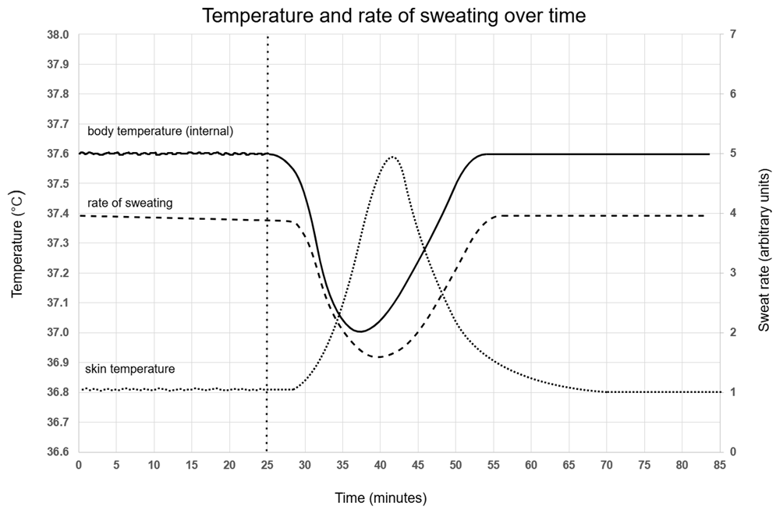
1.3 Slow reveal graph – Step 1
Created by author using Microsoft Excel and draw.io. Adapted from Practical Biology and reproduced with permission of the Royal Society of Biology and the Nuffield Foundation.
Notes:
Use the slow reveal graph technique to assist students in identifying the trends in the graph that will be provided in the student resource Interpreting data about sweating and temperature.
Explain that this graph has no axes, title, scale or labels. We do not know what it represents. We only know that it is a line graph. Ask the students what type of data the graph displays.
Answer: The graph contains continuous data.
Ask students, what do you notice?
Possible answers: There are three variables represented on the graph. There is a vertical line intersecting the plotted data at a particular point.
Ask students what they think the graph represents. Answers will vary.

Slide 37
1.3 Slow reveal graph – Step 2
Created by author using Microsoft Excel and draw.io. Adapted from Practical Biology and reproduced with permission of the Royal Society of Biology and the Nuffield Foundation.
Notes:
Ask students what information they have just learned.
Answer: The X-axis represents time
What time frame is represented on the graph?
Answer: 0–80 minutes.
What do you think happened at 25 minutes? Answers will vary. Students should justify their response with why the 3 variables changed in response to this change.

Slide 38
1.3 Slow reveal graph – Step 3
Created by author using Microsoft Excel and draw.io. Adapted from Practical Biology and reproduced with permission of the Royal Society of Biology and the Nuffield Foundation.
Notes:
Ask students what information they have just learned.
Answer: There are now numbers on the Y-Axis.
Point out the numbers that have also appeared on the right-hand side of the graph. Tell students that some complex graphs represent multiple variables in one graph representation. So, there are three lines on the graph, and at least one is on a different scale than the others.
Ask students what they think the numbers on the left could represent.
Answer: Answers will vary, but they may be able to suggest temperature due to the ranges being close to human body temperature.
Ask students what they think the numbers on the right could represent.
Answer: Answers will vary.

Slide 39
1.3 Slow reveal graph – Step 4
Created by author using Microsoft Excel and draw.io. Adapted from Practical Biology and reproduced with permission of the Royal Society of Biology and the Nuffield Foundation.
Notes:
Ask students what information they have just learned.
Answer: We now have a title and labels on the Y-Axes (both sides). We know that the dependent variables are temperature and sweat rate.
Explain to students that we are still missing one piece of information: the KEY. The key will tell us what the variables that have been plotted over time are.
Read the scenario to the students: This graph shows the results of an experiment to investigate temperature control in the human body. In this experiment, a man stayed in a room kept at a steady 45°C. After 25 minutes in the room, the subject drank a large amount of ice-cold water. Scientists tracked his internal body temperature, skin temperature, and rate of sweating, and the results can be seen in the graph.
Ask the students what the dotted vertical line on at 25 minutes represents.
Answer: The time at which the person drank the ice-cold water.
Ask the students to try and identify which line represents the persons
Internal body temperature
Skin temperature
Rate of sweating
Students should provide their reasoning.

Slide 40
1.3 Slow reveal graph – Step 5 (complete)
Created by author using Microsoft Excel and draw.io. Adapted from Practical Biology and reproduced with permission of the Royal Society of Biology and the Nuffield Foundation.
Notes:
This is the final graph. We can now see that the internal body temperature, rate of sweating and skin temperature are labelled.
Provide students with the Student resource – Interpreting data about sweating and temperature from TRB2. Students work through questions related to the graph. Further information on this is provided in TRB1 1.3.

Slide 41
1.3 Checkpoint
Discuss the following questions as a class
1. Distinguish between stimulus and response.
2. Outline the importance of an organism responding to stimuli in both its internal and external environment.
Notes:
Display this on the board for class discussion.
Sample response:
A stimulus is a change in an organism's internal or external environment that triggers a response, while a response is the organism’s reaction to the stimulus. The stimulus is the incoming information that an organism detects, such as changes in temperature. The response is the outgoing action the organism does in response to the stimulus, such as changing heart rate.
An organism's ability to respond to stimuli is important for survival because it helps organisms maintain balance in changing conditions such as temperature and light. It also allows them to respond to stimuli such as the presence of a predator to avoid danger.

Slide 42
1.4 Feedback mechanisms
Learning intentions and success criteria
We are learning: | I can:
about the role negative feedback loops in maintaining homeostasis. | define negative and positive feedback loops. outline examples of negative and positive feedback loops. describe how negative and positive feedback loops relate to homeostasis.
to synthesise data and information to form an evidence-based argument. | combine data from the heart rate activity and information from the video to establish evidence-based reasoning for regulating internal body temperature as a negative feedback loop.
Notes:
Display this slide at the beginning of the learning sequence. Revisit the slide where appropriate during lesson activities and encourage students to reflect on their progress.

Slide 43
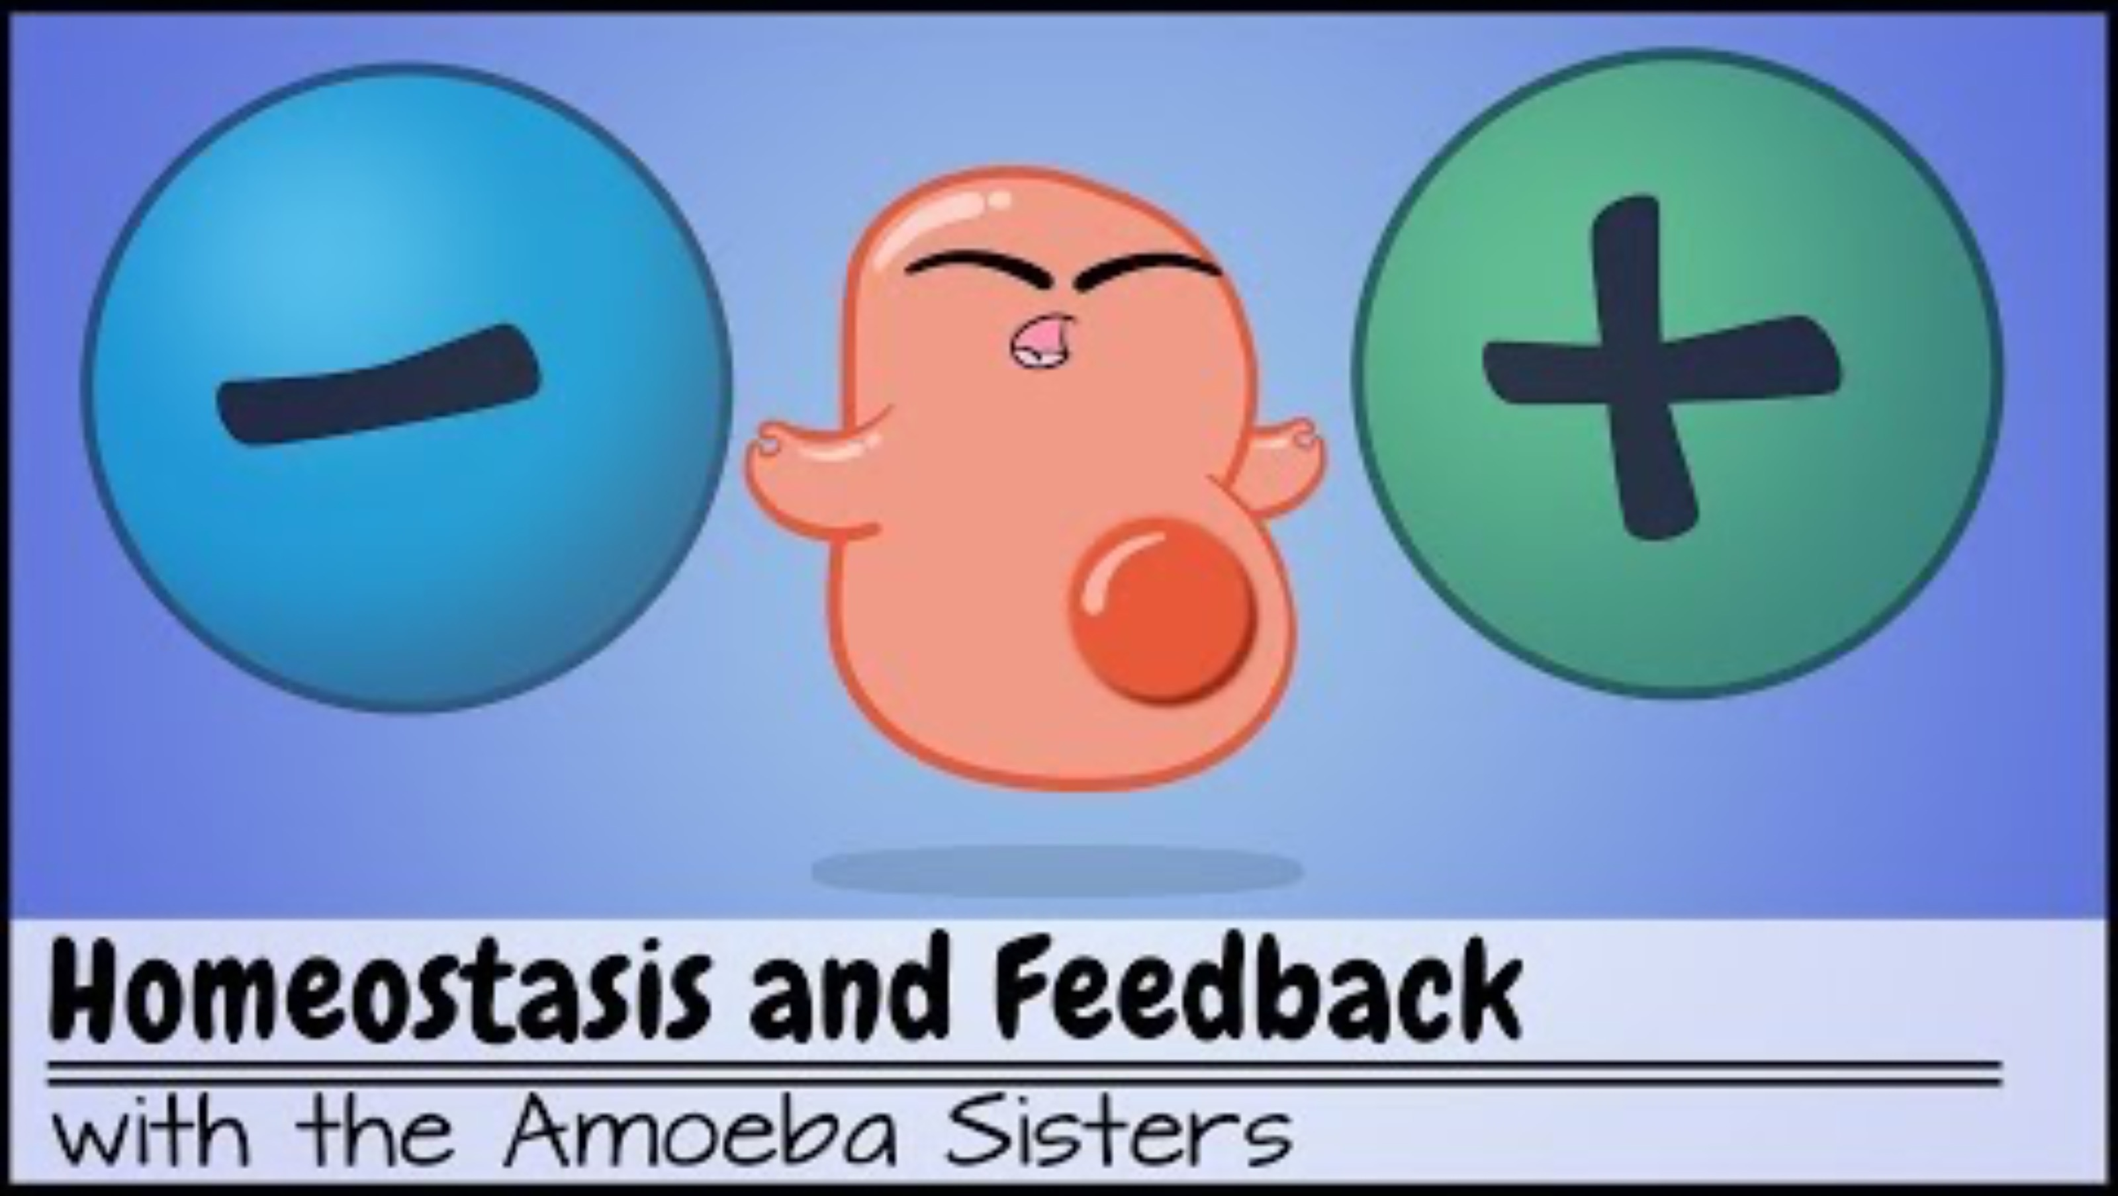
1.4 The role of feedback loops
Watch the video to extract and summarise key points to answer the questions below.
Identify factors in the body that are maintained within a certain range.
Define negative feedback and provide an example.
Define positive feedback and provide an example.
Describe how positive and negative feedback loops relate to homeostasis.
Homeostasis and Feedback
Duration: 6:23
Notes:
This video has closed captions and contains a transcript.
Show students the questions. Tell them these questions, and they will need to extract key points from the video to summarise and answer them.
Watch Homeostasis and Negative/Positive feedback [6:23].
Sample answers are provided in TRB1 1.4 The role of feedback loops.

Slide 44
1.4 What makes you say that?
Temperature regulation in the heart rate activity
You may have noticed that you felt warmer during the heart rate activity. Various body (physiological) processes regulate your internal body temperature to make sure it stays in the optimal range.
Would you classify this as a negative or positive feedback loop?
Notes:
Facilitate classroom discussion about this using the what makes you say that thinking routine linked below.
https://pz.harvard.edu/sites/default/files/What%20Makes%20You%20Say%20That_2.pdf
This will support students to establish evidence-based reasoning for student thinking as a class.
Students should conclude that a negative feedback loop is at work.

Slide 45
1.4 Body temperature feedback loop
This work has been generated using BioRender.com. Any copyright subsisting in this work is owned by © State of New South Wales (Department of Education) 2024.
Notes:
Show students this slide after they have completed the ‘What makes you say that?’ slide.
Ask students to use the information here to support further their reasoning for why internal body temperature regulation is a negative feedback loop.

Slide 46
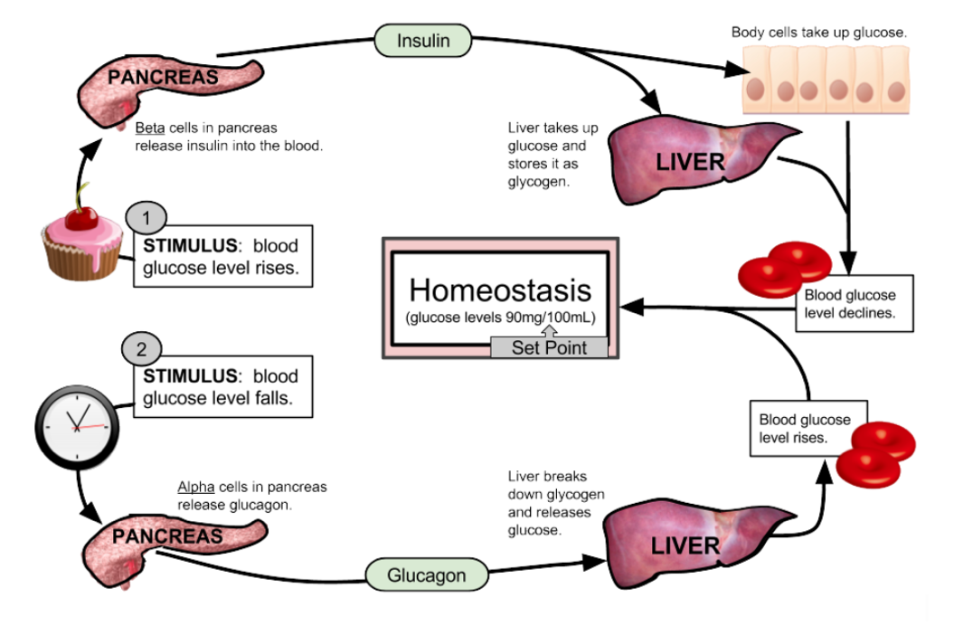
1.4 Checkpoint
Identify whether this is a positive or negative feedback loop. Give a reason to support your answer.
Outline the role of this feedback loop in maintaining homeostasis in relation to blood sugar levels.
Describe the role of negative and positive feedback loops in maintaining homeostasis.
Feedback loop by Shannon Muskopf from LibreTexts Biology licensed under CC BY-NC-SA 4.0
Notes:
Display this on the board to facilitate class discussion when students have completed the checkpoint.
A sample response has been given in TRB 1 and is written below; this can be used to prompt student discussion if required.
Sample response
Identify whether this is a positive or negative feedback loop. Give a reason to support your answer.
This is a negative feedback loop. In this case, when blood glucose levels rise, insulin is released to lower them, and when blood glucose levels fall, glucagon is released to raise them. The loop restores balance by counteracting changes in blood sugar levels, returning them to a stable state.
Outline the role of this feedback loop in blood sugar homeostasis.
This feedback loop plays an important role in keeping blood sugar levels stable, or in homeostasis. When blood sugar rises, such as after eating, the pancreas releases insulin into the bloodstream. As the circulatory system distributes insulin throughout the body, the liver and body cells absorb sugar, thereby reducing blood sugar levels. Conversely, when blood sugar drops, glucagon is released, which tells the liver to release stored glucose, bringing blood levels back up. This cycle ensures that glucose levels stay balanced around a set point to maintain homeostasis.
Describe the role of negative and positive feedback loops in maintaining homeostasis.
Negative feedback loops are crucial for maintaining homeostasis as they work to counteract changes in conditions within optimal ranges. They detect variations from a set point and trigger a response that returns the condition to normal. Homeostatic processes in the body, such as temperature regulation, blood pressure control, and blood glucose, rely on negative feedback.
Positive feedback loops are not homeostatic because they amplify the initial stimulus rather than reversing it, which can lead to an intensified response. Positive feedback loops are important for life, like blood clotting and childbirth. In blood clotting, when a blood vessel is injured, chemicals are released that attract parts of your blood to form a clot. This quick, intensified response prevents excessive blood loss, which is crucial for maintaining internal balance. Once the clot forms, the process stops.

Slide 47
1.5 Coordinating the response to stimuli
Learning intentions and success criteria
We are learning: | I can:
to describe how the response to stimuli in the body is coordinated so that we can explain how it responds to changes and maintains homeostasis. | identify that the human body’s responses are coordinated by the nervous and endocrine systems. describe how the nervous and endocrine systems coordinate responses to stimuli.
how to process information from secondary sources. | identify key points in a text using given questions. summarise key points in my own words to answer questions.
to create written texts to communicate findings from a scientific investigation. | construct a discussion for the experiment using guiding questions. construct an evidence-based conclusion for the experiment using claim-evidence-reasoning.
Notes:
Display this slide at the beginning of the learning sequence. Revisit the slide where appropriate during lesson activities and encourage students to reflect on their progress.

Slide 48
1.5 Brainstorm
Hormones
Hormones
Notes:
This brainstorming session will indicate what students know about hormones from their day-to-day lives.

Slide 49

1.5 Extracting key points
What is a key point in a text?
If I gave you a text and asked you to highlight the key points, what would you give back to me?
When you are completing an assessment or reading a text in class for a purpose, how do you pick which information in the text is important for that assessment or task?
Notes:
These questions are designed to determine students' knowledge about what key points are and how to extract them.
Sample answers / prompts:
A key point in a text is an essential idea, fact, or argument that contributes significantly to the main purpose or message of the text.
Answers will differ. You may have to prompt students and ask, who would give me back the whole text highlighted with the exception of a few words? Outline that key points often summarise important information, support the central theme or highlight critical details needed to understand the overall content. They can be identified by looking for:
Topic sentences – statements that introduce the main idea of a paragraph
Repetition or emphasis – ideas that are repeated, bolded, or emphasised in the text.
Supporting evidence – facts, examples or data that explain or validate the main argument
Conclusions – points that appear in conclusions
Signal words – some phrases can indicate critical information for example ‘most importantly, ‘therefore’, or ‘in summary’.
c) Identify what the purpose of the activity or assessment is. Only extract points that are related to that purpose using the strategies outlined in b). Students should look for key words from the assessment in the text for example.

Slide 50
1.5 Endocrine system
Write the questions below in your book.
Define endocrine system.
Define hormone.
Outline the function of the endocrine system.
Notes:
Ask students to write these questions in their book and extract and summarise information from the texts to answer the question.
Sample responses:
Define endocrine system: This is the system in your body made up of glands that release chemicals called hormones into your blood.
Define hormones: Hormones are chemical messages sent to specific parts of your body to tell them what to do. For example, insulin is a hormone that helps control blood sugar levels.
Outline the function of the endocrine system: The endocrine system is a messaging network in your body. It uses hormones to send messages through your blood to control important things like how you grow, use energy, and feel. Each gland in this system has a specific job to ensure your body works well and stays balanced to maintain homeostasis.

Slide 51
1.5 Endocrine system cloze passage
Endocrine System: This is a system in the human body made up of _________ that release special chemicals called ______________ into the ___________.
Hormones: These are like chemical ______________ sent to specific parts of the body to tell them what to do. For example, _____________ is a hormone that helps control blood _____________ levels.
Function: The endocrine system is like a ______________ network in the human body. It uses _____________ to send messages through the blood to control important things like how people _________, how energy is used and how people feel. Each gland in this system has a specific job to make sure the body works well and stays balanced to maintain _________________.
glands
hormones
blood
messages
insulin
sugar
messaging
hormones
grow
homeostasis
Word bank: hormones sugar blood messages messaging
homeostasis insulin hormones grow glands
Notes:
This slide has been included as a differentiation for the questions on the previous slide. However, you can also use this slide with its animations as sample responses to the questions for all students.

Slide 52
1.5 Checkpoint: Hinge question
Which of the following correctly describes the primary role of the endocrine system?
It uses electrical signals to control body processes.
It uses hormones to regulate processes such as growth, metabolism, and mood.
It helps the body respond to stimuli with quick reactions.
Notes:
This can be displayed on the board for students to answer using mini whiteboards or by raising their hands for the option they select.
However, this would be best set up in a digital form to analyse student responses quickly. The form could also be set up to give the students instant feedback.
The response to the question is B. Further explanation of the understanding and misconceptions students may have based on their response to this question are in TRB 1.
Below is the explanation for each of the responses.
A: Students choosing this option may have confused the endocrine system with the nervous system, which is also a regulatory system. However, although they both function in regulation, the endocrine system uses chemical signalling (hormones produced by glands) while the nervous system uses electrical impulses.
B: This is the correct answer.
C: Students choosing this option may have confused the endocrine system with the nervous system, which is also a regulatory system. However, although they both function in regulation, signal transmission in the endocrine system is slower than in the nervous system since hormones must travel through the bloodstream, but the responses tend to last longer. The nervous system is faster due to the interconnected neurons eliciting much quicker responses.

Slide 53
1.5 Endocrine system simulation
Complete the endocrine system simulation to write an answer to the questions below in your book:
Compare the relative speed of the response coordinated by the endocrine system.
Explain how hormones and feedback loops work to maintain homeostasis.
Use an example to describe how the endocrine system coordinates the body’s response to stimuli.
Notes:
Link to simulation: https://biomanbio.com/HTML5GamesandLabs/Physiologygames/endocrine_edhtml5page.html
Students write the questions in their book. They complete the simulation, extracting and summarising relevant key points to answer the questions.
Sample answers:
1. Endocrine system responses are relatively slow compared to the nervous system.
2. An endocrine gland makes a hormone that has an effect monitored by the brain. Once the change is detected (back to homeostasis), the gland is turned off, and the hormone stops being produced.
3. When blood sugar increases after eating, the pancreas secretes the hormone insulin. This hormone circulates throughout the body via the blood. When insulin comes into contact with cells, it causes them to take in glucose sugar from the blood. If the blood sugar becomes too low, the pancreas secretes glucagon, which signals the liver to release stored sugars into the blood, causing the blood sugar to increase.

Slide 54
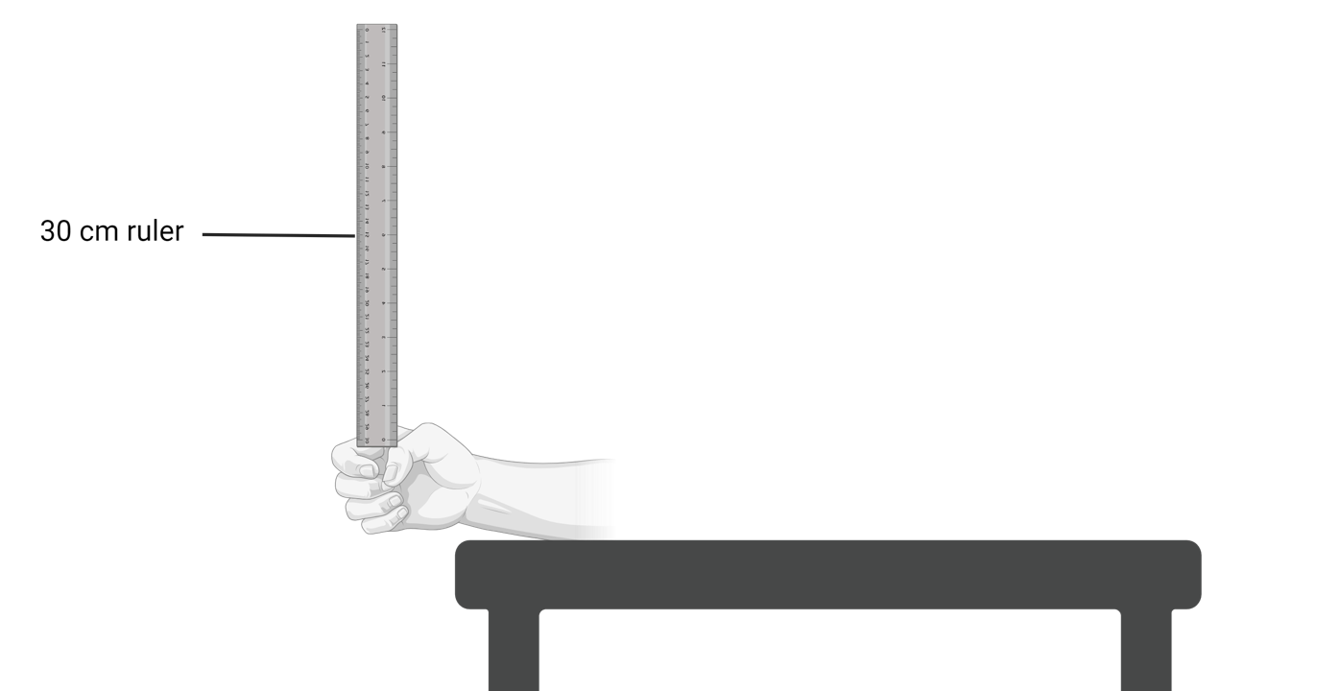
1.5 Observing the body’s response to stimuli experiment set up
This work has been generated using BioRender.com. Any copyright subsisting in this work is owned by © State of New South Wales (Department of Education) 2024.
Notes:
This is to show students how to hold their hand for the experiment with their arm leaning on the table and their hand over the edge.

Slide 55
1.5 Quality criteria: Drawing a table
Enclosed table with ruled sides
Drawn with a ruler and pencil (when hand drawn)
Contains a numbered title (for example, Table 1: …) that reflects the contents of the table
Title is written above the table
Independent variable positioned on the left-hand side of the table
Dependent variable positioned at the top of the table
Appropriate headings including units (when applicable) for both independent and dependent variable
Allows for the collection of multiple data sets (at least five) and an average
Notes:
These are the quality criteria for constructing a table, which can either be projected on the board for students to see or printed out.
You can use the same peer feedback strategy in 1.3 Response to stimuli, or any other.

Slide 56
1.5 Table scaffold 1 (Type of stimulus and catch mark)
Word bank: catch mark (cm) Trial 1 auditory Mean Trial 5
tactile Trial 2 Type of stimulus Trial 3. visual Trial 4
Table 1: The impact of stimulus on reaction indicated by catch mark (cm).
Notes:
This is table scaffold 1 of 3 levels of scaffolding for tables provided on the next slides. This is the least scaffolded table. If students in your class require a scaffold, select the most appropriate scaffold and use that one. There is no requirement to use all 3 scaffolds.

Slide 57
1.5 Table scaffold 2 (Type of stimulus and catch mark)
Word bank: catch mark (cm) Type of stimulus
Table 1: The impact of stimulus on reaction indicated by catch mark (cm).
 | Trial 1 | Trial 2 | Trial 3 | Trial 4 | Trial 5 | Mean
Visual
Auditory
Tactile
Notes:
This table scaffold 2 of 3 levels of scaffolding for tables provided on the next slides. This is the second most scaffolded table. If students in your class require a scaffold, select the most appropriate scaffold and use that one. There is no requirement to use all 3 scaffolds.

Slide 58
1.5 Table scaffold 3 (Type of stimulus and catch mark)
Table 1: The impact of stimulus on reaction indicated by catch mark (cm).
Type of stimulus | Catch mark (cm)
 | Trial 1 | Trial 2 | Trial 3 | Trial 4 | Trial 5 | Mean
Visual
Auditory
Tactile
Notes:
This is table scaffold 3 of 3 levels of scaffolding for tables provided on the next slides. This is the most scaffolded table. If students in your class require a scaffold, select the most appropriate scaffold and use that one. There is no requirement to use all 3 scaffolds.

Slide 59
1.5 Table for stimulus investigation (annotated)
Table is numbered for easy reference.
It is positioned above the table.
A descriptive title.
The table is enclosed and has ruled sides.
A column spanner to group the trials. It contains the heading and units where applicable for the dependent variable.
Table 1: The impact of stimulus on reaction indicated by catch mark (cm).
Column heading for independent variable including units where required
Type of stimulus | Catch mark (cm)
 | Trial 1 | Trial 2 | Trial 3 | Trial 4 | Trial 5 | Mean
Visual
Auditory
Tactile
The first column usually contains the treatment groups and control group (where applicable) for the independent variable.
Only the data is recorded in the cells. Units should only be written in column headings.
Notes:
This is a sample of what the table should look like for the investigation. You may use this slide to consolidate further student understanding of the required components of a quality table.
This slide is animated to allow the teacher to unpack each component.

Slide 60
1.5 Identifying errors through inconsistences in data
Table 1: The impact of stimulus on reaction indicated by catch mark (cm).
Type of stimulus | Catch mark (cm)
 | Trial 1 | Trial 2 | Trial 3 | Trial 4 | Trial 5 | Mean
Visual | 8 | 18* | 8 | 8 | 8 | 8
Auditory | 4 | 4 | 4 | 14* | 4 | 4
Tactile | 5 | 5 | 5 | 5 | 5 | 5
When calculating the average, these measurement errors are not included. However, this
will need to be mentioned in
the discussion component of
a report. The measurement errors are identified in the data set with an asterisk (*).
Notes:
An asterisk has indicated the measurement errors (*) in the table. These measurement errors were noted during the data collection. The student’s response time may have been affected by something other than the stimulus for the investigation, for example, a door slamming and distracting the student.
Discuss with the students how the mean would change if the measurement errors remained for the calculation of the average.
If the trial 2 data was included in the mean calculation for the visual stimulus, the mean would be out by 2cm. (8+18+8+8+8)/5 = 10

Slide 61
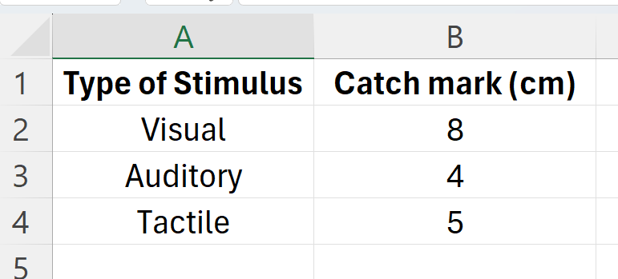
1.5 Graphing in Excel
How to graph in excel
Using Microsoft Excel or Google Sheets, construct a summary table with the independent variable in the left column and the average of the dependent variable in the right column. This is shown below.
Notes:
This slide provides step 1 of 5 in teaching students how to graph data using Excel. Students should use their data from the experiment and follow along with you on laptops for each step.

Slide 62
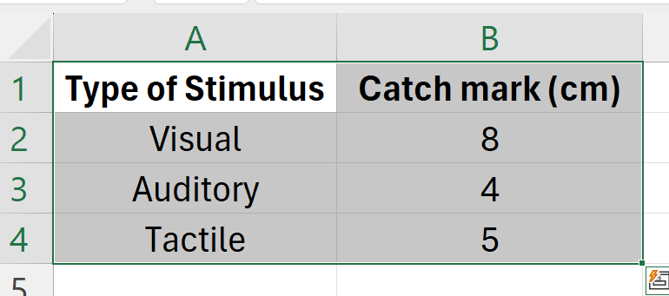
1.5 Graphing in Excel Step 2
Highlight the headings and data by (note that cell values will change if your data set is different or if it is positioned differently):
        Clicking on cell A1
        Holding down shift
        Selecting cell B4
        It should look like the image below.
Notes:
This slide provides step 2 of 5 in teaching students how to graph data using Excel. Students should use their data from the experiment and follow along with you on laptops for each step.

Slide 63
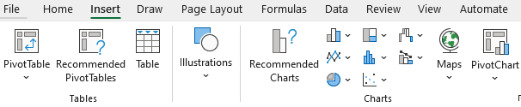
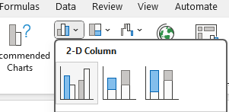
1.5 Graphing in Excel Step 3
3. With the data still highlighted, click on the tab ‘Insert’ (at the top of the page near the File button). The image below should come up.
Notes:
This slide provides step 3 of 5 to teach students how to graph data using Excel. Students should use their data from the experiment and follow along with you on laptops for each step.
Pick the most appropriate graph type based on the data collected. In this experiment, you will use a column chart shown in the blue box above.
This will bring up options for different column charts. Select the most appropriate one.

Slide 64
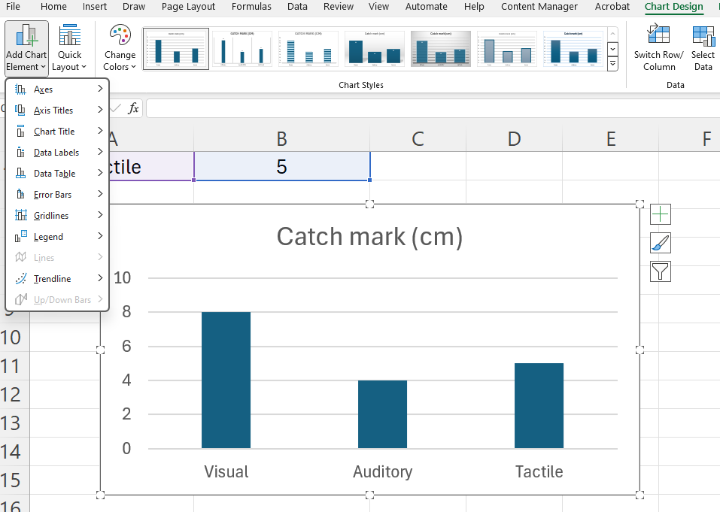
1.5 Graphing in excel Step 4
4. Check the appropriateness of the title and axes labels.
If this has not occurred, click on the chart, select ‘Chart Design’ at the top of the page then ‘Add Chart Element’.
How to fix elements of the graph:
Click axis titles to add a horizontal (x-axis) title and a vertical (y-axis title)
Click on the chart title to reposition it (also, to change the suitability of the title, click on the catch mark and change the title)
Image created by author on Microsoft Excel.
Notes:
This slide provides step 4 of 5 in teaching students how to graph data using Excel. Students should use their data from the experiment and follow along with you on laptops for each step.

Slide 65
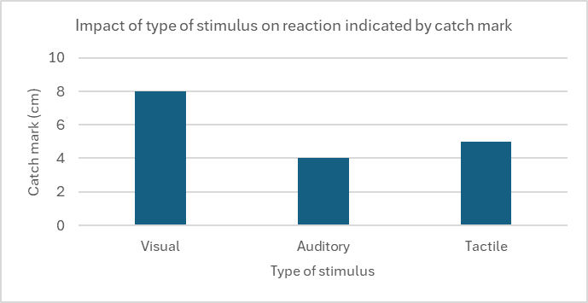
1.5 Graphing in excel Step 5
5. To add the graph to another document, select the chart, right-click and press copy (Ctrl + C).
Paste (Ctrl + V) into the other document. The final product is shown below.
Image created by author on Microsoft Excel.
Notes:
This slide provides the final step in teaching students how to graph data using Excel. Students should use their data from the experiment and follow along with you on laptops for each step.

Slide 66
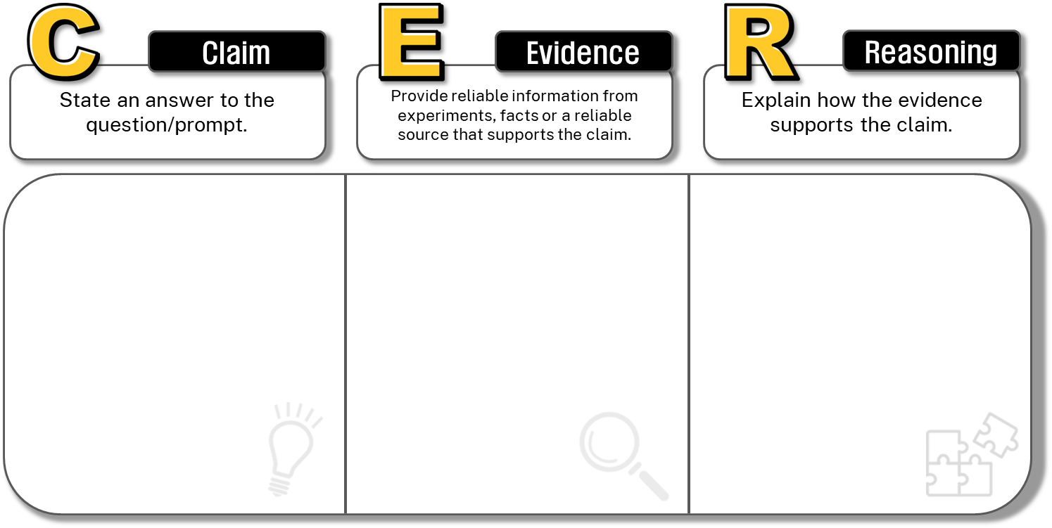
1.5 Claim, Evidence, Reasoning (CER)
Claim: The type of stimulus affects reaction speed.
Evidence: The average catch mark on the ruler was __ cm for touch stimuli, __ cm for auditory stimuli, and __ cm for visual stimuli. The smaller the catch mark, the faster the reaction speed.
Reasoning: Touch is processed more rapidly by the brain than sound and sight, which involve more complex processing – indicated by the lowest catch mark of 10 cm being touch.
Notes:
This slide is animated. This scaffold will support students in writing a conclusion for the stimulus type and reaction speed experiment.
There is additional information in TRB 1 about language resources to be used to express cause and effect. Once this C-E-R scaffold is completed, you can determine which language resources would be suitable to demonstrate causal relationships when writing the conclusion based on the scaffold.

Slide 67
1.5 From C-E-R scaffold to a conclusion
Sample conclusion
Claim
Evidence
The type of stimulus affects reaction speed, as shown by the experiment. The average catch mark on the ruler was 10 cm for touch stimuli, indicating the fastest reactions, 12 cm for auditory stimuli, and 16 cm for visual stimuli, which had the slowest reactions. This indicates that touch is processed more rapidly by the brain compared to sound and sight, which involve more complex processing. Therefore, the experiment clearly shows that the type of stimulus impacts reaction speed, directly answering the inquiry question.
Reasoning
Notes:
This is a constructed conclusion written based on the completed C-E-R scaffold on the previous slide. The slide is animated to highlight the conclusion’s components: the claim, the evidence and the reasoning.
There is additional information in TRB 1 about language resources to be used to express cause and effect. You can go through this conclusion and identify language that indicates causal relationships.

Slide 68
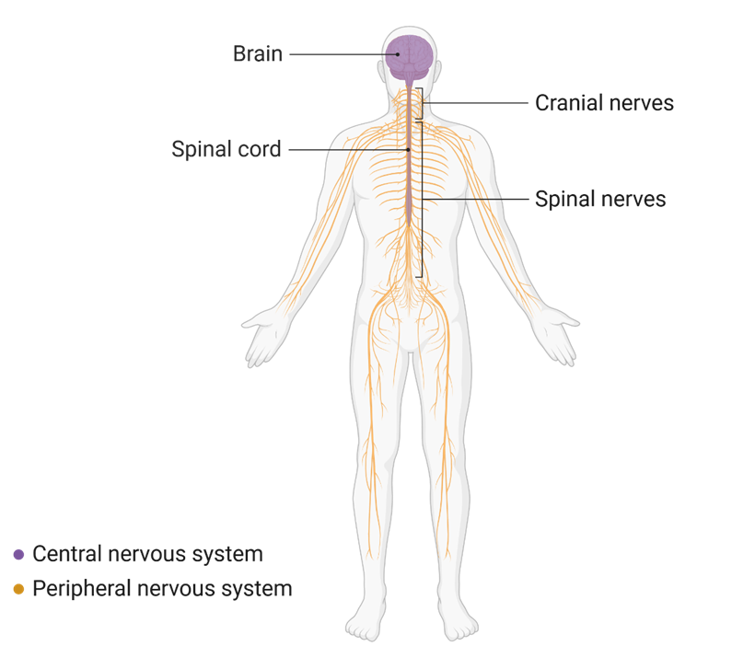
1.5 The nervous system
Components of the nervous system
The nervous system is a network of nerve cells that allows the body to communicate with itself and the outside world.
This work has been generated using BioRender.com. Any copyright subsisting in this work is owned by © State of New South Wales (Department of Education) 2024.
Notes:
Define the nervous system and describe the general structure using the labelled components on the slide.

Slide 69
1.5 Jigsaw: home group organisation
Home group number | Students
Home group 1 | Student from expert group 1 – the structure of the nervous system Student from expert group 2 – function of the nervous system Student from expert group 3 – stimulus-response pathway Student from expert group 4 – nervous system coordinating responses
Home group 2
Home group 3
Home group 4
Home group 5
Home group 6
Home group 7
Notes:
Students start this activity in their home groups to allocate roles. Teachers can assign students to groups using this slide.

Slide 70
1.5 Jigsaw: expert group organisation
Expert group number | Component
Expert group 1 | Students from each home group are assigned to: The structure of the nervous system, including the central and peripheral nervous system.
Expert group 2 | Students from each home group assigned to: The function of the nervous system including the central and peripheral nervous system.
Expert group 3 | Students from each home group are assigned to: Outline of the stimulus-response pathway, including applying it to the previous catching a ruler and heart rate activities.
Expert group 4 | Students from each home group assigned to: How the nervous system coordinates the body’s response to stimuli
Notes:
Once students have joined their group of 4, allocate them to one of the following expert groups. They will then join other students in the same expert group to extract and summarise relevant information from the text to create their agreed mode of presentation for their home group.

Slide 71
1.5 Structure and function of the nervous system
Using examples, describe how the nervous system coordinates the body’s response to different stimuli. Your response should refer to both the stimulus-response model and the reflex arc.
Key concepts and terms to include in your response:
central nervous system-brain and spinal cord, peripheral nervous system-neurons, electrical impulses, stimulus, receptors, effectors, control centre.
Notes:
This question is answered as a class, with the teacher joint constructing the response with the class using the information they collected from the jigsaw activity.
A samples response is provided in TRB1.

Slide 72
1.6 Comparing the nervous and endocrine system
Learning intentions and success criteria
We are learning: | I can:
to compare and contrast how the human nervous and endocrine systems respond to stimuli so we can understand their role in responding to stimuli. | identify the response of the nervous and endocrine system to a stimulus. outline similarities and differences in the responses of the nervous and endocrine systems.
to create written texts to communicate scientific understanding to different audiences. | construct a written response to an examination-style question to communicate understanding using correct and precise scientific terminology. use connectives/cohesive devices to create cohesion.

Slide 73
1.6 Double Venn diagram
Topic: Responses of the nervous and endocrine systems
Nervous system
Endocrine system
Has a quick response time
Uses electrical impulses to send messages
Responses have a short term effect
Response acts on individualised cells (localised)
Has a slower response time
Uses chemical messengers (hormones) to send messages
Responses can have a longer effect
Responses have a more widespread effect (however, will still only act on target cells)
Both are systems of the body that send messages to respond to stimuli
Both help maintain homeostasis
Notes:
Ask students to draw the double Venn diagram in their book (do not show them the sample responses yet).
Students complete the double Venn diagram to outline the similarities and differences between the responses of the nervous and endocrine systems.
Discuss the responses in the double Venn diagram. The slides are animated to allow the teacher to project the sample responses on the board.
Please note the double Venn diagram sample response above does not contain a complete list of features of responses to compare and contrast. However, it provides adequate examples to construct the written response for a stage 5 student.

Slide 74
1.6 Unpacking the V-C-F-S strategy
Abbreviation | Term | Explanation
V | Verb | Identify the verb/s and the requirements of the verb This helps to determine the requirements of the response. For example, is a judgment needed? (if a judgement is needed, you need to identify points for and/or against).
C | Content | Identify the content – circle and annotate keywords that relate to what you have learnt.
F | Focus | Outline the focus of the question Is it related to a particular context or a stimulus? Does the question contain a how or a why? This means you need to draw relationships between ideas.
S | Singular or Plural | Identify if words in the question are singular or plural. Are there words that indicate the response needs to refer to two or more ideas? If the question states to give examples, the ‘s’ at the end of example indicates more than one.
Notes:
Display this on the board when unpacking the V-C-F-S strategy from the student resource, Table 1 –Requirements for deconstructing a question using VCFS.
Use this slide to further explain some of the points on the student resource. Students should annotate their resource to add this information.

Slide 75
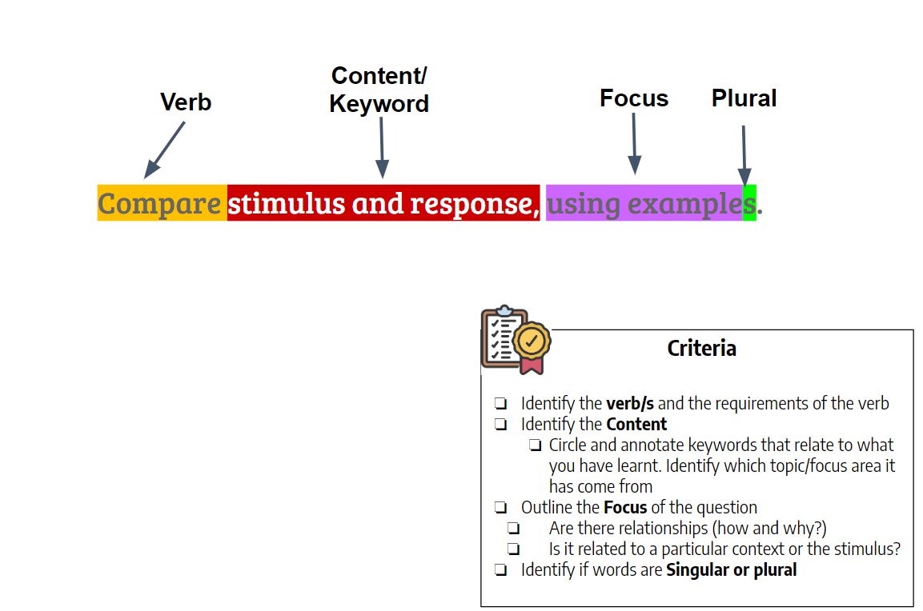
1.6 Annotated example of V-C-F-S
Notes:
Use the VCFS strategy table and the sample annotations above to model for students if and how the provided example has been appropriately deconstructed.
Tell students when you write a response to compare and contrast that you should compare features which are ‘like for like’.

Slide 76
1.6 Compare and contrast question
Use a strategy such as V-C-F-S to deconstruct this question.
Compare and contrast how the human nervous and endocrine systems respond to stimuli. In your response, provide 2 similarities and 2 differences that highlight key features of the systems. (4 marks)
Notes:
Students have a go on how to unpack the question above using V-C-F-S.
If students require further practice, deconstruct it as a class.
Discuss the deconstruction of the question using V-C-F-S. Link the points below to plan a response:
First, look at the verb/s. Compare means to show how things are similar or different. Contrast means to show how things are different or opposite, so our response needs to focus on similarities and differences.
The content identified is nervous and endocrine systems, responses and stimuli. This means we will need to make statements looking at how similar and different the nervous and endocrine systems respond to stimuli
The focus has clearly been identified as humans. This means we are looking at the responses of the nervous and endocrine systems to stimuli in humans.
Words given have been plural. For example, the use of ‘and’ between nervous and endocrine and the use of an ‘s’ after systems indicate you must talk about both types of systems in your response.
Model how to make a plan to write the response taking into consideration the points above (students write the plan in their student resource):
Look at the marks allocated to the question. This is a 4-mark compare response, so we should focus on looking at similarities/differences for 4 ways the systems respond to stimuli in humans.
Identify four features of responses that can be compared in the nervous and endocrine system response to stimuli.
Determine if they are similar or different.
Write a statement for each that outlines the feature's similarity/difference, ensuring it is linked to humans. Remember, you are comparing and contrasting ‘like for like’.

Slide 77
1.6 Marking criteria
Marks | Criteria
4 | Compares and contrasts the response of the nervous and endocrine systems to stimuli in humans by providing similarities and differences. Constructs a cohesive written response that effectively uses connectives/cohesive words to illustrate comparison and contrast. Effective use of correct and precise scientific terminology to provide detail and show understanding of the contribution of each system to homeostasis.
3 | Compares and contrasts the response of the nervous and endocrine systems to stimuli in humans by providing a similarity and difference(s). Constructs a written response that effectively uses connectives/cohesive words to illustrate comparison and contrast. Use of correct scientific terminology to provide detail.
2 | Compares the nervous and endocrine system responses by providing a similarity or difference OR Outlines responses of the endocrine and/or nervous system.
1 | Outlines a response of the endocrine and/or nervous system.
Notes:
Deconstruct the marking criteria with students (they have a copy in the student resource in TRB 1), asking them to annotate any points discussed.
These marking criteria are going to be used to deconstruct given sample responses.

Slide 78
1.6 Sample response 1
The nervous and endocrine systems receive stimuli, transmit messages, and elicit responses. They are also both systems in the human body that help maintain homeostasis. However, they do so in a different way. The nervous system sends messages as electrical impulses, resulting in a fast response, unlike the endocrine system, which uses hormones to send messages, resulting in a slower response. Responses coordinated by the nervous system are typically localised, affecting a particular part of the body. Conversely, responses coordinated by the endocrine system typically have a more widespread effect.
Notes:
Deconstruct ‘Sample response 1’ as a class against the marking criteria on the previous slide and in the student resource in TRB 1.
Annotate how the response does and does not meet the marking criteria.
Highlight where cohesive words have been used to indicate a similarity or difference.

Slide 79
1.6 Sample response 1 annotated
The nervous and endocrine systems receive stimuli, transmit messages, and elicit responses. They are also both systems in the human body that help maintain homeostasis. However, they do so in a different way. The nervous system sends messages as electrical impulses, resulting in a fast response, unlike the endocrine system which uses hormones to send messages, resulting in a slower response. Responses coordinated by the nervous system are typically localised, affecting a particular part of the body. Conversely, responses coordinated by the endocrine system typically have a more widespread effect.
Key
Yellow highlighting: words to indicate similarity or difference
Blue words: scientific terminology
Notes:
This is an annotated sample of where connectives (cohesive words) have been used, indicated by the yellow highlighter, and blue indicates where scientific terminology has been used.
This response would have achieved full marks.
The student has correctly provided two similarities between the two systems.
They have also correctly provided two differences (type and speed of message, localised or widespread effect)
The response is cohesive, written in a logical manner and uses connectives/cohesive effectively to indicate similarity or difference (shown in yellow highlighting)
The student has effectively used correct and precise scientific terminology (shown in blue) to demonstrate their understanding of both systems.

Slide 80
1.6 Sample response 2
The nervous system acts fast, and its response affects a particular part of the body. Both the nervous and endocrine systems respond to help keep a balance in the body. The endocrine system uses chemical messengers and has a slow response.
Notes:
Deconstruct ‘Sample response 2’ as a class against the marking criteria on the previous slide and in the student resource in TRB 1.
Annotate how the response does and does not meet the marking criteria.
Highlight where cohesive words have been used to indicate a similarity or difference.

Slide 81
1.6 Sample response 2 annotated
The nervous system acts fast, and its response affects a particular part of the body. Both the nervous and endocrine systems respond to help keep a balance in the body. The endocrine system uses chemical messengers and has a slow response.
Key
Yellow highlighting: words to indicate similarity or difference
Blue words: scientific terminology
Notes:
This is an annotated sample of where connectives (cohesive words) have been used indicated by the yellow highlighter and blue indicates where scientific terminology has been used.
This response would have achieved two marks.
The student has provided a similarity between the nervous and endocrine system.
Although they have provided other information about the responses of the endocrine and nervous system in the first and last sentence, they have not compared the features.

Slide 82
1.6 Comparing and contrasting cohesive words
Similar | Different
Like | Unlike
Similar to | Compared to
Also | In contrast
Similarly | Contrasted with
In the same way | On the contrary
Likewise | However
Like | Conversely
Are both | While
Notes:
Show students this list of connectives (cohesive words) indicating similarities or differences.
This will be used when Sample response 2 is jointly constructed as a class (next slide).

Slide 83
1.6 Rewriting sample response 2
Compare and contrast how the human nervous and endocrine systems respond to stimuli. In your response, provide 2 similarities and 2 differences that highlight key features of the systems. (4 marks)
Notes:
Use the plan constructed with students to improve the response based on the feedback annotated on sample response 2. This should be similar to sample response 1 and sample response 3 (level-up activity).
Highlight where connectives (cohesive words) and correct and precise scientific terminology have been used.

Slide 84
1.6 Level up activity: Sample response 3
The nervous and endocrine systems are both important for how our bodies respond to stimuli, but they work in different ways. The nervous system sends electrical impulses through connected neurons, allowing us to react quickly, such as pulling our hands away from a hot surface. In contrast, the endocrine system responds more slowly by releasing hormones into the bloodstream, which take longer to reach target organs but have longer effects. The nervous system's responses are fast and specific, affecting particular parts of the body for a short time. In contrast, the endocrine system, which uses hormones to regulate processes like growth and metabolism, can influence multiple parts of the body at the same time. Both systems are essential for maintaining homeostasis and often interact to effectively coordinate the body's functions.
Notes:
Instruct students to deconstruct and annotate Samples response 3 in pairs using the marking criteria. Students also annotate where they can see cohesive words that highlight similarities or differences in the responses to stimuli and highlight examples of the use of correct and precise scientific terminology.

Slide 85
1.6 Level up activity: Sample response 3 annotated
The nervous and endocrine systems are both important for how our bodies respond to stimuli, but they work in different ways. The nervous system sends electrical impulses through connected neurons, allowing us to react quickly, such as pulling our hands away from a hot surface. In contrast, the endocrine system responds more slowly by releasing hormones into the bloodstream, which take longer to reach target organs but have longer effects. The nervous system's responses are fast and specific, affecting particular parts of the body for a short time. In contrast, the endocrine system, which uses hormones to regulate processes like growth and metabolism, can influence multiple parts of the body at the same time. Both systems are essential for maintaining homeostasis
and often interact to effectively
coordinate the body’s functions.
Key
Yellow highlighting: words to indicate similarity or difference
Blue words: scientific terminology
Notes:
This is an annotated sample of where connectives (cohesive words) have been used, indicated by the yellow highlighter, and blue indicates where scientific terminology has been used.
This response would have achieved full marks.
The student has correctly provided two similarities between the two systems.
They have also correctly provided two differences (type and speed of message, localised or widespread effect)
The response is cohesive, written in a logical manner and uses connectives/cohesive effectively to indicate similarity or difference (shown in yellow highlighting)
The student has effectively used correct and precise scientific terminology (shown in blue) to demonstrate their understanding of both systems.

Slide 86
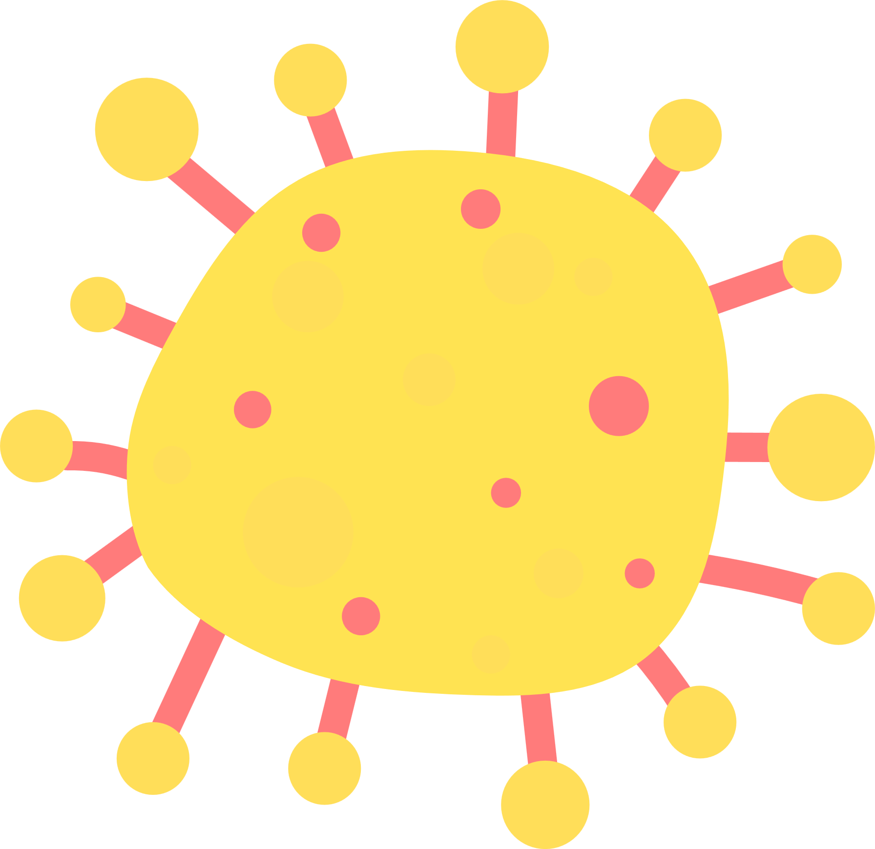
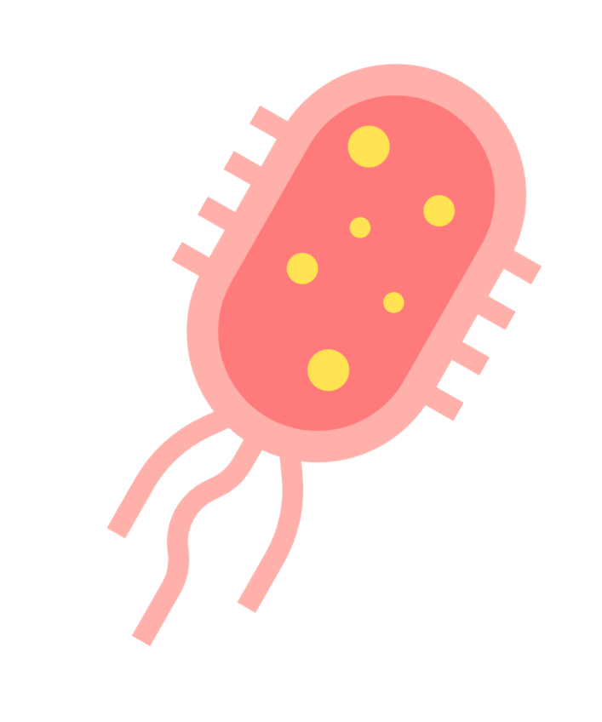
2. How do we effectively manage and treat infectious diseases?
Notes:
Content in this section aligns with essential question 2 in the program of learning and Teacher resource book 2 (TRB2)

Slide 87
2.1 Causes of infectious diseases
Learning intentions and success criteria
We are learning: | I can:
to identify the causes of infectious diseases to determine how to prevent and control them. | define disease and infectious disease. identify the cause of a range of infectious diseases. outline the mode of transmission for a range of infectious diseases.
how to identify reliable, accurate and valid secondary sources. | define accuracy, reliability and validity in the context of secondary sources. outline the requirements for a secondary source to be accurate, reliable, and valid. assess the accuracy, reliability and validity of secondary sources.
Notes:
Display this slide at the beginning of the learning sequence. Revisit the slide where appropriate during lesson activities and encourage students to reflect on their progress.

Slide 88
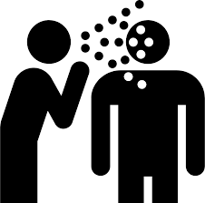
2.1 Defining disease and infectious disease
Disease: An illness or condition of the body affecting how an organism, or parts of an organism, or its organs function. Examples include COVID-19, diabetes, and malaria.
Infectious disease: An illness caused by organisms that can be passed, directly or indirectly, from one living thing to another. Examples include malaria, COVID-19, influenza, cholera and herpes.
Person coughing by Noun Project from Wikimedia Commons, licensed under CC0 1.0
Notes:
Define and outline disease and infectious disease with students, including examples drawn from the concept map activity.

Slide 89


2.1 What are pathogens?
A pathogen is any organism or agent that causes or can cause disease or illness to its host.
Types of pathogens include bacteria, viruses, fungi and protists
Pathogens spread from the host to infect other organisms through:
        Contact
        Air
        Water
        Food
        Vectors
Notes:
Further expand on the definition of infectious disease by explaining to students what pathogens are.
Speaker notes:
A pathogen is a microorganism that can cause disease
Types of pathogens include:
Bacteria – Bacteria are single-cell prokaryotic (which means they have no nucleus) organisms (students may have heard of some disease-causing bacteria such as E. coli and Salmonella)
Viruses – Viruses are a non-cellular infective agent that can only replicate inside the cells of a living host. (Influenza, Human Papilloma Virus (HPV)
Fungi – fungi are a large group of eukaryotic organisms, including yeasts, moulds and mushrooms. Examples of diseases caused by fungi include athlete’s foot and ringworm.
Protists – Are eucaryotic (which means they have a nucleus). Examples of diseases caused by protists include malaria and Giardiasis.
Pathogens spread from the host to infect other organisms through:
Contact
Air
Water
Food
Vectors

Slide 90
2.1 Disease transmission
Mode | Definition | Examples
Direct transmission | Occurs when a disease is passed directly from one infected person or animal to another person or animal. | Kissing (herpes simplex virus) Touching Sexual contact (Human papillomavirus) Droplet spread through coughing, sneezing and talking (influenza, whooping cough)
Indirect transmission | Occurs when a disease is passed from an infected person to another person, even though they have not had direct contact. | Airborne transmission – where the particles are suspended for extended periods in the air (Measles) Food (Salmonella) Water (Cholera) Surfaces (Common cold, influenza)
Vector transmission | Vector transmission requires another organism to transmit the disease from person to person. | Mosquitos are vectors for malaria, dengue fever, Ross River fever and Japanese encephalitis Ticks are vectors for Lyme disease Fleas are vectors for the plague Rats are vectors for leptospirosis
Notes:
Facilitate a class discussion about how infectious diseases are transmitted. Draw on students' prior understanding and describe additional examples to close knowledge gaps. Co-construct a table to collate information on the modes of transmission.
This slide is animated to bring up sample responses.

Slide 91
2.1 Checkpoint
Which one is a non-infectious disease?
Name of disease | Cause of the disease
Pneumonia | Caused by a pathogen such as a bacteria or virus.
Cystic fibrosis | Inherited from parents
Rhino virus (common cold) | Caused by a pathogen that is transmitted from person to person.
Notes:
Show students the checkpoint and ask them to identify which disease is non-infectious based on their definition of infectious disease.
Students can write their responses on a whiteboard, raise their hands to indicate their choice or the teacher can set this up as a digital form to get quick feedback.

Slide 92



2.1 Investigating the causes of infectious disease
Secondary source reliability, accuracy and validity
Reliability – This refers to the consistency of information with other reliable sources.
Accuracy – The information presented is correct, with information we know to be true.
Validity – This evaluates the appropriateness of the information for the topic under investigation.
Notes:
Inform students that not all the sources that come up through the search will be reliable and valid. Read the ‘Tips for a quick check for validity’ in the student resource. Define reliability, accuracy and validity using the definitions on the slide. Teach students what it means for a secondary source to be reliable, accurate and valid. There is a scaffold in the student resource, ‘Is the secondary source reliable, accurate and valid?

Slide 93
2.1 Criteria for secondary source reliability, accuracy and validity
Reliability | Accuracy | Validity
Has someone with an appropriate scientific background written the source? What are their qualifications? Is the source published on a credible medium? (For example, .edu, .gov) Is there evidence of bias? Is the information current? (consider the topic being investigated and research being conducted in the field) Is information consistent with at least two other reliable sources? | Is the information in this source similar to information accepted or referenced values? (For example, information in peer-reviewed journal articles) | Is the information in this source relevant to the question/topic being investigated? Is the information reliable and accurate?
Notes:
This is for students who can assess sources' reliability, accuracy and validity after they have been explicitly taught how to do it in the activity.
Please note that for the following point, “Is the information current? (consider the topic being investigated and research being conducted in the field)”, we do not suggest generic guidelines such as ‘within 5 years’. The field of research needs to be taken into consideration. For example, is it a field where information is rapidly outdated due to the amount of research, or is it a field where we have understood a concept and there have been no changes in our understanding for 20 years?
Instead of giving the full ‘Is the secondary source reliable, accurate and valid?’ to determine these features of a source, they can use the checklist above. However, they should still look for evidence from the source to support their judgement.

Slide 94
2.1 Checkpoint
What causes an infectious disease?
A problem in your DNA that you inherit from your parents.
Getting hurt or injured.
Pathogens like bacteria, viruses, or fungi invading your body.
Not eating enough healthy food.
Notes:
The correct answer is C.
Reasons for other options being incorrect
A genetic problem passed down from your parents - This describes a genetic disorder (non-infectious disease), not an infectious disease. Infectious diseases are caused by microorganisms like bacteria, viruses, fungi, or parasites, not by inherited genes.
Damage to the body from an injury-Injuries are physical harm and are not caused by microorganisms. While injuries can sometimes lead to infections, the injury is not infectious.
D. Not getting enough nutrients from your diet - This refers to a nutritional deficiency or malnutrition, not an infectious disease. Infectious diseases involve pathogens invading the body, while a poor diet causes different types of health issues (non-infectious disease).

Slide 95
2.2 Disease transmission
Learning intentions and success criteria
We are learning: | I can:
how infectious diseases spread through a population so that we can determine how to prevent their spread. | outline how infectious diseases are transmitted describe how disease transmission can be reduced.
how scientific models are used to predict outcomes. | outline the purpose of the scientific model identify the strengths of the scientific model identify the limitations of the scientific model outline how scientific models can be used to predict outcomes.
Notes:
Display this slide at the beginning of the learning sequence. Revisit the slide where appropriate during lesson activities and encourage students to reflect on their progress.

Slide 96
2.2 Checkpoint
Which of the following statements is correct?
Infectious diseases can only be transmitted through physical contact with an infected person.
Infectious diseases can be transmitted indirectly through air, water, and vectors.
Only bacteria can spread through the air, while viruses spread through direct contact.
Infectious diseases cannot be transmitted through insect bites.
Notes:
The correct answer is B. Infectious disease can also be spread through direct contact such as touch, exchange of body fluids and
A) Infectious diseases can only be transmitted through physical contact with an infected person.
Misconception: Some students might believe that diseases like the flu or cold can only spread through direct physical contact, ignoring the role of airborne transmission.
C) Only bacteria can spread through the air, while viruses spread through direct contact.
Misconception: This suggests a confusion between how different pathogens spread. In fact, both bacteria and viruses can spread through the air, not just through direct contact.
D) Infectious diseases cannot be transmitted through insect bites.
Misconception: This response ignores the fact that many diseases, such as malaria and dengue, are transmitted by insect vectors like mosquitoes.

Slide 97
2.2 Checkpoint: Transmission scenarios
Classify each transmission scenario as direct, indirect or vector-based.
You are sick, you sneeze, and the person you are talking to breathes in the droplets.
An infective mosquito bites you while you are outdoors, and you develop malaria.
A person with the flu sneezed into their hands then touched the handle of the shopping trolley. You touch the same handle then rub your eyes and nose.
After playing at a public playground, you touch your mouth before washing your hands.
A flea from an infected rate bites you, causing you to develop the plague.
You kiss someone who has cold sores and later develop herpes.
You help someone who has fallen down, making contact with their skin. You discover later that they had scabies, which you now have as well.
Notes:
This slide is animated to bring up one scenario at a time.
After each scenario, ask students to use mini whiteboards to indicate if it is an example of indirect, direct or vector transmission.
After each one, discuss their choices and provide feedback. The answers are below.
You are sick, you sneeze, and the person you are talking to breathes in the droplets: DIRECT.
An infective mosquito bites you while you are outdoors, and you develop malaria: VECTOR.
A person with the flu sneezed into their hands and then touched the handle of the shopping troller. You touch the same handle, then rub your eyes and nose. : INDIRECT.
After playing at a public playground, you touch your mouth before washing your hands: INDIRECT.
A flea from an infected rate bites you, causing you to develop the plague: VECTOR.
You kiss someone who has cold sores and later develops herpes: DIRECT.
You help someone who has fallen down making contact with their skin, and later discover they had scabies, which you now have as well: DIRECT.

Slide 98
2.3 Preventing the entry of and responding to pathogens
Learning intentions and success criteria
We are learning: | I can:
to describe how the three lines of defence protect the body from infecting pathogens so that we can understand how our body stays healthy. | identify whether each line of defence is specific or non-specific. explain the three lines of defence in the immune system. describe how vaccines work.
to recognise how scientific texts develop arguments and position the reader to accept the authority of a text. | define the authority of a text. outline qualities of texts with scientific authority. identify the features of a scientific text. describe how the scientific text develops arguments using evidence.
Notes:
Display this slide at the beginning of the learning sequence. Revisit the slide where appropriate during lesson activities and encourage students to reflect on their progress.

Slide 99
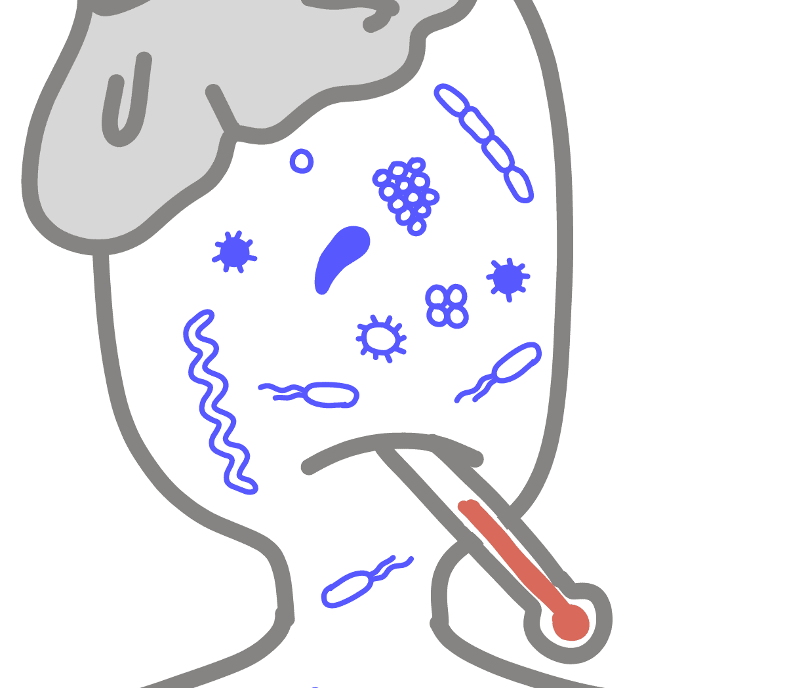
2.3 Pathogen
A pathogen is any organism or agent that causes or can cause disease or illness to its host.
Pathogens can include bacteria, viruses, fungi, protozoa, and parasites.
They can invade a host organism and disrupt normal bodily functions, leading to various health issues.
Different pathogens by IGI from Innovative Genomics Institute licensed under CC BY-NC-SA 4.0
Notes:
Recall the definition of pathogen as any organism or agent that causes or can cause disease or illness to its host.

Slide 100
2.3 Brainstorm: Body response
How does your body respond when sick?
When I’m sick…..
Notes:
Brainstorm ways that your body responds when you are sick. Students should draw on their personal experiences or observations, such as:
Runny or blocked nose
Coughing and sneezing
Fever
Aching joints
Pain
vomiting
Tell students they have learnt about what causes infectious diseases and how they are spread. Now, they will focus on what happens when a person encounters a pathogen.

Slide 101
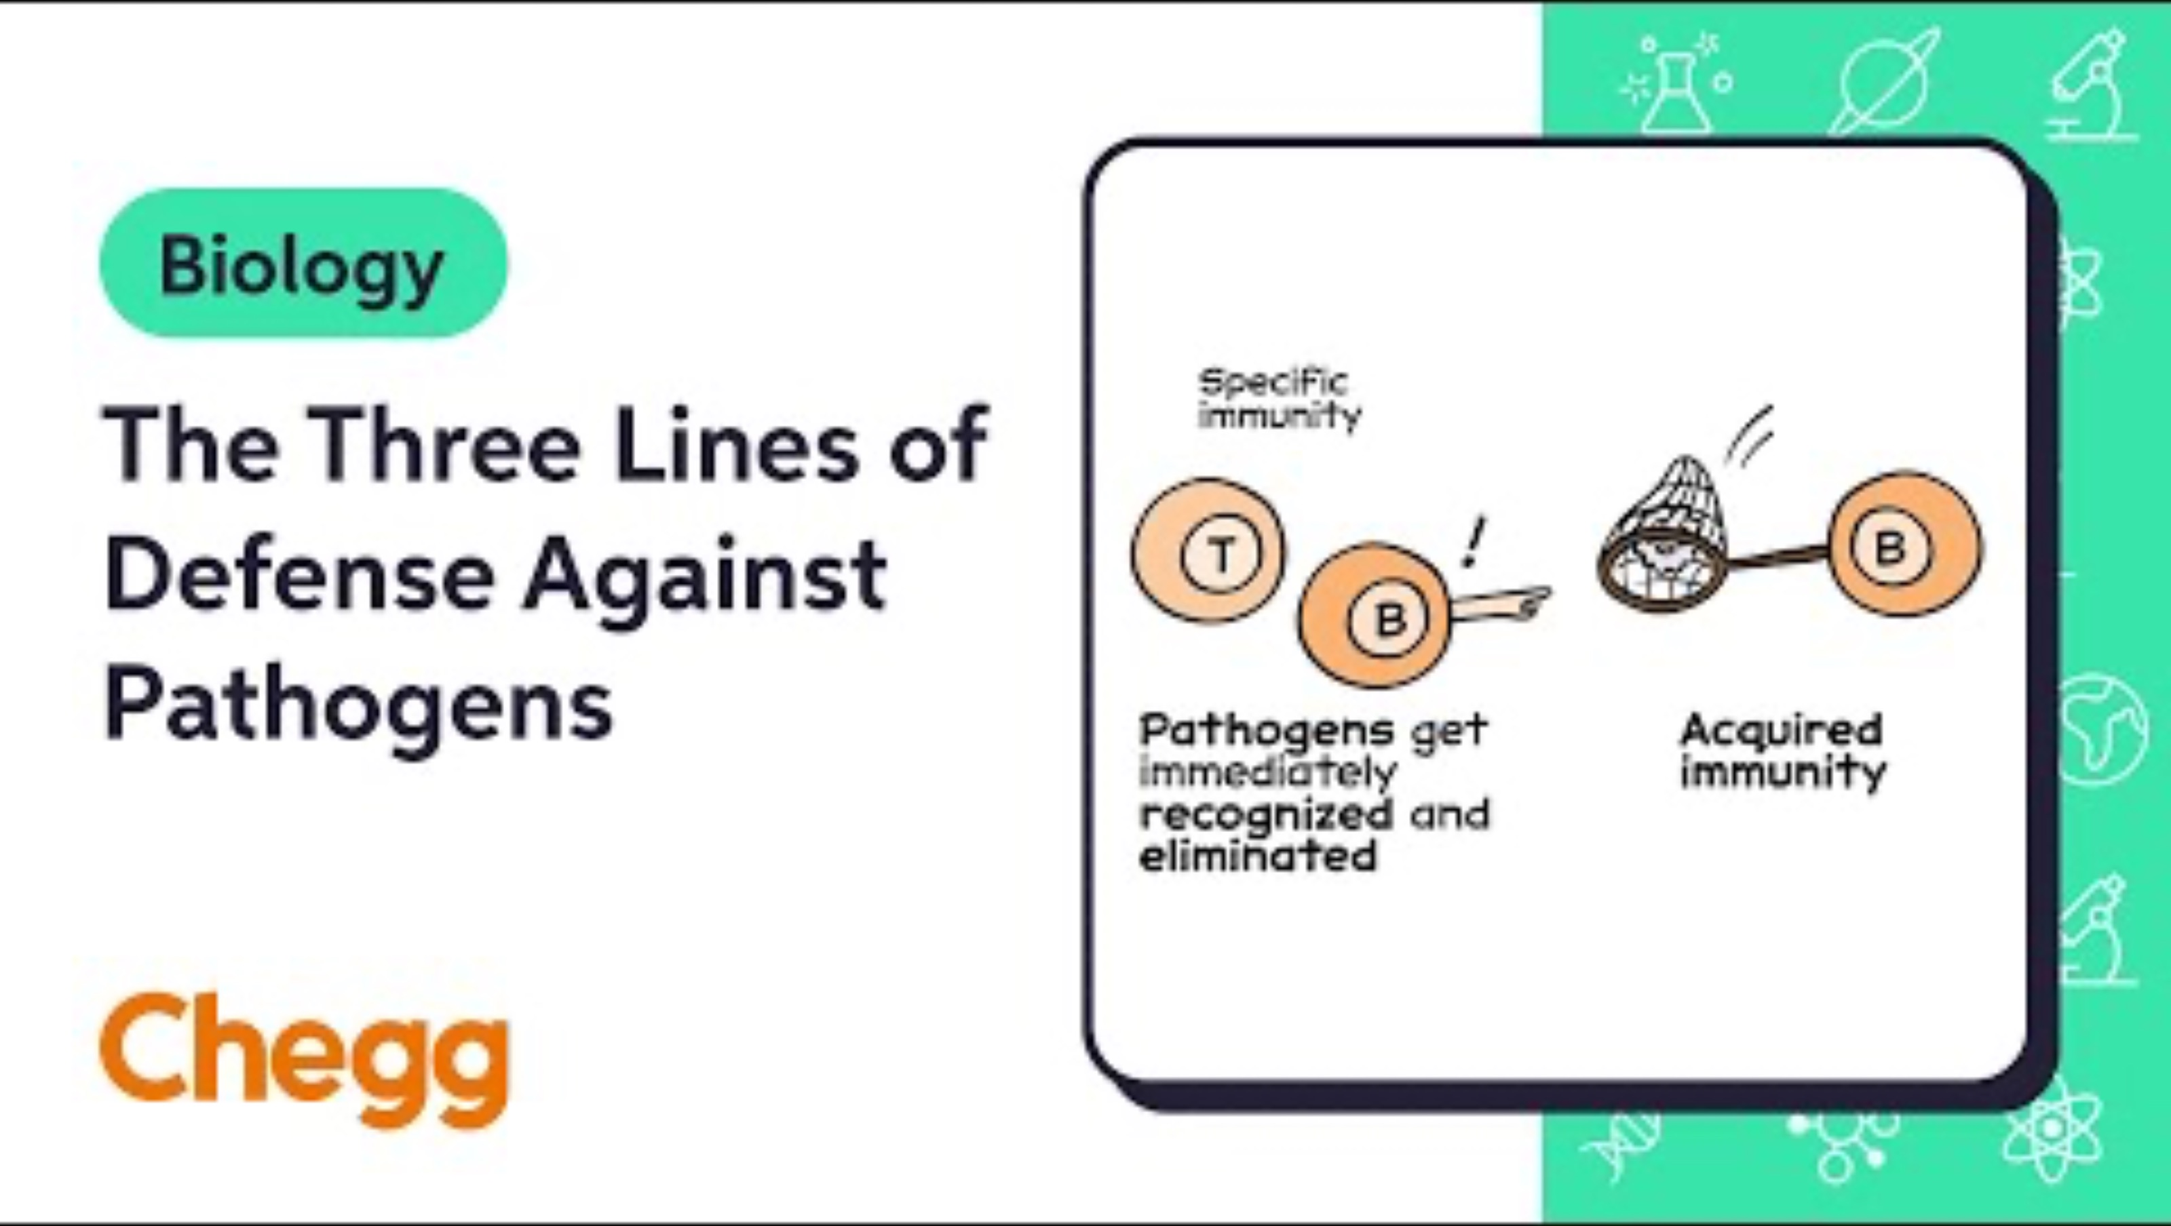
2.3 The three lines of defence against pathogens
Complete the table in the Student resource – The three lines of defence
Notes:
Prompt students to use the headings in Table 1 of the student resource to support them in identifying key points in the video. For example, they need to find information about the first line of defence in the video, whether it is a specific or non-specific immune response and how it functions. Inform students that although other information in the video may be good, it is not useful because it does not relate to what they seek.
Show students the video once without them taking notes, then play the video again and ask students to indicate when a key point has been shown by raising their hand and asking the teacher to pause. Allow time for students to summarise the information (The teacher may need to model or work as a class to extract and summarise key points if students are unable to).

Slide 102

2.3 The first line of defence
A non-specific response
Acts as a physical barrier preventing pathogen entry.
Kill ingested pathogens due to its highly acidic environment (low pH).
Washes microbes from the mouth and contains enzymes to destroy pathogens.
Beneficial microorganisms that outcompete harmful pathogens on skin and mucosal surfaces
Word bank
Saliva
Mucous
Microflora
Traps pathogens and particles to prevent them from entering deeper tissues
Skin
Stomach
Notes:
Note: This slide includes animations. Click on the tiles under the Word bank (in any order) to match it to its meaning.
Go through each term and unpack its function with the class. Emphasise the first line of defence as non-specific, which means that all of these responses will be triggered regardless of the invading microorganism.

Slide 103
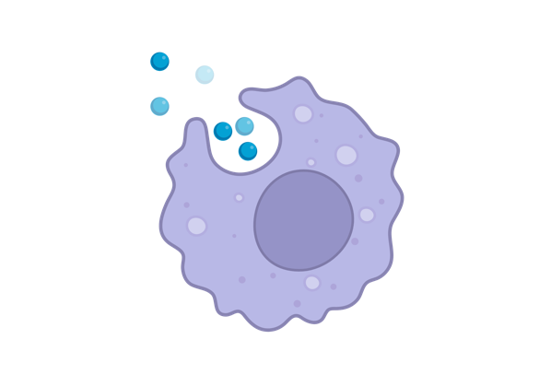
2.3 The second line of defence
A non-specific response
Redness and swelling caused by the body sending white blood cells to fight an infection.
The body heats up to make it harder for pathogens to survive.
A thick yellowish or white liquid made of dead germs and cells.
Word bank
Pus
Phagocytes
Cells that fight infection by destroying pathogens or signaling other immune cells.
White blood cells
Inflammation
Fever
White blood cells that engulf and destroy pathogens.
This work has been generated using BioRender.com. Any copyright subsisting in this work is owned by © State of New South Wales (Department of Education) 2024.
Notes:
Note: This slide includes animations. Click on the tiles under the Word bank (in any order) to match it to its meaning.
Go through each term and unpack its function with the class. Emphasise that the second line of defence is non-specific, like the first line. This second line is activated when a pathogen gets past the first line of defence, and it works to prevent it from getting any further into the tissues of the body by mounting a non-specific attack.

Slide 104
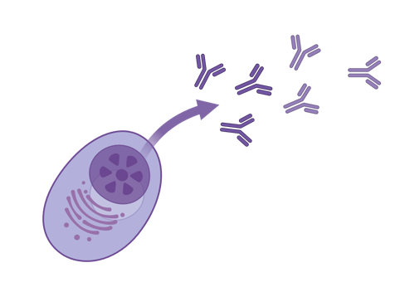
2.3 The third line of defence
A specific response
A special protein that sticks to certain pathogens to help destroy it. They are specific.
Special cells that ‘remember’ pathogens so the body can fight them faster the next time.
A type of white blood cell that makes antibodies to fight specific pathogens.
Word bank
B cells
T cells
The part of the immune system that learns to recognise and attack specific pathogens.
Adaptive immunity
Antibody
Memory cells
A type of white blood cell that destroys infected cells or helps other immune cells.
This work has been generated using BioRender.com. Any copyright subsisting in this work is owned by © State of New South Wales (Department of Education) 2024.
Notes:
Note: This slide includes animations. Click on the tiles under the Word bank (in any order) to match it to its meaning.
Go through each term and unpack its function with the class. Emphasise that the third line of defence is antigen-specific. The body’s immune system builds a memory of the antigens it responded to in the initial response so that future encounters with the same pathogen provoke quicker and stronger responses. This is how you build a natural immunity. Vaccination uses the immune system’s memory to help fight off disease, which will be unpacked in future lessons.

Slide 105

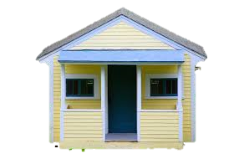



2.3 Differentiation option 1: Building a house analogy
Grass image and Fence image from Rawpixel licensed under CC0 1.0
House image from Picryl licensed under CC0 1.0
Thief image from Vector Portal licensed under CC BY 4.0
Notes:
This modelling activity has been provided to extend students’ understanding of the immune response. There are two levels of analogies provided. The ‘building a house’ analogy and the ‘Your body is a fortress’ analogy unpack the immune response at increasing depth.
The slides for modelling the immune response are animated. There are notes below to guide the discussion of the model.
Inform the students that you bought a block of land and built a house on it with a fence.
Ask students the following questions:
What do the fence and walls of the house represent?
What is the purpose of the fence and windows in relation to intruders?
How does the skin act like the fence for our body?
Describe to students that there are openings in these barriers like the space between the fence palings, the windows and doors.
Ask students the following question:
How do the walls, doors and windows of a house help protect it from intruders?
*CLICK*
Ask students the following question:
Do the fence, walls, doors and windows protect the home from just this thief or all thieves?
Explanation: The fences surround the house like how the skin surrounds the body. It has made it more challenging for the thief, representing the pathogen, to enter the house or human body. The walls provide another layer of protection, similar to how mucous membranes line places such as the respiratory and digestive tracts. The windows and doors represent openings like the skin, eyes, nose, mouth and other openings that have additional defences such as saliva and mucus (to trap and neutralise pathogens), tears and stomach acid. The response will be the same for all intruders/pathogens, not specific for the one thief.
Ask students the following question:
What else could you add to your house to make it more challenging for intruders to get in?
Install locks on windows: Add secure locks to windows to prevent them from being easily opened.
Set up motion-sensor lights: Use lights that turn on when someone approaches to deter intruders.
Use alarms: Place sensors on doors, windows, or other entry points to detect intrusions faster.
Add a guard dog: A trained dog can be a physical deterrent and alert to intruders.
Install surveillance cameras: Set up visible cameras to monitor all entry points and discourage intrusions.
Add stronger fences: Use taller or more durable fences to improve the physical barrier.
If students are unable to answer the question, prompt them to consider security alarms and cameras.
*CLICK*

Slide 106

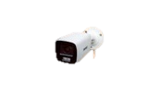




2.3 Building a house analogy 2
Grass image and Fence image from Rawpixel licensed under CC0 1.0
House image from Picryl licensed under CC0 1.0
Thief image and Alarm image from Vector Portal licensed under CC BY 4.0,
Security camera image from Trusted Reviews licensed under CC BY-NC-ND 4.0
Notes:
Ask students the following question:
What is the purpose of an alarm system? If the intruder breaks in, what will it do?
What is the purpose of the security system?
How does our body detect when a pathogen gets past the skin or other barriers in the first line of defence?
*CLICK*
Ask students the following question:
The thief has come back. Will the alarm system and security cameras respond specifically to this thief, or will all intruders trigger the same response?
Explanation: The alarm system and security cameras will have the same response no matter who the intruder is, just like the second line of defence. The alarm system will alert the household (human body) when a thief (pathogen) breaches the first line of defence. Inflammation is represented by the sound of an alarm, causing redness, heat, swelling, and pain, which is the body’s immediate response to fight the pathogen. Security cameras are analogous to the white blood cells, which seek out pathogens and destroy them.
*CLICK*

Slide 107

2.3 Building a house analogy 3
Grass image, Fence image and Security car and personnel image from Rawpixel licensed under CC0 1.0
House image from Picryl licensed under CC0 1.0
Thief image and Alarm image from Vector Portal licensed under CC BY 4.0
Security camera image from Trusted Reviews licensed under CC BY-NC-ND 4.0 ,
Notes:
Tell students that you update your security system so that each time the alarm is triggered, a response is sent to the offsite security company, which has access to your camera footage and live feed.
*CLICK*
Ask students the following question:
How does the upgraded security system help identify the thief? How is this like the third line of defence?
*CLICK*
Ask students the following question:
What does the security team do once they know the thief is inside?
How is this response like the third line of defence?
Explanation: The third line of defence aims to eliminate specific pathogens that the immune system recognises. The upgraded security system helps identify the thief (pathogen) specifically, and the security team (immune cells) responds in a quick and targeted way to remove the threat (destroy the pathogen).

Slide 108
2.3 Building a house analogy
Discussion questions
The immune response is quite complex. What is the advantage of constructing a model to represent it?
Based on your previous use of models and the immune response model. Define scientific models and outline their purpose.
Outline the strengths and limitations of your model in representing the immune response.
Notes:
These are the questions to be used after the house model activity.

Slide 109

2.3 Differentiation option 2 – Your body is a fortress analogy
Castle image from World History Encyclopaedia licensed under CC BY-NC 4.0
Notes:
This is for the alternative extension activity. The image can be used as a stimulus for the activity outlined in TRB2 2.3 Preventing the entry of and responding to pathogens. See Differentiation extension – Modelling the immune response, Option 2: Your body is a fortress!

Slide 110
2.3 Your body is a fortress analogy
Discussion questions
The immune response is quite complex, what is the advantage of constructing a model to represent it?
Based on your previous use of models and the immune response model. Define scientific models and outline their purpose.
Outline the strengths and limitations of your model in representing the immune response.
Notes:
Students work through the discussion questions in relation to the use of models to communicate complex ideas.

Slide 111

2.3 How do vaccinations work?
Watch the video to extract and summarise information to answer the questions.
Identify what vaccines are made up of.
How do vaccines trigger the body’s adaptive immune system?
Outline how vaccines stimulate the body to produce antibodies.
Notes:
Link to video:
https://www.youtube.com/watch?v=rb7TVW77ZCs&t=2s
This video has closed captions and a transcript.
Show students the questions. Tell them they must extract key points from the video, summarise the information and answer the question.
Discuss student responses as a class to ascertain student understanding. If required, reteach how vaccines work, focusing on how a vaccination stimulates the body to produce antibodies.
Sample answers:
a) Vaccines contain weakened or dead bacteria or viruses, or even just part of them.
b) Vaccines trick the immune system into thinking that a real invader has entered the body. This triggers the adaptive immune system to produce antibodies and fight off the invader.
c) Vaccines trigger the immune system the same way that a bacteria or virus would, except that they usually do not cause illness. This allows the body’s immune system to recognise and memorise the pathogen so that it can attack very quickly if exposed to the actual infectious pathogen in the future. This means the body can fight off an infection before it makes you sick.

Slide 112
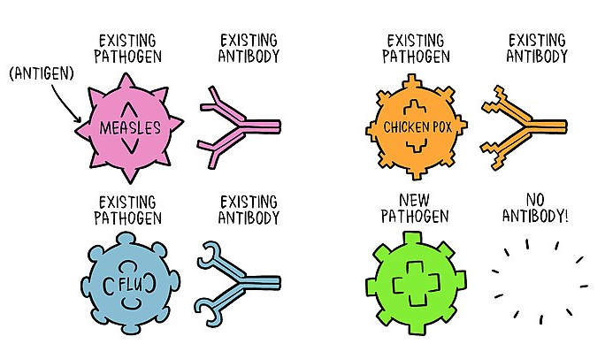
2.3 Think-Pair-Share
How do vaccinations work?
Why do you need an understanding of the immune response to know how vaccines work?
Why is the lag between infection and antibody production an issue? How can vaccines curb this issue?
Image of antibodies and pathogens by World Health Organisation from Wikimedia Commons, licensed under CC BY-SA 4.0
Notes:
Describe the image to students to point out the specific shape of the antibody matching the specific shape on the pathogen’s surface. Outline that these antibodies have a memory of the pathogens due to previous exposure. However, when there is a new pathogen in your body, your immune response needs to develop a memory for it to have a quicker and stronger response when the pathogen is introduced again.
Ask students the question, and allow them to think independently. After independent thinking, instruct students to pair up with the person next to them to discuss. Then, share as a class.
Sample answers:
a)
Understanding the immune response helps you understand how vaccines work because vaccines use the body’s natural ability to fight diseases. When a pathogen enters your body, your immune system identifies it as a threat and produces antibodies to attack it. This process also creates memory cells, which help your body respond faster if the same pathogen reappears.
Vaccines work by introducing a harmless part of a pathogen, like a weakened or inactive form, into your body. This "tricks" your immune system into making antibodies and memory cells without causing the actual disease. So, understanding the immune response explains how vaccines prepare your body to defend itself in the future.
b)
The lag between infection and antibody production is an issue because it gives the pathogen time to multiply and potentially cause damage to the body before the immune system can mount a proper defence. During this lag phase, the immune system identifies the pathogen and activates the necessary processes to produce antibodies, which can take days. If the pathogen spreads too quickly, it may overwhelm the body before the immune system can respond effectively.
Vaccines help curb this issue by introducing a harmless form of the pathogen or its antigens into the body beforehand. This allows the immune system to "practice" recognizing the pathogen and creating memory cells. As a result, if the real pathogen enters the body later, the immune system can respond much faster and produce antibodies immediately, reducing or preventing illness.

Slide 113
2.3 Checkpoint: Vaccines hinge question
How do vaccines help protect the body from infectious diseases?
They inject a live pathogen into the body to cause illness and build immunity.
They contain antibiotics that directly kill pathogens in the bloodstream to prevent infection.
They enhance the body’s physical barriers, such as skin and mucous membranes, to prevent the pathogen from entering.
They stimulate the immune system to produce antibodies without causing the disease.
Notes:
This can be displayed on the board for students to answer using mini whiteboards or by raising their hands for the option they select.
However, this would be best set up in a digital form to analyse student responses quickly. The form could also be set up to give the students instant feedback.
The response to the question is D. Further explanation of the understanding and misconceptions students may have based on their response to this question are in TRB 1.
Below is the explanation for the responses.
A: A common notion is that getting vaccinated makes you very sick with the disease. However, this is extremely unlikely. Most vaccines use inactive pathogens. Hence, it is improbable that the vaccine will cause disease. Instead, the inactive pathogens in the vaccine trick the immune system into thinking there is a threat so it will produce protective antibodies.
B: There is a misconception that the vaccine kills the pathogen it targets. However, this is not the case. Vaccines activate the immune system, helping the body to learn how to defend itself from disease without getting a full-blown infection (People may still get some symptoms).
C: This is a misunderstanding. We know that vaccinations stimulate the immune response and that barriers form the first line of defence in the immune system. However, vaccinations do not work in the first line of defence. They are priming the immune system to mount a quick and specific response against a particular pathogen.
D: This is the correct answer.

Slide 114
2.4 Endemics, epidemics and pandemics
Learning intentions and success criteria
We are learning: | I can:
to distinguish between epidemics, endemics and pandemics. | define epidemic, endemic and pandemic. outline the similarities and differences between epidemics, endemics and pandemics using examples. describe factors that can influence the incidence of epidemics, endemics and pandemics.
to use scientific evidence in the form of data and information to draw evidence-based conclusions. | draw an appropriate conclusion about NERD’s status as a pandemic using scientific evidence.
Notes:
Display this slide at the beginning of the learning sequence. Revisit the slide where appropriate during lesson activities and encourage students to reflect on their progress.

Slide 115
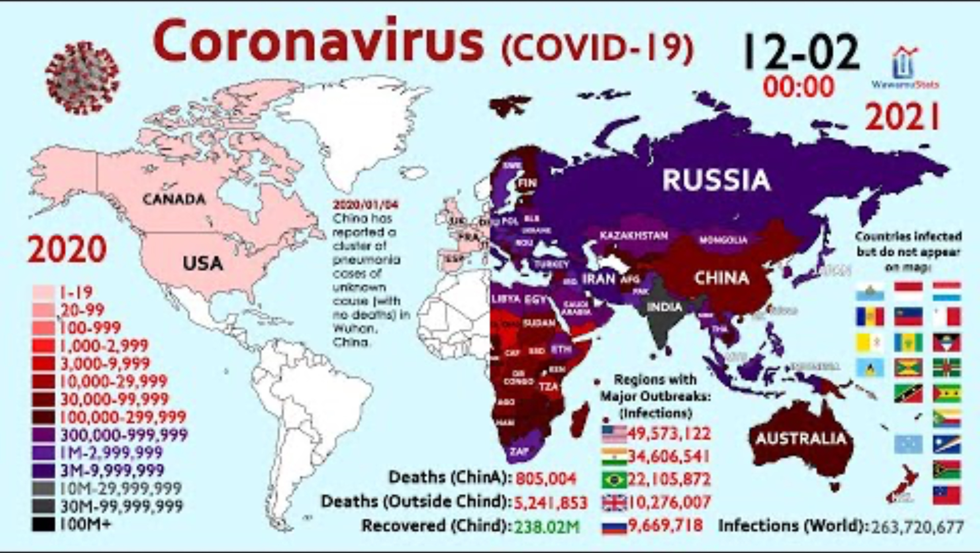
COVID-19
Notes:
As a class, watch ‘The spread of coronavirus in 2 years’ [5:59] video. Recall that cases of COVID-19 were first detected in Wuhan, China, at the end of 2019 and spread quickly across China and beyond. COVID-19 caused a pandemic to be declared on 11th March 2020 by the World Health Organisation as it spread around the globe.

Slide 116

2.4 Defining endemic, epidemic and pandemic?
Endemic: a disease that persists in a community at a consistent level over time.
Epidemic: a temporary occurrence of a disease which spreads rapidly and extensively within a specific population, community, or region, typically affecting a significantly higher number of individuals than expected.
Pandemic: an epidemic that has spread over several countries or continents and affects a very large number of people.
Earth image by Kamilon from Open Clipart, licensed under CC0 1.0
Notes:
Speaker notes:
We describe disease outbreaks by the number of cases and the geographical area affected using the terms endemic, epidemic and pandemic. These terms do not describe the severity of a disease but rather how confined or widespread the disease is.
CLICK – read the definition of endemic from the slide
A disease that persists in a community at a consistent level over time is referred to as endemic. This means that there is a level of disease that is expected in certain populations or areas. For example:
Q Fever is caused by a bacteria and is endemic in rural Australia, especially among people working with livestock.
Leptospirosis is in tropical regions of Australia, particularly in Queensland. It is spread through water contaminated with animal urine, often affecting farmers and outdoor workers.
CLICK – read the definition of epidemic from the slide
An epidemic occurs when a specific population or region has an unusual spike in disease cases. Examples in Australia include:
Ross River Virus is a mosquito-borne disease with occasional outbreaks in specific regions, particularly after heavy rainfall and flooding.
Measles epidemics have occurred in Australia due to declines in vaccination rates or travellers bringing it back with them
CLICK – read the definition of pandemic from the slide
Pandemics are a type of epidemic, but the number of people and geographical locations affected is much higher. Examples of pandemics include:
The COVID-19 pandemic started in 2020 and quickly spread worldwide.
The Spanish flu, from 1918 to 1920 (immediately after WWI), killed over 50 million people worldwide.

Slide 117
2.4 Claim-Evidence-Reasoning (C-E-R)
Claim: NERD is a pandemic.
Evidence: NERD has been reported in 73 countries across six continents.
The total number of cases worldwide exceeds 260,000, with some countries experiencing 5,000–15,000 new cases daily.
Hospitals operating at 120% and workforce operating with 40% absences
Reasoning: Its global reach across many countries and continents demonstrates widespread transmission.
The 260,000 total cases and the rapid daily increases show its potential for exponential growth, a hallmark of pandemics.
The strain on healthcare systems and the economic disruption further show the impact on society.
Notes:
This slide concludes the activity ‘Investigating a fictional disease as a potential pandemic’ in TRB2.
NERD is a pandemic has been animated to appear in the claim section. As a class, co-construct a justification with the data and scientific evidence available from each of the groups. Please note this is a scaffold, you will need to construct a written response as a paragraph based on the information in the scaffold.
This slide has been animated for evidence and reasoning to come up.

Slide 118
2.4 From C-E-R scaffold to a justification
Sample justification
Claim
Evidence
NERD qualifies as a pandemic based on the definition, which requires a disease to spread across multiple countries or continents and involve a large number of cases, causing significant impacts on society. In the scenario provided, NERD has been reported in 73 countries across six continents, with over 260,000 total cases and daily increases of 5,000–15,000 in some regions. Hospitals are operating at 120% capacity, and 40% of the workforce in certain industries is unable to work, demonstrating widespread impacts on society. These facts show that NERD's global reach, rapid case growth, and significant disruptions align with the definition of a pandemic.
Reasoning
Notes:
This is a constructed justification based on the completed C-E-R scaffold on the previous slide. The slide is animated to highlight the conclusion’s components: the claim, the evidence and the reasoning.
There is additional information in TRB 1 about language resources to be used to express cause and effect. You can go through this conclusion and identify language that indicates causal relationships.

Slide 119
2.4 Comparing endemics, epidemics and pandemics
Create a triple Venn diagram to compare endemics, epidemics and pandemics
Feature | Endemic | Epidemics | Pandemic
Geographic spread | Continuous presence of a disease in a specific area | Limited to a region or population | Widespread across the world
Duration | Long-term, persistent over years | Usually short term, typically weeks to months | Temporary but may last months or years
Scale | Generally low numbers. | Can affect a significant number of people in a particular region (contained geographically) | Affects significant portions of the world’s population
Behaviour | Number of cases is stable, or consistent over time. | Sudden or rapid rise of infections in a particular region or population. | Sudden or rapid rise of infections across countries/continents.
Public health impact | Routine health policies manage the disease | May overwhelm local health care systems | Disrupts healthcare on a global scale.
Example | Malaria is endemic in 85 countries (WHO, 2022) | Ebola in West Africa 2014–2016 | Spanish flu 1918-1919 COVID19 2020-2023
Notes:
This slide provides summary information about the classification of disease outbreaks. Students extract information from this table to complete the Student resource – Comparing endemics, epidemics and pandemics triple Venn diagram (See TRB2).
Unpack the examples and explain why they fit the ‘endemic’, ‘epidemic’, and ‘pandemic’ classifications. The speaker notes below are provided to help with this.
Speaker notes.
Malaria is endemic in 85 countries. You may wonder why this does not mean it is a Pandemic… While malaria exists across many countries, the disease only occurs in certain regions within those countries. For example, in rural areas with standing water, mosquitoes that transmit the disease can breed. The incidence of malaria in these locations is predictable.
Ebola was classified as an epidemic because it involved a rapid spike in the number of cases in areas of West Africa. It is not considered endemic as it does not have a constant baseline presence in any region. The Ebola epidemic overwhelmed local healthcare systems in the affected areas and required rapid international support.
The Spanish flu and COVID-19 spread worldwide, leading to their classification as pandemics. The Spanish flu was caused by an influenza A virus which was novel to the human population. It spread worldwide because large numbers of soldiers moved across continents after World War 1.

Slide 120
2.4 Three-way Venn diagram
Topic: Epidemics, endemics and pandemics
Epidemics
Endemics
Confined to a particular area or population
Ongoing, consistent levels of disease in the areas
Found in a particular community or locality
Can affect a significant amount of people within a localised region (contained geographically)
Confined to particular areas
Number of cases is stable, consistent over time
Involve transmission of disease in human populations
Have a sudden increase in cases. Rapid spread
Can be ongoing, lasting extended periods of time
Prevalent across different countries and the world.
Affects large portions of the world's population and can affect millions.
Pandemics
Notes:
As a class, work through the three-way Venn diagram to compare the features and incidences of endemics, epidemics and pandemics.
This slide is animated to bring up the sample response for each section.

Slide 121
2.4 Checkpoint
Compare epidemics, endemics and pandemics including an example of each
Epidemics, endemics, and pandemics all involve spreading infectious diseases but differ in duration and spread. An epidemic refers to a sudden, localised increase in disease cases within a specific region, such as the Ebola outbreak in West Africa (2014–2016), where the spread is rapid but geographically limited. In contrast, an endemic is a disease consistently present in a specific region or population over time, like malaria in sub-Saharan Africa, where case numbers remain stable and predictable. A pandemic, like COVID-19 (2020–2023), is a global outbreak, spreading across multiple countries or continents and affecting large populations over an extended period. While epidemics are short-term and confined to a particular area, endemics are ongoing and geographically limited, and pandemics have a broad, global reach.
Notes:
Students complete a response to the question: Compare epidemics, endemics and pandemics, including examples of each.
This slide is animated to bring up the sample response.
Have students write the question in their book and use information from the previous activities to construct a response.
Show the sample response and provide feedback to students on their responses.

Slide 122
2.5 Using vaccines to prevent diseases
Learning intentions and success criteria
We are learning: | I can:
to describe how vaccines can reduce the incidence and severity of diseases so that we can make informed decisions about health. | outline the use of vaccinations in limiting the incidence and severity of diseases. draw conclusions about the effectiveness of vaccinations in the National Immunisation Program Schedule.
how to analyse data from a graph. | make predictions in a graph by interpolating and extrapolating data. describe trends, patterns and relationships in graphs, using data as evidence.
Notes:
Display this slide at the beginning of the learning sequence. Revisit the slide where appropriate during lesson activities and encourage students to reflect on their progress.

Slide 123
2.5 Investigating vaccine effectiveness
What deems a vaccine as being ‘effective’? Why do you think it is important for the general public to understand this?
What data needs to be collected to determine the effectiveness of a vaccine or an immunisation program?
Analyse how misconceptions about vaccines could negatively impact public health efforts
Notes:
These questions should be projected on the board. When students read through the ‘Investigating Vaccine effectiveness’ text in TRB2, they use these questions to determine the key points in the text. They then summarise the points to answer the questions. (note that some questions will require thinking beyond the information in the text)
Sample responses
a) What deems a vaccine as being ‘effective’? Why do you think it is important for the general public to understand this?
A vaccine is deemed effective if it significantly reduces the chance of getting a disease or prevents severe illness and death in vaccinated individuals. For example, vaccinated individuals may still get sick but often experience less severe symptoms. This is important for the public to understand because some people incorrectly believe vaccines are ineffective when vaccinated people still get the disease. Understanding vaccine effectiveness encourages more people to participate in immunisation programs, reducing the spread and impact of diseases.
b) What data needs to be collected to determine the effectiveness of a vaccine or an immunisation program
Data must compare infection rates, disease severity, and outcomes (e.g., hospitalisations or deaths) in vaccinated versus unvaccinated populations. Additional data, such as the proportion of people who get sick in both groups and the severity of symptoms, helps clarify vaccine benefits. For example, even if 20% of vaccinated people become ill compared to 85% of unvaccinated people, the vaccine is still effective because it prevents illness in a large portion of the population., which helps limit the spread of the disease to others.
c) Misconceptions like “vaccines should prevent all cases of disease” can lead to unrealistic expectations and undermine public confidence in vaccines. If people believe a vaccine is ineffective because some individuals get sick, they may choose not to vaccinate, reducing vaccination rates. This could lead to declining herd immunity, increasing the risk of disease outbreaks and putting vulnerable populations at risk.

Slide 124
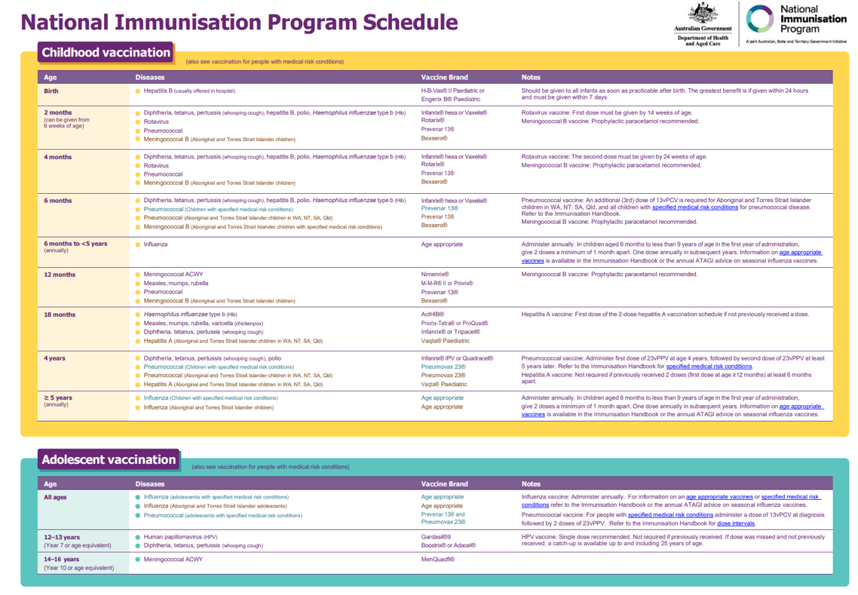
2.5 National Immunisation Program Schedule
Skim and scan the schedule and respond to the questions
Which column identifies:
      the disease
      the name of the vaccine
What is the purpose of having information written in different colours?
When are children vaccinated for diphtheria, tetanus and pertussis (whooping cough)?
Australian Governments National Immunisation Program Schedule
Notes:
This slide supports students understanding of the National Immunisation Program (NIP) (TRB2).
Speaker notes:
Vaccinations on the childhood immunisation schedule have been carefully researched to give the best possible protection against diseases that affect children. The schedule takes into consideration:
the most common childhood illnesses
the severity of the disease at different ages – some diseases are much more severe when babies get them, so therefore they are vaccinated early – some vaccines can only be given once a child’s immune system is further developed; consequently, they are vaccinated at higher age.
how many vaccine doses are required to provide the best protection against the disease?
Diseases like measles and polio are no longer common in Australia, but for them to remain uncommon, then the majority of the population needs to be vaccinated.
Sample answers:
Diseases are listed in column 2, and the vaccine names are listed in column 3.
The different coloured writing helps to communicate additional information. Purple is for everyone, the teal colour writing is for people with specified medical risk conditions, and the red/brown colour highlights additional vaccinations recommended for Aboriginal and Torres Strait Islander Peoples.
The schedule lists vaccination for diphtheria, tetanus, and pertussis (whooping cough) 5 times: 2 months, 4 months, 6 months, 18 months, 4 years and 12-13 years old.
Speaker notes:
Some vaccines like the diphtheria, tetanus and pertussis vaccine require booster shots to ensure immunisation. Immunity to the diseases can be reduced over time, so a booster shot helps to provide longer-term protection from the disease/s. Children get more vaccines today than in the past because more vaccines are available due to advances in medical research.

Slide 125
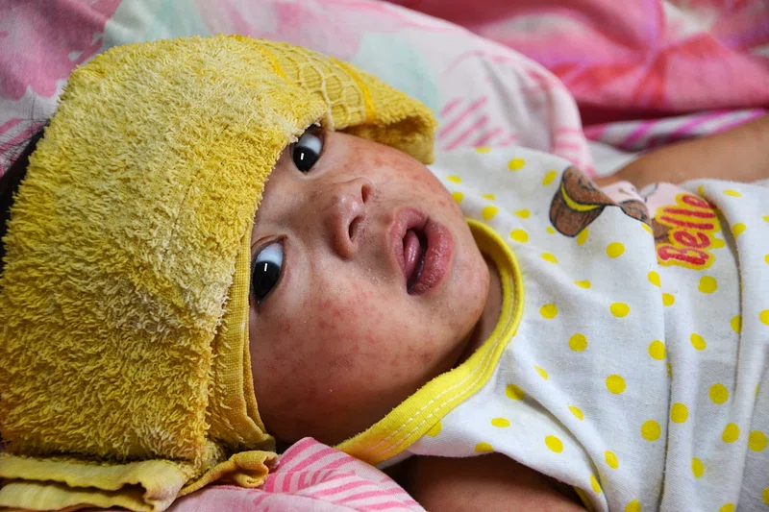
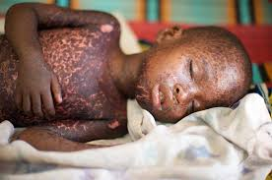
2.5 Measles case study
Baby with measles by Matt Smith from Chiswick Calendar, licensed under CC0 1.0
Child with measles by Julien Harneis From Flickr, licensed under CC BY-SA 2.0
Notes:
This slide shows students the effects of measles if they are not familiar with it.
Speaker notes:
Measles is a very infectious viral infection. It can result in symptoms such as fever, cough, discomfort, a head cold, and a rash, typically starting on the face and upper neck. About 10% of measles cases result in complications, which are more common and severe in people who are less than 5 years of age, chronically ill or adults. In pregnant women, measles can result in miscarriage or early birth of the child. Worldwide, measles is one of the leading causes of death in young children. The World Health Organisation oversees practices put in place to eradicate measles worldwide using vaccination and surveillance strategies.
A vaccine for measles in the NIP has existed since the mid-1970s. The measles, mumps-rubella (MMR) vaccine was added to the NIP in 1989. Measles cases in Australia continue to happen, mostly due to travellers who are not immune coming into Australia and spreading it to other people. This can result in a measles outbreak. To protect the community, as many people as possible need to be vaccinated.

Slide 126
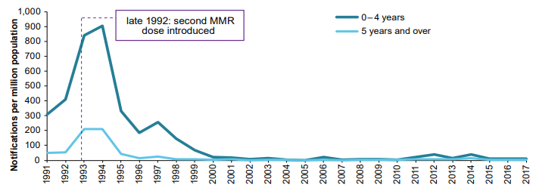
2.5 Measles case study data
Trend from 1995 = Exponential decrease
The rate of measles in the Australian population since 1991 by Australian Institute of Health and Welfare licensed under CC BY 4.0
Notes:
This graph will teach students about trends, patterns and relationships. Refer to the information in TRB2 about how to describe trends and patterns, and relate it to this graph. There is also a student resource to support this in TRB2.
Students have to describe the trend in the graph after the second dose of the MMR Vaccine in the student resource. A red line is animated to show the exponential decrease in cases after the introduction of the second dose of MMR.
Additional speaking notes that give further insight into the data in this graph are outlined below:
Since 1991, Australia has experienced significant changes in measles incidence among different age groups, particularly following the introduction of enhanced vaccination strategies.
1991-1992: Measles notification rates were relatively high across all age groups. In late 1992, Australia introduced a second dose of the measles-mumps-rubella (MMR) vaccine for school-aged children to increase immunity levels.
1993-1994: Despite the additional MMR dose, Australia experienced a nationwide measles outbreak during these years. The outbreak predominantly affected adolescents and young adults, particularly those aged 15 to 19 years, who may have missed vaccination or had waning immunity.
1998: The Australian Measles Control Campaign was launched, focusing on mass vaccination of primary school-aged children (5–12 years) and catch-up vaccinations for older individuals. This campaign significantly reduced measles cases across all age groups.
Post-2000: Measles cases in Australia declined markedly, with the country achieving measles elimination status in 2014, indicating the absence of endemic transmission. However, imported cases occasionally led to outbreaks, primarily affecting unvaccinated individuals or those too young to be vaccinated.

Slide 127
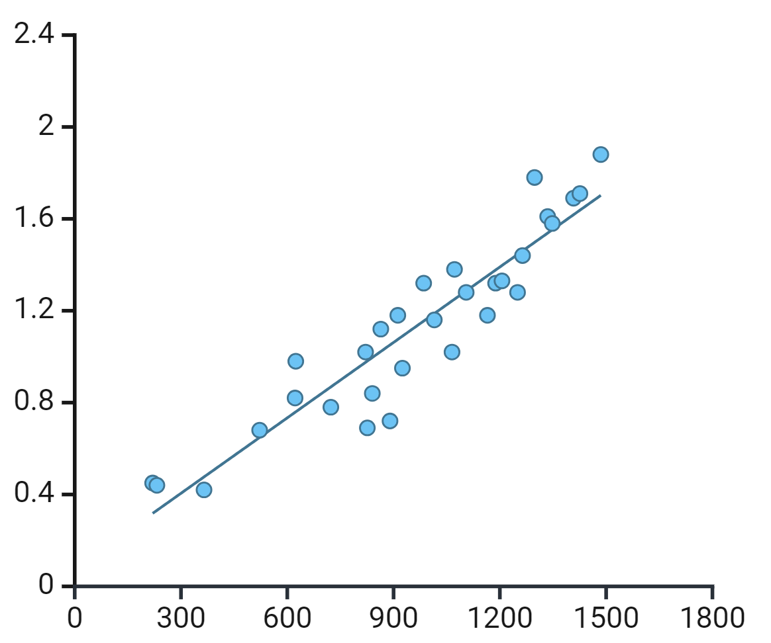
2.5 Interpolate and extrapolate
Interpolate: Using a graph to estimate a value between data points that have been collected. Indicated by the red dot in the graph.
To interpolate within a graph, read up from the x-axis at the data point given and then across to the vertical axis to find the new value.
Extrapolate: Using a graph to predict a data point outside the given graph. Indicated by the green dot on the graph.
To extrapolate a graph, you may first extend the line. Then, read up from the x-axis to the line and across to the y-axis to find the new value.
extrapolating
interpolating
This work has been generated using BioRender.com. Any copyright subsisting in this work is owned by © State of New South Wales (Department of Education) 2024.
Notes:
This graph will teach students about interpolating and extrapolating.
Read through the definitions of interpolate and extrapolate. Use the graph on the slide to show visually what each term means. The slide is animated to show the point first then the dashed line to show how to read to the x axis and y axis to interpolate and extrapolate data.
Support students in interpolating and extrapolating from this graph using the identified points.

Slide 128
2.6 Reducing the incidence and spread of infectious diseases
Learning intentions and success criteria
We are learning: | I can:
to assess strategies used to reduce the spread and number of cases of infectious diseases so that we can maintain a healthy population. | describe a range of strategies used to reduce the incidence and spread of infectious diseases. make a judgement about the success of strategies in reducing the incidence and spread of a selected infectious disease. relate the success of the strategies to the pathogen and mode of transmission.
Notes:
Display this slide at the beginning of the learning sequence. Revisit the slide where appropriate during lesson activities and encourage students to reflect on their progress.

Slide 129
2.6 Strategies for reducing the incidence and spread of infectious diseases
Construct a table to outline each of the strategies for reducing the incidence and spread of infectious diseases.
Strategies for reducing the incidence and spread of infectious diseases
Hygiene practices such as handwashing, regularly cleaning surfaces, safe food handling | Reducing contact with vector
Vaccination | Social distancing
Personal Protective Equipment (PPE) such as masks, condoms | Medication (antibiotics and antivirals)
Quarantine | Water treatment
Contact tracing | Public health education
Notes:
This slide supports activity 2.6, outlined in more detail in TRB 2.
This slide contains a list of strategies that can be used to reduce the incidence and spread of infectious diseases. Please note that not all strategies need to be unpacked by the students. You can select a list for students to look at depending on the pace and capability of your class. However, all students will need to do the same strategies for the purpose of the activity. Modify the slide to suit your class.
Instruct students to construct a table with the strategies outlined on this slide in the first column and space for them to outline the strategy in the second column. Students use research to complete the outline for each strategy.
Facilitate a sharing session to draw students to the conclusion that different diseases require different strategies to reduce the incidence and spread of disease.

Slide 130
2.6 Reducing the incidence and spread of an infectious disease
For your allocated infectious disease, you will need to:
Identify the pathogen that causes it.
Outline the mode of transmission.
For each strategy to reduce the incidence and spread of disease, describe if and how it would be used for your allocated disease. Support your response with reasoning.
Infectious disease examples
Chickenpox Whooping cough Athlete’s foot Pinworms Flu Gastroenteritis Covid-19 Malaria Chlamydia Variant Creutzfeldt-Jakob disease (CJD)
Notes:
Allocate each student with a disease for their research. Each disease should be selected at least once across the class before students are allowed to double up. Students use the information gathered in their research to respond to each of the questions outlined on the slide.

Slide 131
2.6 Disease strategies discussion questions
Do all strategies to work for every infectious disease? Why/Why not?
How does the pathogen and mode of transmission influence the strategies used to reduce the incidence and spread of the infectious disease? Use examples to support your answer.
Notes:
Jointly construct responses to the following questions to draw together the students’ research on strategies for preventing various infectious diseases.

Slide 132
2.6 Assessing strategies to reduce incidence and spread
Writing a response
Assess strategies used to reduce the incidence and spread of the infectious disease you studied.
Assess: Make a judgement of value, quality, outcomes, results or size
Key concepts and terms to include in your response:
Incidence, spread, effective, disease (including specific information about the chosen disease), transmission, strategies (refer to specific ones), reducing
Notes:
Read the question on the slide to the students and unpack it. You may want to use a strategy such as V-C-F-S to deconstruct the question and create a plan. More information about this is in TRB1, 1.6, Comparing the endocrine and nervous systems. To answer the ‘assess’ question, tell students they will need to make a judgement about the effectiveness of the strategies in reducing the incidence and spread of their chosen infectious disease. Students must provide reasons, including data, to support their response.
A sample response to this question is provided in TRB2 2.6 Strategies to reduce the incidence and spread of disease.

Slide 133
2.7 Aboriginal and Torres Strait Islander Peoples’ use of plants
Learning intentions and success criteria
We are learning: | I can:
to describe how plants were used by Aboriginal and Torres Strait Islander Peoples for disease management. | identify plants used by First Nations Peoples to prevent or control diseases. describe how the plants are prepared for use as a medicine. describe how plants were used to prevent or control diseases.
Notes:
Display this slide at the beginning of the learning sequence. Revisit the slide where appropriate during lesson activities and encourage students to reflect on their progress.

Slide 134

2.7 Using plants to prevent or control diseases
Watch the video to extract and summarise information to answer the questions below in their book
Learn about how Aboriginal People use Native Plants
Identify two plants that First Nations Peoples used to prevent or control diseases.
How did First Nations Peoples use plants to prevent or control diseases?
What else did First Nations Peoples use plants for?
Duration: 10:02
Notes:
Link to video: https://www.youtube.com/watch?v=-muIoWofsCE
This video has closed captions and a transcript.
Show students the questions. Tell them they must extract key points from the video to summarise the information and answer the question. Play the video and pause at key points for students to construct their responses.

Slide 135
2.7 Checkpoint question
Write a response to the checkpoint in your book
How do Aboriginal and Torres Strait Islander Peoples’ use plants to prevent or control disease? Describe one specific example and explain how it works.
Notes:
Ask students to write the question and answer in their book.
Facilitate class discussion using the sample response in TRB2.

Slide 136
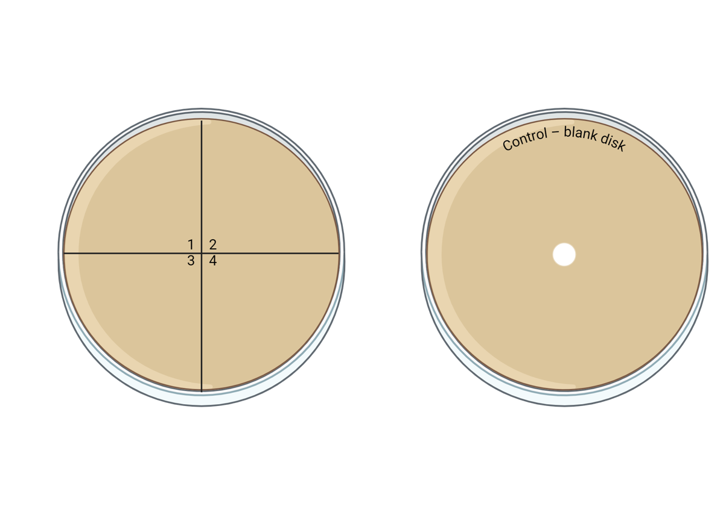
2.8 Assessment task
Unpacking the assessment task
Notes:
The slides for the assessment task are designed to be used in conjunction with the assessment task section of the program.

Slide 137
2.8 Antibiotic susceptibility test
Table 1: Antibiotic susceptibility test for E.coli.
Antibiotic name | Zone of inhibition (mm)
Amoxicillin (AMC)
Cephalothin (CF)
Chloramphenicol (C)
Ciprofloxacin (CIP)
Clindamycin (CC)
Erythromycin (E)
Oxacillin (OX)
Penicillin G (P)
Streptomycin (S)
Tetracycline (TE)
Tobramycin (TM)
Trimethoprim sulfa (SXT)
Notes:
Students copy this table in their books to complete the simulation: https://learn.chm.msu.edu/vibl/vibl/KirbyBauer/KirbyBauer_HTML5Canvas.html

Slide 138
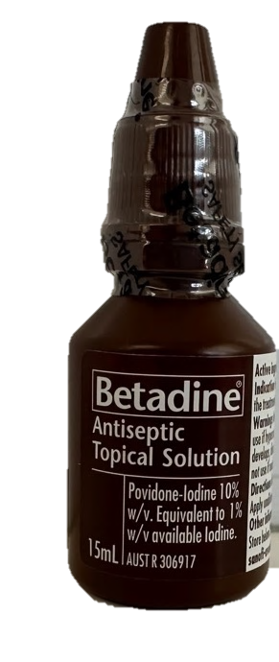
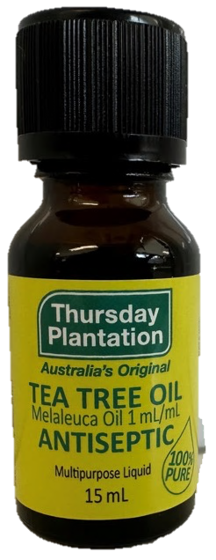
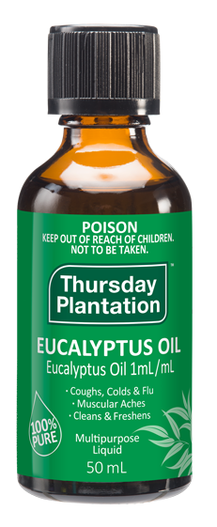
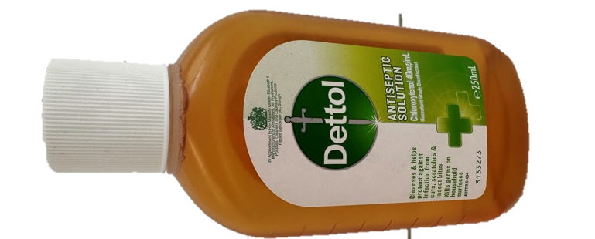
2.8 Antiseptic substances
Notes:
This shows the antiseptic substances students will be testing in the assessment task.

Slide 139
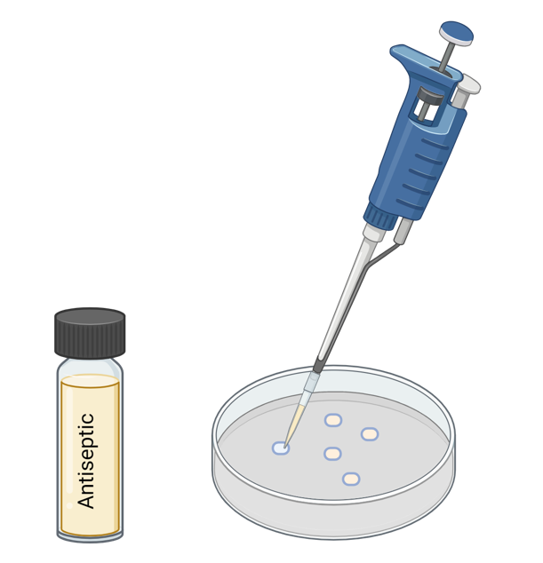
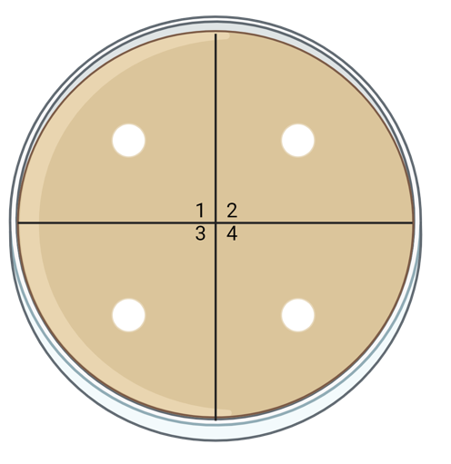
2.8 Disc diffusion method
Definition: a method of placing paper discs soaked with antiseptic substances on an agar plate with bacteria to see what the bacteria is susceptible to.
Authors own image created with BioRender.com
Notes:
The definition of disc diffusion method. Show this to students when unpacking the assessment task so they can visualise part of the process.

Slide 140
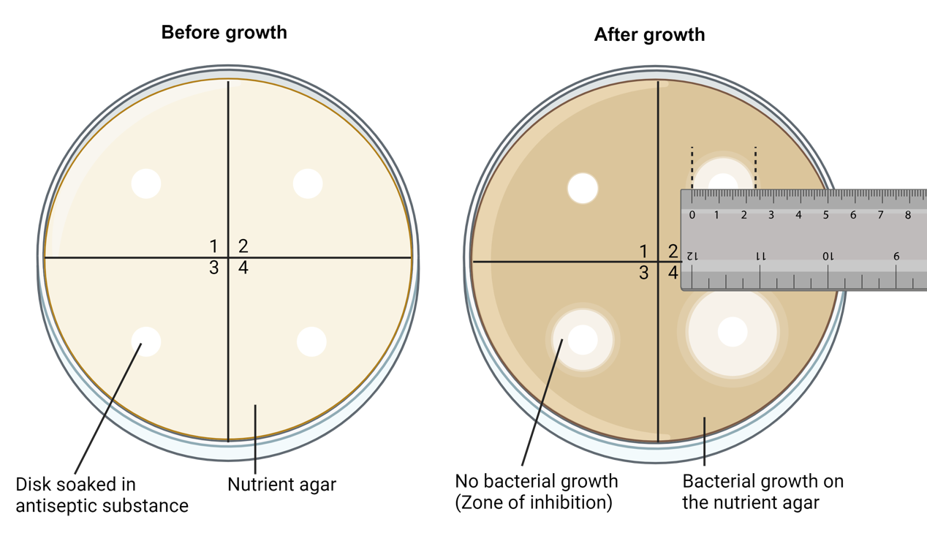
2.8 Defining the disc diffusion method
Definition: a method of placing paper discs soaked with antiseptic substances on an agar plate with bacteria to see what the bacteria is susceptible to.
Created with BioRender.com
Notes:
The definition of the disc diffusion method. Show this to students when unpacking the assessment task so they can visualise part of the process. This slide also shows how to measure the zone of inhibition.

Slide 141
3. How do we effectively prevent and manage non-infectious diseases?
Notes:
Content in this section aligns with essential question 3 in the program of learning and Teacher resource book 3 (TRB3)

Slide 142
3.1 What is a non-infectious disease?
Learning intentions and success criteria
We are learning: | I can:
to differentiate between infectious and non-infectious diseases so that we can understand how to appropriately prevent, manage and control them. | define non-infectious disease. identify causes of non-infectious diseases. distinguish between infectious and non-infectious diseases.
Notes:
Display this slide at the beginning of the learning sequence. Revisit the slide where appropriate during lesson activities and encourage students to reflect on their progress.

Slide 143
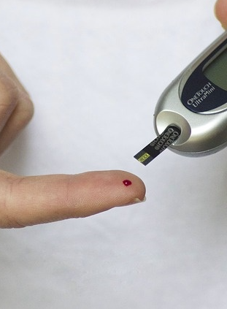
3.1 Defining non-infectious disease
Non-infectious disease: A medical condition that cannot be transmitted from one person to another. Genetic factors, lifestyle choices, environmental factors, or a combination of these factors typically cause these diseases. Examples include heart disease, skin cancer, and asthma.
Person checking blood glucose levels by Daniel Max from Flickr Commons, licensed under CC By 4.0
Notes:
Discuss the definition of non-infectious disease with the class and outline how a non-infectious disease differs from infectious diseases.
Inform students that this image shows a blood glucose monitoring device used to measure blood sugar levels, a key part of managing diabetes. A drop of blood from a fingertip is applied to a test strip inserted into the device, which detects the blood glucose levels. Regular monitoring helps individuals with diabetes maintain their blood sugar levels within a healthy range and adjust their treatment plans accordingly.

Slide 144
3.1 Classifying causes of non-infectious diseases
Many factors can cause non-infectious diseases. They may be classified in these three categories:
Genetic
Inherited or spontaneous changes in DNA that predispose individuals to certain non-infectious diseases
Examples:
Inherited mutations
Acquired mutations
Chromosomal abnormalities
Environmental
External environmental factors contribute to the development of non-infectious diseases by direct exposure to harmful agents or by influencing health outcomes.
Examples:
Pollution
Exposure to toxins
Radiation
Socioeconomic factors
Lifestyle
Personal choices or behaviours that contribute to the onset or progression of non-infectious disease.
Examples:
Diet and nutrition
Physical inactivity
Drugs and alcohol
Notes:
This slide is animated to introduce the definition, followed by the examples for each category.
Speaker notes:
Many factors can cause non-infectious disease. The causes of non-infectious diseases can be classified as *CLICK* genetic, *CLICK* environmental, *CLICK* and lifestyle.
*CLICK*
Genetic risk factors include:
Inherited mutations in genes such as:
BRCA genes that increase the risk of breast cancer
CTFR gene causes cystic fibrosis, a genetic disorder affecting the lungs and digestive system.
Acquired mutations: this means that the mutation was acquired in an individual’s lifetime rather than inherited. They can be caused by:
Random DNA replication errors when cells are dividing
Infections – some infectious diseases can cause mutations in the DNA which lead to cancer (like HPV and cervical cancer)
Aging – Normal cellular processes can slow down or become disrupted over time.
Mutations caused by exposure to carcinogens (see the cross-over with environmental risk factors?).
Chromosomal abnormalities
An additional chromosome 21 causes Down’s syndrome
A missing X chromosome causes Turner syndrome
*CLICK*
Environmental risk factors include:
Pollution, such as air pollution, can cause or trigger respiratory diseases like asthma and lung cancer.
Exposure to toxins – Long-term exposure to asbestos can lead to mesothelioma, and lead exposure can cause neurological (nerve) damage. Asbestos was used in many building materials until it started to be regulated in the 1970s.
Radiation – Prolonged exposure to ultraviolet (UV) radiation increases the risk of skin cancer
Seriocomic factors include living conditions and access to healthcare. Poor living conditions and lack of access to healthcare can exacerbate (make worse) chronic illness
*CLICK*
Lifestyle risk factors include:
Diet and nutrition – not eating a balanced diet can lead to nutritional deficiency, which can cause further problems. For example, a lack of calcium can contribute to osteoporosis. High-fat diets can contribute to cardiovascular disease.
Physical inactivity increases the risk of many diseases
Substance abuse can lead to lung cancer in the case of smoking, and liver cirrhosis in the case of excessive alcohol consumption
Many non-infectious diseases result from interactions among multiple risk factors, not just from one category. For example:
Cardiovascular disease can arise from a genetic predisposition, exacerbated by environmental pollution and lifestyle choices like a poor diet and physical inactivity.
Cancer may develop due to inherited mutations, exposure to carcinogens (like radiation or tobacco smoke), and lifestyle factors such as diet or alcohol consumption.

Slide 145
3.1 Causes of non-infectious disease
Exposure to second hand smoke
Exposure to UV radiation
High stress
Drinking alcohol
Inherited conditions
Eating an unhealthy, unbalanced diet
Poor sleep
Physical inactivity
Exposure to toxins
Family history
Urbanisation resulting in less opportunity to exercise
Air pollution
Smoking
Changes in genes
Notes:
Ask students to construct a table with three columns: one for genetic causes, environmental causes and lifestyle causes. Students then classify each risk factor on the slide as genetic, environmental or lifestyle. Call upon students to contribute their answers.

Slide 146
3.1 Causes of non-infectious disease (answers)
Answers
Genetic | Environmental | Lifestyle
Family history Inherited conditions Changes in genes | Exposure to second hand smoke Air pollution Urbanisation resulting in less opportunity to exercise Exposure to UV radiation Exposure to toxins | Eating an unhealthy, unbalanced diet Physical inactivity Drinking alcohol Smoking Poor sleep High stress
Notes:
Show students the sample answers and then discuss any that students may have placed incorrectly.

Slide 147
3.1 Type 2 Diabetes
Can you identify the risk factors?
Type 2 diabetes is a non-infectious disease where the body loses its ability to produce enough insulin in the pancreas, making it unable to regulate blood sugar levels. It typically occurs in adults over the age of 45. However, it is more common in the younger population. Type 2 diabetes can lead to other severe health issues if it is not managed well, including cardiovascular disease, kidney disease, nerve damage, vision loss, infections and amputations.
The disease has strong genetic and family-related risk factors and is more common in people of particular ethnic backgrounds. However, it is also associated with leading an unhealthy lifestyle, with the risk increasing in people who are overweight, eat a poor diet, are physically inactive and have high blood pressure. Type 2 diabetes can often be managed by healthy eating and regular physical activity. Over time, some people may need to have medication to manage Type 2 diabetes and reduce the likelihood of them experiencing complications.
Notes:
Read the information about Type 2 Diabetes and ask students to make note of any risk factors.
This slide is animated to highlight the risk factors one at a time.
You can also discuss with students how some risk factors are interlinked with others. For example, urbanisation can contribute to people’s physical inactivity. Urbanisation can lead to less access to parks and green spaces for people to do the recommended amount of physical activity.

Slide 148
3.1 Type 2 Diabetes summary
Example presentation slide
Type 2 diabetes is a non-infectious disease where the body becomes resistant to the effects of insulin and loses its ability to produce enough insulin in the pancreas. As a result, the body is unable to regulate blood sugar levels.
Symptoms
Early symptoms can include:
Increased thirst
Frequent urination
Fatigue
Other symptoms may include:
Blurred vision
Slowed healing or infections
Tingling or numbness in hands and feet
What risk factors contribute to causing the disease?
Genetic factors
Family history of Type 2 diabetes
Specific genes may influence how the body processes insulin
Lifestyle factors
Unhealthy diet of highly processed food, sugary foods and drinks
Physical inactivity can cause weight gain, which can result in insulin resistance
Environmental factors
Urbanisation leading to sedentary lifestyles and access to high-calorie fast foods
Treatment/ Management
Improved diet with a focus on reducing sugary foods and highly processed foods
Regular physical activity
Medications to regulate blood sugar levels
Notes:
This slide is a sample response that can be used as ‘what a good one looks like’ for the activity.

Slide 149
3.1 Non-infectious disease summary slide template
Change the heading above to the name of the non-infectious disease and then delete this sentence
[insert a description of the disease here]
Symptoms
[insert symptoms]
What risk factors contribute to causing the disease?
Genetic factors
[outline of the factor that contributes to the disease]
Lifestyle factors
[outline of the factor that contributes to the disease]
Environmental factors
[outline of the factor that contributes to the disease]
Treatment/ Management
[insert treatment]
Notes:
This template slide can be assigned to students to work collaboratively to produce a presentation for the class. Note that not all diseases will have risk factors from all three categories. For example, a genetic disease such as cystic fibrosis will not have lifestyle factors and environmental factors that contribute to causing the disease. Lifestyle and environmental factors may worsen the symptoms of the disease. This distinction should be made clear to students.

Slide 150
3.1 Checkpoint: Disease
Is it a non-infectious or infectious disease?
This disease is caused by bacteria and can be transmitted through contaminated food
A genetic mutation leads to this disease, and it can be passed from parents to children
Poor diet and lack of exercise are leading causes of this disease
This disease spreads through the air when an infected person coughs or sneezes. The droplets from their cough/sneeze contain virus particles
A fungus infects the skin, causing red, itchy patches
This disease is caused by a virus and can be prevented through vaccination
Long-term exposure to harmful chemicals increases the risk of developing this disease
Notes:
This slide is animated to bring up one scenario at a time.
After each scenario, ask students to use mini whiteboards to indicate if it is an infectious or non-infectious disease.
Discuss their choices, ask for their reasoning and provide feedback. The answers and reasoning are outlined below.
Bacteria cause this disease and can be transmitted through contaminated food: Infectious
Infectious because it is caused by bacteria, a type of pathogen, that can be transmitted via contaminated food.
A genetic mutation leads to this disease, and it can be passed from parents to children: Non-infectious
Non-infectious because it results from inherited changes in genes, not caused by a pathogen.
Poor diet and lack of exercise are the leading causes of this disease: Non-infectious
Non-infectious because it develops due to lifestyle choices rather than infection by pathogens.
This disease spreads through the air when an infected person coughs or sneezes. The droplets from their cough/sneeze contain virus particles: Infectious
Infectious because it is caused by a viral pathogen that spreads via airborne droplets.
A fungus infects the skin, causing red, itchy patches. Infectious
Infectious, because it is caused by a fungal pathogen that can spread through contact.
A virus causes this disease and can be prevented through vaccination: Infectious
Infectious, because a viral pathogen causes it.
Long-term exposure to harmful chemicals increases the risk of developing this disease: Non-infectious
Non-infectious, because environmental toxins, not any pathogen, cause it.

Slide 151
3.1 V-C-F-S strategy
Abbreviation | Term | Explanation
V | Verb | Identify the verb/s and the requirements of the verb This helps to determine the requirements of the response. For example, is a judgment needed? (If a judgment is required, identify points for and/or against it.)
C | Content | Identify the content by circling and annotating keywords that relate to what you have learnt.
F | Focus | Outline the focus of the question Is it related to a particular context or a stimulus? Does the question contain a how or a why? This means you need to draw relationships between ideas.
S | Singular or Plural | Identify if words in the question are singular or plural. Are there words that indicate the response needs to refer to two or more ideas? If the question states to give examples, the ‘s’ at the end of example indicates more than one.
Notes:
To recall how to deconstruct a question using V-C-F-S, use this table.
Discuss the deconstruction of the question using V-C-F-S. Link the points below to plan a response.
First, look at the verb/s. Distinguish means to recognise or note/indicate as distinct or different from OR to note differences between.
The content identified is infectious and non-infectious diseases. This means we must make statements looking at the difference between infectious and non-infectious diseases.
The focus has been identified as ‘between’ and indicates the need for examples. This means we are looking at how infectious and non-infectious diseases are different to each other.
Words given are plural. It asks for examples, so students should use more than one example.

Slide 152
3.1 Marking criteria
Marks | Criteria
3 | Distinguishes between infectious and non-infectious diseases by providing relevant differences and specific examples. Use of correct and precise scientific terminology to construct a cohesive response.
2 | Distinguishes between infectious and non-infectious diseases by providing a relevant difference and a specific example. OR Distinguishes between infectious and non-infectious disease by providing relevant differences. AND Use of correct and precise scientific terminology.
1 | Outlines features of infectious and/or non-infectious diseases. OR Provides a distinct difference between infectious and non-infectious diseases. OR Provides an example of an infectious and/or non-infectious disease.
Notes:
Deconstruct these marking guidelines with students. Use this along with the deconstructed question using VCFS to devise a plan for writing the response. More information about this is available in TRB3.

Slide 153
3.1 Distinguishing cohesive devices
Cohesive devices are words or phrases used to connect ideas in a text
different
contrasted with
however
although
unlike
on the contrary
conversely
whereas
in contrast
on the other hand
while
Notes:
Speaker notes:
Cohesive devices can indicate addition, contrast, cause and effect, sequence, comparison, and a conclusion. To distinguish between infectious and non-infectious diseases, we use contrast cohesive devices. Some examples are outlined in this slide.

Slide 154
3.1 Sample response with word bank
Using examples, distinguish between infectious and non-infectious diseases
Word bank: genetic influenza cannot non-infectious transmitted
infectious diabetes
______________ diseases are caused by pathogenic microorganisms or agents such as bacteria, viruses, fungi, or parasites, while _____________ diseases result from _____________, environmental, or lifestyle factors. Infectious diseases, such as _________ or tuberculosis, can be ___________ from one individual to another via indirect or direct modes of transmission. In contrast, non-infectious diseases, such as ______________ or cancer, ___________ be transmitted between individuals.
Infectious
non-infectious
genetic
influenza
transmitted
diabetes
cannot
Notes:
For the differentiated sample response with words missing, students rewrite the response in their book and fill in the blanks using the word bank.
The slide has been animated to complete the sample response.
Identify the cohesive devices in the response – ‘while’ and ‘In contrast’.

Slide 155
3.2 Non-infectious diseases in Australia
Learning intentions and success criteria
We are learning: | I can:
to analyse data to draw conclusions about common non-infectious diseases in Australia. | identify common non-infectious diseases in Australia. describe factors contributing to the incidence of a non-infectious disease in Australia. compare the incidence data of the non-infectious disease in different sexes and age groups.
to explain our scientific ideas clearly to the intended audience using evidence to support our arguments. | create a presentation to communicate scientific understanding to a specific audience. identify scientific evidence from secondary sources to support communicated ideas.
Notes:
Display this slide at the beginning of the learning sequence. Revisit the slide where appropriate during lesson activities and encourage students to reflect on their progress.

Slide 156
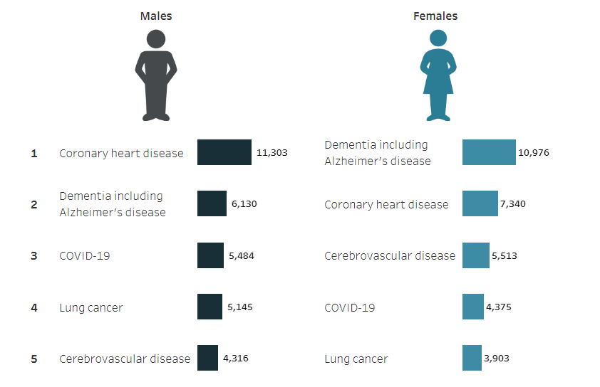
3.2 Leading causes of death in Australia
Leading causes of death in Australia by the Australian Institute of Health and Welfare licensed under CC BY 4.0
Notes:
Describe some of the information in the graphic to the students:
The numbers represent the deaths in Australia for males and females in 2022.
Coronary heart disease involves blockages in the arteries of the heart
Dementia is an umbrella term that describes diseases that affect memory, thinking, and the ability to perform daily activities. Alzheimer’s disease is the most common form of dementia.
In 2022, COVID-19 was still a large cause of death. In 2024 and beyond COVID-19, it is unlikely to feature in the top 5 underlying causes of death due to significant interventions such as vaccination programs.
Unpack the term cerebrovascular. ‘Cerebro’ refers to the large part of the brain, and ‘vascular’ means arteries and veins, so cerebrovascular diseases are disorders of the blood vessels supplying the brain and its covering membranes. An example of cerebrovascular disease is stroke. A stroke is a sudden blockage to an artery supplying blood to the brain or a ruptured artery that begins to bleed.
Instruct the students to work through the questions in the student resource with reference to the graphic. Pause at points to discuss the responses with students.

Slide 157
3.2 What makes a quality presentation?
Presentation component
Ensure your content is well-researched, reliable and summarised in your own words.
The flow of your presentation is logical, with a clear introduction, body and conclusion.
All information presented is relevant to the topic.
Use images that support your explanation of concepts. These could be graphs as well.
Provide the main points on the slide and verbally elaborate on these to avoid cluttering on slides.
Maintain a consistent design and layout throughout your presentation.
Use clear and legible fonts and colours.
Notes:
To be projected on the board when teaching students what a quality presentation is.

Slide 158
3.2 Delivering a quality presentation
Delivery component
Test all technical equipment before your presentation (Projector, laptop).
Have a backup plan in case of technical difficulties (For example, handouts).
Ensure you have rehearsed for smooth delivery and timing.
Engage with the audience through eye contact.
Speak clearly and at a moderate pace so people can follow what you are saying.
Be prepared to answer questions at the end of your presentation.
Notes:
To be projected on the board when teaching students what a quality presentation is.

Slide 159
3.3 Reducing the incidence of non-infectious diseases
Learning intentions and success criteria
We are learning: | I can:
to describe strategies used in Australia to prevent non-infectious diseases so that we understand what it takes to be healthy. | identify a range of non-infectious diseases based on the strategies used to prevent them. describe different strategies that have been implemented to reduce the incidence of non-infectious diseases. compare the strategies used to reduce the incidence of infectious and non-infectious diseases.
Notes:
Display this slide at the beginning of the learning sequence. Revisit the slide where appropriate during lesson activities and encourage students to reflect on their progress.

Slide 160
3.3 Disease 1
Lung Cancer
Which non-infectious disease is this?
Graphic health warnings
Advertising bans
Plain packaging laws
High tobacco taxes
Smoke-free laws
Anti-smoking campaigns such as ‘Quit for you-Quit for Two’, targeted at pregnant women.
Quitline services
Awareness campaigns
Asbestos regulations
Support groups
Research funding
Surveillance programs
Health education
Notes:
This slide has been animated to allow one strategy to come up at a time and the answer to come up at the end.

Slide 161
3.3 Disease 2
Coronary heart disease
Which non-infectious disease is this?
Nutritional education to promote healthy eating and portion control
Education about the importance of physical activity for your heart
Anti-smoking campaigns
Regular health screenings
Community health programs to promote heart healthy living
Regulation of harmful products through policy for unhealthy foods high in saturated fats and trans fat.
Increased taxes on sugary drinks, tobacco, unhealthy foods.
Stress management including awareness of stress in workplaces
Urban planning to ensure cities are designed with spaces that promote physical activity through parks, walking paths and cycling lanes.
Public awareness campaigns.
Health education incorporated into curriculum to teach children about leading a heart healthy lifestyle.
Notes:
This slide has been animated to allow one strategy to come up at a time and the answer to come up at the end.

Slide 162
3.3 Disease 3
Type 2 diabetes
Which non-infectious disease is this?
Nutritional education to promote healthy eating.
Education about the importance of physical activity.
Access to weight loss programs.
Regulation of harmful products through policy for unhealthy foods
high in sugar or very processed.
Increased taxes on sugary drinks and junk food.
Regular health screenings for people who are at a higher risk.
Community health programs to provide accessible screening services, particularly in areas of low socioeconomic status.
Awareness campaigns about the risk factors and importance of prevention.
Health education incorporated into curriculum to teach children about leading a healthy lifestyle.
Promote adhering to medications for controlling blood glucose levels in individuals with people with prediabetes.
Provision of preventative medications from healthcare professionals for individuals at high risk of developing Type 2 diabetes.
Notes:
This slide has been animated to allow one strategy to come up at a time and the answer to come up at the end.

Slide 163
3.3 Think-pair-share
Strategies to reduce incidence of non-infectious disease
Outline what you noticed about the strategies used for reducing incidence of the non-infectious diseases.
What is one of the main messages for reducing the likelihood of getting a non-infectious disease?
How can schools contribute to reducing the incidence of non-infectious diseases?
Identify strategies that are the same in reducing the incidence of infectious and non-infectious diseases. Why are they able to be the same?
Identify strategies for reducing the incidence of infectious and non-infectious diseases. Why are they different?
Notes:
Ask students the questions that allow them to think independently. After independent thinking, instruct students to pair up with the person next to them to discuss. Then, share as a class.
Prompts for each question:
Outline what you noticed about the strategies used for reducing the incidence of non-infectious diseases.
What types of strategies did you observe (e.g., lifestyle, education, government initiatives)?
Are most of the strategies preventative or reactive? Why might that be?
Did any strategies surprise you? Which ones and why?
What is one of the main messages for reducing the likelihood of getting a non-infectious disease?
Why is prevention so important for non-infectious diseases?
How does individual behaviour (e.g., diet, exercise, avoiding harmful substances) reduce risk?
What role does early detection play in managing non-infectious diseases
How can schools contribute to reducing the incidence of non-infectious diseases?
What programs or activities can schools implement to encourage healthy habits?
How can schools educate students about the causes of non-infectious diseases?
Are there examples of healthy behaviours schools already encourage? How can these be improved?
How can physical education, mental health programs, and nutrition initiatives reduce the risk of non-infectious diseases?
Identify strategies that are the same in reducing the incidence of infectious and non-infectious diseases. Why are they able to be the same?
Why do healthy lifestyles minimise the chances of developing diseases, regardless of their cause?
How does general education about health and wellbeing reduce disease incidence overall?
Identify strategies for reducing the incidence of infectious and non-infectious diseases. Why are they different?
How are vaccines and treatments important for infectious diseases but not as relevant for non-infectious diseases?
Why are lifestyle choices (e.g., smoking, diet) more significant in preventing non-infectious diseases?
How are genetic factors or environmental conditions more significant in non-infectious disease prevention?
What makes the spread of infectious diseases fundamentally different from the causes of non-infectious diseases?

Slide 164
3.3 Checkpoint: Stimulus question
Write a response to the checkpoint on the sheet given to you
Based on the data, describe the number of Australians per 100,000 who have Type 2 Diabetes from 2010 to 2020. Suggest two reasons for this.
Calculate the percentage difference in the number of Australians with Type 2 diabetes between 2010 and 2020.
Type 2 Diabetes is a non-infectious disease often linked to lifestyle factors. Describe two ways to reduce the incidence of Type 2 Diabetes in Australia.
Write your name at the top of the checkpoint and hand it into your teacher for marking and feedback when you are done.
Notes:
Print out the checkpoint from TRB3 and give it to students to complete independently.
After marking student responses, provide class feedback.

Slide 165
3.4 Australia’s medical technology
Learning intentions and success criteria
We are learning: | I can:
to explain Australian technologies that have advanced medicine so that we can appreciate the contributions of Australian innovation to global medical advancements. | identify technological advances made by Australians in medicine. explain how the technologies work. outline the importance of these technologies for society.
Notes:
Display this slide at the beginning of the learning sequence. Revisit the slide where appropriate during lesson activities and encourage students to reflect on their progress.

Slide 166
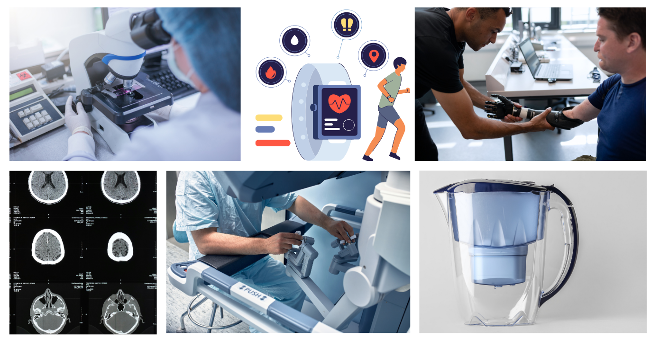
3.4 Defining technology
Technology: applying scientific knowledge for practical purposes or applications
Notes:
Unpack this definition with students, then ask them to brainstorm as many technologies as possible.
Inform students that technologies related to detecting, diagnosing, managing and treating diseases, disorders and physical trauma have developed significantly in the last century and continue to develop as scientific knowledge develops.

Slide 167
3.4 Australian technologies to improve health
Person | Technological advance
Fiona Wood | Spray on skin cells to treat physical trauma
Monash Vision Group | Work on the bionic eye
Professor Graeme Clark | Invention of the cochlear implant
Professor Colin Sullivan (and ResMed) | Invention of the sleep apnoea machine
Matt Bowtell (Engineer) | Affordable prosthetics using 3D printing
CSIRO | App to help heart attack patients recover
Notes:
Allocate each student one the medical technological advances developed in Australia.

Slide 168
3.4 Australian medical technology discussion
Outline the diversity and innovation in Australian healthcare technologies.
Describe how these technologies improve quality of life.
Discuss the implications of the technology for health care and society.
Outline the importance of continued research and development of technologies in healthcare.
Notes:
Give students the questions below and time to think about them. Facilitate class discussion for each of the questions.
Outline the diversity and innovation in Australian healthcare technologies.
Wide range of health issues addressed: Technologies include solutions for trauma (spray-on skin), sensory impairments (bionic eye, cochlear implant), and respiratory conditions (sleep apnoea machine).
Advanced and new methods: For example, Spray-on skin (Fiona Wood) revolutionised burn treatment through rapid regeneration of skin cells.
Bionic eye and cochlear implant (Monash Vision Group and Graeme Clark) showcase cutting-edge biomedical devices that restore senses.
3D-printed prosthetics (Matt Bowtell) made affordable assistive devices widely accessible.
Cross-disciplinary expertise: Includes medicine, engineering, and digital technology. Collaboration between researchers, clinicians, and engineers is a hallmark of Australian innovation.
Describe how these technologies improve quality of life.
Improvements in physical recovery: For example, spray-on skin accelerates healing for burn victims, reducing scarring and recovery times, and 3D-printed prosthetics provide cost-effective solutions for amputees, improving mobility and independence.
Restoring senses such as sight and hearing: For example, the bionic eye restores vision, while the cochlear implant enables sound perception in deaf individuals. Both these technologies improve social inclusion and communication.
Improved sleeping and breathing: For example, the sleep apnoea machine enhances sleep quality, reduces fatigue, and lowers health risks (e.g., cardiovascular disease).
Improved patient care: For example, the heart recovery app supports patients post-heart attack by monitoring progress, reducing hospital readmissions, and providing guidance.
Discuss the implications of the technology for health care and society.
Addressing emerging health challenges: Ongoing research is vital for combating new diseases (for example, pandemics) and improving treatments for chronic conditions.
Reducing healthcare costs: Continued innovation leads to cost-effective alternatives, such as 3D-printed prosthetics, which make treatments more accessible and affordable. Preventive tools, such as recovery apps, like recovery apps help avoid expensive hospitalisations and long-term care.
Supporting preventive healthcare: Advances in monitoring tools (e.g., apps and wearable devices) provide real-time data, helping people manage conditions before they escalate. Preventive healthcare reduces disease incidence, resulting in healthier populations.
Improving treatment effectiveness: Ongoing research allows refinement of existing technologies (e.g., improving cochlear implants or bionic eye precision) to enhance outcomes. Treatments become safer, more efficient, and tailored to individual patients, maximising their success rates.
Future-proofing healthcare: Innovations like AI, apps, and biotechnology will enhance predicting, preventing, and treating diseases.

Slide 169
3.5 Consolidating the disease concept map
Learning intentions and success criteria
We are learning: | I can:
to summarise information about infectious and non-infectious diseases . | distinguish between infectious and non-infectious diseases. represent relationships between concepts in a concept map. summarise the information logically.
Notes:
Display this slide at the beginning of the learning sequence. Revisit the slide where appropriate during lesson activities and encourage students to reflect on their progress.

Slide 170

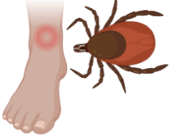




3.5 What have we learnt about infectious diseases?
Cartoon image of a pathogen by unknown from Rawpixel, licensed under CC0 1.0
Person coughing by Noun Project from Wikimedia Commons, licensed under CC0 1.0
Authors image from Biorender.com
Authors image from Biorender.com
Person getting vaccinated by Eric Sales from Flickr, licensed under CC BY-NC-ND 4.0
Carton image of hand washing by Laura Reen from CC Null, licensed under CC BY 4.0
Quarantine image by Marco Verch from Iconscout, licensed under CC BY 4.0
Notes:
These images can be used for the final activity where students construct a concept map, similar to the one they did at the beginning of the disease learning sequence.

Slide 171


3.5 What have we learnt about non-infectious diseases?
World map showing mortality from non-infectious disease by Our World in Data from Wikimedia commons, licensed under CC BY 4.0
Normal and partially blocked blood vessels by Bruce Blaus from Wikimedia commons, licensed under CC BY 4.0
Notes:
These images can be used for the final activity where students construct a concept map, similar to the one they did at the beginning of the disease learning sequence.
Take time after to compare their new concept map to their old one.

Slide 172
References (1)
This presentation contains NSW Curriculum and syllabus content. The NSW Curriculum is developed by the NSW Education Standards Authority. This content is prepared by NESA for and on behalf of the Crown in the right of the State of New South Wales. The material is protected by Crown copyright.
Please refer to the NESA Copyright Disclaimer for more information https://educationstandards.nsw.edu.au/wps/portal/nesa/mini-footer/copyright.
NESA holds the only official and up-to-date versions of the NSW Curriculum and syllabus documents. Please visit the NSW Education Standards Authority (NESA) website https://educationstandards.nsw.edu.au/wps/portal/nesa/home and the NSW Curriculum website https://curriculum.nsw.edu.au.
Science 7–10 (2023) © Syllabus NSW Education Standards Authority (NESA) for and on behalf of the Crown in right of the State of New South Wales, 2023.
Agency for Clinical Innovation (2021) ‘COVID-19 Monitor’ [PDF 1230 KB], NSW Department of Health, accessed 8 July 2024.
AIHW (Australian Institute of Health and Welfare) (2024) Leading causes of death, AIHW, accessed 29 August 2024.
AITSL (Australian Institute for Teaching and School Leadership Limited) (n.d.) Learning intentions and success criteria [PDF 251 KB], AITSL, accessed 31 July 2024.
Asian Development Bank (2021) Philippines: COVID- 19 Asia Pacific Vaccine Access Facility (APVAX), Flickr, accessed 29 August 2024.
Brittanica (2024) Technology, Brittanica, accessed 12 August 2024.
Gidding, H. F. (2005). The Impact of Australia’s Measles Control Programme over the Past Decade. Epidemiology and Infection, 133(1), 99–105. Accessed 19 November 2024.
Innovative Genomics Institute (2024) Glossary: Pathogen, Innovative Genomics Institute, accessed 29 August 2024.
Keats D (5 Jul 2012) ‘Human homeostasis: Part 3 – Regulation of carbon dioxide’ [video], Derek Keats, YouTube, accessed 12 August 2024.

Slide 173
References (2)
NESA (NSW Education Standards Authority) (2023) Glossary, NESA, accessed 12 August 2024.
NSW Health (n.d.) Chickenpox and Shingles fact sheet, NSW Health, accessed 4 July 2024.
Rose K (2018) Medieval castle: definition, World History Encyclopedia, accessed 29 August 2024
Smith M (2024) Parents urged to vaccinate children against measles as number of cases surges, The Chiswick Calendar, accessed 29 August 2024.
The Writing Center (n.d.) Comparing and Contrasting, University of North Carolina, accessed 4 June 2024.
World Health Organisation (WHO) Global Health Observatory Malaria, World Health Organisation, accessed 8 December 2024.

Slide 174
Copyright
© State of New South Wales (Department of Education), 2025

