Slide 1
Instructions for use
This resource is not a teaching and learning program. It should be used in conjunction with Technology7-8-materials-timber-20-weeks-program.docx
Classroom teachers are encouraged to add and adapt slides as required to meet the needs of their students.
Save a copy of the file to make changes to the slide deck. Go to File > Download a Copy (this downloads a copy to the computer to edit in the PowerPoint app).
To convert the PowerPoint to Google Slides:
Upload the file into Google Drive and open it.
Go to File > Save as Google Slides.
(Note – conversion may cause formatting changes in the slides.)

Slide 2
My BBQ rules
Technology – Stage 4/Years 7–8
Materials and production processes – timber

Slide 3
Difference between wood and timber
Wood is still in the form of a tree or branches and logs. It becomes timber after it has been converted to useable lengths and shapes and after it has been seasoned. Seasoning is the process of removing much of the moisture from timber.
Watch From Trees to Lumber: Watch how boards are made from pine trees (8:12)

Slide 4
Learning intentions and success criteria 1
We are:
investigating where wood comes from and products that are made from timber.
We can:
identify where wood comes from.
explain how timber is used differently in real world contexts.
Notes:
Notes for teachers:
Learning intentions and success criteria are best co-constructed with students. Adapt the learning intention as required and add matching success criteria.
For more information See ⁠AITSL or the NSW Department of Education explicit teaching strategies, ⁠Sharing learning intentions and ⁠Sharing success criteria
LISC is not necessarily presented at the beginning of the lesson. Teacher needs to consider most effectual time to introduce
LISC should be revisited during the lesson to support students' evaluation of their learning

Slide 5
Class expectations
Co-construct class expectations for safe lessons in technology 7–8 – timber

Slide 6
Class procedures
Co-construct procedures for safe lessons in technology 7–8 – timber

Slide 7
Made from timber
Brainstorm 10 things you have used in the last 24 hours made from timber
Made from
timber

Slide 8
What are the qualities of timber?
List the qualities of timber

Slide 9
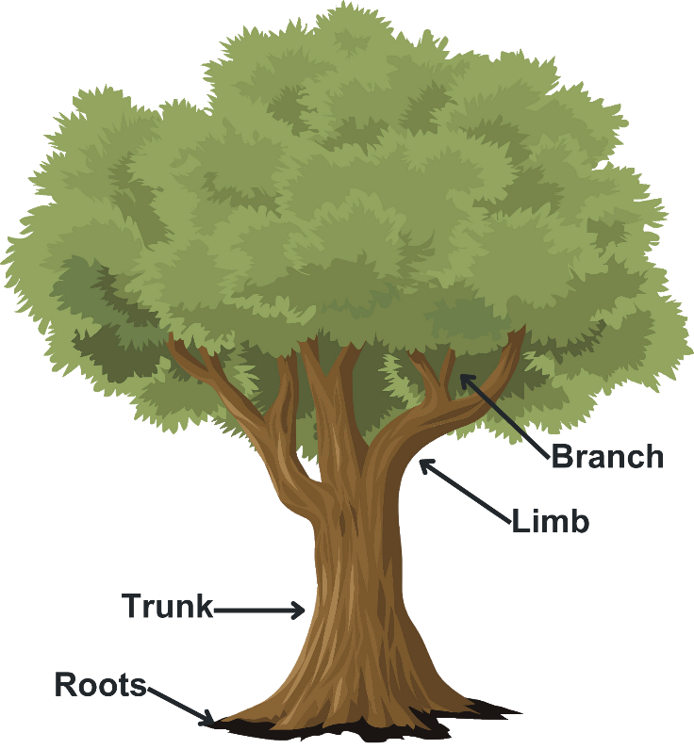
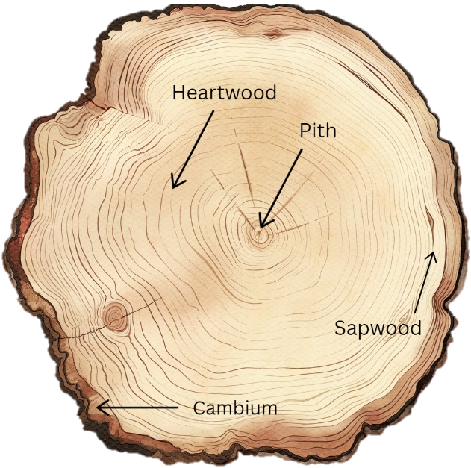
Parts of tree

Slide 10
Tree to timber
1
tree felled
cut to lengths required by the mills
2
lengths debarked
3
cut round logs into square
cut into dimensional timber
4
Seasoned in a kiln
planed to finished dimensions

Slide 11
Timber terminology
Edge
Label the piece of timber
With the grain
Face
Across the grain
Length
Thickness
Width
Face | Across the grain | With the grain | Edge
Thickness | Width | Length

Slide 12
Learning intentions and success criteria 2
We are:
learning to understand safe processes and practices in the workshop
learning to apply safe processes and practices in the workshop
We can:
follow safe processes and practices when learning in the workshop.
identify PPE required to use workshop equipment.
Notes:
Notes for teachers:
Learning intentions and success criteria are best co-constructed with students. Adapt the learning intention as required and add matching success criteria.
For more information See ⁠AITSL or the NSW Department of Education explicit teaching strategies, ⁠Sharing learning intentions and ⁠Sharing success criteria
LISC is not necessarily presented at the beginning of the lesson. Teacher needs to consider most effectual time to introduce
LISC should be revisited during the lesson to support students' evaluation of their learning

Slide 13
Workshop safety
Timber Technology - Workshop Walkthrough.mp4
Notes:
Watch workshop walk through.
Teacher note: the TAS Safety resources (sharepoint.com) are created for Department of Education schools, using relevant information from Equipment safety in schools (ESIS). These resources have been developed specifically for the equipment and machinery that has been approved for use in department schools.
Safety tests are mandated by ESIS for selected equipment and machinery.
The tests may be attempted in electronic or other formats with the result recorded and retained as per the Department's records management policy.
Students must provide the correct answer (with or without support) to each question on the safety test as evidence that they knew correct procedures at that point in time for the tool, equipment or machine. Students may attempt each test multiple times to achieve correct answers.

Slide 14
Safety signage

Slide 15
‘The sign’

Slide 16
Learning intentions and success criteria 3
We are:
continuing to learn to apply safe processes and practices in the workshop.
learning to apply material and design considerations to the planning and production of a project.
We can:
follow safe processes and practices when learning in the workshop.
identify a suitable material to produce my project.
produce simple working drawings for my project.
Notes:
Notes for teachers:
Learning intentions and success criteria are best co-constructed with students. Adapt the learning intention as required and add matching success criteria.
For more information See ⁠AITSL or the NSW Department of Education explicit teaching strategies, ⁠Sharing learning intentions and ⁠Sharing success criteria
LISC is not necessarily presented at the beginning of the lesson. Teacher needs to consider most effectual time to introduce
LISC should be revisited during the lesson to support students' evaluation of their learning

Slide 17
The design and production process

Slide 18
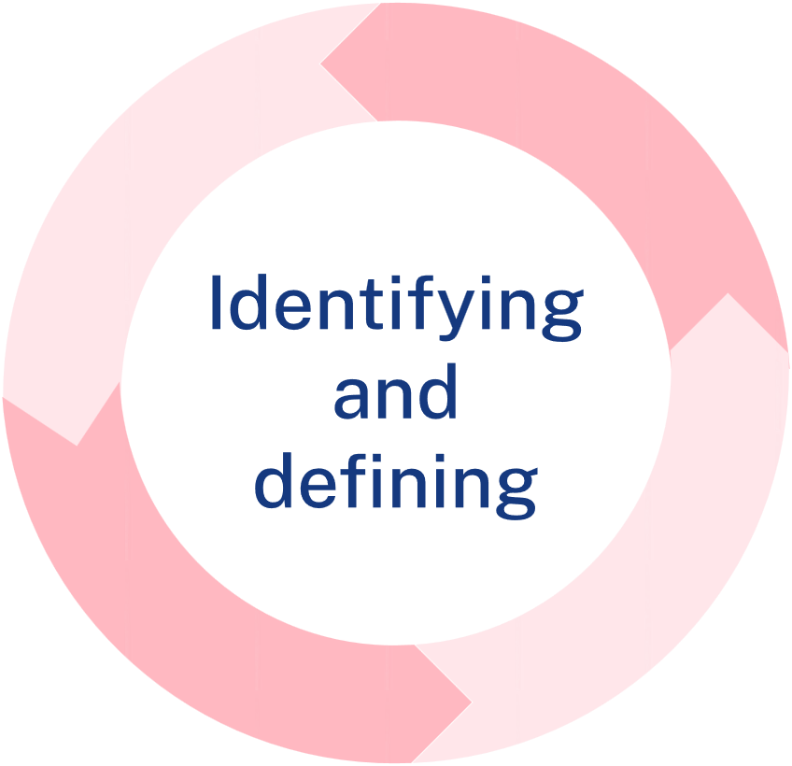
Identifying and defining
The design brief
Create a custom door sign from radiata pine, featuring a graphic or logo along with a title or name. The sign should include a chamfered edge and at least one aesthetic enhancement such as wood burning, colour, and/or laser print transfer. The final product should be finished to ensure durability and a polished appearance.
Limitations
You have 4 lessons. The width and length will largely be determined by the material and your teacher. Keep your design simple to ensure you have adequate time to complete it.

Slide 19
Design ideas
Sketch 2 design ideas. Experiment with logo design, font size and style and/or transfer of graphics or pictures which inspire you. Annotate each design to describe your choices.

Slide 20
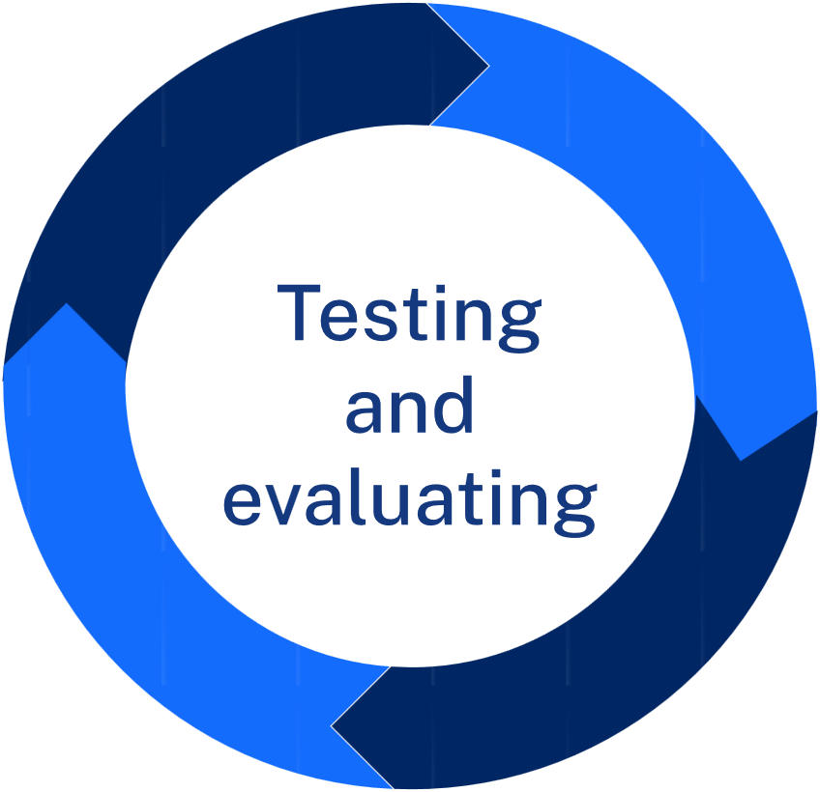
Testing and evaluating
Justification
Which design have you selected and why? Consider the design brief and limitations in your response.
Evaluation
Does your project satisfy the design brief? Are you happy you’re your project?

Slide 21
Learning intentions and success criteria 4
We are:
learning how to safely and competently use hand tools to produce quality projects.
We can:
identify hand tools used for specific processes.
use hand tools in a safe and competent manner to achieve a quality project.
Notes:
Notes for teachers:
Learning intentions and success criteria are best co-constructed with students. Adapt the learning intention as required and add matching success criteria.
For more information See ⁠AITSL or the NSW Department of Education explicit teaching strategies, ⁠Sharing learning intentions and ⁠Sharing success criteria
LISC is not necessarily presented at the beginning of the lesson. Teacher needs to consider most effectual time to introduce
LISC should be revisited during the lesson to support students' evaluation of their learning

Slide 22
Skill development
I see | I think | I wonder
I see a piece of scrap timber and a tool called a plane. The teacher has marked out with a pencil where the chamfer edge will go. | I think the plane might dig into the timber or I think the plane might fall off the pointed edge of the timber. | The timber ribbons were cool. I wonder how I will make the chamfer edge even and not wider at one edge from the other on my project.

Slide 23
The BBQ Caddy
Project

Slide 24
Learning intentions and success criteria 5
We are:
learning to work collaboratively
learning to outline the factors affecting the design of products
learning to describe the practices and processes of designers and producers.
We can:
examine a product and identify design features that contribute to a successful product
identify the steps in the design and production process
Notes:
Notes for teachers:
Learning intentions and success criteria are best co-constructed with students. Adapt the learning intention as required and add matching success criteria.
For more information See ⁠AITSL or the NSW Department of Education explicit teaching strategies, ⁠Sharing learning intentions and ⁠Sharing success criteria
LISC is not necessarily presented at the beginning of the lesson. Teacher needs to consider most effectual time to introduce
LISC should be revisited during the lesson to support students' evaluation of their learning

Slide 25
BBQ caddy project
Design brief
People all over the world come together in the outdoors to eat and socialise. You will design a BBQ caddy to carry paper serviettes and condiments, such as sauces. You can use the design provided or individualise the project to reflect your abilities and interests.

Slide 26
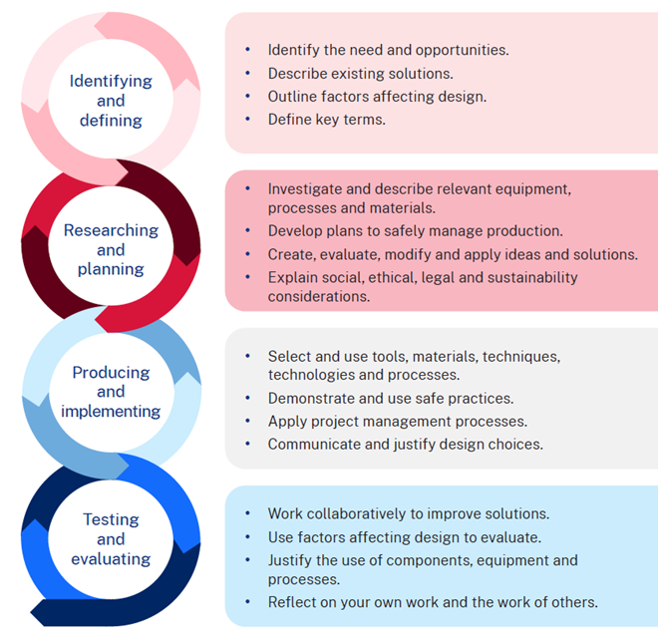
The design and production process
There are four main steps in the process that help to create a quality solution to design challenges or problems. Evaluation happens at each step and is constant throughout the process.

Slide 27
BBQ caddy folio requirements
To support your production of a high quality, personalised BBQ Caddy, you will need to complete the folio and production requirements, including:
Assess 3 existing products, evaluating the components that could enhance your design solution.
Demonstrate the development of your ideas through 4 annotated sketches. Select one idea and provide a clear justification for your choice.
Create an accurate CAD drawing that includes all necessary dimensions.
Produce and evaluate a timeline for completing your project.
Discuss 2 alternative timber choices for your project and their advantages.
Identify and explain which joints in your design require the greatest strength.
Write a procedure for an alternative joint that could be used in your project.
Evaluate your project by discussing how it relates to your research and planning.

Slide 28
Factors affecting design
There are many factors that affect design. These must be considered when creating a product, system, or solution to ensure the success of a project. By carefully considering these factors during the design process, designers, producers and manufacturers can create more effective and efficient solutions. Factors affecting the success and quality of designs include:
accessibility,
aesthetics,
durability,
ergonomics,
ethics,
functionality,
safety.
Briefly describe each factor affecting design.

Slide 29
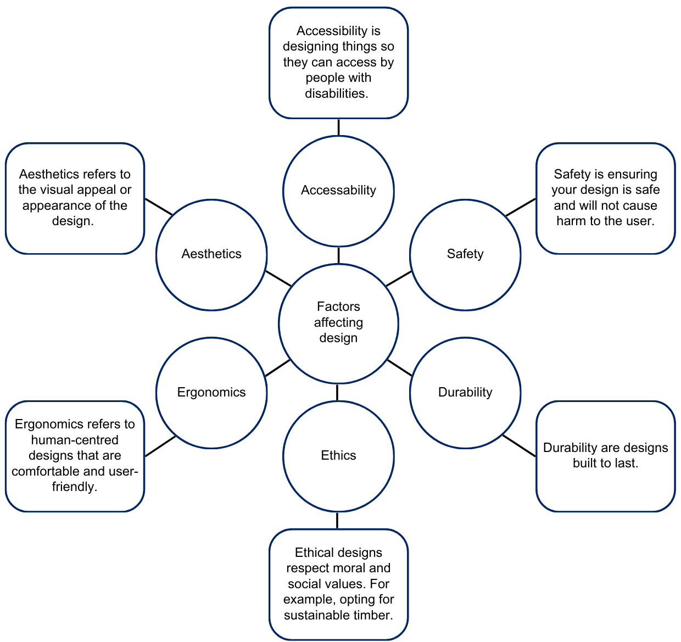
Sample answers for factors affecting design
29

Slide 30
Design spotlight
Watch: Designer, Furniture Maker (Episode 87) (4:47).
Notes:
Video URL: https://youtu.be/9mm9PWMEbmM?si=Hz2zdmP2j2ssqm6h

Slide 31
Designer, Furniture maker – questions
How does Judson start his day?
Judson says “A career in woodworking can take you in all different directions” – list 3 directions it can take you.
True or False – Judson creates cheap, fast-fashion timber pieces designed to last a season and be replaced. Explain your response.
How does Judson describe the pieces he creates for his clients?
Woodworking is a career with a lot of opportunities for growth. List some possible careers Judson mentioned.
What is Judson’s adrenaline rush?

Slide 32
Learning intentions and success criteria 6
We are:
learning how to document the design process, apply creative thinking
learning to improve our BBQ Caddy by considering factors affecting design through collaboration and evaluation.
We can:
document my design process effectively, showing clear steps from idea generation to solution refinement.
apply design and creative thinking strategies to assess the quality of my ideas and proposed solutions.
Notes:
Notes for teachers:
Learning intentions and success criteria are best co-constructed with students. Adapt the learning intention as required and add matching success criteria.
For more information See ⁠AITSL or the NSW Department of Education explicit teaching strategies, ⁠Sharing learning intentions and ⁠Sharing success criteria
LISC is not necessarily presented at the beginning of the lesson. Teacher needs to consider most effectual time to introduce
LISC should be revisited during the lesson to support students' evaluation of their learning

Slide 33
Measurement – FEWTEL
The acronym FEWTEL helps you remember the correct order for processing wood into a finished, usable product. By following this sequence, you handle the wood more efficiently, save time, and reduce the risk of accidents.
Acronym | Description | Process
F | Face side | Select and mark the face side
E | Face edge | select and mark the face edge
W | Width | Check and cut timber to width
T | Thickness | Check and plane timber to desired thickness
E | Square end | Square one end
L | Length | Measure and mark length

Slide 34
Joining timber
When we make things, some methods alone won’t hold materials together securely. If we join two pieces without extra support, they could easily fall apart. To fix this, we use fasteners to keep them attached. Fasteners can be mechanical, like nails or screws, or chemical, like glue.

Slide 35
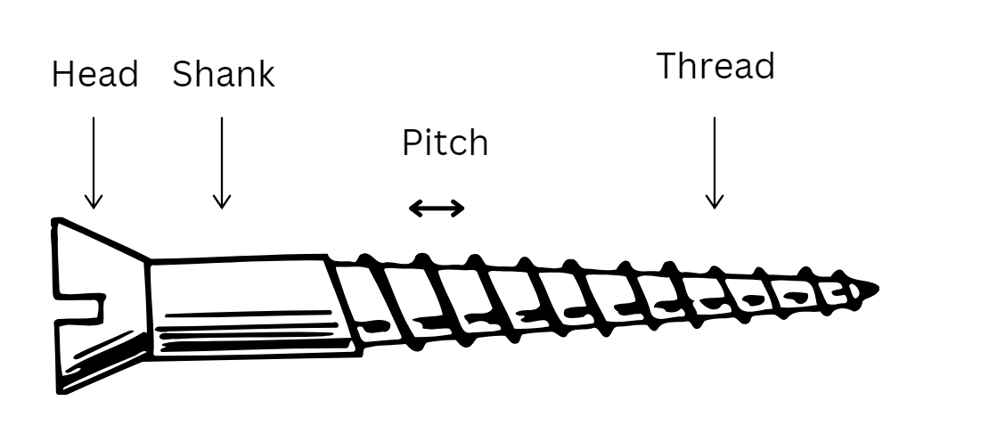
Types of screws
Sheet metal screw – a short screw with coarse threads and a typically round head, used to fasten sheet metal or other thin materials.
Drywall screw – features a bugle-shaped head and a thin shank, designed specifically to secure drywall to studs, but often serves as a versatile screw.
Wood screw – usually has coarse threads and a pointed tip that cuts into the wood to form its own threads.

Slide 36
Screw head shapes
Screw head types
Flat head
Round head
Pan head
Phillips head
Square head
Allen head
Slotted/Flat head

Slide 37
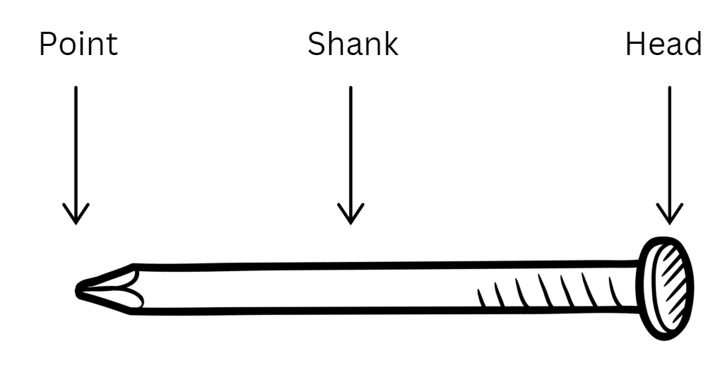
Types of nails
Common nail – as a large, flat head and is used for general purposes.
Finishing nail – features a small barrel-shaped head and a thin shank, designed to be driven below the surface and concealed with putty.
Screw nail – has a flat head and a spiral shank that twists like a screw when driven in.

Slide 38
Learning intentions and success criteria 7
We are:
understanding the purpose of workshop drawings in various industries.
developing skills in production planning including creating timelines and cutting lists.
We can:
identify and explain the different types of workshop drawings and their uses.
develop a project timeline that outlines key stages of our BBQ Caddy project.
create a cutting list that includes all materials required for the project.
Notes:
Notes for teachers:
Learning intentions and success criteria are best co-constructed with students. Adapt the learning intention as required and add matching success criteria.
For more information See ⁠AITSL or the NSW Department of Education explicit teaching strategies, ⁠Sharing learning intentions and ⁠Sharing success criteria
LISC is not necessarily presented at the beginning of the lesson. Teacher needs to consider most effectual time to introduce
LISC should be revisited during the lesson to support students' evaluation of their learning

Slide 39
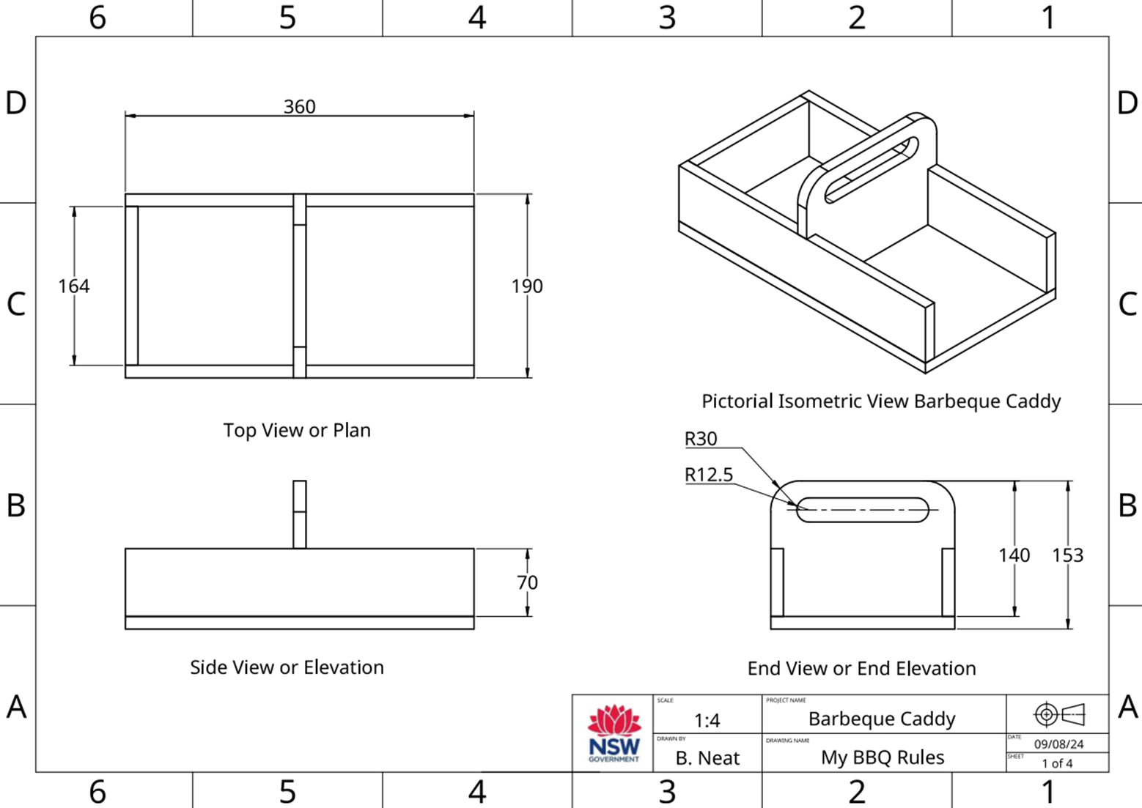
Workshop drawings
Workshop drawings are detailed and precise drawings used in the construction and manufacturing of a product or structure.
They provide essential information that guides builders, engineers, and manufacturers in creating the design as intended.

Slide 40
Production planning
Time management
Time management is the planning we do to make sure our project is completed in the time we have available. When we are planning for time management for this project we need to look at the time we have available and the tasks we need to do to complete the project.
Question | Answer
How many weeks do we have available to make the BBQ Caddy
How many practical lessons do we have in a week
How many practical lessons do we have to complete the BBQ Caddy

Slide 41
Production planning – folio
4. Produce and evaluate a timeline for completing your project.
Break down your BBQ caddy project into key phases.
For each phase, estimate how much time you think it will take to complete.
Use a timeline tool (e.g. Gantt chart) to visually represent your project timeline.
Include milestones for important tasks, such as when you plan to complete your CAD drawing or start building.
Write a brief evaluation of your timeline, reflecting on if the timeline is realistic.

Slide 42
Production planning – BBQ caddy key phases
What tasks do we need to do and how long will they take?
Prepare drawings
Mark out and cut sides and ends
Mark out and cut handle
Mark out and cut housing joints
Mark out and cut halving joint
Mark out, drill and cut out napkin holder recess
Design and make the napkin weight
Glue, nail and clamp caddy together
Attach base and plane to size
Prepare and apply finish

Slide 43
BBQ caddy key phases time estimates
Step | Estimated Time (in lessons)
Prepare drawings
Mark out and cut sides and ends
Mark out and cut handle
Mark out and cut housing joints
Mark out and cut halving joint
Mark out, drill and cut out napkin holder recess
Design and make the napkin weight
Glue, nail and clamp caddy together
Attach base and plane to size
Prepare and apply finish

Slide 44
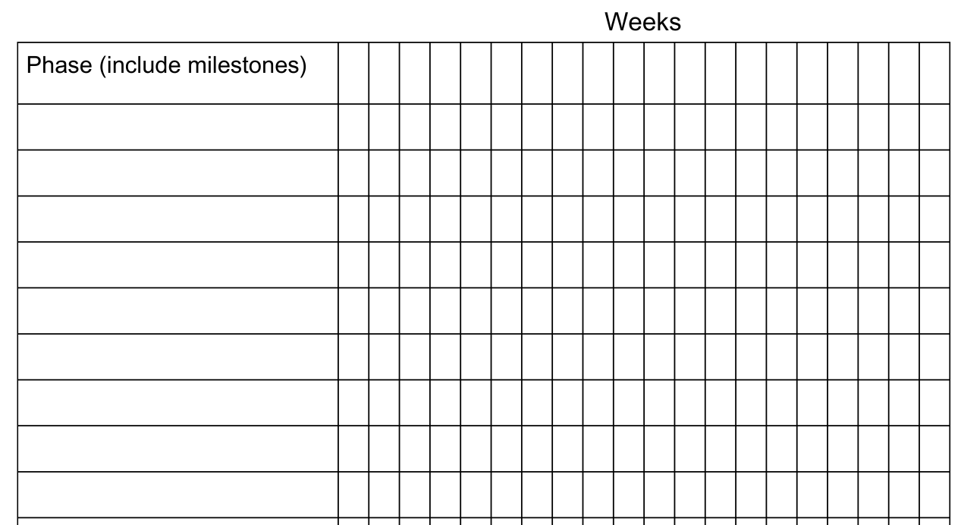
Gantt chart
What is it?
A Gantt chart is a visual tool used for project management that displays a project schedule. It helps in planning, tracking, and managing tasks and activities over time.
Add timeline (lessons)
List phases/ steps

Slide 45
Production planning – cutting list
The cutting list describes to the builder the type of material to be used, the dimensions of the material, the number of parts, the name of each part and other information relevant to the manufacture of the project. It is presented as a table.
No. | Description | Qty | L mm | W mm | T mm | Material | Notes (joinery methods used)

Slide 46
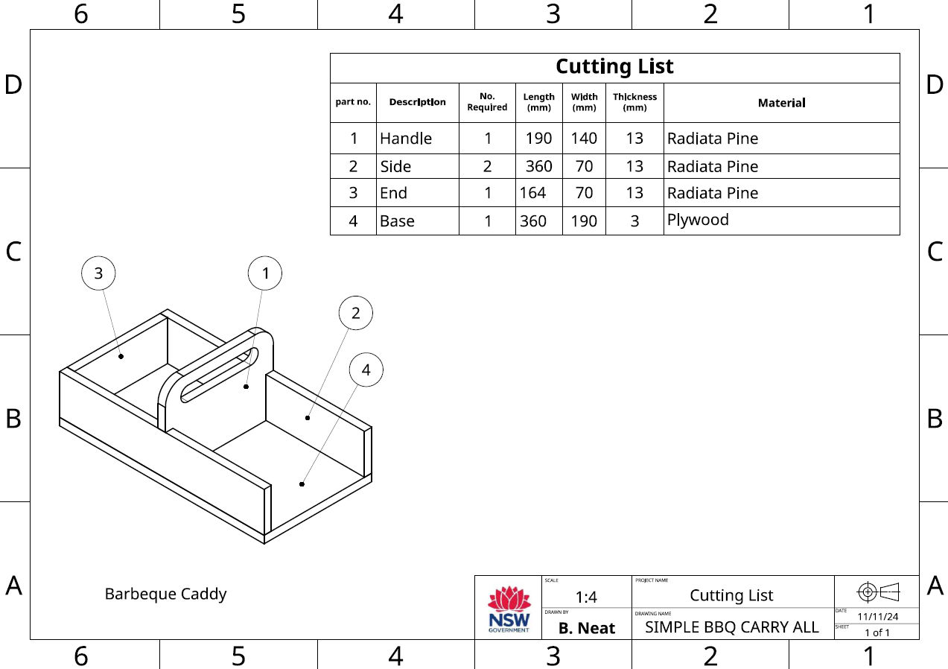
BBQ caddy cutting list workshop drawing
46

Slide 47
Learning intentions and success criteria 8
We are:
understanding the different types of timber (hardwood, softwood and engineered).
researching the properties, characteristics and uses of each timber type.
We can:
identify and describe the different types of timber and their significance in woodworking and construction.
present key characteristics and uses of a specific type of timber to our peers effectively.
Notes:
Notes for teachers:
Learning intentions and success criteria are best co-constructed with students. Adapt the learning intention as required and add matching success criteria.
For more information See ⁠AITSL or the NSW Department of Education explicit teaching strategies, ⁠Sharing learning intentions and ⁠Sharing success criteria
LISC is not necessarily presented at the beginning of the lesson. Teacher needs to consider most effectual time to introduce
LISC should be revisited during the lesson to support students' evaluation of their learning

Slide 48
Types of timbers
Hardwood and softwood
Softwoods and hardwoods are used by designers, producers and manufacturers for specific purposes.
Feature | Hardwoods | Softwoods
Physical Properties | Denser, stronger, more durable | Less dense, better workability
Fibre Structure | Higher density of longer, thicker-walled fibres | Fewer, shorter, less dense fibres
Growth Rings | More irregular and varied in size | More uniform and distinct
Types

Slide 49
Properties of Radiata Pine
Botanical Name | Pinus radiata
Other Common Names | Monterey Pine, Insignis Pine
Tree Description | Evergreen tree, 30-50 meters tall, straight trunk, conical crown, rough dark grey to brown bark.
Timber Colour | Pale yellow to light brown heartwood; lighter sapwood.
Grain and Texture | Straight and even grain, medium to coarse texture; easy to work with.
Density | Ranges from 500 to 600 kg/m³, depending on moisture content and growth conditions.
Durability | Moderately durable; natural resistance to decay and insects but best treated for outdoor use.
Sustainability | Grown in plantations; sustainable choice with responsible forestry practices.
Uses | Construction (framing, beams, flooring), furniture, plywood, fencing, decking, packaging.

Slide 50
Properties of Tasmanian Oak
Botanical Name | Eucalyptus delegatensis
Other Common Names | Tasmanian Ash, Victorian Ash, Mountain Ash
Tree Description | Tall evergreen tree, can grow up to 60 meters; straight trunk with a smooth, greyish bark.
Timber Colour | Light to medium brown with pinkish or yellow hues; colour may darken with age.
Grain and Texture | Fine to medium grain with a straight texture; generally has a smooth finish.
Density | Density ranges from 600 to 800 kg/m³, depending on the specific species and moisture content.
Durability | Moderately durable; has good resistance to wear but can be susceptible to insect attack.
Sustainability | Often sourced from sustainably managed forests in Tasmania and Victoria; considered eco-friendly.
Uses | Furniture, flooring, cabinetry, joinery, and decorative items; widely used in construction.

Slide 51
Learning intentions and success criteria 9
We are:
learning to understand the differences between sustainable and traditional timber sourcing practices and their environmental impact.
exploring how sustainable design can benefit both the user and the environment
We can:
explain ethical and legal responsibilities involved in sourcing timber and other materials.
compare sustainable sourcing practices and resource management practices.
minimise waste during design and production.
Notes:
Notes for teachers:
Learning intentions and success criteria are best co-constructed with students. Adapt the learning intention as required and add matching success criteria.
For more information See ⁠AITSL or the NSW Department of Education explicit teaching strategies, ⁠Sharing learning intentions and ⁠Sharing success criteria
LISC is not necessarily presented at the beginning of the lesson. Teacher needs to consider most effectual time to introduce
LISC should be revisited during the lesson to support students' evaluation of their learning

Slide 52
Sustainability
What is it?
Sustainability is supporting the needs of the present without compromising the ability of future generations to meet their needs.
It is a way of using resources that meets our needs today without harming the ability of future generations to meet their own needs. It’s about balancing how we use resources like timber, water, and energy, so that they will still be available for people in the future.

Slide 53
Sustainable wood from sustainable forests
Watch Sustainable Wood from Sustainable Forests (15:35).

Slide 54
Sustainable terms
Term | Description
Resource | A resource is any material, substance, or asset that can be used to produce goods and services, fulfil needs, or provide benefits. Resources can be natural or human-made.
Natural Resource | A natural resource is a material or substance that occurs in nature and can be used for economic gain. This includes resources like water, minerals, forests, and fossil fuels.
Renewable Natural Resource | A renewable natural resource is a resource that can be replenished naturally over time. Examples include sunlight, wind, water, and forests, which can regenerate through natural processes.
Non-renewable Resource | A non-renewable resource is a resource that exists in finite amounts and cannot be replaced once it is depleted. Examples include fossil fuels (coal, oil, natural gas) and certain minerals.
Resource Management | Resource management refers to the planning, monitoring, and control of natural resources to ensure their sustainable use and conservation. This includes practices aimed at balancing ecological health and human needs.
Harvesting | Harvesting is the process of collecting or gathering resources, particularly renewable resources like timber, crops, or fish. It involves the methods and practices used to obtain these resources responsibly.

Slide 55
Learning intentions and success criteria 10
We are:
learning about techniques to join timber.
We can:
apply techniques to measure and mark out my project
complete a butt joint and rebate joint.
Notes:
Notes for teachers:
Learning intentions and success criteria are best co-constructed with students. Adapt the learning intention as required and add matching success criteria.
For more information See ⁠AITSL or the NSW Department of Education explicit teaching strategies, ⁠Sharing learning intentions and ⁠Sharing success criteria
LISC is not necessarily presented at the beginning of the lesson. Teacher needs to consider most effectual time to introduce
LISC should be revisited during the lesson to support students' evaluation of their learning

Slide 56
Learning intentions and success criteria 11
We are:
learning about the history and culture of products and systems developed by Aboriginal and Torres Strait Islander Peoples
developing an awareness of the ethical and legal considerations in design and production
We can:
describe the historical engineering and function of timber products and design by Aboriginal and Torres Strait Islander Peoples
appreciate Aboriginal and Torres Strait Islander Peoples art and identify the difference between inspiration and copyright (ICIP).
Notes:
Notes for teachers:
Learning intentions and success criteria are best co-constructed with students. Adapt the learning intention as required and add matching success criteria.
For more information See ⁠AITSL or the NSW Department of Education explicit teaching strategies, ⁠Sharing learning intentions and ⁠Sharing success criteria
LISC is not necessarily presented at the beginning of the lesson. Teacher needs to consider most effectual time to introduce
LISC should be revisited during the lesson to support students' evaluation of their learning

Slide 57
Aboriginal and Torres Strait Islander Peoples materials, products and systems
Aboriginal people used a variety of tools, utensils and weapons as they hunted, fished and gathered foods. Some technology was simple with the item being made, used for its purpose and then thrown away. Others needed more complex methods of making them like heat and pressure to set sap and fibres to determine the shape, flexibility and durability of the item.
Australia contains many different climates and environments. The general pattern of Aboriginal life was similar, small groups moved with the seasons over their territory. The tools, utensils and weapons made by Aboriginal people were adapted to the environment in which they were used. They were developed over many generations and made from readily available materials.

Slide 58
Aboriginal and Torres Strait Islander – tools and equipment
Aboriginal and Torres Strait Islander people invented many tools, pieces of equipment and technology to use in everyday life. This technology was made using natural resources in highly creative ways.
Aboriginal Plant use and Technology
Tools & Technology – Deadly Story
Yandi (coolamon) fact sheet (PDF)
13 Indigenous innovations that are truly amazing

Slide 59
Aboriginal and Torres Strait Islander – art and symbols
Aboriginal art is vibrant, diverse, and carries important cultural meaning. Throughout time, it has been used as a mode through which knowledge and stories are passed down through the generations. When you look at Aboriginal art, you will see that symbols are often used, and their meanings and ways of depicting them vary greatly across nations. Examples of symbols engraved or painted on rock art sites show a record of use of these marks for tens of thousands of years.
Read: Understanding symbols in Aboriginal art – Red Kangaroo
Research: Where is local place of yarning for Aboriginal people in your local area?

Slide 60
Protecting Indigenous Cultural Intellectual Property
watch Protecting Indigenous Cultural and Intellectual Property rights (ICIP) (2:02)

Slide 61
Indigenous Cultural Intellectual Property (ICIP)
It is essential to respect ICIP rights, ensuring that traditional knowledge and cultural expressions are protected and that Aboriginal communities maintain control over their cultural heritage.
Read First Nations artists and souvenir sellers back crackdown on fake Indigenous art and identify important issues and actions raised in the article.
What are the issues with non-Aboriginal people selling Aboriginal Art?
Are there laws protecting ICIP?
Would it be appropriate for you to decorate your bedroom sign with Aboriginal symbols? Why/Why not?

Slide 62
Learning intentions and success criteria 12
We are:
learning about the products and systems created by a diverse range of designers, producers and manufacturers.
We can:
research and describe the production techniques and materials used by designers, producers and manufacturers.
Notes:
Notes for teachers:
Learning intentions and success criteria are best co-constructed with students. Adapt the learning intention as required and add matching success criteria.
For more information See ⁠AITSL or the NSW Department of Education explicit teaching strategies, ⁠Sharing learning intentions and ⁠Sharing success criteria
LISC is not necessarily presented at the beginning of the lesson. Teacher needs to consider most effectual time to introduce
LISC should be revisited during the lesson to support students' evaluation of their learning

Slide 63
Learning intentions and success criteria 13
We are:
learning about the function of the serviette weight
considering designs for our project
learning about finishing techniques of timber.
We can:
design and manufacture an appropriate serviette weight
identify and select appropriate finishing techniques for my project
apply functional and aesthetic requirements to my project.
Notes:
Notes for teachers:
Learning intentions and success criteria are best co-constructed with students. Adapt the learning intention as required and add matching success criteria.
For more information See ⁠AITSL or the NSW Department of Education explicit teaching strategies, ⁠Sharing learning intentions and ⁠Sharing success criteria
LISC is not necessarily presented at the beginning of the lesson. Teacher needs to consider most effectual time to introduce
LISC should be revisited during the lesson to support students' evaluation of their learning

Slide 64
Surface finishes
Finishing timber is essential for enhancing its durability, protecting it from environmental factors, improving its aesthetic appeal, and ensuring ease of maintenance. These benefits contribute to the longevity and performance of wooden products in various applications.

Slide 65
Types of finishes
There is a range of finishes that can be applied to timber, including oil, wax, varnish, lacquer, stain, paint and water-based finish. Each has its own practical use and application method.
Consider how and where your BBQ caddy will be used. What finishes would be suitable for your project? Give a brief explanation for your choice.

Slide 66
Preparing for surface finishing
The quality of a finish on wood depends a lot on how smooth and clean the wood surface is before you apply it. Clear finishes, like varnish or lacquer, can make any scratches or marks on the wood more noticeable. This is why it’s important to prepare the wood surface properly before putting on the finish. Taking the time to make the surface nice and smooth will help ensure that the final look is great. The following procedure should be used.
Cleaning up
Removal of dents
Initial use of abrasive paper
Final use of abrasive paper
Application of finish

Slide 67
Learning intentions and success criteria 14
We are:
investigating evaluation as a way of self-assessing our work and our peers.
learning to refer to the criteria for success to gauge the success of our project.
We can:
evaluate the success of our project and my peers against the criteria for success.
select and apply appropriate finishing techniques to my project.
Notes:
Notes for teachers:
Learning intentions and success criteria are best co-constructed with students. Adapt the learning intention as required and add matching success criteria.
For more information See ⁠AITSL or the NSW Department of Education explicit teaching strategies, ⁠Sharing learning intentions and ⁠Sharing success criteria
LISC is not necessarily presented at the beginning of the lesson. Teacher needs to consider most effectual time to introduce
LISC should be revisited during the lesson to support students' evaluation of their learning

Slide 68
References
This presentation contains NSW Curriculum and syllabus content. The NSW Curriculum is developed by the NSW Education Standards Authority. This content is prepared by NESA for and on behalf of the Crown in the right of the State of New South Wales. The material is protected by Crown copyright.
Please refer to the NESA Copyright Disclaimer for more information https://educationstandards.nsw.edu.au/wps/portal/nesa/mini-footer/copyright.
NESA holds the only official and up-to-date versions of the NSW Curriculum and syllabus documents. Please visit the NSW Education Standards Authority (NESA) website https://educationstandards.nsw.edu.au/wps/portal/nesa/home and the NSW Curriculum website https://curriculum.nsw.edu.au.
Technology 7–8 © Syllabus NSW Education Standards Authority (NESA) for and on behalf of the Crown in right of the State of New South Wales, [Year of publication].
Archae-aus, 2024, Yandi (coolamon) fact sheet (PDF), Archae-aus, accessed 19 November 2024.
Australian National Botanic Gardens, 2020, Aboriginal Plant use and Technology (PDF), Australian National Botanic Gardens, accessed 19 November 2024.
Bombora Furniture, 2024, About Bombora Custom Furniture | Recycled Timber Furniture & Custom Wooden Cabinetry Bombora Custom Furniture, accessed 19 November 2024.
City of Newcastle, 2022, NSW Government declaration to protect cultural significance of Aboriginal ceremonial site, City of Newcastle, accessed 19 November 2024.
Deadly Story, 2023, Tools & Technology, Deadly Story, accessed 19 November 2024.
Dion Devow, D, 2017, 13 Indigenous innovations that are truly amazing, Téa&Belle Collective, accessed 19 November 2024.
E9design, 2024, The E9 Design Story: Sustainable Australian Furniture Using Technology, E9design, accessed 19 November 2024.

Slide 69
References 2
Forest Learning, 2024, Forester Time with Gavin Livingston: Forestry 101. Managing today's forests for tomorrow's generations, Forest Learning, accessed 19 November 2024.
Heartwood Timber Designs, 2020, Home - Heartwood Timber Designs, Heartwood Timber Designs, accessed 19 November 2024.
Madji Indigenous Furniture, 2024, Madji Indigenous Furniture - Furniture created with Indigenous designs, Madji Indigenous Furniture, accessed 19 November 2024.
Manapan, 2024, Manapan - Inspired Indigenous Furniture Manapan, accessed 19 November 2024.
NSW Department of Education, 2024, understand local community protocols and engage with the community respectfully and authentically, Getting to know local Aboriginal and/or Torres Strait Islander Histories and Cultures, accessed 19 November 2024.
Rayonier Inc. (1 October 2021) From Trees to Lumber: Watch how boards are made from pine trees (8:12) Rayonier Inc., YouTube, accessed 19 November 2024.
Red Kangaroo, 2024, Understanding symbols in Aboriginal art, Red Kangaroo, accessed 19 November 2024.
Responsible Wood, 2023, responsiblewood.org.au, Responsible Wood, accessed 19 November 2024.
Responsible Wood, 2023, Value Of Australian Sustainable Timber, Responsible Wood, accessed 19 November 2024.
Richardson H, Testa C, Lee J, 2023, First Nations artists and souvenir sellers back crackdown on fake Indigenous art, ABC News, accessed 19 November 2024.
TAS Safety resources (sharepoint.com)

Slide 70
References 3
Thompson, R and Dryen, D, 2022, ,Beyond Ordinary: Contemporary Women Makers — Victorian Woodworkers Association, Victorian Woodworkers Association, accessed 19 November 2024.
timber technology workshop walkthrough (5:37)
WorkBC's Career Trek (11 June 2020) Designer, Furniture Maker (Episode 87) (4:47) WorkBC's Career Trek, YouTube, accessed 19 November 2024.

Slide 71
Copyright
© State of New South Wales (Department of Education), 2025
The copyright material published in this resource is subject to the Copyright Act 1968 (Cth) and is owned by the NSW Department of Education or, where indicated, by a party other than the NSW Department of Education (third-party material).
Copyright material available in this resource and owned by the NSW Department of Education is licensed under a Creative Commons Attribution 4.0 International (CC BY 4.0) license.
This license allows you to share and adapt the material for any purpose, even commercially.
Attribution should be given to © State of New South Wales (Department of Education), 2025.
Material in this resource not available under a Creative Commons license:
the NSW Department of Education logo, other logos and trademark-protected material
Material owned by a third party that has been reproduced with permission. You will need to obtain permission from the third party to reuse its material.
Links to third-party material and websites
Please note that the provided (reading/viewing material/list/links/texts) are a suggestion only and implies no endorsement, by the New South Wales Department of Education, of any author, publisher, or book title. School principals and teachers are best placed to assess the suitability of resources that would complement the curriculum and reflect the needs and interests of their students.
If you use the links provided in this document to access a third-party’s website, you acknowledge that the terms of use, including licence terms set out on the third-party’s website apply to the use which may be made of the materials on that third-party website or where permitted by the Copyright Act 1968 (Cth). The department accepts no responsibility for content on third-party websites.

