Slide 1
Instructions for use
This resource is not a teaching and learning program. It should be used in conjunction with the program and teacher resource Data visualisation – Enterprise Computing 11–12 in Week 4.
Classroom teachers are encouraged to add and adapt slides as required to meet the needs of their students.
Save a copy of the file to make changes to the slide deck. Go to File > Download a Copy (this downloads a copy to the computer to edit in the PowerPoint app).
To convert the PowerPoint to Google Slides:
Upload the file into Google Drive and open it.
Go to File > Save as Google Slides.
(Note: conversion may cause formatting changes in the slides.)

Slide 2
Data visualisation
Enterprise Computing 11–12

Slide 3
Learning intentions and success criteria
We are learning to
understand the purpose and benefits of data visualisation
create clear and accurate data visualisations
choose the correct chart type for various data relationships.
We can
explain why data visualisation is essential for uncovering trends and communicating insights
design visualisations to ensure clarity that focus on key data
implement appropriate chart types to communicate data relationships
critically assess visualisations for clarity, accuracy and potential bias.
Notes:
Notes for teachers:
Learning intentions and success criteria are best co-constructed with students. Adapt the learning intention as required and add matching success criteria.
For more information See ⁠AITSL or the NSW Department of Education explicit teaching strategies, ⁠Sharing learning intentions and ⁠Sharing success criteria
LISC is not necessarily presented at the beginning of the lesson. Teacher needs to consider most effectual time to introduce
LISC should be revisited during the lesson to support students' evaluation of their learning

Slide 4
Why visualise data?

Slide 5
Why visualise data?
Data is only as good as our ability to understand and communicate it
​Data visualisation helps:​
uncover trends and patterns – visualisations help spot trends and patterns in data that might be missed in spreadsheets or raw numbers. ​
​make data accessible – charts and graphs translate complex data sets into a format that's easier to understand for a wider audience.​
​communicate insights clearly – visuals can present findings in a compelling way, making it easier to share data stories and recommendations.​
​spark action and decision making – by highlighting key trends, visualisations can guide better decision-making based on clear data insights.​
make data memorable – information presented visually is more likely to be remembered and recalled.

Slide 6
General design tips

Slide 7
General design tips (1)
Make sure you do the following
Ensure focus on the data and tone-down or remove the non-data elements such as grid lines, axis lines, chart borders and colour that does not have a purpose.
Label it up and always include clear and concise legends and data labels to provide context and ensure viewers understand what they're looking at.​
The squint test. Take a step back and squint at your visualisation. If the overall message is still clear without reading any labels, you're on the right track.​
Get feedback. Don't be afraid to ask for fresh eyes! Sharing your visualisation with others that can help you identify areas for improvement and ensure your message is clear.

Slide 8
General design tips (2)
Make sure you don’t do the following
Avoid clutter by adding too much information to a single chart as this eliminates the advantages of processing data visually​.
Avoid 3D visualisations as they can be visually distracting and make it difficult to compare data points accurately. Stick to simpler 2D charts for better clarity.​
Use ‘bad’ colour combinations. Always try and avoid harsh colour combinations such as red/green or blue/yellow. These can cause strain on the eyes and make it hard to distinguish between data points. ​
Don't make users perform visual or mental calculations to interpret your visualisation. If the chart is complex, break it down into separate visuals and reduce the viewer's cognitive load.

Slide 9
Core considerations

Slide 10
Before you start
Self-reflection questions
Before jumping to specifics, think about what you want to accomplish with the visualisation, as this will help you decide what data to include. ​Ask yourself these questions:​
Who is my audience? How well will they understand data?​
What questions do they have?​
What answers am I finding for them?​
What am I trying to say?​
What other questions will my visualisation inspire or what conversations may result?​
If the above questions are answered well, the visualisations can tell an interesting story.

Slide 11
Be mindful
Data can be misrepresented or misinterpreted when visualised incorrectly
It is best to keep the following in mind when designing data visualisations:
the key message can get lost in a poorly designed visualisation
including too much data can hide the most important insights
visualisation choices can introduce bias
visualisations can imply causation where it may not exist
without clear context, viewers might misinterpret the information and draw inaccurate conclusions.

Slide 12
Data charts (1)

Slide 13
Data charts (2)
Data charts act as the bridge between data visualisation principles and data dashboards​
Data visualisation principles
These principles guide how to effectively represent data in a clear and informative way. They cover aspects like pre-attentive attributes, nuances of using colour effectively and keeping the design clear.​
Data charts
These are the building blocks of data visualisation. They translate raw data points and relationships into visual elements like bars, lines, pie slices and so on. They put the data visualisation principles into action.​
Data dashboards
These are collections of multiple data visualisations designed to provide a comprehensive view of a specific topic or area. They leverage data charts to present key metrics and insights in a single, user-friendly interface. The dashboard also involves thinking about consistent themes and report navigation amongst other considerations.​
​
Think of data graphs as the individual bricks, data visualization principles as the blueprint, and the data dashboard as the final built structure.

Slide 14
Chart types

Slide 15
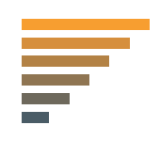
Data relationships
Nominal comparison This is a simple comparison of the quantitative values of subcategories. Example – Number of employees.
Deviation This examines how data points relate to each other, particularly how far any given data point differs from the mean. Example – Budget versus actual spending.
Time series This tracks changes in values of a consistent metric over time. Example – Monthly sales.
Distribution This shows data distribution, often around a central value. Example – Performance results meeting targets.
Correlation This is data with 2 or more variables that may demonstrate a positive or negative correlation to each other. Example – Sick leave and employee wellbeing.
Part-to-whole This shows a subset of data compared to the larger whole. Example – % of different categories.
Ranking This shows how 2 or more values compare to each other in relative magnitude. Example – Annual sales.

Slide 16
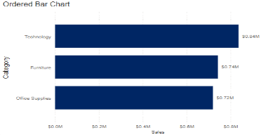
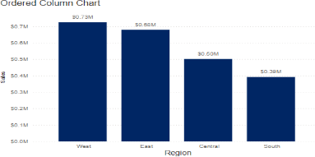
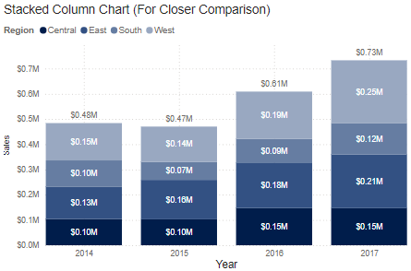
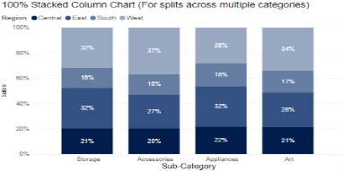
Bar chart – variations
Bar charts are very versatile. They are best used to show change over time, compare different categories or compare parts of a whole.
Horizontal
Best used for data with long category labels.
Vertical
Best used for chronological data or when visualising negative values below the x-axis.
Stacked
Best used when there is a need to compare multiple part-to-whole relationships.
100% Stacked
Best used for percentage breakdowns when overall value is not important.

Slide 17
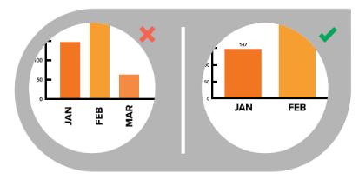
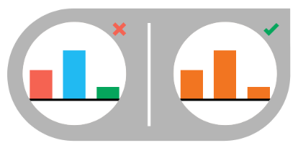
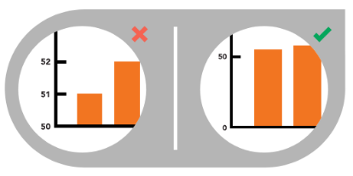
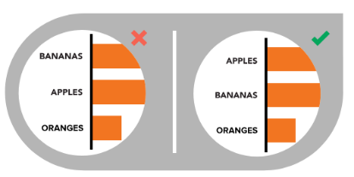
Bar chart – best design practices
Use horizontal labels
Avoid steep diagonal or vertical type, as it can be difficult to read.
Use consistent colours
Use one colour for bar charts. You may use an accent colour to highlight a significant data point.
Start the y-axis value at 0
Starting at a value above zero truncates the bars and doesn’t accurately reflect the full value.
Order data appropriately
Order categories alphabetically, sequentially or by value.

Slide 18
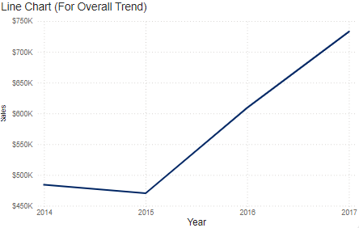
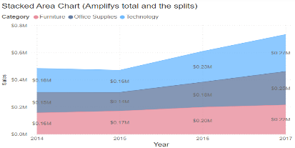
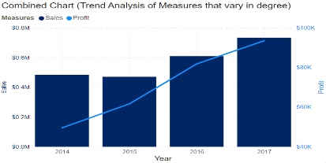
Line chart – variations
Line charts are used to show time-series relationships with continuous data. They help show trend, acceleration, deceleration and volatility.
Line
Best suited for overall trend.
Stacked area chart
Best used to visualise part-to-whole relationships, helping show how each category contributes to the total.
Combined chart
Best suited for trend analysis of measures that vary in degree.

Slide 19
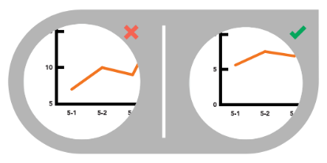
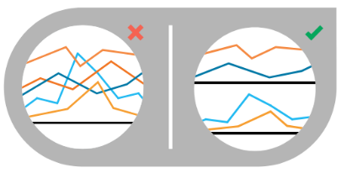
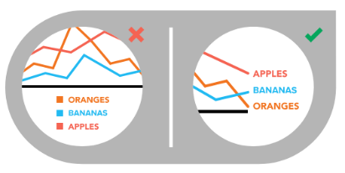
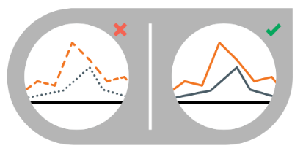
Line chart – best design practices
Include zero baseline if possible
Although a line chart does not have to start at a zero baseline, it should be included if possible.
Don’t plot more than 4 lines
If you need to display more, break them out into separate charts for better comparison.
Label the lines directly
This lets readers quickly identify lines and corresponding labels instead of referencing a legend.
Use solid lines only
Dashed and dotted lines can be distracting.

Slide 20
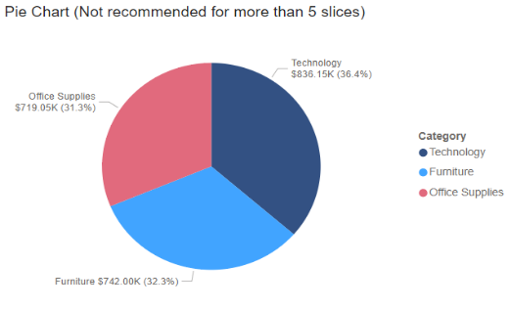
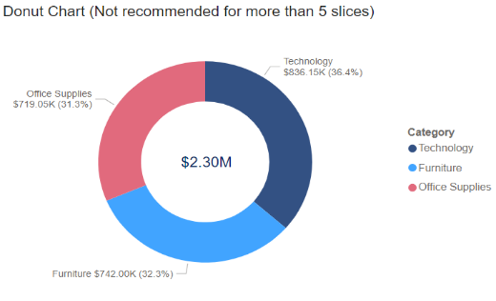
Pie chart – variations
Pie charts are best used for making part-to-whole comparisons with discrete or continuous data. They are most impactful with a small data set.
Pie
Used to show part-to-whole relationships.
Donut
Stylistic variation that enables the inclusion of a total value or design element in the centre.

Slide 21
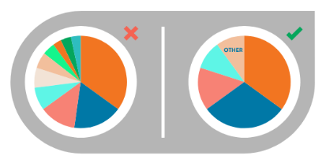
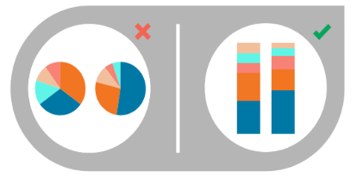
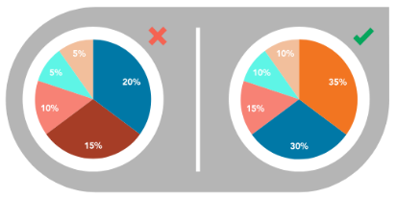
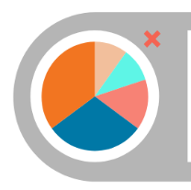
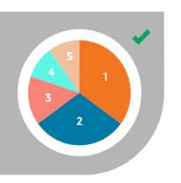
Pie chart – best design practices
Limit chart categories to 5
Depicting too many slices decreases the impact of the visualisation. Use ‘Other’.
Avoid pie chart comparisons
Use stacked bars instead. Slices are tricky to compare.
Make sure the slices add up
Verify that values total 100% and that pie slices are sized proportionate to their value.
Order slices correctly
Largest section at 12 o’clock and place remaining sections in descending order, going clockwise.

Slide 22
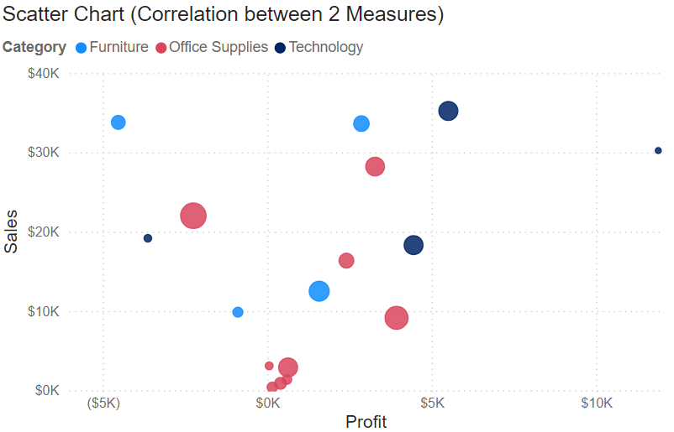
Scatter plot – variation
Scatter plots show the relationship between items based on 2 sets of variables. They are best used to show correlation in a large amount of data.
Scatter
Best used to explore correlation and detect outliers.

Slide 23
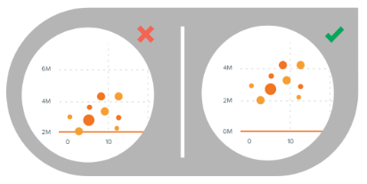
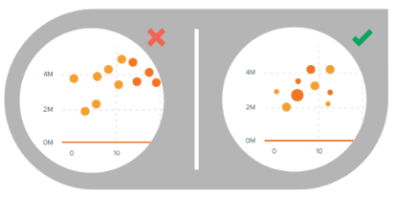
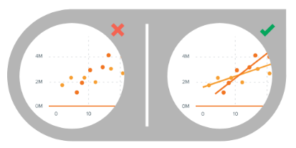
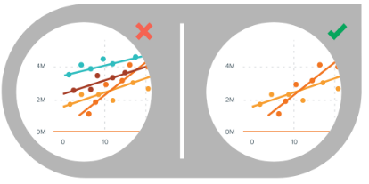
Scatter plot – best design practices
Start y-axis value at 0
Starting the axis above zero truncates the visualisation of values.
Include more variables
Use size and dot colour to encode additional data variables.
Use trend lines
These helps draw correlation between the variables to show trends.
Limit trend line to 2
Too many lines make data difficult to interpret.

Slide 24
Links
Useful reading for data visualisation
Visual Vocabulary
Data Visualization Cheat Sheet
Data Visualization Reference Guides
12 Great Books About Data Visualization
The 10 Best Data Visualization Blogs To Follow

Slide 25
References
This presentation contains NSW Curriculum and syllabus content. The NSW Curriculum is developed by the NSW Education Standards Authority. This content is prepared by NESA for and on behalf of the Crown in the right of the State of New South Wales. The material is protected by Crown copyright.
Please refer to the NESA Copyright Disclaimer for more information https://educationstandards.nsw.edu.au/wps/portal/nesa/mini-footer/copyright.
NESA holds the only official and up-to-date versions of the NSW Curriculum and syllabus documents. Please visit the NSW Education Standards Authority (NESA) website https://educationstandards.nsw.edu.au and the NSW Curriculum website https://curriculum.nsw.edu.au.
Enterprise Computing 11–12 Syllabus © NSW Education Standards Authority (NESA) for and on behalf of the Crown in right of the State of New South Wales, 2022.
Enterprise Computing 11–12 course specifications © NSW Education Standards Authority (NESA) for and on behalf of the Crown in right of the State of New South Wales, 2022.
Cotton R (2022) ‘Data Visualization Cheat Sheet’, Cheat Sheets, DataCamp website, accessed 29 October 2024.
Krum R, InfoNewt LLC (2023) Data Visualization Reference Guides, Cool Infographics website, accessed 29 October 2024.
Salesforce, Inc (2024) ‘The 10 Best Data Visualization Blogs To Follow’, Tableau, accessed 29 October 2024.
Salesforce, Inc (2024) ‘12 Great Books About Data Visualization’, Tableau, accessed 29 October 2024.
Thomas J (n.d.) Visual Vocabulary [Microsoft PowerBI], Microsoft Fabric website, accessed 29 October 2024.

Slide 26
Copyright
© State of New South Wales (Department of Education), 2024
The copyright material published in this resource is subject to the Copyright Act 1968 (Cth) and is owned by the NSW Department of Education or, where indicated, by a party other than the NSW Department of Education (third-party material).
Copyright material available in this resource and owned by the NSW Department of Education is licensed under a Creative Commons Attribution 4.0 International (CC BY 4.0) license.
This license allows you to share and adapt the material for any purpose, even commercially.
Attribution should be given to © State of New South Wales (Department of Education), 2024.
Material in this resource not available under a Creative Commons license:
the NSW Department of Education logo, other logos and trademark-protected material
Material owned by a third party that has been reproduced with permission. You will need to obtain permission from the third party to reuse its material.
Links to third-party material and websites
Please note that the provided (reading/viewing material/list/links/texts) are a suggestion only and implies no endorsement, by the New South Wales Department of Education, of any author, publisher, or book title. School principals and teachers are best placed to assess the suitability of resources that would complement the curriculum and reflect the needs and interests of their students.
If you use the links provided in this document to access a third-party’s website, you acknowledge that the terms of use, including licence terms set out on the third-party’s website apply to the use which may be made of the materials on that third-party website or where permitted by the Copyright Act 1968 (Cth). The department accepts no responsibility for content on third-party websites.

