Slide 1
Instructions for use
This resource is not a teaching and learning program. It should be used in conjunction with the program and teacher resource Software Engineering 11–12 – Secure software architecture.
Classroom teachers are encouraged to add and adapt slides as required to meet the needs of their students.
Save a copy of the file to make changes to the slide deck. Go to File > Download a Copy (this downloads a copy to the computer to edit in the PowerPoint app).
To convert the PowerPoint to Google Slides:
Upload the file into Google Drive and open it.
Go to File > Save as Google Slides.
(Note: conversion may cause formatting changes in the slides.)

Slide 2
Secure software architecture
Software Engineering 11–12

Slide 3
Learning intentions and success criteria
We are learning to
understand the purpose and benefits of secure software architecture
identify and apply key concepts from secure software architecture.
We can
explain why secure software architecture is essential for reducing cyber attacks
apply key concepts to code and a security report.
Notes:
Notes for teachers:
Learning intentions and success criteria are best co-constructed with students. Adapt the learning intention as required and add matching success criteria.
For more information See ⁠AITSL or the NSW Department of Education explicit teaching strategies, ⁠Sharing learning intentions and ⁠Sharing success criteria
LISC is not necessarily presented at the beginning of the lesson. Teacher needs to consider most effectual time to introduce
LISC should be revisited during the lesson to support students' evaluation of their learning

Slide 4
Defining secure coding

Slide 5
Defining secure coding
Preventing cybersecurity incidents starts with the source code
Secure coding is the practice of writing software in a way that protects it from vulnerabilities.
This practice is crucial in software development because it directly addresses the increasing concerns of cyber threats and security breaches.
Secure coding is not just about fixing bugs after they are discovered, it is about proactively designing and writing code to prevent security vulnerabilities from occurring in the first place.
Security from the start helps reduce long-term costs which may arise if an exploit results in the leak of sensitive information of users.

Slide 6
Why write secure code?
‘The security of software is as important as its functionality.’ – The Art of Secure coding (Prasad 2024)
Developing secure software to minimise cyber attacks and vulnerabilities protects data and systems, enhances trust, ensures regulatory compliance, improves business continuity, saves costs and provides a competitive edge in the market.
Secure coding is more than just writing, compiling and releasing code into applications.
It requires an understanding of secure software architecture: the IT infrastructure, hardware, software and systems.

Slide 7
Key concepts

Slide 8
Key concepts
Provide a definition, characteristics and example of each
Topics
Data protection
Cyber attacks
Static application security testing (SAST)
Dynamic application security testing (DAST)
Vulnerability assessment
Penetration testing
API security
Cross-site scripting (XSS)
Notes:
A definition provides the fundamental meaning of a term or concept, while characteristics offer detailed descriptions that help to elaborate on and understand the concept more fully.
Definitions are about what something is, while characteristics describe how it is or what it is like.
The characteristics of an apple might include: "Sweet or tart flavour, high in vitamin C, can be eaten raw or cooked, comes in various varieties such as Granny Smith and Fuji, and has a core with seeds. The definition of "apple" could be: "A round fruit produced by the apple tree, typically with red, green, or yellow skin, and a crisp texture.

Slide 9
Data protection (sample)
Topic | Data protection
Definition | The process of protecting sensitive information from damage, loss or corruption (Imperva 2024a).
Characteristics | Confidentiality: securing protection of data from unauthorised access, permitting only select users with proper authorisation and credentials. Integrity: maintaining data to be trustworthy, reliable, accurate, and complete without accidental alteration or modification. Availability: ensuring that data is readily accessible and available when needed for ongoing business continuity.
Example | Data security: authentication is required to access data. Access controls: the user must be authorised to view data. Storage requirements: Is data protected when stored and transferred?
Notes:
Teachers use the 5 why’s approach to deepen discussion around these concepts.

Slide 10
Cyber attacks (sample)
Topic | Cyber attacks
Definition | Acts performed by individuals with harmful intent, whose goal is to steal data, cause damage to or disrupt computing systems (Imperva 2024b).
Characteristics | Includes malware, social engineering, man in the middle (MitM) attacks, denial-of-service (DoS), and injection attacks.
Example | Common examples of cyber attacks: malware, phishing, man-in-the-middle attack, denial-of-service attack, Structured Query Language (SQL) injection, zero-day exploit, domain name system (DNS) tunnelling.
Notes:
Students investigate each of these examples of cyber attackers and share with the class.

Slide 11
Static application security testing (SAST) (sample)
Topic | Static application security testing (SAST)
Definition | Static Application Security Testing (SAST), are ‘white-box’ tools to inspect source code (Imperva 2024c).
Characteristics | A developer's approach – testers have access to underlying framework, design and implementation to fix vulnerabilities early in the development cycle without executing the program. Code is analysed more quickly than humans and real-time feedback with graphical representations show the exact location of vulnerabilities and problem code. Customized reports for dashboards can be produced and the process can be automated.
Example | Some examples of SAST Tools: Aikido Security, SAST by Cycode, Checkmarx, Contrast Security, Fortify, GitLab, HCL AppScan, Snyk, Sonar, Coverity Static Analysis by Synopsys, Veracode.

Slide 12
Dynamic application security testing (DAST) (sample)
Topic | Dynamic application security testing (DAST)
Definition | Dynamic Application Security Testing (DAST), are ‘black-box’ tools to test products during operation and provide feedback on compliance and general security issues. These tools are used during the testing phase (late in the cycle) (Imperva 2024c).
Characteristics | A hacker's approach: testers have no knowledge of the internals. Testing highlights authentication and server configuration issues and is language independent. The tests evaluate the whole application and system, checks memory consumption and resource use and attempts to break encryption algorithms from the outside. The tests check for cross-site scripting, SQL injection, and cookie manipulation, as well as for vulnerabilities in third-party interfaces.
Example | Some popular DAST tools include: The Open Worldwide Application Security Project (OWASP), Zed Attack Proxy (ZAP), Arachni, Web Application Attack and Audit Framework (w3af).

Slide 13
Vulnerability assessment (sample)
Topic | Vulnerability assessment
Definition | A systematic review of security weaknesses in an information system (Imperva 2024d).
Characteristics | Evaluates if the system is susceptible to any known vulnerabilities, assigns severity levels to those vulnerabilities, and recommends remediation or mitigation, if and whenever needed.
Example | Types: host assessment of critical servers, which may be vulnerable to attacks. Network and wireless assessment of policies and practices to prevent unauthorized access to private or public networks and network-accessible resources. Database assessment of databases or big data systems for vulnerabilities and misconfigurations. Application scans to identify security vulnerabilities in web applications and their source code.

Slide 14
Penetration testing (sample)
Topic | Penetration testing
Definition | Also known as a pen test, it is a simulated cyber attack against your computer system to check for exploitable vulnerabilities (Imperva 2024e).
Characteristics | Involves the attempted breaching of any number of application systems (for example, application protocol interfaces (APIs), frontend or backend servers) to uncover vulnerabilities, such as unsanitised inputs that are susceptible to code injection attacks.
Example | Tools commonly used for pen testing: vulnerability scanner, web proxy, network sniffer, port scanner, password cracker.

Slide 15
API security (sample)
Topic | API security
Definition | API security is the use of any security practice relating to application programming interfaces (APIs). API security involves managing API privacy and access control, and the identification and remediation of attacks on APIs. These attacks exploit API vulnerabilities or reverse engineer APIs .
Characteristics | Developers build client-side web or mobile application that interacts with the server-side via APIs. Being available through public networks (accessed via any location), they are easily accessible to attackers. Being well-documented makes them simple to reverse-engineer a natural target for cybercriminals and they are especially sensitive to denial-of-service (DoS) attacks. API security focuses on securing this application layer and attending to what may happen if a cybercriminal interacts directly with the API.
Example | Broken authentication, unrestricted resource consumption, server-side request forgery (SSRF), security misconfiguration.
Notes:
An Application Programming Interface (API) is a software intermediary that allows your applications to communicate with one another.
Students investigate examples of current API security concerns: https://owasp.org/API-Security/editions/2023/en/0x11-t10/

Slide 16
Cross-site scripting (XSS) (sample)
Topic | Cross-site scripting (XSS)
Definition | A cyber-attack method that involves running malicious code as part of a vulnerable web application (Dizdar 2022).
Characteristics | A type of cyber-attack where a threat actor injects malicious code into a trusted website. The code is then delivered to a victim’s browser. Unlike other attack vectors like SQL injections, XSS does not target the application directly – it primarily targets the user. XSS is one of the most common web application vulnerabilities.
Example | Real life examples of cross-site scripting attacks include: British Airways Fortnite eBay
Notes:
An Application Programming Interface (API) is a software intermediary that allows your applications to communicate with one another.

Slide 17
Vulnerabilities

Slide 18
Learn about this vulnerability (1)
Structured Query Language (SQL) injection
Cross-site scripting (XSS)
Cross-site forgery request (CSFR)
Invalid forwarding and redirecting
Memory management
Session mismanagement
Broken authentication
Race conditions

Slide 19
Learn about this vulnerability (2)
Complete the online lessons for each vulnerability
SQL injection: https://www.hacksplaining.com/lessons/sql-injection/start
Cross site scripting: https://www.hacksplaining.com/lessons/xss-stored/start
Cross site forgery request: https://www.hacksplaining.com/lessons/csrf/start
Invalid forwarding and redirecting: https://www.hacksplaining.com/lessons/open-redirects/start
Memory management: https://www.hacksplaining.com/lessons/information-leakage/start
Session mismanagement: https://www.hacksplaining.com/lessons/session-fixation/start
Broken authentication: https://www.hacksplaining.com/lessons/password-mismanagement/start
Race conditions: Foundations of Cybersecurity 2–6: Race Conditions (9:09)
For each lesson take a screenshot and annotate the picture with an explanation of what is happening. Share this with the class.

Slide 20
Familiarisation questions
Slides 21 to 33 contain content sourced from the HSC Software Engineering Familiarisation Questions (NESA 2024)

Slide 21
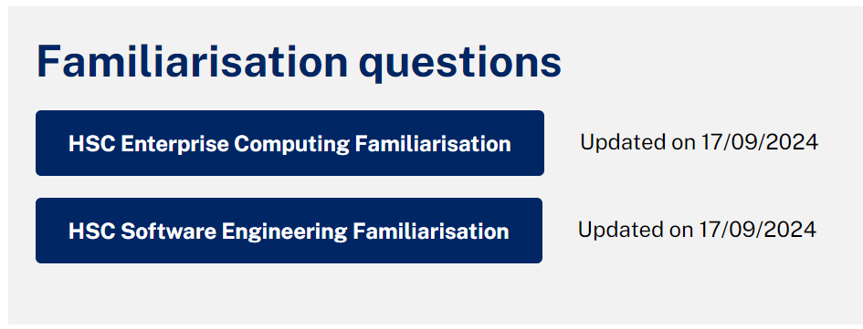
NESA advice
Secure software architecture
‘Secure Software Architecture provides opportunities for students to develop knowledge, understanding and skills associated with developing secure software.
Students investigate and practise industry-recognised techniques for developing secure programming code and how these techniques contribute to the development of secure software.’ (NESA 2022)
Image adapted from NESA (2024).
Notes:
The Secure Software Architecture focus area may be studied independently or combined with the Programming for the Web topic to support the consolidation of key concepts experienced by software development engineers.

Slide 22
HSC Software Engineering Familiarisation Question 6
A new operating system is to be developed for a mobile phone.
The operating system needs to allow users to install a variety of third-party applications such as social media applications and games on the phone.
Marking criteria:
Discuss the use of sandboxing in this operating system. (3 marks)
Provides a thorough discussion of the use of sandboxing in the operating system. (3 marks)
Shows some understanding of the advantages and/or disadvantages of the use of sandboxing. (2 marks )
Identifies a feature of sandboxing. (1 mark)
Notes:
How confident are you in teaching this content, theoretically or practically?

Slide 23
Sample answer
HSC Software Engineering Familiarisation Question 6
Sandboxing allows each application to be isolated so that it cannot pose a security risk by accessing system resources or other applications.
However, it requires more resources, as each application requires its own container.
It may also be less convenient for users to access resources such as the device's camera or files, as the sandbox will either prevent access or make it more difficult.

Slide 24
Sample answers (2)
HSC Software Engineering Familiarisation Question 6
Sandboxing limits the resource use of different processes (for example, applications) running on the device, ensuring that if a process contains bad code, such as a memory leak, it does not consume all the resources of the operating system — potentially starving other processes, or the operating system itself, of resources.

Slide 25
HSC Software Engineering Familiarisation Question 9 (6 marks)
A web form has a number of fields including username, password and date of birth.
Each username must satisfy these rules.
There must be no more than 8 characters.
Only uppercase and lowercase letters are accepted.
The character "<" is not allowed, to prevent attempts at injecting code through the username.
9 (a) Distinguish between input validation and sanitisation.
Support your answer with examples from the web form. (3 marks)
Notes:
How confident are you in teaching this content, theoretically or practically?

Slide 26
HSC Software Engineering Familiarisation Question 9(a) (3 marks)
Criteria:
Clearly distinguishes between input validation and sanitization
Provides examples from the web form. (3 marks)
Shows a clear understanding of input validation or sanitisation and provides an example.
OR
Shows some understanding of input validation and sanitisation. (2 marks)
Identifies a feature of input validation or sanitisation. (1 mark)
Notes:
Answer discussed
Note: Link is just for reference

Slide 27
Sample answer – Question 9 (a)
HSC Software Engineering Familiarisation Question 9 (6 marks)
Input validation ensures that input conforms to a set of defined rules.
For example, the 'date of birth' field may require a date in the form dd/mm/yyyy.
Sanitisation involves checking, cleaning and filtering data inputs of any unwanted characters and strings to prevent the injection of harmful codes into the system.
For example, '<' is not allowed in usernames.
Notes:
Answer discussed
Note: Link is just for reference

Slide 28
HSC Software Engineering Familiarisation Question 9 (continued)
A web form has a number of fields including username, password and date of birth.
Each username must satisfy these rules.
There must be no more than 8 characters.
Only uppercase and lowercase letters are accepted.
The character "<" is not allowed, to prevent attempts at injecting code through the username.
9 (b) Write a function in Python that will check whether a username satisfies the rules. (3 marks)
Notes:
How confident are you in teaching this content, theoretically or practically?

Slide 29
HSC Software Engineering Familiarisation Question 9 (6 marks) (4)
Criteria
Provides a correct function in Python that checks whether a username satisfies the rules. (3 marks)
Provides a partially correct function in Python that attempts to check whether a username satisfies the rules. (2 marks)
Shows some understanding of the problem and Python programming. (1 mark)
Notes:
How confident are you in teaching this content, theoretically or practically?

Slide 30
Sample answer – Question 9 (2)
HSC Software Engineering Familiarisation Question 9 (6 marks)
def validateUsername (username) :
# Length check
if len (username) > 8:
return False
# Alpha character only check
elif username . isalpha() == False:
return False
# < character check
elif “<“ in username:
return False
# If we reach here then the username meets the requirements
return True
Answers may include print statements to test the code.
For example:
print (validateUsername ( “test"))
Notes:
How confident are you in teaching this content, theoretically or practically?

Slide 31
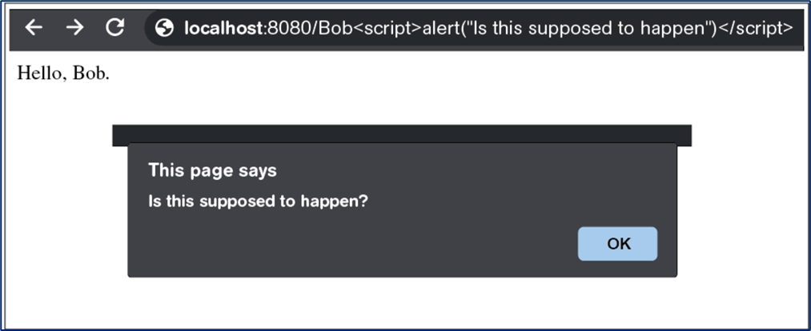
Question 11 (3 marks) (1)
Bob is testing a website for vulnerability. The website allows the user to add their name at the end of the URL and print their name on the webpage. In addition to his name, Bob has added some code to the URL and the following is displayed.
Notes:
Answer discussed
Note: Link is just for reference

Slide 32
Question 11 (3 marks) (2)
11 (a) What type of vulnerability is being demonstrated? (1 mark)
Invalid redirecting
Cross site scripting
Broken authentication
Cross site request forgery
11 (b) Explain ONE way to minimise this vulnerability. (2 marks)
Notes:
How confident are you in teaching this content, theoretically or practically?
What would you expect from a band 5-6 student?

Slide 33
Sample answer – Question 11
Criteria
Question 11 (a) Correct answer.
Question 11 (b) Explains ONE way to minimise the vulnerability. (2 marks)
Provides some relevant information. (1 mark)
Sample answer:
Question 11 (a): Cross site scripting
Question 11 (b): The website could check and change user input so that markup and script become plain text. This will still allow the page to display the information but will prevent it from executing script code.
Note:
For example, special characters such as < > and ( ) would be encoded to their HTML equivalent (%3C %#E and %28 %29).
Notes:
How confident are you in teaching this content, theoretically or practically?
What would you expect from a band 5-6 student?

Slide 34
Links
Useful reading for Secure software architecture
SQL injection
Cross-site scripting
Cross-site forgery request
Invalid forwarding and redirecting
Memory management
Session mismanagement
Broken authentication
Race conditions

Slide 35
References (1)
This presentation contains NSW Curriculum and syllabus content. The NSW Curriculum is developed by the NSW Education Standards Authority. This content is prepared by NESA for and on behalf of the Crown in the right of the State of New South Wales. The material is protected by Crown copyright.
Please refer to the NESA Copyright Disclaimer for more information https://educationstandards.nsw.edu.au/wps/portal/nesa/mini-footer/copyright.
NESA holds the only official and up-to-date versions of the NSW Curriculum and syllabus documents. Please visit the NSW Education Standards Authority (NESA) website https://educationstandards.nsw.edu.au/wps/portal/nesa/home and the NSW Curriculum website https://curriculum.nsw.edu.au.
Software Engineering 11–12 Syllabus © NSW Education Standards Authority (NESA) for and on behalf of the Crown in right of the State of New South Wales, 2022.
Software Engineering 11–12 Course Specifications © NSW Education Standards Authority (NESA) for and on behalf of the Crown in right of the State of New South Wales, 2022.
Cisco Systems, Inc (2024) ‘What Are the Most Common Cyber Attacks?’, Security, Cisco website, accessed 19 November 2024.
Dizdar A (4 April 2022) ‘What is XSS? Impact, Types, and Prevention’, Bright Security blog, accessed 19 November 2024.
Dizdar A (28 June 2023) ‘11 API Security Best Practices You Must Know’, Bright Security blog, accessed 19 November 2024.
Imperva (2024a)’Data Protection’, Imperva Learning Center: Data Security, Imperva website, accessed 19 November 2024.
——(2024b) ‘Cybersecurity Threats’, Imperva Learning Center: Cybersecurity 101, Imperva website, accessed 19 November 2024.

Slide 36
References (2)
——(2024c) ‘SAST, DAST, IAST and RASP’, Imperva Learning Center: Cybersecurity Solutions and Tools, Imperva website, accessed 19 November 2024.
——(2024d) ‘Vulnerability Assessment’, Imperva Learning Center: Testing and Assessment, Imperva website, accessed 19 November 2024.
——(2024e) ‘Penetration Testing’, Imperva Learning Center: Testing and Assessment, Imperva website, accessed 19 November 2024.
NESA (NSW Education Standards Authority) (2022) ‘Year 12 – Teaching advice for Secure software architecture: Why is it important?’, Software Engineering 11–12 Syllabus: Content, NESA website, accessed 19 November 2024.
NESA (2024) ‘HSC Software Engineering Familiarisation’, Familiarisation questions, HSC Online Examinations, accessed 19 November 2024.
OWASP (Open Worldwide Application Security Project) API Security Project team (2023) ‘OWASP Top 10 API Security Risks – 2023’, OWASP API Security Top 10: 2023, OWASP website, accessed 19 November 2024.
Prasad V (14 March 2024) ‘The Art of Secure Coding’, AppSecEngineer blog, accessed 19 November 2024.
Proofpoint (2024) ‘What Is Data Protection?’, Cybersecurity Glossary, Proofpoint website, accessed 19 November 2024.

Slide 37
Copyright
© State of New South Wales (Department of Education), 2024
The copyright material published in this resource is subject to the Copyright Act 1968 (Cth) and is owned by the NSW Department of Education or, where indicated, by a party other than the NSW Department of Education (third-party material).
Copyright material available in this resource and owned by the NSW Department of Education is licensed under a Creative Commons Attribution 4.0 International (CC BY 4.0) license.
This license allows you to share and adapt the material for any purpose, even commercially.
Attribution should be given to © State of New South Wales (Department of Education), 2024.
Material in this resource not available under a Creative Commons license:
the NSW Department of Education logo, other logos and trademark-protected material
material owned by a third party that has been reproduced with permission. You will need to obtain permission from the third party to reuse its material.
Links to third-party material and websites
Please note that the provided (reading/viewing material/list/links/texts) are a suggestion only and implies no endorsement, by the New South Wales Department of Education, of any author, publisher, or book title. School principals and teachers are best placed to assess the suitability of resources that would complement the curriculum and reflect the needs and interests of their students.
If you use the links provided in this document to access a third-party’s website, you acknowledge that the terms of use, including licence terms set out on the third-party’s website apply to the use which may be made of the materials on that third-party website or where permitted by the Copyright Act 1968 (Cth). The department accepts no responsibility for content on third-party websites.

