Slide 1
High potential and gifted education – Curriculum Reform
Information for leaders
Notes:
Purpose – this slide deck is designed for all leaders to download and use with their staff to learn more about HPGE alignment with NSW Curriculum Reform
Speaker notes - In this slide deck school leaders will learn how HPGE guiding principles and concepts align with NSW Curriculum Reform.

Slide 2
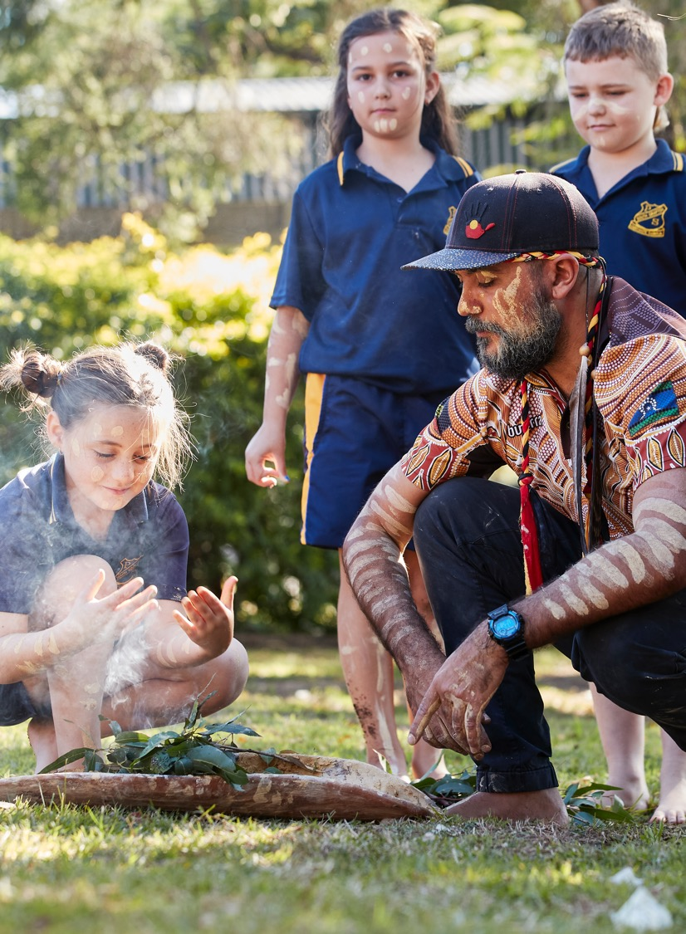
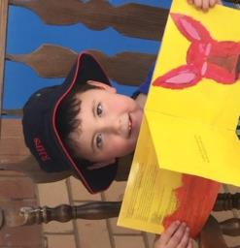
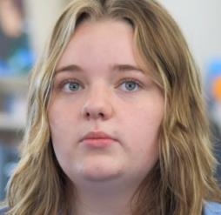
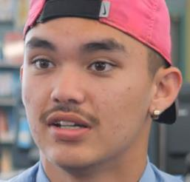
Acknowledgement of Country
We recognise the Ongoing Custodians of the lands and waterways where we work and live. We pay respect to Elders past and present as ongoing teachers of knowledge, songlines and stories.
We strive to ensure every Aboriginal and Torres Strait Islander learner in NSW achieves their potential through education.
Tahj
Ben
Bethany
Dylan
Notes:
Purpose – Acknowledgement of country
Speaker notes
One of the HPGE Policy aims is specifically to close excellence gaps for Aboriginal and Torres Strait Islander students. The starting point is knowing and celebrating who these students are. High potential and gifted Aboriginal students are a diverse group, whose needs depend on individual circumstances. Aboriginal students can display high potential across any of the four domains of potential – intellectual, creative, social-emotional and physical. Engaging activities that are culturally relevant, challenging and individually appropriate for these students should take place in an environment that is culturally safe.
The faces of the students you see here – Tahj, Ben, Bethany and Dylan, represent Aboriginal HPGS who across 4 domains have illustrations of practice created on the HPGE web page. Go the illustrations of practice page for more information. https://education.nsw.gov.au/teaching-and-learning/high-potential-and-gifted-education/supporting-educators/illustrations-of-practice

Slide 3
Key actions and guiding principles
High potential and gifted education policy
5 key actions
4 guiding principles
Excellence and equity
All students regardless of background or personal circumstance require access to learning programs that enable them to aspire to and achieve personal excellence.
Evaluate
Implement
High expectations for all students
Our commitment to high expectations for all students includes high potential and gifted students.
Build capacity
Quality teaching, learning, leadership
Achieving excellence for high potential and gifted students is underpinned by effective school environments including quality teaching, learning and leadership.
Collaborate
A continuum of potential
Potential exists along a continuum, where degrees of potential require differing approaches and levels of adjustment and intervention.
Assess and identify
Notes:
Purpose - to outline the 5 key actions framework for schools and guiding principles of the HPGE
Speaker notes
A 5 key action policy framework is designed to assist schools with beginning their HPGE Policy implementation journey. These key actions are iterative, and schools can start at any place in the process. The HPGE web pages are currently designed around these 5 key actions to support schools in finding required information.
CLICK
4 guiding principles outline the core concepts that guide thinking in policy implementation. They include:
excellence and equity – All students regardless of background or personal circumstance require access to learning programs that enable them to aspire to and achieve personal excellence.
high expectations – Our commitment to high expectations for all students includes high potential and gifted students.
quality teaching, learning and leadership – Achieving excellence for high potential and gifted students is underpinned by effective school environments including quality teaching, learning and leadership.
potential on a continuum – Potential exists along a continuum, where degrees of potential require differing approaches and levels of adjustment and intervention.
To find out more, these principles are further described in a guiding principles video on the HPGE web page:
Additional information
Key actions web link - https://education.nsw.gov.au/teaching-and-learning/high-potential-and-gifted-education/supporting-educators#50
Guiding principles web link - https://education.nsw.gov.au/teaching-and-learning/high-potential-and-gifted-education/HPGE-policy-information#Guiding2

Slide 4
4 domains of potential
Intellectual
Social-emotional
Physical
Creative
Notes:
The 5 key actions and 4 guiding principles relate equally to the 4 domains of potential to provide focus for talent development:
CLICK – intellectual
CLICK – social-emotional
CLICK – physical and the
CLICK – creative domains
Additional information
For further detail on:
Domains of potential definitions – https://education.nsw.gov.au/teaching-and-learning/high-potential-and-gifted-education/HPGE-policy-information#Domains5
Indicators or signs of high potential in each domain – https://education.nsw.gov.au/teaching-and-learning/high-potential-and-gifted-education/supporting-educators/assess-and-identify#Signs6
Research and discussion papers for each domain - https://education.nsw.gov.au/teaching-and-learning/high-potential-and-gifted-education/HPGE-research#Research1

Slide 5
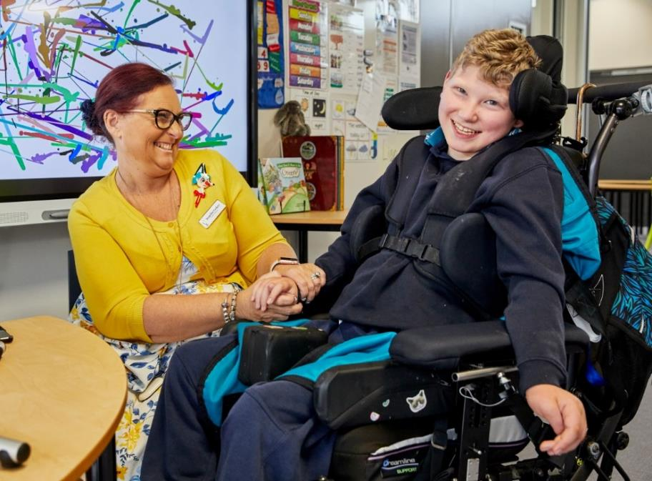
Misconceptions about high potential and gifted students
High potential and gifted students will make it on their own.
High potential and gifted students are a homogenous group.
You cannot have high potential and a disability.
Acceleration is not effective and can be harmful.
Identification of high potential and gifted students is obvious.
A differentiated curriculum suffices.
Notes:
Purpose - to provide background information about some key misconceptions in gifted education and consider how that might impact the understanding of our policy implementation journey
Speaker notes
Misconceptions about high potential and gifted learners can significantly impact appropriate education of advanced ability students across all 4 domains of potential.
Rebutting these prevalent misconceptions assists with understanding the evidence base about how HPG students best learn, and which strategies are effective in optimising their growth and achievement.
Which of these misconceptions resonates with you?
How can the 4 domains be considered?
Background information:
Misconception #1: “HPG students don’t need help; they can make it on their own."
Truth: Would you expect that an elite athlete train for the Olympics without a coach or support? HPGS students, like all students, require well-trained teachers who challenge and support them in order to fully develop their abilities. Many HPG students may be so far ahead of their same-age peers, in one or more domains, that they know more than half of the grade-level curriculum before the school year even begins. Resulting boredom and frustration can lead to low achievement, despondency, or unhealthy learning habits. Some research has found levels of underachievement as high as 57% (Peterson & Colangelo 1996).
Underachievement describes a discrepancy between a student’s performance and their actual ability. The roots of this problem differ, based on individual experience. Some students may mask abilities to try to fit in socially with their same-age peers, and still others may have a learning disability that masks their potential and/or giftedness. Others may be achieving highly and yet still underachieving – not performing to the best of their true potential or ability.
Prof Françoys Gagne’s DMGT model reinforces the powerful role of the teacher in finding and nurturing talent in their classrooms. Some teachers who believe this misconception may leave their HPGS to work in the corner on an individual project or task, without any explicit teaching, or they may provide “fast finisher” tasks …but this is just more of the same to keep students ‘busy’. Some of these students realise that working faster means they get more to do and either underachieve, work slower, become a behaviour problem or refuse to attend school. Any ‘extra’ tasks should be qualitatively different, not just more of the same, and should be accompanied by quality explicit teaching as would be expected for other students on the continuum of ability. Similarly, HPG students benefit from interactions with peers at similar ability levels and can become bored, frustrated, and unmotivated when not placed in ability groups with like-minded individuals. You wouldn’t expect an elite musician to be playing with beginners all the time and also expect they would be motivated to improve their ability.
An earlier belief (e.g. Berger 1991) that gifted students do not need as much structure or scaffolding in their learning has been dispelled by recent research. Instead, research in cognitive science fields indicates that gifted learners benefit from explicit teaching techniques such as worked examples, scaffolding, and well-sequenced learning tasks, especially in the early stages of learning a new topic or skill (Martin 2016).
Misconception #2: “HPGS are a homogenous group and teachers know how to develop their talent.
Truth: HPGS are not a homogenous group, particularly when we consider high potential across 4 domains: intellectual, creative, physical and social-emotional and that these students can be represented in disadvantaged communities , such as those from rural and remote areas, culturally diverse linguistic backgrounds, low SES communities or with a disability.
More recent research acknowledges that ability sits on a continuum whereby students fall along that continuum across all domains of potential. Although teachers try to address this range of ability and aim to challenge all students, they are frequently unfamiliar with the needs of the range of HP & gifted children.
As of October 2023, the NSW HPGE Attitudes and Teaching Practices Survey (ATPS) (1025 schools and 30 500 participants) found that 58% had fewer than 5 years teaching experience teaching HPGS and 13 % had undergraduate training in gifted ed. 41% had no training at all, with 76% not possessing additional qualifications, skills, and/or experience in one of more of the 4 domains of potential. 67% agreed that HPG students cannot achieve on their own. 50% agreed that teacher training is a determining factor in the success of hpgs outcomes. 88% agreed that all teachers require ongoing PL to improve the growth and achievement of HPG students.
Other studies conducted by the Fordham Institute found that 58% of teachers have received no professional development focused on teaching advanced students and 73% of teachers agreed that “Too often, the brightest students are bored and under-challenged in school–we’re not giving them a sufficient chance to thrive.” This report confirms that not all teachers are able to recognize and support HP & gifted learners.¹
Misconception #3: “Students can’t have high potential or be a gifted learner if they have a disability."
Truth: Some HPG students also have learning or other disabilities. These students often go unidentified in classrooms because their disability and high potential mask each other, making them appear “average” or not high potential at all. Other HPG students are identified as having a learning disability and, as a result, are not considered for gifted programs or classes. In both cases, it is important to focus on a student’s strengths and allow them to have challenging curricular in addition to receiving support for their learning disability .
A study undertaken in partnership between the University of Wollongong and the NSW department of education revealed that at least 11% of HPGS in NSW classrooms also have a disability. Other studies such as that conducted by Karen Rogers (2011) found up to 14% .
Additional information about this can be found in the report https://education.nsw.gov.au/content/dam/main-education/teaching-and-learning/high-potential-and-gifted-education/survey-hpg-students-with-disability-2021.pdf and on the HPGE web page https://education.nsw.gov.au/teaching-and-learning/high-potential-and-gifted-education/HPGE-research#High0
Misconception #4: "Acceleration options are not effective or can be socially harmful."
Truth: Research shows that many teachers and school leaders hold negative views on acceleration, with particular concern over social and emotional issues (Rambo & McCoach 2012; Dare, Smith & Nowicki 2016) Extensive research shows that these concerns are generally unfounded (Neihart 2007). Like all educational interventions, the quality of the implementation of an acceleration is the key to its success.
Acceleration allows students to progress to the next grade or stage of learning earlier than is usual for a student of that age (Pressey 1949). This can be for a subject or whole grade. It creates a closer match between student ability and the curriculum, potentially reducing boredom and increasing engagement for gifted students (Tannenbaum 1983). Acceleration also recognises the capacity of gifted students to potentially master new content and skills faster than their age peers (Geake 2009b). Research supports that these students naturally gravitate toward older students who are more similar as “intellectual peers.” Studies have shown that many students are happier with older students who share their interests than with children the same age.³ Therefore, acceleration placement options such as early entrance to kindergarten, grade acceleration, or early exit should be considered.
Acceleration is one of the most effective educational interventions for gifted students (Rogers 2007, 2015). Repeated meta-analyses and systematic reviews of the research evidence on acceleration across a vast diversity of educational settings and contexts have shown that all forms of acceleration can offer significant learning benefits for gifted students (Steenbergen-Hu & Moon 2011; Warne 2017). The typical effect size of acceleration is between +0.42 and +1.62 standard deviations of learning growth, placing acceleration among the most effective educational practices (Steenbergen-Hu, Makel & Olszewski-Kubilius 2016).
Research also confirms a lack of empirical evidence that acceleration results in negative academic or social outcomes for students. These findings have been consistent across students from diverse backgrounds (Lee et al. 2010). Early entry to school and radical (double) acceleration are also supported by the literature (Gross 2006; Rogers 2015).
Acceleration can be more effective when it is used earlier in a student’s schooling (Gross 1992, 2006; Gallagher et al. 2010; Rogers 2015).
Misconception #5: “Identification of HPGS is obvious
For some schools, assessment and identification of HPGS can often be a controversial aspect (Moon 2012) where there are winners and losers due to cut off points and rigid programs. Knowing students well, including their interests, passions and ability is crucial in being able to identify their unique learning needs.
The HPGE Policy instead places focus not on identification as a label for students, but rather that teachers should instead focus on assessing identifying a student’s needs in an ongoing manner. Gifted students with disability often underachieve due to lack of identification, a lack of appropriate educational programming and support, and lack of strategies in schools to meet their social and emotional needs (Wormald & Vialle 2011; Foley-Nicpon et al. 2011). NESB students may experience challenges in demonstrating their HP with language barriers impeding identification of these students.
Problems with assessment and identification practices may lead to fewer low-SES students being identified and selected for gifted student programs (Hodges et al. 2018), meaning they miss out on programs that may benefit them the most (Loveless 2014). A study by Hamilton et al. (2018) showed that bright but disadvantaged students in lower SES areas were less likely to be identified or nominated than similar students in more average schools. The Equity Placement Model (nsw.gov.au) has been designed to make access to OC and SHS programs fairer for under-represented groups.
Flawed identification and assessment practices are believed to contribute significantly to the under-representation and underachievement of students from minority and low-socioeconomic backgrounds, as well as gifted students with learning difficulties (McCoach et al. 2001) Culturally sensitive assessment tools and those that target spatial ability rather than verbal or mathematical will help to identify those students form these groups.
Current best-practice in school-based identification and assessment is to use multiple measures – that is, a mix of qualitative, quantitative, objective, and observational methods – that have strong validity and reliability characteristics (Moon 2012; Acar et al. 2016) and to assess attributes and learning directly relevant to the gifted programs used (Hamilton et al., 2019).
Misconception#6: “Differentiated curriculum suffices and is enough to meet the need so of HPG students
Truth: Curriculum differentiation occurs where teachers adapt the syllabus to meet the specific learning needs of a group of students. Curriculum differentiation strategies aim to meet advanced learning needs by increasing the level of challenge, complexity, depth and learning pace (Kaplan 2009; Warne 2017).
However, other forms of differentiation such as curriculum acceleration, extension and enrichment, and formative assessment-informed learning experiences have strong potential for classroom use. Positive outcomes have been shown when learning experiences have been matched to the assessed advanced learning needs of gifted students (Gavin et al. 2007; Fischer, Frey & Hattie 2016). This may include role models, mentors and other advanced learning pathways.
Other examples of misconceptions include:
Misconception "All children have high potential."
Truth: All children have strengths and positive attributes, but not all children are gifted in the educational sense of the word. The “high potential or gifted” label in a school setting means that when compared to others in their age or grade, a child has an advanced capacity to learn and apply what is learned in one or more domains of potential. This advanced capacity requires modifications to the regular curriculum to ensure these children are challenged and learn new material (Gagne, 2008). Gifted does not connote good or better; it is a term that allows students to be identified for teaching and learning that is appropriately matched to their unique learning needs.
Misconception "Gifted education programs are elitist."
Truth: Gifted education programs are meant to help all high-ability students achieve their potential in one or more domains. Gifted learners are found in all cultures, ethnic backgrounds, and socioeconomic groups. However, many of these students are denied the opportunity to maximize their potential because of the way in which programs and services are funded, and/or flawed identification practices or a lack of understanding of how to best meet their learning needs. For example, reliance on a single test score for an extension program may exclude students with different cultural experiences and opportunities. (Loveless, 2014; Hamilton et al, 2018)
Misconception "Gifted students are happy, popular, and well adjusted
Truth: Many HPG students flourish in their community and school environment. However, some differ in terms of their emotional and moral intensity, sensitivity to expectations and feelings, perfectionism, and deep concerns about societal problems. Others do not share interests with their classmates, resulting in isolation or being labelled unfavourably as a “nerd.” Some mask their true ability to ‘fit in’ with their age peers and go through a ‘forced choice’ dilemma of whether to be themselves or hide their ability for fear of isolation and bias. (Gross, 2012)

Slide 6
Curriculum Reform and HPGE (1 of 2)
Curriculum Reform​
The NSW Government is reforming the curriculum, so every student is prepared and ready for their future.​
’Nurturing wonder and igniting passion, excellent and ongoing progress’ are shared concepts for both reform and HPGE.
Engage, enact, embed
HPGE policy implementation follows a similar journey to the phases of curriculum implementation.
Notes:
Purpose – To highlight some basic considerations relevant to curriculum planning, curriculum reform and how HPGE policy implementation enhances CR
Speaker notes
Curriculum reform
•The Curriculum Reform is about preparing students for their future, so they achieve potential. This is also a key principle of HPGE. Both CR and HPGE emphasise “igniting passion and wonder” (as outlined by the Masters’ report) and students making “excellent and ongoing progress”.
CLICK
Engage enact and embed
•The department has designed 3 phases for curriculum implementation: engage, enact and embed. This journey of implementation is similar to that of HPGE policy implementation. Leaders, teachers and staff initially engage with the changes, then begin their journey of enacting, until they feel confident that changes are embedded into practice. The 3 phases (particularly with regard to enact and embed) should be considered with regard to how HPGE policy implementation aligns with Curriculum Reform.

Slide 7
Curriculum Reform and HPG students
Depth of learning
The new curriculum prioritises fewer outcomes to be studied in greater depth.
Flexibility
Teachers can make judgements about when students have achieved syllabus outcomes and are ready for further challenge.
More time = challenge
Outcomes can then be differentiated to provide challenge through complexity, provocative questioning and applying learning to new contexts.
Authenticity
Curriculum reform promotes strong links to real-world problem solving and career pathways
Focus on explicit teaching and effective assessment practices
Curriculum reform provides time to embed explicit teaching of higher order thinking skills, and problem solving in numeracy and literacy. Effective assessment practices recognise prior learning.
Parents/carers and employers
New syllabuses require schools to determine the best ways to monitor and report on student progress and promote stronger pathways in vocational education.
Notes:
Purpose – To highlight specific aspects of how CR aligns with HPGE policy
Speaker notes
Curriculum reform aligns more specifically with HPGE policy by:
CLICK
Depth of learning
The new curriculum will give teachers more time to concentrate on deep learning by reducing the hours teachers spend on non-essential learning and compliance requirements. (p8 p5 NSW Govt response)
“The underlying principle is that learning is maximized when learners are presented with appropriately challenging material, rather than being under-challenged by what they already know or over-challenged by what they are not yet ready to learn.”
(NSW Curriculum Review, p. xv) and (p9 Govt response)
CLICK
More time = challenge
The new curriculum will give teachers and students more time to focus on the key learning areas necessary for a deeper understanding of core concepts. ( p5 , 11 NSW Govt response)
Depth for HPG students is one important way to provide differentiation that is also more complex and abstract that provides challenge learning to meet their advanced learning needs.
CLICK
Focus on explicit teaching
We know that explicit teaching strategies are just as important for HPG learners as they are for other learners. A focus in the new curriculum on higher order thinking , concept-based learning, thinking skills and problem solving aligns well with HPGE strategies. We also know that effective assessment practices such as pre-assessment and ongoing formative assessment lead to less repetition and greater engagement.
CLICK
Enable flexibility
The amount of day-to-day monitoring of student learning by teachers should be no different for the new curriculum. Teachers will need to make judgements about when students have achieved the syllabus on which they are working and are ready to move to the next. These judgements will be based on teacher observations of student work, including through classroom tests and other assessment activities, as at present.
P15
Teachers also then decide when a student has mastered the content of the syllabus and is ready to move to the next. P16 and The C. Review refers to Excellent and ongoing progress – students progress to new learning when they have mastered current learning” (Page 6 Governments response to CR)
… for a student who is performing well above the expectations for their year level, knowing how they perform on that syllabus may provide few insights into their actual level of attainment and what they are now capable of learning. To establish and understand where individuals are in their learning, teachers require a different approach to assessment and a different skill set. The development of teachers’ understandings of the nature of long-term progress in an area of learning needs to be accompanied by support in establishing and diagnosing where individual students are at in their learning.
Reference NSW CR Chapter 8 https://nswcurriculumreform.nesa.nsw.edu.au/pdfs/phase-3/final-report/chapter/8_-_Implementing_the_New_Curriculum.pdf
p1
CLICK
Authentic Learning and real-world application
The department recognises that “In the middle years of school, the new curriculum maintains existing subject requirements and a strong discipline focus. These are essential to a rounded education and crucial foundations for advanced and specialised learning in the later years.” For HPGS authentic learning is crucial as they require learning to be relevant and meaningful to remain engaged and motivated to learn. (P11 NSW Govt response)
For HPGS advanced learning pathways, including career pathways are important in harnessing their high potential towards appropriate and meaningful avenues. The review acknowledges that - Stronger pathways into vocational education for senior students; designing and linking subjects to deliver clear paths to both university study and vocational training; ensure rigorous subjects that integrate knowledge and the practical application of knowledge
(P6 Govt response and reference - better prepare Year 11 and 12 students for future work and study with new learning areas and career pathways https://curriculum.nsw.edu.au/learning-areas/english/english-k-10 )
Parent and carers and employers
The review has been informed by extensive consultation with thousands of teachers, parents and education experts from around the state, along with detailed examination of curriculum in the world’s top performing education systems ( p 4 Govt response)
The department is committed to providing better information to parents and carers about where their child’s learning.
A priority for new syllabuses is to work with teachers and parents to determine the most appropriate ways to monitor and report on student progress. (P 11 Govt response)
The new curriculum is designed to deliver improved student outcomes. This includes the opportunity for students to engage in further education and employment when they leave school. These reforms are vital for the young people in our schools today and for those who will arrive in the years to come. These changes are an investment in their lives and in the future of our society. (P 4 Government response)
Stronger links are needed between schools, universities and VET providers, employers and industry. P 12 Govt response) Note that this was the election commitment made that began the process of the development of the HPGE Policy – and is the rationale behind the policy

Slide 8
Curriculum Reform and HPGE (2 of 2)
Sunrise, not sunset​
Every student in every classroom requires deliberate planning from the beginning. Proactive approaches in recognising student diversity enables engagement and growth.​
A rising tide lifts all ships…​
Many school leaders agree that implementation of HPGE policy has led to higher expectations and improved outcomes for all students.​
Facilitating HPGE in curriculum​
What questions can you ask to support HPGE policy implementation aligned to Curriculum Reform in your school? ​
Notes:
Purpose – To highlight specific aspects of how CR aligns with HPGE policy implementation
Sunrise not sunset
•Leaving curriculum planning to afterwards as a bolt on – at sunset is not evidenced-based practice. It is crucial that effective HPGE pedagogical practices are embedded into planning from the beginning, not as an afterthought.
•Deliberate, proactive planning assists HPG students to participate in learning so that the best outcomes are achieved.
CLICK
A rising tide lifts all ships approach
•High expectations for all students, including HPG learners are key aspects of both the new curriculum and HPGE. Many effective strategies used for HPG learners benefit all students.
CLICK
How might you facilitate questions about how HPGE policy implementation aligns with CR at your school?
•Take a few moments to brainstorm relevant questions that might facilitate embedding HPGE into curriculum implementation at your school
Background knowledge
There may be some who raise the possibility of the new syllabus structure lowering expectations for some students. Implicit in this question is the belief that it is ‘fair’ to provide every student of the same age with the same syllabus. But this belief confuses equity with equality. When students have very different needs, it is not fair to treat them equally; equity demands differentiated responses. Given the very wide variability in students’ levels of attainment and learning needs in each year of school, to treat every student fairly, the new curriculum must be structured to support teachers to meet individual learning needs. This is also a key to ensuring every student makes excellent ongoing progress in their learning and achieves at least a minimally acceptable standard by the completion of their schooling.
The current practice of providing the same syllabus to all students of the same age is a contributor to the poor progress many students now make.

Slide 9
Guiding rich conversations (1 of 2)
when implementing new curriculum for high potential and gifted students
Assessment
How do we know what students have already mastered so only new material is taught?
How do we know that formative and summative assessments allow students to show their advanced level of understanding?
In response to each question consider the:
actions
timeframe
responsibility
Explicit teaching
How can we engage students with explicit teaching that matches their current level of mastery?
Questioning
How do we ensure that we incorporate open-ended and provocative questions?
How will students ask questions to enable their learning?
Notes:
Purpose – To highlight the key questions to be asked as syllabus implementation occurs for HPG students
Speaker notes
Here are some key questions you may use to engage staff in rich discussions about implementing new syllabus for high potential and gifted students
CLICK
For your context, it may help to think of responses to each by considering possible:
actions
timeframes
responsibilities
CLICK
Assessment
How do we know what students have already mastered so only new material is taught?
How do we know that formative and summative assessments allow students to show an advanced level of understanding?
Further question: How might we respond to the diversity of learners by differentiating assessments?
CLICK
Explicit teaching
How can we engage students with explicit teaching that matches their current level of mastery?
Further question: How might we use a new syllabus to unlock knowledge that goes beyond current mastery and how will we know when it is time to progress to the next level?
CLICK
Questioning
How do we ensure that we incorporate open-ended and provocative questions, so we challenge and develop student thinking?
How will students ask questions to enable their learning?
Further question: How can we explicitly teach students the types of questions they need to ask during the learning process?
Further question: How will students know which questions are worth asking?

Slide 10
Guiding rich conversations (2 of 2)
when implementing new curriculum for high potential and gifted students
Pace
How will we recognise when to move from explicit teaching to provide more time for in-depth responses?
In response to each question consider the:
actions
timeframe
responsibility
Outside the box!
With new syllabuses, how do we encourage risk-taking and innovation?
How do we provide student choice to demonstrate learning?
Authenticity
How can we provide links to real-world learning for our students?
Notes:
CLICK
Pace
How will we recognise when to move from explicit teaching to provide more time for in-depth responses?
Further question: What can teachers do to understand when HPGS may require the pace of learning to be faster?
Further question: What can teachers do to ensure students are not having to relearn content that has already been mastered?
CLICK
Outside the box
With new syllabuses, how do we encourage risk-taking, innovation, and entrepreneurship across all 4 domains of potential?
How do we provide student choice to demonstrate learning and understanding?
Further question: How do we provide advanced learning pathways for students as curriculum implementation is enacted?
CLICK
Authenticity
How can we provide links to real-world learning for our students?
Further question: How might we engage students in authentic learning on local contextual topics that matter to them, their culture and/or their community?

Slide 11
Diversity of high potential and gifted students
low socio-educational advantage
High potential and gifted students can face barriers to achieving potential.
Which groups are represented in your school context?
How can you ensure your students achieve their true potential within Curriculum Reform?
Aboriginal and/or Torres Strait Islander
high potential and gifted students with disability
rural, regional and remote
non-English speaking background
Notes:
Purpose – to highlight that during curriculum implementation the diversity of students needs to be considered in an ongoing manner
Speaker notes
This list provides some idea of the extent of diversity of HPG students who may be represented in one or more of these groups.
CLICK
HPGS can face barriers to achieving their potential if they are represented by one or more of these groups. This is compounded if teachers do not have the skills or knowledge in how to make appropriate modifications to syllabus so that they grow and thrive and remain engaged with learning.
Talent development programs and processes will be necessary in ensuring that the learning environment is optimised for these students.
Take a moment to think about which groups of HPG students may be represented at your school.
How can you ensure all your students achieve their true potential within curriculum reform and implementation of new syllabuses? Will this be different compared to past syllabuses? Why or why not?

Slide 12
HPGE Policy leader responsibilities
Assessment
lead and support teachers in assessment and identification across all domains of potential and in providing effective differentiation
Collaboration
lead collaboration with families, school communities and the wider community
Plan and report
lead, plan and report on implementation of the policy
4.1.2
4.1.5
4.1.8
Acceleration
provide and support access to acceleration or advanced learning pathways and opportunities
Learning support
lead support for HPGS through the work of the Learning Support Team and school counsellor / psychologist
Teaching practice
embed quality, evidence- based teaching practices in school planning.
4.1.3
4.1.6
4.1.9
4.1.1
4.1.4
4.1.7
4.1.10
Talent development
lead optimal development of HPG students in all domains
Professional learning
engage in quality professional learning to enhance personal understanding of research and practice
Evaluation
lead evaluation and analysis of data to enable monitoring of school procedures, programs and practices
Manage staffing
manage staffing and support of programs and classes, including specialist classes
Notes:
Purpose –To explore the key responsibilities to for principals in the HPGE Policy and how this might relate to new curriculum implementation
Speaker notes
There are 10 key responsibilities for principals in the HPGE Policy:
4.1.1 speaks to talent development and the role of principals in leading this in their school
CLICK
4.1.2 refers to leading assessment across all domains and to provide effective differentiation for HPGS
CLICK
4.1.3 reinforces acceleration support and advanced learning pathway opportunities
CLICK
4.1.4 emphasises the importance of professional learning to engage staff in the most current research and evidence base to inform practice
CLICK
4.1.5 includes collaboration across the entire school community
CLICK
4.1.6 directly references the role of learning support teams and school counsellor psychologists
CLICK
4.1.7 highlights the importance of evaluation and analysis of data in leading school procedures, programs and practices
CLICK
4.1.8 reminds leaders about their role in planning and reporting for these students and policy implementation
CLICK
4.1.9 explores the idea of embedding evidence-based practices into school planning
CLICK
And 4.10 gives leaders permission to consider staffing for programs and specialists settings
How might these responsibilities affect new syllabus implementation at your school?

Slide 13
HPGE Policy teacher responsibilities
Embedding an evidence-based approach
apply evidence-based approaches that extend HPGS beyond current level of mastery in all domains
Professional learning
undertake professional learning to build capability in planning and programming effective learning experiences for HPGS across all domains of potential
Transitions
use assessment and identification information to support successful transition of HPGS
Deputy principals, assistant principals, APCIs, HT, support teachers to:
4.2.2
4.2.4
4.2.6
sustain improvement
maintain vision
optimise learning
enable an inclusive and equitable culture
use evidence purposefully and strategically
4.2.1
4.2.3
4.2.5
Assessment and data
use assessment and data to assess and identify the specific learning needs of HPGS in all domains
Differentiation
develop, design and model teaching of differentiated learning programs that meet the learning needs of HPGS
Collaboration
support talent development through collaboration with families and community
Notes:
Purpose –To explore the key responsibilities for teachers in implementing the HPGE Policy and how this might relate to new curriculum implementation
Speaker notes
There are 6 key responsibilities for teachers in the HPGE Policy…
4.2.1 – engaging with new syllabus, teachers will need to consider how assessment and data will be used to identify the specific advanced learning needs of HPGS across all 4 domains of potential
CLICK
4.2.2 – teachers are required to apply evidence-based approaches that extend HPGS beyond their current level of mastery and we know that flexibility within new syllabus grants permission for this.
CLICK
4.2.3 - differentiated programs within new syllabuses should meet the learning needs of HPGS
CLICK
4.2.4 – the impact of professional learning for teachers cannot be underestimated regarding new syllabus requirements when building capability to effectively plan for HPGS
CLICK
4.2.5 – supporting talent development within the new curriculum requires collaboration between teachers particularly at the beginning stages of syllabus implementation.
CLICK
4.2.6 supporting transitions continues to be crucial during new syllabus planning, programming and assessment – teachers should consider how they might communicate during transition points. These include early entry into kindergarten, stage or grade acceleration, and entry into high school from a primary setting.
CLICK
Middle leadership have a key role in supporting teachers with these responsibilities so that
CLICK
Improvement is sustainable, vision is maintained, and learning is optimised. This will include consideration of inclusion, equity and strategic purposeful use of evidence.

Slide 14
Phases of curriculum implementation
Notes:
Purpose – a reminder that curriculum implementation and implementation of the HPGE Policy go hand in hand in optimising learning for students.
Speaker notes
•When we consider the 3 phases of curriculum implementation – engage – enact – embed, we can see that they align with HPGE Policy implementation in finding high potential and developing talent for all students; so that teachers and school leaders can make a difference.
Speaker notes
How does implementation of HPGE policy relate to the 3 phases of curriculum implementation – engage – enact – embed?

Slide 15
Phases of curriculum implementation through an HPGE lens
Engage
Enact
Embed
Lead staff to explore HPGE policy (entrée course AC00513).
Identify and plan for changes required for effective policy implementation (Leaders course AC00017, Evaluation and Planning Tool).
Lead and support staff to teach, assess and report for HPG students.
Evaluate to refine practices and systems to optimise talent development for HPG students.
Build school culture in an ongoing way through professional learning.
Sustain and strengthen HPGE practices and systems incorporating the four domains of potential in curriculum implementation.
Notes:
Purpose – how curriculum implementation and implementation of the HPGE Policy go hand in hand in optimising learning for students.
Speaker notes
Consider which phase your school/s is/are in for HPGE policy implementation with regards to Curriculum Reform and implementation of new syllabuses.

Slide 16
Support for schools – HPGE
The High Potential and Gifted Education Policy
A dedicated HPGE web-section and HPGE PL and Resource Hub
Revisiting Gifted Education and domain research
HPGE Professional learning courses
A HPGE leadership package
School Excellence in Action – Excellence for High Potential and Gifted Students
The HPGE Policy Evaluation and Planning Tool
Illustrations of practice, including early adopter school journeys
Differentiation Adjustment Tool
HPGE Statewide Staffroom and HPGE Viva engage group

Slide 17
Support for schools – curriculum implementation
Curriculum reform
Phases of curriculum implementation
Engage, enact, embed
Curriculum K–12 – Keep up to date
Curriculum planning for every student in every classroom (AC00180)
NESA

Slide 18
Professional support
If you have further inquiries regarding this presentation, please contact the HPGE team at hpge@det.nsw.edu.au
Find the high potential
Develop the talent for all students
How will you make a difference?
Engage with other colleagues in the HPGE statewide staffroom where updates and professional learning are promoted.
Notes:
If you have further inquiries regarding this presentation, please contact the HPGE team at hpge@det.nsw.edu.au. You may also like to engage with other colleagues in the HPGE statewide staffroom where updates and professional learning are promoted.

Slide 19
Copyright
© State of New South Wales (Department of Education), 2024
The copyright material published in this resource is subject to the Copyright Act 1968 (Cth) and is owned by the NSW Department of Education or, where indicated, by a party other than the NSW Department of Education (third-party material).
Copyright material available in this resource and owned by the NSW Department of Education is licensed under a Creative Commons Attribution 4.0 International (CC BY 4.0) licence.
This licence allows you to share and adapt the material for any purpose, even commercially.
Attribution should be given to © State of New South Wales (Department of Education), 2023.
Material in this resource not available under a Creative Commons licence:
the NSW Department of Education logo, other logos and trademark-protected material
Material owned by a third party that has been reproduced with permission. You will need to obtain permission from the third party to reuse its material.
Links to third-party material and websites
Please note that the provided (reading/viewing material/list/links/texts) are a suggestion only and implies no endorsement, by the New South Wales Department of Education, of any author, publisher, or book title. School principals and teachers are best placed to assess the suitability of resources that would complement the curriculum and reflect the needs and interests of their students.
If you use the links provided in this document to access a third party’s website, you acknowledge that the terms of use, including licence terms set out on the third-party’s website apply to the use which may be made of the materials on that third-party website or where permitted by the Copyright Act 1968 (Cth). The department accepts no responsibility for content on third-party websites.

