Slide 1
Major study appreciation
Introduction and overview

Slide 2
Contents
Major study appreciation | Slide number
Introduction | 3
The seminal work | 5
Era | 7
Prescribed artists | 9

Slide 3
Outcomes
H1.1 understands dance from artistic, aesthetic and cultural perspectives through movement and in written and oral form
H1.2 performs, composes and appreciates dance as an artform
H1.3 appreciates and values dance as an artform through the interrelated experiences of performing, composing and appreciating dances
H4.1 understands the concept of differing artistic, social and cultural contexts of dance
H4.2 recognises, analyses and evaluates the distinguishing features of major dance works
H4.3 utilises the skills of research and analysis to examine dance as an artform
H4.4 demonstrates, in written and oral form, the ability to analyse and synthesise information when making discriminating judgments about dance
H4.5 acknowledges that the artform of dance is enhanced through reflective practice, study and evaluation
Dance Stage 6 Syllabus © NSW Education Standards Authority (NESA) for and on behalf of the Crown in right of the State of New South Wales, 2009.

Slide 4
Introduction
In major study appreciation, you will demonstrate knowledge, understanding and skills in critical analysis of dance and its sociocultural context. You will learn about:
prescribed seminal artists and works from the past 200 years
the sociohistoric context in which the artists and their works exist/ed.
You will study a mandatory seminal work, one prescribed era and 2 prescribed artists.
A seminal artist/work is one which has significantly influenced how dance as an artform is perceived.
An era is an identifiable period of time in which significant development in dance took place that relates to a developmental aspect of dance as an artform.
Dance Stage 6 Course prescriptions © NSW Education Standards Authority (NESA) for and on behalf of the Crown in right of the State of New South Wales, 2021.
Dance Stage 6 Syllabus © NSW Education Standards Authority (NESA) for and on behalf of the Crown in right of the State of New South Wales, 2009.

Slide 5
The seminal work
1
Mandatory seminal work

Slide 6
The seminal work – overview
A seminal work is a dance work of art that has significantly influenced how dance as an artform is perceived. In studying the seminal work, students consider a thorough, detailed analysis of the work within its socio-cultural-historic context to understand the ideas and intent communicated by the choreographer.
This analysis is then used to make evaluations and critical judgments about the seminal work and its contributions to the development of dance as an artform.
To best understand how to analyse the seminal work, you should apply your knowledge of core appreciation. The areas of study in the Dance Stage 6 Syllabus outline the skills of analysis that you should use when writing about dance works.
When analysing a dance work, it is important to always keep the choreographer's intention in mind. What techniques are they using and why (to communicate their intention)? How is the movement used to communicate this intention?
Dance Stage 6 Course prescriptions © NSW Education Standards Authority (NESA) for and on behalf of the Crown in right of the State of New South Wales, 2021.

Slide 7
Analysis – components
The components of a work includes the key aspects of a dance work. In the table below, each component is listed along with examples of aspects you could refer to in your response to address each component.
Component | Possible responses
Movement | Dance style, genre, movement descriptions, choreographic style
Spatial elements | Aspects of space
Dynamic elements | Aspects of dynamics, the qualities of movement, Laban’s effort actions
Aural elements | Any sound that can be heard as a part of the performance, including accompaniment, natural rhythms, music, soundscape and sound effects
Dancers | Number of dancers, gender, formations, relationships between the dancers, relationship of the dancers to the space/props/costumes
Setting and environment | Type of performance space, lighting, props, costume, set design

Slide 8
Activity 1 – components
Create a table in your student workbook (see example below) outlining the components of a dance work.
Watch the mandatory seminal work for the first time.
Record any observations you have for each component in the table. An example has been completed for you in the table below. Throughout this process, reflect on the possible response for each component outlined on the previous slide.
Component | Observations
Movement | Dance theatre hybrid No specific genre Contemporary style Movement description – repetitious, pedestrian, cliché theatrical movements Choreographic style – technical movement often generated from the torso and/or head, improvisational, distorted shapes, fluid transitions, narrative form
Dance Stage 6 Course prescriptions © NSW Education Standards Authority (NESA) for and on behalf of the Crown in right of the State of New South Wales, 2021.

Slide 9
Analysis – interpretation
Interpretation occurs when the audience attributes meaning to the components and form of a dance work. It is common for there to be multiple interpretations of a work.
As you analyse the work, your interpretation of the choreographer's intention should become clear. The choices a choreographer has made should maximise the audience’s understanding and appreciation of their selected subject matter.
To assist you in gaining a clear interpretation of the work, you may also consider:
the choreographer’s background and training
the sociocultural context of the work
the era or period in which it was made
the choreographic style
the choreographer’s philosophy (a theory, attitude or belief that guides their creative work).

Slide 10
Activity 2 – interpretation
Research the mandatory seminal work to identify the choreographer's intention.
Identify the components of the work that best communicate the thematic considerations of the mandatory seminal work. Thematic considerations could be themes, issues, concepts or intentions arising from the interpretation of the work. Create a brainstorm or mind map to record your ideas, either in your workbook or by using an online interactive tool such as Canva whiteboard.

Slide 11
Analysis – form
Form refers to how a dance work is structured. You should consider the internal and external structure of the work. Think about how the movement is organised within each phrase/sequence and how the entire dance work is organised. The tables below list suggested discussion points when writing about the form of a dance work.
Organising the movement
Motif
Movement phrasing
Motif into phrase (manipulation)
Organising the dance
Sequencing
Transition
Repetition
Variation and contrast
Formal structure
Unity

Slide 12
Activity 3 – organising the movement
Complete the activities below for the mandatory seminal work, recording information on organising the movement. An example is outlined in the table on the next slide.
Identify possible motifs or reoccurring movements and/or components within the work.
Name each motif for easy referencing when writing about the motifs.
Record a detailed movement description of the original motifs.
Identify manipulations throughout the work where variations of each motif are showcased.
Justify how each motif communicates the choreographer's intent.

Slide 13
Activity 4 – organising the dance
Review the common types of formal structures listed on the HSC Dance Google site and identify the overarching formal structure of the mandatory seminal work.
Copy the table below into your logbook. Complete the table outlining how each section communicates the choreographer's intention and list movement examples that could be used as evidence of this.
Section | Communication of intent | Movement examples
Section 1
Section 2
Section 3

Slide 14
Activity 3 – example
Organising the movement
Motif | Description | Manipulations (motif into phrase) | Communication of the intent
Mocking gestures | A group of dancers appear in the soloist's personal space. They are wearing clown makeup and perform gestures to mock the protagonist’s crippling trauma, such as pointing and exaggerated expressions of shock, crying and laughter. | tap-dancing questioning showgirls holding him up/pushing/pulling | The ensemble of dancers mocking the protagonist represent his inner voices. They personify the soloist’s conscious emotions about his ability to cope with the trauma he is experiencing.
The Guardian (2017) Betroffenheit review – trauma and grief shape a startling, disturbing performance [website], accessed 14/09/2023.

Slide 15
Activity 4 continued
Review a range of extended writing paragraph scaffolds. Select one to support you in structuring your writing. Answer the extended response questions below, using specific examples from the work to support your ideas.
Explain how the formal structure of the mandatory seminal work supports the communication of the choreographer’s intention.
Describe how sequencing and transitions are used by the choreographer throughout the mandatory seminal work to support the thematic consideration.
Identify if the choreographer has or has not used repetition throughout the mandatory seminal work. How does the use of repetition support the choreographer’s concept/intent?
How has the choreographer used variation and contrast to develop the movement within the mandatory seminal work?

Slide 16
Analysis – evaluation
Evaluating dance works requires critical thinking to make a judgement. To do this successfully, you need to view the work within the context in which it was choreographed and consider how this would have influenced both the choreographer and the dance work.
When evaluating a dance work, it is important to ensure that you are not letting your uninformed opinion cloud your judgement. This will allow you to create a critical response that uses a combination of analysing, describing, interpreting and evaluating to decide on a work's worth and merit. Your responses should always be justified with evidence from the work. When evaluating a dance work, consider:
the concepts of the work
the values of the society in which the work was made at the time the work was choreographed
any specific values of the choreographer/society identified when contextualising the work
if or how your personal opinion and experience may have impacted your interpretation of the work
the work’s worth and merit (is it deserving of praise in the context of the previous points?)
if the choreographer's work was effective in its communication of the intention and/or was the intention appropriate for the world in which it was created
if the performance was effective and/or appropriate in communicating the choreographer’s intention.

Slide 17
Activity 5 – evaluation
Research the mandatory seminal work to answer the questions below.
What year was the mandatory seminal work choreographed?
What significant events were happening in society at the time the work was choreographed?
What significant events throughout the choreographer’s life could have influenced them to create this work?
Was the work praised when it was first staged? Why or why not?
Based on these findings, do you think the performance has worth and merit as a seminal work? Why?
Do you think the choreographer was successful in communicating their intention throughout the mandatory seminal work? Use examples from the work to support your response.

Slide 18
Writing and criticism
When learning to write critically about dance, it is important to engage with a range of samples from experienced dance critics. This will help you to grasp the style, formatting and language used when taking on the role of a critic in dance.
As outlined on the Analysis – evaluation slide, to effectively critically analyse a dance work, you must view the work within the context in which it was choreographed and consider how this would have influenced both the choreographer and the work.
Writing and criticism involves:
reading and writing reviews
the role of the critic in dance
placing criticism in context.
Dance Stage 6 Syllabus © NSW Education Standards Authority (NESA) for and on behalf of the Crown in right of the State of New South Wales, 2009.

Slide 19
Activity 6 – writing and criticism
Complete the Writing and criticism activities from the Writing about dance in Stage 6 resource.
Navigate to the Activity 4 – Writing and criticism page.
Download the embedded document titled ‘Extended writing activity 4 – Writing and criticism student workbook’.
Read the information on evaluation, engaging with reviews and approaches to review writing.
Complete the ‘Plan your paragraph’ activities, recording your responses in the workbook.

Slide 20
The choreographer – communication of ideas through the work
Dance as an artform is the overarching philosophy of the dance syllabuses and it is defined as artistic, aesthetic and cultural education through dance. Dance as an artform allows us to communicate physically and is a distinctive way in which we can express our own experiences. This could also include the development of cultural meanings and artistic traditions.
Choreographers use dance as an artform to express their thoughts, feelings and experiences and often use it as a vehicle to comment on the sociocultural, historic and/or political climate of the world at that time.
When analysing the choreographer’s communication of ideas through the work, it is important to consider:
the era/period in which they created the work
their personal background and education/training
the influences that have shaped them as an artist.
Dance 7–10 Syllabus © NSW Education Standards Authority (NESA) for and on behalf of the Crown in right of the State of New South Wales, 2003.

Slide 21
The choreographer – other works
The choreographer’s other dance works can be examined to identify a distinctive choreographic style.
Choreographic style refers to the consistent choices a choreographer makes in relation to all choreographic components across their works. This could include the themes, use of choreographic devices, selection of dancers, setting and environment and motif.
The choreographic style can be analysed to support the interpretation of dance works of art. It helps us to understand the choreographer's interests and influences, leading to a clearer interpretation of their work.

Slide 22
Activity 7 – the choreographer
Identify 3 other works the choreographer of the seminal work has staged.
For each work, find 2 reviews critiquing the work. Make a list of quotations from the review that describe the choreography.
For each work, create your own description of the choreography using technical and descriptive language.
Based on your research, create a list that outlines the choreographer’s choreographic style.

Slide 23
Contextual background
The contextual background of a work helps the audience to understand why a choreographer has created the work and can clarify the intention.
Context forms the setting for the work and defines the terms in which it can be understood. Background refers to the past events that led to the work being created.
When writing about the contextual background of the mandatory seminal work, you could refer to:
cultural background
relationships
religion and personal beliefs
political climate
occupation, income and economic climate
education and training
gender and/or identity
media.

Slide 24
Present context
Present context simply refers to the now. In the circumstances of today’s society, how can the choreographer’s work be interpreted?
When evaluating a work based on present context, some questions you may like to ask yourself include:
Are the issues and themes explored in the work relevant for today's society?
Have the values of society changed since the work was choreographed?
Does the present context change or manipulate the interpretation of the work?
Is the performance effective and/or appropriate for the present context?

Slide 25
History of the work
The history of the work involves the series of past events that are connected to the mandatory seminal work. The study of history covers all aspects of human society including social, economic, political, cultural, religious, military, technological, medical and intellectual developments. All these aspects can be considered when evaluating why a choreographer chose to create a work.
When evaluating a work based on its history, some questions you may like to ask yourself include:
How does the mandatory seminal work reflect the personal history of the choreographer or the culture of a particular group of people?
How does the work portray the thematic ideas or societal issues present during the time it was created?
Does the musical accompaniment reflect a particular culture, style, or historical period?
Does the mandatory seminal work communicate or comment on any social or political beliefs?

Slide 26
Activity 8 – context of the work
Use the information on the slides 23–25 as a stimulus to generate 5 questions for investigating the context of the mandatory seminal work.
Research the mandatory seminal work to answer the 5 questions you have generated.

Slide 27
The contribution of the work to dance as an artform
In recent years, the world of dance has been growing and transforming. A fusion of styles paired with advancements in technology and the media has made dance more accessible to be appreciated by wider society. Although dance has always had great cultural significance, this has led to greater value of dance as an artform.
Answer the extended response question on the right, using specific examples from the work to support your ideas.
How has the mandatory seminal work helped dance as an artform to be recognised and influenced how we define dance?

Slide 28
Era
2
Prescribed era

Slide 29
Prescribed era
Overview
This area of study explores the contribution of seminal artists to their era and the evolution of dance as an artform. The focus is on significant developments in dance within the specified era. This includes the relationship between the artists, their work and the social, cultural and historical contexts in which they worked.
Dance Stage 6 Course prescriptions © NSW Education Standards Authority (NESA) for and on behalf of the Crown in right of the State of New South Wales, 2021.

Slide 30
Historical context
When writing about the prescribed era, you must have a strong understanding of the history of the time. You need to know and understand information about the period, the place, and the events that created, influenced, or formed the backdrop to the era.
The historical context classifies information about a time in history that shares a common theme/issue and geographical location. These patterns or trends that surround a specific time and place can give it meaning and help us to understand what society was like and what was important to people in that era.

Slide 31
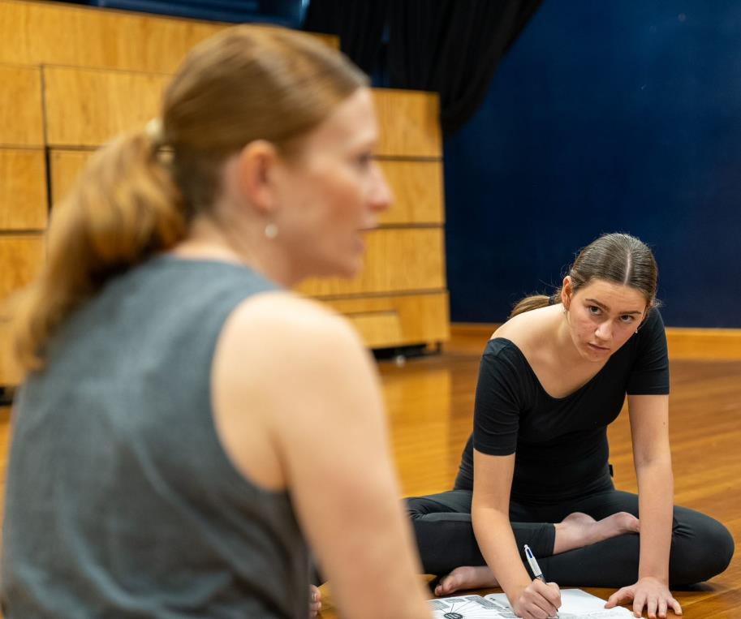
Activity 9 – historical context
Identify the prescribed era.
Collect information about the key historical events of the prescribed era.
Research the era to identify:
trends in society’s values and perspectives
advancements in knowledge (scientific, technological, medical)
key aesthetic and artist principles
famous artists from any discipline (dance, drama, music, visual arts).

Slide 32
Sociocultural influences which shape characteristics
Sociocultural influences are characteristics within society that shape the thoughts, feelings, and beliefs of individuals and/or communities within that society. These influences could relate to:
gender
identity
education
technology
social norms/taboos
culture
religion.
The sociocultural influences are strongly linked to the contextual background of the era.

Slide 33
How the characteristics are reflected in the arts
The characteristics defined by the sociocultural influences of the era are often reflected in the art created at that time, across all disciplines, including dance as an artform.
Complete the activities below to investigate the sociocultural influences of the prescribed era and how these characteristics are reflected in dance as an artform.
Select a visual artwork, a musical piece and a dramatic work from the prescribed era. Create a Venn diagram that lists the different and common characteristics/themes of the selected works.
Identify choreographers who could be considered pioneers of the prescribed era. For each pioneer of dance, outline:
the style of dance they create
their personal choreographic style
key influences and interests
common themes/concepts of their works.

Slide 34
Impact on the development of dance as an artform
The events and societal perspectives of the prescribed era will have impacted dance as an artform. The historical context, sociocultural influences and characteristics shaped the world of dance and impacted choreographers' development of style and choice of intention/thematic considerations.
Answer the extended response question on the right, using specific examples from the prescribed era to support your ideas. Examples could include references to the historical context, quotes from public figures, and works of art from any discipline.
How has the prescribed era impacted the development of dance as an artform?

Slide 35
Prescribed artists
3

Slide 36
Prescribed artists overview
Overview
In this area of study, students consider the prescribed artists’ significance to the development of dance within the specified era.
Students also consider how and why the prescribed artists and their works are recognised as seminal.
Dance Stage 6 Course prescriptions © NSW Education Standards Authority (NESA) for and on behalf of the Crown in right of the State of New South Wales, 2021.

Slide 37
How the prescribed artist’s work establishes them as a seminal artist
To understand how the prescribed artist’s work has established them as a seminal artist, you need to analyse the choreographer and a range of their dance works in relation to the information you learnt in the seminal work areas of study.
Research each seminal artist to identify at least 3 notable dance works that they have choreographed.
Analyse each of the works to explore the components and form and to formulate an interpretation and evaluation.
Investigate writing and criticism about the works and the choreographer.
Develop your understanding of the choreographer and the contextual background, including the historical context, the contribution of the work to dance as an artform, and how it is impacted by the present context.

Slide 38
Why the prescribed artist is considered a seminal artist in relation to dance and the era
To understand why each of the prescribed artists is considered a seminal artist, you need to analyse each choreographer’s work in relation to the information you have learnt about the prescribed era. Compare the key themes of the 2 prescribed artists’ works to your knowledge of the era’s:
historical context
sociocultural influences/characteristics
characteristics that are reflected in the arts
impact on the development of dance as an artform.
This will highlight how each choreographer’s works have been influenced by the era and have contributed to social commentary and change within that era.

Slide 39
Activity 10 – prescribed artists
Apply your knowledge and understanding from the activities on slides 37 – 38 to answer the questions below for each of the prescribed artists. These questions have been derived from the major study appreciation areas of study from the Stage 6 dance syllabus.
Why is the prescribed artist considered a seminal dance artist in relation to the era?
When formulating your response, consider:
notable dance works they have choreographed
common themes/concepts their work explores and how they relate to the prescribed era
how their works have contributed to the social commentary of the time.
How has the prescribed artist’s work established them as a seminal artist?
When planning your writing, consider:
your analysis of their notable dance works
writing and criticism surrounding the choreographer and their works
the contextual background of their works.
Dance Stage 6 Syllabus © NSW Education Standards Authority (NESA) for and on behalf of the Crown in right of the State of New South Wales, 2009.

Slide 40
Well done!
You have now completed the major study appreciation introduction and overview.
Best wishes for completing your major study work and the dance HSC.

Slide 41
References
This presentation contains NSW Curriculum and syllabus content. The NSW Curriculum is developed by the NSW Education Standards Authority. This content is prepared by NESA for and on behalf of the Crown in the right of the State of New South Wales. The material is protected by Crown copyright.
Please refer to the NESA Copyright Disclaimer for more information https://educationstandards.nsw.edu.au/wps/portal/nesa/mini-footer/copyright.
NESA holds the only official and up-to-date versions of the NSW Curriculum and syllabus documents. Please visit the NSW Education Standards Authority (NESA) website https://educationstandards.nsw.edu.au/wps/portal/nesa/home and the NSW Curriculum website https://curriculum.nsw.edu.au.
Dance Stage 6 Syllabus © NSW Education Standards Authority (NESA) for and on behalf of the Crown in right of the State of New South Wales, 2009.
Dance Stage 6 Course prescriptions © NSW Education Standards Authority (NESA) for and on behalf of the Crown in right of the State of New South Wales, 2021.
Dance 7–10 Syllabus © NSW Education Standards Authority (NESA) for and on behalf of the Crown in right of the State of New South Wales, 2003.
NSW Department of Education (2023) Digital learning selector – brainstorming [website], accessed 02/08/2023.
Canva (2023) Canva whiteboard [website], accessed 02/08/2023.
NSW Department of Education (2023) HSC Dance Google site [website], accessed 02/08/2023.
NSW Department of Education (2023) Writing about dance in Stage 6 [website], accessed 02/08/2023.
NSW Department of Education (2023) Jiri Kylian – Sarabande student-centred online module [website], accessed 02/08/2023.
NSW Department of Education (2023) Digital learning selector – graphic organisers [website], accessed 02/08/2023.

Slide 42
Copyright

