Slide 1
Learning map – My neighbourhood
Stage 2

Slide 2
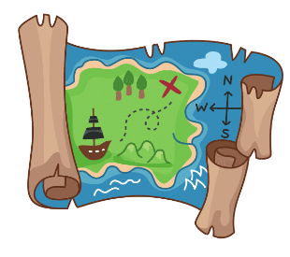
Learning map – My neighbourhood
Stage 2
1. Maps
2. In my neighbourhood
3. How do I get there?
4. Treasure hunt
5. Assessment criteria and practice task
7. Self-assessment and goal setting
6. Task
8. Language review

Slide 3
© State of New South Wales (Department of Education) 2023

