Slide 1
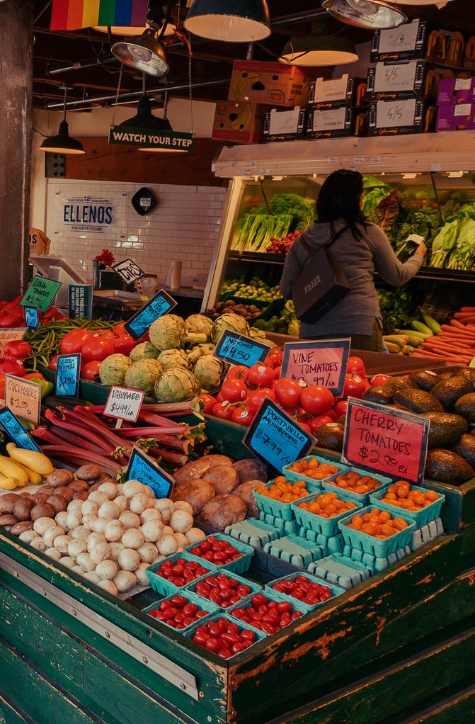
A trip to the markets!

Slide 2

My family takes me to the market every day.

Slide 3
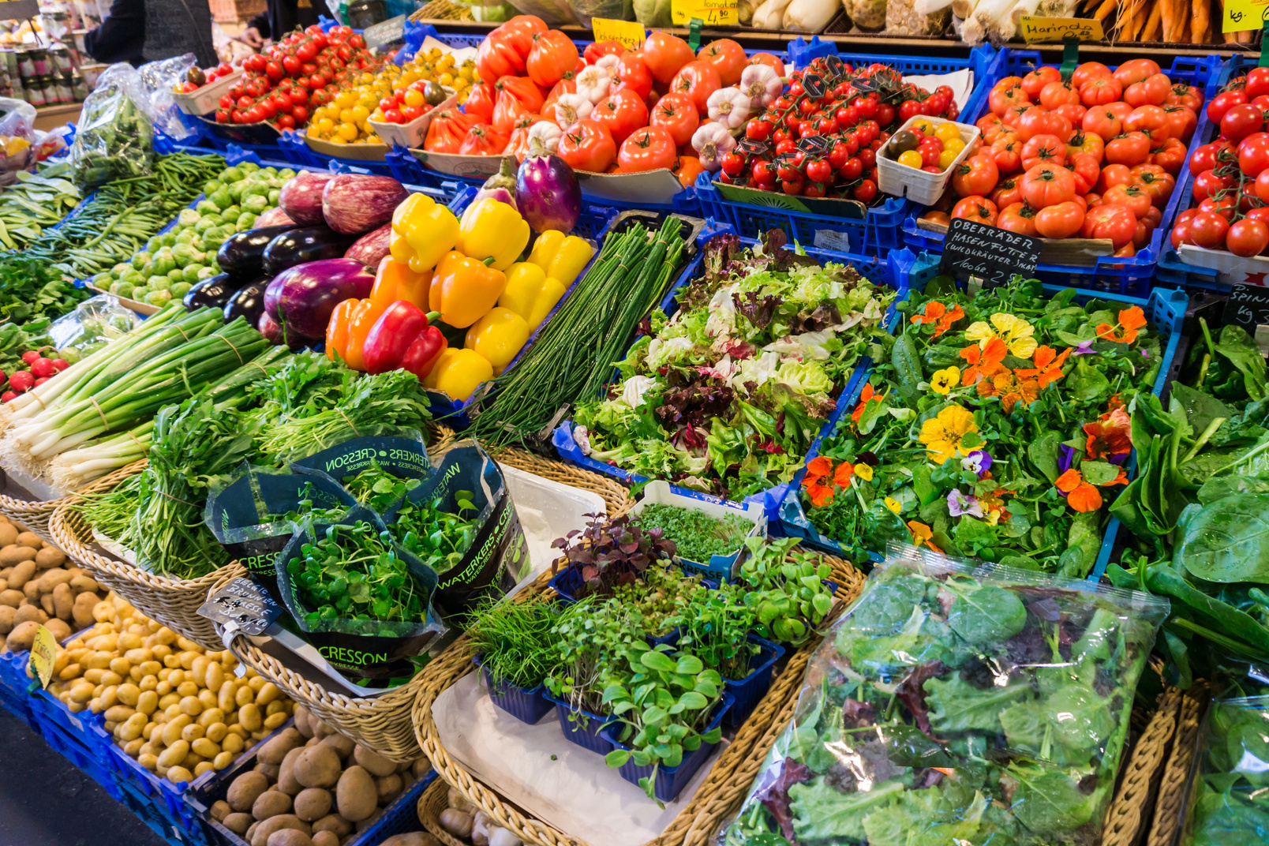
We go to the market to buy fruit and vegetables.

Slide 4
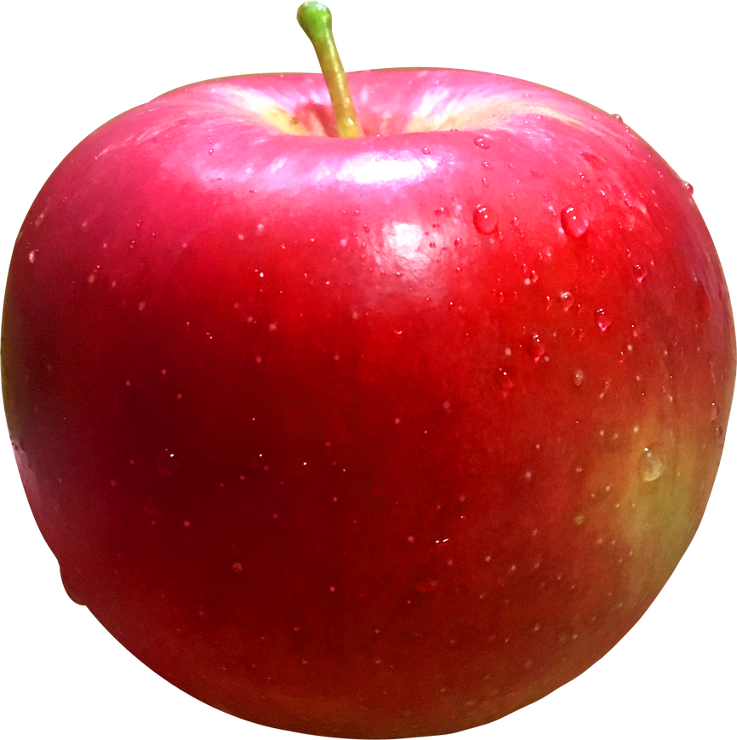
On Monday, my mum and I bought a red apple.

Slide 5
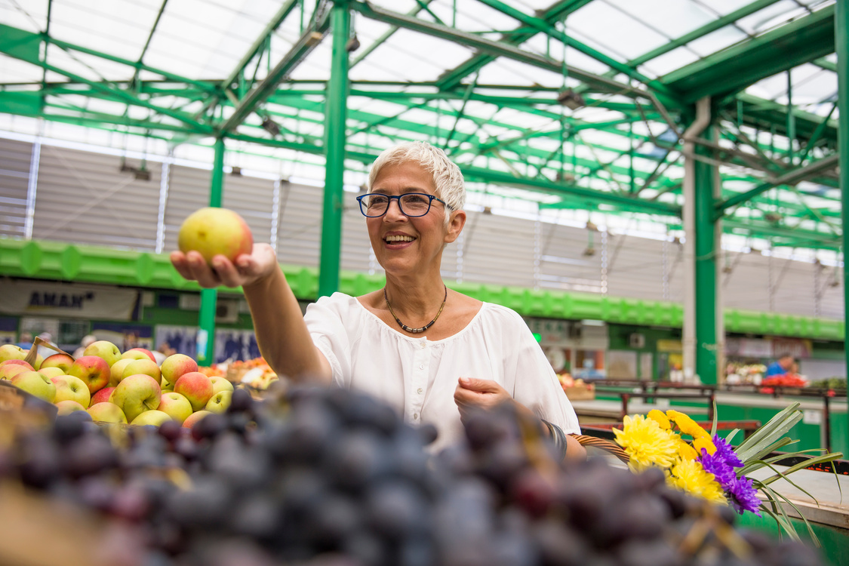
My mum asked the shopkeeper, "How much does one apple cost?"

Slide 6

The shopkeeper replied, "One apple costs one Euro".

Slide 7
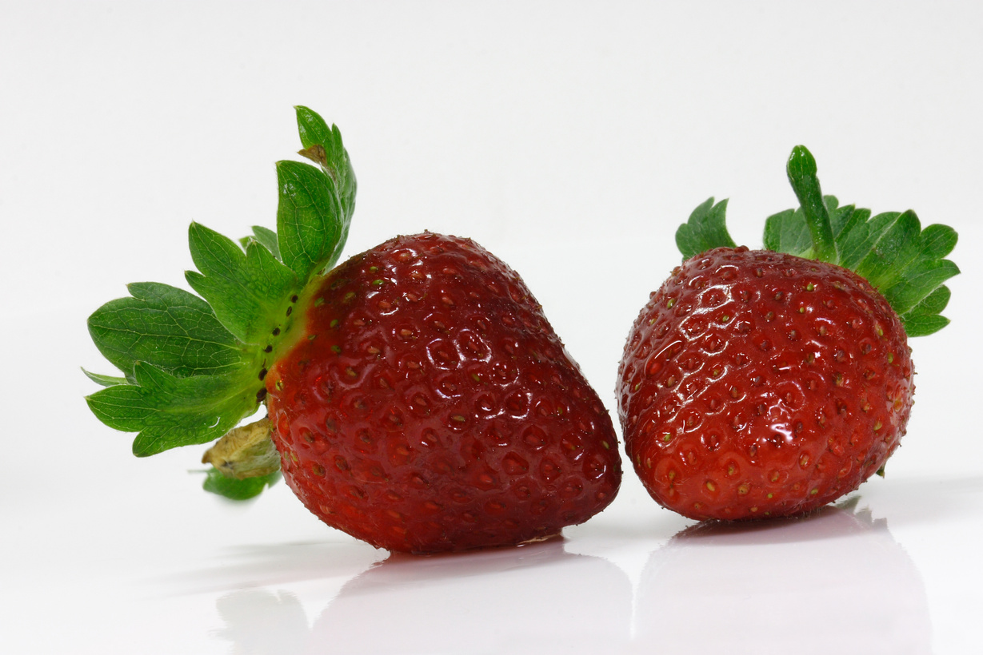
On Tuesday, my dad and I bought red strawberries.

Slide 8
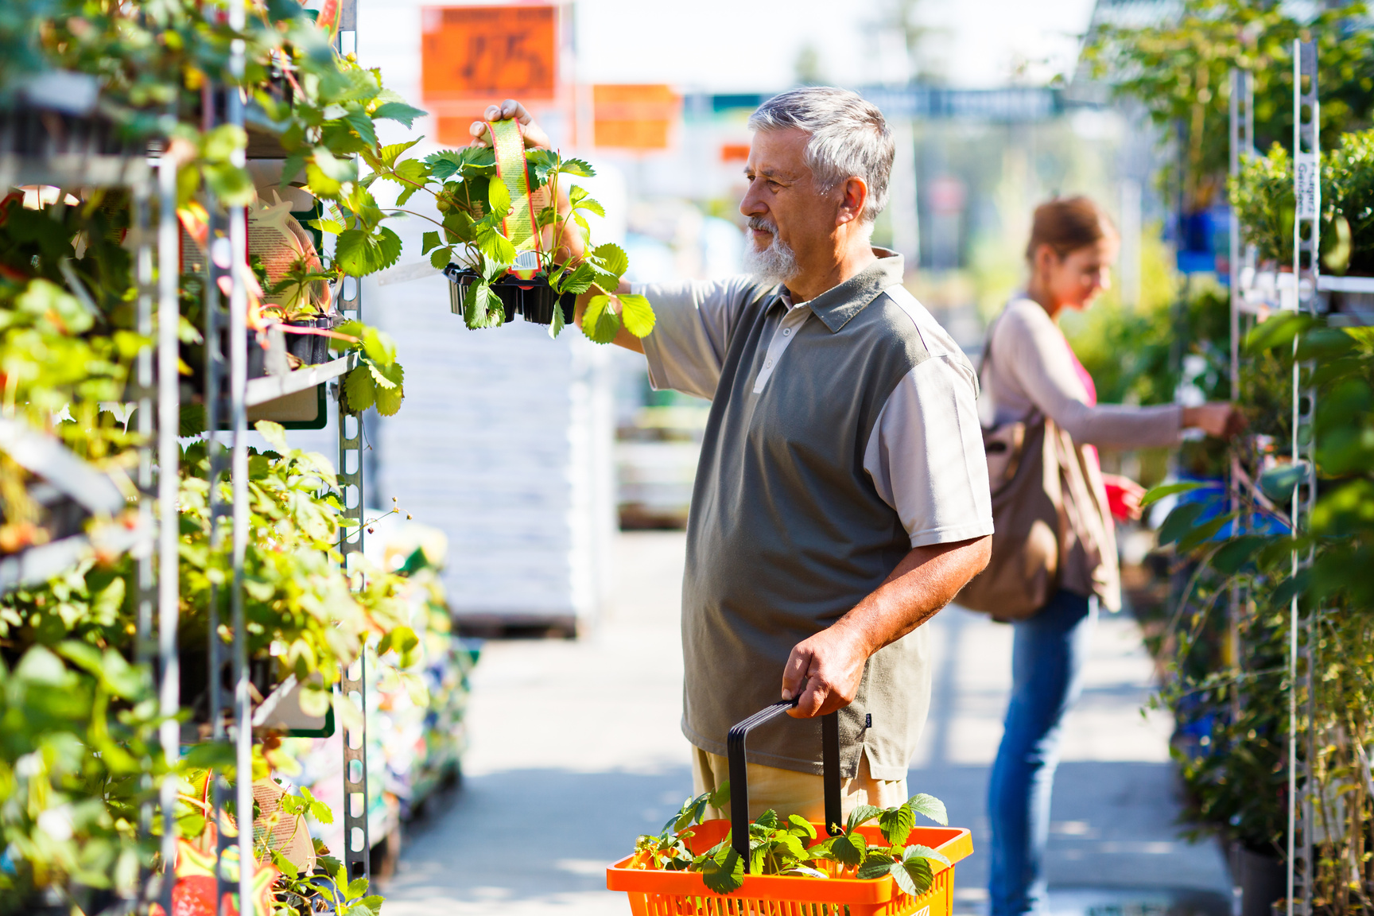
My dad asked the shopkeeper, "How much do the strawberries cost?"

Slide 9
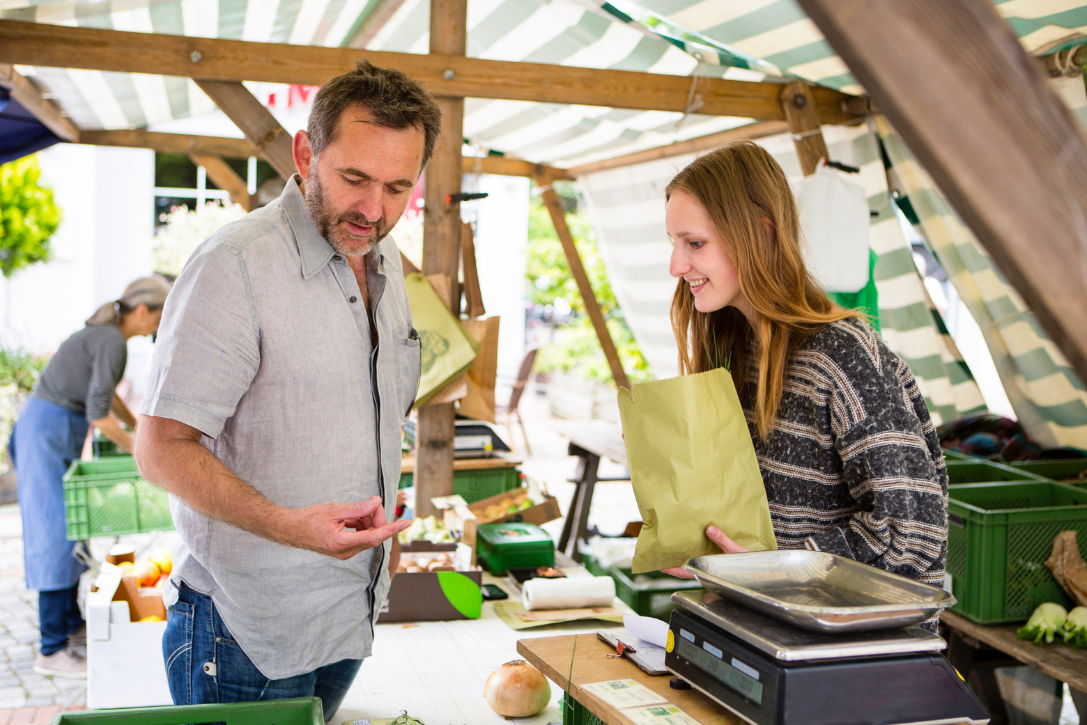
The shopkeeper replied, "The strawberries cost two Euros".

Slide 10

On Wednesday, my brother and I bought a purple plum.

Slide 11
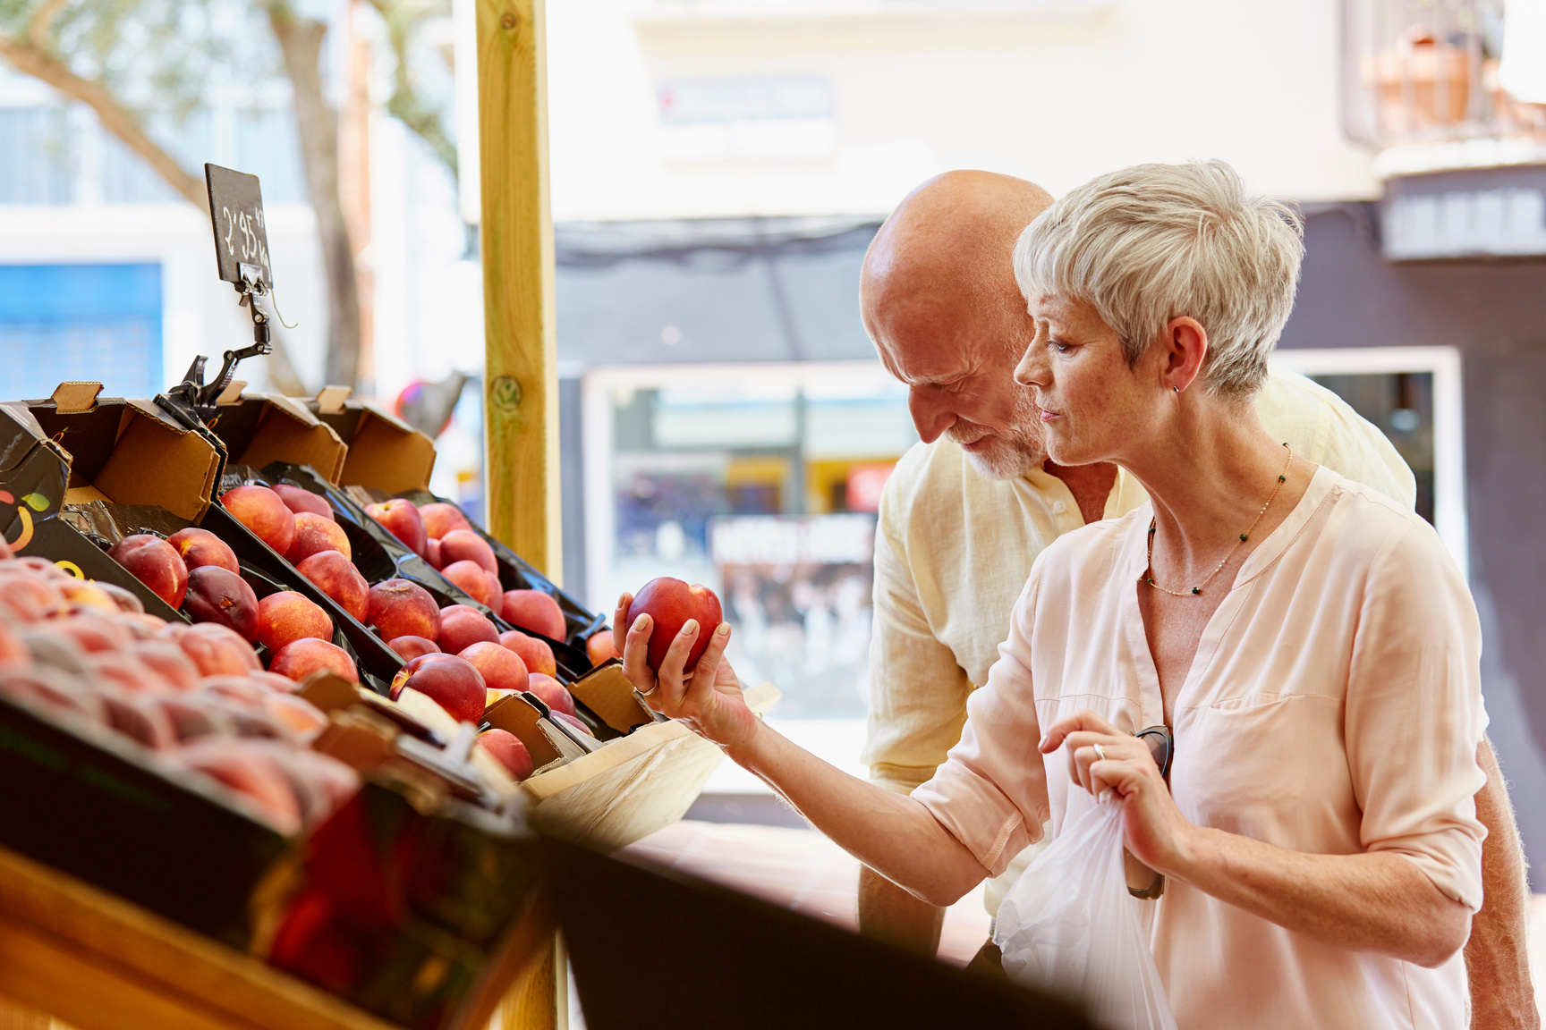
My brother asked the shopkeeper, "How much does one plum cost?"

Slide 12

The shopkeeper replied, "The plum costs three Euros".

Slide 13
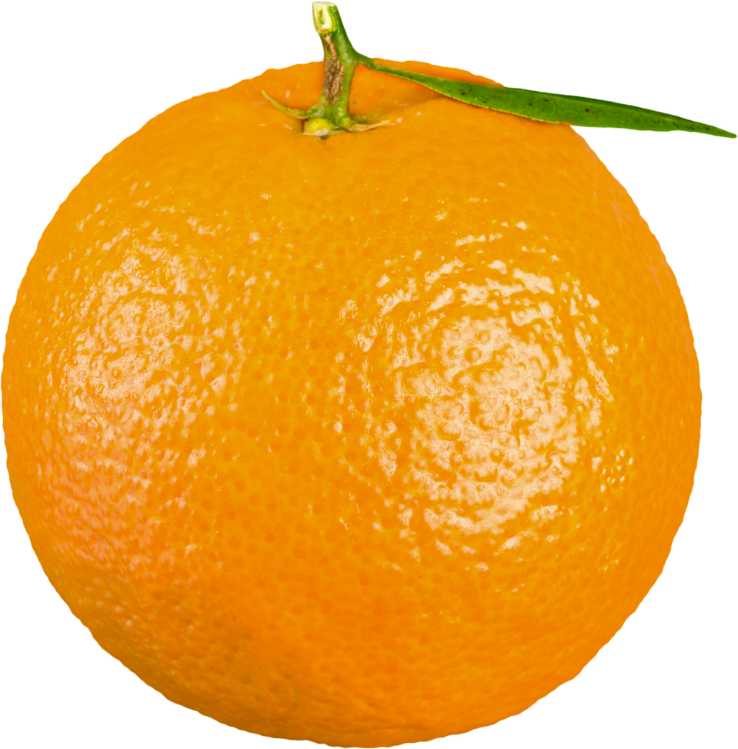
On Thursday, my sister and I bought an orange orange.

Slide 14
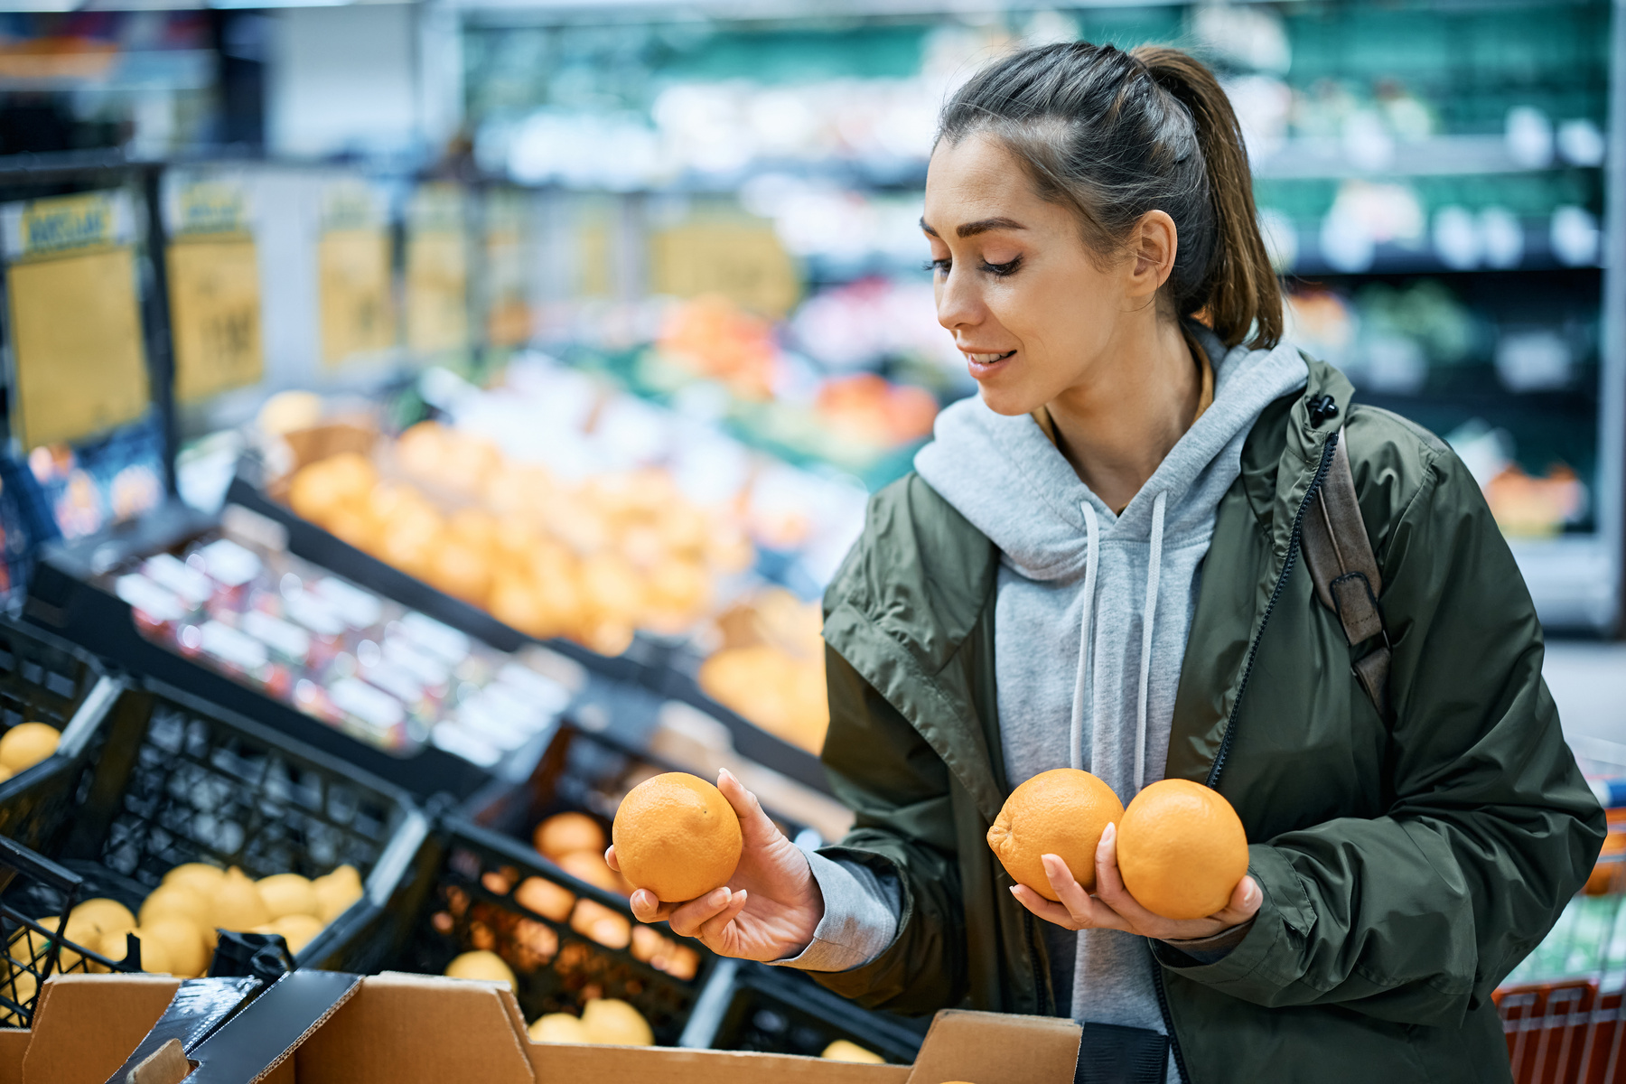
My sister asked the shopkeeper, "How much does one orange cost?"

Slide 15
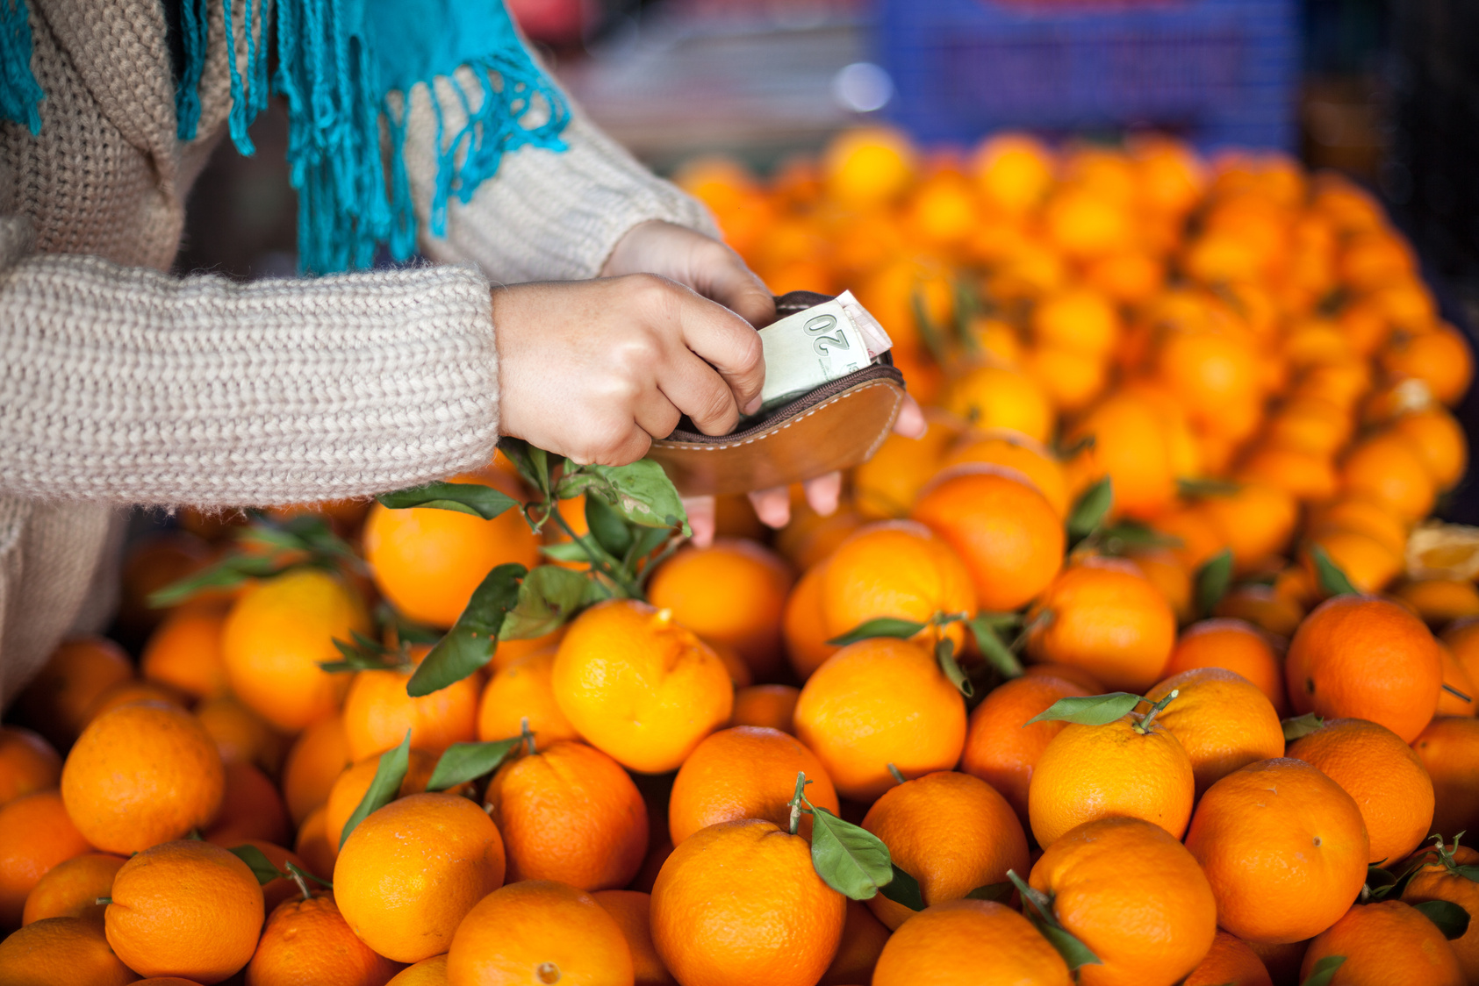
The shopkeeper replied, "The orange costs four Euros and 10 cents".

Slide 16
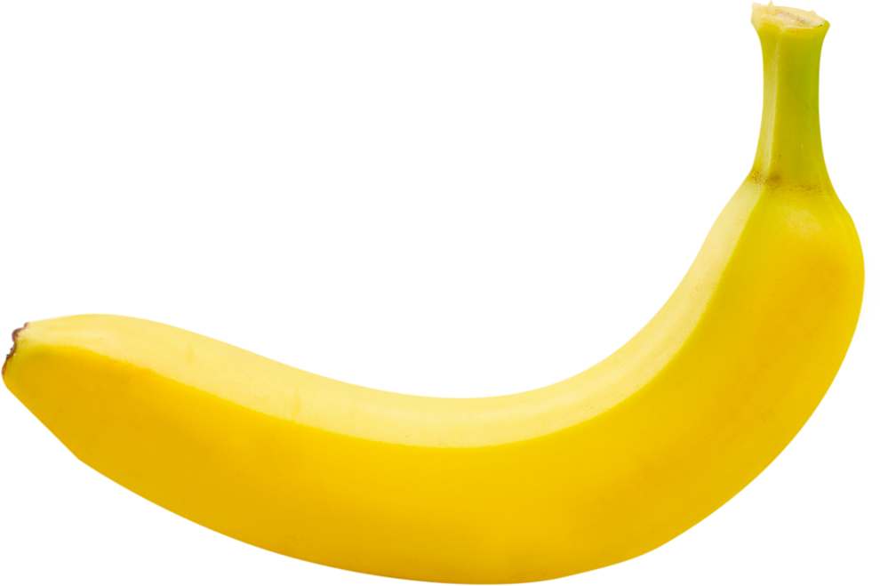
On Friday, my grandma and I bought a yellow banana.

Slide 17

My grandma asked the shopkeeper, "How much does one banana cost?"

Slide 18
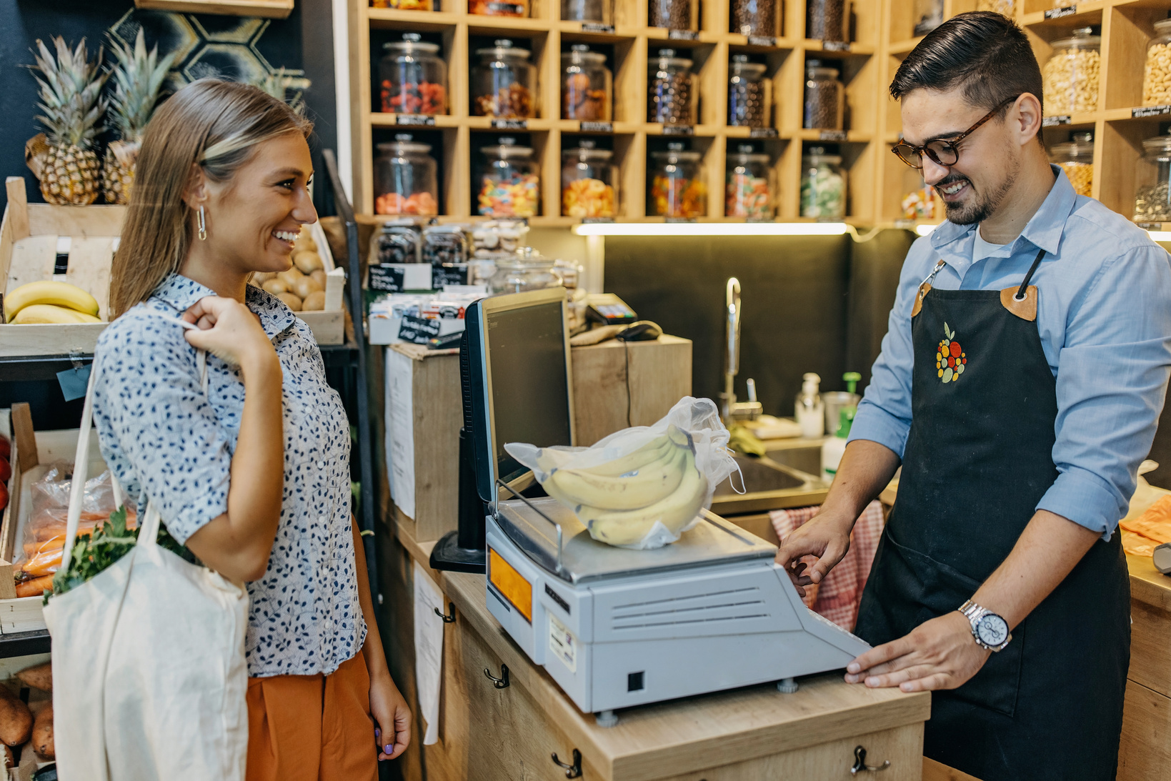
The shopkeeper replied, "The banana costs five Euros and thirty cents".

Slide 19
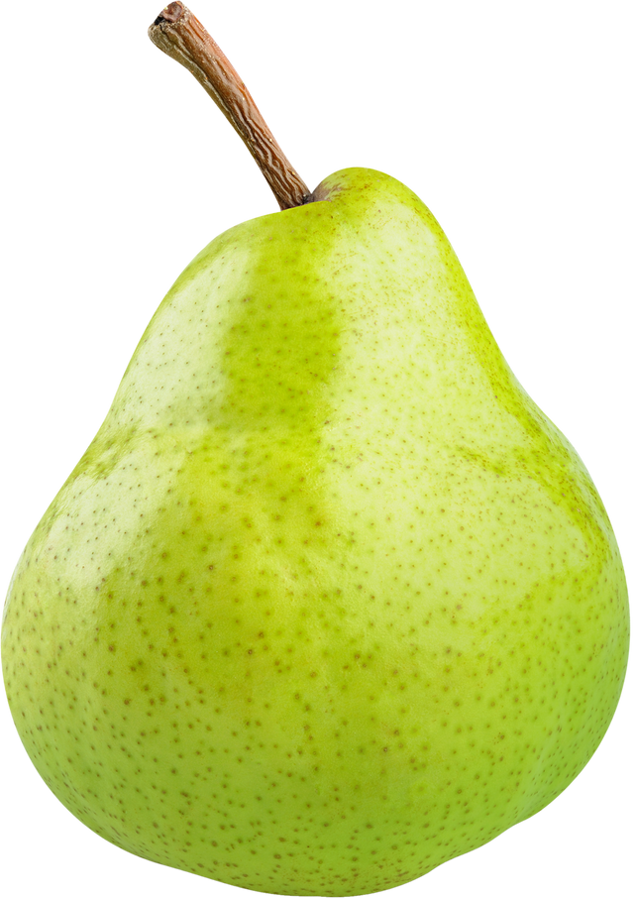
On Saturday, my grandpa and I bought a green pear.

Slide 20
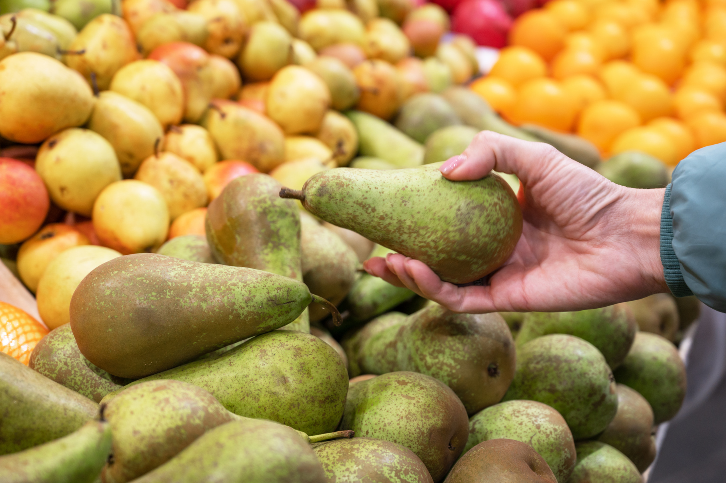
My grandpa asked the shopkeeper, "How much does one pear cost?"

Slide 21
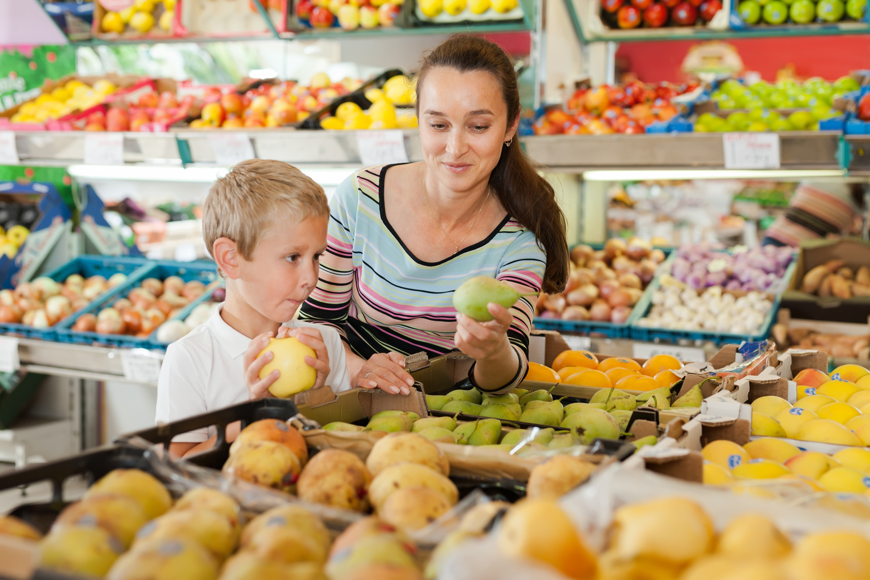
The shopkeeper replied, "The pear costs six Euros and forty cents".

Slide 22
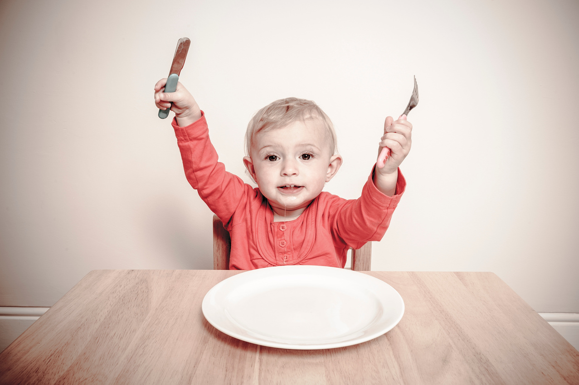
On Sunday morning I was very hungry.

Slide 23
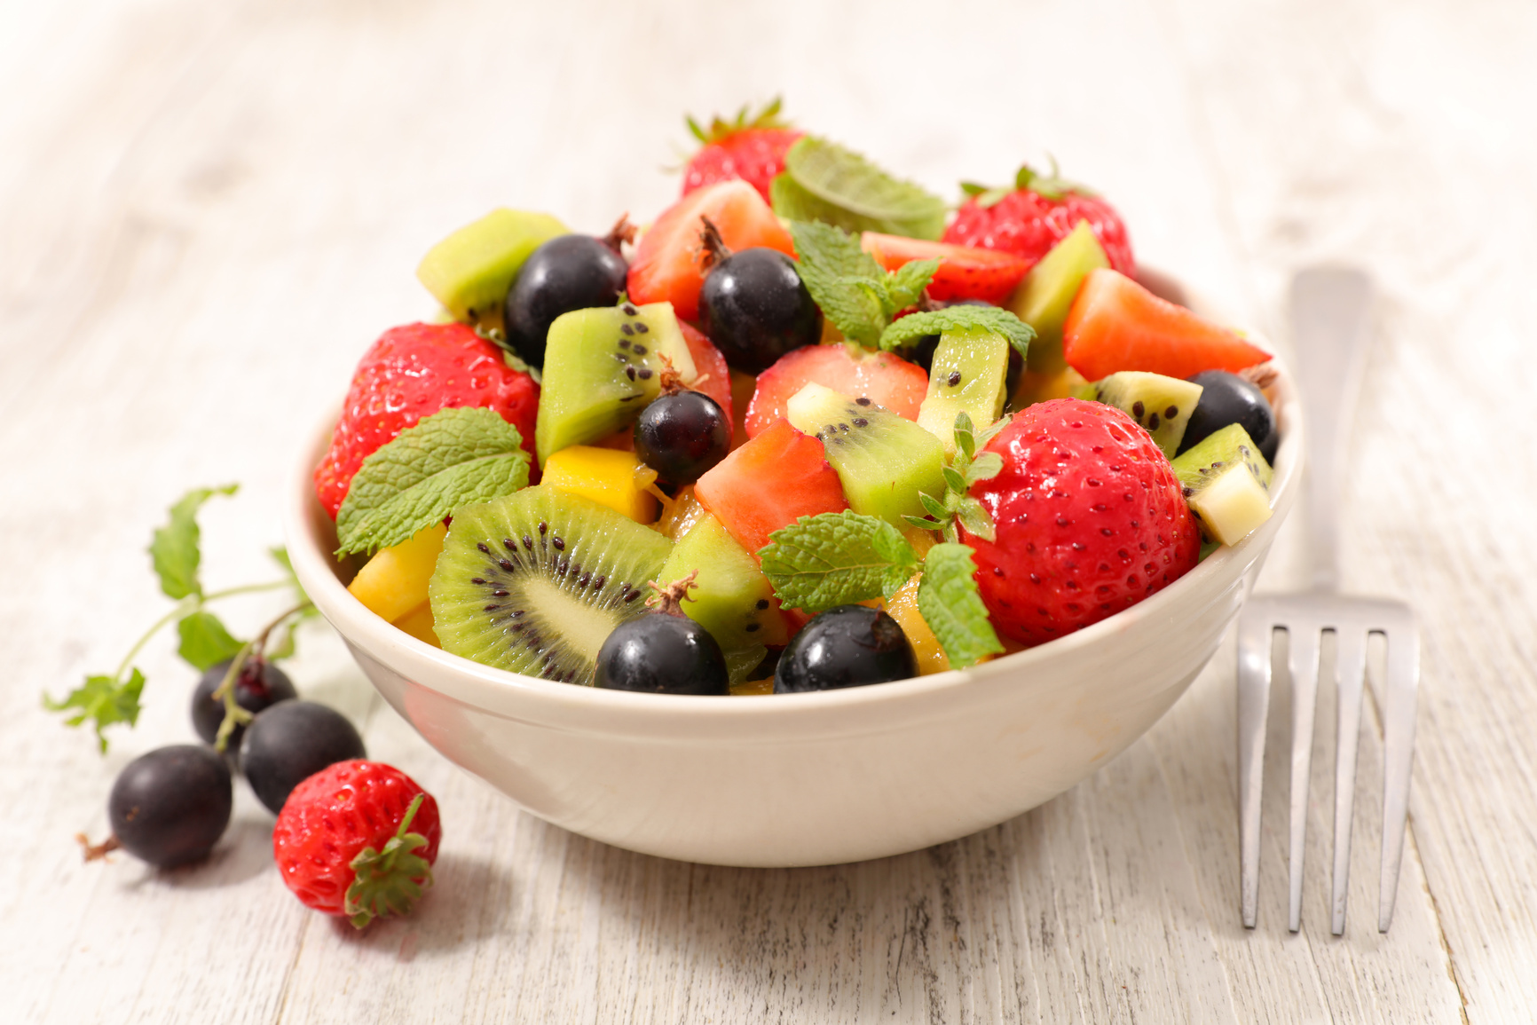
I woke my family and we all made a delicious fruit salad with all the fruit we bought from the market.

Slide 24
References (1 of 2)
This presentation contains NSW Curriculum and syllabus content. The NSW Curriculum is developed by the NSW Education Standards Authority. This content is prepared by NESA for and on behalf of the Crown in the right of the State of New South Wales. The material is protected by Crown copyright.
Please refer to the NESA Copyright Disclaimer for more information https://educationstandards.nsw.edu.au/wps/portal/nesa/mini-footer/copyright.
NESA holds the only official and up-to-date versions of the NSW Curriculum and syllabus documents. Please visit the NSW Education Standards Authority (NESA) website https://educationstandards.nsw.edu.au/wps/portal/nesa/home and the NSW Curriculum website https://curriculum.nsw.edu.au.
©Caio from Pexels via Canva.com
©Latino Life via Canva.com
©ewastudio from Getty Images via Canva.com
©eommina from pixabay via Canva.com
©boggy22 from Getty Images via Canva.com
©Syda Productions via Canva.com
©mrosley from Getty Images Life via Canva.com

Slide 25
References (2 of 2)
©ViktorCap from Getty Images Canva.com
©fotografixx from Getty Images Canva.com
©Anna Kucherova Canva.com
©Morsa Images from Getty Images Signature Canva.com
©JackF from Getty Images Canva.com
©Billion Photos Canva.com
©selimaksan from Getty Images Canva.com
©Valeriy_G from Getty Images Canva.com
©supersizer from Getty Images Signature Canva.com
©rusak from Getty Images Canva.com
©JohnnyGreig from Getty Images Signature Canva.com
©margouillatphotos from Getty Images Canva.com

Slide 26
Copyright
© State of New South Wales (Department of Education), 2023
The copyright material published in this resource is subject to the Copyright Act 1968 (Cth) and is owned by the NSW Department of Education or, where indicated, by a party other than the NSW Department of Education (third-party material).
Copyright material available in this resource and owned by the NSW Department of Education is licensed under a Creative Commons Attribution 4.0 International (CC BY 4.0) licence.
This licence allows you to share and adapt the material for any purpose, even commercially.
Attribution should be given to © State of New South Wales (Department of Education), 2023.
Material in this resource not available under a Creative Commons licence:
the NSW Department of Education logo, other logos and trademark-protected material
Material owned by a third party that has been reproduced with permission. You will need to obtain permission from the third party to reuse its material.
Links to third-party material and websites
Please note that the provided (reading/viewing material/list/links/texts) are a suggestion only and implies no endorsement, by the New South Wales Department of Education, of any author, publisher, or book title. School principals and teachers are best placed to assess the suitability of resources that would complement the curriculum and reflect the needs and interests of their students.
If you use the links provided in this document to access a third party’s website, you acknowledge that the terms of use, including licence terms set out on the third-party’s website apply to the use which may be made of the materials on that third-party website or where permitted by the Copyright Act 1968 (Cth). The department accepts no responsibility for content on third-party websites.

