Slide 1
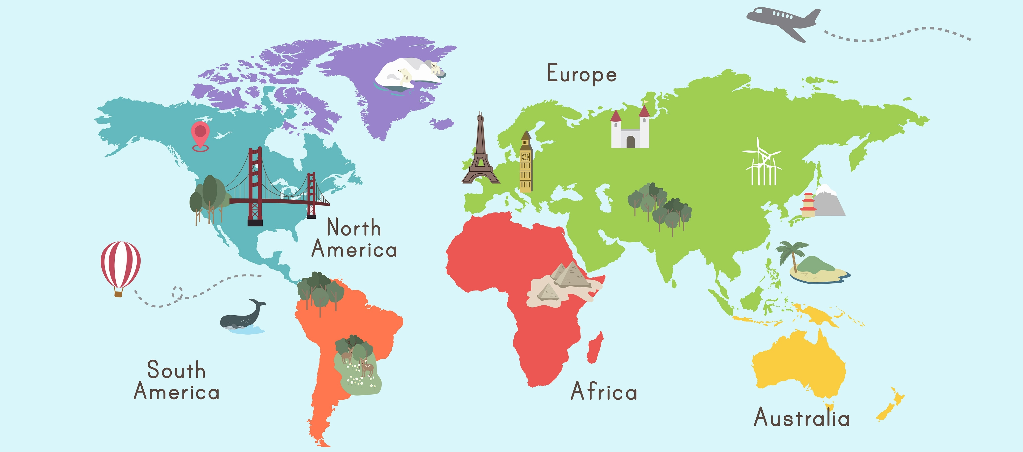
Countries and cities
你是哪国人？
你住在哪？

Slide 2
Guide for teachers
This resource can be used to drill vocabulary and structures about cities and countries, and to discuss nationality and where people live. It may also be used to discuss languages people speak.
You can use it to:
recall vocabulary and structures and ask students to use them in sentences
practise pronunciation and tones
provide stimulus for spontaneous interactions where students ask each other questions about the images such as ‘What nationality are you?’, ‘Where do you live?’, ‘Do you live in Sydney?’, ‘Are you Italian?’
students may choose a slide each and, using the persona, create a role play of people meeting each other for the first time in Chinese.

Slide 3
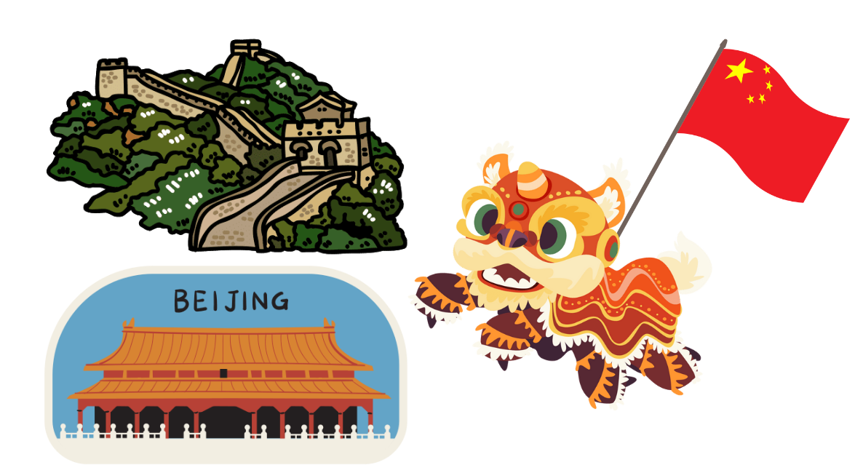
中国 Zhōngguó
北京 Běijīng

Slide 4
澳大利亚 Àodàlìyǎ
悉尼 Xīní

Slide 5
英国 Yīngguó
伦敦 Lúndūn

Slide 6
印度 Yìndù
德里 Délǐ

Slide 7
新西兰 Xīnxīlán
奥克兰 Àokèlán

Slide 8
美国 Měiguó
纽约 Niǔyuē

Slide 9
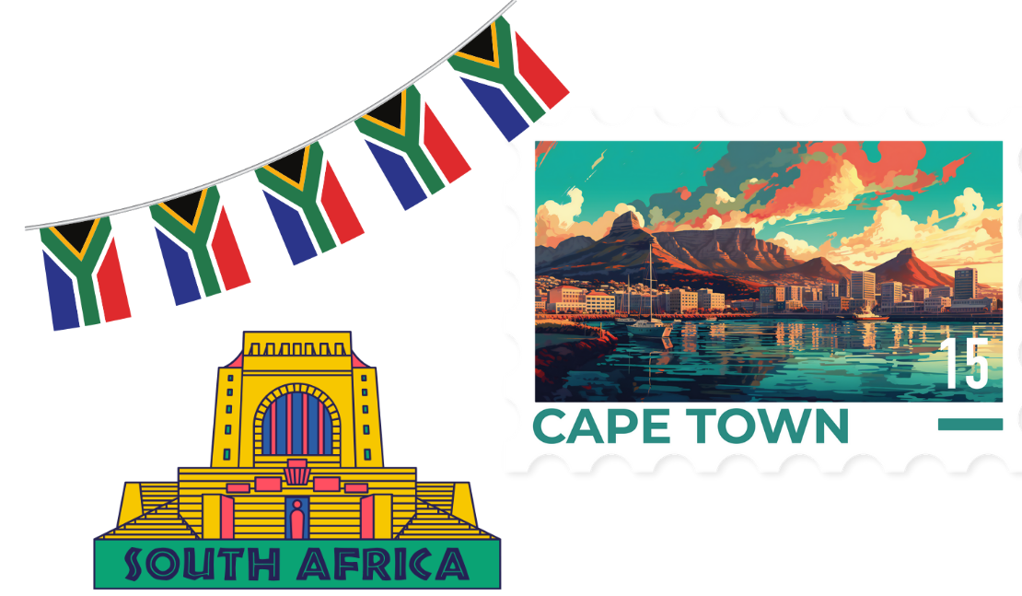
南非 Nánfēi
开普敦 Kāipǔdūn

Slide 10
日本 Rìběn
东京 Dōngjīng

Slide 11
印度尼西亚 Yìndùníxīyà
雅加达 Yǎjiādá

Slide 12
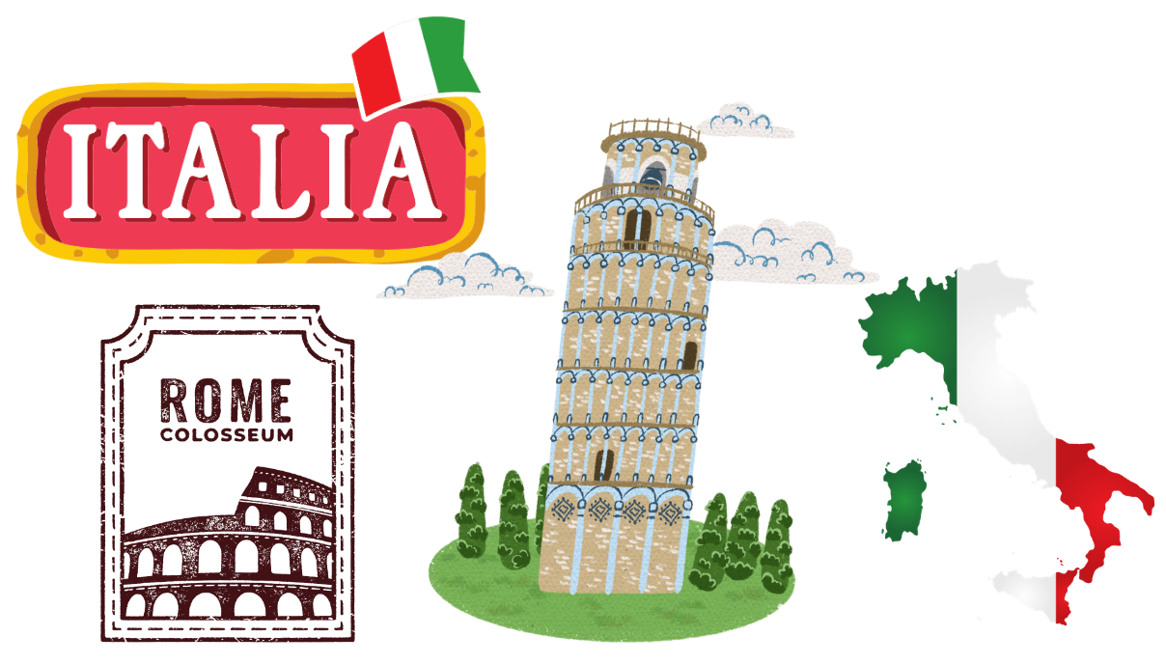
意大利 Yìdàlì
罗马 Luómǎ

Slide 13
Copyright
© State of New South Wales (Department of Education), 2023
The copyright material published in this resource is subject to the Copyright Act 1968 (Cth) and is owned by the NSW Department of Education or, where indicated, by a party other than the NSW Department of Education (third-party material).
Copyright material available in this resource and owned by the NSW Department of Education is licensed under a Creative Commons Attribution 4.0 International (CC BY 4.0) licence.
This license allows you to share and adapt the material for any purpose, even commercially.
Attribution should be given to © State of New South Wales (Department of Education), 2023.
Material in this resource not available under a Creative Commons license:
the NSW Department of Education logo, other logos and trademark-protected material
Material owned by a third party that has been reproduced with permission. You will need to obtain permission from the third party to reuse its material.
Links to third-party material and websites
Please note that the provided (reading/viewing material/list/links/texts) are a suggestion only and implies no endorsement, by the New South Wales Department of Education, of any author, publisher, or book title. School principals and teachers are best placed to assess the suitability of resources that would complement the curriculum and reflect the needs and interests of their students.
If you use the links provided in this document to access a third party’s website, you acknowledge that the terms of use, including licence terms set out on the third-party’s website apply to the use which may be made of the materials on that third-party website or where permitted by the Copyright Act 1968 (Cth). The department accepts no responsibility for content on third-party websites.

Slide 14
© State of New South Wales (Department of Education) 2023

