Slide 1
¿Qué comemos y bebemos?
What do we eat and drink?
September 2023

Slide 2
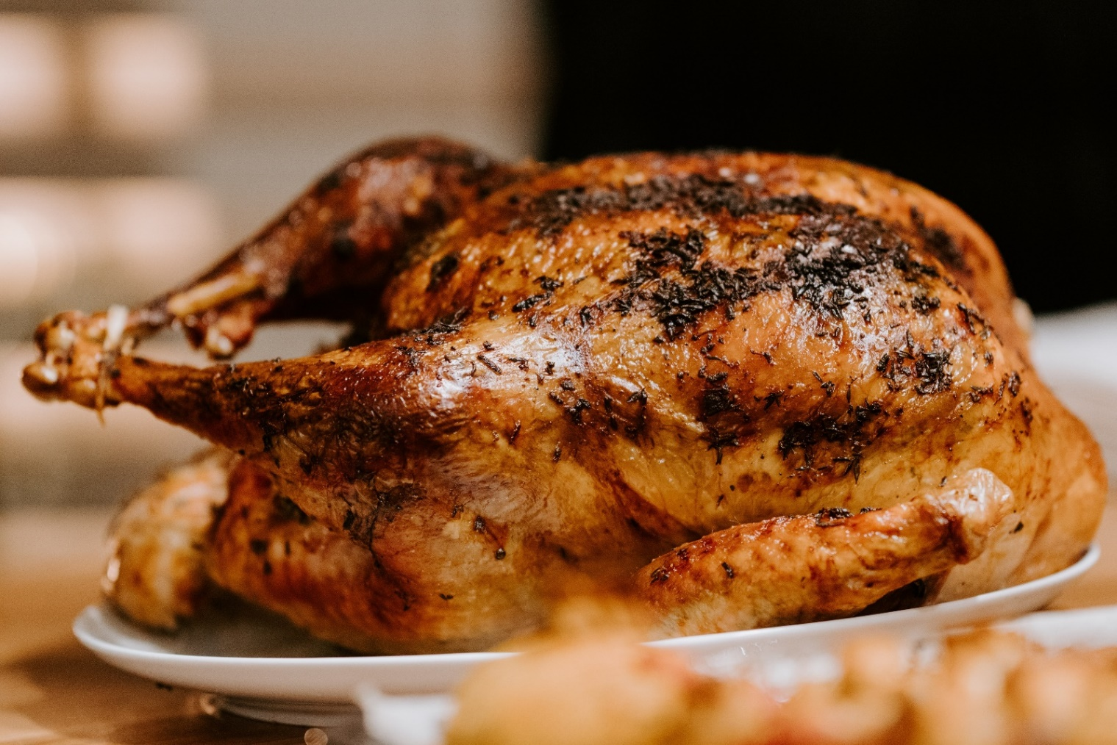
el pollo

Slide 3
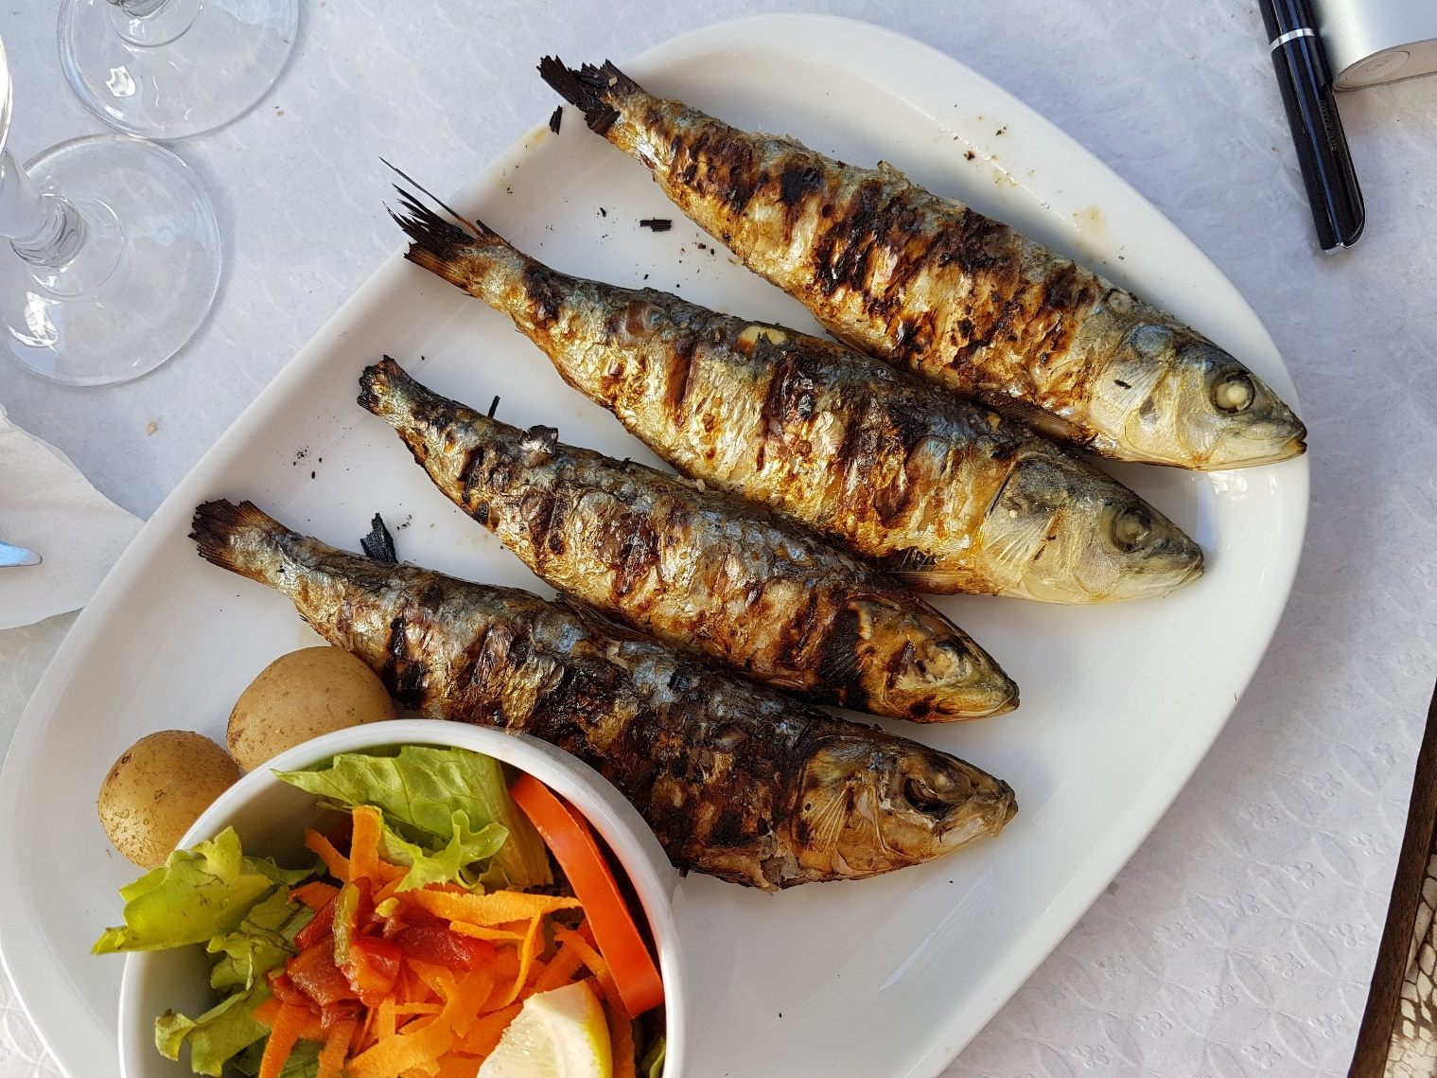
el pescado

Slide 4
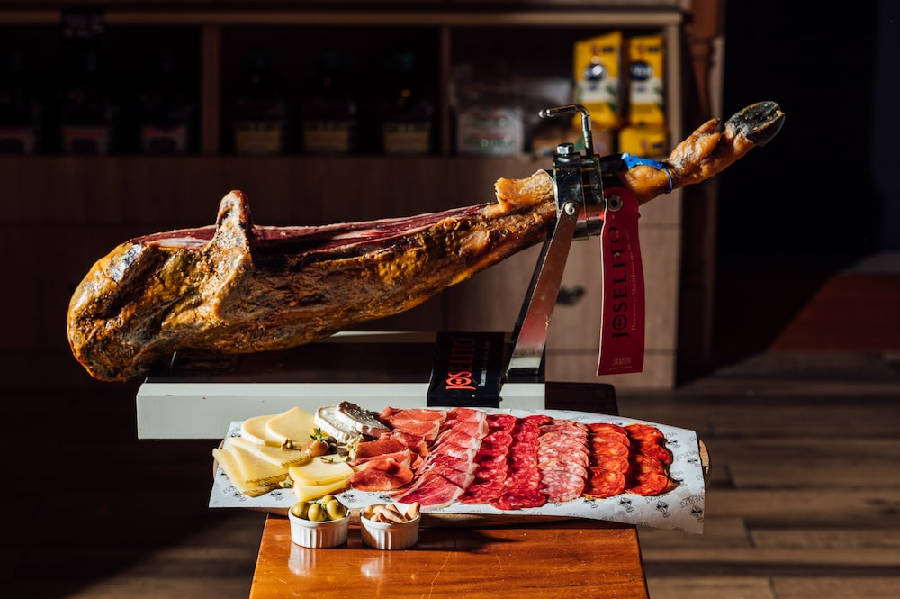
el jamón

Slide 5
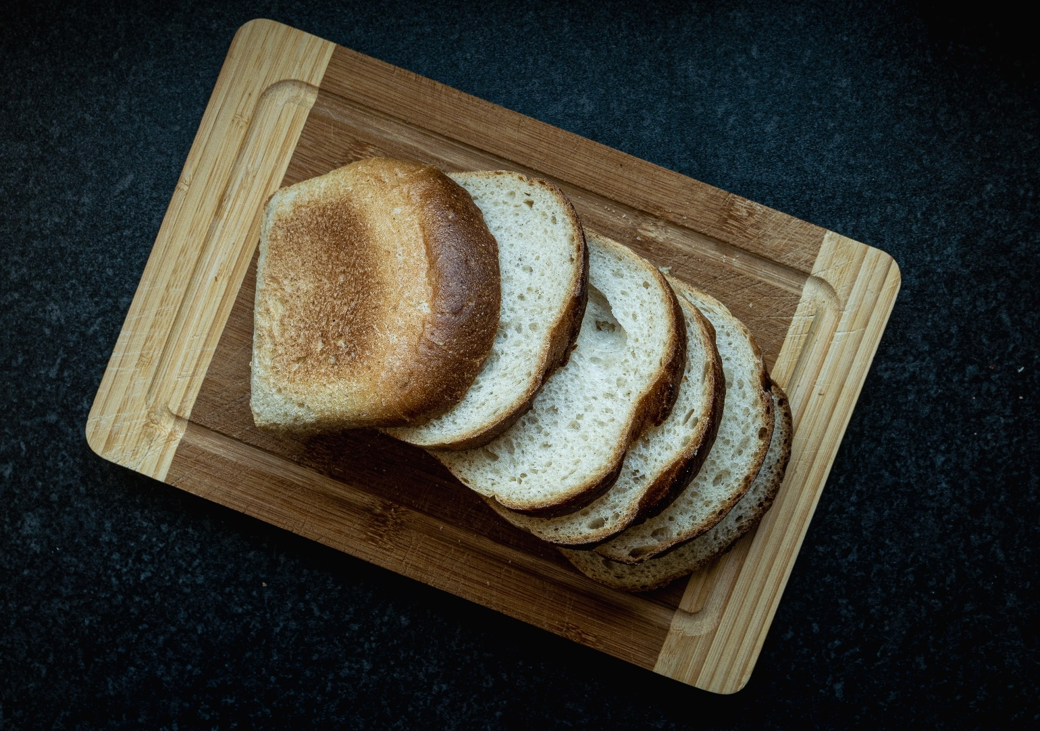
el pan

Slide 6
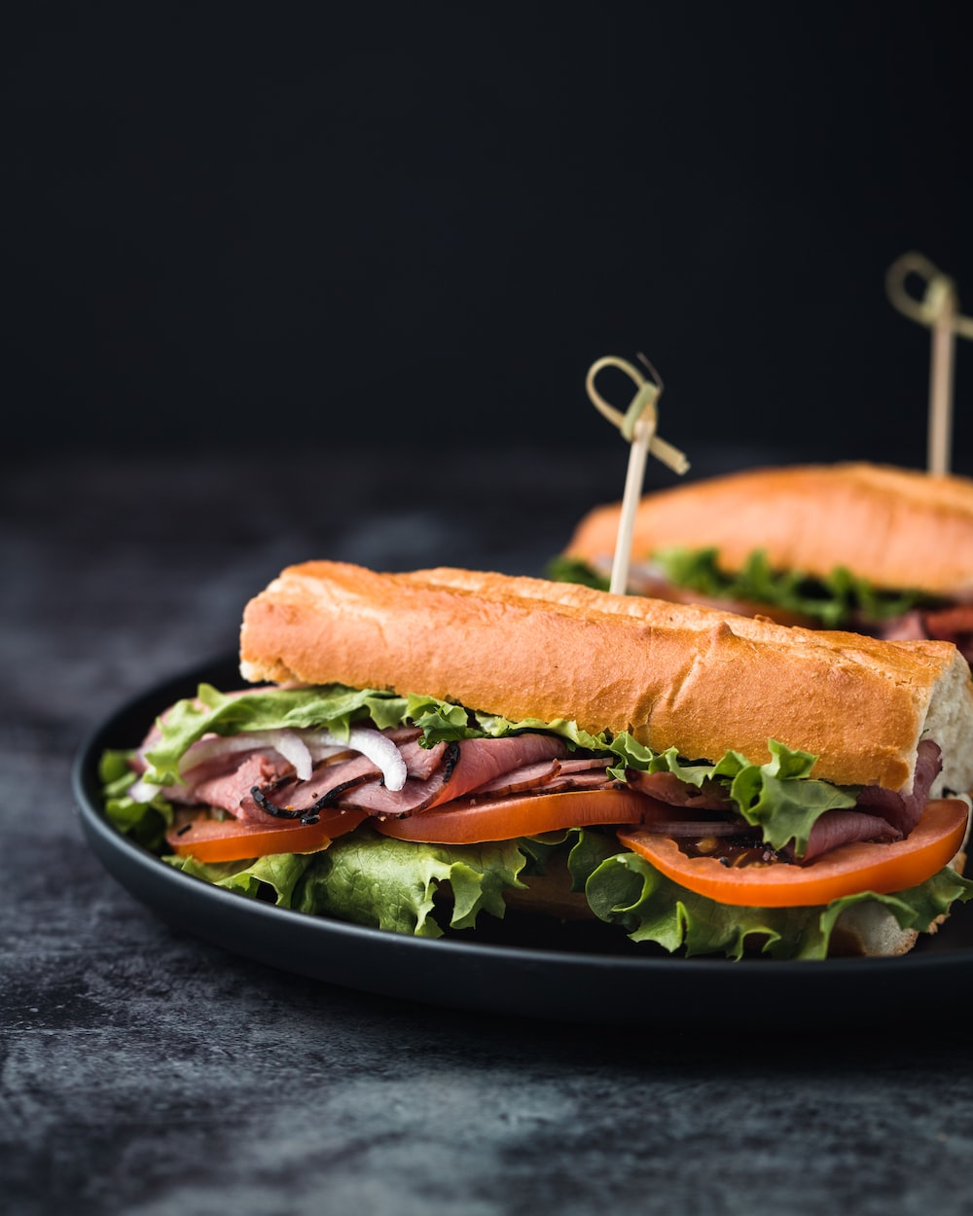
el bocadillo

Slide 7
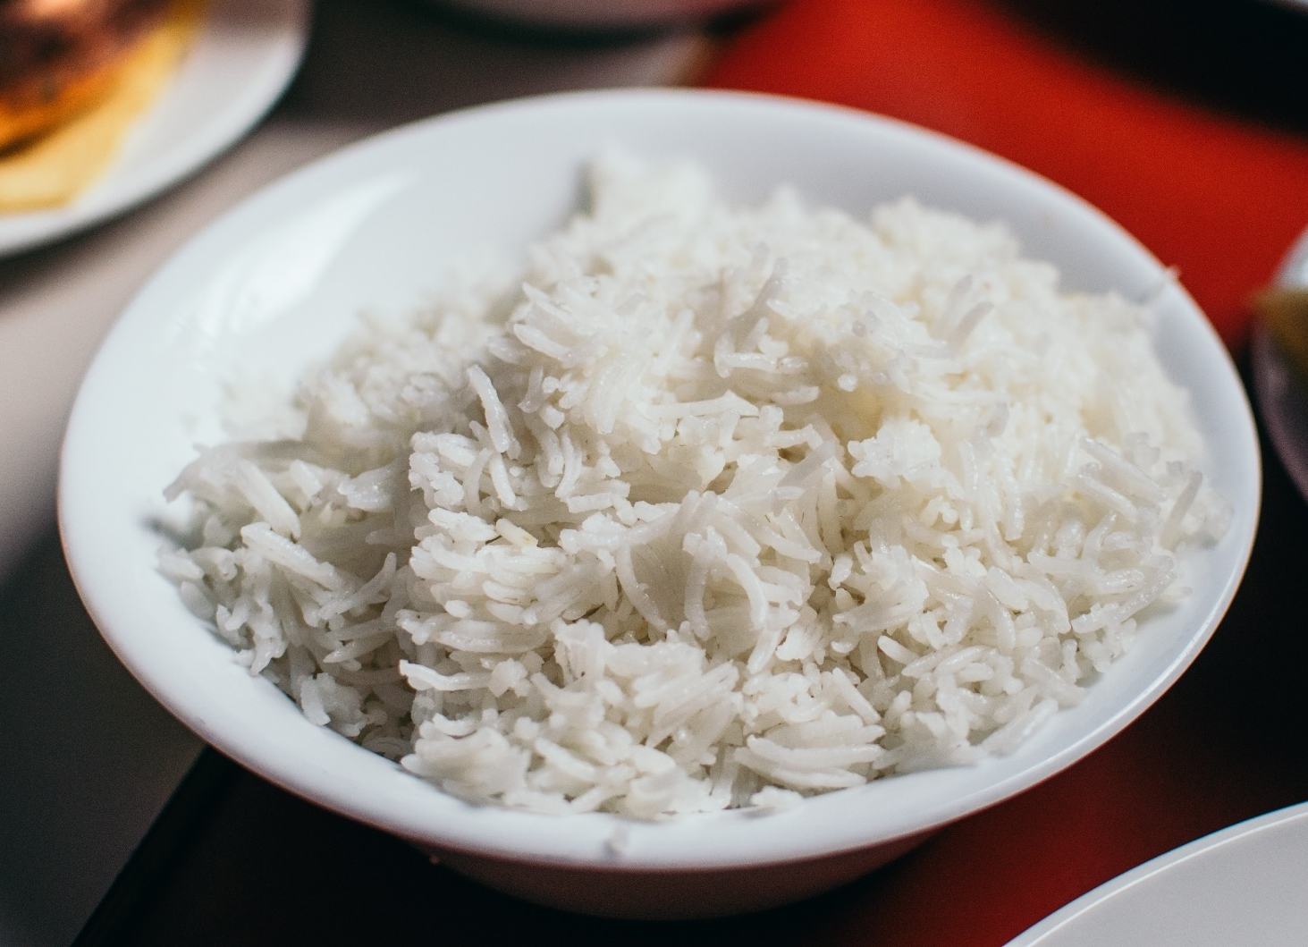
el arroz

Slide 8
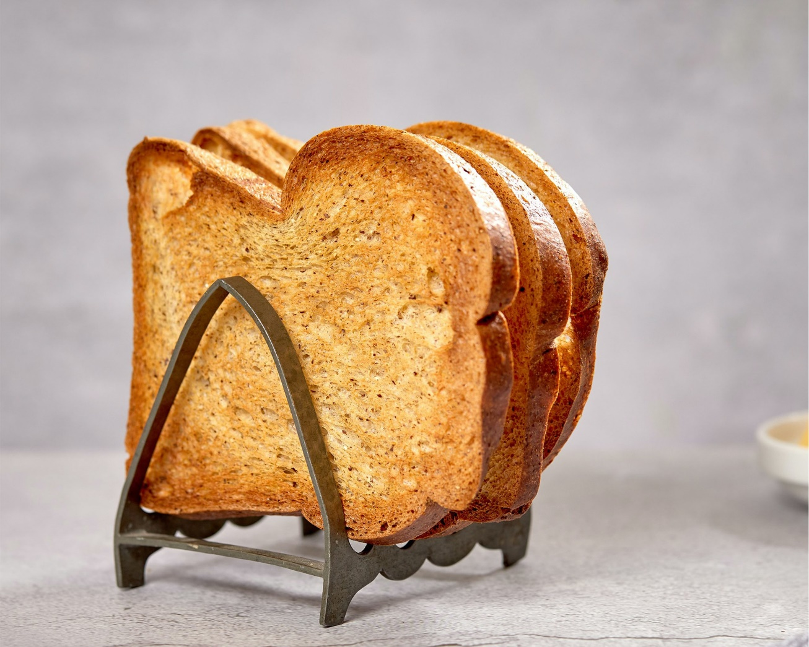
la tostada

Slide 9
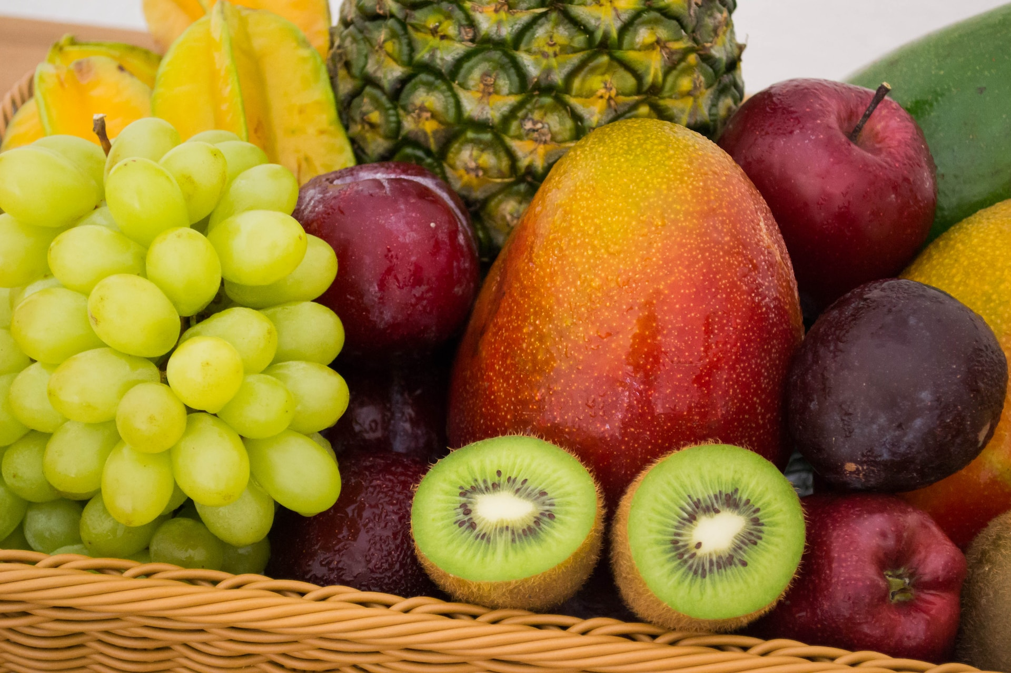
la fruta

Slide 10
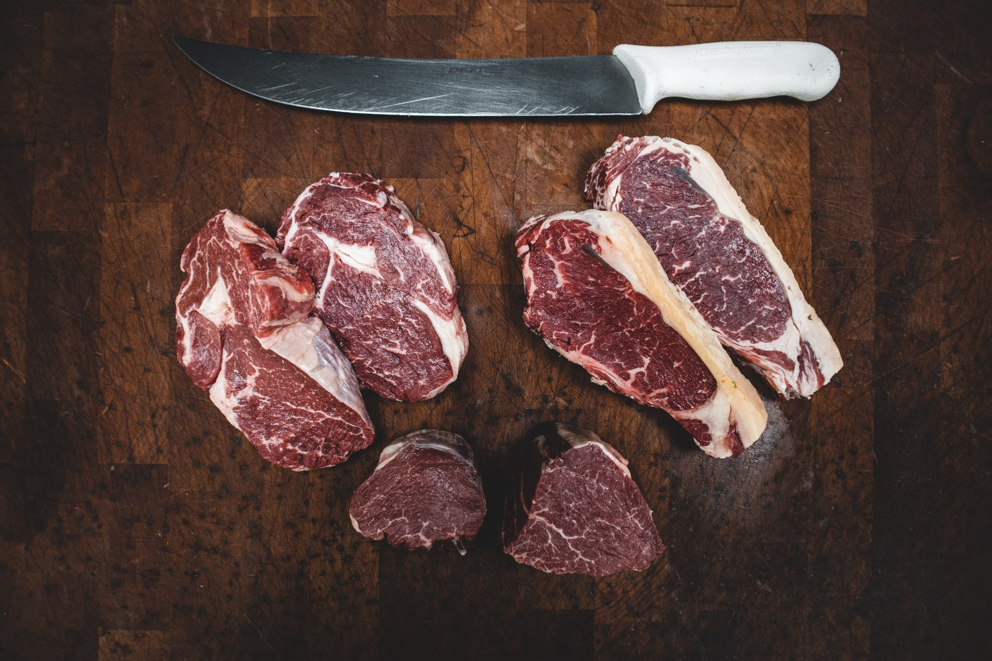
la carne

Slide 11
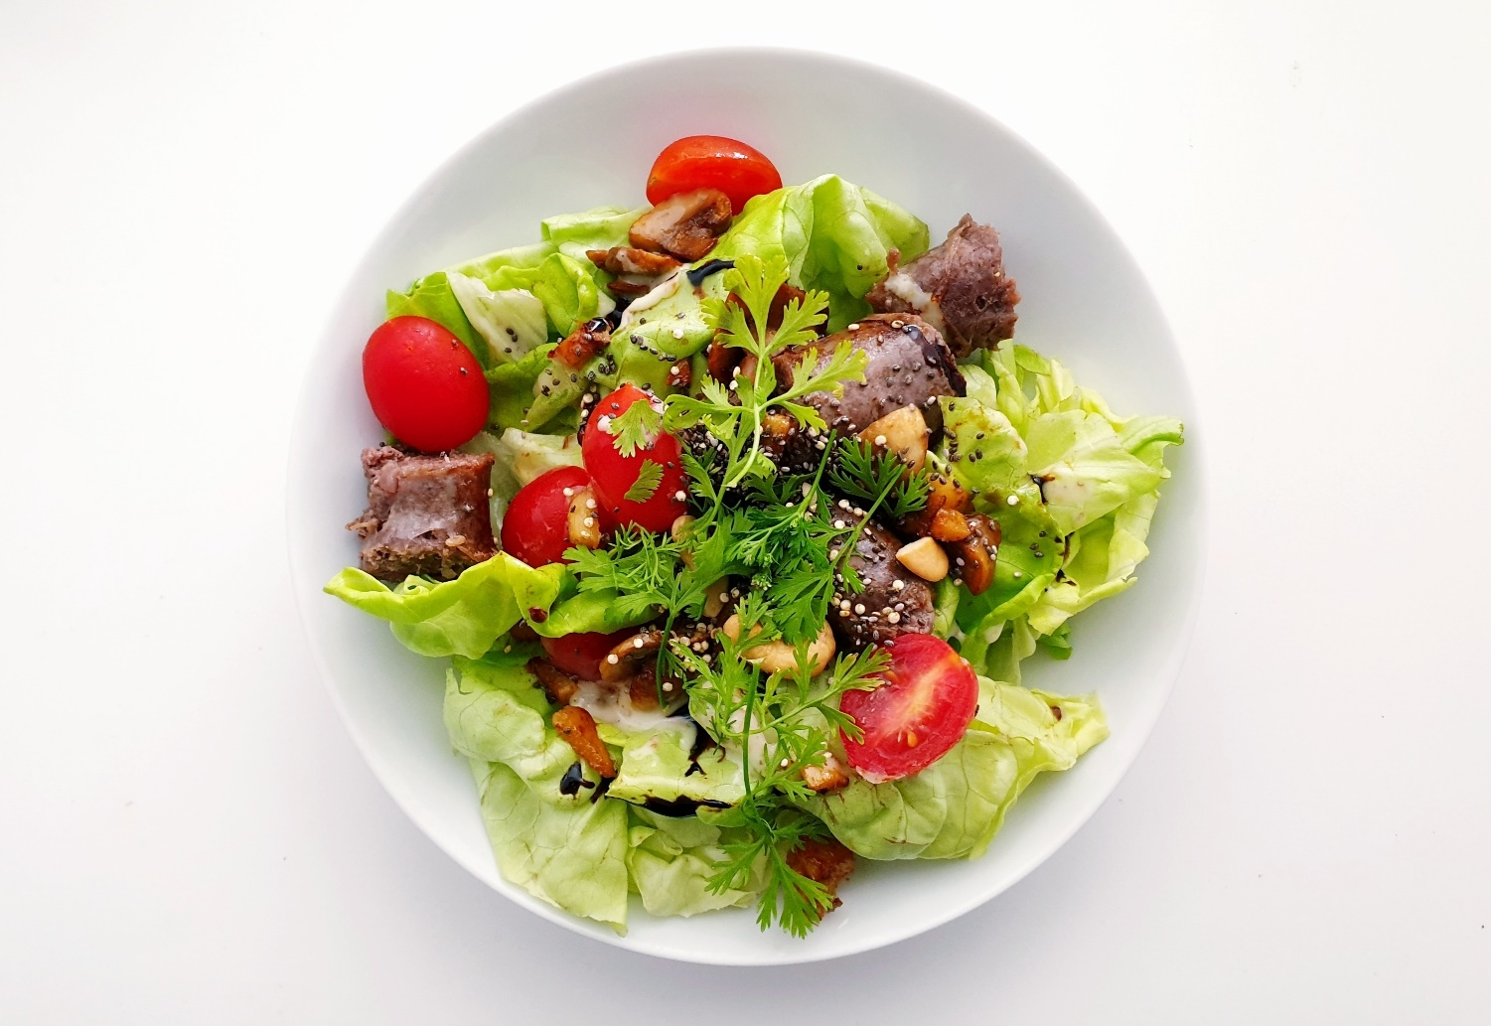
la ensalada

Slide 12
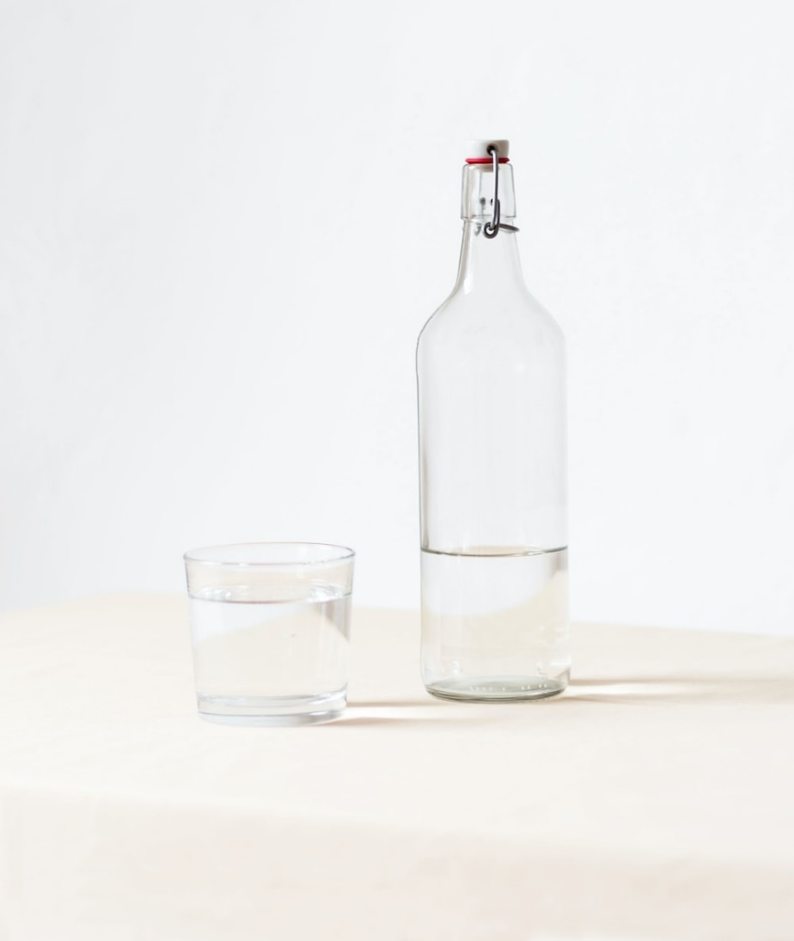
el agua

Slide 13
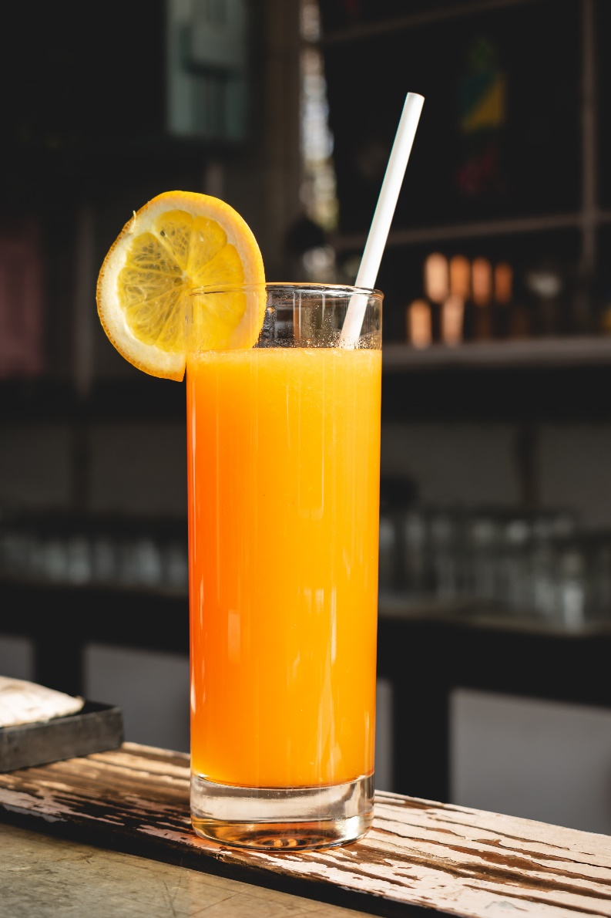
el zumo de naranja

Slide 14
el café

Slide 15
el té

Slide 16
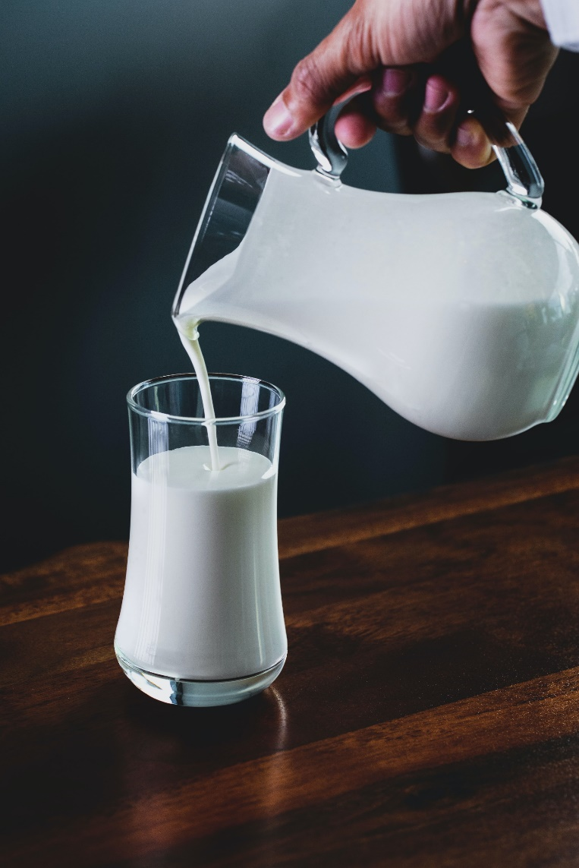
la leche

Slide 17
el helado

Slide 18
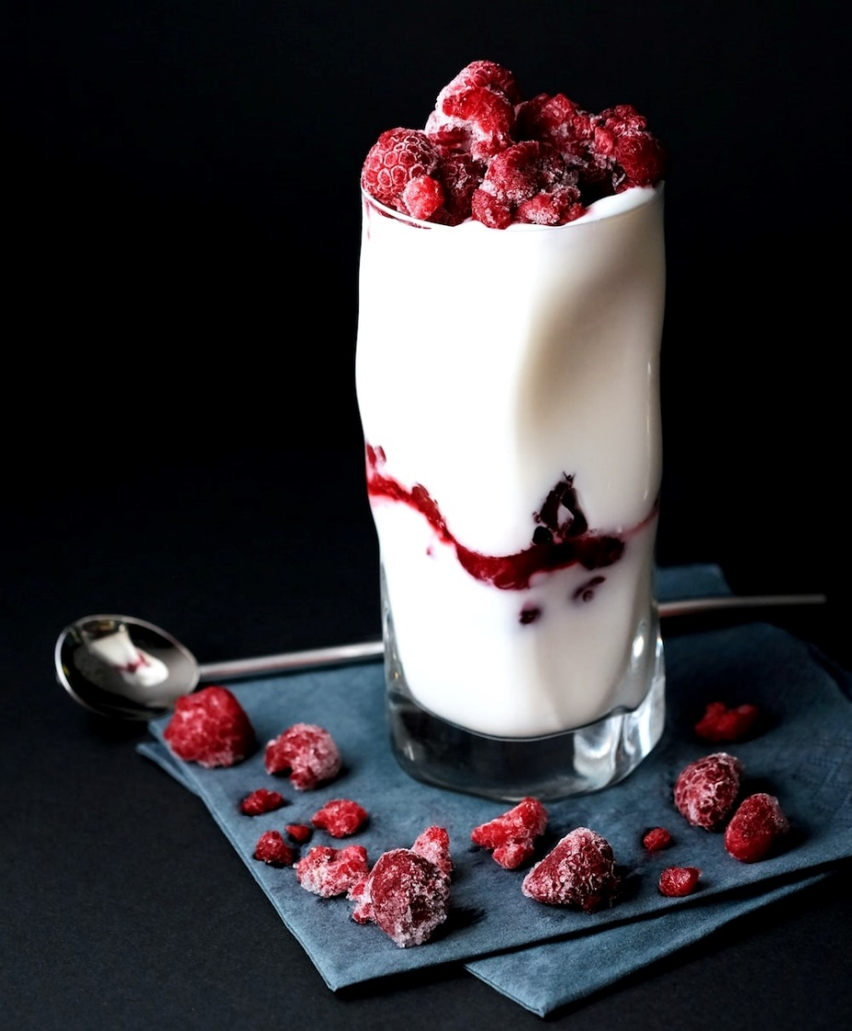
el yogur

Slide 19
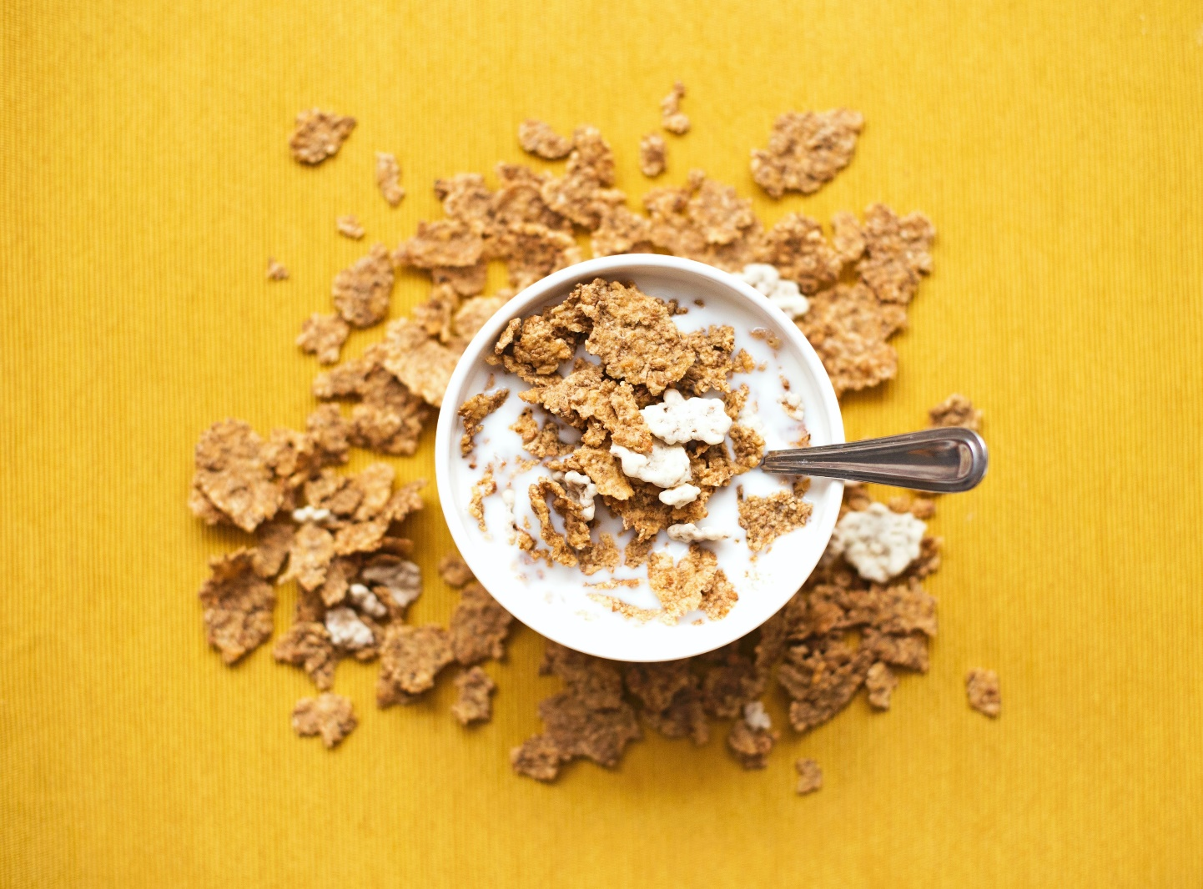
los cereales

Slide 20
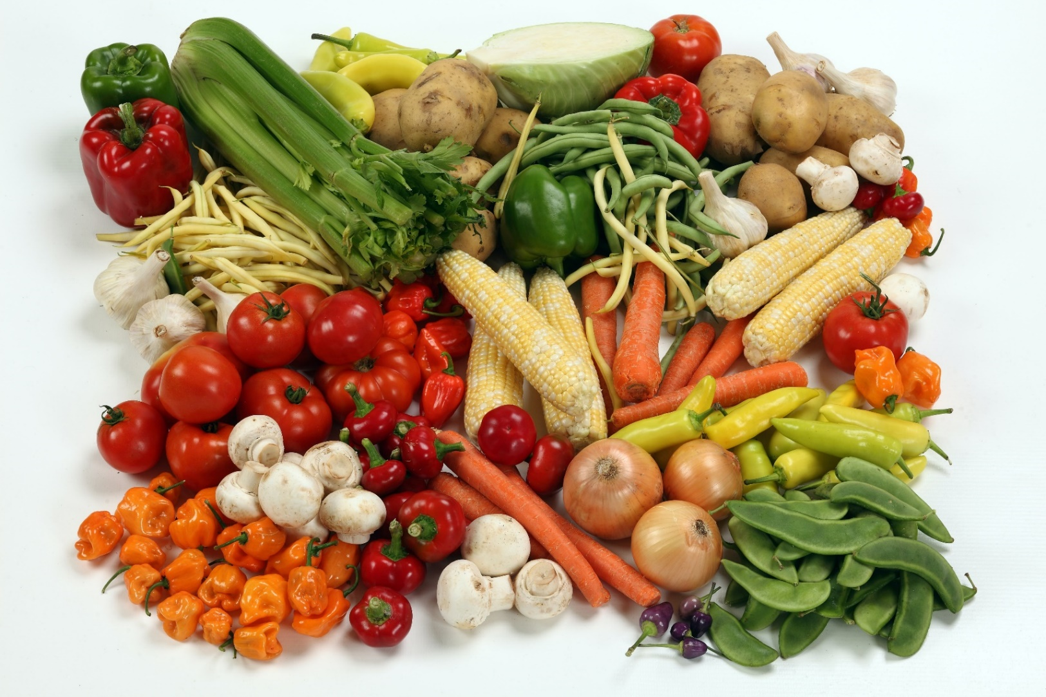
las verduras

Slide 21
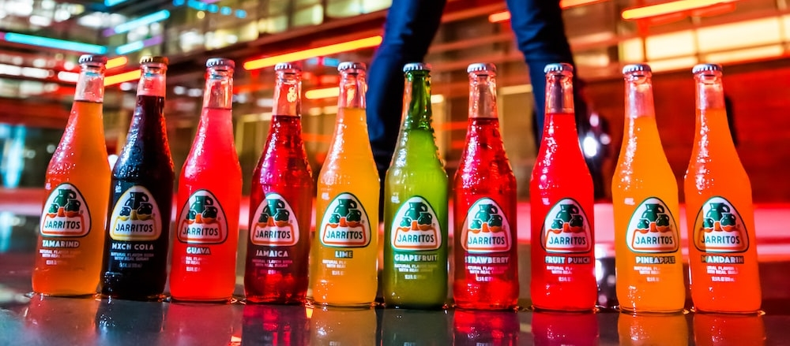
los refrescos

Slide 22
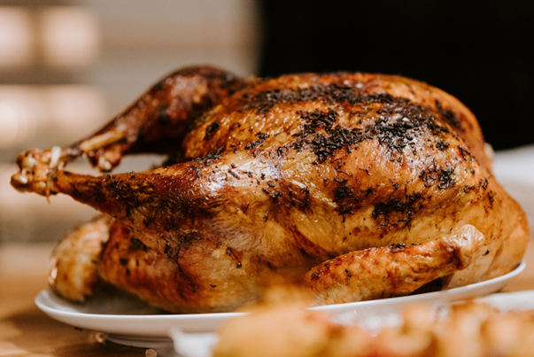
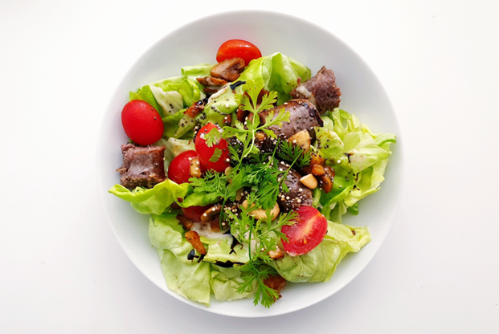
delicious
El pollo es delicioso
La ensalada es deliciosa

Slide 23
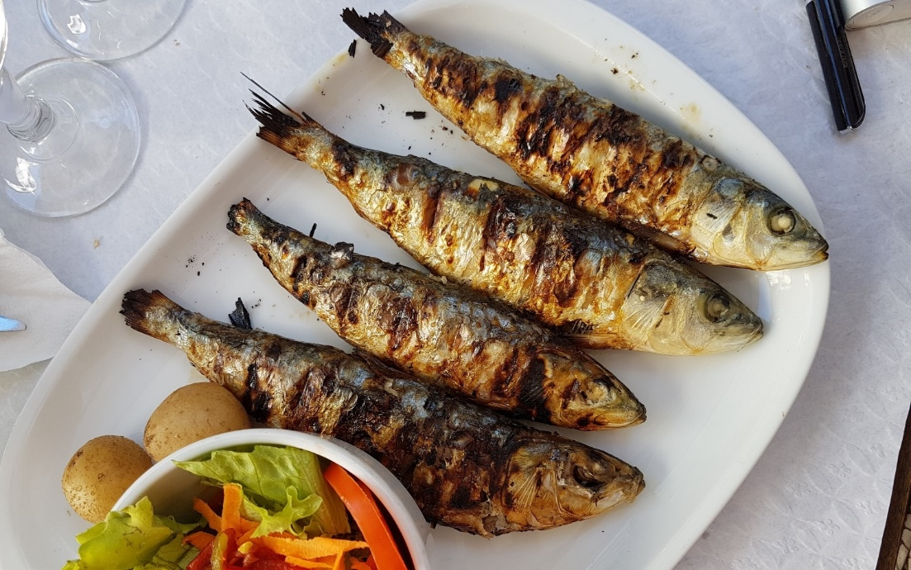
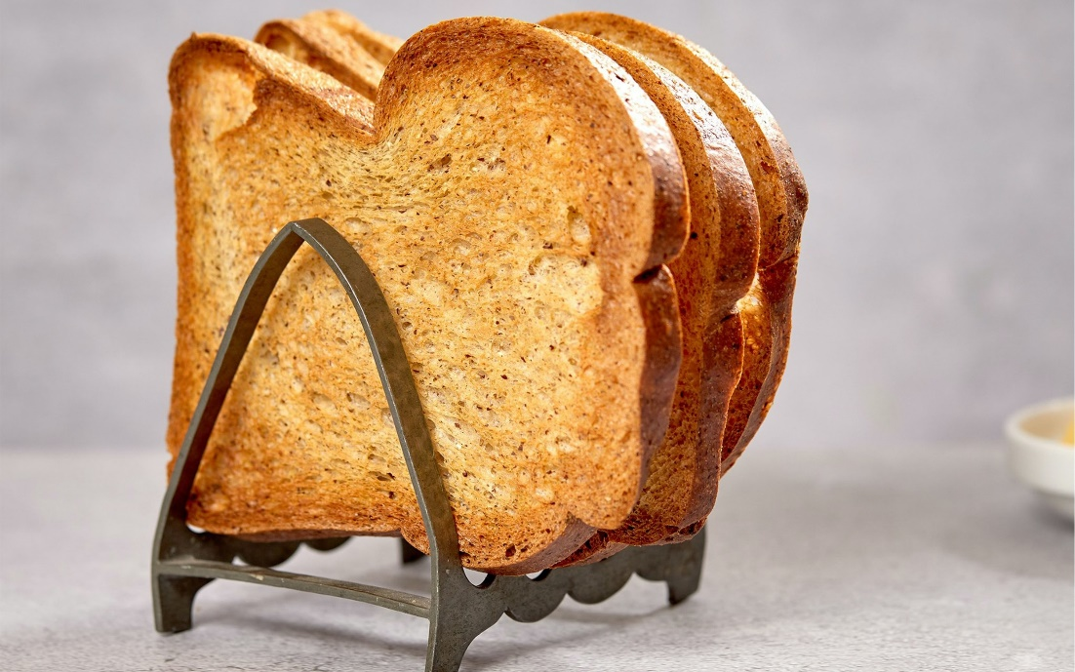
tasty
El pescado es sabroso
La tostada no es sabrosa

Slide 24
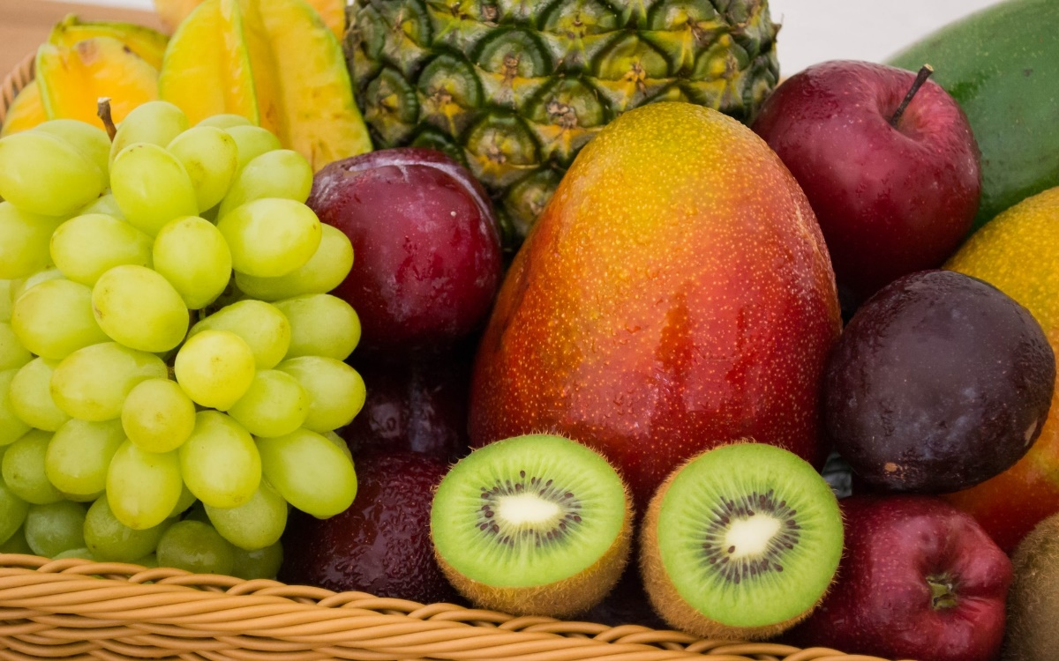
salty
El jamón es salado
La fruta no es salada

Slide 25
bitter
El café es amargo
La leche no es amarga

Slide 26
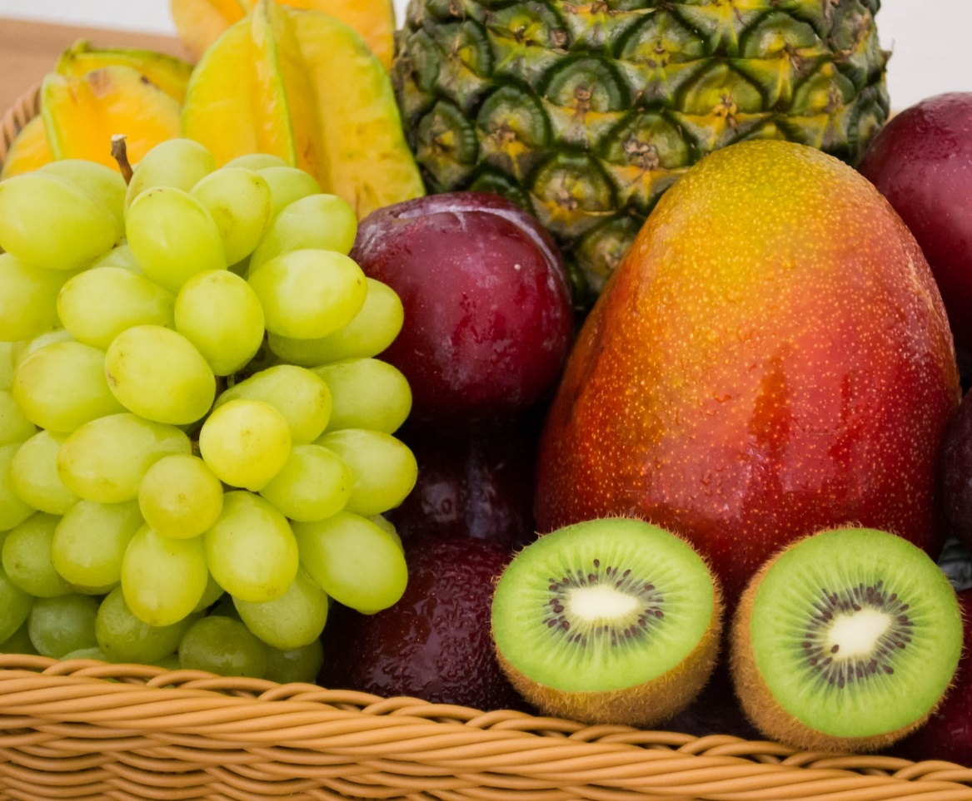
sweet
El café no es dulce
La fruta es dulce

Slide 27
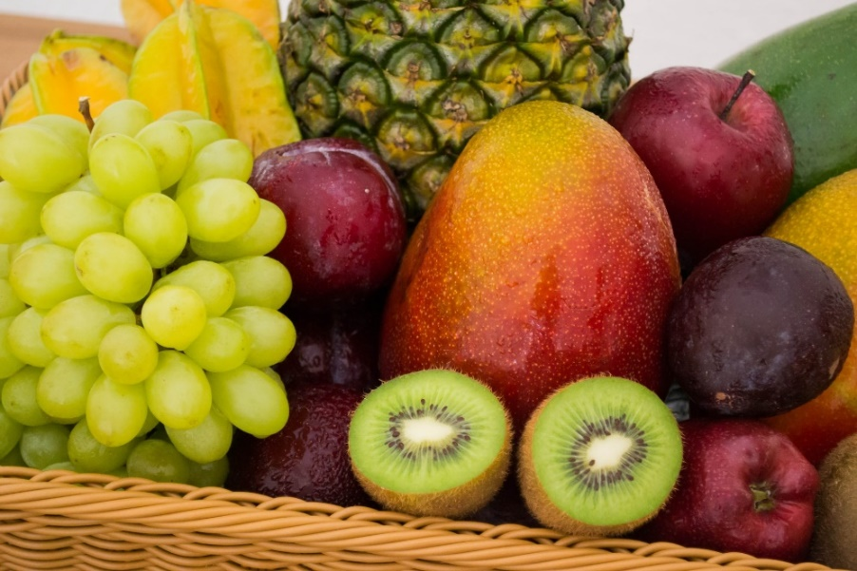
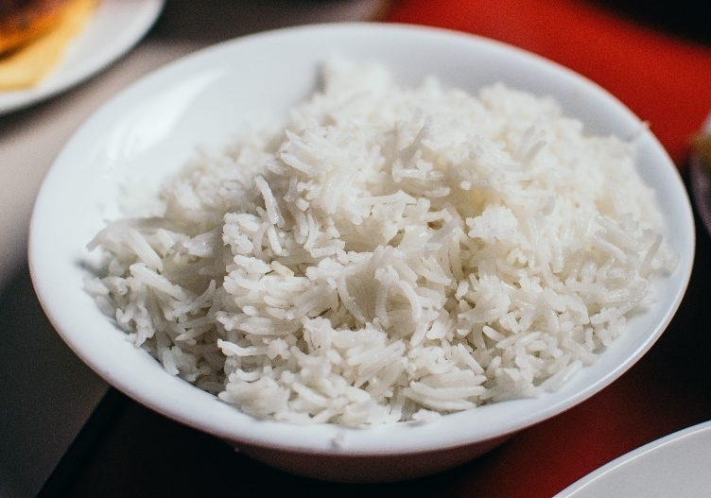
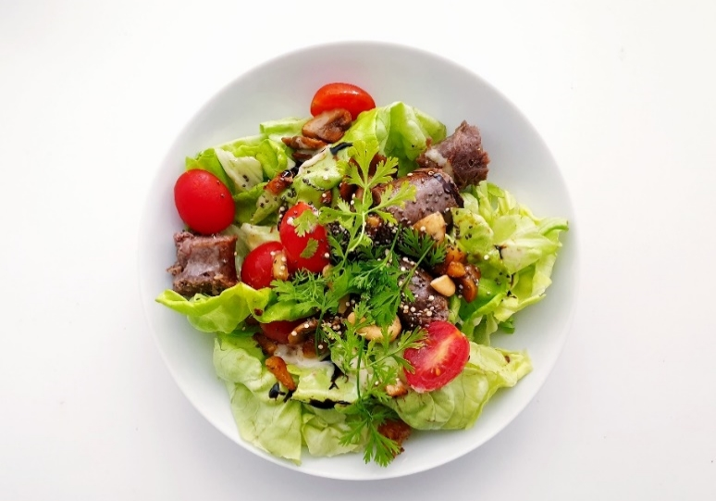
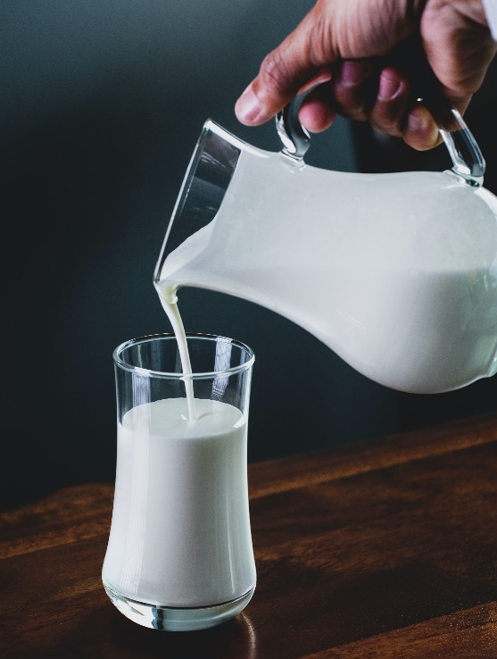
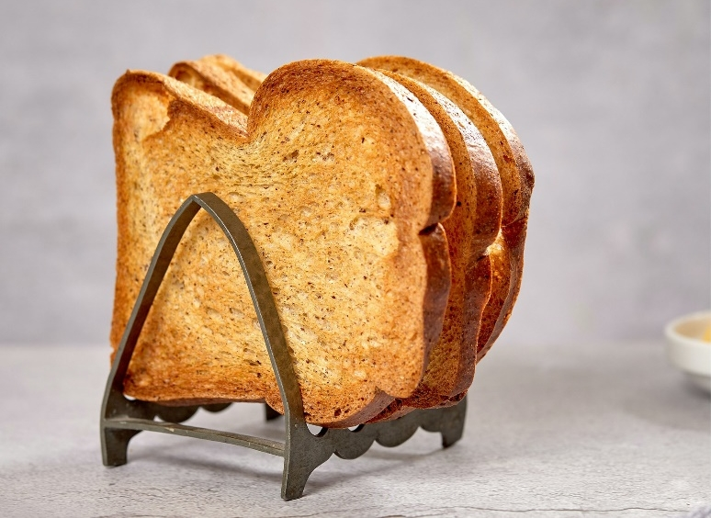
¿Te gusta…? ¿Porqué? (1)
¿Te gusta…? ¿Porqué?

Slide 28
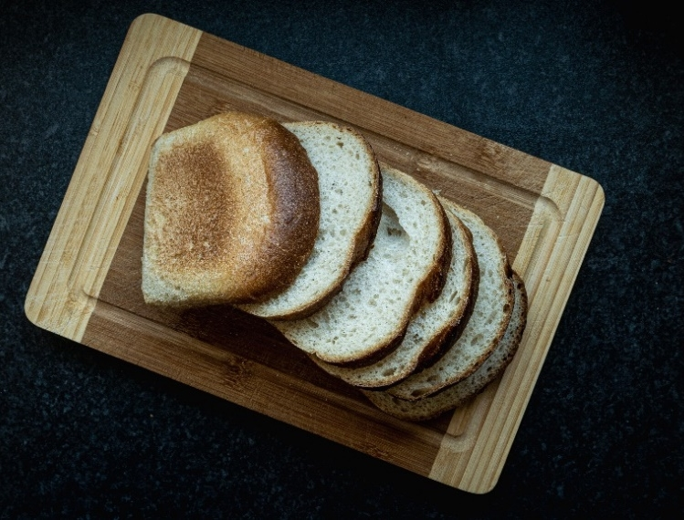
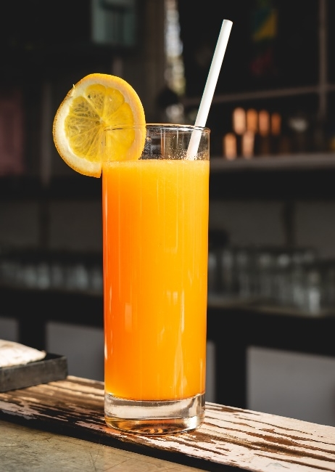
¿Te gusta…? ¿Porqué? (2)
¿Te gusta…? ¿Porqué?

Slide 29
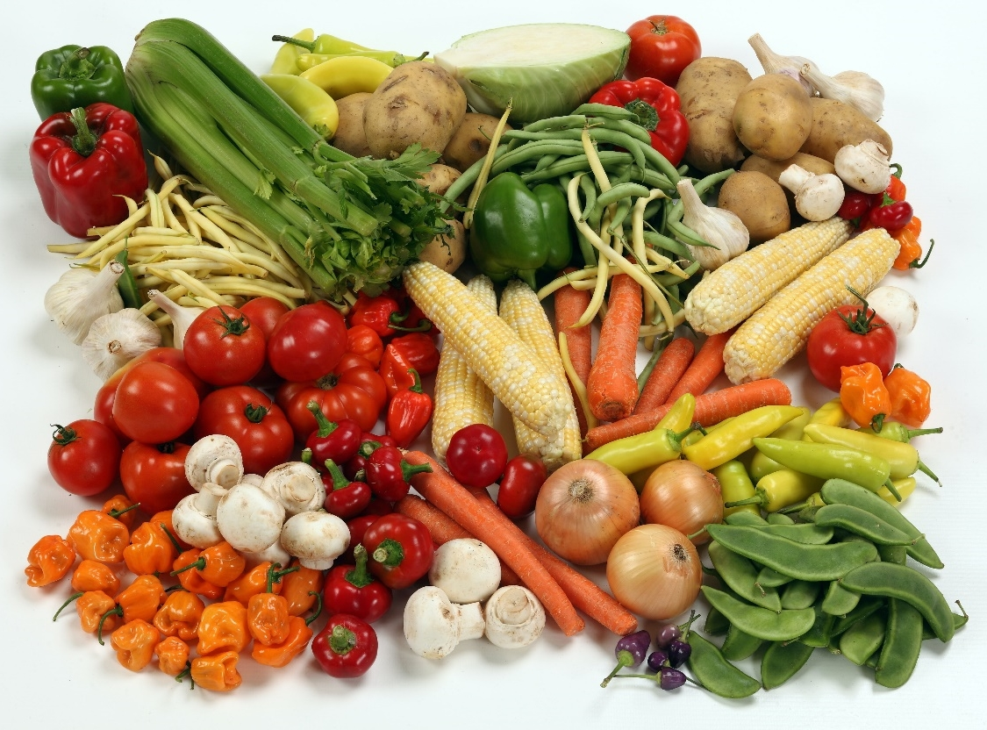
¿Te gusta…? ¿Porqué? (3)
¿Te gusta…? ¿Porqué?

Slide 30
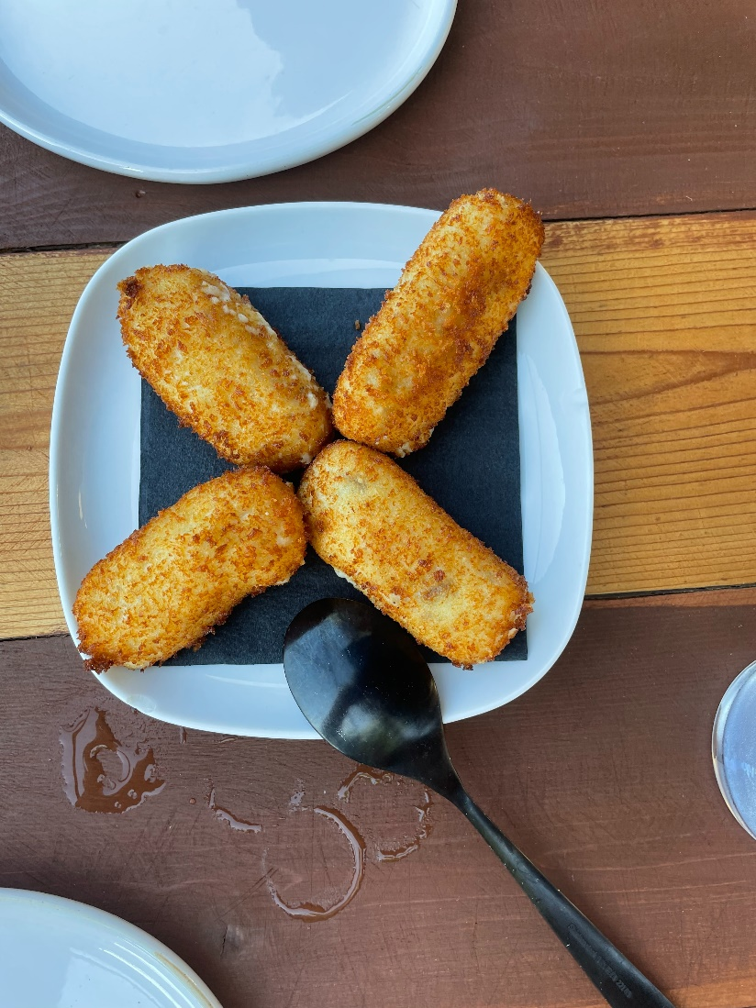
las croquetas

Slide 31
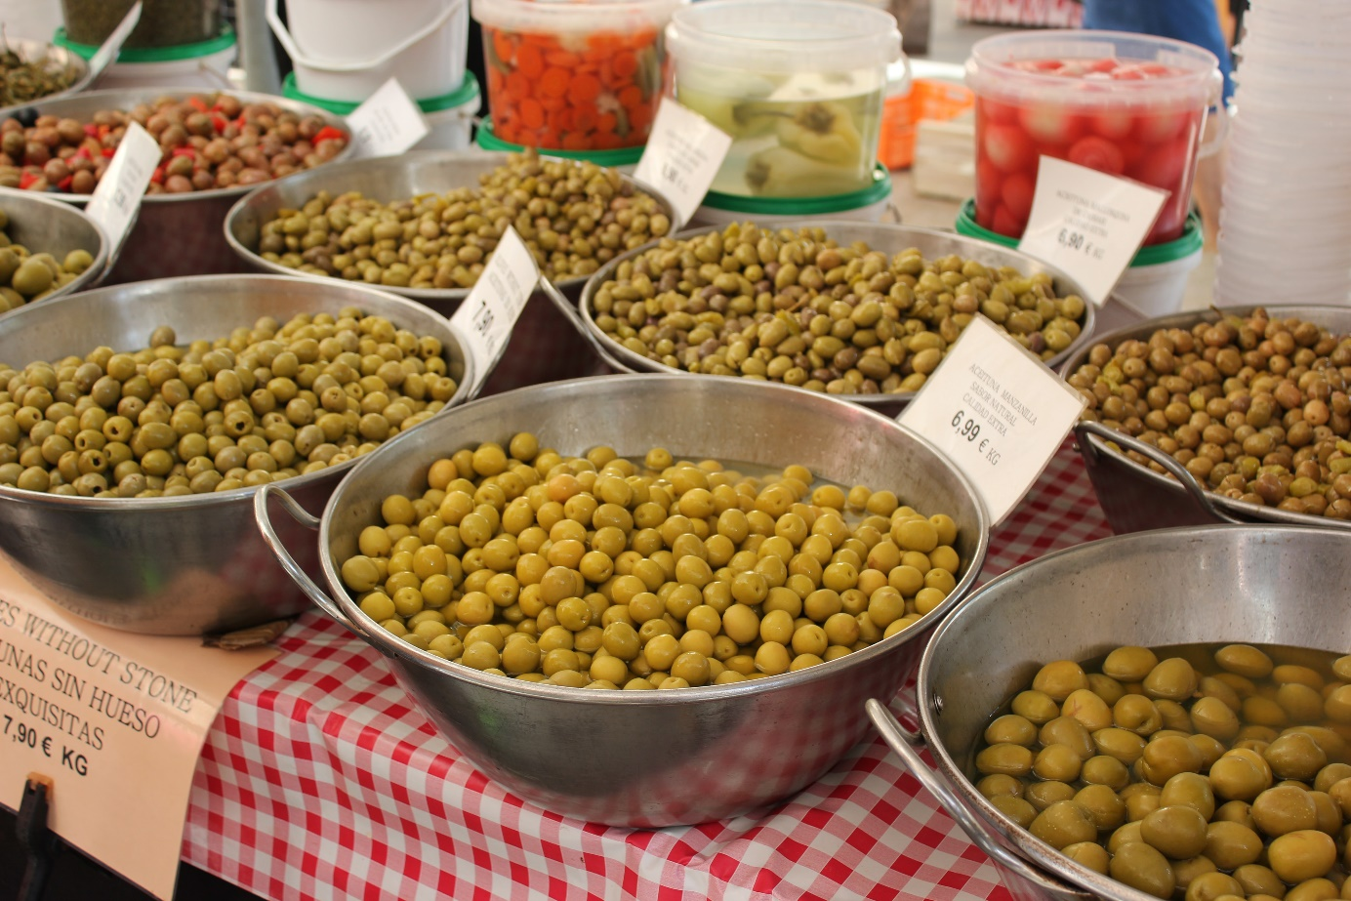
las aceitunas

Slide 32
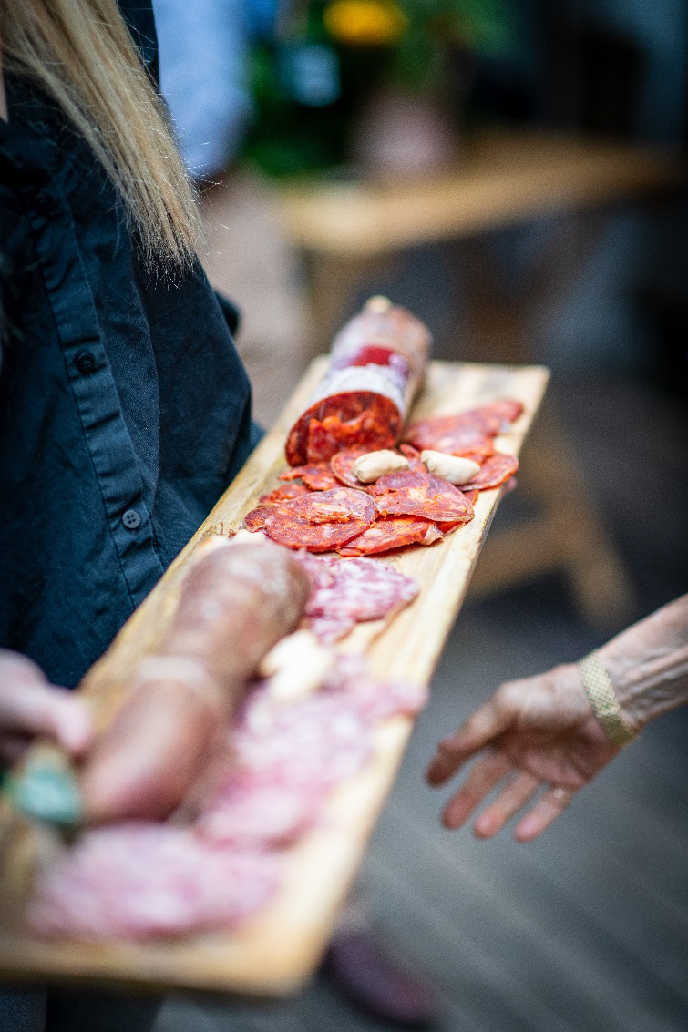
el chorizo

Slide 33
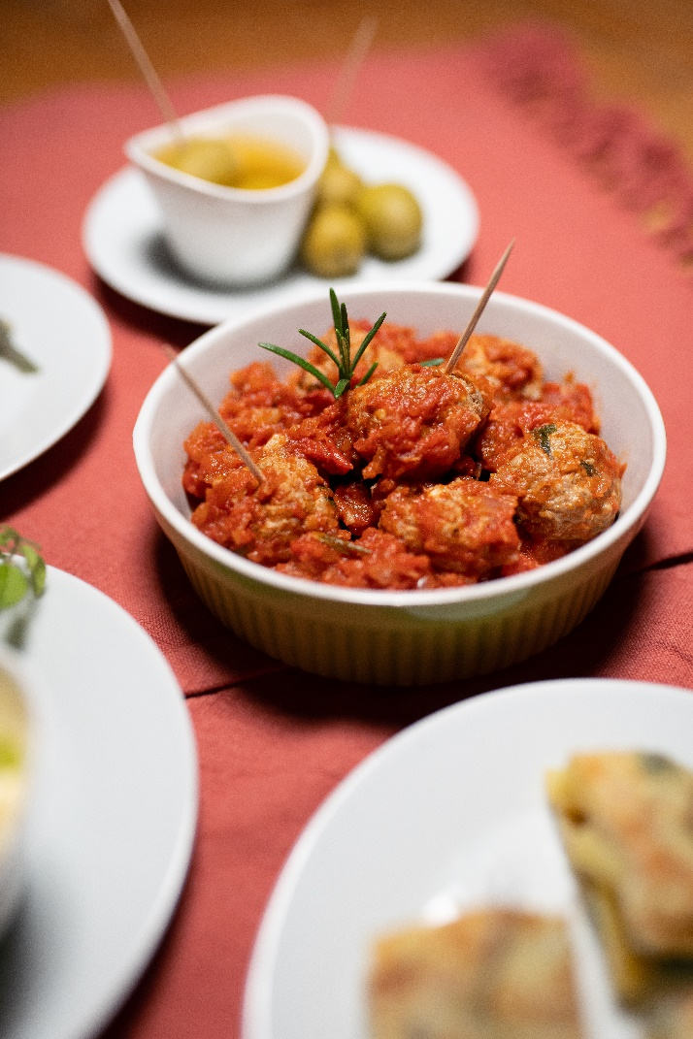
las albóndigas

Slide 34
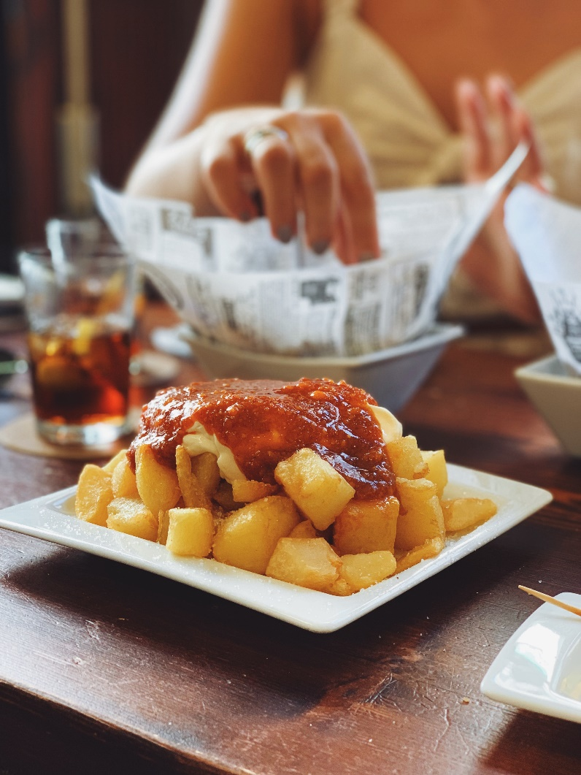
las patatas bravas

Slide 35
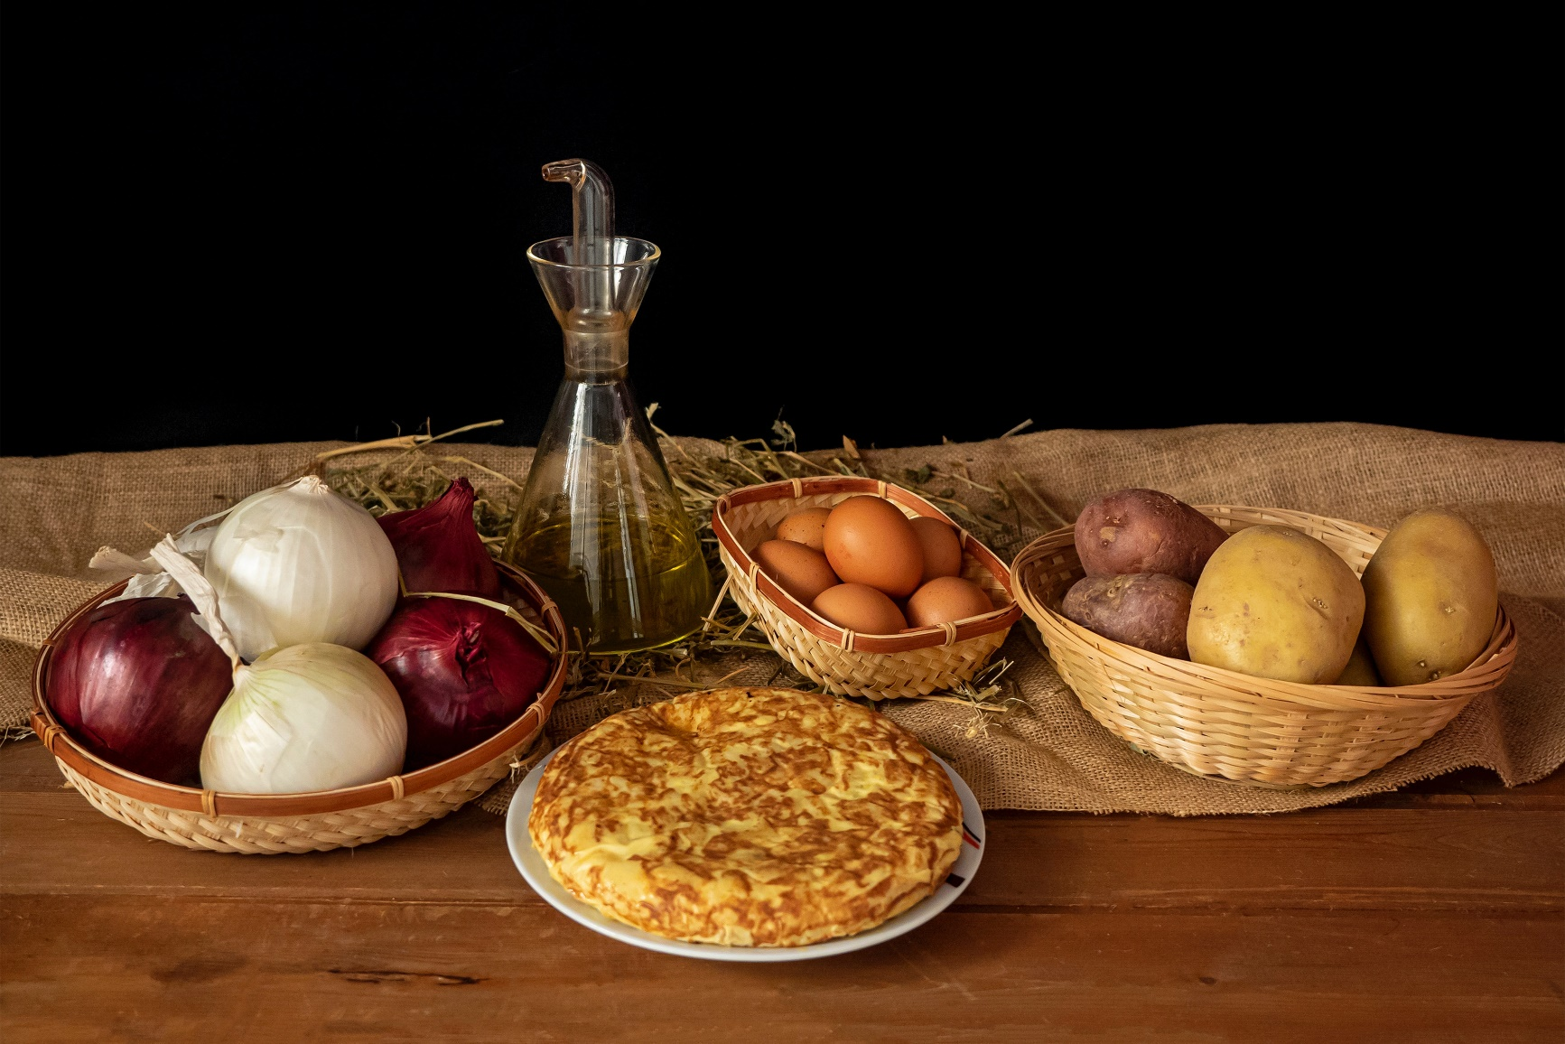
la tortilla de patatas

Slide 36
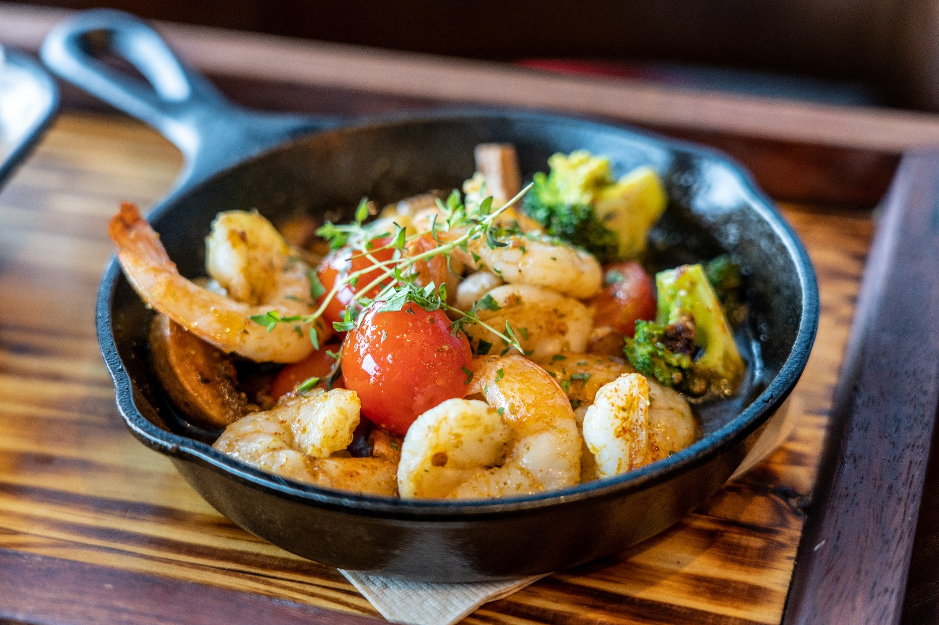
las gambas al ajillo

Slide 37
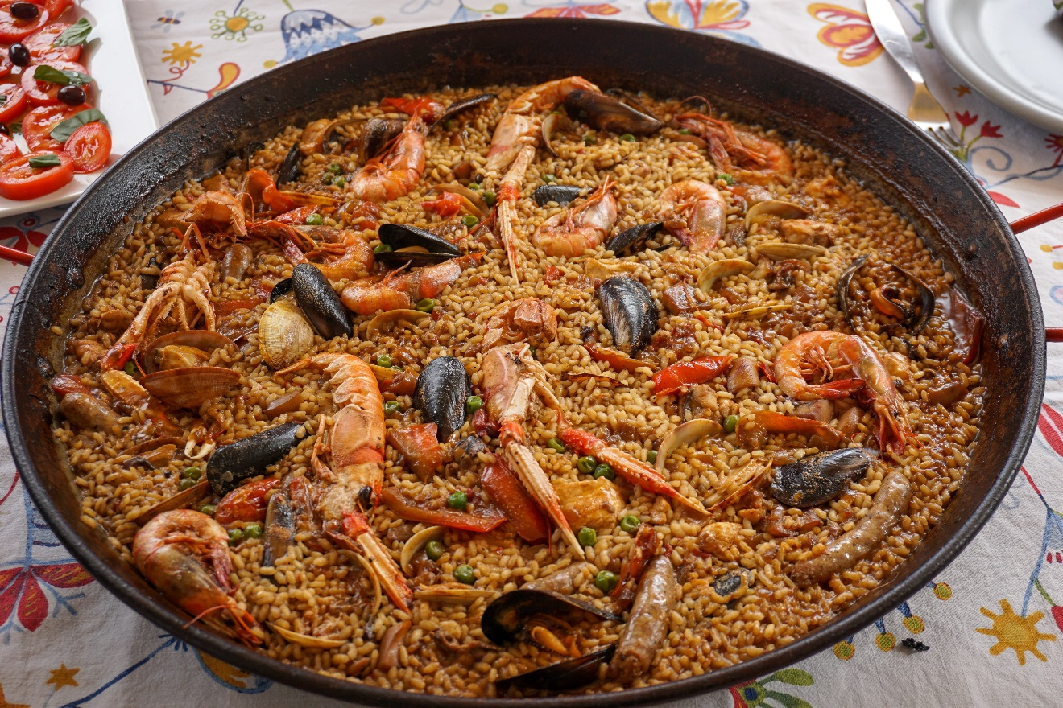
la paella

Slide 38
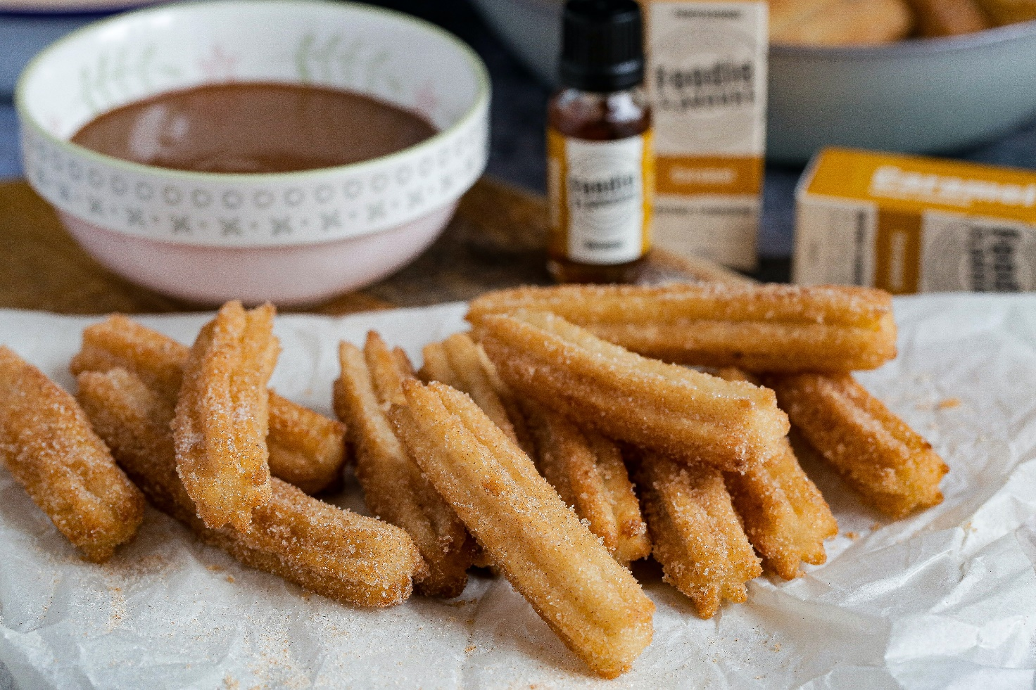
los churros

Slide 39
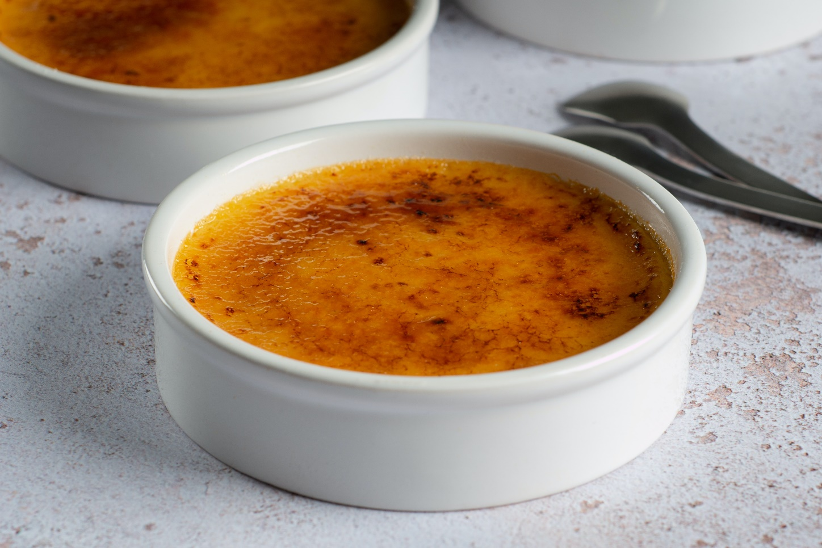
la crema catalana

Slide 40
Copyright
© State of New South Wales (Department of Education), 2023
The copyright material published in this resource is subject to the Copyright Act 1968 (Cth) and is owned by the NSW Department of Education or, where indicated, by a party other than the NSW Department of Education (third-party material).
Copyright material available in this resource and owned by the NSW Department of Education is licensed under a Creative Commons Attribution 4.0 International (CC BY 4.0) licence.
This license allows you to share and adapt the material for any purpose, even commercially.
Attribution should be given to © State of New South Wales (Department of Education), 2023.
Material in this resource not available under a Creative Commons license:
the NSW Department of Education logo, other logos and trademark-protected material
Material owned by a third party that has been reproduced with permission. You will need to obtain permission from the third party to reuse its material.
Links to third-party material and websites
Please note that the provided (reading/viewing material/list/links/texts) are a suggestion only and implies no endorsement, by the New South Wales Department of Education, of any author, publisher, or book title. School principals and teachers are best placed to assess the suitability of resources that would complement the curriculum and reflect the needs and interests of their students.
If you use the links provided in this document to access a third party’s website, you acknowledge that the terms of use, including licence terms set out on the third-party’s website apply to the use which may be made of the materials on that third-party website or where permitted by the Copyright Act 1968 (Cth). The department accepts no responsibility for content on third-party websites.

Slide 41
© State of New South Wales (Department of Education) 2023

