Slide 1
Quels sont tes passe-temps ?
What do you do in your free time?

Slide 2
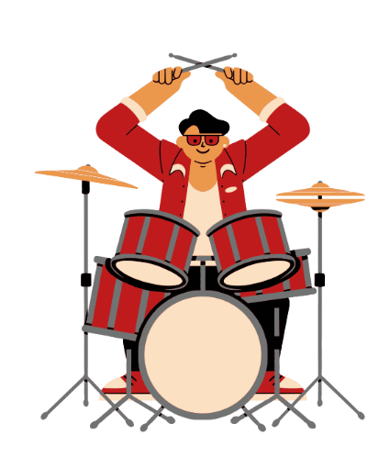
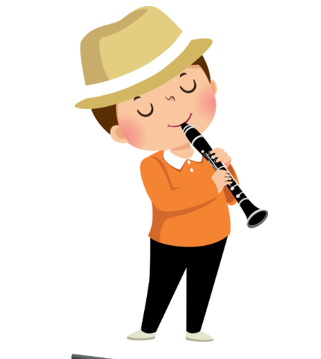
Play clarinet
Notes:
Je joue de la clarinette: I play the clarinet
Je joue de la batterie: I play the drums

Slide 3
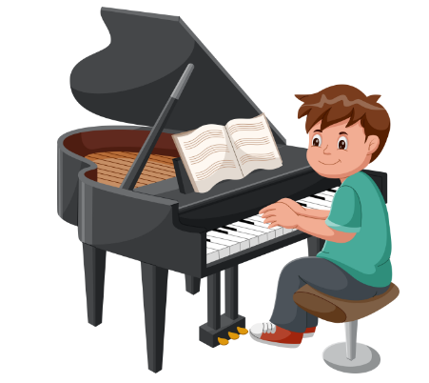
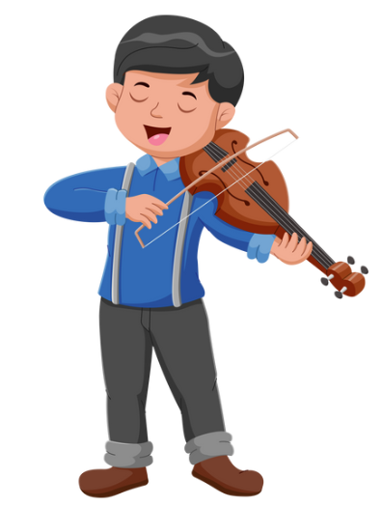
Play piano
Notes:
Je joue du piano: I play the piano
Je joue du violon: I play the violin

Slide 4
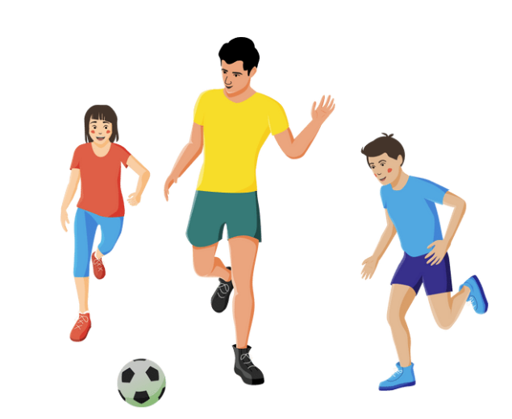
Play soccer
Notes:
Je joue au foot: I play soccer

Slide 5
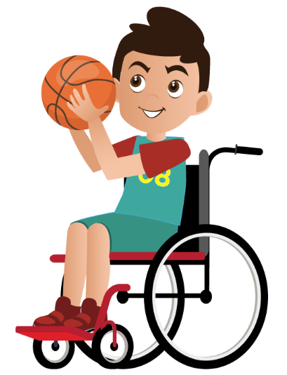
Play basketball
Notes:
Je joue au basket: I play basketball

Slide 6
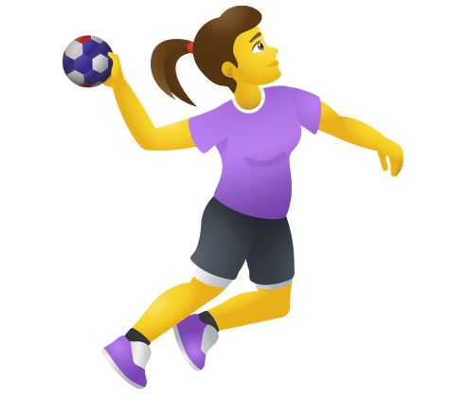
Play handball
Notes:
Je joue au handball: I play (European) handball

Slide 7
Play chess
Notes:
Je joue aux échecs: I play chess

Slide 8
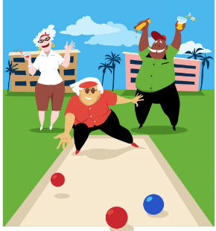
Play bowls
Notes:
Je joue à la pétanque: I play bowls

Slide 9
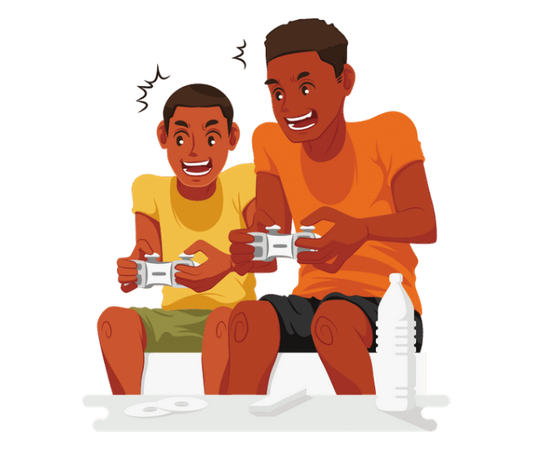
Play video games
Notes:
Je joue aux jeux vidéo: I play video games

Slide 10
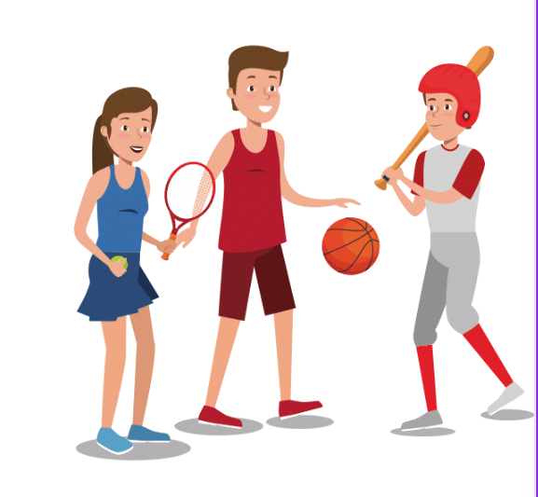
Play sport
Notes:
Je fais du sport: I do sport

Slide 11
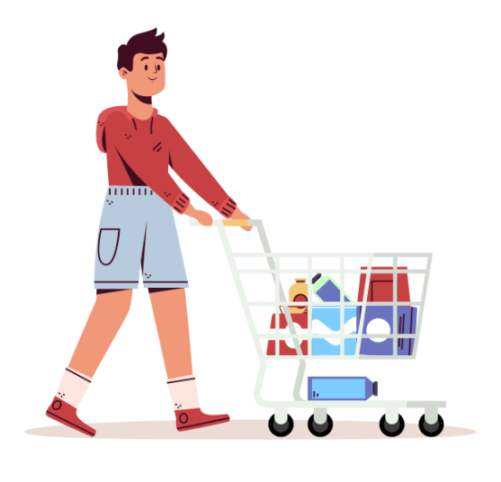
Do the groceries
Notes:
Je fais les courses: I do the shopping

Slide 12
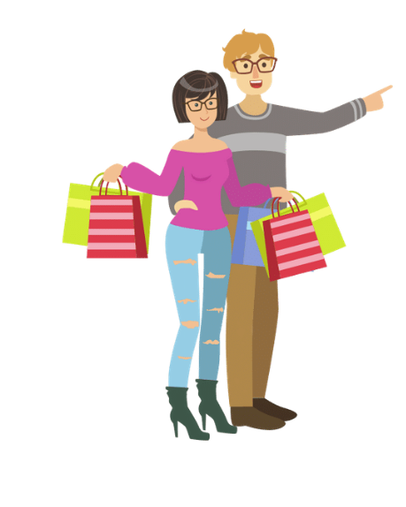
Go shopping
Notes:
Je fais du shopping: I go shopping

Slide 13
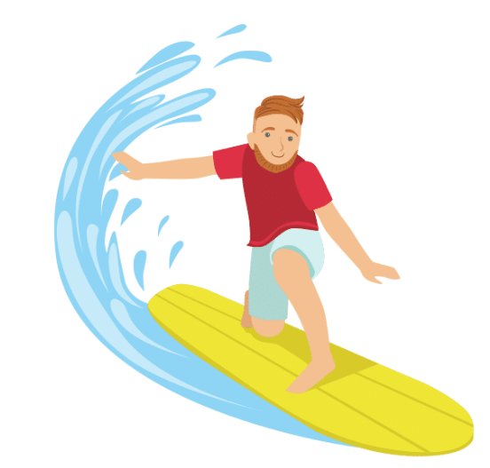
Go surfing
Notes:
Je fais du surf: I surf

Slide 14
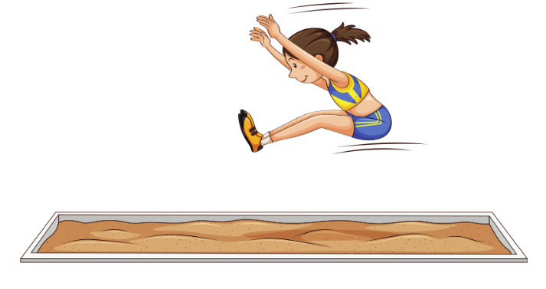
Do athletics
Notes:
Je fais de l’athlétisme: I do athletics

Slide 15
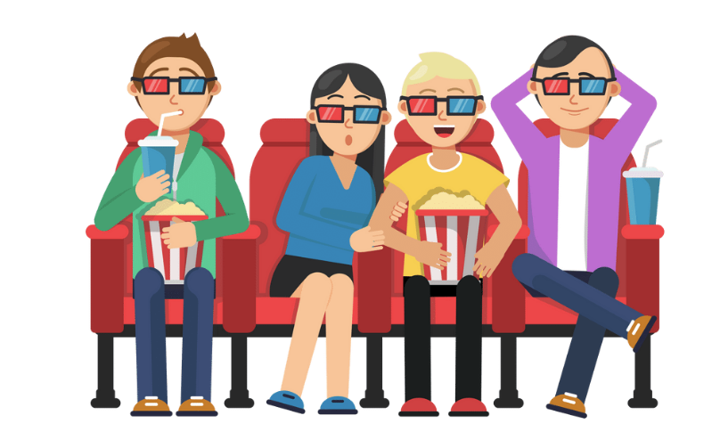
Go to the movies
Notes:
Je vais au cinéma: I go to the movies

Slide 16
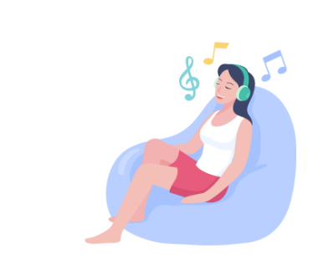
Listen to music
Notes:
J’écoute de la musique: I listen to music

Slide 17
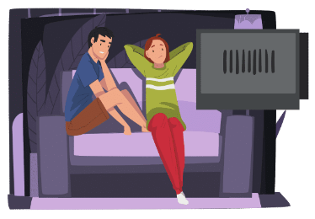
Watch TV
Notes:
Je regarde la télé: I watch TV

Slide 18
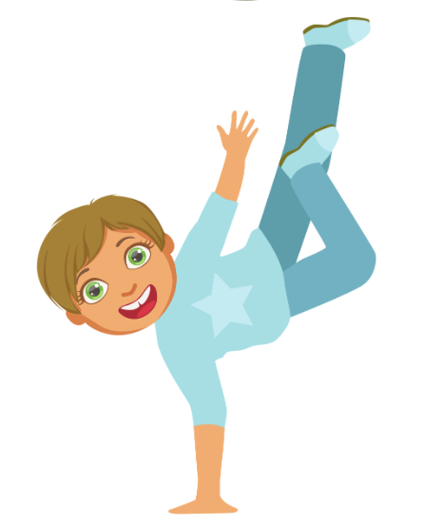
Dancing
Notes:
Je danse: I dance

Slide 19
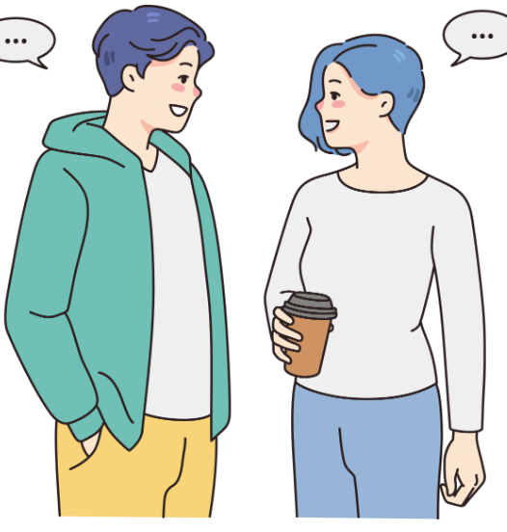
Hang out with friends
Notes:
Je traîne avec des amis: I hang out with friends
(Note: discuss the concept of ‘false friends’ between languages.)

Slide 20
Copyright
© State of New South Wales (Department of Education), 2023
The copyright material published in this resource is subject to the Copyright Act 1968 (Cth) and is owned by the NSW Department of Education or, where indicated, by a party other than the NSW Department of Education (third-party material).
Copyright material available in this resource and owned by the NSW Department of Education is licensed under a Creative Commons Attribution 4.0 International (CC BY 4.0) licence.
This license allows you to share and adapt the material for any purpose, even commercially.
Attribution should be given to © State of New South Wales (Department of Education), 2023.
Material in this resource not available under a Creative Commons license:
the NSW Department of Education logo, other logos and trademark-protected material
Material owned by a third party that has been reproduced with permission. You will need to obtain permission from the third party to reuse its material.
Links to third-party material and websites
Please note that the provided (reading/viewing material/list/links/texts) are a suggestion only and implies no endorsement, by the New South Wales Department of Education, of any author, publisher, or book title. School principals and teachers are best placed to assess the suitability of resources that would complement the curriculum and reflect the needs and interests of their students.
If you use the links provided in this document to access a third party’s website, you acknowledge that the terms of use, including licence terms set out on the third-party’s website apply to the use which may be made of the materials on that third-party website or where permitted by the Copyright Act 1968 (Cth). The department accepts no responsibility for content on third-party websites.

Slide 21
© State of New South Wales (Department of Education) 2023

