Slide 1
La ropa
Clothing
NSW Department of Education

Slide 2
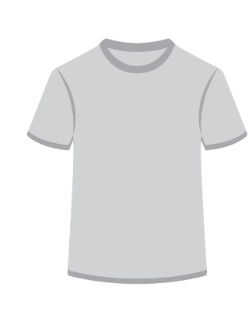
Una camiseta
Notes:
una camiseta: T-shirt

Slide 3
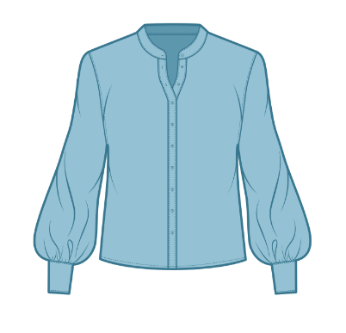
Una blusa
Notes:
una blusa: blouse

Slide 4
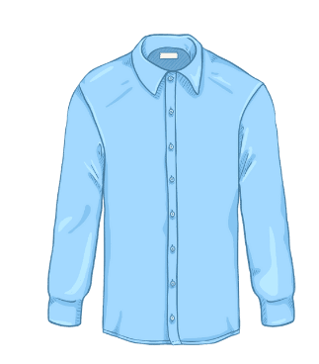
Una camisa
Notes:
una camisa: shirt

Slide 5
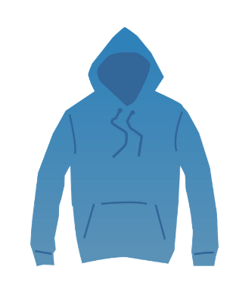
Un suéter
Notes:
un suéter: sweater

Slide 6
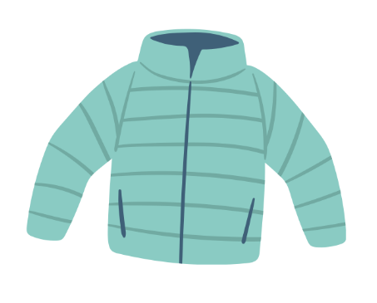
Una chaqueta
Notes:
una chaqueta: jacket

Slide 7
Una gorra
Notes:
una gorra: cap

Slide 8
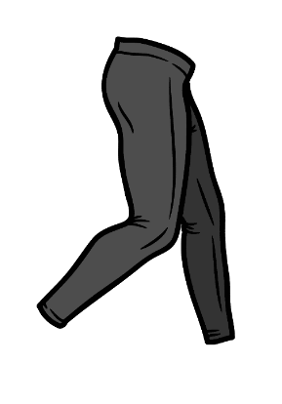
Unas mallas
Notes:
unas mallas: tights

Slide 9
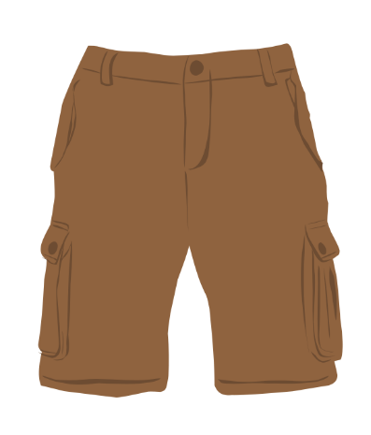
Unos shorts/pantalones cortos
Notes:
unos shorts/pantalones cortos: shorts

Slide 10
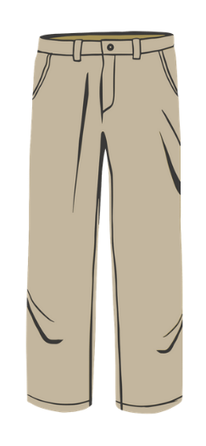
Unos pantalones
Notes:
unos pantalones: pants

Slide 11
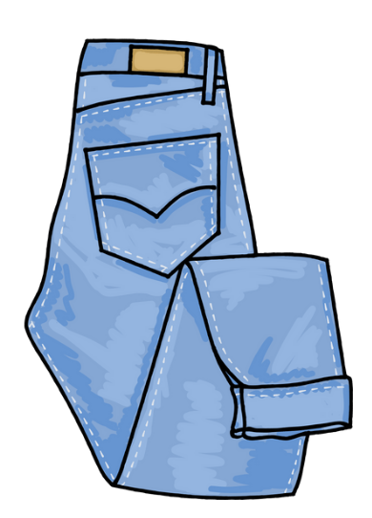
Unos vaqueros
Notes:
unos vaqueros: jeans

Slide 12
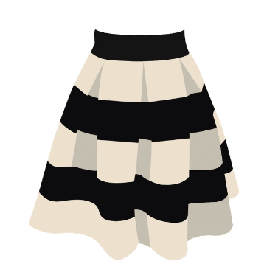
Una falda
Notes:
una falda: skirt

Slide 13
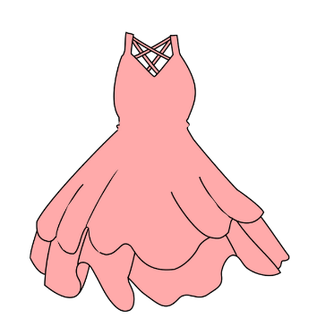
Un vestido
Notes:
un vestido: dress

Slide 14
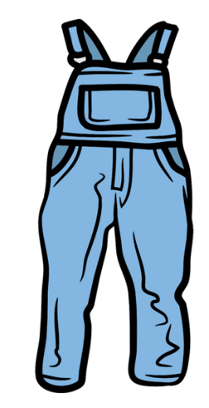
Un mono
Notes:
un mono: overalls

Slide 15
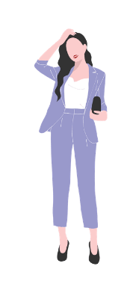
Un traje
Notes:
un traje: a suit

Slide 16
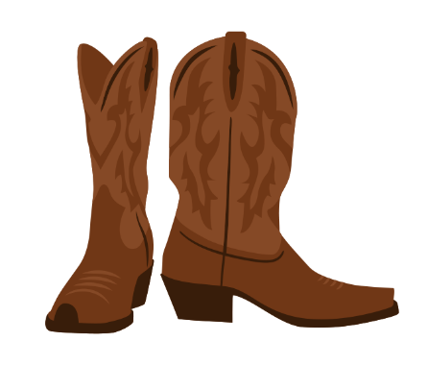
Unas botas
Notes:
unas botas: boots

Slide 17
Unos zapatos
Notes:
unos zapatos: shoes

Slide 18
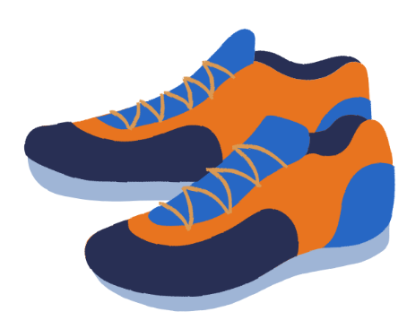
Unas zapatillas de deporte
Notes:
unas zapatillas de deporte: runners

Slide 19
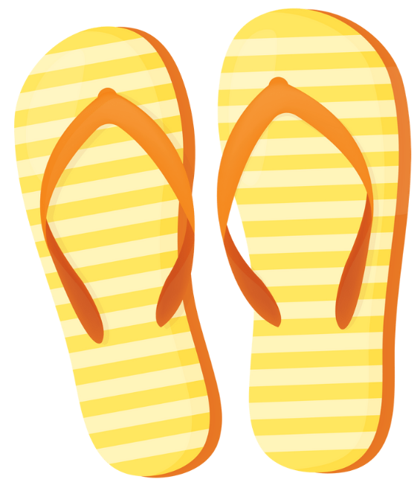
Unas chancletas
Notes:
unas chancletas: thongs

Slide 20
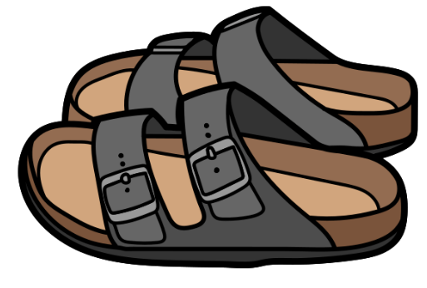
Unas sandalias
Notes:
unas sandalias: sandals

Slide 21
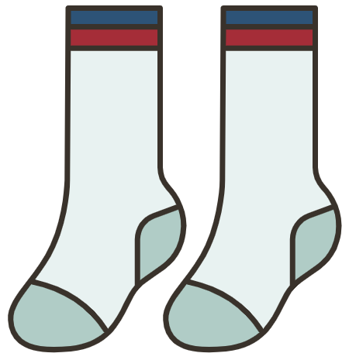
Unos calcetines
Notes:
unos calcetines: socks

Slide 22
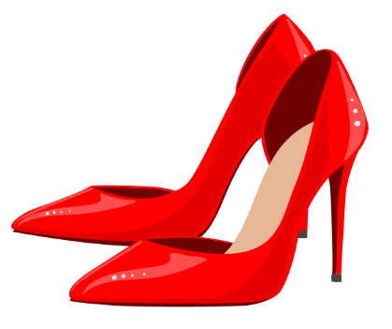
Unos tacones
Notes:
unos tacones: heels

Slide 23
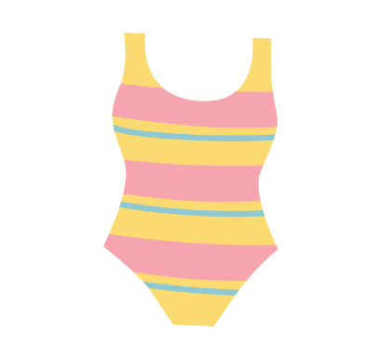
Un traje de baño
Notes:
un traje de baño: a swimsuit

Slide 24
Describe las camisetas
lisa
estampada
floreada
a rayas
Notes:
una camiseta lisa – a plain T-shirt
una camiseta estampada – a patterned T-shirt
una camiseta estampada – a floral T-shirt
una camiseta a rayas – a stripey T-shirt

Slide 25
Describe los pantalones
azules y cómodos
a rayas
lisos y baratos
elegantes
Notes:
unos pantalones azules y cómodos – comfortable, blue pants
unos pantalones a rayas – stripey pants
unos pantalones lisos y baratos – plain, cheap pants
unos pantalones elegantes – elegant pants

Slide 26
Describe los vestidos
largo, rojo y bonito
corto y rosa
anticuado y feo
lujoso, negro y caro
Notes:
un vestido largo, rojo y bonito – a long, red beautiful dress
un vestido corto y rosa – a short, pink dress
un vestido anticuado y feo – an old-fashioned, ugly dress
un vestido lujoso, negro y caro – a fancy, black, expensive dress

Slide 27
Describe los tacones
brillantes
feos
anticuados
Notes:
unos tacones brillantes – shiny high heels
unos tacones feos – ugly high heels
unos tacones anticuados – old-fashioned/outdated high heels

Slide 28
Describe las zapatillas de deporte
caras
baratas
cómodas
Notes:
unas zapatillas caras – expensive sports shoes
unas zapatillas baratas – cheap sports shoes
unas zapatillas cómodas – comfortable sports shoes

Slide 29
Describe los calcetines
a lunares
a rayas
lisos
largos
Notes:
unos calcetines a lunares – spotty socks
unos calcetines a rayas – stripey socks
unos calcetines lisos – plain socks
unos calcetines largos – long socks

Slide 30
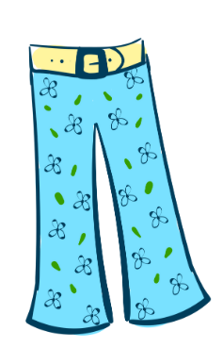
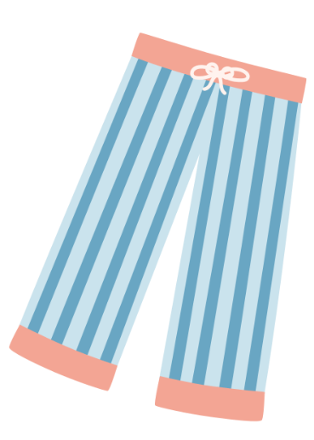
¿Cuáles pantalones prefieres?

Slide 31
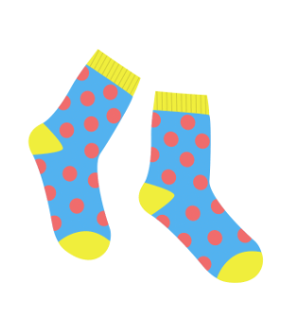
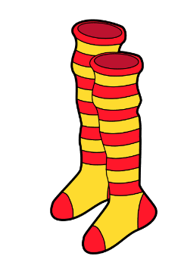
¿Cuáles calcetines prefieres?

Slide 32
¿Cuáles shorts prefieres?

Slide 33
¿Cuál camisa prefieres?

Slide 34
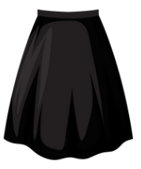
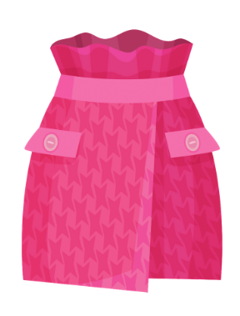
¿Cuál falda prefieres?

Slide 35
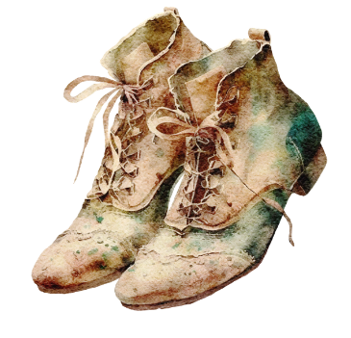
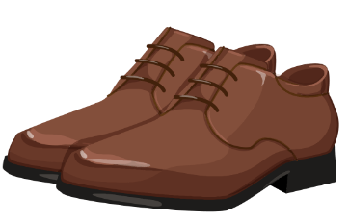
¿Cuáles zapatos prefieres?

Slide 36
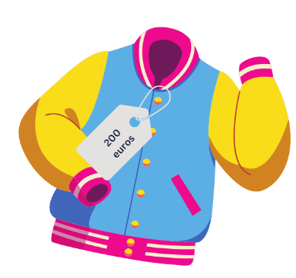
Compara las chaquetas
La chaqueta negra es más cara que la rosa.
La chaqueta rosa es menos lujosa que la negra.
La chaqueta azul es tan cara como la negra.

Slide 37
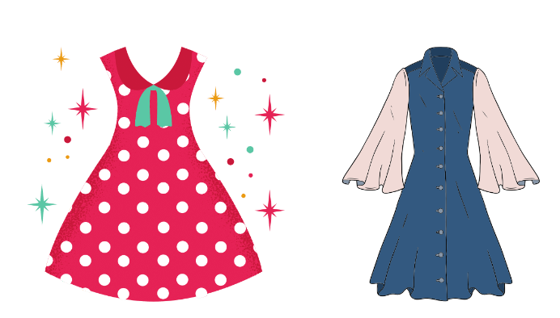
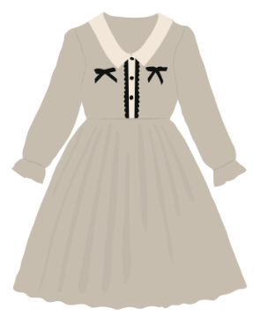
Compara los vestidos
El vestido rojo es más bonito que el azul
El vestido azul es menos lujoso que el rojo
El vestido gris es tan anticuado como el azul

Slide 38
Copyright
© State of New South Wales (Department of Education), 2023
The copyright material published in this resource is subject to the Copyright Act 1968 (Cth) and is owned by the NSW Department of Education or, where indicated, by a party other than the NSW Department of Education (third-party material).
Copyright material available in this resource and owned by the NSW Department of Education is licensed under a Creative Commons Attribution 4.0 International (CC BY 4.0) licence.
This licence allows you to share and adapt the material for any purpose, even commercially.
Attribution should be given to © State of New South Wales (Department of Education), 2023.
Material in this resource not available under a Creative Commons licence:
the NSW Department of Education logo, other logos and trademark-protected material
Material owned by a third party that has been reproduced with permission. You will need to obtain permission from the third party to reuse its material.
Links to third-party material and websites
Please note that the provided (reading/viewing material/list/links/texts) are a suggestion only and implies no endorsement, by the New South Wales Department of Education, of any author, publisher, or book title. School principals and teachers are best placed to assess the suitability of resources that would complement the curriculum and reflect the needs and interests of their students.
If you use the links provided in this document to access a third party’s website, you acknowledge that the terms of use, including licence terms set out on the third-party’s website apply to the use which may be made of the materials on that third-party website or where permitted by the Copyright Act 1968 (Cth). The department accepts no responsibility for content on third-party websites.

Slide 39
© State of New South Wales (Department of Education) 2023

