Slide 1
Comparing using place value
Explicit teaching

Slide 2
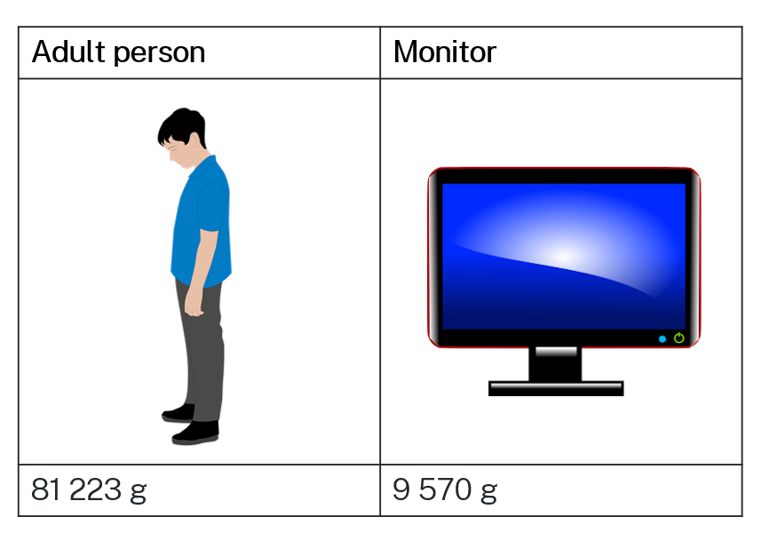
Comparing weights
Which is heavier? How do you know?
Notes:
https://www.desmos.com/calculator/6yjfdrmmpe

Slide 3
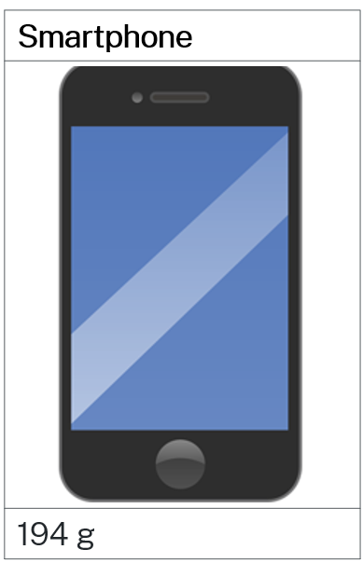
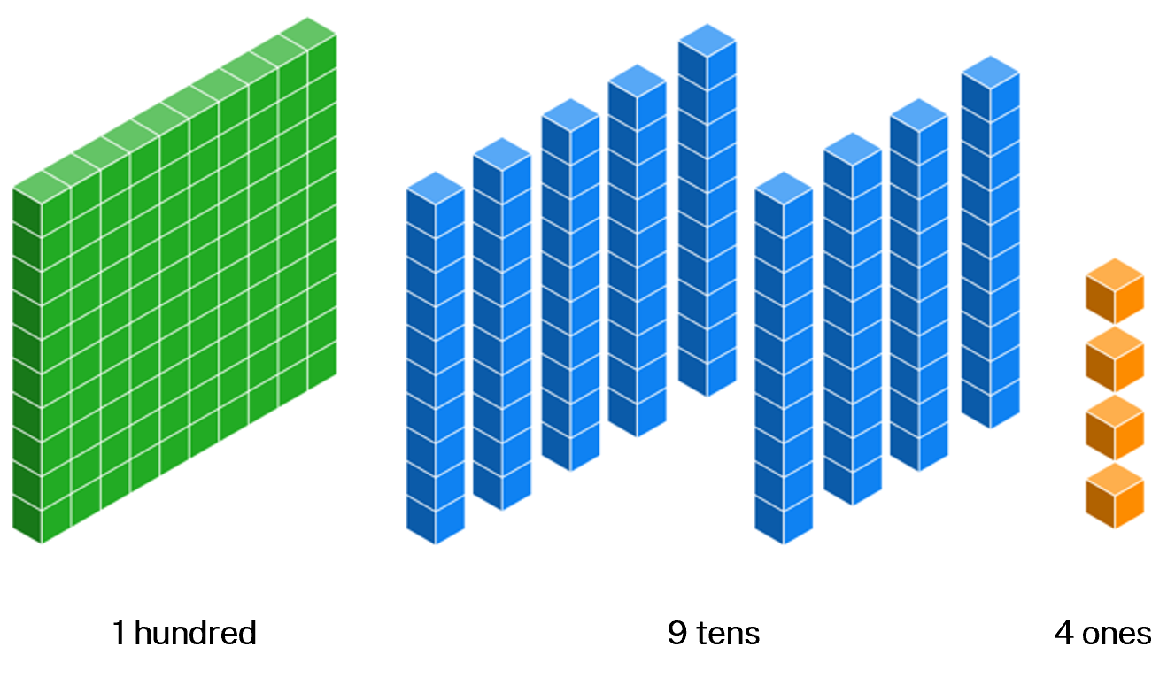
Representing hundreds
Notes:
https://www.desmos.com/calculator/6yjfdrmmpe

Slide 4
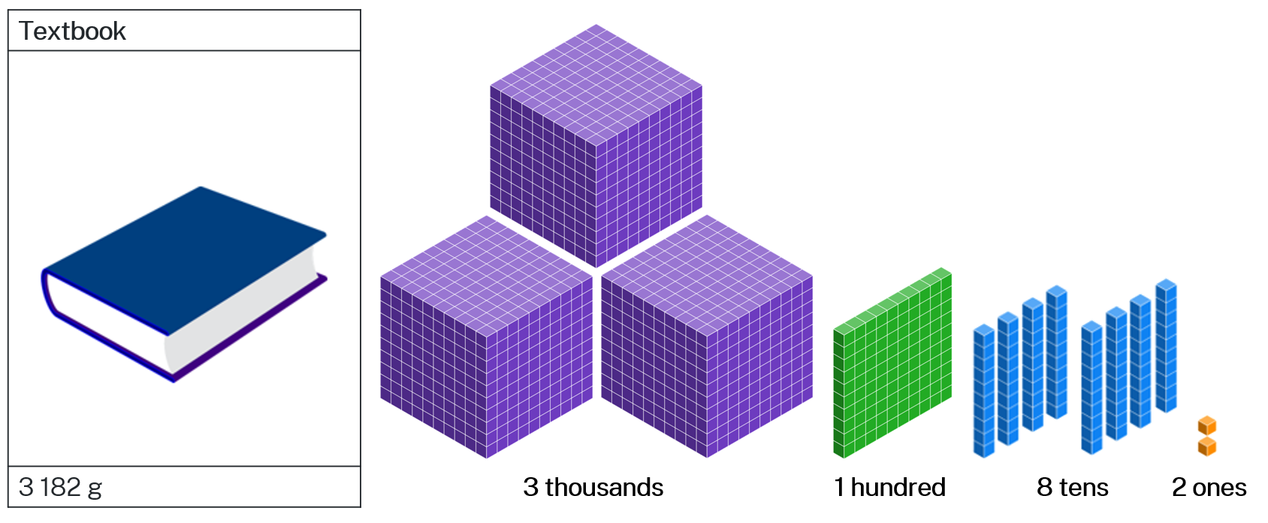
Representing thousands

Slide 5
Comparing chip packets
Which bag would you most like to have? Why?
Bag 1 | Bag 2 | Bag 3 | Bag 4 | Bag 5 | Bag 6 | Bag 7 | Bag 8
24.1 g | 24.12 g | 24.2 g | 24.036g | 24.3 g | 24.24 g | 24.31 g | 24.127 g
Notes:
https://www.desmos.com/calculator/6yjfdrmmpe

Slide 6
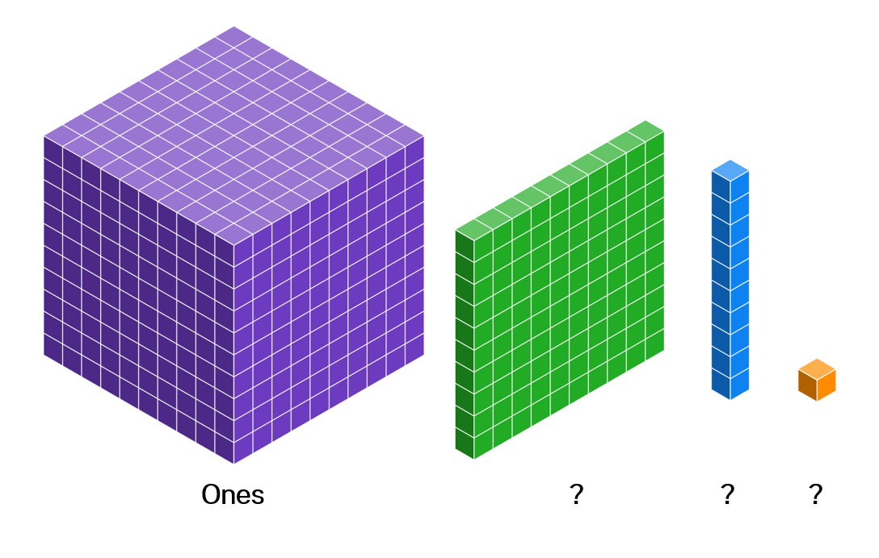
Changing representations
What would each of these smaller blocks represent?
Notes:
https://www.desmos.com/calculator/6yjfdrmmpe

Slide 7
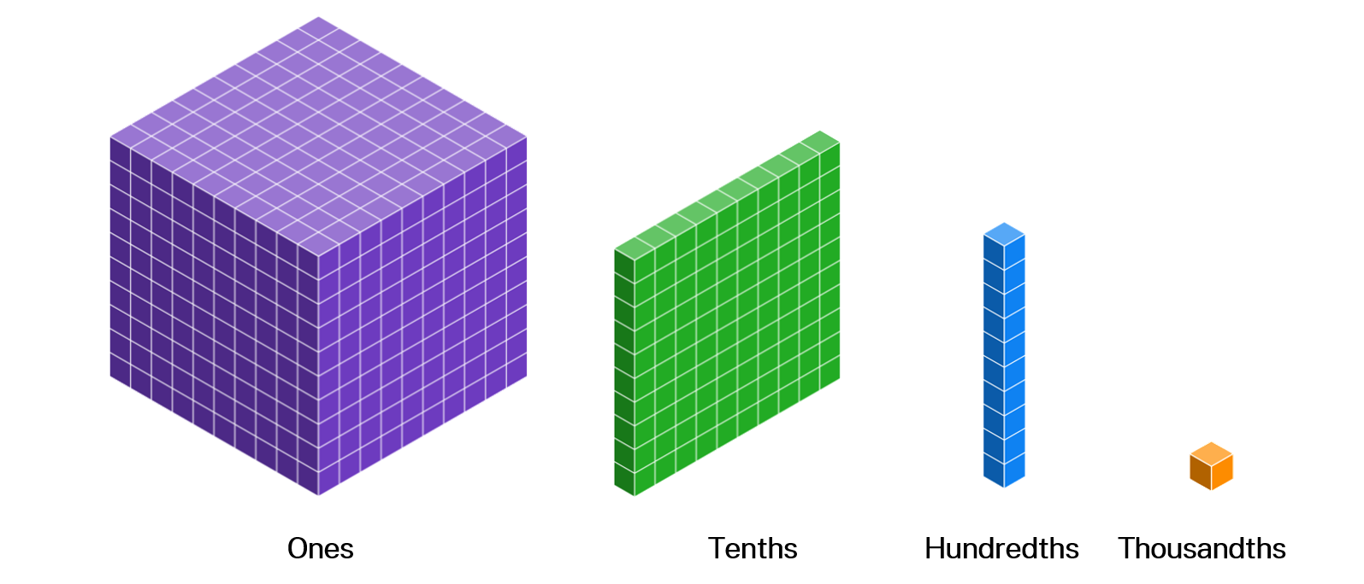
Representing thousandths
Notes:
https://www.desmos.com/calculator/6yjfdrmmpe

Slide 8
Placing decimals on a number line – worked example
Place the number 5.41 on a number line.
Notes:
https://www.desmos.com/calculator/6yjfdrmmpe

Slide 9
Placing decimals on a number line – prompts
Place the number 5.41 on a number line.
How do we know the number is between 5 and 6?
How many dashes do you draw between the whole numbers? What about between tenths?
Why are there always 10 gaps between integers and between tenths?

Slide 10
Your turn – placing decimals on a number line
Place the number 2.37 on a number line.

Slide 11
Your turn – solution
Place the number 2.37 on a number line.

