Slide 1
Seeing double
Explicit teaching

Slide 2
Warm up
Instructions
Throw both dice.
Look for the numbers that are common multiples of the numbers rolled.
Place counters on the common multiples on your game board.
Swap turns.
Game ends after 5 rounds – player with the most numbers covered, wins.
Notes:
Explain that if you rolled a 2 and a 3, the common multiples would be 6, 12, 18 etc

Slide 3
Explore – example 1
Representing addition and subtraction of fractions
Using vectors, draw the expression on the number line.
State the sum of $\frac{1}{4}+\frac{1}{8}$.
$$\frac{1}{4}+\frac{1}{8}=\frac{3}{8}$$
$$\frac{1}{8}$$
$$\frac{2}{8}$$
$$\frac{3}{8}$$
$$\frac{4}{8}$$
$$\frac{5}{8}$$
$$\frac{6}{8}$$
$$\frac{7}{8}$$
Notes:
Ask students if 3/8 has any equivalent fractions. Could it be written as quarters or halves?

Slide 4
Explore – self-explanation prompts 1
Representing addition and subtraction of fractions
Using vectors, draw the expression on the number line.
State the sum of $\frac{1}{4}+\frac{1}{8}$.
$$\frac{1}{4}+\frac{1}{8}=\frac{3}{8}$$
What is $\frac{1}{4}$ equivalent to?
Why is the number line labelled as eighths?
$$\frac{1}{8}$$
$$\frac{2}{8}$$
$$\frac{3}{8}$$
$$\frac{4}{8}$$
$$\frac{5}{8}$$
$$\frac{6}{8}$$
$$\frac{7}{8}$$
Notes:
Ask students if 3/8 has any equivalent fractions. Could it be written as quarters or halves?

Slide 5
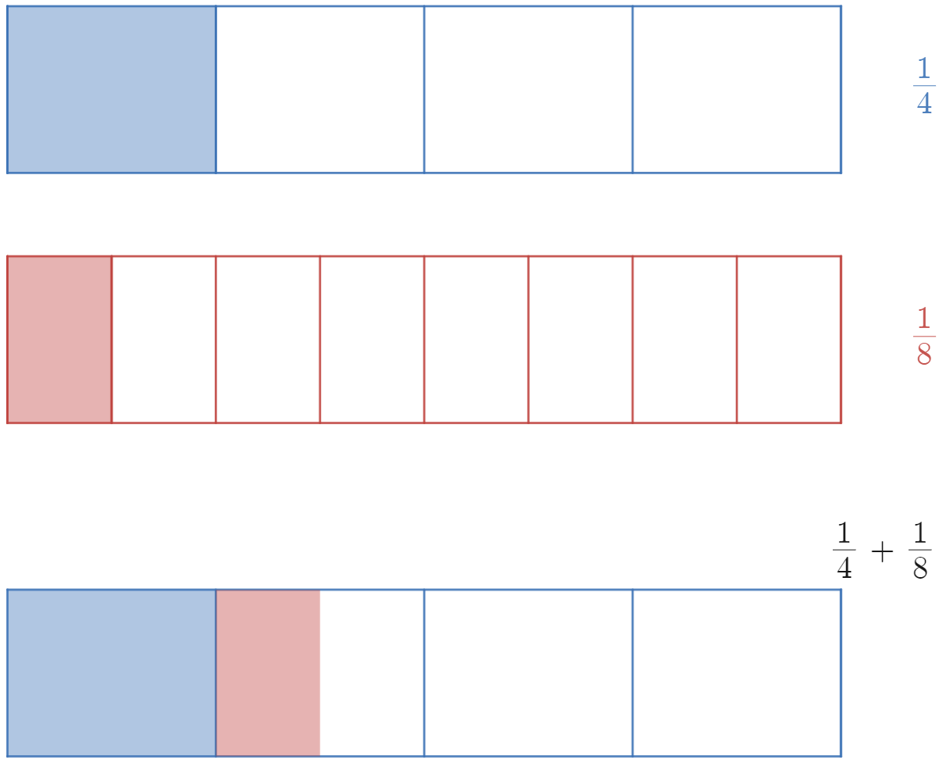
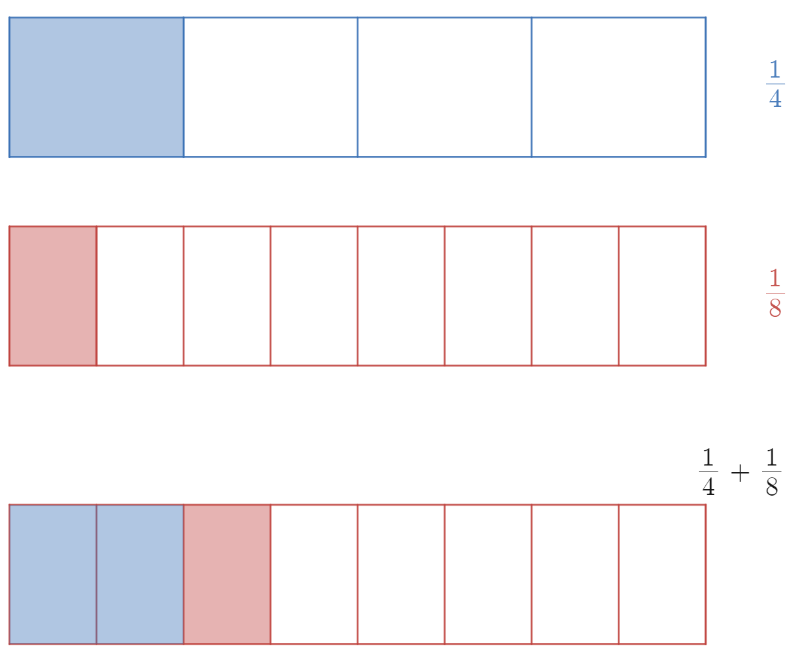
Explore – alternate representation 1
Representing addition and subtraction of fractions
Notes:
Here is ¼+1/8 shown in a quarters model and an eighths model.
Students should see that just like the number line, these fractions can only be added by making a common denominator of 8.

Slide 6
Explore – your turn 1
Representing addition and subtraction of fractions
Using vectors, draw the expression on the number line.
State the sum of $\frac{1}{2}+\frac{1}{4}$.
$$\frac{1}{2}+\frac{1}{4}$$

Slide 7
Explore – your turn 1 – solution
Representing addition and subtraction of fractions
Using vectors, draw the expression on the number line.
State the sum of $\frac{1}{2}+\frac{1}{4}$.
$$\frac{1}{2}+\frac{1}{4}=\frac{3}{4}$$
$$\frac{1}{4}$$
$$\frac{2}{4}$$
$$\frac{3}{4}$$
Notes:
There are lots of potential discussions to have with students. For example:
How did you divide your number line?
Did you choose to write 2/4 or ½ and why?
Does the answer ¾ make sense to you?

Slide 8
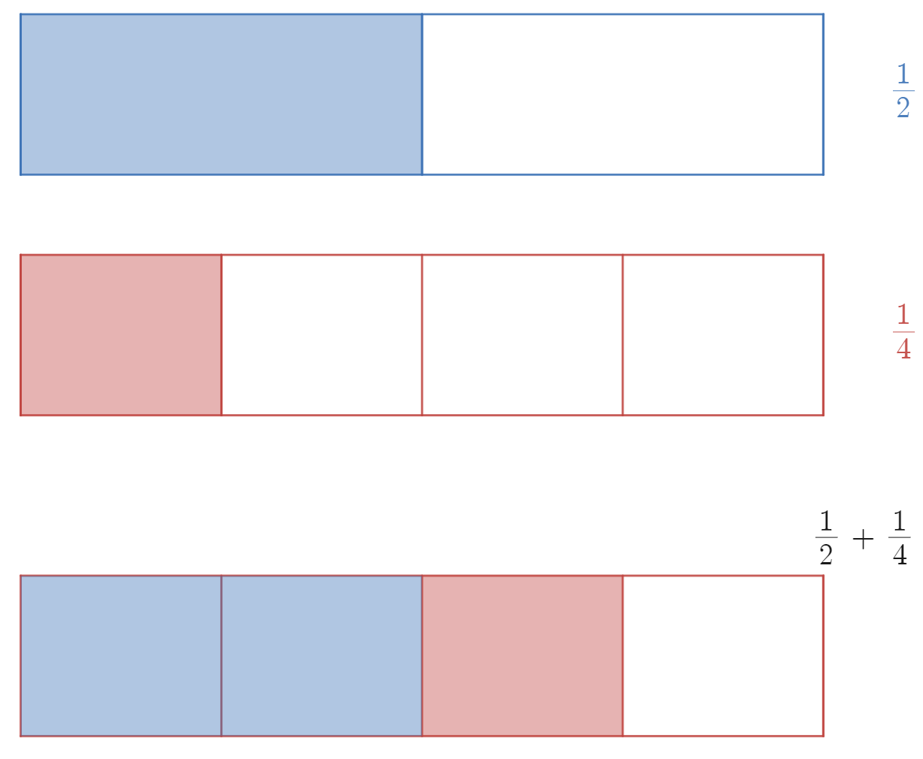
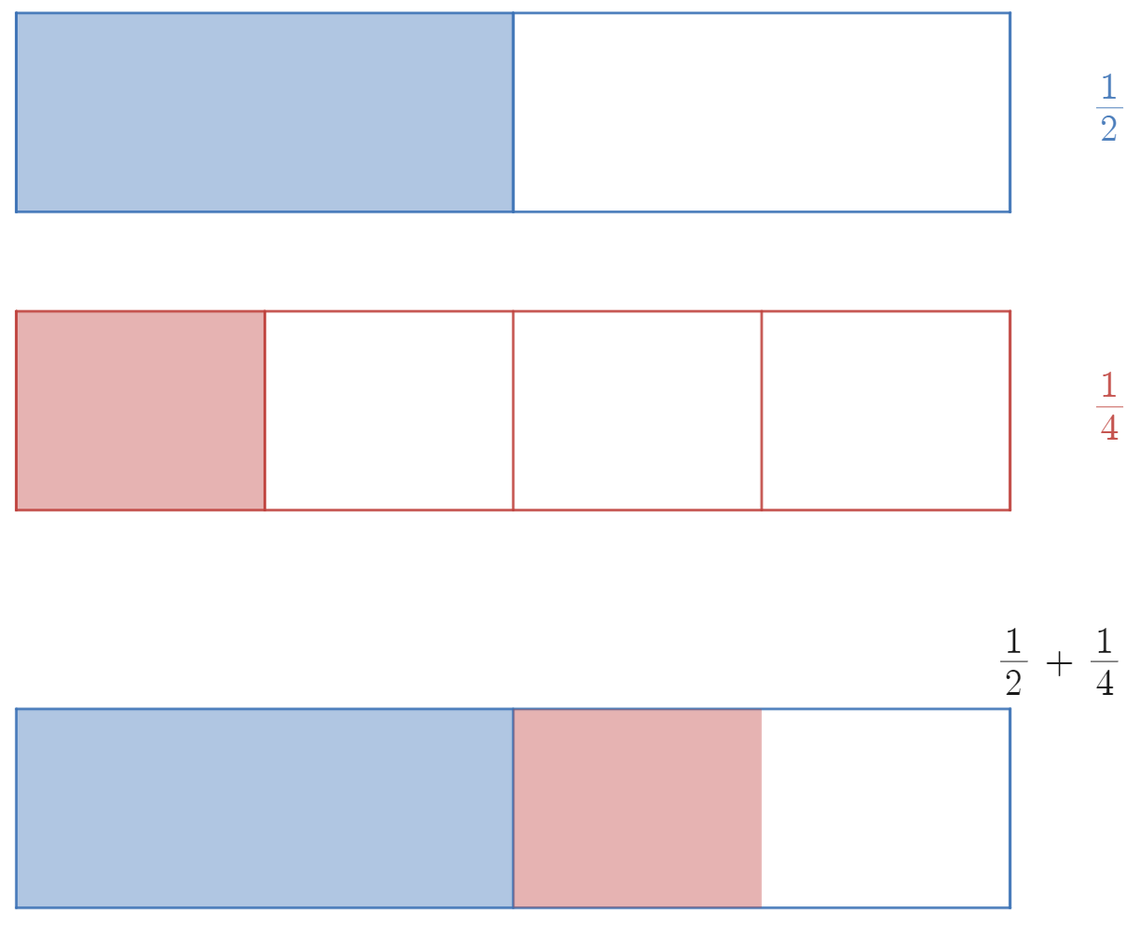
Explore – your turn 1 – alternate representation
Representing addition and subtraction of fractions
Notes:
Students should see that just like the number line, these fractions can only be added by making a common denominator of 4.

Slide 9
Summarise – example 2
Representing addition and subtraction of fractions
If we only presented the expression, how would you evaluate this expression?
$$\frac{1}{4}+\frac{1}{8}$$
$$=\frac{2}{8}+\frac{1}{8}$$
$$=\frac{3}{8}$$
Notes:
Ask students if 3/8 could be written any other way.

Slide 10
Summarise – self-explanation prompts 2
Representing addition and subtraction of fractions
If we only presented the expression, how would you evaluate this expression?
$$\frac{1}{4}+\frac{1}{8}$$
$$=\frac{2}{8}+\frac{1}{8}$$
$$=\frac{3}{8}$$
Why does $\frac{1}{4}$ become $\frac{2}{8}$ ?
How would you know which denominator to change?
Notes:
Ask students if 3/8 could be written any other way.

Slide 11
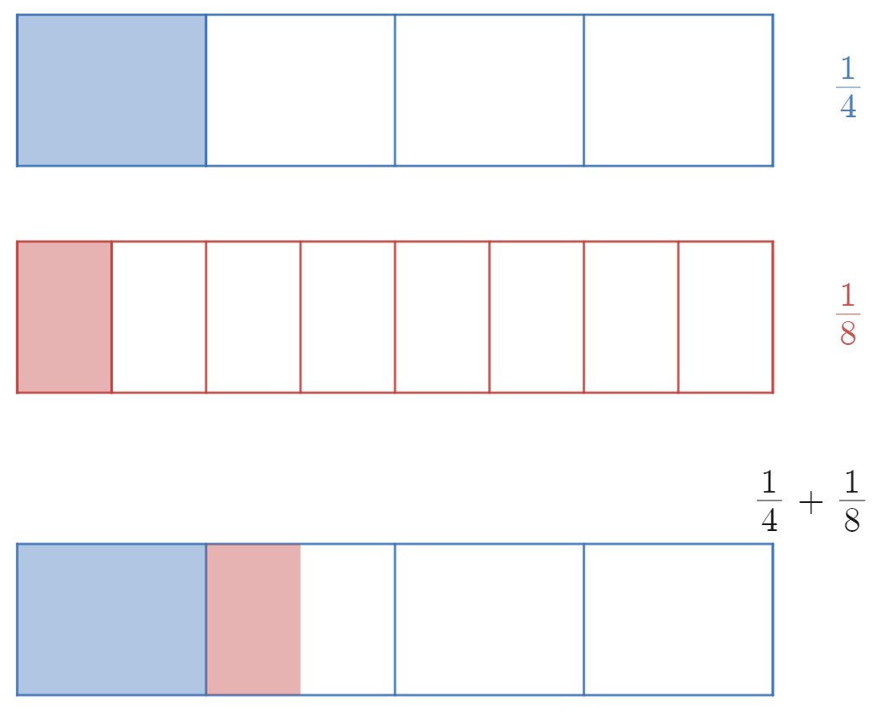
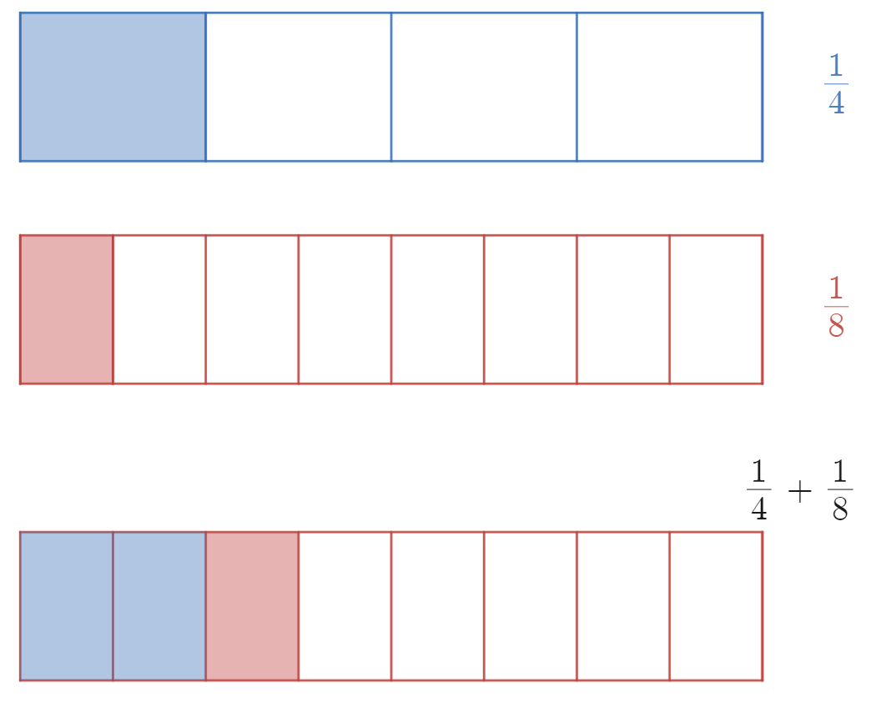
Summarise – example 2 – alternate representation
Representing addition and subtraction of fractions

Slide 12
Summarise – your turn 2
Representing addition and subtraction of fractions
Without drawing a number line, how could you evaluate this expression?
$$\frac{1}{6}+\frac{1}{3}$$
Notes:
Ask students if 3/8 could be

Slide 13
Summarise – your turn 2 – solution
Representing addition and subtraction of fractions
Without drawing a number line, how could you evaluate this expression?
$$\frac{1}{6}+\frac{1}{3}$$
$$=\frac{1}{6}+\frac{2}{6}$$
$$=\frac{3}{6}$$
Notes:
Ask students if 3/6 could be written any other way. Can be simplified to ½.

Slide 14
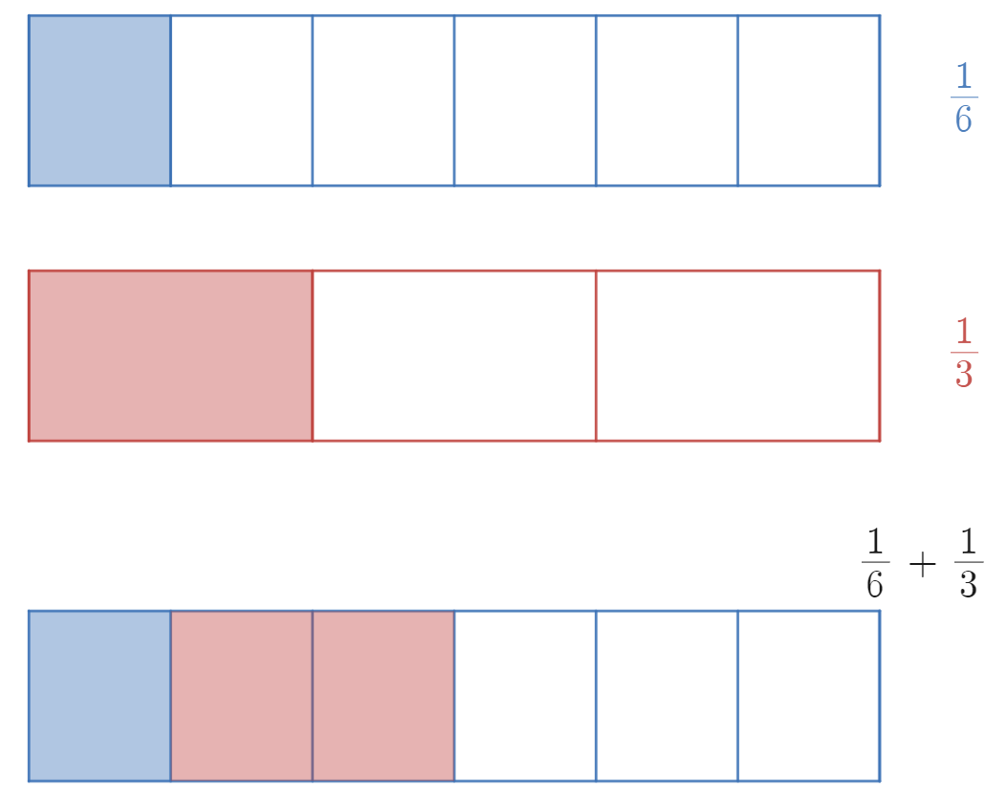
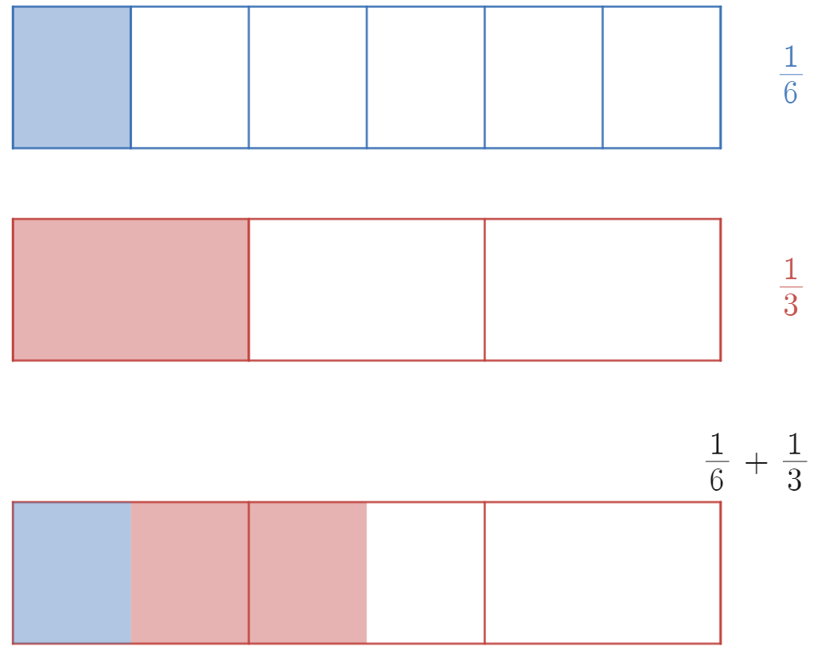
Summarise – your turn 2 – alternate representation
Representing addition and subtraction of fractions

