Slide 1
Laying the foundations of algebra
Explicit teaching

Slide 2
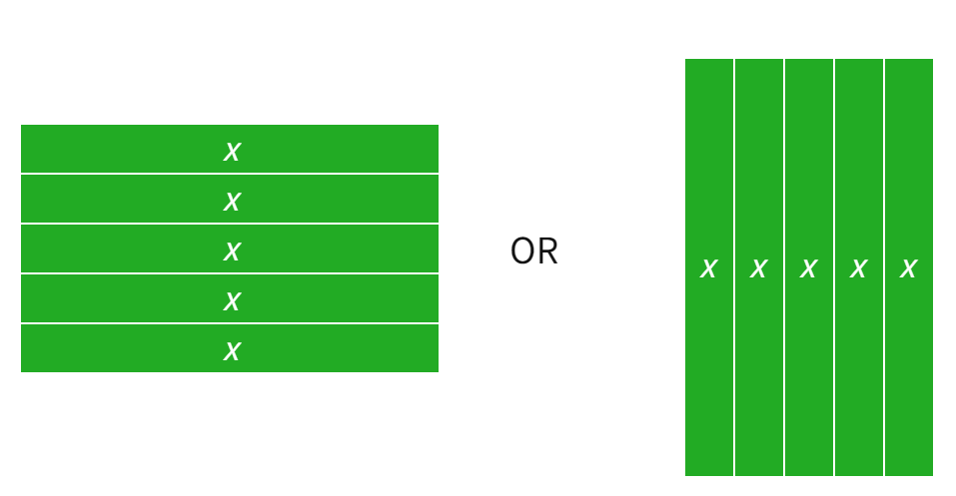
Example 1
Representing $5x$
Notes:
5x can be shown using the horizontal or vertical x tiles.

Slide 3
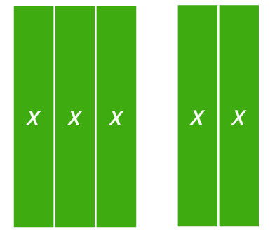
Example 2
Adding like terms
$$3x+2x$$
Would this work with horizontal $x$ tiles?
= $5x$
Notes:
3x + 2x can be simplified to 5x

Slide 4
Your turn 1
$$5x+2x$$
Notes:
Students fill this in on Appendix C – “Algebra tiles practice”.
5x + 2x can be simplified to 7x

Slide 5
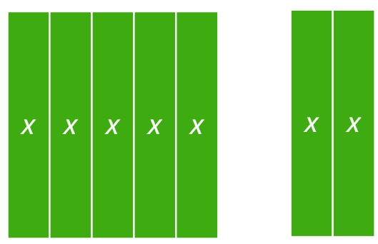
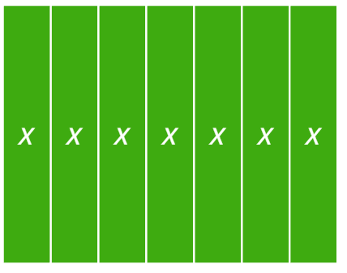
Your turn 1 – solution
Adding like terms
$$5x+2x$$
= $7x$
Notes:
5x + 2x can be simplified to 7x

Slide 6
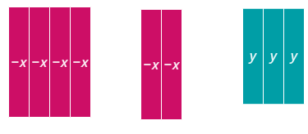
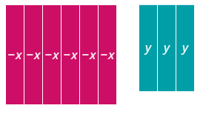
Example 3
Adding like terms
$(−4x)+(−2x)$+ $3y$
= $−6x+3y$
Notes:
$$\left(−4x\right)+\left(−2x\right) can be simplified to −6x$$

Slide 7
Example 3 – self-explanation prompt
Adding like terms
$(−4x)+(−2x)$+ $3y$
How else could this expression be written?
= $−6x+3y$
Notes:
$$\left(−4x\right)+\left(−2x\right) can be simplified to −6x$$

Slide 8
Your turn 2
Adding like terms
$$\left(−3x\right)+\left(−x\right)+(−2y)$$

Slide 9
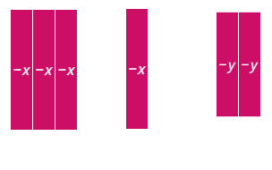
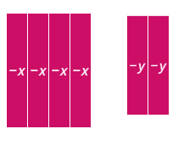
Your turn 2 – solution
Adding like terms
$$\left(−3x\right)+\left(−x\right)+(−2y)$$
= $(−4x)+(−2y)$
Notes:
$\left(−3x\right)+(−x)$ can be simplified to $−4x$

Slide 10
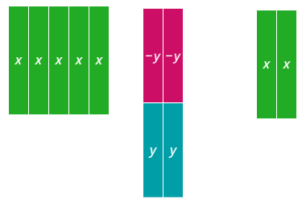
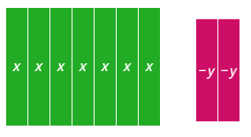
Example 4
Adding like terms
$$5x−2y+2x$$
$$=7x−2y$$
Notes:
5x+(-2x) can be simplified to 3x

Slide 11
Example 4 – self-explanation prompts
Adding like terms
$$5x−2y+2x$$
How else could we have solved this question?
Why have we added zero pairs?
$$=7x−2y$$
Notes:
5x+(-2x) can be simplified to 3x

Slide 12
Your turn 4
Adding like terms
$$5x−2y−2y$$

Slide 13
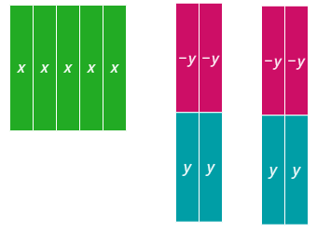
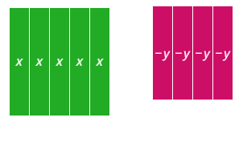
Your turn 4 – solution
Adding like terms
$$5x−2y−2y$$
$$=5x−4y$$

