Slide 1
Sharing, grouping and negating
Explicit teaching
NSW Department of Education

Slide 2
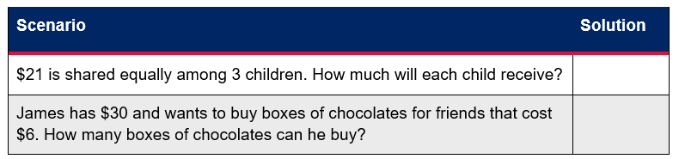
Think-Pair-Share

Slide 3
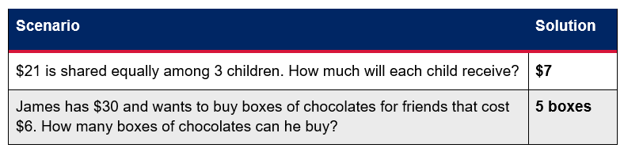
Think-Pair-Share – solution
What was the same in these questions? What was different?

Slide 4
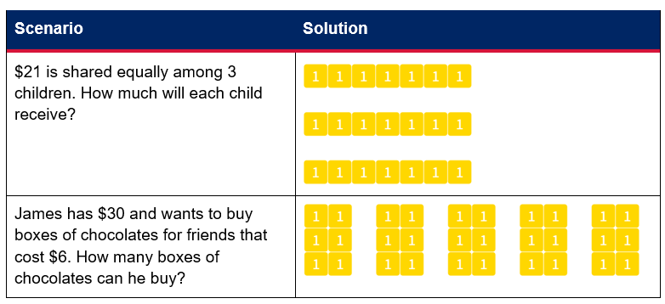
Representations
Images created using the free virtual manipulatives at Polypad.org.
What is different about the representations for each question?

Slide 5
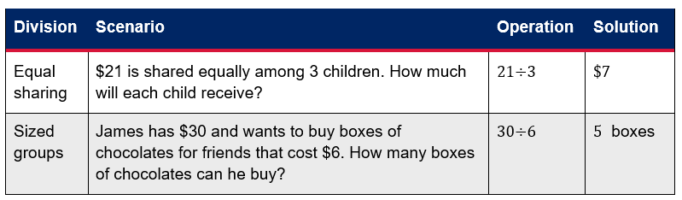
Representations – part 2
Division as grouping is where we form groups of a certain size.
Division as sharing is where we share equally.

Slide 6
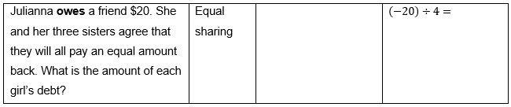
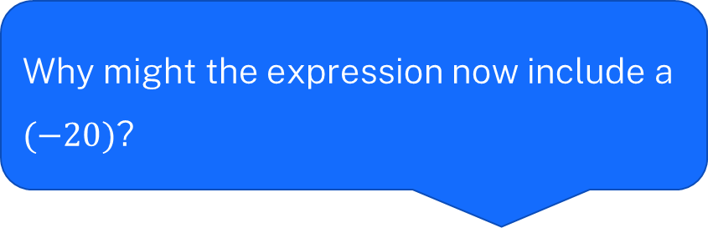
Equal sharing with negatives
Why might the expression now include a $(−20)$?

Slide 7
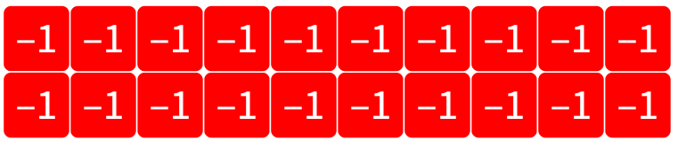

Representing equal sharing with negatives – part 1
$$(−20)$$
Images created using the free virtual manipulatives at Polypad.org.

Slide 8
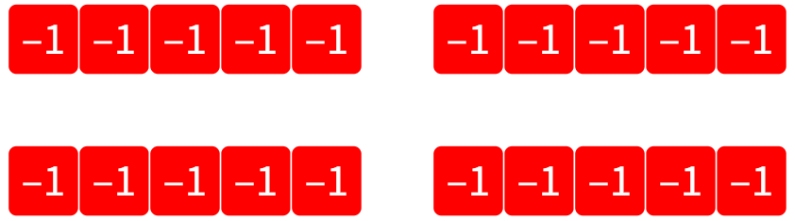

Representing equal sharing with negatives – part 2
$$\left(−12\right)÷4=−5$$
Images created using the free virtual manipulatives at Polypad.org.

Slide 9
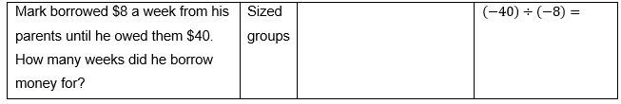
Sized groups with negatives
Why might the both values be negative here?

Slide 10
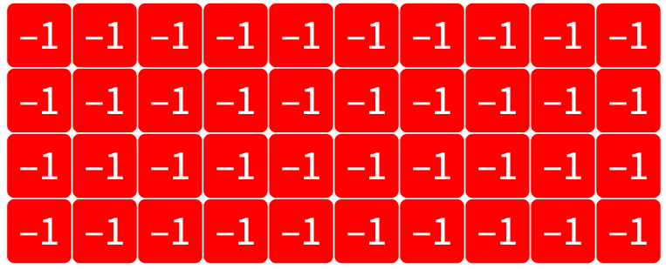
Representing sized groups with negatives – part 1
Images created using the free virtual manipulatives at Polypad.org.

Slide 11
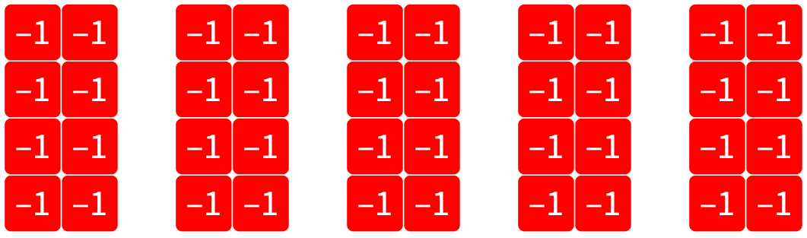
Representing sized groups with negatives – part 2
Images created using the free virtual manipulatives at Polypad.org.

Slide 12
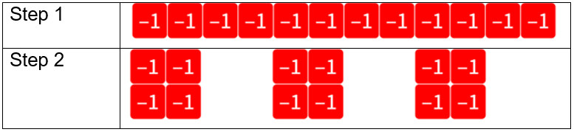


Sharing division – example 1
$$(−12)÷3=$$
Images created using the free virtual manipulatives at Polypad.org.
$$(−12)÷3=(−4)$$
Notes:
Teacher notes: Step 1 should be seen as making (-12).
Step 2 should be seen as sharing this into 3 equal groups.

Slide 13

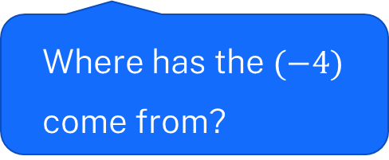

Sharing division – self-explanation prompts
Why don’t we make groups of 3?
$$(−12)÷3=$$
Images created using the free virtual manipulatives at Polypad.org.
How do we know to make 3 groups?
$$(−12)÷3=(−4)$$
Where has the $(−4)$ come from?
Notes:
Teacher notes: Step 1 should be seen as making (-12).
Step 2 should be seen as sharing this into 3 equal groups.

Slide 14

Your turn – question 1
$$\left(−10\right)÷5=$$

Slide 15
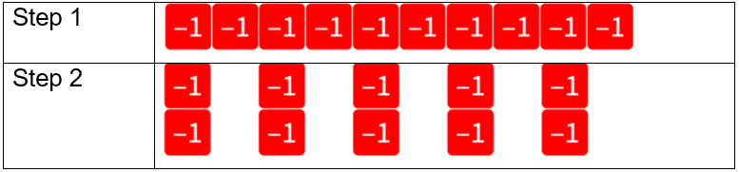

Your turn – solution 1
$$\left(−10\right)÷5=(−2)$$
Images created using the free virtual manipulatives at Polypad.org.

Slide 16
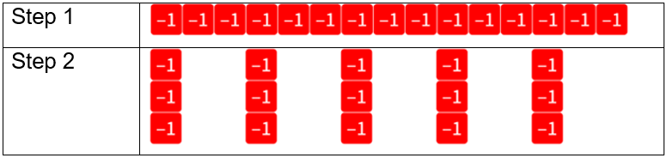


Grouping division – example 2
$$(−15)÷(−3)=$$
Images created using the free virtual manipulatives at Polypad.org.
$$(−15)÷(−3)=5$$
Notes:
Teacher notes: Step 1 should be seen as making (-15).
Step 2 should be seen as sharing this into groups of (-3), of which there are exactly 5.

Slide 17
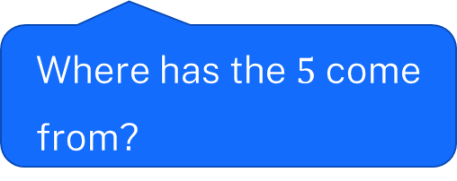
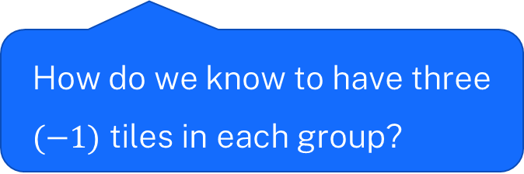
Grouping division – self-explanation prompts
$$(−15)÷(−3)=$$
Images created using the free virtual manipulatives at Polypad.org.
How do we know to have three $(−1)$ tiles in each group?
$$(−15)÷(−3)=5$$
Where has the $5$ come from?
Notes:
Teacher notes: Step 1 should be seen as making (-15).
Step 2 should be seen as sharing this into groups of (-3), of which there are exactly 5.

Slide 18

Your turn – question 2
$$\left(−12\right)÷(−4)=$$

Slide 19
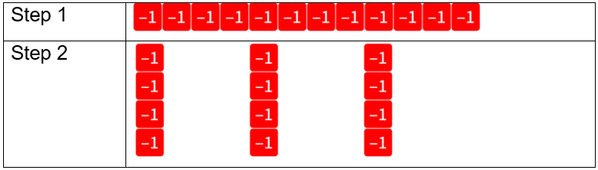

Your turn – solution 2
$$\left(−12\right)÷(−4)=3$$
Images created using the free virtual manipulatives at Polypad.org.

Slide 20
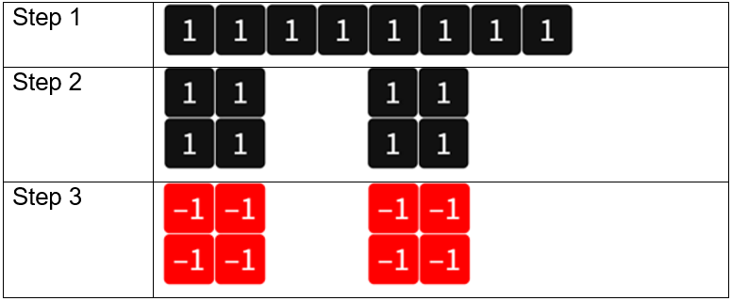


Negating division – example 3
$$8÷(−2)=$$
Images created using the free virtual manipulatives at Polypad.org.
$$8÷(−2)=(−4)$$
Notes:
Teacher notes: Step 1 should be seen as making 8.
Step 2 should be seen as sharing this into 2 equal groups.
Step 3 should be seen as negating these 2 equal groups.

Slide 21
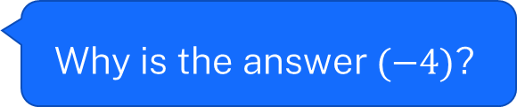
Negating division – self-explanation prompts
$$8÷(−2)=$$
Why do we start with 8?
What question has been answered in step 2?
Images created using the free virtual manipulatives at Polypad.org.
$$8÷(−2)=(−4)$$
Why is the answer $(−4)$?
Notes:
Teacher notes: Step 1 should be seen as making 8.
Step 2 should be seen as sharing this into 2 equal groups.
Step 3 should be seen as negating these 2 equal groups.

Slide 22

Your turn – question 3
$$6÷(−3)=$$

Slide 23
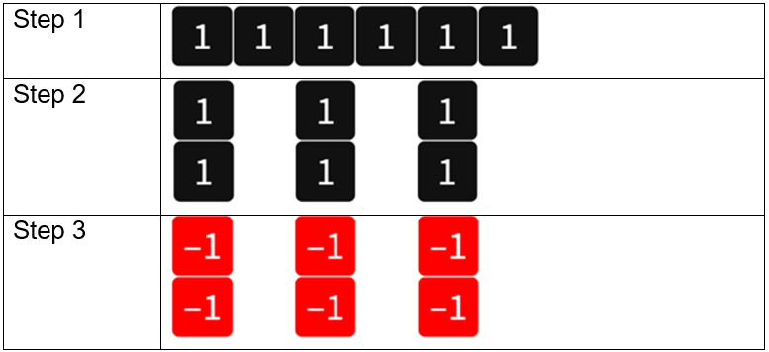

Your turn – solution 3
$$6÷(−3)=(−2)$$
Images created using the free virtual manipulatives at Polypad.org.

