Slide 1
A big problem with small numbers
Explicit teaching

Slide 2
Arrays
Launch

Slide 3
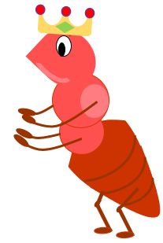


A big problem with small numbers (1)
Hundreds of years ago …
A traveller arrived at a colony with a gift of a new game for the King.
The game was called Chess.

Slide 4
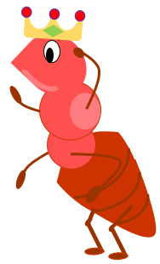
A small start
The king is grateful.
I like this new game.
I’d like to reward you as a sign of my gratitude.
You can reward me with a grain of rice on the first day and then, each day, double it, until every square of the chessboard is full.
I’m not sure it will amount to much, but I will do as you ask.
What do you think?
What do you wonder?

Slide 5
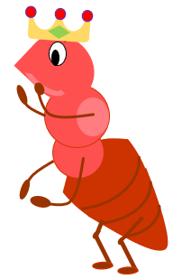
We have a problem!
But it’s only one grain of rice.
What is wrong?
The chess board is 8 by 8.
But you start with only one grain of rice.
The numbers seem only small, but they make a big problem.

Slide 6
It doubles every day!
How many days?
The numbers represent the grains of rice for each day.
1 | 2 | 4 | 8
There is an easier way to watch the numbers grow.

Slide 7
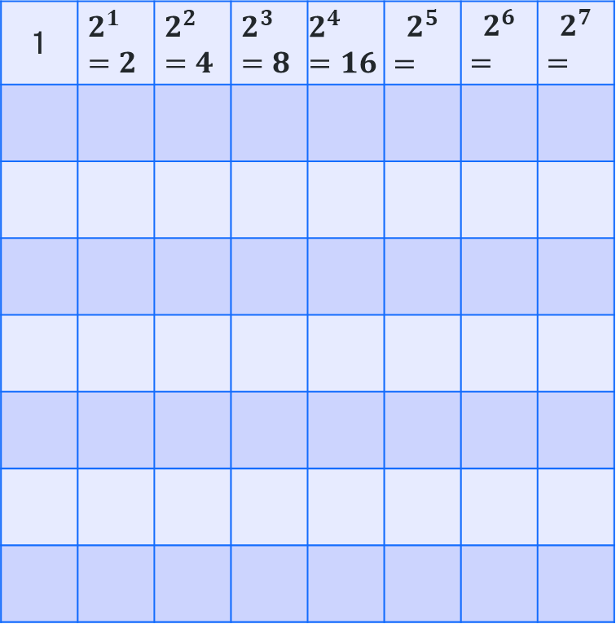
A better deal?
How much rice?
Maybe I should have offered him 1000 grains of rice each day for 1000 days.
1 | $$2^{1}=2$$ | $$2^{2}=4$$ | $$2^{3}=8$$ | $$2^{4}=16$$ | $$2^{5}$$ $$=$$ | $$2^{6}$$ $$=$$ | $$2^{7}$$ $$=$$
What do you notice?
What do you think?
What do you wonder?

Slide 8
Explore
A big problem with small numbers

Slide 9
How many zeroes are in a billion? (1)
What do you think?
Statement 1
The number ‘one billion’ is written as 1,000,000,000.
Statement 2
The number ‘one billion’ is written as 1,000,000,000,000.
What do you notice?
What do you wonder?

Slide 10
How many zeroes are in a billion? (2)
What do you think?
Statement 1
The number ‘one billion’ is written as 1,000,000,000.
Statement 2
The number ‘one billion’ is written as 1,000,000,000,000.
Raise your left hand if you think Statement 1 is true.
Raise your right hand if you think Statement 2 is true.

