Slide 1
That’s about right
Launch

Slide 2
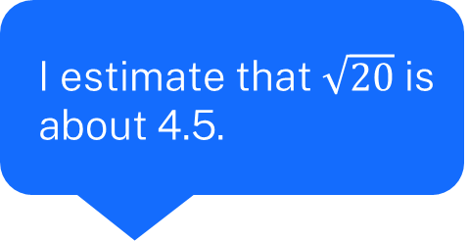
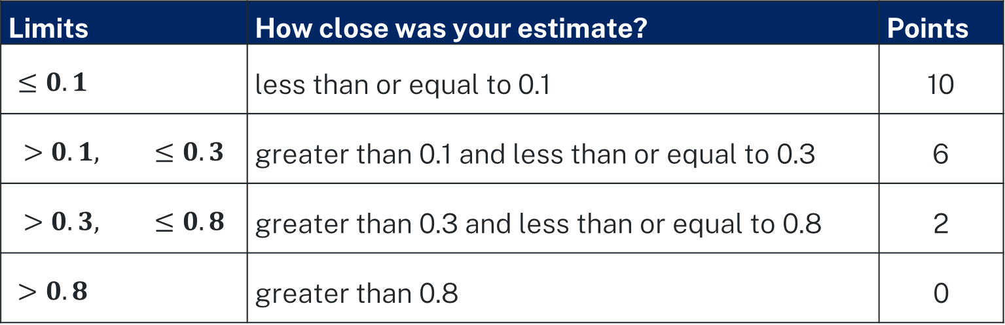
Points scale
Who is the best estimator and can score the most points?
Limits | How close was your estimate? | Points
$$≤0.1$$ | less than or equal to 0.1 | 10
$$>0.1, ≤0.3$$ | greater than 0.1 and less than or equal to 0.3 | 6
$$>0.3, ≤0.8$$ | greater than 0.3 and less than or equal to 0.8 | 2
$$>0.8$$ | greater than 0.8 | 0
I estimate that $\sqrt{20}$ is about 4.5.

Slide 3

Points scale – how many?
Who is the best estimator and can score the most points?
Limits | How close was your estimate? | Points
$$≤0.1$$ | less than or equal to 0.1 | 10
$$>0.1, ≤0.3$$ | greater than 0.1 and less than or equal to 0.3 | 6
$$>0.3, ≤0.8$$ | greater than 0.3 and less than or equal to 0.8 | 2
$$>0.8$$ | greater than 0.8 | 0
When I square 4.5, I get 20.25.
That’s a difference of 0.25.
It’s more than 0.1 and less than 0.3. That’s 6 points.

