Slide 1
Cooking for one
Explicit teaching
NSW Department of Education

Slide 2
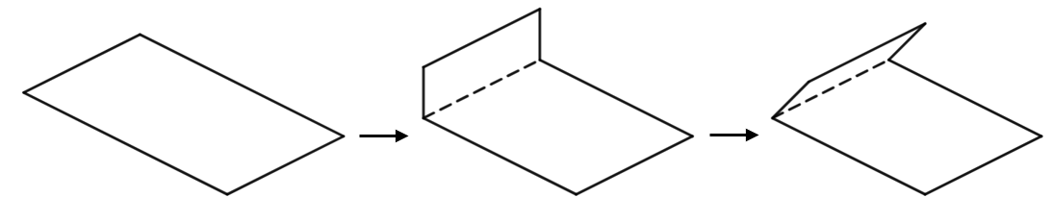
Quarters paper folding – part 1

Slide 3
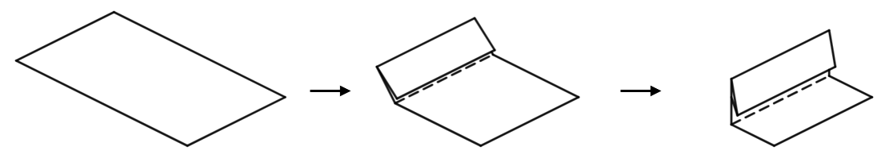
Quarters paper folding – part 2

Slide 4
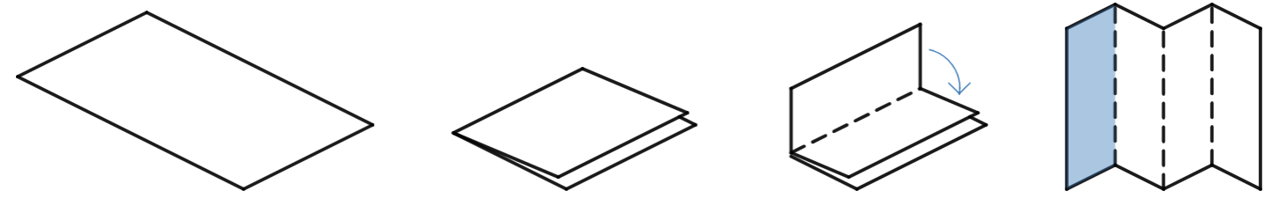
Quarters paper folding – part 3

Slide 5
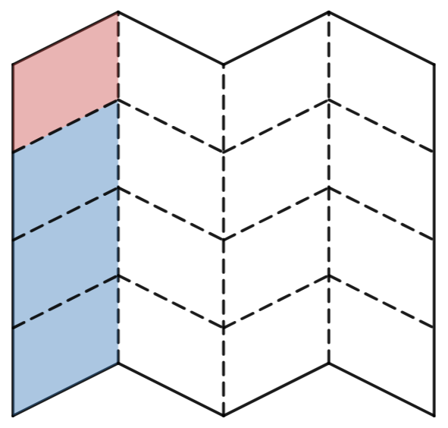
Quarters paper folding – part 4

Slide 6
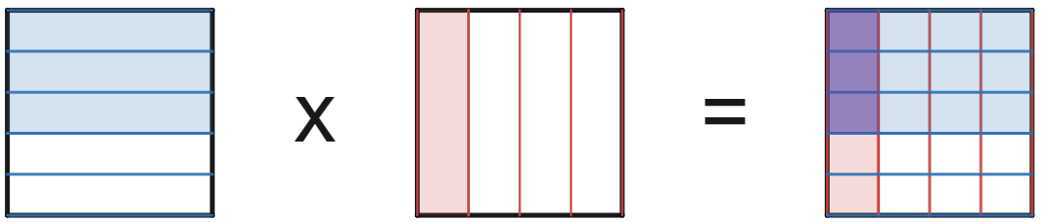
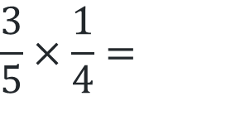
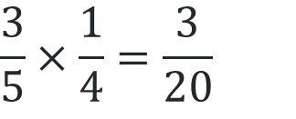
Multiplying fractions – example 1
$$\frac{3}{5}×\frac{1}{4}=$$
$$\frac{3}{5}×\frac{1}{4}=\frac{3}{20}$$

Slide 7
Multiplying fractions – prompts
Why do we represent one fraction horizontally and the other vertically?
$$\frac{3}{5}×\frac{1}{4}=$$
Where have the 3 and the 20 come from?
Why is the denominator in the answer equal to 4 x 5?
$$\frac{3}{5}×\frac{1}{4}=\frac{3}{20}$$

Slide 8
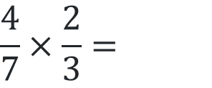
Your turn – question 1
$$\frac{4}{7}×\frac{2}{3}=$$

Slide 9
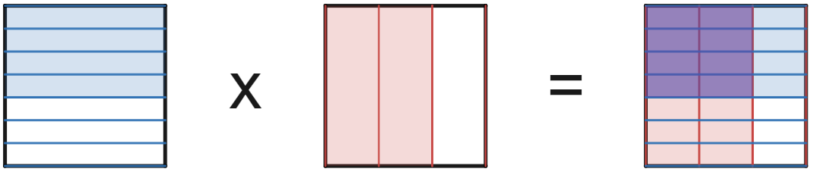
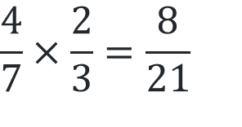
Your turn – solution 1
$$\frac{4}{7}×\frac{2}{3}=\frac{8}{21}$$

Slide 10
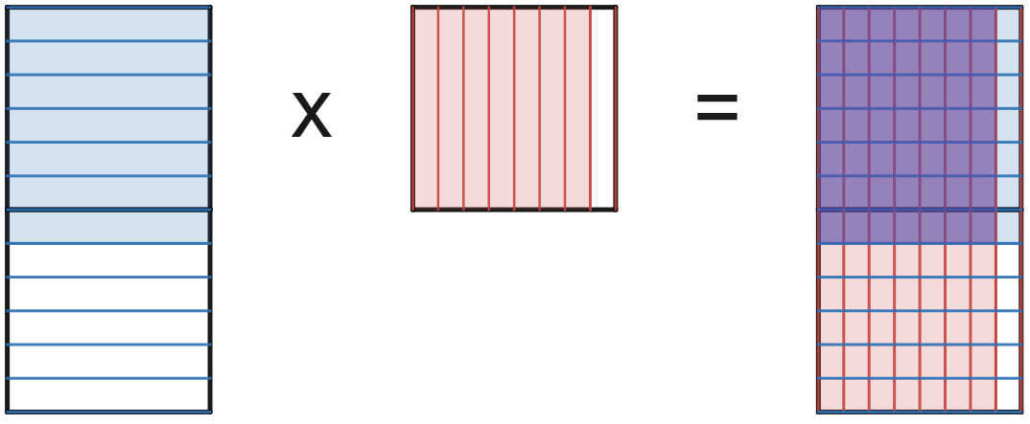
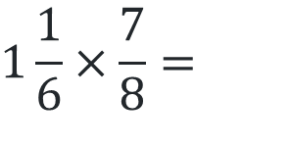
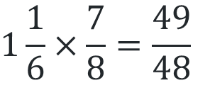

Multiplying fractions – example 2
$$1\frac{1}{6}×\frac{7}{8}=$$
$$1\frac{1}{6}×\frac{7}{8}=\frac{7}{6}×\frac{7}{8}$$
$$1\frac{1}{6}×\frac{7}{8}=\frac{49}{48}$$

Slide 11
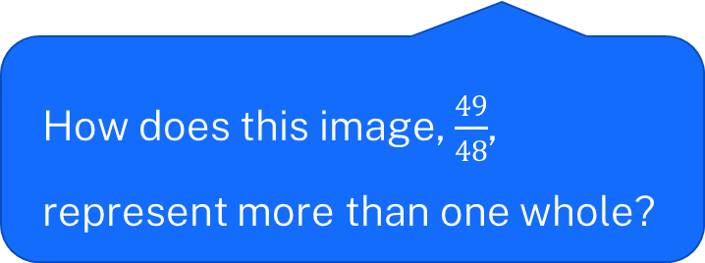
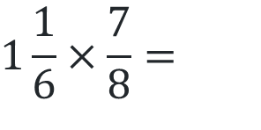
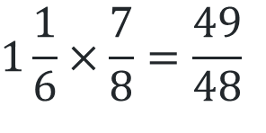
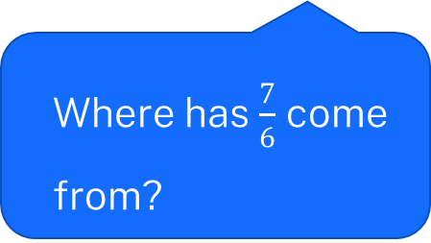
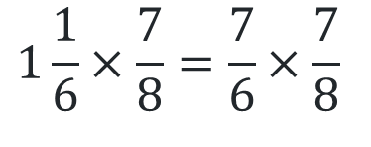
Multiplying fractions– prompts 2
$$1\frac{1}{6}×\frac{7}{8}=$$
$$1\frac{1}{6}×\frac{7}{8}=\frac{7}{6}×\frac{7}{8}$$
What value does one large black square represent?
Where has $\frac{7}{6}$ come from?
How does this image, $\frac{49}{48}$, represent more than one whole?
$$1\frac{1}{6}×\frac{7}{8}=\frac{49}{48}$$

Slide 12
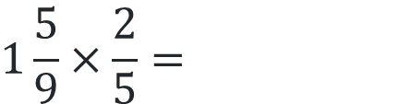
Your turn – question 2
$$1\frac{5}{9}×\frac{2}{5}=$$

Slide 13
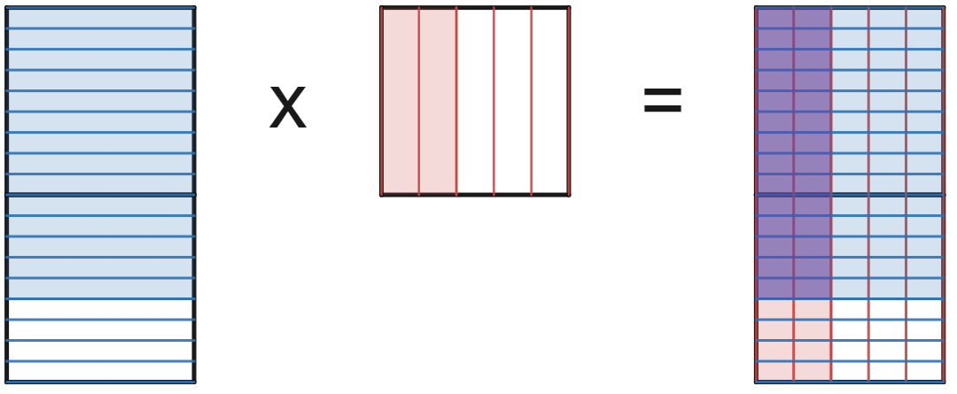
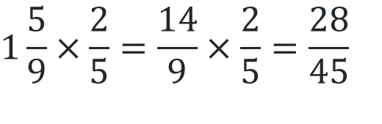
Your turn – solution 2
$$1\frac{5}{9}×\frac{2}{5}=\frac{14}{9}×\frac{2}{5}=\frac{28}{45}$$

Slide 14
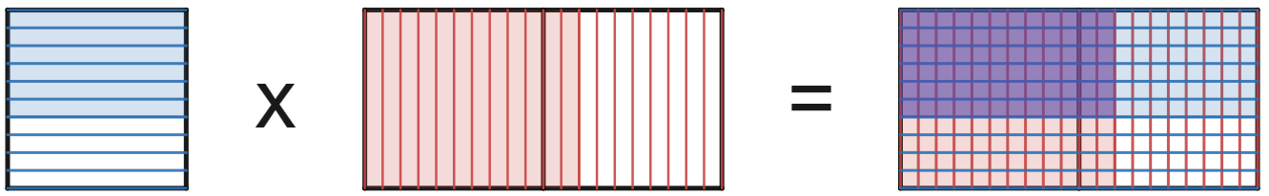


Multiplying decimals – example 3
$$0.6×1.2=$$
$$0.6×1.2=0.72$$

Slide 15


Multiplying decimals – prompts 3
When multiplying decimals, how do we split our whole?
$$0.6×1.2=$$
What is the value of each square? How many squares are highlighted purple?
$$0.6×1.2=0.72$$

Slide 16

Your turn – question 3
$$0.3×1.8=$$

Slide 17
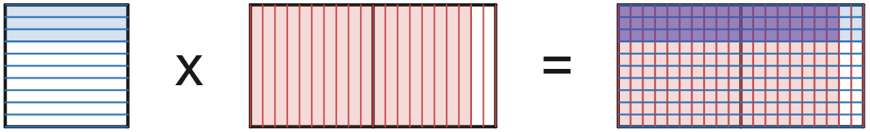

Your turn – solution 3
$$0.3×1.8=0.54$$

Slide 18
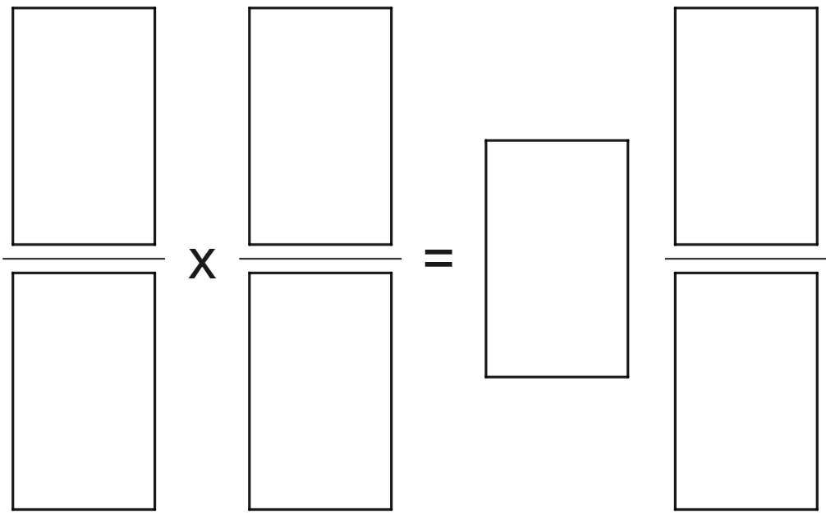
Open middle problem
Use the integers 1–9 at most once each to make a true equation.

Slide 19
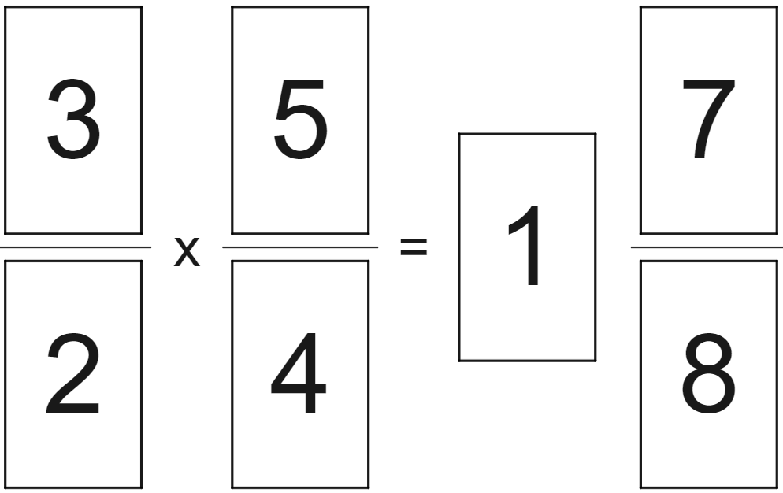
Open middle problem – sample solution

