Slide 1
When it’s fair to compare the pair
Explicit teaching

Slide 2
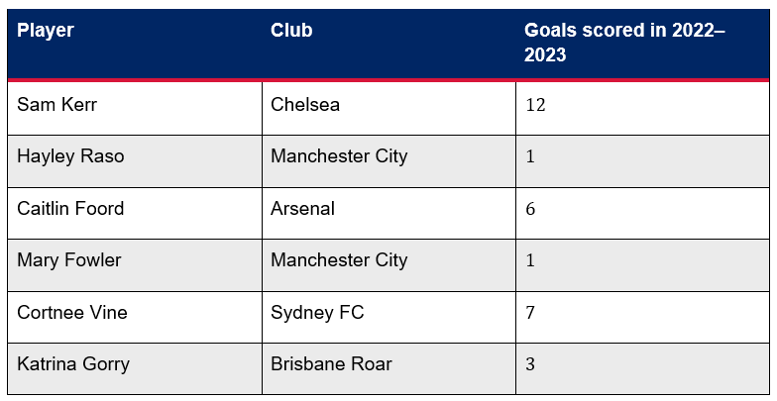
When it's fair to compare the pair (1)
Launch
Which player is best in this list?

Slide 3
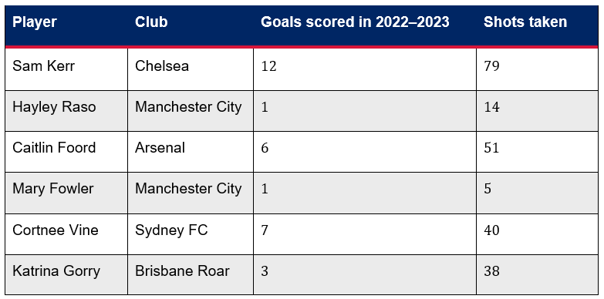
When it's fair to compare the pair (2)
Launch 2
Does knowing the number of shots each player has taken change your opinion?

Slide 4
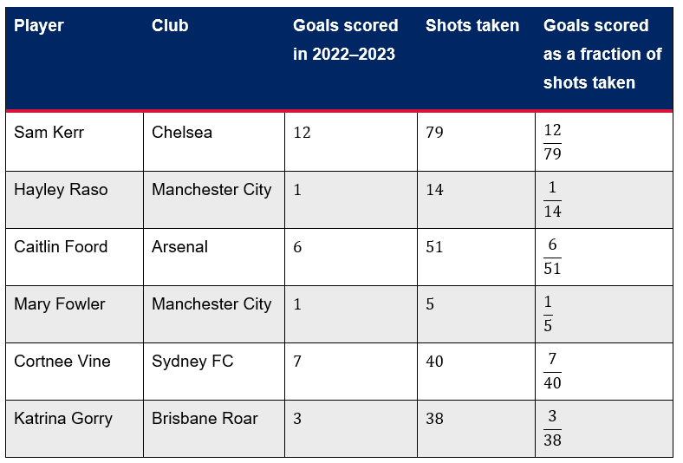
When it's fair to compare the pair (3)
Launch 3
Can you compare these fractions and rank the players?

Slide 5
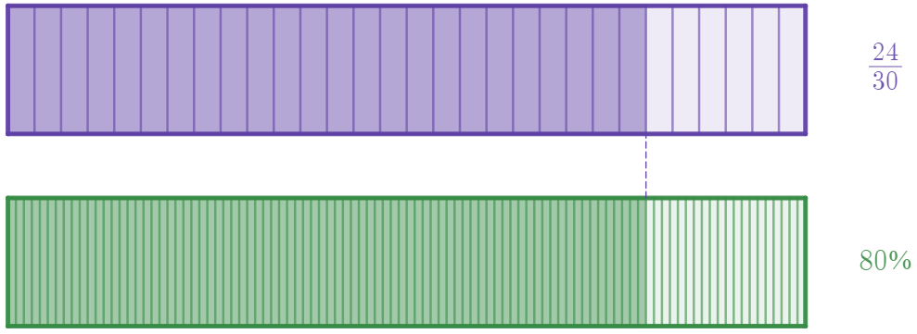
When it's fair to compare the pair (4)
One quantity as a percentage of another – example 1
What is $24$ goals as a percentage of $30$ shots on goal?
$$\frac{24}{30}×100=80\%$$

Slide 6
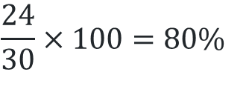
When it's fair to compare the pair (5)
One quantity as a percentage of another – prompts 1
What is $24$ goals as a percentage of $30$ shots on goal?
$$\frac{24}{30}×100=80\%$$
Why do we multiply by 100?
What is the same about the 2 rectangles?

Slide 7
When it's fair to compare the pair (6)
Your turn – question 1
What is $16$ goals as a percentage of $40$ shots on goal?

Slide 8
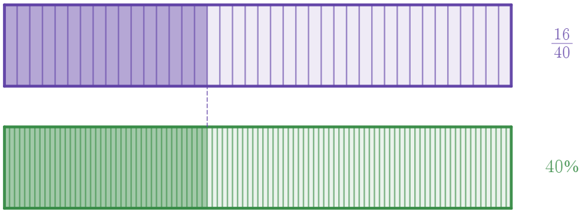
When it's fair to compare the pair (7)
Your turn – solutions 1
What is $16$ goals as a percentage of $40$ shots on goal?
$$\frac{16}{40}×100=40\%$$

