Slide 1
A fair share
Explicit teaching

Slide 2

A fair share (1)
Launch
Each of these people will receive a pay increase of $100 per week.
Is the $100 the same for each person?

Slide 3
A fair share (2)
Launch 2
Each of these products will be reduced by $100 for a sale.
Is it fair to decrease all products by $100?

Slide 4
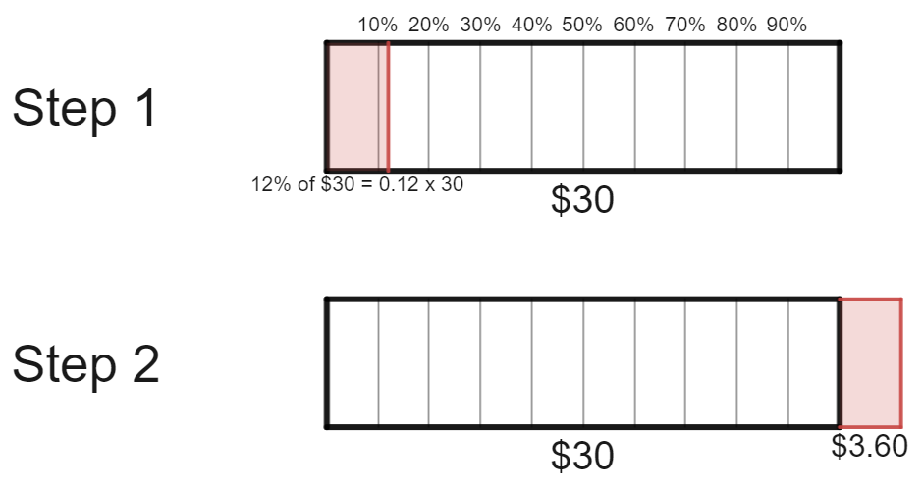

A fair share (3)
Percentage increase – example 1
Increase $\$30$ by $12\%$.
$$30+3.60=\$33.60$$

Slide 5
A fair share (4)
Percentage increase – self-explanation prompts 1
Increase $\$30$ by $12\%$.
Why is this being added onto the total?
How can we find 12% of $30?
$$30+3.60=\$33.60$$

Slide 6

A fair share (5)
Your turn – question 1
Increase $\$150$ by $21\%$

Slide 7
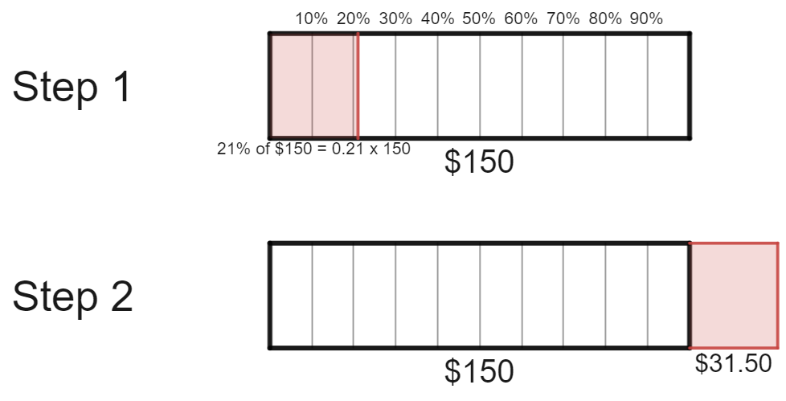

A fair share (6)
Your turn – solutions 1
Increase $\$150$ by $21\%$
$$150+31.50=\$180.50$$

Slide 8
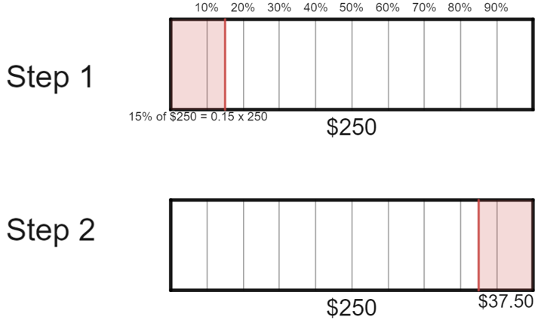

A fair share (7)
Percentage decrease – example 2
Decrease $\$250$ by $15\%$.
$$250−37.50=\$212.50$$

Slide 9
A fair share(8)
Percentage decrease – self-explanation prompts 2
Decrease $\$250$ by $15\%$.
If the original price was $300, do we need a larger rectangle?
How do we know to subtract from the total?
$$250−37.50=\$212.50$$

Slide 10

A fair share (9)
Your turn – question 2
Decrease $\$720$ by $38\%$

Slide 11
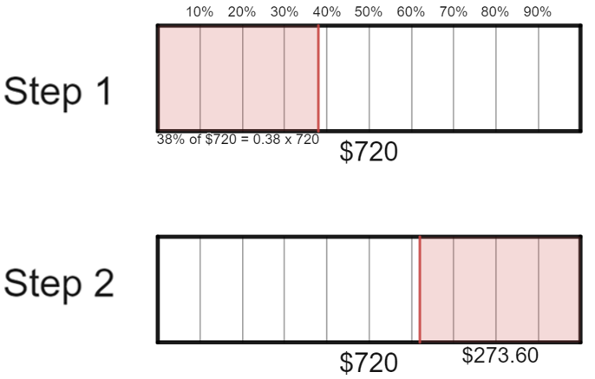

A fair share (10)
Your turn – solution 2
Decrease $\$720$ by $38\%$
$$720−273.60=\$446.40$$

