Slide 1
The order of things
Explicit teaching

Slide 2
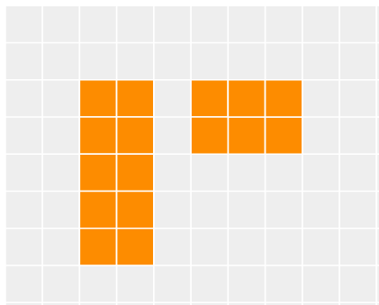
The order of things (1)
Multiplication before addition
$$5×2+2×3=16$$

Slide 3
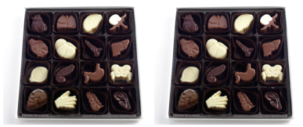
The order of things (2)
Powers first
$$2×4^{2}=32$$

Slide 4
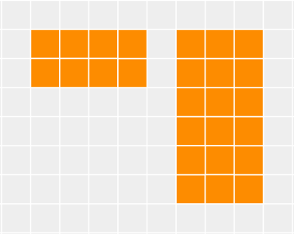
The order of things (3)
Order of operations – example 1
$$2×4+6×3=8+18$$
$$=26$$

Slide 5
The order of things (4)
Which part of the question does each rectangle represent?
Order of operations – example 1
$$2×4+6×3=8+18$$
$$=26$$
Which operations have been completed first?

Slide 6
The order of things (5)
Your turn – question 1
$$5×3+2×4$$

Slide 7
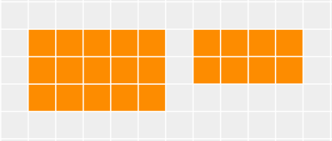
The order of things (6)
Your turn – solution 1
$$5×3+2×4=15+8$$
$$=23$$

Slide 8
The order of things (7)
Order of operations – example 2
$$24÷4×2−3×3=6×2−9$$
$$=12−9$$
$$=3$$

Slide 9
The order of things (8)
Which part of the expression has been completed first?
Order of operations – example 2
$$24÷4×2−3×3=6×2−9$$
$$=12−9$$
$$=3$$
What would be the result if we evaluated this from left to right?

Slide 10
The order of things (9)
Your turn – question 2
$$32÷8+2×4−9÷3$$

Slide 11
The order of things (10)
Your turn – solution 2
$$32÷8+2×4−9÷3=4+8−3$$
$$=12−3$$
$$=9$$

Slide 12
The order of things (11)
Order of operations – example 3
$$5×2^{2}+10÷2=5×4+10÷2$$
$$=20+5$$
$$=25$$

Slide 13
The order of things (12)
Order of operations – example 3
$$5×2^{2}+10÷2=5×4+10÷2$$
$$=20+5$$
Which part of the expression has been completed first?
$$=25$$
What would be the result if we evaluated this from left to right?

Slide 14
The order of things (13)
Your turn – question 3
$$3×4^{2}−16÷2$$

Slide 15
The order of things (14)
Your turn – solution 3
$$3×4^{2}−16÷2=3×16−16÷2$$
$$=48−8$$
$$=40$$

