Slide 1
Four 4’s
Explicit teaching

Slide 2
Four 4’s (1)
Order of operations – example 1
$4+8+4×2=20$
$(4+8+4)×2=32$

Slide 3
Four 4’s (2)
Order of operations – self-explanation prompts 1
$4+8+4×2=20$
$(4+8+4)×2=32$
What is the impact of putting brackets around 4+8+4?
Why has this resulted in a larger total?

Slide 4
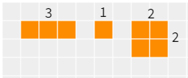
Four 4’s (3)
Your turn – question 1
Insert brackets to change the value of this expression
$$3+1+2×2=8$$

Slide 5
Four 4’s (4)
Your turn – solution 1
Insert brackets to change the value of this expression
$$3+1+2×2=8$$
$$3+(1+2)×2=8$$
Or
$$(3+1+2)×2=8$$

Slide 6
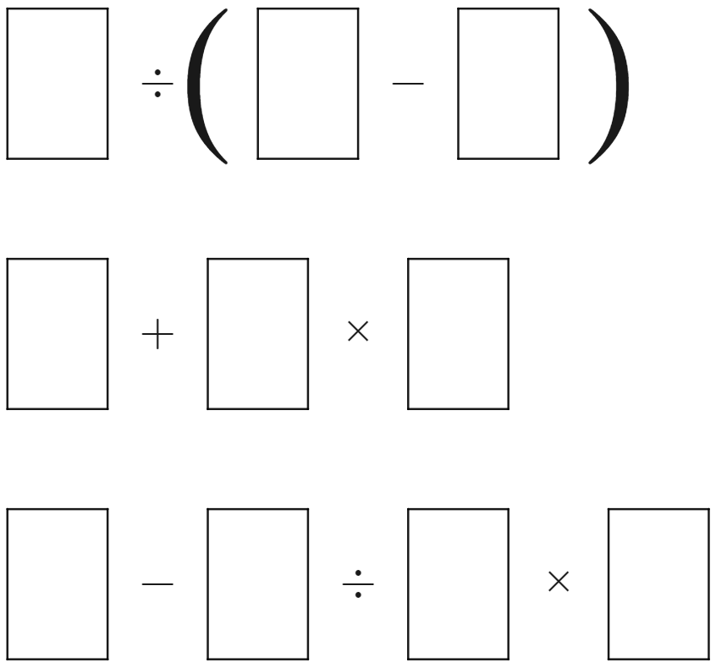
Four 4’s (5)
Open middle problem
Complete the expressions by filling each of the empty boxes with a digit from 0–9, so that all 3 expressions make an odd number. Each digit 0–9 can be used only once. Explore to see if there is more than one solution.

Slide 7
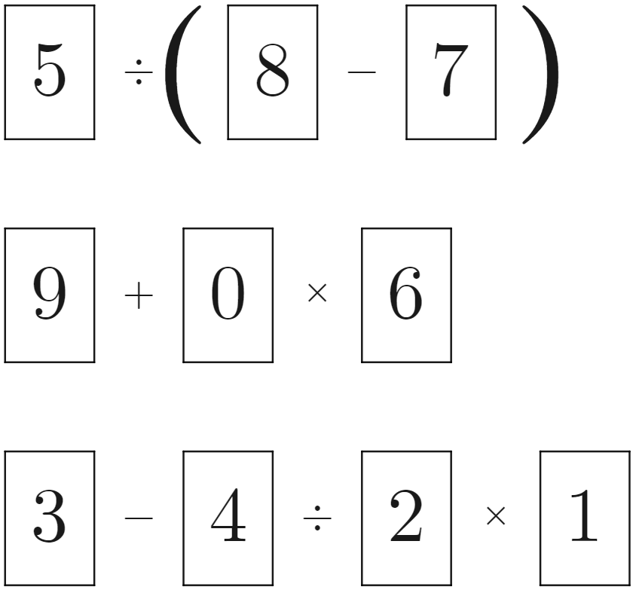
Four 4’s (6)
Open middle problem – solution

