Slide 1
Groups of mysteries
Explicit teaching

Slide 2

Groups of mysteries (1)
Algebraic conventions
$$5×p=5p$$
$$1×m=m$$
$$a×b=ab$$
$$q×q=q^{2}$$
$$a×a×a×a=a^{4}$$
These are ways that we can shorten multiplications.

Slide 3


Groups of mysteries (2)
Multiplying algebraic terms – example 1
$$2×3x=6x$$

Slide 4
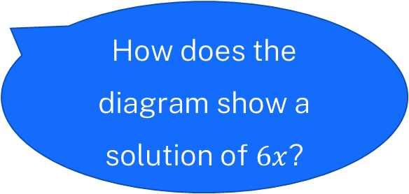

Groups of mysteries (3)
Multiplying algebraic terms – self-explanation prompts 1
$$2×3x=6x$$
Where is the $3x$ from this question shown in the diagram?
How does the diagram show a solution of $6x$?

Slide 5

Groups of mysteries (4)
Your turn – question 1
$$5×2y=$$

Slide 6
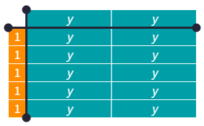

Groups of mysteries (5)
Your turn – solution 1
$$5×2y=10y$$

Slide 7
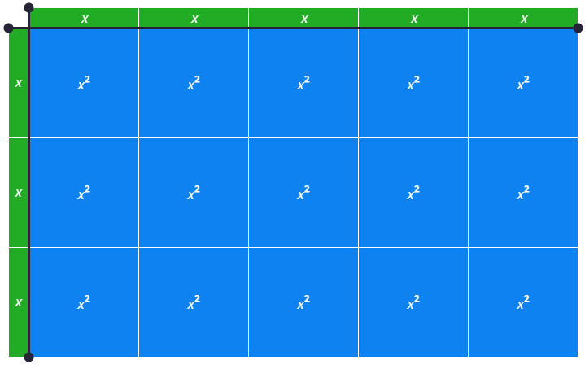

Groups of mysteries (6)
Multiplying algebraic terms – example 2
$$5x×3x=15x^{2}$$

Slide 8
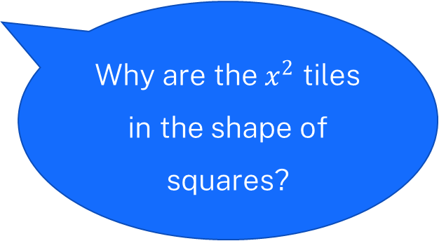
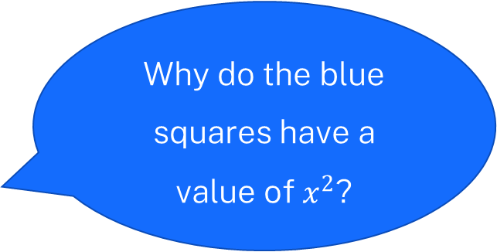
Groups of mysteries (7)
Multiplying algebraic terms – self-explanation prompts 2
$$5x×3x=15x^{2}$$
Why do the blue squares have a value of $x^{2}$?
Why are the $x^{2}$ tiles in the shape of squares?

Slide 9

Groups of mysteries (8)
Your turn – question 2
$$2y×4y=$$

Slide 10
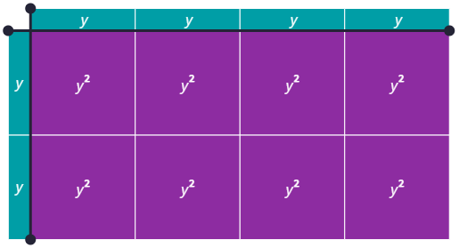

Groups of mysteries (9)
Your turn – solution 2
$$2y×4y=8y^{2}$$

Slide 11
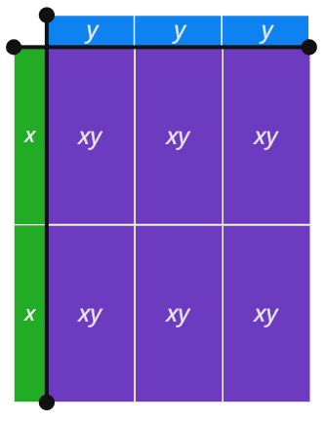

Groups of mysteries (10)
Multiplying algebraic terms – example 3
$$2x×3y=6xy$$

Slide 12
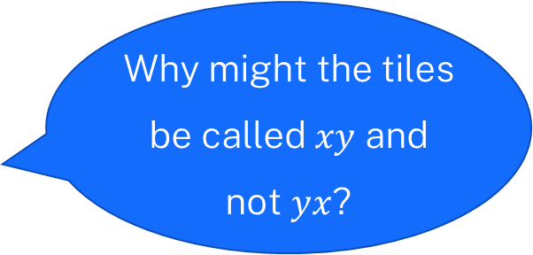
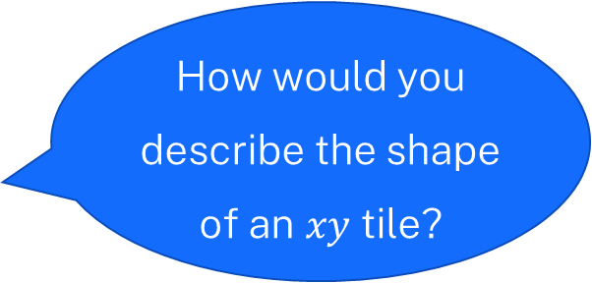
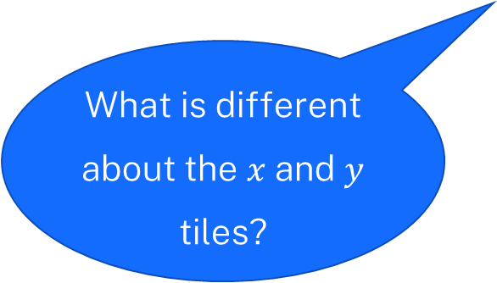
Groups of mysteries (11)
Multiplying algebraic terms – self-explanation prompts 3
$$2x×3y=6xy$$
How would you describe the shape of an $xy$ tile?
What is different about the $x$ and $y$ tiles?
Why might the tiles be called $xy$ and not $yx$?

Slide 13

Groups of mysteries (12)
Your turn – question 3
$$x×8y=$$

Slide 14
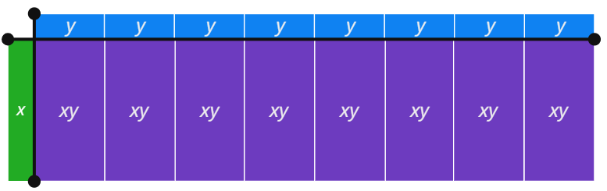

Groups of mysteries (13)
Your turn – solution 3
$$x×8y=8xy$$

Slide 15

Groups of mysteries (14)
Notes to your future self
$$4x×3$$
$$5x×2x$$
$$4x×4y$$
$$2ab×3a$$

