Slide 1
Dividing into the unknown
Explicit teaching

Slide 2

Dividing into the unknown (1)
Algebraic conventions
$$x÷2=\frac{x}{2}$$
$$ab÷c=\frac{ab}{c}$$
$$\frac{y}{1}=y$$
These are ways that we can shorten divisions.

Slide 3
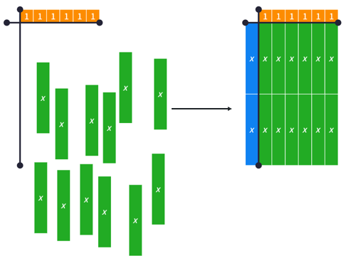
Dividing into the unknown (2)
Dividing algebraic terms – example 1
$$12x÷6=\frac{12x}{6}=2x$$

Slide 4
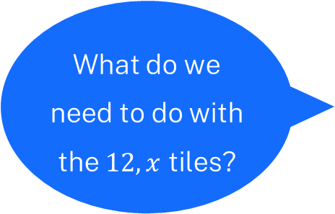
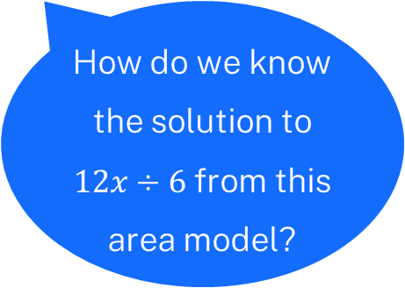
Dividing into the unknown (3)
Dividing algebraic terms – self-explanation prompts 1
$$12x÷6=\frac{12x}{6}=2x$$
What do we need to do with the $12, x$ tiles?
How do we know the solution to $12x÷6$ from this area model?

Slide 5
Dividing into the unknown (4)
Your turn – question 1
$$9y÷3=$$

Slide 6
Dividing into the unknown (5)
Your turn – solution 1
$$9y÷3=\frac{9y}{3}=3y$$

Slide 7
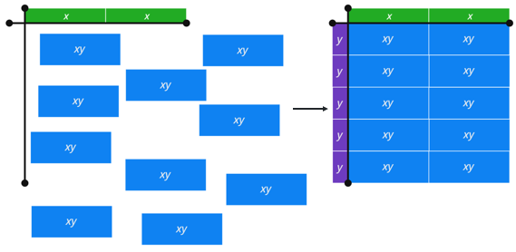
Dividing into the unknown (6)
Dividing algebraic terms – example 2
$$\frac{10xy}{2x}=5y$$

Slide 8
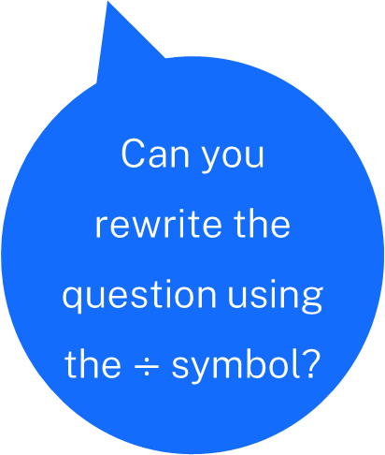
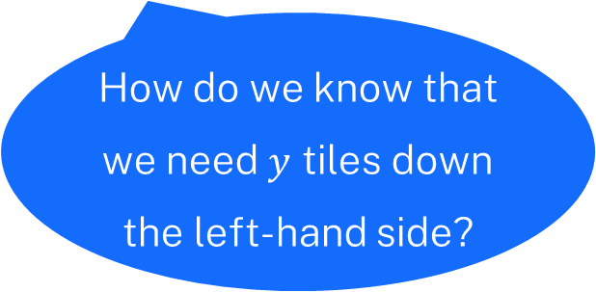
Dividing into the unknown (7)
Dividing algebraic terms – self explanation prompts 2
$$\frac{10xy}{2x}=5y$$
Can you rewrite the question using the $÷$ symbol?
How do we know that we need $y$ tiles down the left-hand side?

Slide 9
Dividing into the unknown (8)
Your turn – question 2
$$15y^{2}÷3y=$$

Slide 10
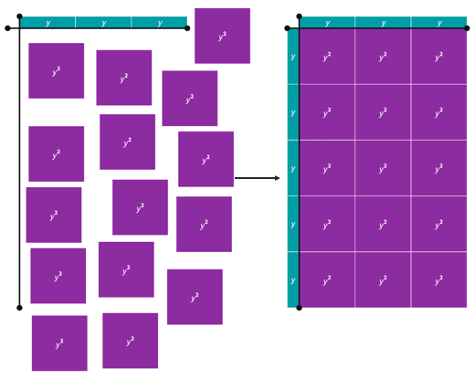
Dividing into the unknown (9)
Your turn – solution 2
$$15y^{2}÷3y=5y$$

Slide 11
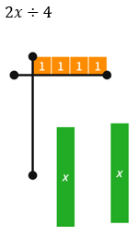
Dividing into the unknown (10)
When things don’t divide nicely
What does $2x÷4$ look like as a simplified algebraic expression?
What does $2x÷4$ look like as an area model?

Slide 12
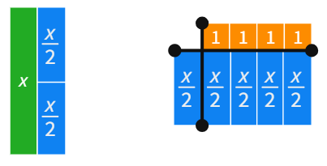
Dividing into the unknown (11)
When things don’t divide nicely – solution
$$2x÷4=\frac{x}{2}$$
$$x=2×\frac{x}{2}$$

Slide 13
Dividing into the unknown (12)
Further problems
Simplify the following expressions
(a) $2x÷8$ (b) $3y÷9$

Slide 14
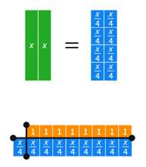
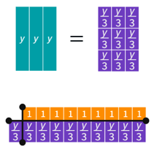
Dividing into the unknown (13)
Further problems – solutions
Simplify the following expressions
(a) $2x÷8$ (b) $3y÷9$

Slide 15

Dividing into the unknown (14)
Notes to your future self
$$14x÷7$$
$$−9y÷3$$
$$16x÷4x$$
$$6xy÷2y$$
$$2x÷6$$

