Slide 1
Strike a pose
NSW Department of Education

Slide 2
Launch
What angles can we see?
NSW Department of Education

Slide 3
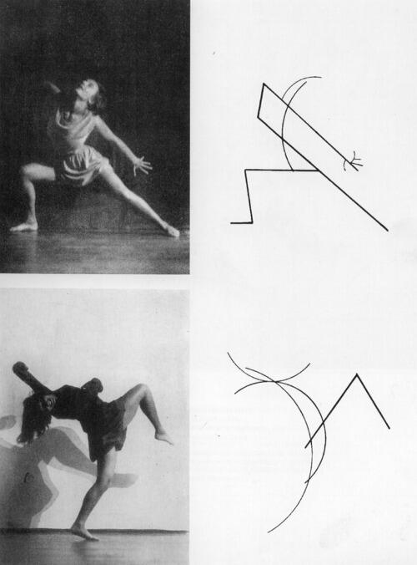
Angles and lines
Explore
What do you notice?
What do you wonder?
‘Kandinsky, Palucca Dance, Bauhaus Theatre, 1926’ by bianca.maggio is marked with Public Domain Mark 1.0.
Notes:
Ask students what they notice. Pause to let students think, then use a method to randomly call on a student or take volunteers to share. Encourage students to be observant. Allow them to look closely at the image. They can share anything they notice.
2. Ask students what they wonder. Pause to let students think, then randomly call on a student or take volunteers to share. Encourage students to be creative. Allow them to share any wondering that pops into their mind. Again, this doesn't have to be maths related.
3. Invite students to ask for clarification and make connections.

Slide 4
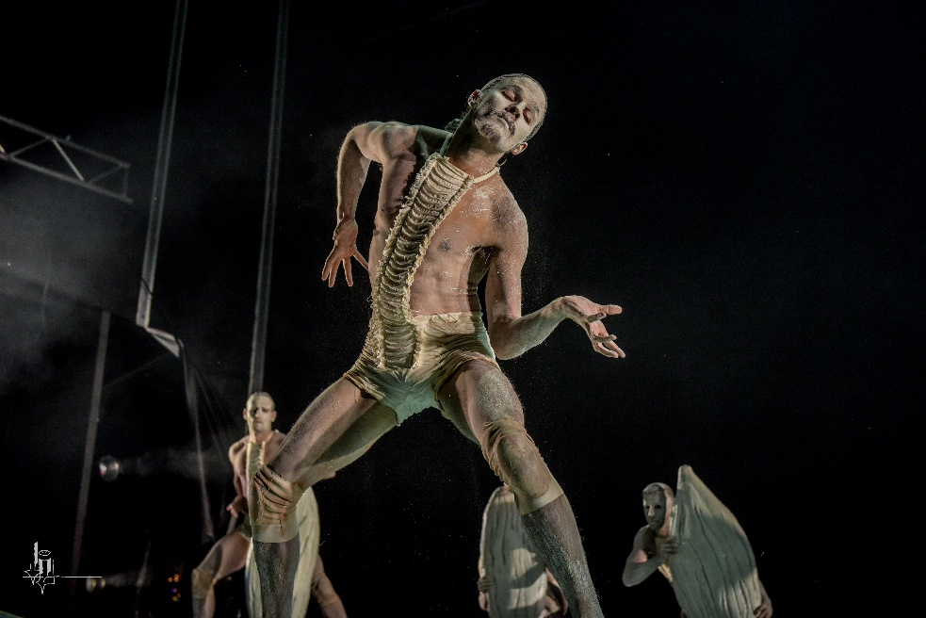
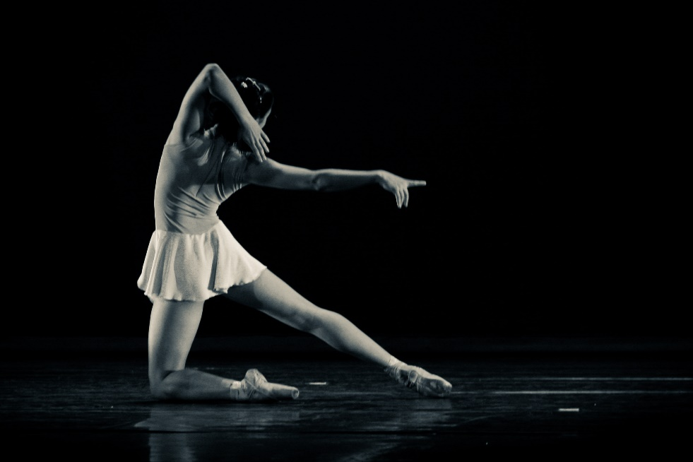
Angles and dance
Explore
'Bangarra Dance Theatre' by badjonni is licensed under CC BY-NC-SA 2.0.
'para lá' by rdenubila is licensed under CC BY-SA 2.0.
'Kandinsky, Palucca Dance, Bauhaus Theatre, 1926' by bianca.maggio is marked with Public Domain Mark 1.0.
Notes:
Students should try to draw a line sketch of one of the dancers. The sketches need only be small, taking a space approximately 5cm by 5cm.
Encourage students to attempt the sketch a few times, if they aren’t satisfied with their first attempt.
Remind students that the point of the activity is to think about the angles and lines they can see.

Slide 5
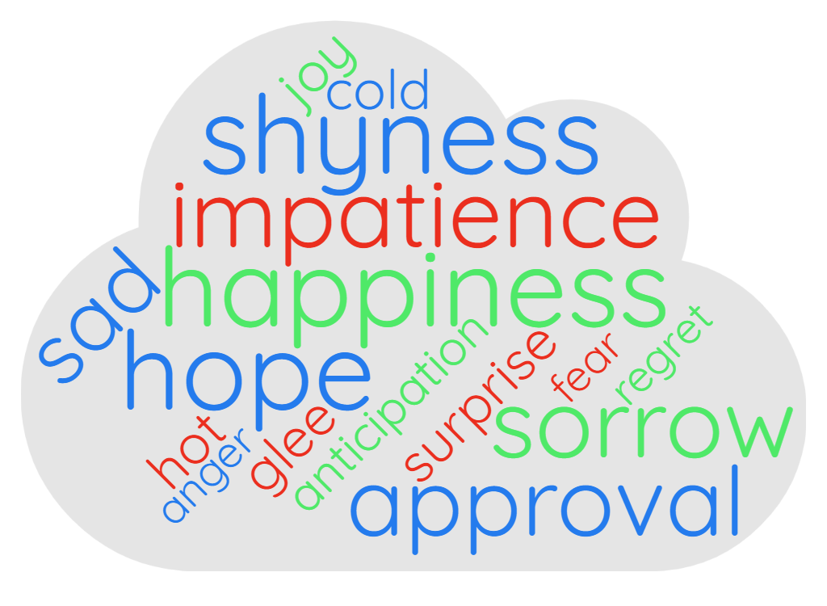
How do you feel?
An emotion cloud
Notes:
The emotion cloud is not comprehensive. You might like to suggest that the students may think of another emotion, that is not in the cloud.
You may wish to prompt this by suggesting that pride and strength are not shown but could be used.

Slide 6
Explore
What angles can we see?
NSW Department of Education

Slide 7
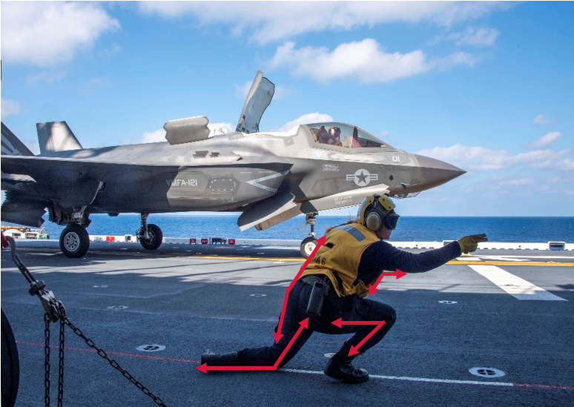
Angles on the go
What angles can you see?
'A Sailor signals an F-35B Lightning II to take off from the flight deck of USS America (LHA 6).' by Official U.S. Navy Imagery is licensed under CC BY 2.0.
Notes:
What types of angles can you see?
How could you identify the angles?

Slide 8
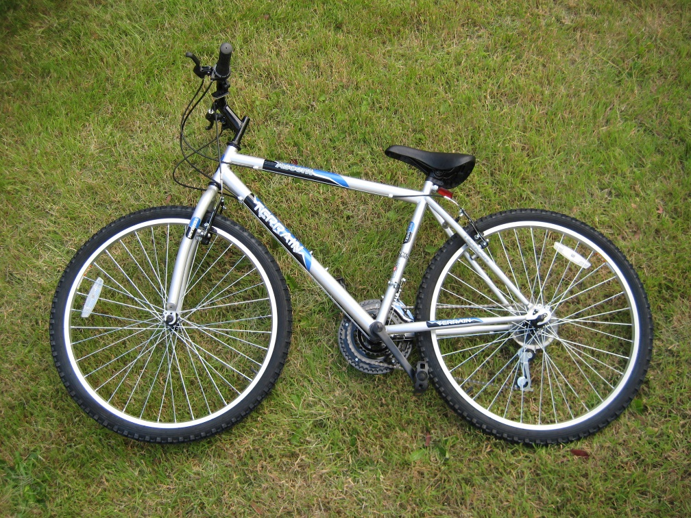
Angles in a bike (1)
What angles can you see?
'tesco bicycle' by osde8info is licensed under CC BY-SA 2.0.

Slide 9
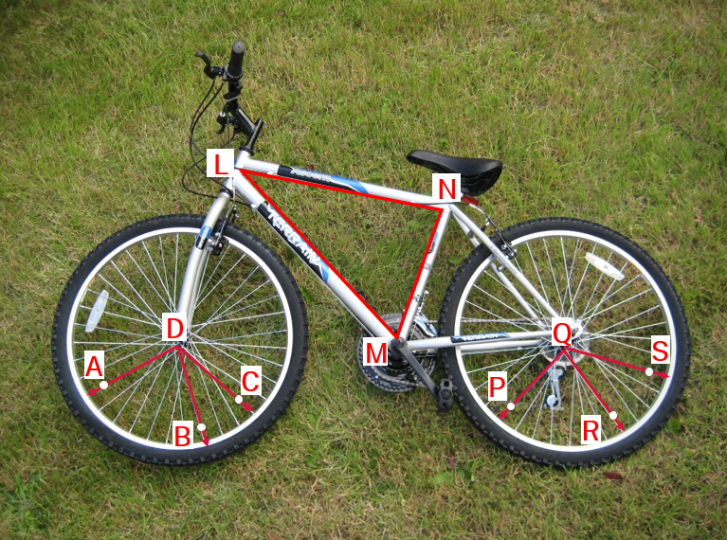
Angles in a bike (2)
What angles can you see?
'tesco bicycle' by osde8info is licensed under CC BY-SA 2.0.
Notes:
How can you use the letters to help you describe which angle you are referring to?
Can you identify an acute angle?
Can you identify an obtuse angle?
Can you identify a reflex angle?

Slide 10
Summarise
Types of angles
NSW Department of Education

Slide 11
Naming angles (1)
Communicating effectively
What is similar?
What is different?
A
A
A
B
C
B
C
B
C
$$∠ABC$$
$$∠CBA$$
$$∠ABC$$

Slide 12
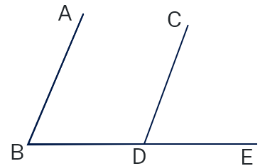
Naming angles (2)
Communicating effectively
∠𝐴𝐵𝐷 is acute.
∠𝐵𝐷𝐶 is obtuse.

Slide 13
Naming angles (3)
Communicating effectively
How might you name a different acute angle?
∠𝐴𝐵𝐷 is acute.
∠ 𝐴𝐵𝐷 is reflex.
What other angles can you see?
How else might you name $∠ABD$?

Slide 14
Apply
Bingo
NSW Department of Education

Slide 15
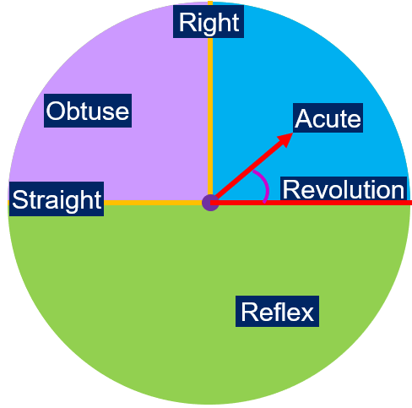
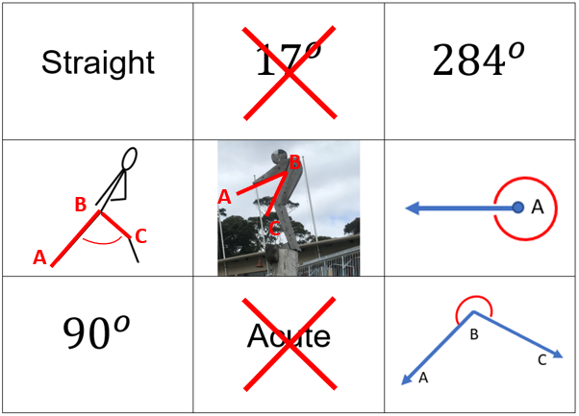
Bingo!
Cross out an acute angle.
Game card example
Label an acute angle.
Notes:
Discuss the game cards with the students and explain how they will work.
The game cards include names of angles, angle sizes, pictures of angles, stick figure drawings and an image.
Ask students to look at the stick figure drawing and the image and identify some of the angle types they can see in them. Note that some of the drawings and images have more than one angle type.
Explain that the PowerPoint will show a circle with an arrow pointing to either acute, obtuse or reflex.
Each student will cross out the angle type, if possible, or they will label the angle type on the drawing or image, as per the example.
Emphasise that they cross out only one square each time.

Slide 16
Let’s play!
Pick a number
1
2
3
4
5
6
7
8
9
10
11
12
13
14
15
16
17
18
19
20
21
22
23
24
Notes:
Ask individual students to pick a number.
Click on the number and a picture of an angle spinner will appear, pointing to one of the angle types.
Students will mark off the angle type, if possible.
When you click return, the PowerPoint will return to the buttons, but the numbers which have been selected each time will not be visible.

Slide 17
Acute angle
Strike a pose
Return
Notes:
Students can:
Mark out an acute angle and label it in the stick person drawing
Cross out an acute angle size
Cross out the word ‘acute’
Cross out an image of an acute angle
Click return when you think students are ready for the next one.

Slide 18
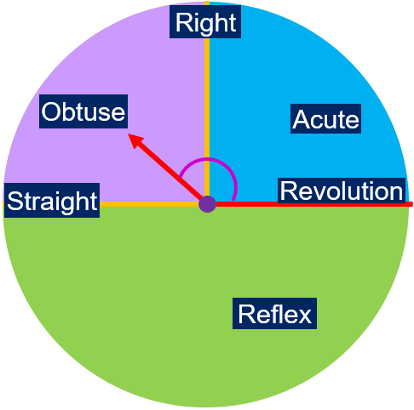
Obtuse angle
Strike a pose
Return
Notes:
Students can:
Mark out an obtuse angle and label it in the stick person drawing
Cross out an obtuse angle size
Cross out the word ‘obtuse’
Cross out an image of an obtuse angle
Click return when you think students are ready for the next one.

Slide 19
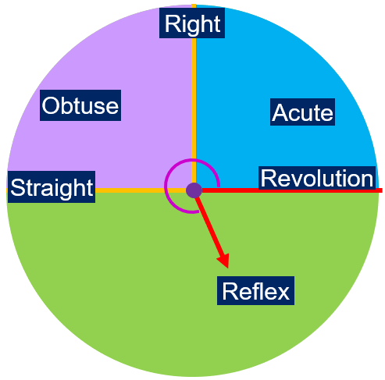
Reflex angle
Strike a pose
Return
Notes:
Students can:
Mark out a reflex angle and label it in the stick person drawing
Cross out a reflex angle size
Cross out the word ‘reflex’
Cross out an image of an reflex angle
Click return when you think students are ready for the next one.

Slide 20
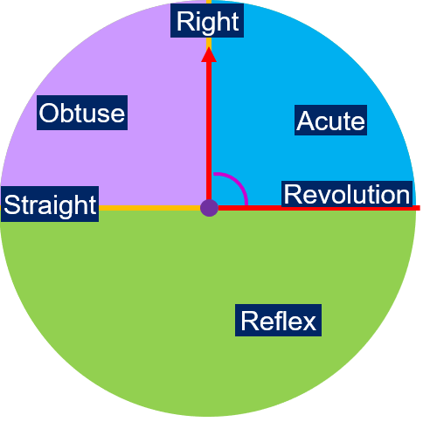
Right angle
Strike a pose
Return
Notes:
Students can:
Mark out a right angle and label it in the stick person drawing
Cross out a right-angle size
Cross out the word ‘right’
Cross out an image of a right angle
Click return when you think students are ready for the next one.

Slide 21
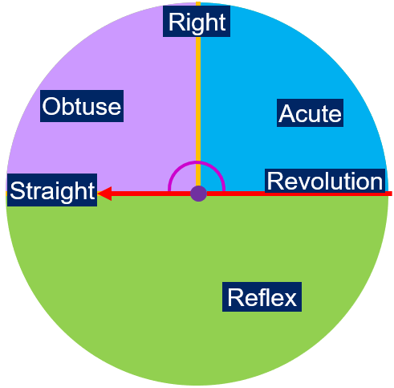
Straight angle
Strike a pose
Return
Notes:
Students can:
Mark out a straight angle and label it in the stick person drawing
Cross out a straight angle size
Cross out the word ‘straight’
Cross out an image of an straight angle
Click return when you think students are ready for the next one.

Slide 22
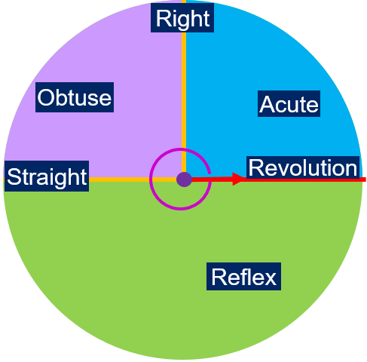
Revolution
Strike a pose
Return
Notes:
Students can:
Mark out a revolution and label it in the stick person drawing
Cross out a revolution angle size
Cross out the word ‘revolution ’
Cross out an image of a revolution angle
Click return when you think students are ready for the next one.

Slide 23
Copyright
© State of New South Wales (Department of Education), 2023
The copyright material published in this resource is subject to the Copyright Act 1968 (Cth) and is owned by the NSW Department of Education or, where indicated, by a party other than the NSW Department of Education (third-party material).
Copyright material available in this resource and owned by the NSW Department of Education is licensed under a Creative Commons Attribution 4.0 International (CC BY 4.0) licence.
This licence allows you to share and adapt the material for any purpose, even commercially.
Attribution should be given to © State of New South Wales (Department of Education), 2023.
Material in this resource not available under a Creative Commons licence:
the NSW Department of Education logo, other logos and trademark-protected material
Material owned by a third party that has been reproduced with permission. You will need to obtain permission from the third party to reuse its material.
Links to third-party material and websites
Please note that the provided (reading/viewing material/list/links/texts) are a suggestion only and implies no endorsement, by the New South Wales Department of Education, of any author, publisher, or book title. School principals and teachers are best placed to assess the suitability of resources that would complement the curriculum and reflect the needs and interests of their students.
If you use the links provided in this document to access a third party’s website, you acknowledge that the terms of use, including licence terms set out on the third-party’s website apply to the use which may be made of the materials on that third-party website or where permitted by the Copyright Act 1968 (Cth). The department accepts no responsibility for content on third-party websites.

