Slide 1
I see triangles
Explicit teaching
NSW Department of Education

Slide 2
Launch
I see triangles
NSW Department of Education

Slide 3
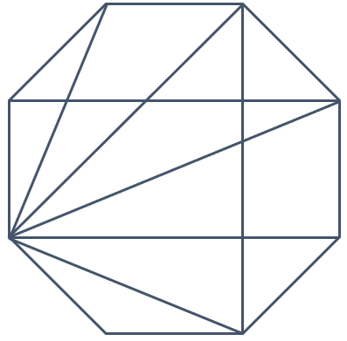
I see many triangles
I see triangles
How many triangles can you see?

Slide 4
Explore
I see triangles
NSW Department of Education

Slide 5
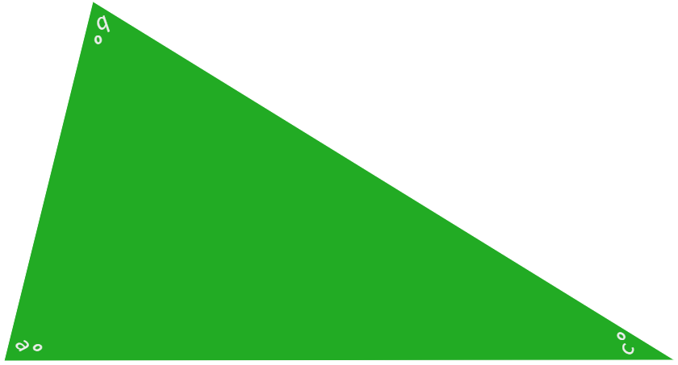
Label your triangle
Write $a^{o}$ in one vertex, $b^{o}$ in a second vertex and $c^{o}$ in the third vertex.
Use the picture below to guide you.
bº
Turn the triangle to point each vertex at yourself, as you write.
cº
aº

Slide 6

Cut the triangle into 3 pieces
Draw lines on the triangle and check there is a label in each piece before you cut the triangle up.

Slide 7
Summarise
I see triangles
NSW Department of Education

Slide 8
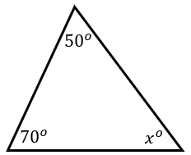
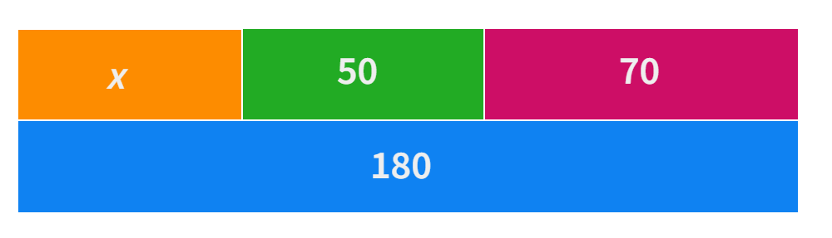
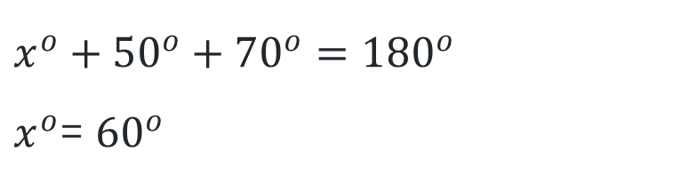
Calculating the size of an angle (1)
Angle sum of a triangle – example 1
Find the value of the missing angle.
$$x^{o}+{50}^{o}+{70}^{o}={180}^{o}$$
$x^{o}$= ${60}^{o}$
Notes:
Reveal the questions.
Students read in silence
Students individually think and explain to themselves what is happening in each step
Students hold up a thumbs up to the teacher when they have finished reading and have some sort of understanding
Think, pair, share. Students explain the solution to their partner.

Slide 9
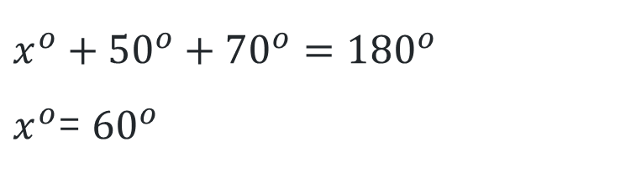
Calculating the size of an angle (2)
Angle sum of a triangle – example 1 prompts
How does the bar model represent what we know in the triangle?
Find the value of the missing angle.
$$x^{o}+{50}^{o}+{70}^{o}={180}^{o}$$
$x^{o}$= ${60}^{o}$
How do we know this?
How else can we write this equation?
Notes:
In pairs students then answer the self-explanation questions.
Finally, randomly select students to share their answers with the whole class.

Slide 10
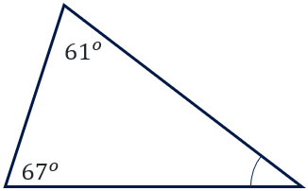

Calculating the size of an angle (3)
Your turn – question 1
Find the value of the missing angle.
$$m^{0}$$
Notes:
Reveal the question and give students time to complete the question on their own.
They can then pair/share with a partner and make corrections if necessary.
Randomly call on students to give their answers and then reveal one approach.

Slide 11
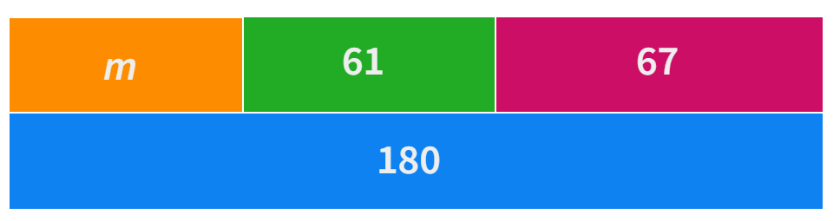
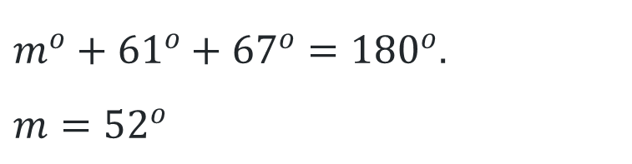

Calculating the size of an angle (4)
Your turn – solution 1
Find the value of the missing angle.
$m^{o}+{61}^{o}+{67}^{o}={180}^{o}$.
$$m={52}^{o}$$
$$m^{0}$$
Notes:
Reveal the question and give students time to complete the question on their own.
They can then pair/share with a partner and make corrections if necessary.
Randomly call on students to give their answers and then reveal one approach.

Slide 12
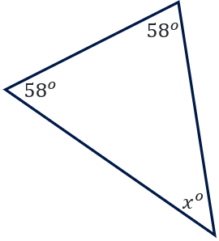
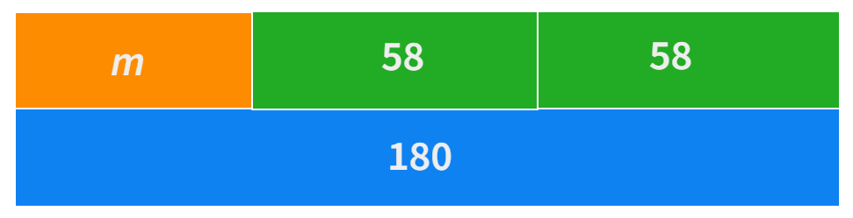

Calculating the size of an angle (5)
Angle sum of a triangle – example 2
Determine the value of 𝑥^𝑜.
$$x^{o}+{58}^{o}+{58}^{o}={180}^{o}$$
$$x^{o}={64}^{o}$$
Notes:
Reveal the questions.
Students read in silence
Students individually think and explain to themselves what is happening in each step
Students hold up a thumbs up to the teacher when they have finished reading and have some sort of understanding
Think, pair, share. Students explain the solution to their partner.

Slide 13
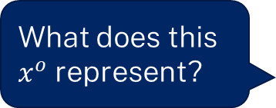
Calculating the size of an angle (6)
Angle sum of a triangle – example 2 prompts
Determine the value of 𝑥^𝑜.
What does this $x^{o}$ represent?
$$x^{o}+{58}^{o}+{58}^{o}={180}^{o}$$
$$x^{o}={64}^{o}$$
How do we know this?
How do we know what type of triangle this is?
Notes:
In pairs students then answer the self-explanation questions.
Finally, randomly select students to share their answers with the whole class.

Slide 14
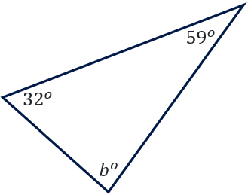
Calculating the size of an angle (7)
Your turn – question 2
Determine the value of $b^{o}$.
Notes:
Reveal the question and give students time to complete the question on their own.
They can then pair/share with a partner and make corrections if necessary.
Randomly call on students to give their answers and then reveal one approach.

Slide 15
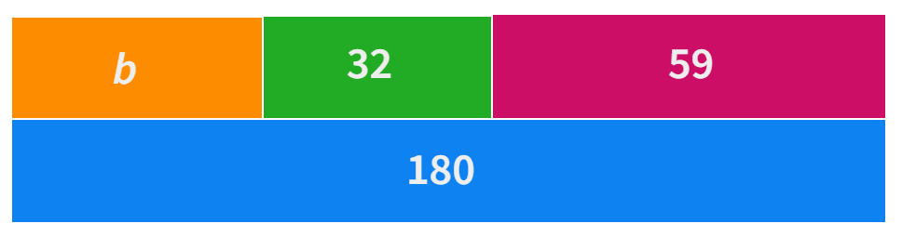

Calculating the size of an angle (8)
Your turn – solution 2
Determine the value of $b^{o}$.
$$b^{o}+{32}^{o}+{59}^{o}={180}^{o}$$
$$b^{o}={89}^{o}$$

Slide 16
Apply
I see triangles
NSW Department of Education

Slide 17
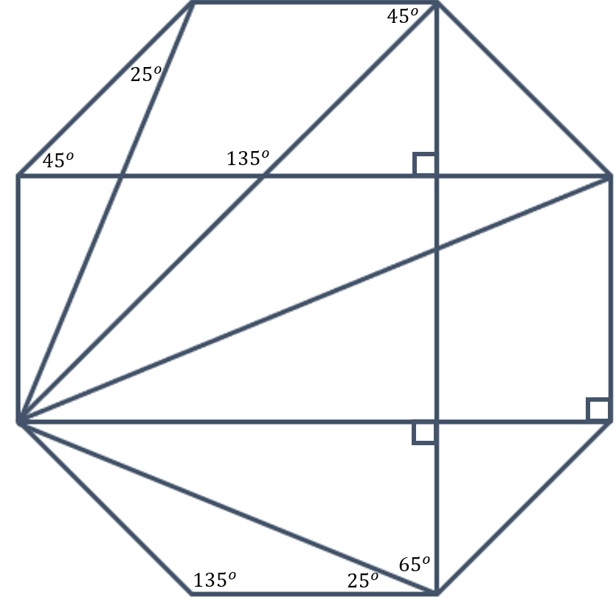
Angle size
Determine the size of the unknown angles

Slide 18
Copyright
© State of New South Wales (Department of Education), 2023
The copyright material published in this resource is subject to the Copyright Act 1968 (Cth) and is owned by the NSW Department of Education or, where indicated, by a party other than the NSW Department of Education (third-party material).
Copyright material available in this resource and owned by the NSW Department of Education is licensed under a Creative Commons Attribution 4.0 International (CC BY 4.0) licence.
This licence allows you to share and adapt the material for any purpose, even commercially.
Attribution should be given to © State of New South Wales (Department of Education), 2023.
Material in this resource not available under a Creative Commons licence:
the NSW Department of Education logo, other logos and trademark-protected material
Material owned by a third party that has been reproduced with permission. You will need to obtain permission from the third party to reuse its material.
Links to third-party material and websites
Please note that the provided (reading/viewing material/list/links/texts) are a suggestion only and implies no endorsement, by the New South Wales Department of Education, of any author, publisher, or book title. School principals and teachers are best placed to assess the suitability of resources that would complement the curriculum and reflect the needs and interests of their students.
If you use the links provided in this document to access a third party’s website, you acknowledge that the terms of use, including licence terms set out on the third-party’s website apply to the use which may be made of the materials on that third-party website or where permitted by the Copyright Act 1968 (Cth). The department accepts no responsibility for content on third-party websites.

