Slide 1
Throwing light on the exteriors
Explicit teaching

Slide 2
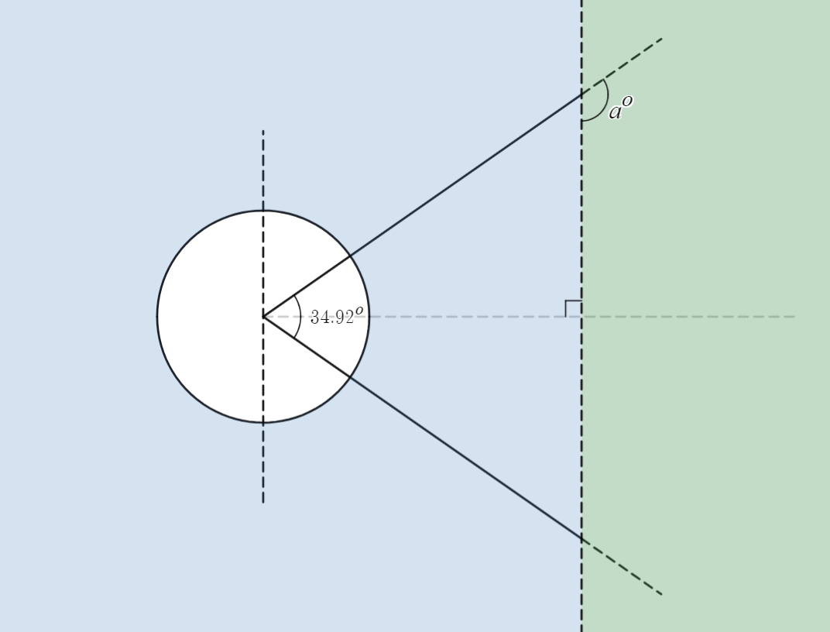
Discus field
Exterior angles

Slide 3
Exterior angle of a triangle
What’s an exterior angle?
Why do you think $∠ABC$and $∠BAC$are called the ‘interior opposite’ angles?
Why do you think $∠ACD$is called the ‘exterior angle’?
A
B
C
D

Slide 4
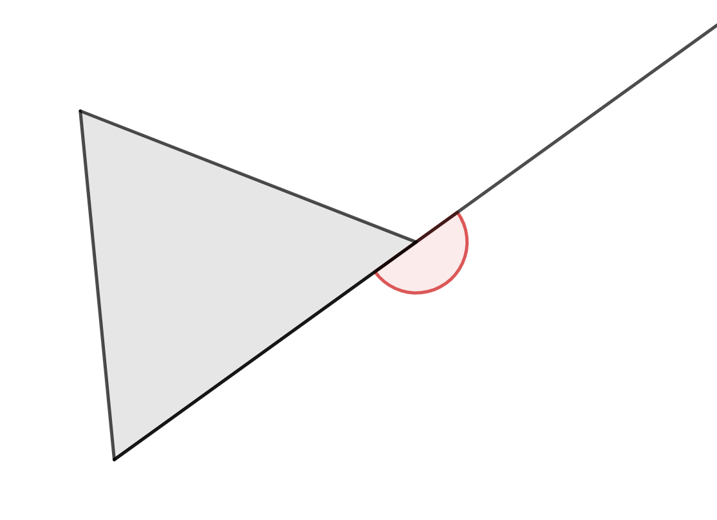
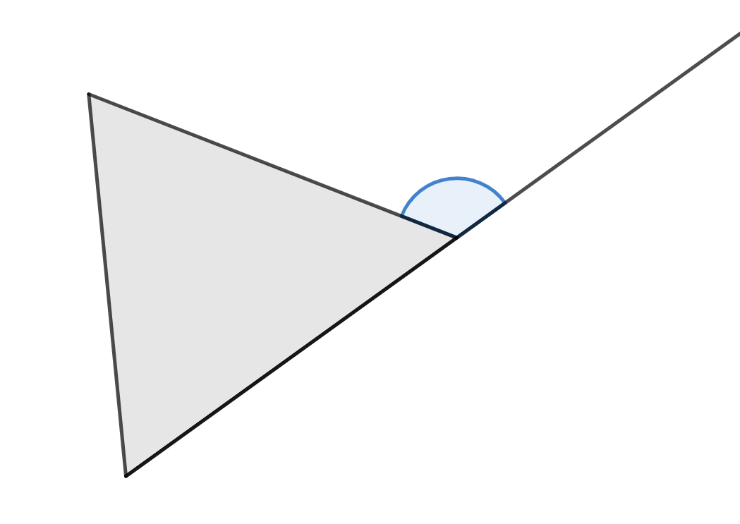
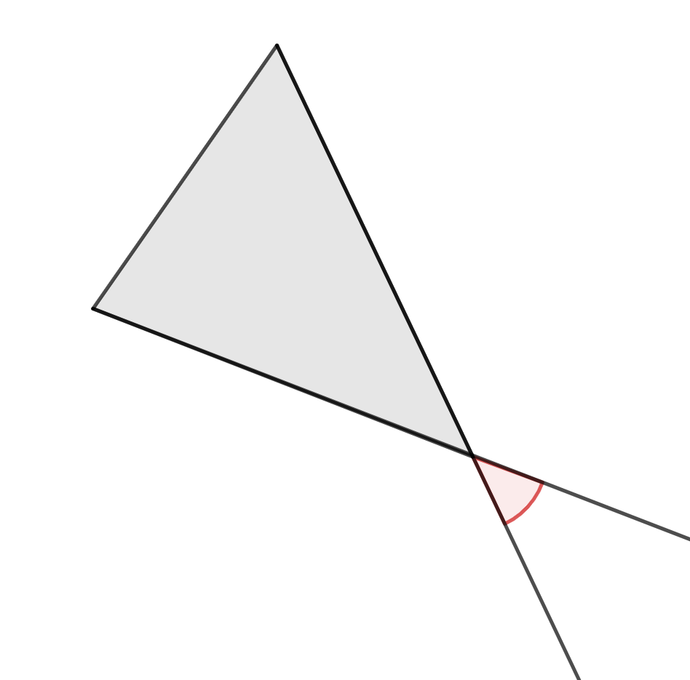
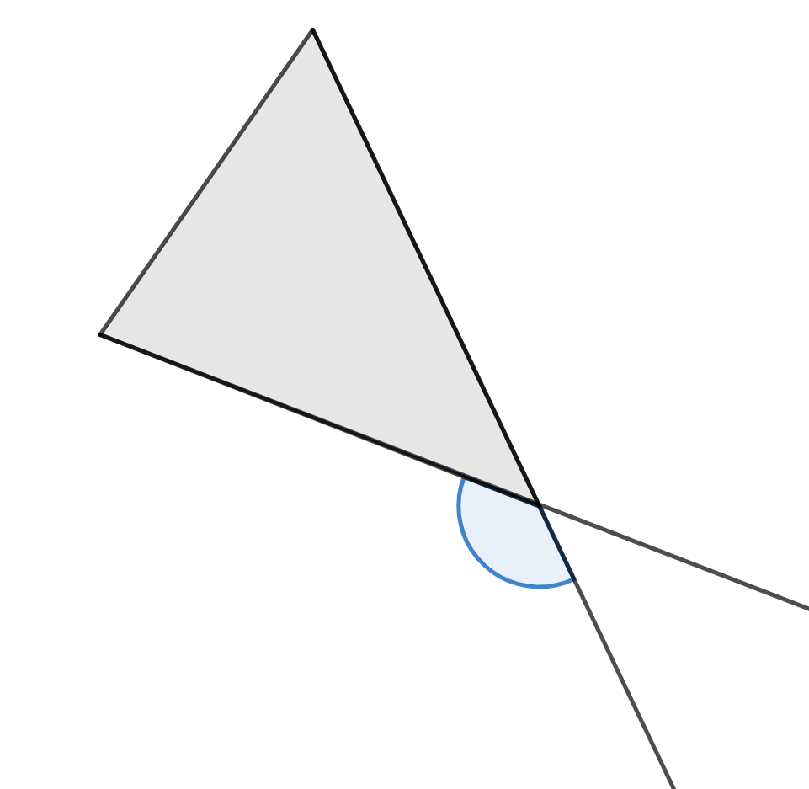
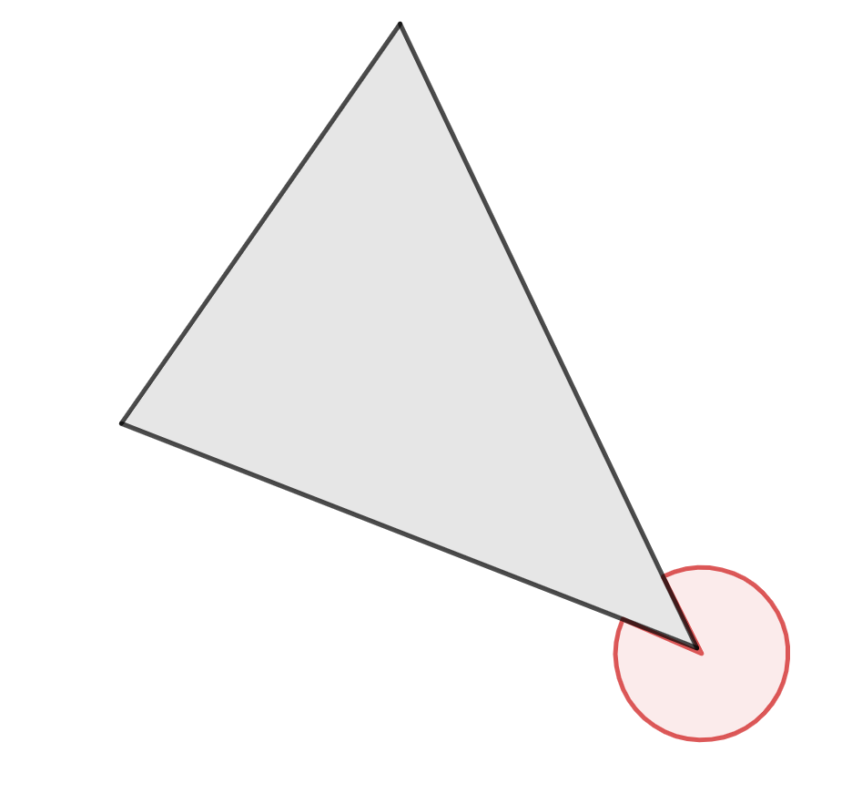
Exterior angle of a triangle (2)
Examples and non-examples

Slide 5
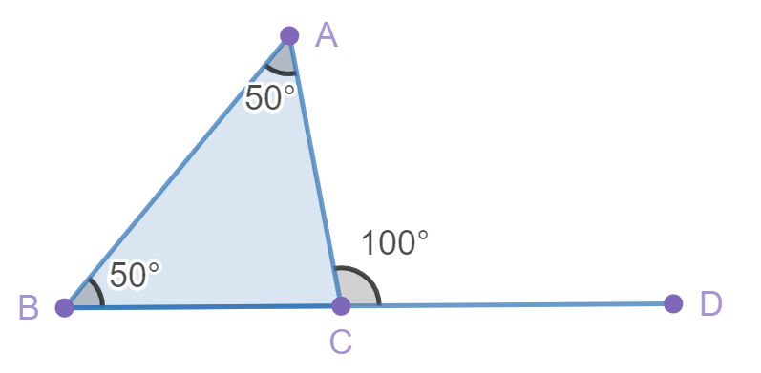
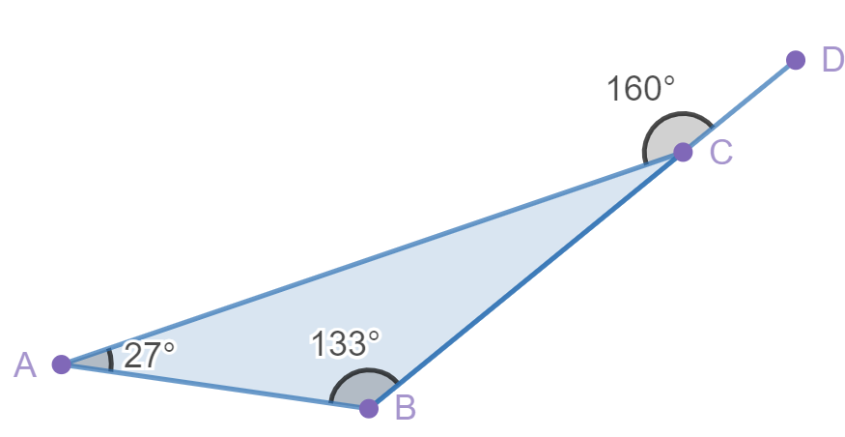
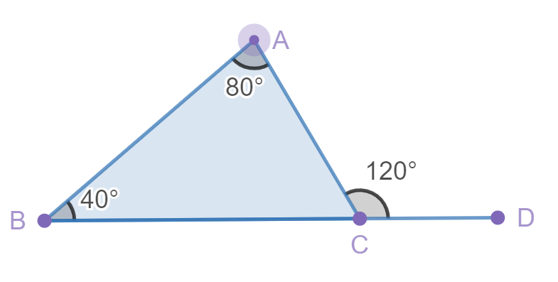
Exterior angle of a triangle (3)
What do you notice?
What do you wonder?

Slide 6
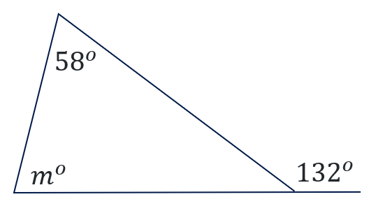
Calculating the size of an angle (1)
Exterior angle of a triangle – example 1
Determine the value of $m^{o}$.
$$m^{o}+{58}^{o}={132}^{o}$$
$$m^{o}={74}^{o}$$
Notes:
Reveal the question.
Students read in silence.
Students individually think and explain to themselves what is happening.
Students hold up a thumbs up to the teacher when they have finished reading and have some sort of understanding.
Think, pair, share. Students explain the solution to their partner. .

Slide 7
Calculating the size of an angle (2)
Exterior angle of a triangle – example 1 prompts
Determine the value of $m^{o}$.
$$m^{o}+{58}^{o}={132}^{o}$$
$$m^{o}={74}^{o}$$
How does this equation relate to the bar model?
How do we know this?
Notes:
Reveal the question.
Students read in silence.
Students individually think and explain to themselves what is happening.
Students hold up a thumbs up to the teacher when they have finished reading and have some sort of understanding.
Think, pair, share. Students explain the solution to their partner. .

Slide 8
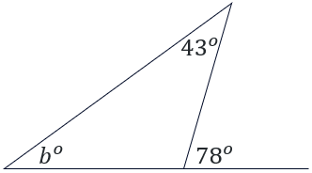
Calculating the size of an angle (3)
Your turn – question 1
Determine the value of $b^{o}$.
Notes:
Reveal the question and give students time to complete the question on their own.
They can then pair/share with a partner and make corrections if necessary.
Randomly call on students to give their answers and then reveal one approach.

Slide 9
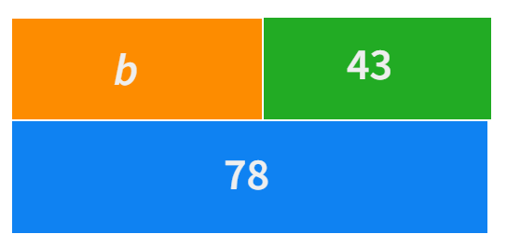
Calculating the size of an angle (4)
Your turn – solution 1
Determine the value of $b^{o}$.
$$b^{o}+{43}^{o}={78}^{o}$$
$$b^{o}={35}^{o}$$

Slide 10
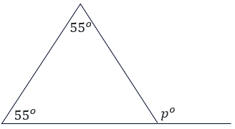
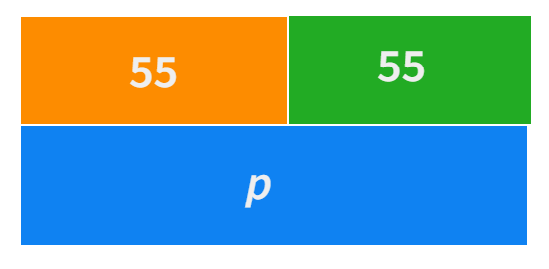
Calculating the size of an angle (5)
Exterior angle of a triangle – example 2
Determine the value of $p^{o}$.
$$p^{o}={55}^{o}+{55}^{o}$$
$$p^{o}={110}^{o}$$
Notes:
Reveal the question.
Students read in silence.
Students individually think and explain to themselves what is happening.
Students hold up a thumbs up to the teacher when they have finished reading and have some sort of understanding.
Think, pair, share. Students explain the solution to their partner.

Slide 11
Calculating the size of an angle (6)
Exterior angle of a triangle – example 2 prompts
Determine the value of $p^{o}$.
$$p^{o}={55}^{o}+{55}^{o}$$
$$p^{o}={110}^{o}$$
How does the bar model relate to this equation?
How do we know what type of triangle this is?
How do we know this?
Notes:
Reveal the question.
Students read in silence.
Students individually think and explain to themselves what is happening.
Students hold up a thumbs up to the teacher when they have finished reading and have some sort of understanding.
Think, pair, share. Students explain the solution to their partner.

Slide 12
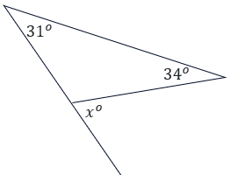
Calculating the size of an angle (7)
Your turn – question 2
Determine the value of $x^{o}$.
Notes:
Reveal the question and give students time to complete the question on their own.
They can then pair/share with a partner and make corrections if necessary.
Randomly call on students to give their answers and then reveal one approach.

Slide 13
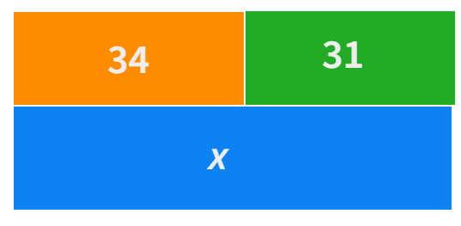
Calculating the size of an angle (8)
Your turn – solution 2
Determine the value of $x^{o}$.
$$x^{o}={34}^{o}+{31}^{o}$$
$$x^{o}={65}^{o}$$
Notes:
Reveal the question and give students time to complete the question on their own.
They can then pair/share with a partner and make corrections if necessary.
Randomly call on students to give their answers and then reveal one approach.

Slide 14
Copyright
© State of New South Wales (Department of Education), 2023
The copyright material published in this resource is subject to the Copyright Act 1968 (Cth) and is owned by the NSW Department of Education or, where indicated, by a party other than the NSW Department of Education (third-party material).
Copyright material available in this resource and owned by the NSW Department of Education is licensed under a Creative Commons Attribution 4.0 International (CC BY 4.0) licence.
This licence allows you to share and adapt the material for any purpose, even commercially.
Attribution should be given to © State of New South Wales (Department of Education), 2023.
Material in this resource not available under a Creative Commons licence:
the NSW Department of Education logo, other logos and trademark-protected material
Material owned by a third party that has been reproduced with permission. You will need to obtain permission from the third party to reuse its material.
Links to third-party material and websites
Please note that the provided (reading/viewing material/list/links/texts) are a suggestion only and implies no endorsement, by the New South Wales Department of Education, of any author, publisher, or book title. School principals and teachers are best placed to assess the suitability of resources that would complement the curriculum and reflect the needs and interests of their students.
If you use the links provided in this document to access a third party’s website, you acknowledge that the terms of use, including licence terms set out on the third-party’s website apply to the use which may be made of the materials on that third-party website or where permitted by the Copyright Act 1968 (Cth). The department accepts no responsibility for content on third-party websites.

