Slide 1
Sides and angles united
Explicit teaching
NSW Department of Education

Slide 2
Launch
NSW Department of Education

Slide 3
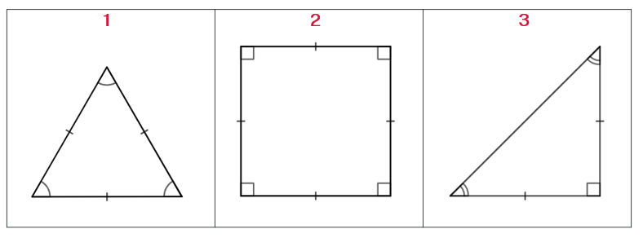
Which one doesn’t belong?
Launch activity

Slide 4
Explicit teaching
Sides and angles united
NSW Department of Education

Slide 5

Angles and sides united (1)
Properties of a square
All sides are equal
Notes:
Ask students how they might show this on the diagram.

Slide 6
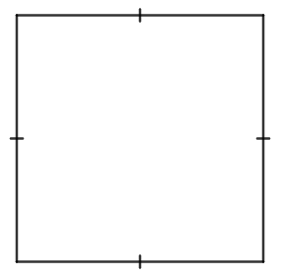
Angles and sides united (2)
Properties of a square
All sides are equal
Adjacent sides are perpendicular
Notes:
Explain to students that the dashes on the sides indicate that the sides are all equal in length.
Ask students:
What adjacent means and then define it as sides that are next to each other and share a common vertex.
What perpendicular means and then define it as 2 lines that meet at a right angle.
How might you show that adjacent sides are perpendicular?

Slide 7
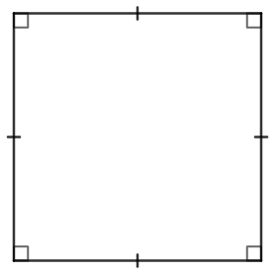
Angles and sides united (3)
Properties of a square
All sides are equal
Adjacent sides are perpendicular
Diagonals bisect at right angles
Notes:
Explain to students that the squares within the interior angles show that the angles are 90 degrees.
Ask students:
to demonstrate using their arms what diagonals are.
what bisect means and then define it as dividing into 2 equal parts.
how might you might show that diagonals bisect at right angles?

Slide 8
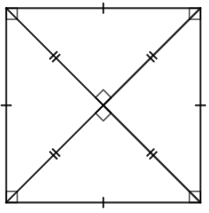
Angles and sides united (4)
Properties of a square
All sides are equal
Adjacent sides are perpendicular
Diagonals bisect at right angles
Diagonals are equal
Notes:
Explain to students how the diagonals have been drawn in to show that they bisect at right angles.
Ask students:
How to mark on the diagram equal diagonals.
Is it already shown?

Slide 9
Angles and sides united (5)
Properties of a square
All sides are equal
Adjacent sides are perpendicular
Diagonals bisect at right angles
Diagonals are equal
Diagonals bisect the angles of the quadrilateral
Notes:
Ask students again what bisect means and what it might mean to bisect the angles of the quadrilateral.
Ask students how this might be shown on a diagram.

Slide 10
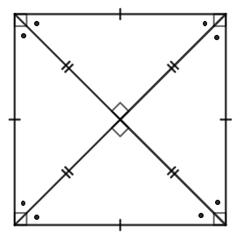
Angles and sides united (6)
Properties of a square
All sides are equal
Adjacent sides are perpendicular
Diagonals bisect at right angles
Diagonals are equal
Diagonals bisect the angles of the quadrilateral
Notes:
Explain to students that the dots indicate that the angles are all equal. Ask the students how many degrees each angle marked with a dot might be.

Slide 11
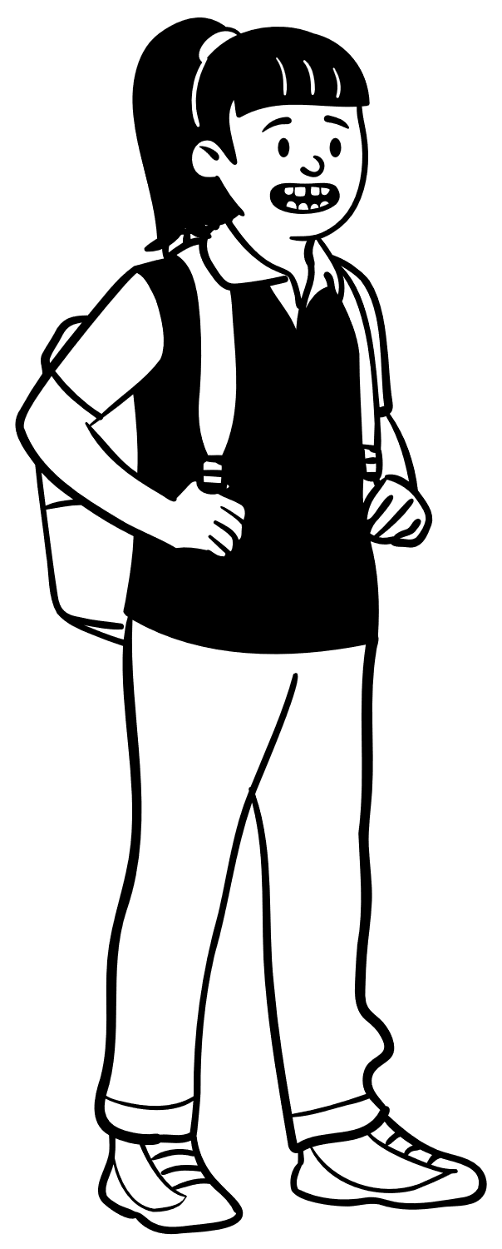
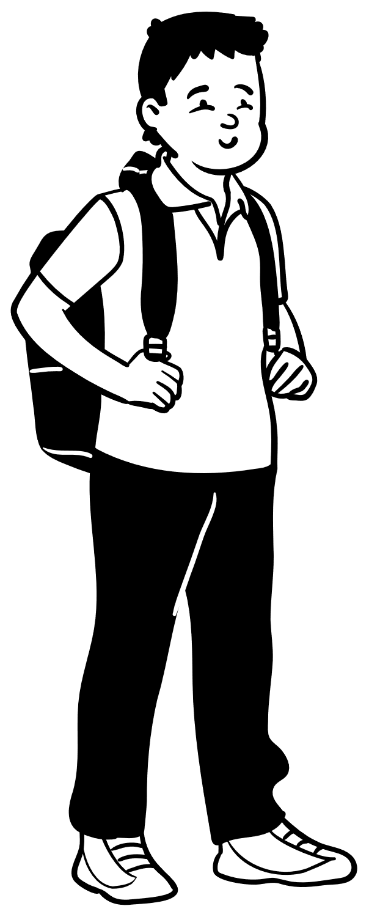
What is a square most like?
Who do you agree with?
No, squares are most like isosceles triangles because the diagonal splits a square into 2 identical isosceles triangles.
Squares are most like equilateral triangles because they both have all sides equal.
Luana
Ashvin

Slide 12
Copyright
© State of New South Wales (Department of Education), 2023
The copyright material published in this resource is subject to the Copyright Act 1968 (Cth) and is owned by the NSW Department of Education or, where indicated, by a party other than the NSW Department of Education (third-party material).
Copyright material available in this resource and owned by the NSW Department of Education is licensed under a Creative Commons Attribution 4.0 International (CC BY 4.0) licence.
This licence allows you to share and adapt the material for any purpose, even commercially.
Attribution should be given to © State of New South Wales (Department of Education), 2023.
Material in this resource not available under a Creative Commons licence:
the NSW Department of Education logo, other logos and trademark-protected material
Material owned by a third party that has been reproduced with permission. You will need to obtain permission from the third party to reuse its material.
Links to third-party material and websites
Please note that the provided (reading/viewing material/list/links/texts) are a suggestion only and implies no endorsement, by the New South Wales Department of Education, of any author, publisher, or book title. School principals and teachers are best placed to assess the suitability of resources that would complement the curriculum and reflect the needs and interests of their students.
If you use the links provided in this document to access a third party’s website, you acknowledge that the terms of use, including licence terms set out on the third-party’s website apply to the use which may be made of the materials on that third-party website or where permitted by the Copyright Act 1968 (Cth). The department accepts no responsibility for content on third-party websites.

