Slide 1
Visualising nets
Prisms and cylinders

Slide 2
Launch
Visualising nets

Slide 3
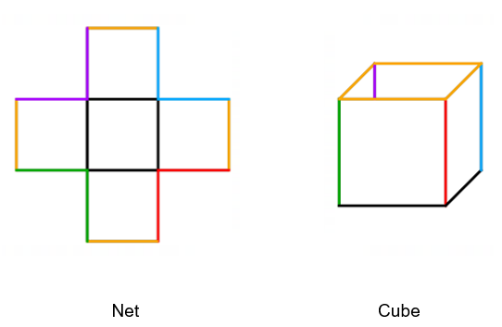
Example 1
Launch
Will this net form the open cube shown?

Slide 4
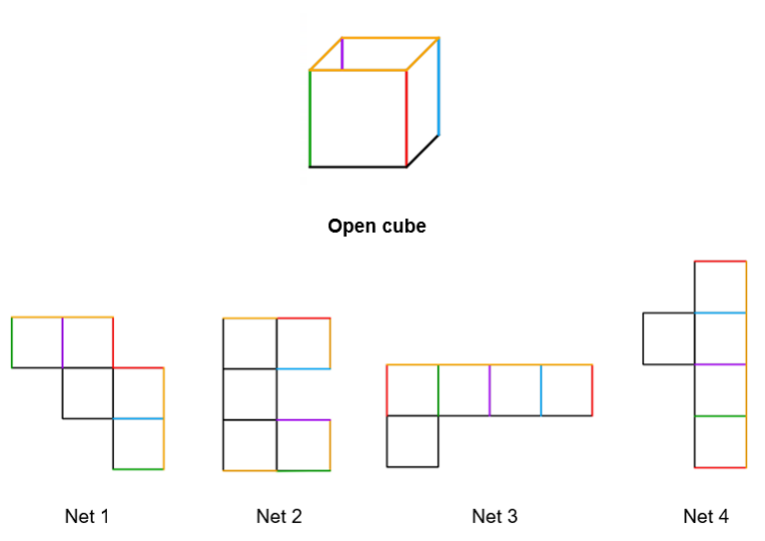
Example 2
Launch
Determine which nets will make this open cube.

Slide 5
Example 2 – solution
Launch
Determine which nets will make this open cube.

Slide 6
Explore
Visualising nets

Slide 7
Pentomino
Definition
A pentomino is a polygon made up of 5 equal-sized squares connected edge-to-edge.

Slide 8
Pentomino arrangements
Definition
A pentomino is a polygon made up of 5 equal-sized squares connected edge-to-edge.
This image shows the same pentomino.
Can you explain how the pentominoes below are the same?

Slide 9
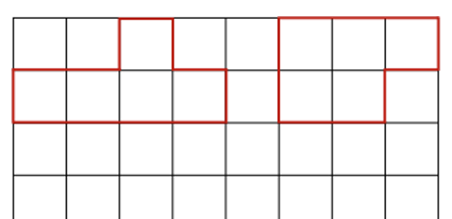
Example 3
Pentomino
How many pentominoes are possible?
Record every possible pentomino on the grid below. Two have been drawn for you.

Slide 10
Example 3 – solutions
Pentomino
Follow the link to discover the 12 different pentominoes.
bit.ly/setofpentominoes

Slide 11
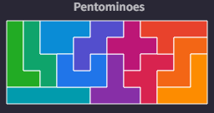
Example 4
Pentomino
The 12 different pentominoes can be arranged to form a rectangle.
Which pentomino has the greatest area? Justify why.
Which pentomino has the greatest perimeter? Justify why
Do all pentominoes represent a net of an open cube?
If yes, which of the 5 faces represents the base face of the cube?
mathigon.org/polypad#polyominoes

Slide 12
Example 4 – solutions
Nets of an open cube
Follow the link to explore which pentominoes fold to form the net of an open cube.
https://mathigon.org/polypad/hu4mXz1rW4NxEA

Slide 13
Summarise
Visualising nets

Slide 14
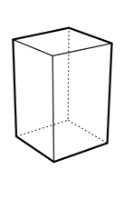
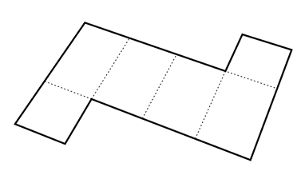
Example 5
Identifying edges, faces and nets
Consider the following prism and its net.
Can you match the edges of the prism to the edges of the net?
Can you match the faces of the prism to the faces of the net?
What shape are the faces?
What is the name of the solid? How do you know?

Slide 15
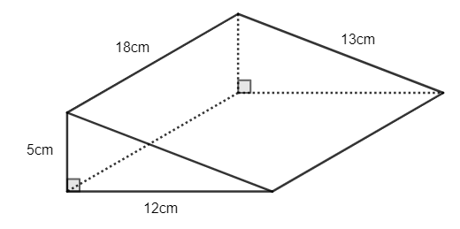
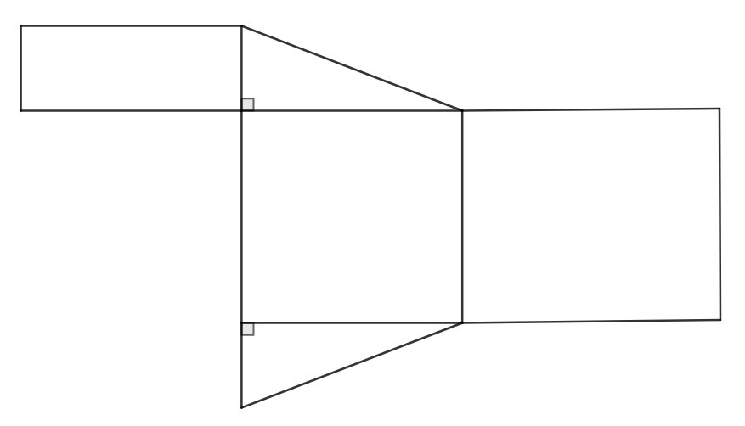
Example 6
Worked example
For the prism shown:
Add on any missing lengths to the edges.
Calculate the total edge length of the prism.
Identify the shapes that make up the faces.
Determine if the given net represents the prism.

Slide 16
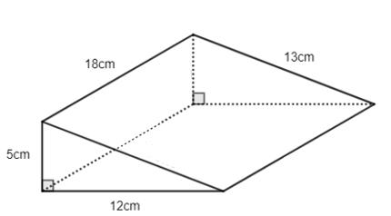
Example 6 – solutions
Could the total edge length be calculated in another way?
Worked example – answers
For the prism shown:
Add on any missing lengths to the edges.
Calculate the total edge length of the prism.
$5+12+13+18+18+18+5+12+13=114cm$
Identify the shapes that make up the faces.
Two equal right-angled triangles and three different rectangles.
Determine if the given net represents the prism.
The net represents the prism as it folds to form a triangular prism.
5 cm
18 cm
12 cm
13 cm
18 cm

Slide 17
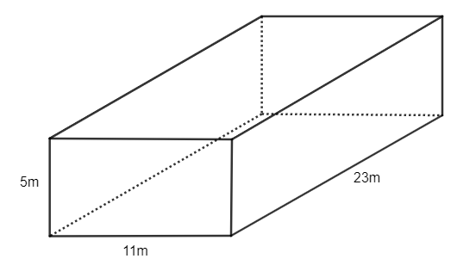
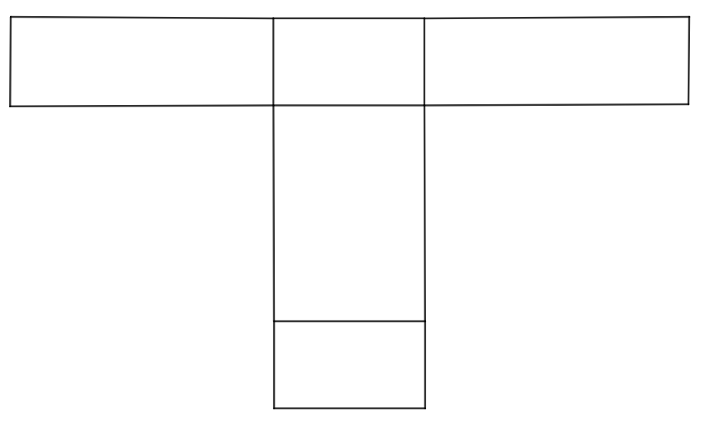
Example 7
Your turn
For the prism shown:
Add on any missing lengths to edges.
Calculate the total edge length of the prism.
Identify the shapes that make up the faces.
Determine if the given net represents the prism.

Slide 18
Example 7 – solutions
Your turn – answers
11m
For the prism shown:
Add on any missing lengths to edges.
Calculate the total edge length of the prism.
$4×11+4×5+4×23=156m$
Identify the shapes that make up the faces.
3 pairs of the same rectangle, that is, six rectangles.
Determine if the given net represents the prism.
The net does not represent the prism as there are only five faces not six.
23m
5m
23m
5m
11m
11m
23m
5m

Slide 19
Copyright
© State of New South Wales (Department of Education), 2024
The copyright material published in this resource is subject to the Copyright Act 1968 (Cth) and is owned by the NSW Department of Education or, where indicated, by a party other than the NSW Department of Education (third-party material).
Copyright material available in this resource and owned by the NSW Department of Education is licensed under a Creative Commons Attribution 4.0 International (CC BY 4.0) licence.
This licence allows you to share and adapt the material for any purpose, even commercially.
Attribution should be given to © State of New South Wales (Department of Education), 2023.
Material in this resource not available under a Creative Commons licence:
the NSW Department of Education logo, other logos and trademark-protected material
Material owned by a third party that has been reproduced with permission. You will need to obtain permission from the third party to reuse its material.
Links to third-party material and websites
Please note that the provided (reading/viewing material/list/links/texts) are a suggestion only and implies no endorsement, by the New South Wales Department of Education, of any author, publisher, or book title. School principals and teachers are best placed to assess the suitability of resources that would complement the curriculum and reflect the needs and interests of their students.
If you use the links provided in this document to access a third party’s website, you acknowledge that the terms of use, including licence terms set out on the third-party’s website apply to the use which may be made of the materials on that third-party website or where permitted by the Copyright Act 1968 (Cth). The department accepts no responsibility for content on third-party websites.

