Slide 1
Cube houses
Prisms and cylinders

Slide 2
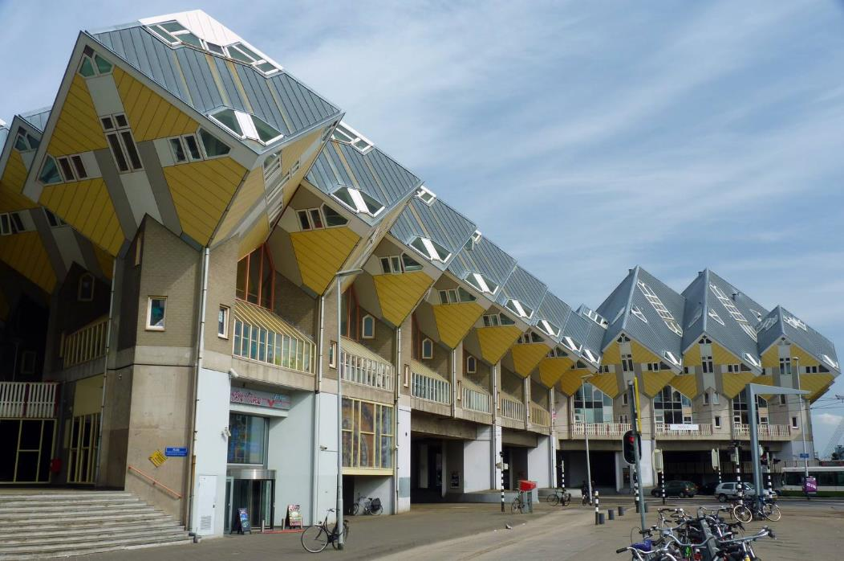
Rotterdam's Cube Houses
Figure 1: "File:Rotterdam Cube House street view.jpg" by Raul Ayres is licensed under CC BY-SA 3.0.

Slide 3



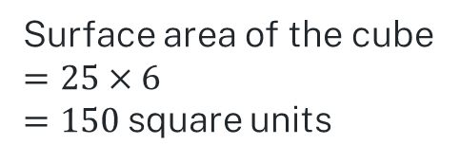

Surface area of prisms
Define
The surface area of a solid is the measure of the total area of surface(s) of a 3-dimensional shape or object.
For example, the surface area of a cube with side length 5 units is 150 square units.
Area of one square
5 units
5 units
Surface area of the cube
$$=25×6$$
$=150$ square units
5 units
5 units
$$A=5×5$$
$$=25$$

Slide 4
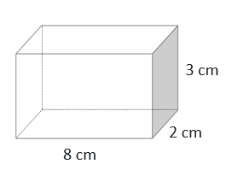
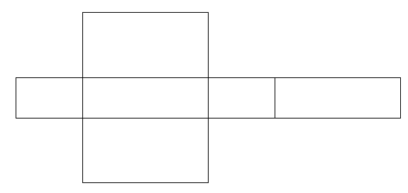
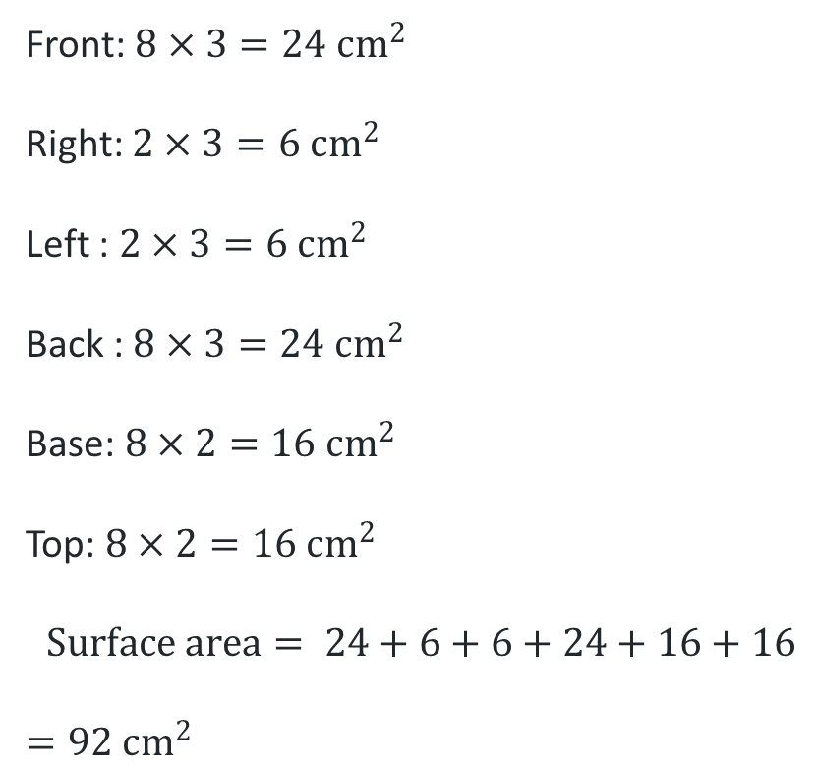
Worked example 1
Calculating the surface area of rectangular prisms
Which face on the net represents the front?
Front: $8×3=24 cm^{2}$
Right: $2×3=6 cm^{2}$
Left : $2×3=6 cm^{2}$
Back : $8×3=24 cm^{2}$
Base: $8×2=16 cm^{2}$
Top: $8×2=16 cm^{2}$
$$Surface area= 24+6+6+24+16+16$$
$=92 cm^{2}$
Are all six of these calculations required to find the surface area?
How else could the surface area be calculated?
Notes:
Reveal the questions.
Students read in silence
Students individually think and explain to themselves what is happening in each step
Students hold up a thumbs up to the teacher when they have finished reading and have some sort of understanding
Think, pair, share. Students explain the solution to their partner.
In pairs students then answer the self-explanation questions.
Finally, randomly select students to share their answers with the whole class.

Slide 5
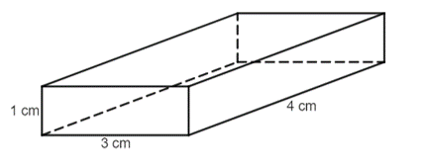
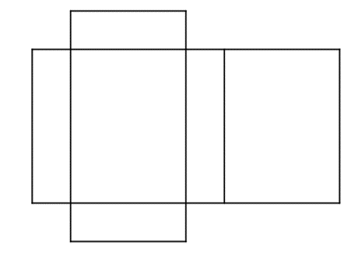
Example 2 – your turn
Calculating the surface area of rectangular prisms
Calculate the surface area of the prism.
Front
Right
Left
Back
Base
Top
Solutions: bit.ly/surfacearearectprism
Notes:
Reveal the question and give students time to complete the question on their own.
They can then pair/share with a partner and make corrections if necessary.
Randomly Call on students to give their answers and then reveal one approach

Slide 6
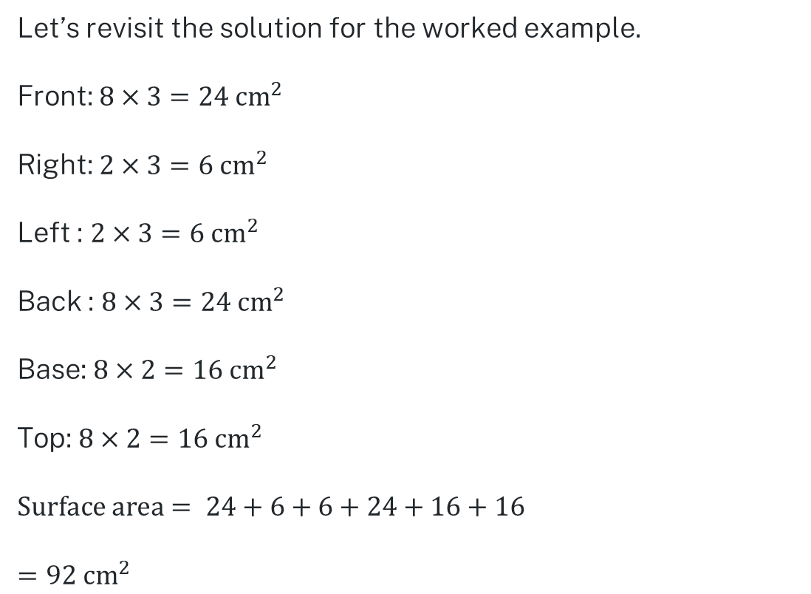
Worked example 3
Calculating surface area of rectangular prisms
Let’s revisit the solution for the worked example.
Front: $8×3=24 cm^{2}$
Right: $2×3=6 cm^{2}$
Left : $2×3=6 cm^{2}$
Back : $8×3=24 cm^{2}$
Base: $8×2=16 cm^{2}$
Top: $8×2=16 cm^{2}$
$$Surface area= 24+6+6+24+16+16$$
$=92 cm^{2}$
Are all six of these calculations required to find the surface area?
How else could this sum be performed?

Slide 7
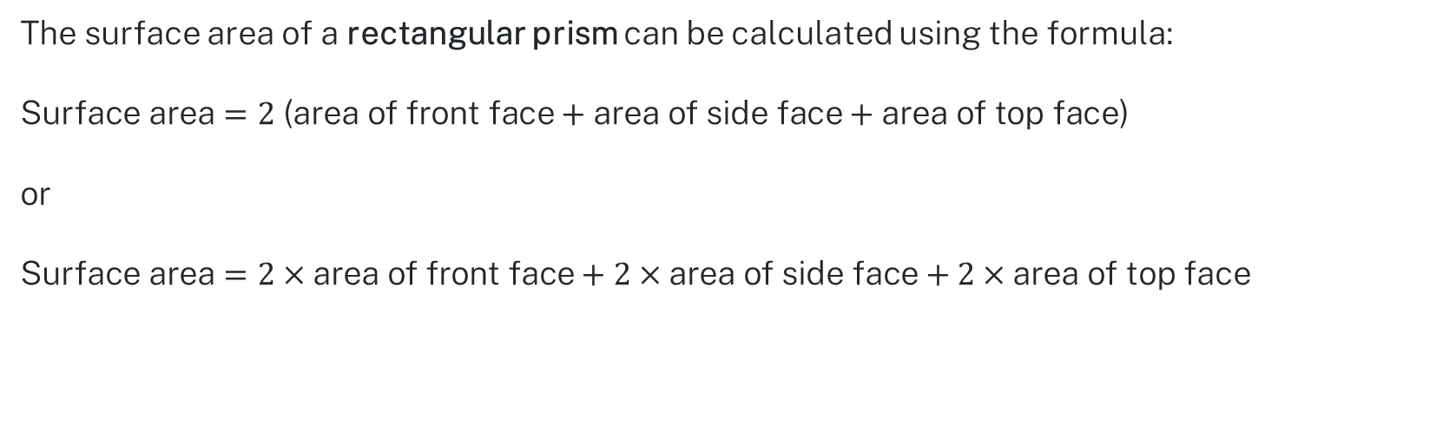
Using the formula
Calculating surface area of rectangular prisms
The surface area of a rectangular prism can be calculated using the formula:
$$\text{Surface} \text{area}=2\text{ (}\text{area} \text{of} \text{front} \text{face}+\text{area} \text{of} \text{side} \text{face}+\text{area} \text{of} \text{top} \text{face}\text{)}$$
or
$$\text{Surface} \text{area}=2×\text{area} \text{of} \text{front} \text{face}+2×\text{area} \text{of} \text{side} \text{face}+2×\text{area} \text{of} \text{top} \text{face}$$
Let’s try this with the first example

Slide 8

Worked example 4
Calculating the surface area of rectangular prisms – using a formula
Is this method more efficient?
$$\text{Surface} \text{area}=2\text{ (}\text{area} \text{of} \text{front} \text{face}+\text{area} \text{of} \text{side} \text{face}+\text{area} \text{of} \text{top} \text{face}\text{)}$$
$$=2\left[\left(8×3\right)+\left(2×3\right)+\left(8×2\right)\right]$$
$$=2\left[24+6+16\right]$$
$$=2\left(46\right)$$
$$=2×46$$
$$=92 cm^{2}$$
Does solving the surface area this way give the same answer?
Notes:
Reveal the questions.
Students read in silence
Students individually think and explain to themselves what is happening in each step
Students hold up a thumbs up to the teacher when they have finished reading and have some sort of understanding
Think, pair, share. Students explain the solution to their partner.
In pairs students then answer the self-explanation questions.
Finally, randomly select students to share their answers with the whole class.

Slide 9
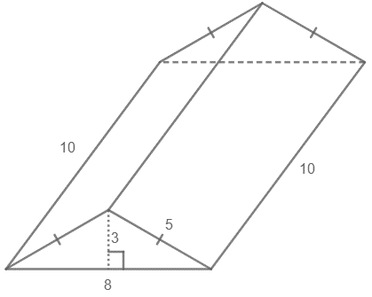
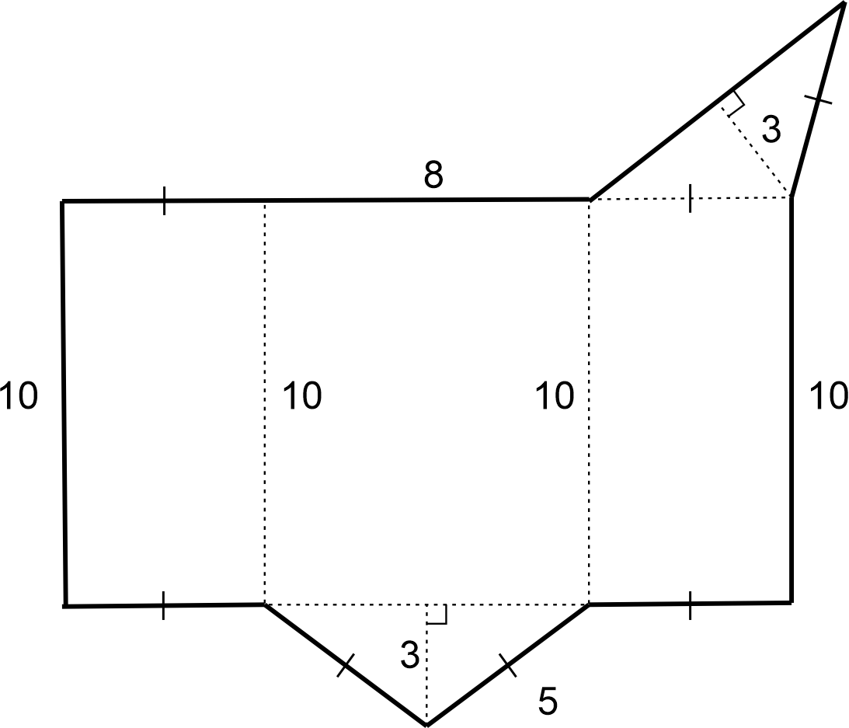
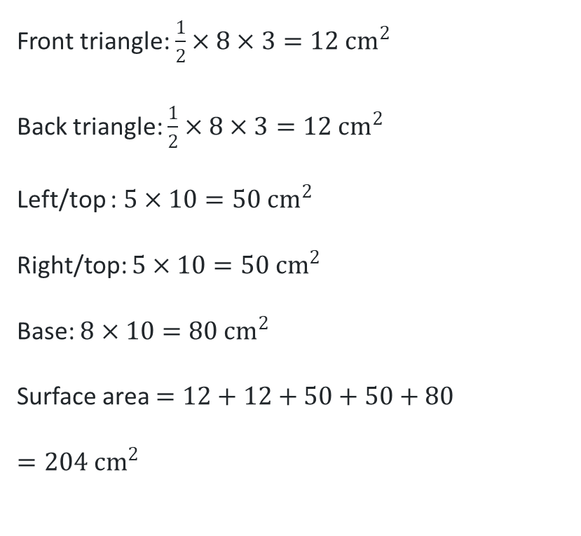
Worked example 5
Worked example – Calculating the surface area of triangular prisms
Calculate the surface area of the prism.
Front triangle: $\frac{1}{2}×8×3=12 cm^{2}$
Back triangle: $\frac{1}{2}×8×3=12 cm^{2}$
Left/top : $5×10=50 cm^{2}$
Right/top: $5×10=50 cm^{2}$
Base: $8×10=80 cm^{2}$
Surface area $=12+12+50+50+80$
$=204 cm^{2}$
Was this calculation required?
Is any face the same as the base?
How could this calculation be done more efficiently?
Notes:
Reveal the questions.
Students read in silence
Students individually think and explain to themselves what is happening in each step
Students hold up a thumbs up to the teacher when they have finished reading and have some sort of understanding
Think, pair, share. Students explain the solution to their partner.
In pairs students then answer the self-explanation questions.
Finally, randomly select students to share their answers with the whole class.

Slide 10
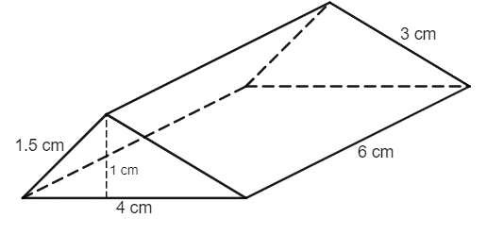
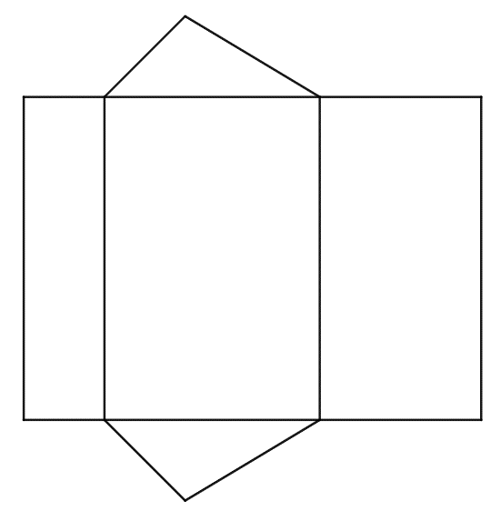
Worked example 6 – your turn
Calculating the surface area of triangular prisms
Calculate the surface area of the prism.
Front
Right
Left
Back
Base
Top
Solutions: bit.ly/surfaceareatriprism
Notes:
Reveal the question and give students time to complete the question on their own.
They can then pair/share with a partner and make corrections if necessary.
Randomly Call on students to give their answers and then reveal one approach

Slide 11
Copyright
© State of New South Wales (Department of Education), 2024
The copyright material published in this resource is subject to the Copyright Act 1968 (Cth) and is owned by the NSW Department of Education or, where indicated, by a party other than the NSW Department of Education (third-party material).
Copyright material available in this resource and owned by the NSW Department of Education is licensed under a Creative Commons Attribution 4.0 International (CC BY 4.0) licence.
This licence allows you to share and adapt the material for any purpose, even commercially.
Attribution should be given to © State of New South Wales (Department of Education), 2023.
Material in this resource not available under a Creative Commons licence:
the NSW Department of Education logo, other logos and trademark-protected material
Material owned by a third party that has been reproduced with permission. You will need to obtain permission from the third party to reuse its material.
Links to third-party material and websites
Please note that the provided (reading/viewing material/list/links/texts) are a suggestion only and implies no endorsement, by the New South Wales Department of Education, of any author, publisher, or book title. School principals and teachers are best placed to assess the suitability of resources that would complement the curriculum and reflect the needs and interests of their students.
If you use the links provided in this document to access a third party’s website, you acknowledge that the terms of use, including licence terms set out on the third-party’s website apply to the use which may be made of the materials on that third-party website or where permitted by the Copyright Act 1968 (Cth). The department accepts no responsibility for content on third-party websites.

