Slide 1
A4 cylinders
Prisms and cylinders

Slide 2
Launch
A4 cylinders

Slide 3
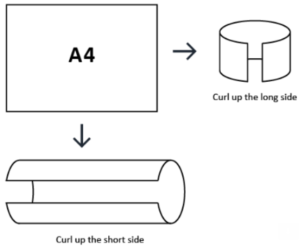
Exploring A4 cylinders
Comparing volumes
Which of the two cylinders has the greatest volume?
How do you know?
What do you notice?
What do you wonder?
A4 paper rolled two ways from nzmaths.co.nz/resource/a4-cylinders

Slide 4
Explore
A4 cylinders

Slide 5
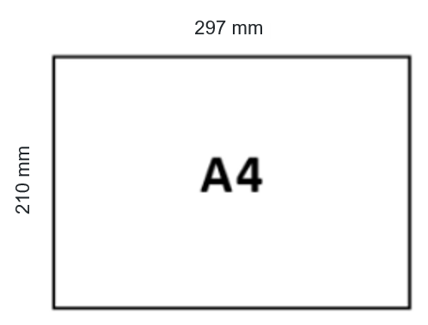
Comparing volumes
A4 cylinders
Which of the two cylinders has the greatest volume?
What further investigating could you do to support your answer if you knew the measurements?
A4 paper rolled two ways from nzmaths.co.nz/resource/a4-cylinders

Slide 6
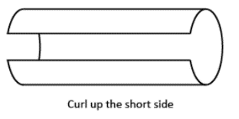
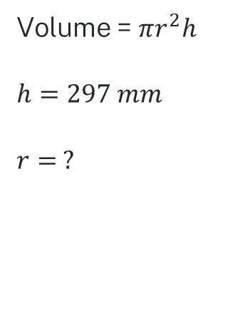
Comparing volumes – solutions 1
A4 cylinders
Volume = $πr^{2}h$
$$h=297 mm$$
$$r= ?$$
How could the radius be found?
What else do we know?
A4 paper rolled two ways from nzmaths.co.nz/resource/a4-cylinders

Slide 7
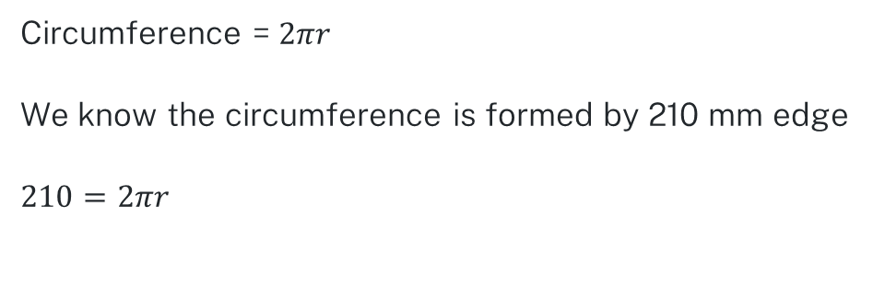
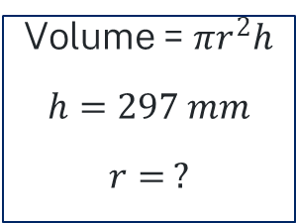
Comparing volumes – solutions 2
A4 cylinders
Volume = $πr^{2}h$
$$h=297 mm$$
$$r= ?$$
Circumference = $2πr$
We know the circumference is formed by 210 mm edge
$210=2πr$
How can the value of r be found?
A4 paper rolled two ways from nzmaths.co.nz/resource/a4-cylinders

Slide 8
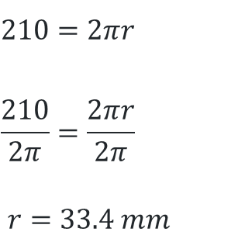
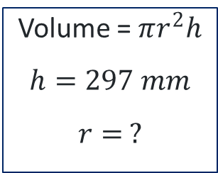
Comparing volumes – solutions 3
A4 cylinders
Volume = $πr^{2}h$
$$h=297 mm$$
$$r= ?$$
$$210=2πr$$
$$\frac{210}{2π}=\frac{2πr}{2π}$$
$r=33.4 mm$
Why were we finding r?
A4 paper rolled two ways from nzmaths.co.nz/resource/a4-cylinders

Slide 9

Comparing volumes – solutions 4
A4 cylinders
Volume = $πr^{2}h$
$$h=297 mm$$
$$r=33.4 mm$$
Volume $=π×{33.4}^{2}×297$
$$=1 040 876.625 mm^{3}$$
A4 paper rolled two ways from nzmaths.co.nz/resource/a4-cylinders

Slide 10
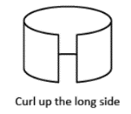
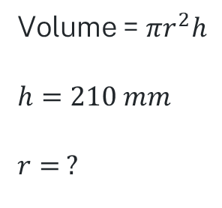
Comparing volumes – solutions 5
A4 cylinders
Volume = $πr^{2}h$
$$h=210 mm$$
$$r= ?$$
How could the radius be found?
What else do we know?
A4 paper rolled two ways from nzmaths.co.nz/resource/a4-cylinders

Slide 11
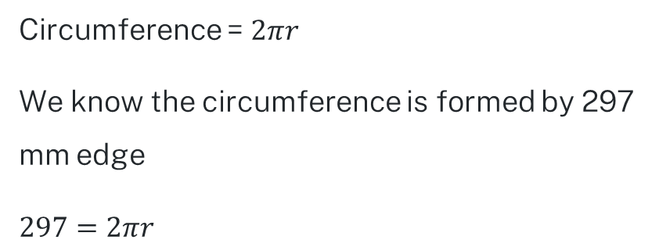
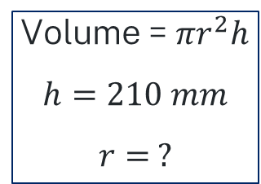
Comparing volumes – solutions 6
A4 cylinders
Volume = $πr^{2}h$
$$h=210 mm$$
$$r= ?$$
Circumference = $2πr$
We know the circumference is formed by 297 mm edge
$297=2πr$
How can the value of r be found?
A4 paper rolled two ways from nzmaths.co.nz/resource/a4-cylinders

Slide 12
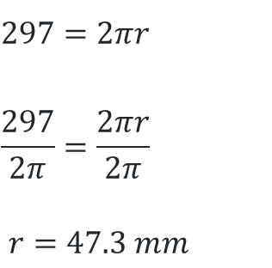
Comparing volumes – solutions 7
A4 cylinders
Volume = $πr^{2}h$
$$h=210 mm$$
$$r= ?$$
$$297=2πr$$
$$\frac{297}{2π}=\frac{2πr}{2π}$$
$r=47.3 mm$
Why were we finding r?
A4 paper rolled two ways from nzmaths.co.nz/resource/a4-cylinders

Slide 13
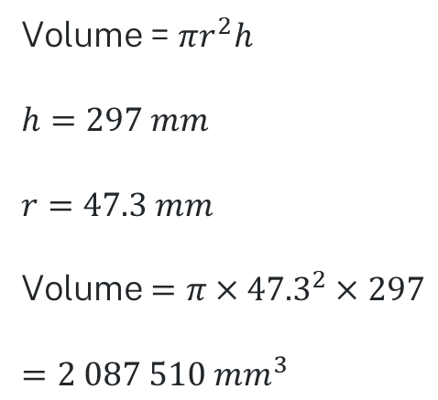
Comparing volumes – solutions 8
A4 cylinders
Volume = $πr^{2}h$
$$h=297 mm$$
$$r=47.3 mm$$
Volume $=π×{47.3}^{2}×297$
$$=2 087 510 mm^{3}$$
A4 paper rolled two ways from nzmaths.co.nz/resource/a4-cylinders

Slide 14


Comparing volumes – solutions 9
A4 cylinders
Which of the 2 cylinders has the greatest volume?
Did you predict correctly?
$$V=1 040 876.625 mm^{3}$$
$$V=2 087 510 mm^{3}$$
A4 paper rolled two ways from nzmaths.co.nz/resource/a4-cylinders

Slide 15
Comparing surface areas
A4 cylinders
Compare the surface area of each cylinder.
What do you notice?
A4 paper rolled two ways from nzmaths.co.nz/resource/a4-cylinders

Slide 16
Comparing surface area – closed one end
A4 cylinders
Compare the surface area of each cylinder.
What if each cylinder was closed at one end?
Are the surface areas equal?
A4 paper rolled two ways from nzmaths.co.nz/resource/a4-cylinders

Slide 17
Comparing surface area – closed both ends
A4 cylinders
Compare the surface area of each cylinder.
What if each cylinder was closed at both ends?
Are the surface areas equal?
A4 paper rolled two ways from nzmaths.co.nz/resource/a4-cylinders

Slide 18
Investigating the surface area
A4 cylinders
What information/dimensions are required to find the surface area of a cylinder?
What shapes make up the net of a cylinder?
How do you find the area of each face?
Can you establish a formula to use to find the surface area of any cylinder?

Slide 19
Developing the formula
Developing the formula for the surface area of a cylinder

Slide 20
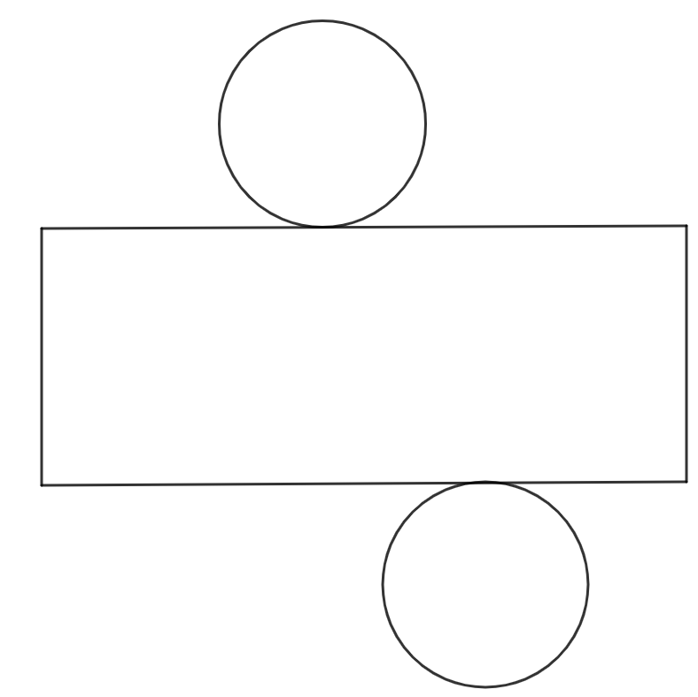
Examining the net
Surface area of a cylinder
How do you find the area of a circle?
How do you find the area of a rectangle?

Slide 21
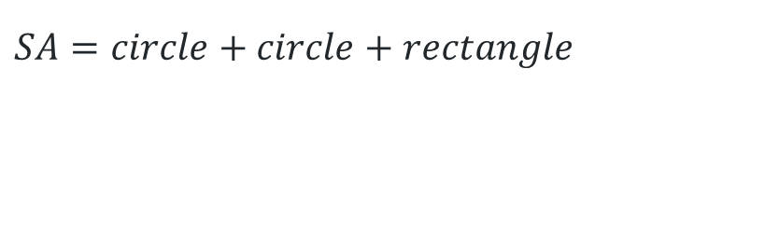
Shapes of the net
Surface area of a cylinder
$$SA=circle+circle+rectangle$$

Slide 22
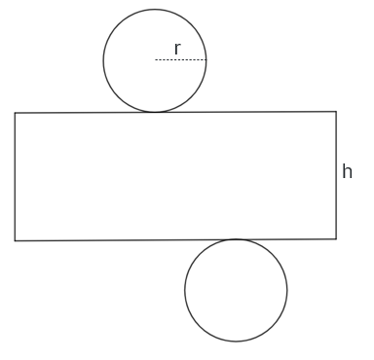
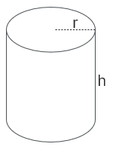
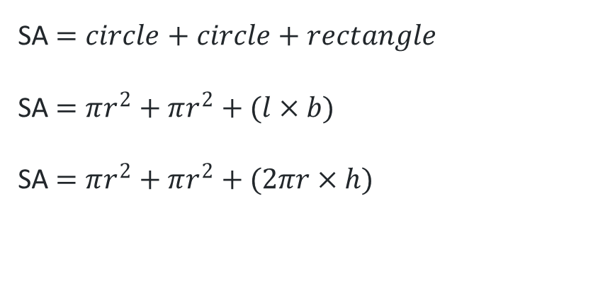
Establishing the formula
Surface area of a cylinder
SA $=circle+circle+rectangle$
SA $=πr^{2}+πr^{2}+(l×b)$
SA $=πr^{2}+πr^{2}+(2πr×h)$

Slide 23
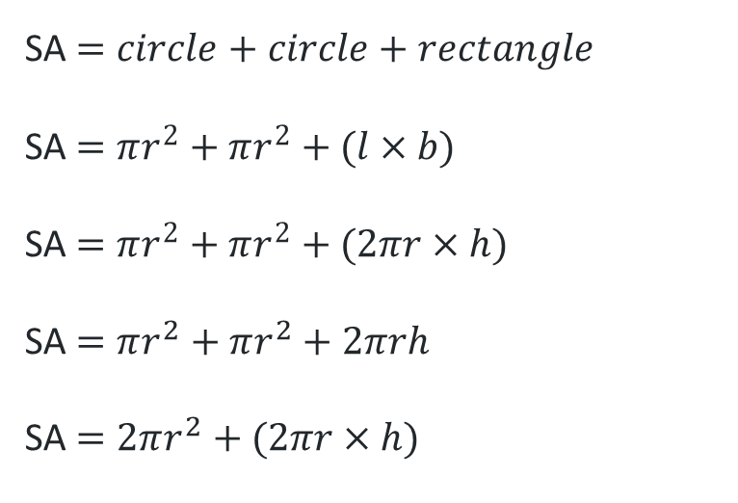
Simplifying the formula
Surface area of a cylinder
SA $=circle+circle+rectangle$
SA $=πr^{2}+πr^{2}+(l×b)$
SA $=πr^{2}+πr^{2}+(2πr×h)$
SA $=πr^{2}+πr^{2}+2πrh$
SA $=2πr^{2}+(2πr×h)$

Slide 24
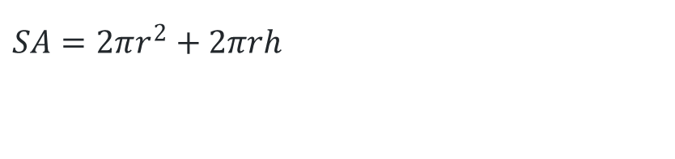
The formula
Surface area of a cylinder
$$SA=2πr^{2}+2πrh$$

Slide 25
Summarise
A4 Cylinders

Slide 26

Worked example 1
Applying the formula
Example 1: Find the surface area of this closed cylinder
Radius = 4cm
Height = 10cm
Formula
Substitution
Answer
$$SA=2πr^{2}+2πrh$$
  $$=2×π{×4}^{2}+2×π×4×10$$
  $$=351.86 cm^{2}$$

Slide 27
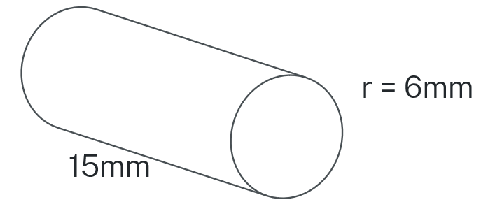

Your turn 1
Applying the formula
Example 2: Find the surface area of this closed cylinder
Formula
Substitution
Answer
$$SA=2πr^{2}+2πrh$$

Slide 28

Your turn 1 – solution
Applying the formula
Example 2: Find the surface area of this closed cylinder
Formula
Substitution
Answer
$$SA=2πr^{2}+2πrh$$
$$SA=2×π×6^{2}+2×π×6×15$$
$$SA=791.7{mm}^{2}$$

Slide 29
Worked example 2
Applying the formula
Example 3: Find the surface area of this open cylinder
What difference does the word open make?
Formula
Substitution
Answer

Slide 30
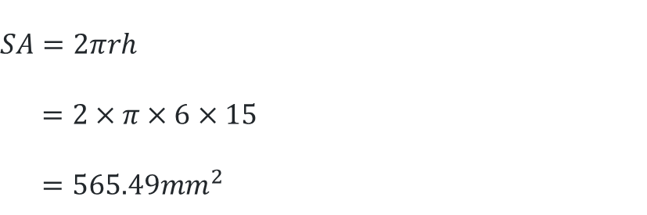
Worked example 2 – solution
Applying the formula
Example 3: Find the surface area of this open cylinder
Formula
Substitution
Answer
$$SA=2πrh$$
$$=2×π×6×15$$
$$=565.49mm^{2}$$

Slide 31
Your turn 2
Applying the formula
Example 4: Find the surface area of a cylindrical drinking glass with a diameter of 9cm and a height of 10cm.
Draw the glass to help you recognise which surfaces you need.
How does this change the formula?
Formula
Substitution
Answer

Slide 32

Your turn 2 – solution
Applying the formula
Example 4: Find the surface area of a cylindrical drinking glass with a diameter of 9cm and a height of 10cm.
$$SA=πr^{2}+2πrh$$
  $$=π{×4.5}^{2}+2×π×4.5×10$$
  $$=346.36 cm^{2}$$
Formula
Substitution
Answer

Slide 33
Copyright
© State of New South Wales (Department of Education), 2024
The copyright material published in this resource is subject to the Copyright Act 1968 (Cth) and is owned by the NSW Department of Education or, where indicated, by a party other than the NSW Department of Education (third-party material).
Copyright material available in this resource and owned by the NSW Department of Education is licensed under a Creative Commons Attribution 4.0 International (CC BY 4.0) licence.
This licence allows you to share and adapt the material for any purpose, even commercially.
Attribution should be given to © State of New South Wales (Department of Education), 2023.
Material in this resource not available under a Creative Commons licence:
the NSW Department of Education logo, other logos and trademark-protected material
Material owned by a third party that has been reproduced with permission. You will need to obtain permission from the third party to reuse its material.
Links to third-party material and websites
Please note that the provided (reading/viewing material/list/links/texts) are a suggestion only and implies no endorsement, by the New South Wales Department of Education, of any author, publisher, or book title. School principals and teachers are best placed to assess the suitability of resources that would complement the curriculum and reflect the needs and interests of their students.
If you use the links provided in this document to access a third party’s website, you acknowledge that the terms of use, including licence terms set out on the third-party’s website apply to the use which may be made of the materials on that third-party website or where permitted by the Copyright Act 1968 (Cth). The department accepts no responsibility for content on third-party websites.

