Slide 1
Margin for error
Prisms and cylinders

Slide 2
Exploring prefixes
Margin for error

Slide 3
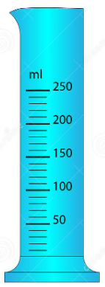
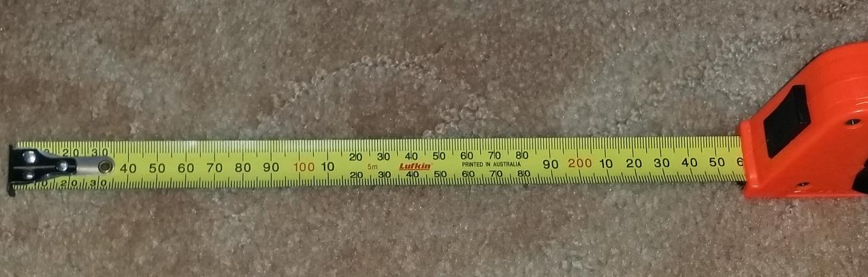
Exploring different measuring instruments
Margin for error
What units is each measuring device using?

Slide 4
Exploring common prefixes
Margin for error
Does either measuring device use a common prefix?

Slide 5
Exploring common prefixes – similarities
Margin for error
Does either measuring device use a common prefix?
millilitres
millimetres
Notes:
Discuss the meaning of milli as 1000 and so millilitres is 1000th of a litre and millimetres is 1000th of a metre

Slide 6
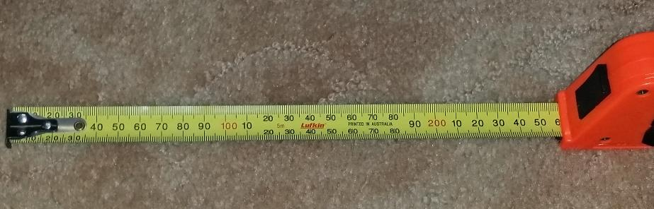

Exploring common prefixes – differences
Margin for error
What do you notice about these measuring devices?
millimetres
centimetres
Notes:
Again, discuss these words in terms of parts of a metre ie 1000th and 100th

Slide 7
Exploring common prefixes overall
Margin for error
During this activity a range of prefixes have been explored and used to measure.
Can you list the ones that you and your classmates worked with?
Can you think of any others?

Slide 8
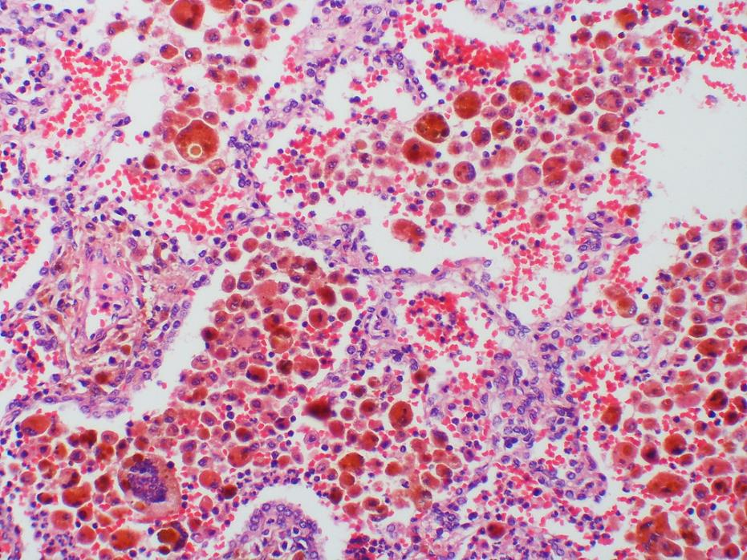
Prefixes for very small measurement units
Margin for error
What if we were measuring a very small distance, for example finding the diameter of a cell?
Would we use millimetres?
Can you think of another prefix, other than milli, that might be used in this scenario?
Notes:
Micro or nano

Slide 9
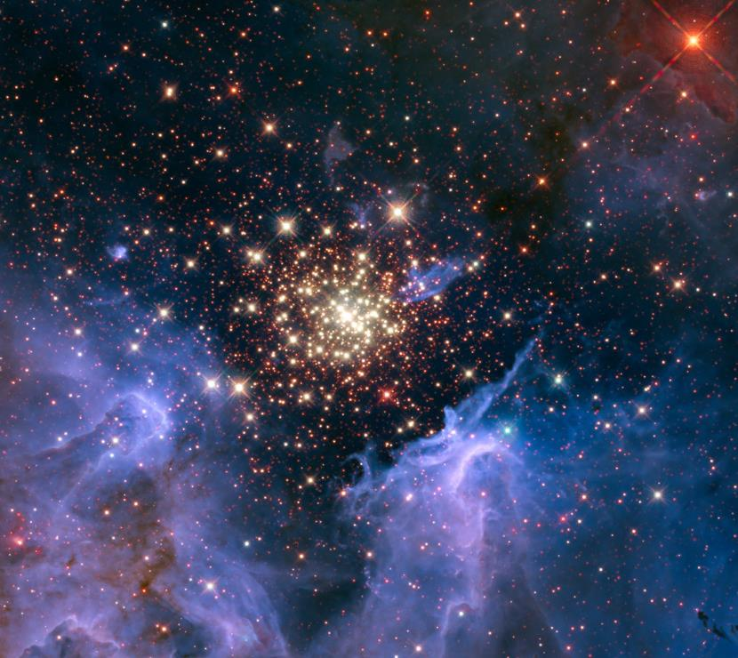
Prefixes for very large measurement units
Margin for error
What if we were measuring a very large distance, for example the distance in space?
Would we use kilometres?
Notes:
Mega, giga, tera

Slide 10
Exploring error
Margin for error

Slide 11
Comparing measuring instruments
Margin for error
Consider the range of measuring instruments used by the class.
What was different about them?

Slide 12
Precision of measuring instruments
Margin for error
Each measuring instrument had a different precision.
The 30cm ruler had a precision of 1mm, as this was the smallest division on the instrument
The 1m ruler had a precision of 1cm, as this was the smallest division on the instrument.

Slide 13
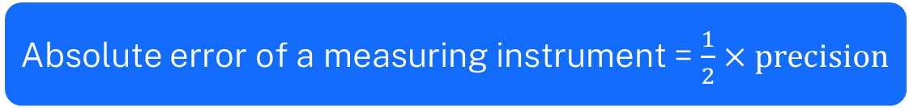
Defining absolute error
Margin for error
This means that each measuring instrument will have a different range of error when it’s used.
Each measuring instrument has a different absolute error.
Absolute error of a measuring instrument = $\frac{1}{2}×precision$

Slide 14
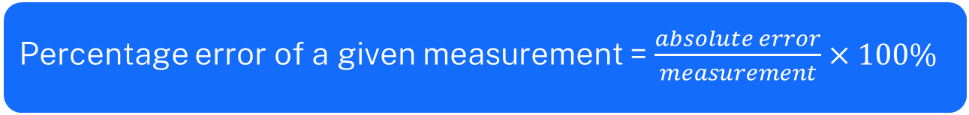
Defining percentage error
Margin for error
Given each measuring instrument has a different precision and absolute error, it will also have a different percentage error when a measurement is taken.
Percentage error of a given measurement = $\frac{absolute error}{measurement}×100\%$

Slide 15
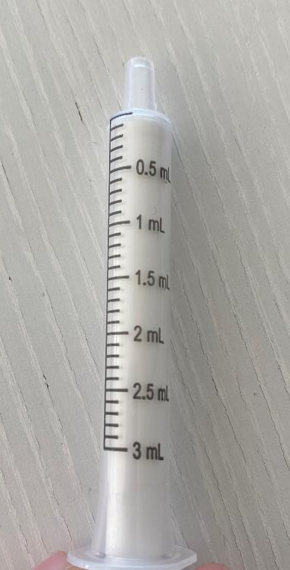

Worked example 1
Margin for error
Calculate the absolute error of the medicine syringe.
Precision = 0.1mL
Absolute error of a measuring instrument = $\frac{1}{2}×precision$
Absolute error $=\frac{1}{2}×0.1mL=0.05mL$
Where did 0.1mL come from?
What does this represent?

Slide 16
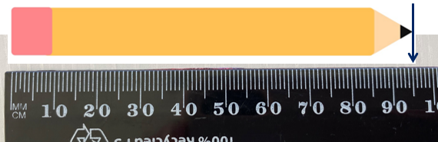

Your turn 1
Margin for error
Calculate the absolute error of the ruler.
Precision =
Absolute error of a measuring instrument = $\frac{1}{2}×precision$

Slide 17

Your turn 1 – solution
Margin for error
Calculate the absolute error of the ruler.
Absolute error of a measuring instrument = $\frac{1}{2}×precision$
Absolute error $=\frac{1}{2}×1mm=0.5mm$

Slide 18

Worked example 2
Margin for error
Determine the percentage error if 1.6mL of medicine is to be drawn using this syringe.
Percentage error of a given measurement = $\frac{absolute error}{measurement}×100\%$
Percentage error $=\frac{0.05}{1.6}×100\%$
$=$ 3.125%
What does this mean?

Slide 19
Your turn 2
Margin for error
Determine the percentage error of the measurement of the pencil shown using this ruler.
Percentage error of a given measurement = $\frac{absolute error}{measurement}×100\%$

Slide 20
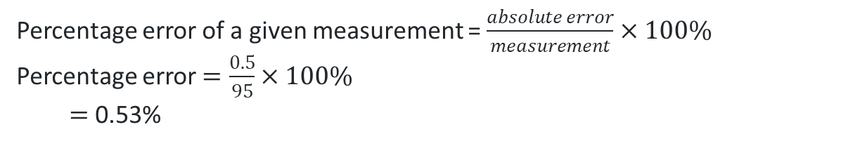
Your turn 2 – solution
Margin for error
Determine the percentage error of the measurement of the pencil shown using this ruler.
Percentage error of a given measurement = $\frac{absolute error}{measurement}×100\%$
Percentage error $=\frac{0.5}{95}×100\%$
$=$ 0.53%

Slide 21
Copyright
© State of New South Wales (Department of Education), 2024
The copyright material published in this resource is subject to the Copyright Act 1968 (Cth) and is owned by the NSW Department of Education or, where indicated, by a party other than the NSW Department of Education (third-party material).
Copyright material available in this resource and owned by the NSW Department of Education is licensed under a Creative Commons Attribution 4.0 International (CC BY 4.0) licence.
This licence allows you to share and adapt the material for any purpose, even commercially.
Attribution should be given to © State of New South Wales (Department of Education), 2023.
Material in this resource not available under a Creative Commons licence:
the NSW Department of Education logo, other logos and trademark-protected material
Material owned by a third party that has been reproduced with permission. You will need to obtain permission from the third party to reuse its material.
Links to third-party material and websites
Please note that the provided (reading/viewing material/list/links/texts) are a suggestion only and implies no endorsement, by the New South Wales Department of Education, of any author, publisher, or book title. School principals and teachers are best placed to assess the suitability of resources that would complement the curriculum and reflect the needs and interests of their students.
If you use the links provided in this document to access a third party’s website, you acknowledge that the terms of use, including licence terms set out on the third-party’s website apply to the use which may be made of the materials on that third-party website or where permitted by the Copyright Act 1968 (Cth). The department accepts no responsibility for content on third-party websites.

