Slide 1
Deep dive
Prisms and cylinders

Slide 2
Launch
Deep dive

Slide 3
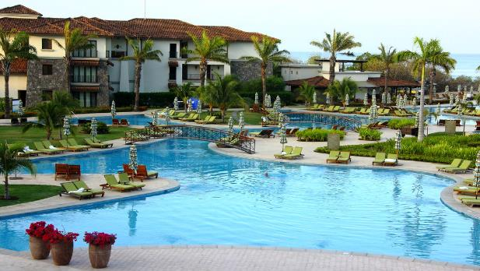
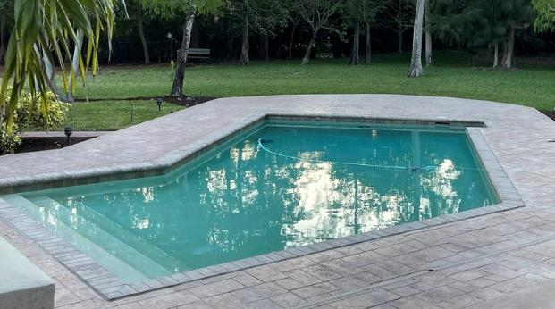
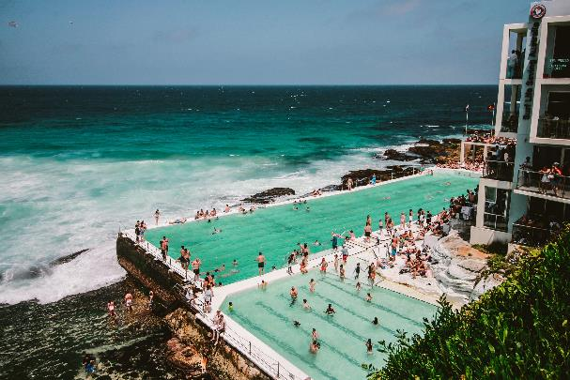
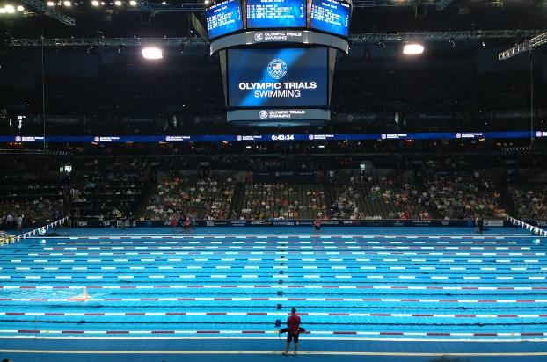
Which pool holds the most amount of water?
Deep dive

Slide 4
Summarise
Deep dive

Slide 5
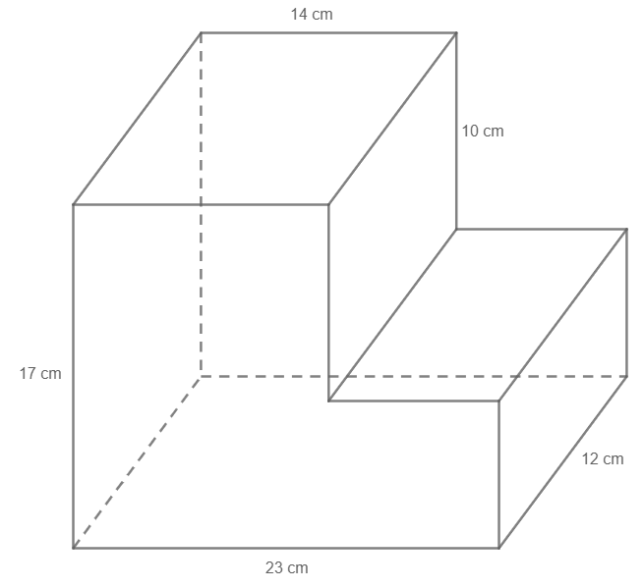

Worked example 1
Volume of composite solids – triangles and quadrilaterals
Calculate the volume of the composite solid.
$$Volume=Ah$$
Area of cross section$=14×17+9×7$
$$h=12cm$$
$$V=\left(14×17+9×7\right)×12$$
$$V=\left(238+63\right)×12$$
$$V=301×12$$
$$V=3612cm^{3}$$
How else could we have worked out the front face?
Where did the 9 come from?
Why is this measurement in units cubed?
Notes:
Reveal the questions.
Students read in silence
Students individually think and explain to themselves what is happening in each step
Students hold up a thumbs up to the teacher when they have finished reading and have some sort of understanding
Think, pair, share. Students explain the solution to their partner.
In pairs students then answer the self-explanation questions.
Finally, randomly select students to share their answers with the whole class.

Slide 6

Worked example 1 – alternate solution
Volume of composite solids – triangles and quadrilaterals
$$Volume=Ah$$
Area of cross section$=23×7+10×14$
$$h=12cm$$
$$V=\left(23×7+10×14\right)×12$$
$$V=\left(161+140\right)×12$$
$$V=301×12$$
$$V=3612{cm}^{3}$$
Where did the 7 come from? What does it represent?
Do we get the same answer?
Notes:
Reveal the questions.
Students read in silence
Students individually think and explain to themselves what is happening in each step
Students hold up a thumbs up to the teacher when they have finished reading and have some sort of understanding
Think, pair, share. Students explain the solution to their partner.
In pairs students then answer the self-explanation questions.
Finally, randomly select students to share their answers with the whole class.

Slide 7
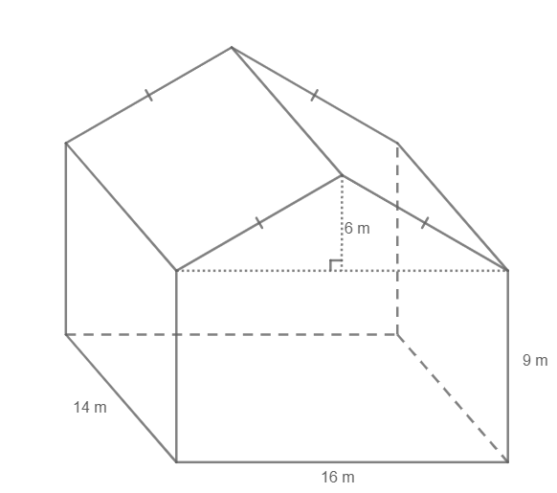
Your turn 1
Volume of composite solids – triangles and quadrilaterals
Calculate the volume of the composite solid.
Notes:
Reveal the question and give students time to complete the question on their own.
They can then pair/share with a partner and make corrections if necessary.
Randomly Call on students to give their answers and then reveal one approach

Slide 8

Your turn 1 – solution
Volume of composite solids – triangles and quadrilaterals
Calculate the volume of the composite solid.
$$Volume=Ah$$
Area of cross section$=\frac{1}{2}×16×6+9×16$
$$h=14cm$$
$$V=\left(\frac{1}{2}×16×6+9×16\right)×14$$
$$V=\left(48+144\right)×14$$
$$V=2688m^{3}$$
Notes:
Reveal the question and give students time to complete the question on their own.
They can then pair/share with a partner and make corrections if necessary.
Randomly Call on students to give their answers and then reveal one approach

Slide 9
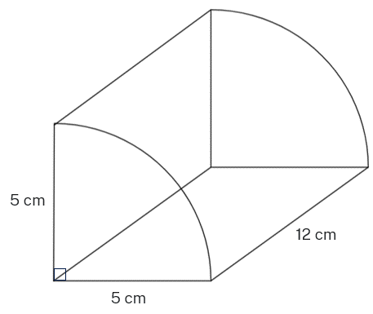

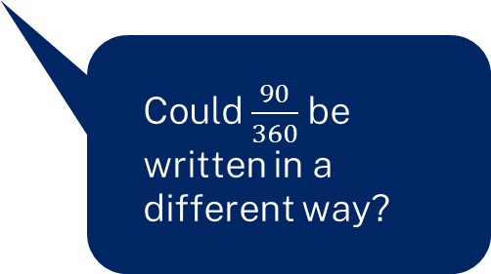
Worked example 2
Volume of solids – sectors, semicircles and quadrants
Calculate the volume of the composite solid.
$$Volume=Ah$$
Area of cross section $=\frac{90}{360}×π×5^{2}$
$$h=12cm$$
$$V=\left(\frac{90}{360}×π×5^{2}\right)×12$$
$$V=235.61944$$
$$V=235.6cm^{3}$$
What formula is this?
Could $\frac{90}{360}$ be written in a different way?
Notes:
Reveal the questions.
Students read in silence
Students individually think and explain to themselves what is happening in each step
Students hold up a thumbs up to the teacher when they have finished reading and have some sort of understanding
Think, pair, share. Students explain the solution to their partner.
In pairs students then answer the self-explanation questions.
Finally, randomly select students to share their answers with the whole class.

Slide 10
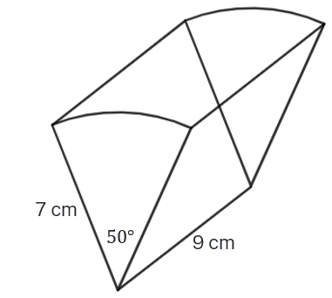

Your turn 2
Volume of solids – sectors, semicircles and quadrants
Calculate the volume of the composite solid.
$$Volume=Ah$$
Notes:
Reveal the question and give students time to complete the question on their own.
They can then pair/share with a partner and make corrections if necessary.
Randomly Call on students to give their answers and then reveal one approach

Slide 11

Your turn 2 – solutions
Volume of solids – sectors, semicircles and quadrants
Calculate the volume of the composite solid.
$$Volume=Ah$$
Area of cross section $=\frac{50}{360}×π×7$
$$h=9cm$$
$$V=\left(\frac{50}{360}×π×7^{2}\right)×9$$
$$V=192.42255$$
$$V=192.4 cm^{3}$$
Notes:
Reveal the question and give students time to complete the question on their own.
They can then pair/share with a partner and make corrections if necessary.
Randomly Call on students to give their answers and then reveal one approach

Slide 12
Copyright
© State of New South Wales (Department of Education), 2024
The copyright material published in this resource is subject to the Copyright Act 1968 (Cth) and is owned by the NSW Department of Education or, where indicated, by a party other than the NSW Department of Education (third-party material).
Copyright material available in this resource and owned by the NSW Department of Education is licensed under a Creative Commons Attribution 4.0 International (CC BY 4.0) licence.
This licence allows you to share and adapt the material for any purpose, even commercially.
Attribution should be given to © State of New South Wales (Department of Education), 2023.
Material in this resource not available under a Creative Commons licence:
the NSW Department of Education logo, other logos and trademark-protected material
Material owned by a third party that has been reproduced with permission. You will need to obtain permission from the third party to reuse its material.
Links to third-party material and websites
Please note that the provided (reading/viewing material/list/links/texts) are a suggestion only and implies no endorsement, by the New South Wales Department of Education, of any author, publisher, or book title. School principals and teachers are best placed to assess the suitability of resources that would complement the curriculum and reflect the needs and interests of their students.
If you use the links provided in this document to access a third party’s website, you acknowledge that the terms of use, including licence terms set out on the third-party’s website apply to the use which may be made of the materials on that third-party website or where permitted by the Copyright Act 1968 (Cth). The department accepts no responsibility for content on third-party websites.

